Slide 1
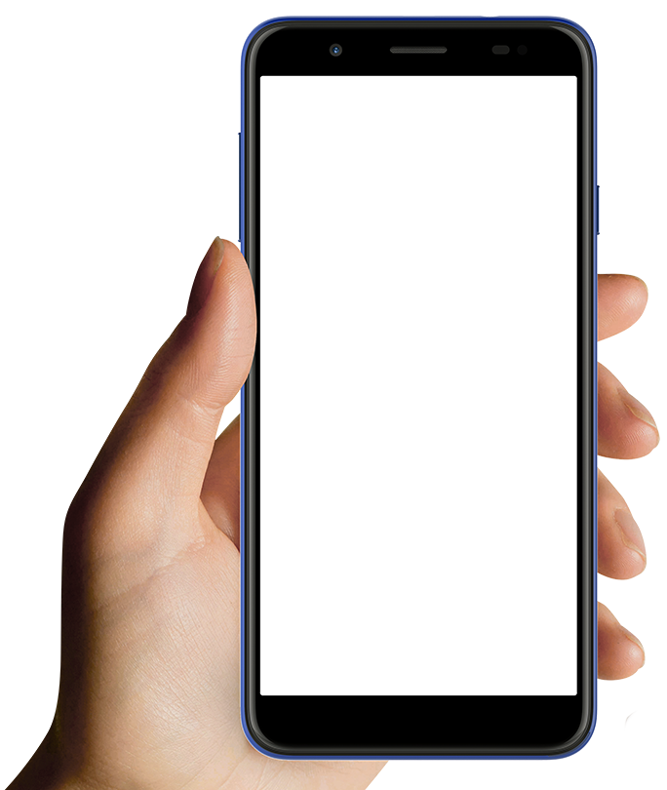
ANALYSIS
Practice Questions
Interview Questions
Mock Interview
Analysis

Slide 2
Practice Questions
USER NAME
Interview Questions
EMAIL ID:
POINTS:
Mock Interview
Analysis
“Random
Quote For
Motivation”

Slide 3
SUBJECT LIST
Aptitude
Reasoning
English
Subject - 1
Subject - 2

Slide 4
Who is the founder of Facebook?
Mark Zuckerburg
Mukesh Ambani
Ajay Devgan
John Cena

Slide 5
INTERVIEW QUES
HR Questions
Question txt
Answer txt

Slide 6
MOCK INTERVIEW
Who is the founder of Facebook?

Slide 7
ANALYSIS

