Slide 1
CNN-LSTM Projection Report — Dual Architecture
Part: Part_A
Baseline+CM CNN-LSTM | CM Date: 2023-06
Generated: 2026-09-03 00:56

Slide 2
Executive Summary
Forecast Horizon
Historical
Baseline Total
CM Total
12 months
48 months
692 claims
649 claims
Claims Saved
Reduction %
Est. Savings
43
6.2%
$36,400

Slide 3
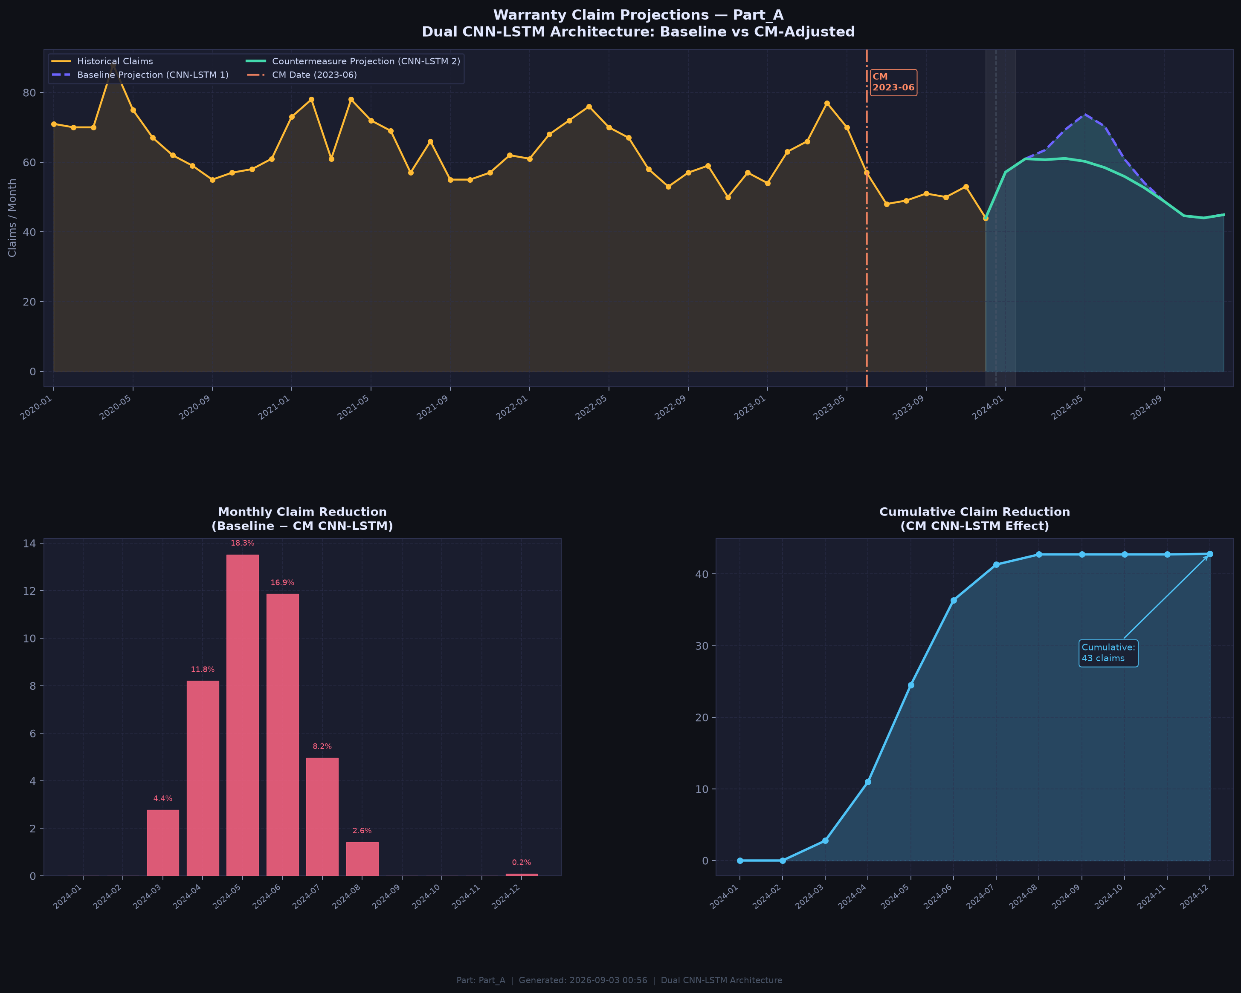
Projection Chart — Baseline vs CM CNN-LSTM

Slide 4
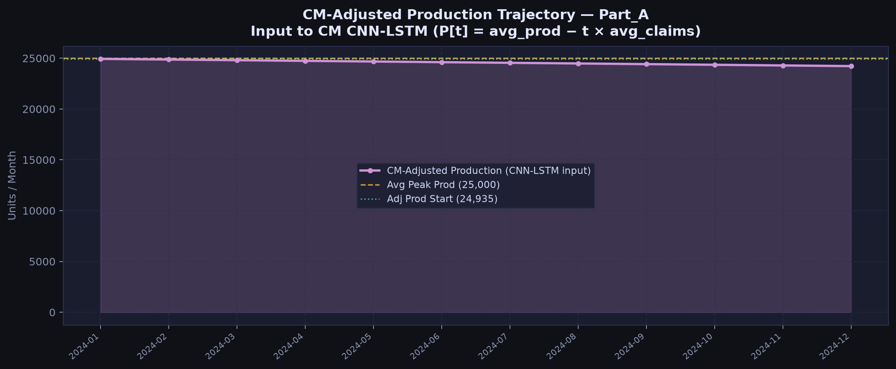
CM-Adjusted Production (Input to CM CNN-LSTM)

Slide 5
Month-by-Month Comparison
Month | Baseline_Claims | CM_Claims | Monthly_Reduction | Cumulative_Reduction | Reduction_% | Cost_Savings
2024-01 | 57.1 | 57.1 | 0.0 | 0.0 | 0.0 | 0.0
2024-02 | 61.0 | 61.0 | 0.0 | 0.0 | 0.0 | 0.0
2024-03 | 63.5 | 60.7 | 2.8 | 2.8 | 4.4 | 2357.1
2024-04 | 69.3 | 61.1 | 8.2 | 11.0 | 11.8 | 6973.3
2024-05 | 73.8 | 60.2 | 13.5 | 24.5 | 18.3 | 11491.7
2024-06 | 70.3 | 58.5 | 11.9 | 36.4 | 16.9 | 10080.0
2024-07 | 60.9 | 55.9 | 5.0 | 41.3 | 8.2 | 4222.1
2024-08 | 54.1 | 52.7 | 1.4 | 42.7 | 2.6 | 1204.3
2024-09 | 48.8 | 48.8 | 0.0 | 42.7 | 0.0 | 0.0
2024-10 | 44.6 | 44.6 | 0.0 | 42.7 | 0.0 | 0.0
2024-11 | 44.0 | 44.0 | 0.0 | 42.7 | 0.0 | 0.0
2024-12 | 45.0 | 44.9 | 0.1 | 42.8 | 0.2 | 72.0

