Slide 1
N-BeatsX Projection Report — Dual Architecture
Part: Part_A
Generated: 2026-09-03 00:53

Slide 2
Executive Summary
Horizon
History
Baseline
CM Total
12 months
48 months
705 claims
655
Saved
Reduction
Savings
51
7.2%
$42,983

Slide 3
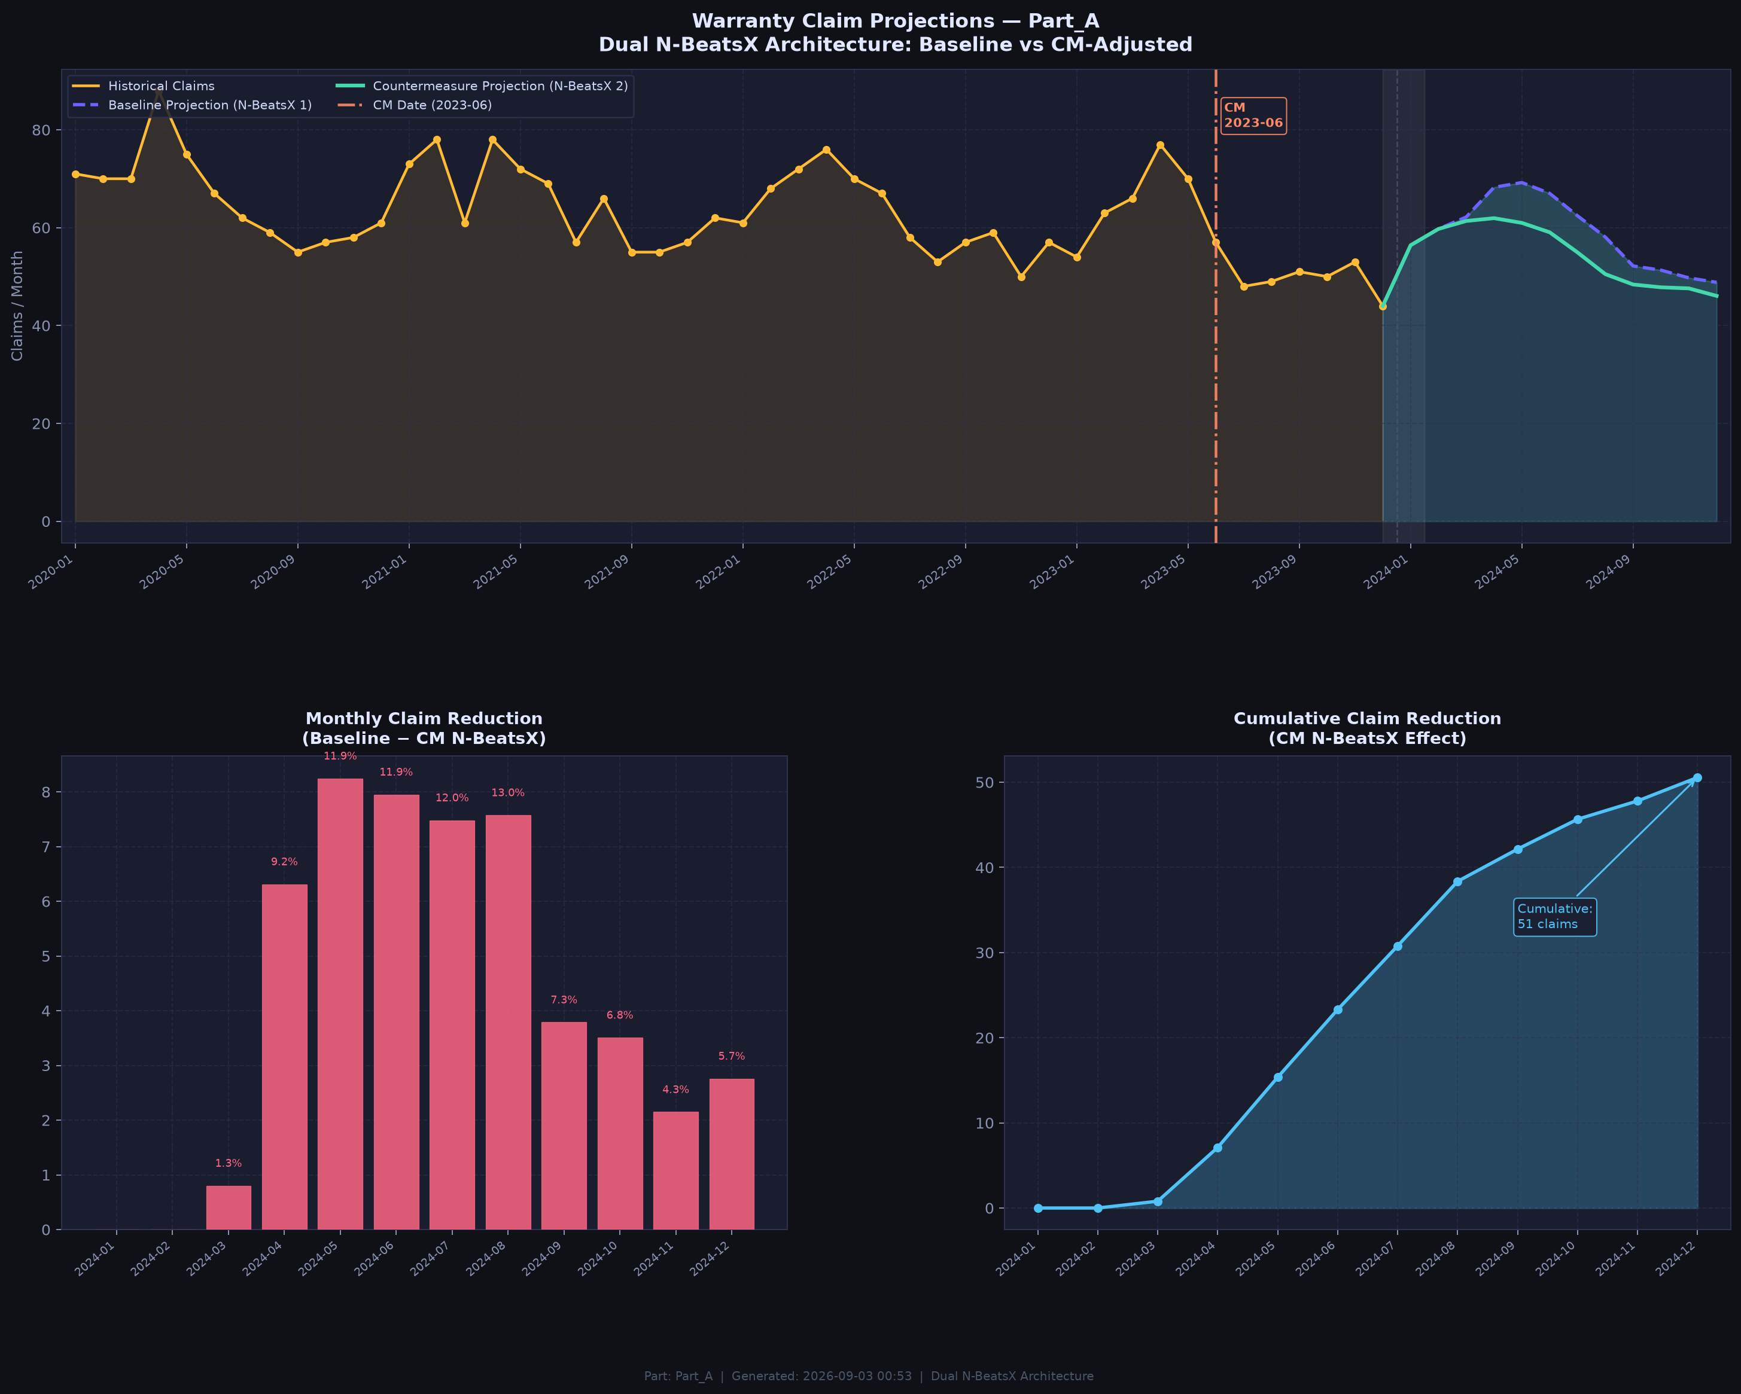
Projection Chart — Baseline vs CM N-BeatsX

Slide 4
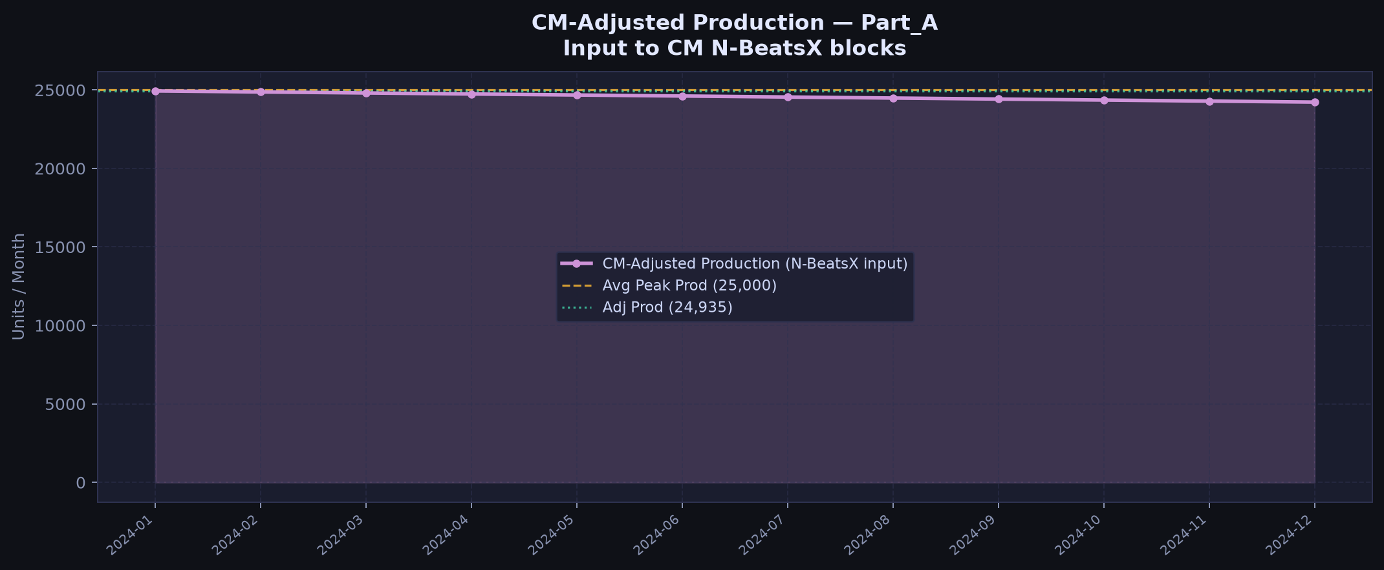
CM Production Trajectory (input to CM N-BeatsX)

Slide 5
Month-by-Month Comparison
Month | Baseline_Claims | CM_Claims | Monthly_Reduction | Cumulative_Reduction | Reduction_% | Cost_Savings
2024-01 | 56.4 | 56.4 | 0.0 | 0.0 | 0.0 | 0.0
2024-02 | 59.7 | 59.7 | 0.0 | 0.0 | 0.0 | 0.0
2024-03 | 62.2 | 61.4 | 0.8 | 0.8 | 1.3 | 681.4
2024-04 | 68.3 | 61.9 | 6.3 | 7.1 | 9.2 | 5365.2
2024-05 | 69.2 | 61.0 | 8.2 | 15.4 | 11.9 | 7007.8
2024-06 | 67.0 | 59.1 | 8.0 | 23.3 | 11.9 | 6758.3
2024-07 | 62.4 | 54.9 | 7.5 | 30.8 | 12.0 | 6358.9
2024-08 | 58.1 | 50.5 | 7.6 | 38.4 | 13.0 | 6437.8
2024-09 | 52.2 | 48.4 | 3.8 | 42.2 | 7.3 | 3220.1
2024-10 | 51.3 | 47.8 | 3.5 | 45.7 | 6.8 | 2982.1
2024-11 | 49.7 | 47.6 | 2.1 | 47.8 | 4.3 | 1826.1
2024-12 | 48.8 | 46.1 | 2.8 | 50.6 | 5.7 | 2345.1

