Slide 1
Transformer Projection Report — Dual Architecture
Part: Part_A
Baseline Transformer + CM Transformer | CM Date: 2023-06
Generated: 2026-09-03 00:16

Slide 2
Executive Summary
Forecast Horizon
Historical Months
Baseline Total
CM Total Forecast
12 months
48
644 claims
707 claims
Claims Saved
Reduction %
Est. Savings
2
0.3%
$1,757
CM Transformer: adj_prod=24,935 | avg_peak_prod=25,000 | FCOK months=42

Slide 3
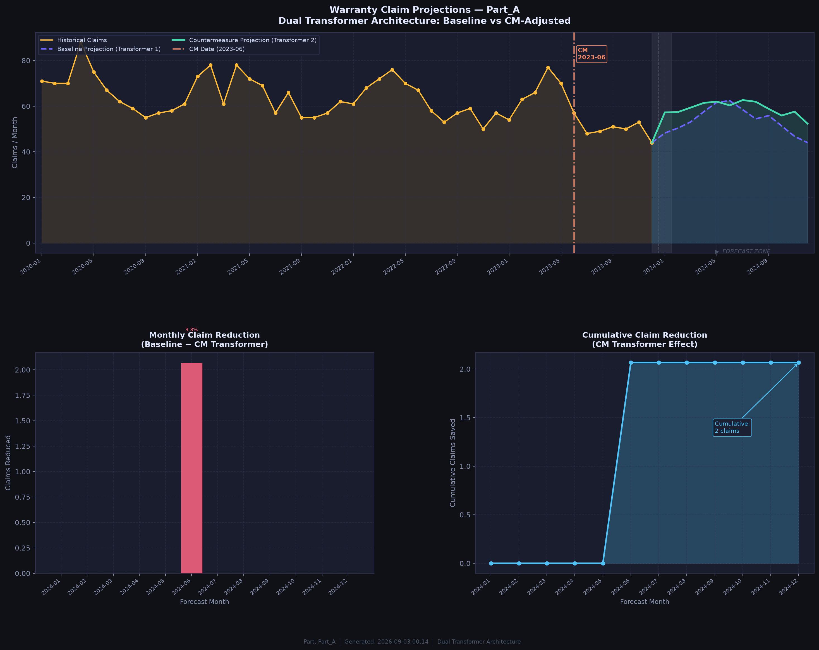
Projection Chart — Baseline vs CM Transformer

Slide 4
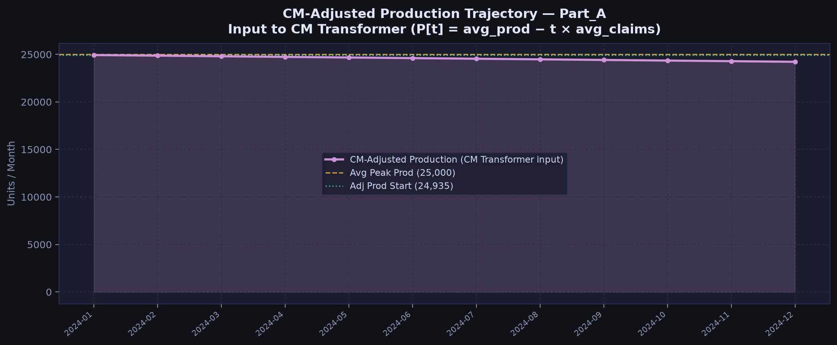
CM-Adjusted Production Trajectory (Input to CM Transformer)

Slide 5
Month-by-Month Comparison Table
Month | Baseline_Claims | CM_Claims | Monthly_Reduction | Cumulative_Reduction | Reduction_% | Cost_Savings
2024-01 | 48.2 | 57.3 | 0.0 | 0.0 | 0.0 | 0.0
2024-02 | 50.4 | 57.4 | 0.0 | 0.0 | 0.0 | 0.0
2024-03 | 53.1 | 59.4 | 0.0 | 0.0 | 0.0 | 0.0
2024-04 | 57.6 | 61.4 | 0.0 | 0.0 | 0.0 | 0.0
2024-05 | 61.7 | 62.0 | 0.0 | 0.0 | 0.0 | 0.0
2024-06 | 62.4 | 60.3 | 2.1 | 2.1 | 3.3 | 1756.9
2024-07 | 58.5 | 62.7 | 0.0 | 2.1 | 0.0 | 0.0
2024-08 | 54.4 | 61.9 | 0.0 | 2.1 | 0.0 | 0.0
2024-09 | 55.9 | 58.8 | 0.0 | 2.1 | 0.0 | 0.0
2024-10 | 51.3 | 55.9 | 0.0 | 2.1 | 0.0 | 0.0
2024-11 | 46.8 | 57.6 | 0.0 | 2.1 | 0.0 | 0.0
2024-12 | 44.0 | 52.3 | 0.0 | 2.1 | 0.0 | 0.0

