Slide 1
COLLEGE DATABASE
BY
Jeet Patel

Slide 2
Introduction
New database mydb has been created.
Tables are created
Moreover,Tables are given Relationships, Primary key and Foreign Key

Slide 3
Goals
The database is created because college system is pretty messed up.
Wrong Foreign key were given in Tables
Students were enrolled in wrong courses
No head was assigned in Departments

Slide 4
Tables
Departments
Course
Head
Students
Instructors

Slide 5
Relationship
Each department can offer any number of courses. So there is One to Many relationship between Departments and Course(1:M).
Many instructors can work in a department, but an instructor can work only in one department. So there is Many to One relationship between Instructors and Departments(M:1).

Slide 6
Each department, there is a head, and an instructor can be head of only one department. So there is One to One relationship between Department and Instructors(1:1).
Each instructor can take any number of courses, and a course can be taken by only one instructor. So there is One to Many between Instructors and Course(1:M).

Slide 7
A student can enroll for any number of courses and each course can have any number of students. So there is Many to Many relationship between Students and Course(M:M)

Slide 8
Table Columns
Department
Department_id(int) NOT NULL AUTO_INCREMENT Primary key.
Department_name(Varchar(45)).
Head_id(int) NOT NULL Foreign Key.
Head
Head_id(int) NOT NULL AUTO-INCREMENT Primary key
Head_name(Varchar(45)) NOT NULL, UNIQUE
Instructor_id(int) NOT NULL Foreign key

Slide 9
Instructor
Instructor_id(int) NOT NULL, AUTO-INCREMENT Primary key
Instructor_name(varchar(45))
Department_id(int) NOT NULL Foreign Key
Courses
Couse_id(int) NOT NULL, AUTO-INCREMENT Primary key
Department_id(int) NOT NULL Foreign Key
Course_name(varchar(45))
Instructor_id(int) NOT NULL Foreign Key

Slide 10
Students
Student_id(int) NOT NULL, AUTO-INCREMENT Primary key
Student_name(vachar(45)) NOT NULL
Student_age(int) NOT NULL
Student_Address(varchar(45))
Student_scores(int) NOT NULL

Slide 11
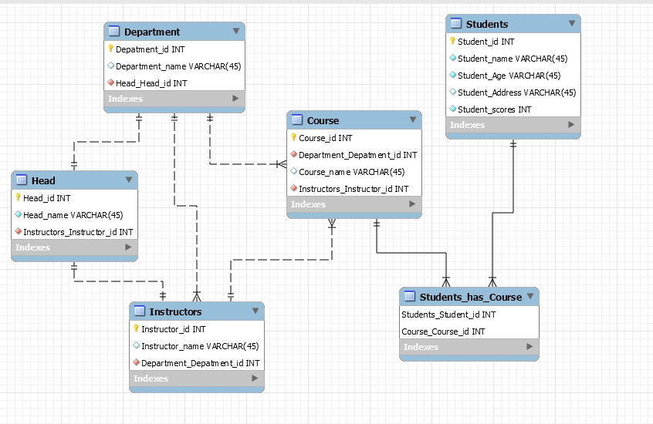
E-R diagram

Slide 12
Conclusion
After creating new tables and giving proper primary and foreign key in right tables students were enrolled in correct programs
No confusions were created at high level

