Slide 1
Why should I trust you?
Explaining the Predictions of Any Classifier
Marco T.R,
Sameer Singh
and Carlos Guestrin
Abhijeet Sahdev
ID: 31669135

Slide 2
Design of Experiment
Drawing inspiration from my submissions for the final term project, this time, I generated a classification dataset with 4000 tuples.
For the first dataframe,
The three dimensions of time were represented as (Seconds, Hours and Minutes).
However, I extended only the domain of hours to 48 hours.
After staring at the surface and mesh plots, I created another set of 2000 tuples.
Followed by assigning a label (‘CT’) to each tuple in the current dataframe.
For the second dataframe, same procedure with ()
Standard
(x,y,z)

Slide 3
Required libraries
import numpy as np
import pandas as pd
import seaborn as sns
import random
import plotly.graph_objects as go
from plotly.subplots import make_subplots
import plotly.express as px
from sklearn.model_selection import train_test_split
from sklearn.linear_model import LogisticRegression
from sklearn.tree import DecisionTreeClassifier, plot_tree
from sklearn.metrics import recall_score
from sklearn.model_selection import GridSearchCV
from lime import lime_tabular
import matplotlib.pyplot as plt
from sklearn.svm import SVC
from sklearn.ensemble import RandomForestClassifier
import warnings
warnings.filterwarnings('ignore')

Slide 4
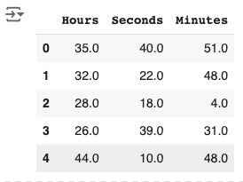
Generating Random Vectors
random.seed(140)
n_vectors = 2000
hours = np.random.randint(1, 49, size=n_vectors) # 1 to 48
seconds = np.random.randint(1, 61, size=n_vectors) # 1 to 60
minutes = np.random.randint(1, 61, size=n_vectors) # 1 to 60
# Combine into vectors where:
# - X-axis: seconds
# - Y-axis: hours
# - Z-axis: minutes
vectors = np.column_stack((seconds, hours, minutes))
print(vectors[:5])
# Save vectors to a CSV file
np.savetxt('random_time_vectors.csv',
vectors, delimiter=',',
header='Hours,Seconds,Minutes', comments='')
df = pd.read_csv('random_time_vectors.csv')
df.head()

Slide 5
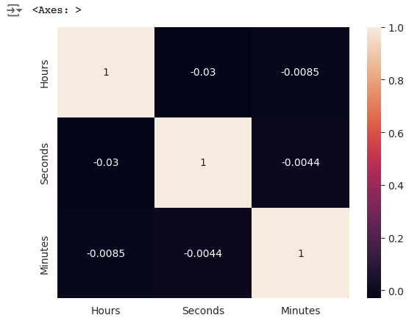
Visualizating df
s.set_style('whitegrid')
sns.heatmap(df.corr(), annot=True)

Slide 6
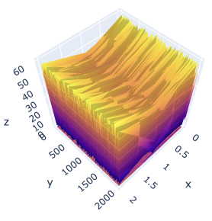
Surface Plot
always paints a vivid picture.

Slide 7
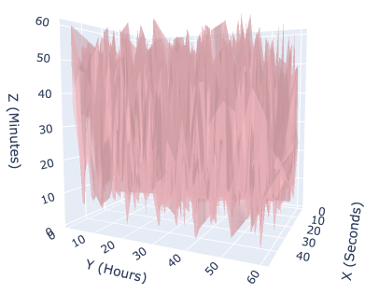
Mesh Plot
x = df['Seconds'].to_list()
y = df['Hours'].to_list()
z = df['Minutes'].to_list()
fig = go.Figure(data=[go.Mesh3d(x=x, y=y, z=z, color='lightpink', opacity=0.50,)], layout=go.Layout(scene=dict(xaxis_title='X (Seconds)', yaxis_title='Y (Hours)', zaxis_title='Z (Minutes)')))
fig.show()
I guess, it’s art.

Slide 8
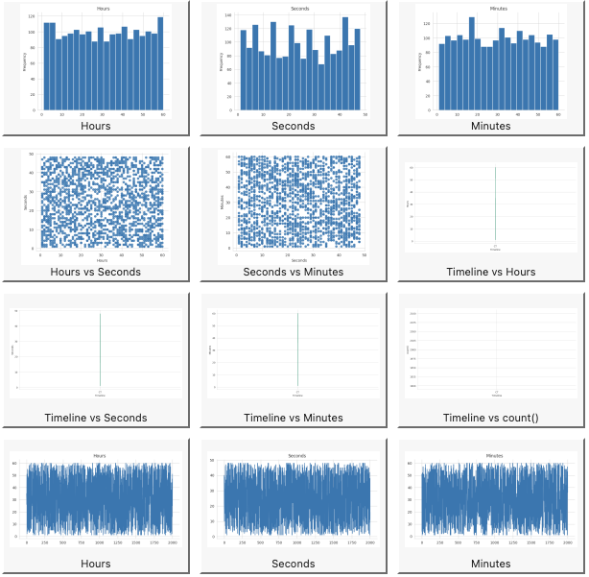
Plot twist?
df['Timeline'] = 'CT'
A label, akin to positive and negative sentiments in the paper.

Slide 9
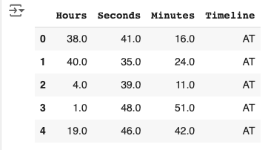
Second genSet
Short for generated dataset
random.seed(151)
n_vectors = 2000
hours = np.random.randint(1, 49, size=n_vectors) # 1 to 48
seconds = np.random.randint(1, 61, size=n_vectors) # 1 to 60
minutes = np.random.randint(1, 61, size=n_vectors) # 1 to 60
# Combine into vectors where:
# - X-axis: seconds
# - Y-axis: minutes
# - Z-axis: hours
vectors = np.column_stack((seconds, hours, minutes))
print(vectors[:5])
# Save vectors to a CSV file
np.savetxt('random_time_vectors2.csv', vectors, delimiter=',', header='Hours,Seconds,Minutes', comments='')
df2 = pd.read_csv('random_time_vectors2.csv')
df2['Timeline'] = 'AT'
df2.head()

Slide 10
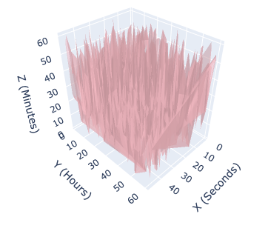
Mesh plot
x = df2['Seconds'].to_list()
y = df2['Minutes'].to_list()
z = df2['Hours'].to_list()
fig = go.Figure(data=[go.Mesh3d(x=x, y=y, z=z, color='lightpink', opacity=0.50,)], layout=go.Layout(scene=dict(xaxis_title='X (Seconds)', yaxis_title='Y (Hours)', zaxis_title='Z (Minutes)')))
fig.show()

Slide 11
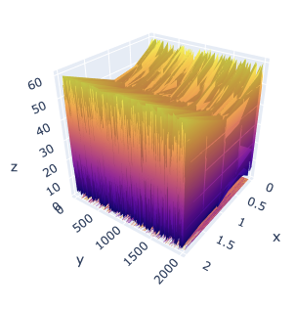
Surface Plot
fig = go.Figure(data=[go.Surface(z=df2.values)])
fig.update_traces(contours_z=dict(show=True, usecolormap=True,
highlightcolor="limegreen", project_z=True), contours_x=dict(show=True, usecolormap=True,
highlightcolor="pink", project_x=True), )
fig.update_layout(title='Surface Plot', autosize=False,
scene_camera_eye=dict(y=2.87,z=-0.64,x=-1),
width=1000, height=500,
margin=dict(l=65, r=50, b=65, t=90)
)
fig.show()
It’s a bit softer or flatter than surfacePlot(df).

Slide 12
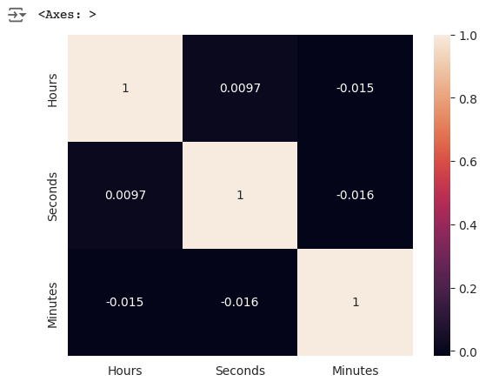
Visualizing df2
sns.set_style('whitegrid')
sns.heatmap(df2.corr(numeric_only=True), annot=True,)

Slide 13
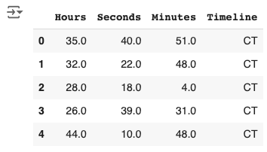
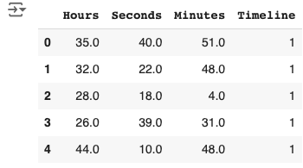
Concatenating df and df1
Number encoding
classificationDf = pd.concat([df, df2], axis=0)
classificationDf.head()
classificationDf['Timeline'] =
classificationDf['Timeline'].map({'AT': 0, 'CT': 1})
classificationDf.head()

Slide 14
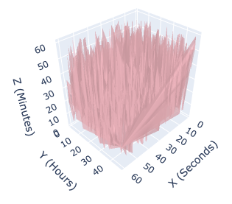
Mesh Plot
x = classificationDf['Hours'].to_list()
y = classificationDf['Seconds'].to_list()
z = classificationDf['Minutes'].to_list()
fig = go.Figure(data=[go.Mesh3d(x=x, y=y, z=z, color='lightpink', opacity=0.50,)], layout=go.Layout(scene=dict(xaxis_title='X (Seconds)', yaxis_title='Y (Hours)', zaxis_title='Z (Minutes)')))
fig.show()
A new streak?

Slide 15
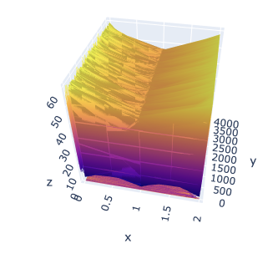
Surface Plots
fig =
go.Figure(data=[go.Surface(z=classificationDf.values)])
fig.update_traces(contours_z=dict(show=True, usecolormap=True,
highlightcolor="limegreen", project_z=True), contours_x=dict(show=True, usecolormap=True,
highlightcolor="pink", project_x=True), )
fig.update_layout(title='Surface Plot', autosize=False,
scene_camera_eye=dict(y=2.87,z=-0.64,x=-1),
width=1000, height=500,
margin=dict(l=65, r=50, b=65, t=90)
)
fig.show()
A clear divide, while filling in the gaps at the same time.

Slide 16
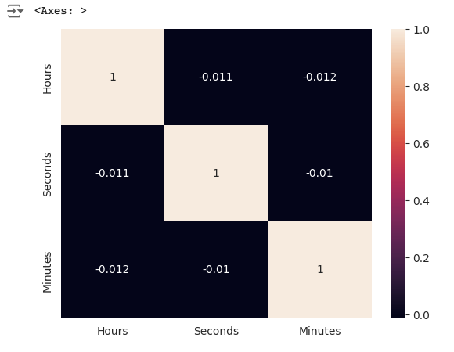
Correlation Matrix
sns.set_style('whitegrid')
sns.heatmap(classificationDf.corr(numeric_only=True), annot=True,)

Slide 17
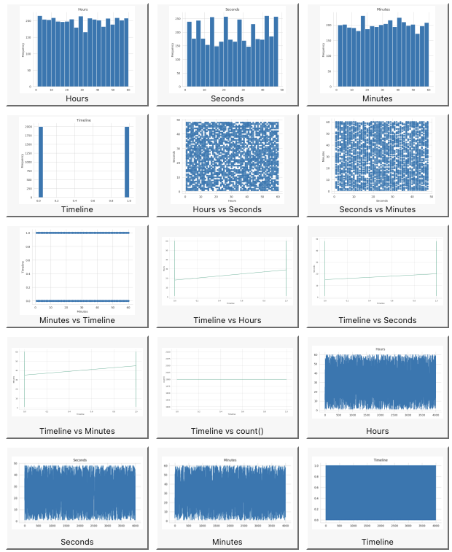
Univariate and Bivariate analysis

Slide 18
Shuffling
Preparation
classificationDf = classificationDf.sample(frac=1).reset_index(drop=True)
Shuffling the dataset to introduce non-linearity and thereby, compelling the algorithms to learn a way to represent the dataset.
X = classificationDf.drop('Timeline', axis=1)
y = classificationDf['Timeline']
X_train, X_test, y_train, y_test = train_test_split(X, y, test_size=0.2, random_state=33)

Slide 19
Models
param_grid_lr = {
'C': np.logspace(-3, 3, 7),
'penalty': ['l2'],
'solver': ['liblinear']
}
lr = LogisticRegression(random_state=33, max_iter=5000)
grid_search_lr = GridSearchCV(lr, param_grid_lr, cv=5, scoring='recall')
grid_search_lr.fit(X_train, y_train)
best_lr = grid_search_lr.best_estimator_
y_pred_lr = best_lr.predict(X_test)
recall_lr = recall_score(y_test, y_pred_lr)
scores = {}
scores['Logistic Regression'] = recall_lr
print(f"Logistic Regression Recall: {recall_lr}")
print("Best parameters:", grid_search_lr.best_params_)
print("Coefficients:", best_lr.coef_)
Logistic Regression

Slide 20
Results
Logistic Regression Recall: 0.5386533665835411
Best parameters: {'C': 10.0, 'penalty': 'l2', 'solver': 'liblinear'}
Coefficients: [[ 0.00074107 -0.00115453 -0.00055034]]

Slide 21
Decision Tree
print(f"Decision Tree Recall: {recall_tree}")
print("Best parameters:", grid_search_tree.best_params_)
scores['Decision Tree'] = recall_tree
plt.figure(figsize=(20,10))
plot_tree(best_tree, feature_names=X.columns, class_names=['0', '1'], filled=True,
rounded=True)
plt.savefig('bestTree.png')
plt.show()
param_grid_tree = {
'max_depth': [3,5],
'min_samples_split': [2, 5, 10],
'min_samples_leaf': [1, 2, 4]
}
dt = DecisionTreeClassifier(random_state=33)
grid_search_tree = GridSearchCV(dt, param_grid_tree, cv=5, scoring='recall')
grid_search_tree.fit(X_train, y_train)
# Best model
best_tree = grid_search_tree.best_estimator_
# Predict and calculate recall
y_pred_tree = best_tree.predict(X_test)
recall_tree = recall_score(y_test, y_pred_tree)
Decision Tree Recall: 0.
2144638403990025
Best parameters: {'max_depth': 5, 'min_samples_leaf': 4, 'min_samples_split': 2}

Slide 22
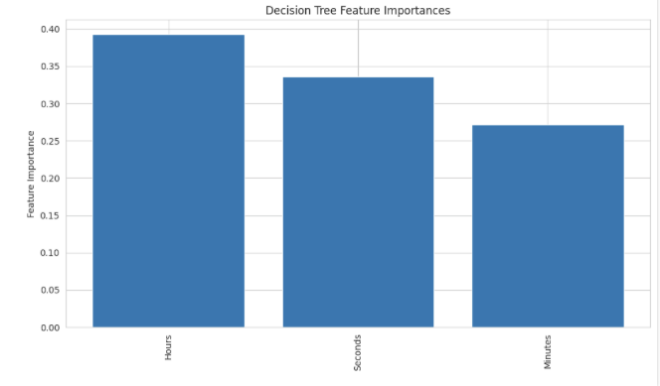
DT ctd…
Feature: Hours, Score: 0.39276
Feature: Seconds, Score: 0.33590
Feature: Minutes, Score: 0.27134
feature_importance = best_tree.feature_importances_
for i, v in enumerate(feature_importance):
print(f'Feature: {X.columns[i]}, Score: {v:.5f}')
# Visualize feature importances
plt.figure(figsize=(10, 6))
plt.bar(X.columns, feature_importance)
plt.xticks(rotation=90)
plt.ylabel('Feature Importance')
plt.title('Decision Tree Feature Importances')
plt.tight_layout()
plt.savefig('fi.png')
plt.show()

Slide 23
Dt ctd…
n_nodes = best_tree.tree_.node_count
children_left = best_tree.tree_.children_left
children_right = best_tree.tree_.children_right
feature = best_tree.tree_.feature
threshold = best_tree.tree_.threshold
# Function to print tree structure
def print_tree(node_id=0, depth=0):
indent = " " * depth
if (children_left[node_id] != children_right[node_id]): # Not a leaf node
print(f"{indent}Node {node_id}: Feature {X.columns[feature[node_id]]} <= {threshold[node_id]}")
print_tree(children_left[node_id], depth + 1)
print_tree(children_right[node_id], depth + 1)
else:
print(f"{indent}Leaf Node {node_id}")
print_tree()

Slide 24
Node 0: Feature Hours <= 56.5
Node 1: Feature Hours <= 5.5
Node 2: Feature Minutes <= 42.5
Node 3: Feature Seconds <= 22.5
Node 4: Feature Seconds <= 1.5
Leaf Node 5
Leaf Node 6
Node 7: Feature Hours <= 3.5
Leaf Node 8
Leaf Node 9
Node 10: Feature Seconds <= 13.5

Slide 25
Node 10: Feature Seconds <= 13.5
Node 11: Feature Minutes <= 48.5
Leaf Node 12
Leaf Node 13
Node 14: Feature Minutes <= 57.5
Leaf Node 15
Leaf Node 16
Node 17: Feature Hours <= 11.5
Node 18: Feature Hours <= 10.5
Node 19: Feature Minutes <= 6.5
Leaf Node 20
Leaf Node 21
Node 22: Feature Seconds <= 11.5
Leaf Node 23
Leaf Node 24

Slide 26
Node 25: Feature Seconds <= 46.5
Node 26: Feature Seconds <= 39.5
Leaf Node 27
Leaf Node 28
Node 29: Feature Hours <= 13.5
Leaf Node 30
Leaf Node 31
Node 32: Feature Seconds <= 13.5
Node 33: Feature Seconds <= 11.5
Node 34: Feature Seconds <= 7.5
Node 35: Feature Hours <= 59.5
Leaf Node 36
Leaf Node 37
Node 38: Feature Minutes <= 26.5
Leaf Node 39
Leaf Node 40
Leaf Node 41
Node 42: Feature Hours <= 58.5
Node 43: Feature Minutes <= 20.5
Node 44: Feature Seconds <= 38.0
Leaf Node 45
Leaf Node 46
Node 47: Feature Hours <= 57.5
Leaf Node 48
Leaf Node 49
Node 50: Feature Minutes <= 19.5
Node 51: Feature Minutes <= 6.5
Leaf Node 52
Leaf Node 53
Node 54: Feature Minutes <= 26.5
Leaf Node 55
Leaf Node 56

Slide 27
n_estimators_range = range(100, 5000, 100) # From 100 to 1000 with a step of 100
rss = []
for n_estimators in n_estimators_range:
rf_model = RandomForestClassifier(n_estimators=n_estimators, random_state=33)
rf_model.fit(X_train, y_train)
y_pred = rf_model.predict(X_test)
rs = recall_score(y_test, y_pred)
rss.append(rs)
print("Best Recall Score = ", max(rss))
Best Recall Score = 0.5187032418952618
for i in n_estimators_range:
numberOfTrees.append(i)

Slide 28
fig = go.Figure()
fig.add_trace(go.Scatter(x=numberOfTrees, y=rss, mode='lines+markers', name='Recall Score'))
fig.update_layout(title='Recall Score vs. Number of Trees in Random Forest',
xaxis_title='Number of Trees (Estimators)',
yaxis_title='Recall Score')
fig.show()
fig = go.Figure()
fig.add_trace(go.Scatter(x=numberOfTrees, y=rss, mode='lines+markers', name='Recall Score'))
fig.update_layout(title='Recall Score vs. Number of Trees in Random Forest',
xaxis_title='Number of Trees (Estimators)',
yaxis_title='Recall Score')
fig.show()

Slide 29
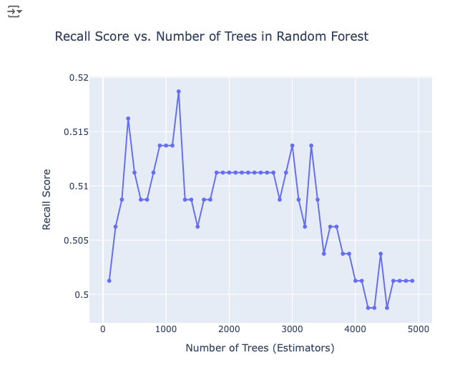
number of Estimators for best recall = 1200

Slide 30
for i in range(1200, 1214, 1):
rfModel = RandomForestClassifier(n_estimators=i, random_state=33)
rfModel.fit(X_train, y_train)
y_pred = rfModel.predict(X_test)
recall = recall_score(y_test, y_pred)
print(f"Number of Estimators: {i}, Recall: {recall}")
bestRandomForestModel = RandomForestClassifier(n_estimators=1205, random_state=33)
bestRandomForestModel.fit(X_train, y_train)
y_pred = bestRandomForestModel.predict(X_test)
recall = recall_score(y_test, y_pred)
scores['Random Forest'] = recall
print(f"Recall: {recall}")
Recall: 0.5211970074812967

Slide 31
importances = bestRandomForestModel.feature_importances_
feature_names = X.columns
# Sort feature importances in descending order
indices = np.argsort(importances)[::-1]
# Plot the feature importances
plt.figure(figsize=(10, 6))
plt.title("Feature Importance (Gini Importance)")
plt.bar(range(X.shape[1]), importances[indices], align="center")
plt.xticks(range(X.shape[1]), feature_names[indices], rotation=90)
plt.xlabel("Features")
plt.ylabel("Importance")
plt.tight_layout()
plt.show()

Slide 32
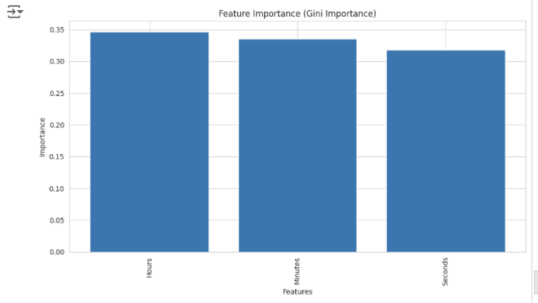

Slide 33
Kernel SVM
param_grid = {
'C': [0.1, 1, 10, 100],
'kernel': ['rbf'],
'gamma': ['scale', 'auto'] + list(np.logspace(-3, 3, 7)),
}
grid_search = GridSearchCV(SVC(random_state=34,probability=True), param_grid, scoring='recall', cv=5)
grid_search.fit(X_train, y_train)
best_svm_model = grid_search.best_estimator_
y_pred = best_svm_model.predict(X_test)
best_recall = recall_score(y_test, y_pred)
print(f"Best Recall: {best_recall}")
print(f"Best Parameters: {grid_search.best_params_}")

Slide 34
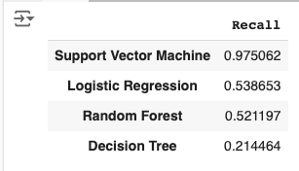
Comparing Recall Scores
bestRecallScoresDf = pd.DataFrame.from_dict(scores, orient='index', columns=['Recall'])
bestRecallScoresDf.sort_values(by='Recall', ascending=False, inplace=True)
bestRecallScoresDf

Slide 35
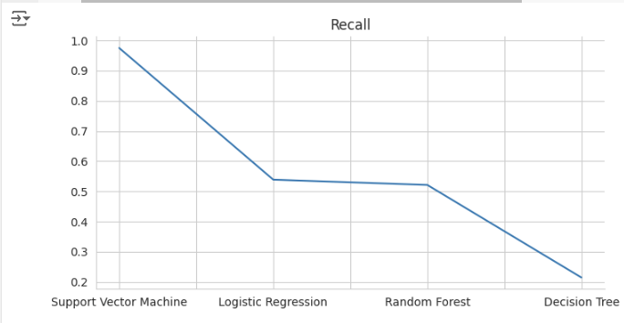
from matplotlib import pyplot as plt
bestRecallScoresDf['Recall'].plot(kind='line', figsize=(8, 4), title='Recall')
plt.gca().spines[['top', 'right']].set_visible(False)

Slide 36
A little trick
I only defined hours to go above the normal convention of 24 hours and when the value of minutes is 60, it’s could simultaneously imply an increase in an hour too, when the individual components are simply added. It’s still time.
anomaly = classificationDf.copy()
anomaly = anomaly[anomaly['Minutes']==60]
anomaly.drop('Timeline', axis=1, inplace=True)
Just a fun setup to understand the main applications of LIME. We know about the computational expenses, along with the precise evaluation metrics of SHAPEly values.

Slide 37
def find_common_vectors(df1, df2):
arr1 = df1.values.flatten()
arr2 = df2.values.flatten()
vectors1 = arr1.reshape(-1, 3)
vectors2 = arr2.reshape(-1, 3)
tuples1 = [tuple(vec) for vec in vectors1]
tuples2 = [tuple(vec) for vec in vectors2]
common = set(tuples1) & set(tuples2)
return list(common)
anomalyInTrain = find_common_vectors(anomaly, X_train)
anomalyInTest = find_common_vectors(anomaly, X_test)
print(f"Anomaly in Train: {len(anomalyInTrain)}")
print(f"Anomaly in Test: {len(anomalyInTest)}")
Train : 50
Test : 8

Slide 38
LIME setup
for model_name, model in models.items():
print(f"Explaining {model_name}")
print(f'Model features: ',model.feature_names_in_)
for i in range(len(anomalyInTest)):
exp = explainer.explain_instance(
anomalyInTest[i],
model.predict_proba
if hasattr(model, 'predict_proba')
else model.decision_function,
num_features=len(X.columns),
top_labels=1) # binary :/
exp.show_in_notebook(show_table=True, show_all=False)
y_pred = model.predict(X_test)
recall = recall_score(y_test, y_pred)
print(f"Recall for {model_name}: {recall}\n"
models = {
'Logistic Regression': best_lr,
'Decision Tree': best_tree,
'Random Forest': bestRandomForestModel,
'SVM': best_svm_model
}
explainer = lime_tabular.LimeTabularExplainer(
X_train.values,
feature_names=X.columns,
class_names=[1, 0],
mode='classification'
)

Slide 39
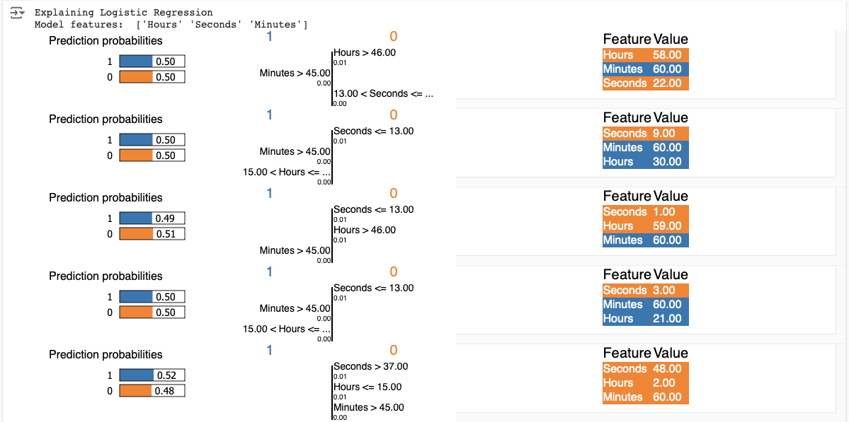

Slide 40
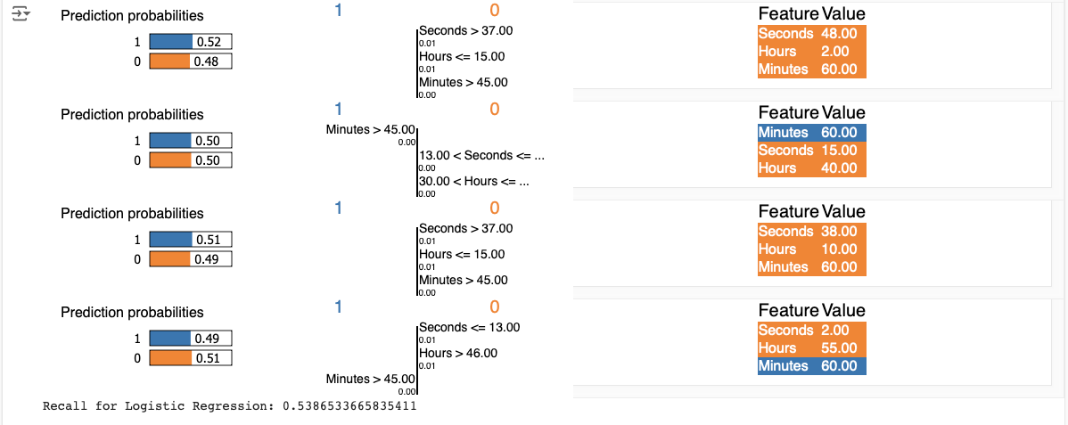

Slide 41
Hours: The feature 'Hours' consistently influences predictions across instances, with conditions like 'Hours > 46.00' and 'Hours < 15.00' showing variable impacts, suggesting that time thresholds significantly sway the logistic regression model's decision towards or away from class 1.
Minutes: The 'Minutes' feature, with conditions such as 'Minutes > 45.00', demonstrates a nuanced role, often having a minimal to no impact on the prediction probability, indicating that the model's sensitivity to minutes is context-dependent and not uniformly decisive.

Slide 42
Seconds: The 'Seconds' feature, with thresholds like 'Seconds <= 13.00' and 'Seconds <= 37.00', shows a strong positive influence when met, but its absence or when not met (e.g., 'Seconds > 37.00') negates this effect, highlighting the model's reliance on specific temporal markers.
Probability Distribution: The model's prediction probabilities are closely balanced, often around 0.50 for both classes, reflecting an inherent uncertainty or equilibrium in decision-making for these instances.

Slide 43
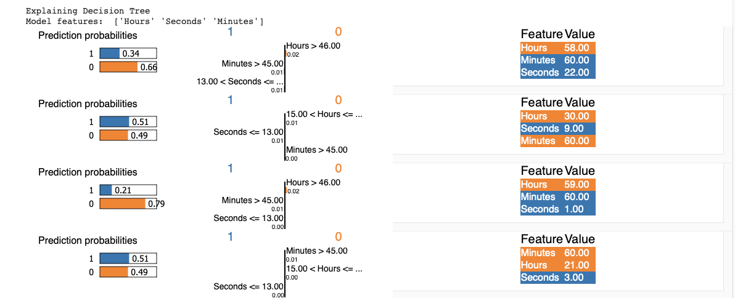

Slide 44
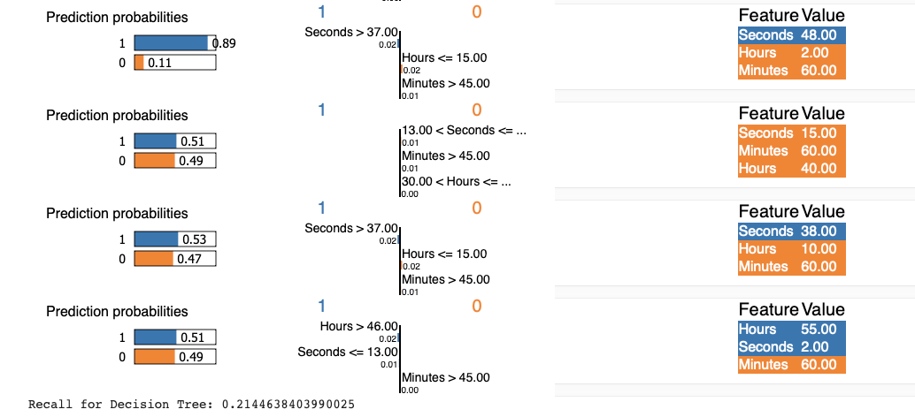

Slide 45
Hours: The 'Hours' feature significantly influences the model's decision path. Conditions like 'Hours > 46.00' and 'Hours < 15.00' guide the tree towards specific outcomes, suggesting that the model heavily relies on the time of day for classification.
Minutes: The 'Minutes > 45.00' condition appears frequently across different decision paths, indicating that the latter part of an hour has a notable impact on the model's predictions, possibly acting as a threshold for decision-making.

Slide 46
Seconds: Specific second thresholds like 'Seconds <= 13.00' and 'Seconds <= 37.00' play crucial roles, with their presence or absence steering the prediction towards one class over the other. This suggests a fine-grained temporal sensitivity in the model's structure.
Probability Distribution: The prediction probabilities often skew significantly towards one class, unlike the logistic regression more balanced approach, reflecting the decision tree's propensity for clear-cut decisions based on feature thresholds.

Slide 47
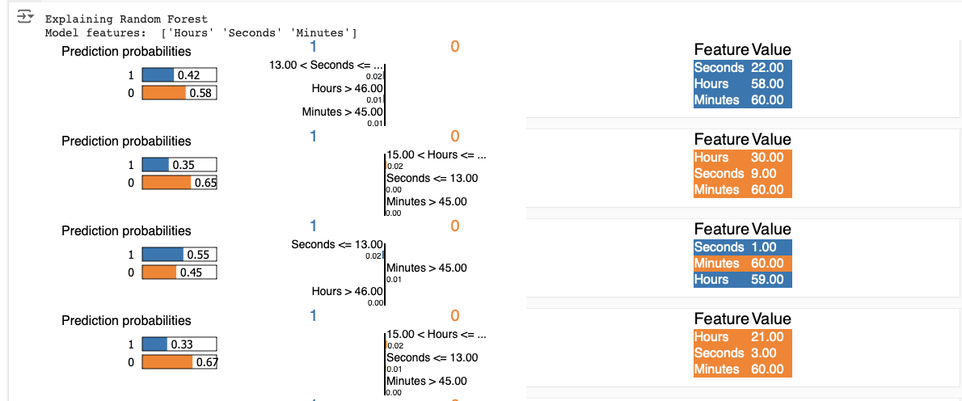

Slide 48
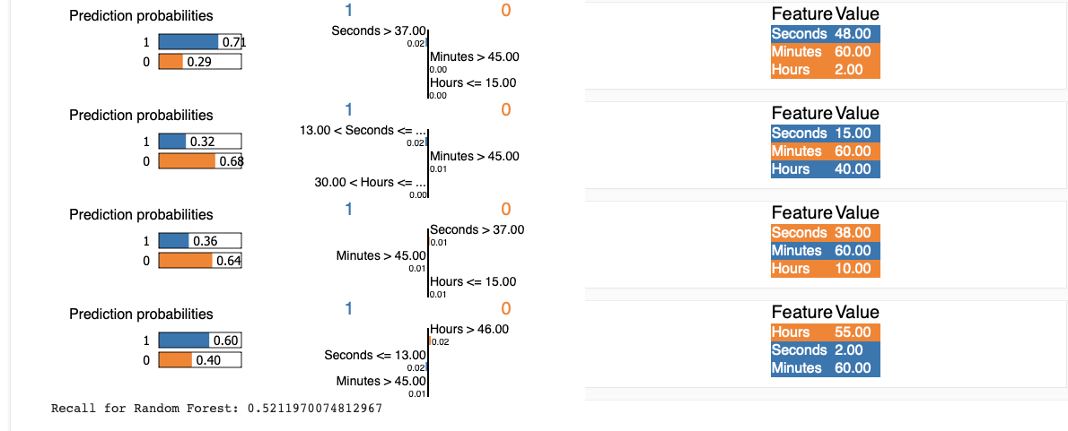

Slide 49
Hours: The 'Hours' feature significantly impacts the decision path, with conditions like 'Hours < 15.00' and 'Hours > 46.00' guiding the tree towards specific outcomes. This indicates that the model places substantial importance on the time of day for classification.
Minutes: The condition 'Minutes > 45.00' appears consistently, suggesting that the latter half of each hour is a critical factor in the model's decision-making process.

Slide 50
Seconds: Thresholds for 'Seconds' like 'Seconds < 13.00', 'Seconds > 37.00', and 'Seconds > 37.00' are pivotal, influencing the model's path towards different predictions. This shows the model's sensitivity to fine temporal details.
Probability Distribution: Unlike decision trees, the Random Forest model often shows more balanced prediction probabilities, reflecting its ensemble nature where multiple trees contribute to a more nuanced decision.

Slide 51
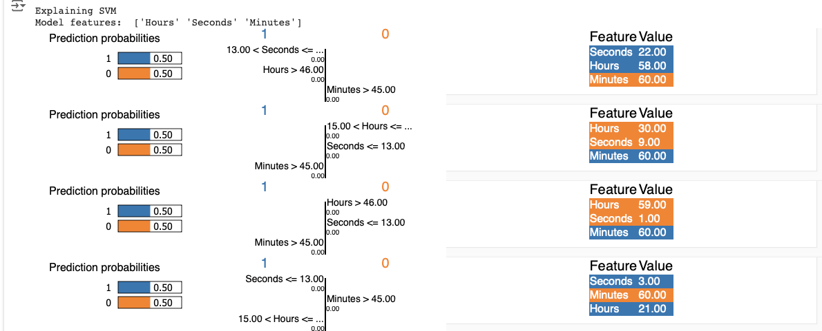

Slide 52
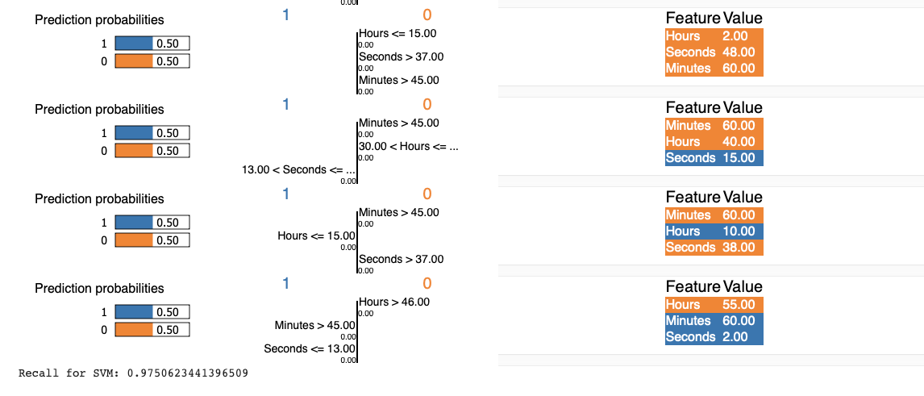

Slide 53
Hours: The 'Hours' feature is critical with conditions like 'Hours < 15.00' and 'Hours > 46.00' guiding the decision path. This suggests that the model places significant importance on the specific time of day.
Minutes: The condition 'Minutes > 45.00' frequently appears across different decision paths, indicating that the latter part of each hour is a key factor in the model's decision-making process.
Seconds: Thresholds like 'Seconds < 13.00' and 'Seconds > 37.00' are used to make predictions, showing that the model is sensitive to specific second values within a minute.
Probability Distribution: Unlike decision trees, SVMs often provide a balanced distribution of prediction probabilities (0.50 for both classes), which might indicate the model's uncertainty in classification or the nature of the dataset.

Slide 54
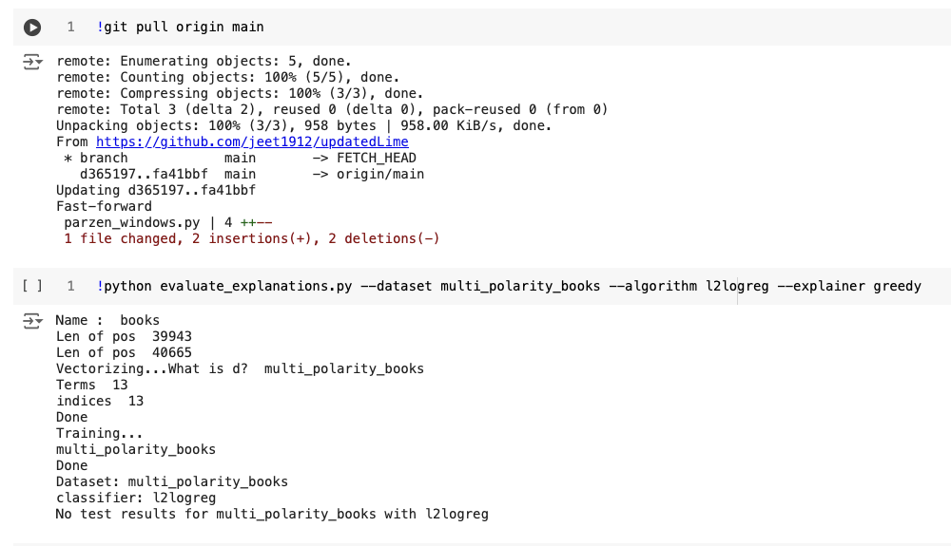

Slide 55
Even setting up experiment 5.2 from the paper with a basic logistic regression and a tree with an embedding layer couldn’t be reproduced because of dropped support (link to the repository).
Moving on, recall was simply chosen to monitor a model’s capability to identify the positive instances, a simple decision made as it is reflected in the overall surface plot of classificationDf.

Slide 56
Personal Comments
The paper touches extensively on extremely sensitive topics while already discussing a novel concept at the time, citing various researchers to captapuble or influence the usage of GPUs, leading us to today’s state, where we have LLMs like front-end frameworks.
Nonetheless, I personally like LIME along with Shapely. It is a total package!

Slide 57
LIME provides a granular view - the how - , offering insights into the impact of feature variations on individual predictions, while SHAP - the why - offers a comprehensive analysis, attributing importance to each feature across the entire dataset based on game theory principles. This dual approach not only enhances our comprehension of the model's inner workings but also fosters trust in its decision-making process.
By integrating these explanatory frameworks, we ensure that our model's decisions are not only accurate but also transparent and interpretable, aligning with higher standards of machine learning governance and ethical AI practice, which involves simple data collection and engineering strategies while ensuring authenticity while reporting experimental results on the World Wide Web.
Here’s the link to the notebook.

