Slide 1
Why should I trust you?
Explaining the Predictions of Any Classifier
Marco T.R,
Sameer Singh
and Carlos Guestrin
Abhijeet Sahdev
ID: 31669135

Slide 2
Summary
The authors highlight two important decisions faced by deployers of systems automated by algorithms, while doing so, they define two different perspectives of ‘trust’ in this context:
Trusting a model to behave appropriately if deployed.
Avoiding overfitting on test or train data to observe considerable performance on real world data.
Trusting a prediction made by the deployed model to drive business decisions.
Example: Using a model in medical diagnosis or terrorism detection.

Slide 3
They suggest that utilizing standard evaluation metrics isn’t sufficient enough even on real world data and considering each individual instance of predictions made and their explanation is a better approach while also highlighting which instance should be taken into consideration, which is useful for large datasets.
LIME (Locally Interpretable Model-Agnostic Explanations) has been designed to explain individual predictions by creating a local interpretable model around a given instance. It can highlight which features are considered most important in diagnosing a particular patient. In other words, it can experts, in this case doctors, verify a problem.

Slide 4
SP-LIME extends LIME. It selects a subsets of instances that explain the global behaviour of a given model. This helps in our understanding of the overall decision making process. In other words, it selects key features amongst various predictions to help us identify the importance given to certain features by our model, aiding trust across various cases.
This way, the authors have also demonstrated the usefulness of LIME in feature engineering to positively enhance the trustworthiness of an untrustworthy model.

Slide 5
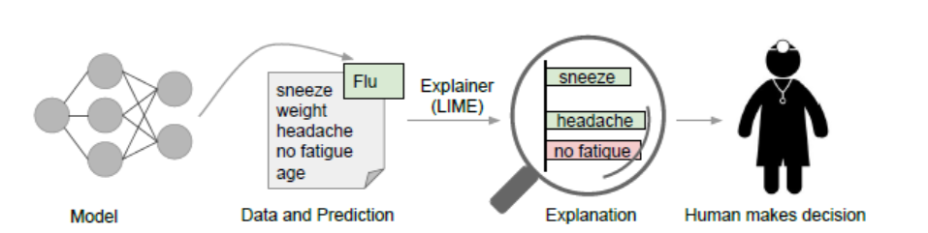
Fig 1
In Fig 1 (from cite, page 2), given a particular patient’s symptoms, model predicts that the patient suffers from flu. LIME highlights that symptoms, ‘sneeze’ and ‘headache’ positively influence the model’s decision whereas ‘no fatigue’ is inversely related to the decision of ‘Flu’. In this way, LIME provides evidences through weights to support the model’s decision to a doctor. The final decision is always made by the end user.

Slide 6
Authors also suggest that LIME can help us navigate through data leakages by providing explanations. An example of data leakage is when mean and standard deviation used for scaling train and validation data is also used for test data as well. This is a challenging task to identify, especially when the model is deployed as users may ignore it because of observed higher performance when accuracy metrics are considered.
By viewing explanations, the algorithm can help navigate data shift, i.e, when there is a vast difference between train and test data.

Slide 7
The algorithm can also help us pick a model from a list by taking individual explanations and accuracy metrics into consideration.
The authors suggest the following desired characteristics for any explainer:
They should be interpretable, i.e, there should be a qualitative understanding between input variable and outcomes.
Explanations should be easy to understand.
The target audience should also be taken into consideration when providing any explanation.
It should be locally faithful.
It should be model agnostic.

Slide 8
Local fidelity or faithfulness does not imply global fidelity but the converse is true. In other words, features that are globally important need to be locally important every time.
Few explanations of predictions are shown to the user that depict the global context.

Slide 9


Goal Of LIME
Stated as it is from cite, Page 3 :
To find an interpretable model over an interpretable representation which is locally faithful to a classifier.
Difference between interpretable representation and features:
Features are complex word embeddings used by the model denoted as , whereas an interpretable representation could be a binary vector indicating the presence or absence of a word, denoted by

Slide 10
LIME defines an interpretable model (g) from a class (G), such as linear models or decision trees, that operate on binary presence/absence features.
The explanation balances fidelity and interpretability by minimizing the loss function , fidelity function, which measures how g approximates the original model (f) locally around the instance (x), while keeping the sd complexity such as #non-zero weights (# is read as number of) or depth of a tree low enough for human understanding.

Slide 11

This trade-off is formalized in the following way:
where LIME uses sparse linear models and perturbations to generate explanations that are faithful to the model and interpretable to users.
Eq 1
From cite, Pg 3

Slide 12
LIME makes no assumptions about f, hence, maintaining its model agnostic capability. It does so by sampling instances around x (a point) and weighting these samples by , a proximity measure. These weighted samples are used to approximate a local loss function (previous slide).
Given the presence of sample noise, LIME still remains robust as it leverages proximity weights to ensure faithfulness in the explanation of the model’s local behaviour.

Slide 13
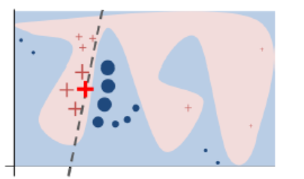
Intuition of LIME
Here, LIME provides an interpretable explanation by approximating a local decision boundary which is linear (dashed line) although the original model is quite complex.
Fig 2, from cite Pg 4
It focuses on the locality around the instance marked by bold red cross with thicker border by sampling points from either categories (red or blue) around it with varying weights based on distance, which is essentially the local dashed decision boundary.

Slide 14
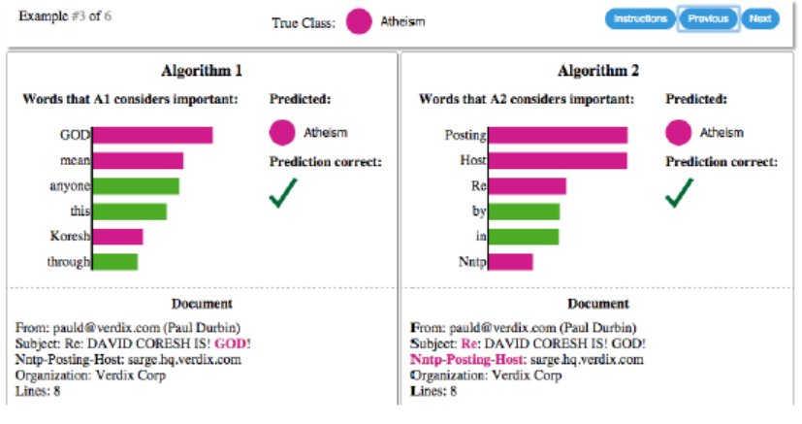
Examples
Fig 3 from cite, Page 2

Slide 15
In Figure 3, although the SVM model has an accuracy score of 94%, the explanations depict that such a score is irrelevant as the words such as ‘mean’, ‘ anyone’, ‘this’, ‘Posting’, ‘host’, ‘re’, etc., have no coherency when placed beside the classes ‘Atheism’ and ‘Christianity’.
This way LIME highlights a core problem in the dataset that has been chosen for the experiment.

Slide 16

Fig 4 from cite, Page 5
Due to the presence of a fretboard, the given image was classified as a Electric Guitar, not an acoustic one, providing further insights into trusting the actual model.

Slide 17
SP-LIME
As mentioned earlier, a global understanding of the model f, can be achieved by picking a set of explained instances while maintaining the property of model agnosticity.
Clearly, end users can only view a certain amount of explanations. Hence, it is important to avoid redundant explanations.
The goal is to depict features that explain many instances with a higher importance score.
.Maximizing this score, i.e, the interpretability gain, for all features is an NP hard problem.

Slide 18
This approach complements the traditional metrics such as held-out accuracy.
Given a limited budget B, the task is to select B instances from a set X for inspection, known as pick step. This way, it considers explanations along with raw data.
An explanation matrix W, of size n*(d)^0 is constructed (for simplicity), where Wij = modulo(w_g(ij)) for linear explanations. This represents the local importance of interpretable components.

Slide 19

The global importance Ij of each component j is calculated as :
, emphasizing features that explain many instances.
The Pick Problem is defined as
Where C(V,W,I) helps us define coverage as a set c, given W and I (continued)...
Eq 2, from cite, Pg 6

Slide 20

Computes the total importance of features that appear in at least one instance of set V.
The above equation aims to maximize the coverage of important features by selecting a non-redundant set of instances. It is approached using a submodular pick algorithm due to its NP-hard nature.
Eq 3, from cite, Pg 6

Slide 21
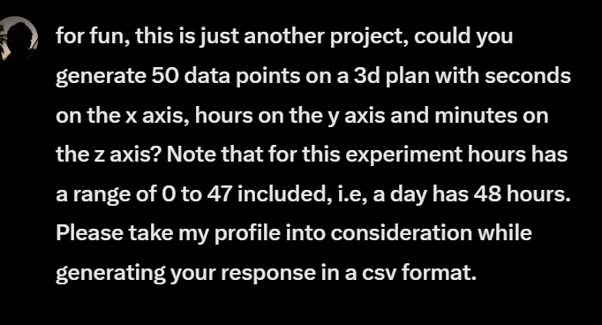
Experimental Setup
First, I asked Grok to generate 1050 data points by repeating the following prompt - :

Slide 22
Required Libraries and Packages
!pip install lime
!pip install python-docx
import numpy as np
import pandas as pd
import seaborn as sns
sns.set_style('whitegrid')
import random
random.seed(33)
import plotly.graph_objects as go
from plotly.subplots import make_subplots
import plotly.express as px
from sklearn.model_selection import train_test_split
from sklearn.linear_model import LogisticRegression
from lime.lime_tabular import LimeTabularExplainer
from sklearn.metrics import recall_score, make_scorer,
mean_squared_error, r2_score

Slide 23
from sklearn.feature_selection import SelectFromModel from sklearn.tree import DecisionTreeClassifier
from lime import lime_tabular, submodular_pick
import matplotlib.pyplot as plt
import warnings
warnings.filterwarnings('ignore')
from sklearn.linear_model import LinearRegression, LassoCV
import gspread
from google.auth import default
from google.colab import auth
import docx
from PIL import Image
import nltk
from sklearn.feature_extraction.text import CountVectorizer
from sklearn.model_selection import train_test_split, cross_val_score
from sklearn.metrics import classification_report
from lime.lime_text import LimeTextExplainer
from sklearn.feature_extraction.text import TfidfVectorizer
from sklearn.preprocessing import StandardScaler
from sklearn.pipeline import Pipeline
from sklearn.feature_selection import f_regression, SelectKBest
nltk.download('punkt')
nltk.download('stopwords')

Slide 24
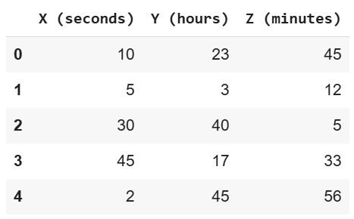
Loading the dataset
auth.authenticate_user()
creds, _ = default()
gc = gspread.authorize(creds)
sheetID = '1-rVhHaHLcFvikSjKXOR6jCOW
-zdpdNAnLWXzJMAzyRg'
worksheet = gc.open_by_key(sheetID).sheet1
# Get all records from the sheet
data = worksheet.get_all_records()
df = pd.DataFrame(data)
df.head()
Fig 5: Dataframe generated using Grok

Slide 25
Identifying incorrect data
# Create a new column 'Check' with initial value as 'Correct'
df['Check'] = 'Correct'
# Update 'Check' to 'Incorrect' if any of the conditions fail
df.loc[~df['X (seconds)'].between(0, 59, inclusive='both'), 'Check'] = 'Incorrect'
df.loc[~df['Y (hours)'].between(0, 47, inclusive='both'), 'Check'] = 'Incorrect'
df.loc[~df['Z (minutes)'].between(0, 59, inclusive='both'), 'Check'] = 'Incorrect'
df = df[df['Check'] != 'Incorrect']
print(df.shape)

Slide 26
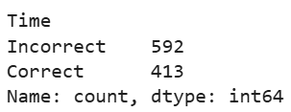
(1005, 4) - indicating that there were 44 incorrectly generated entries by Grok.
Now, we drop the ‘Check’ column and create our binary column ‘Time’ which is ‘Correct’ is the number of hours (Y) is lesser than 24. This column is label encoded as 0 for ‘Correct’ and 1 for ‘Incorrect’.
df.drop(columns=['Check'], inplace=True)
df['Time'] = df['Y (hours)'].apply(lambda x: 'Incorrect' if x >= 24 else 'Correct')
y_counts = df['Time'].value_counts()
print(y_counts)
Fig 6: Distribution of Time

Slide 27
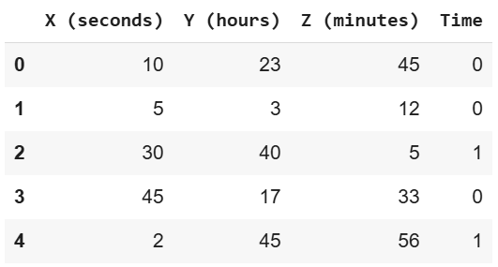
Label Encoding
df['Time'] = df['Time'].map({'Correct': 0, 'Incorrect': 1})
Fig 7 : Dataframe

Slide 28
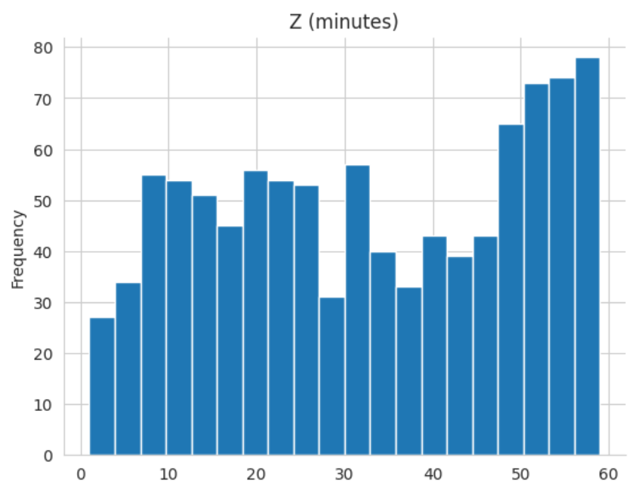
Analysis of Dataframe in Fig 7
Univariate Analysis
Z (minutes) has two common durations - around 10 to 20 mins and 50 to 60 minutes.
df['Z (minutes)'].plot(kind='hist', bins=20,
title='Z (minutes)')
plt.gca().spines[['top', 'right',]].
set_visible(False)
Fig 8: UA of Z (mins)

Slide 29
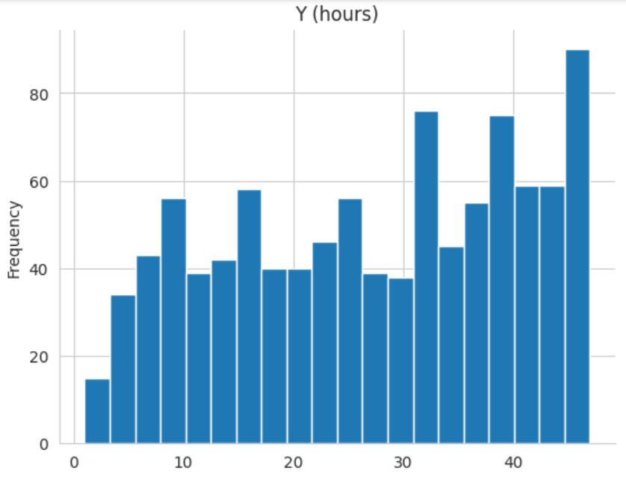
Y(hours) has 6 peaks with the most frequent being at 47.
df['Y (hours)'].plot(kind='hist', bins=20,
title='Y (hours)')
plt.gca().spines[['top', 'right',]].
set_visible(False)
Fig 9 : UA of Y (hours)

Slide 30
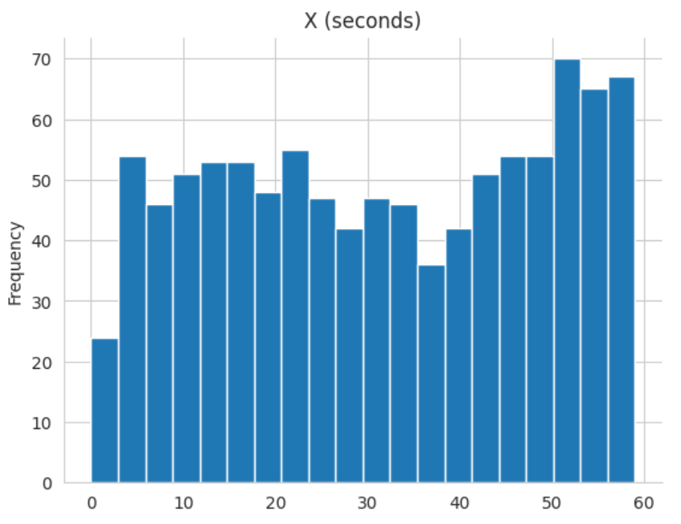
X (seconds) is fairly distributed, except around 0 and between 30 and 45 seconds.
df['X (seconds)'].plot
(kind='hist', bins=20,
title='X (seconds)')
plt.gca().spines[['top',
'right',]].set_visible(False)
Fig 9 : UA of X (seconds)

Slide 31
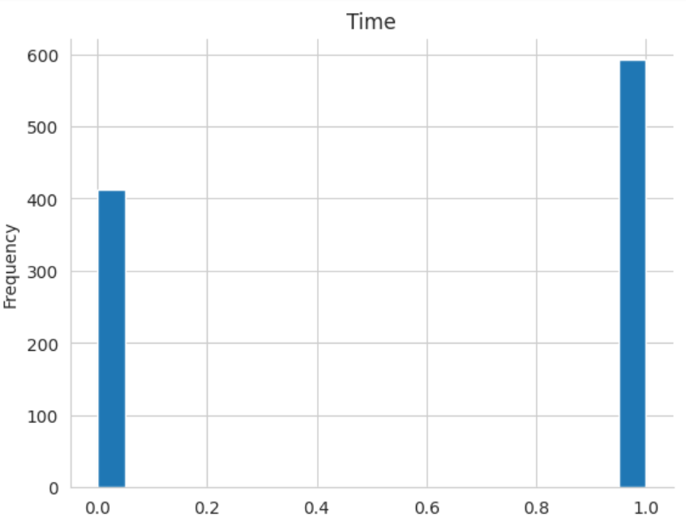
The target column, Time, has an imbalance distribution.
Fig 10 : UA of Time, refer Fig 6

Slide 32
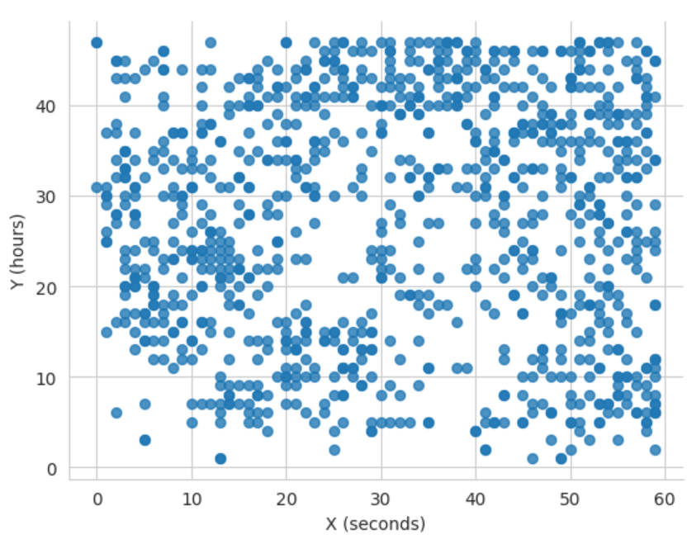
Bivariate Analysis (BvA)
Viewing the scatter plot, it’s evid- ent that seconds and hours do not follow the standard convent- ion. The graph has a grid-like pattern which isn’t monotonic.
df.plot(kind='scatter',
x='X (seconds)', y='Y (hours)',
s=32, alpha=.8)
plt.gca().spines[['top',
'right',]].set_visible(False)
Fig 11 : BvA of X and Y

Slide 33
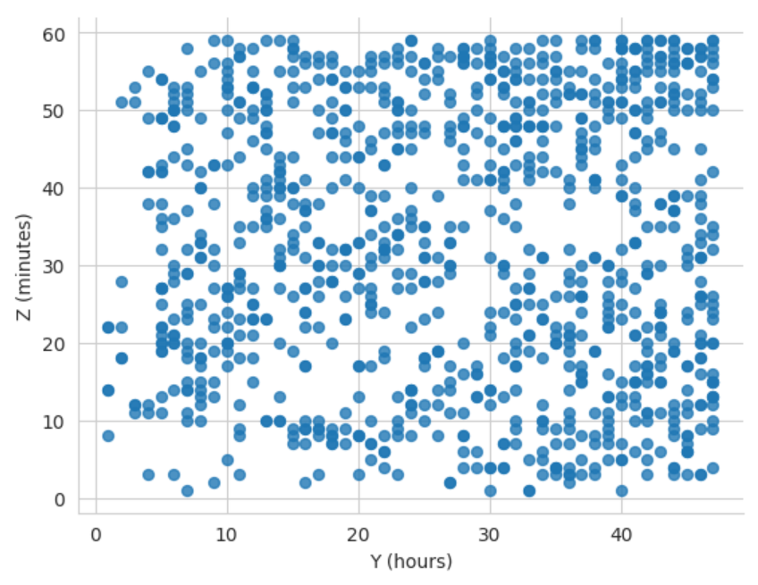
Scatter plot for Y vs Z indicates that there are dense clusters such that for a given value of Y, there are multiple values of Z.
df.plot(kind='scatter',
x='Y (hours)', y='Z (minutes)',
s=32, alpha=.8)
plt.gca().spines[['top',
'right',]].set_visible(False)
Fig 12 : BvA of Y and Z

Slide 34
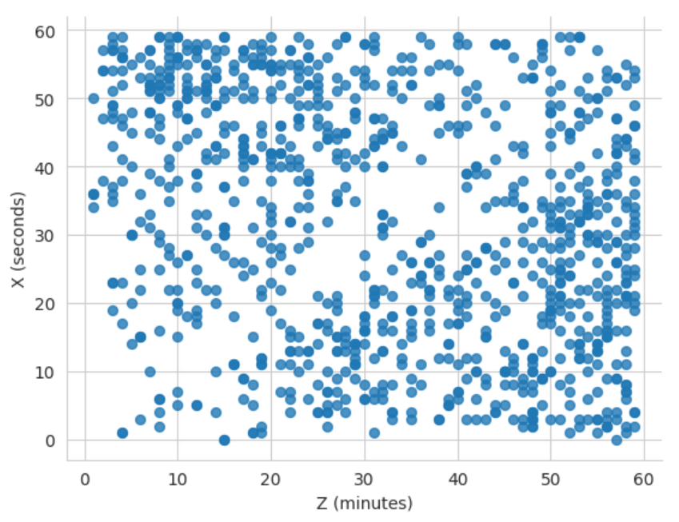
Scatter plot of Z vs X shows the same trend as earlier with dense clusters on the either sides of the region indicating a linear relationship.
df.plot(kind='scatter',
x='Z (minutes)', y='X (seconds)',
s=32, alpha=.8)
plt.gca().spines[['top',
'right',]].set_visible(False)
Fig 13 : BvA of Z and X

Slide 35
Bivariate violin plots for analyzing the relationship between ‘Time’ and other columns.
for column in df.columns:
if column != 'Time':
plt.figure(figsize=(6, 4))
sns.violinplot(x='Time', y=column, data=df)
plt.title(f'Violin Plot of {column} vs. Time')
plt.show()

Slide 36
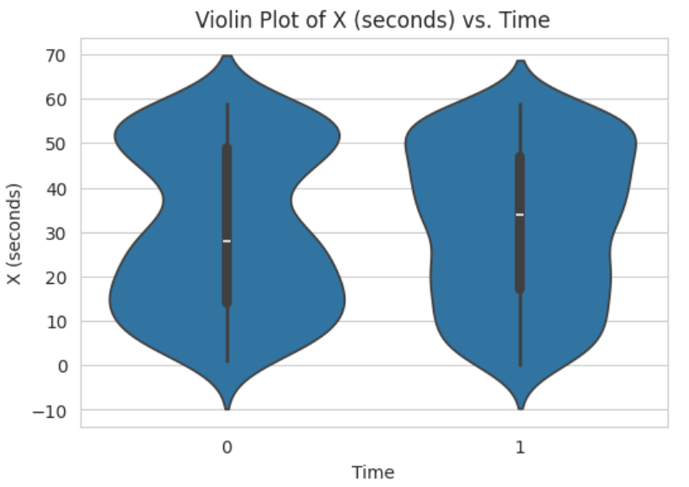
The violin plot depicts that there is a higher variability of X (seconds) when time is 0 than at 1. Their medians are around 30.
Fig 14 : BvA of Time and X

Slide 37
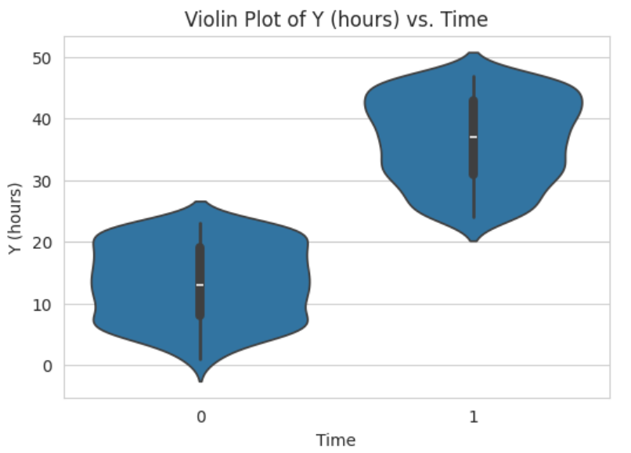
There is a wider range of values of hours (Y) around the median 15 when time is 0. For incorrect time, an inverse relationship is evident around the median 35.
Fig 15 : BvA of Time and Y

Slide 38
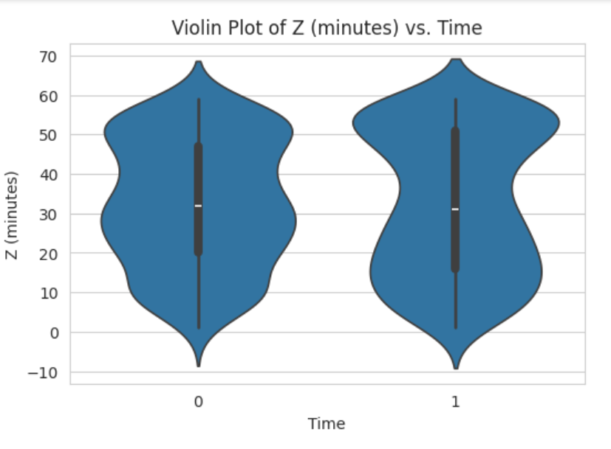
Given the range of Time, distribution of Z has the same median, however, wide range of values are observed around 30 minutes at time = 0 and narrower range is visible for time = 1.
Fig 16 : BvA of Time and Z

Slide 39
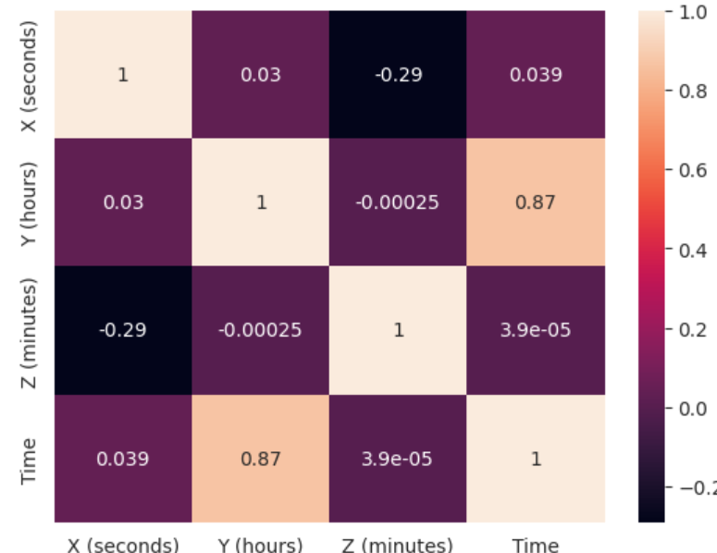
Correlation Matrix
The range of correlation values is between [-0.29, 0.87] apart from self- correlation. There seems to be an - almost linear relationship between Y and Time. Nonetheless, none of the columns need to be dropped.
sns.heatmap(df.corr(), annot=True)
Fig 17 : Correlation Matrix

Slide 40
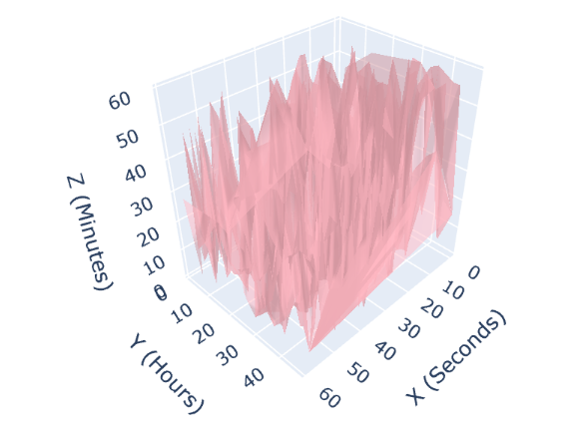
Mesh Plot
It indicates uneven distribution of of Z (minutes) values with var- ious hills and peaks.
x = df['X (seconds)'].to_list()
y = df['Y (hours)'].to_list()
z = df['Z (minutes)'].to_list()
fig = go.Figure(data=[go.Mesh3d(x=x,
y=y, z=z, color='lightpink', opacity=0.
50,)], layout=go.Layout(scene=dict(
xaxis_title='X (Seconds)', yaxis_title=
'Y (Hours)', zaxis_title='Z (Minutes)')))
fig.show()
Fig 18 : Mesh Plot

Slide 41
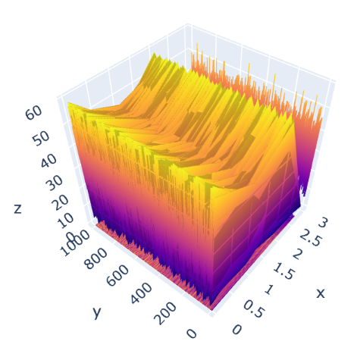
Surface Plot
It further highlights the variations
in Z (minutes), through peaks and
troughs.
fig = go.Figure(data=[go.Surface(z=df.values)])
fig.update_traces(contours_z=dict(show=True,
usecolormap=True,highlightcolor="limegreen",
project_z=True), contours_x=dict(show=True,
usecolormap=True, highlightcolor="pink",
project_x=True), )
fig.update_layout(title='Surface Plot',
autosize=False, scene_camera_eye=dict(y=2.87,
z=-0.64,x=-1), width=1000, height=500,
margin=dict(l=65, r=50, b=65, t=90))
fig.show()
Fig 19 : Surface Plots

Slide 42
Generating textual data
Given 1004 tuples, I decided to create a story, assigning each sentence to a tuple. The story was generated in 21 prompts, a prompt for each part.
The story revolves around a society that values and cherishes time as a scared entity.
The prompts are as follows:

Slide 43
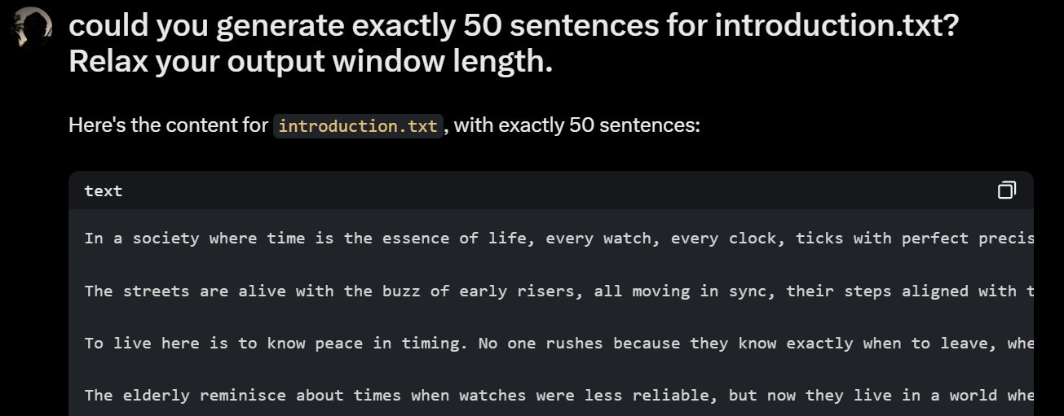

Slide 44
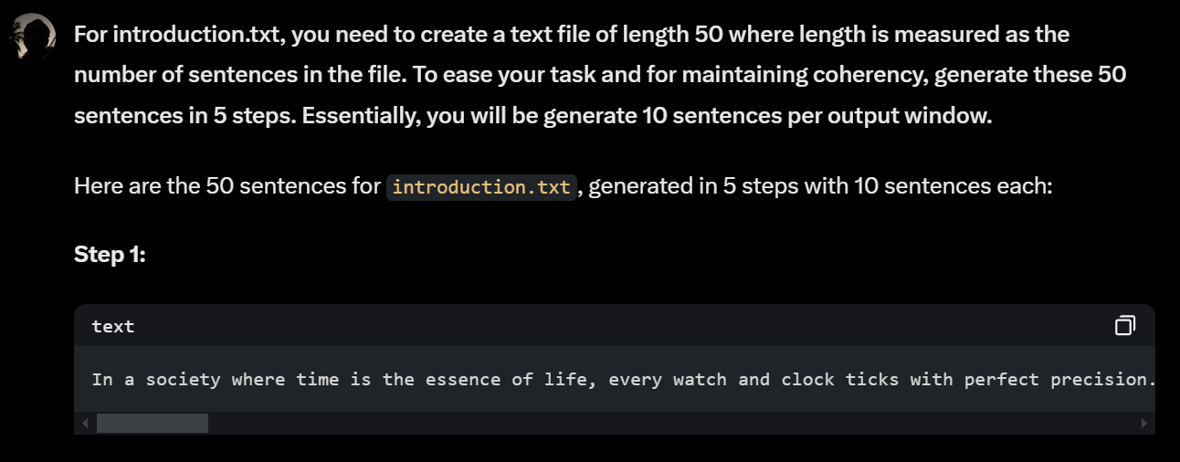
The following prompt was more precise in terms of number of sentences. This was repeated 21 times.For the last par, i.e., conclusion, only 4 sentences were generated.

Slide 45
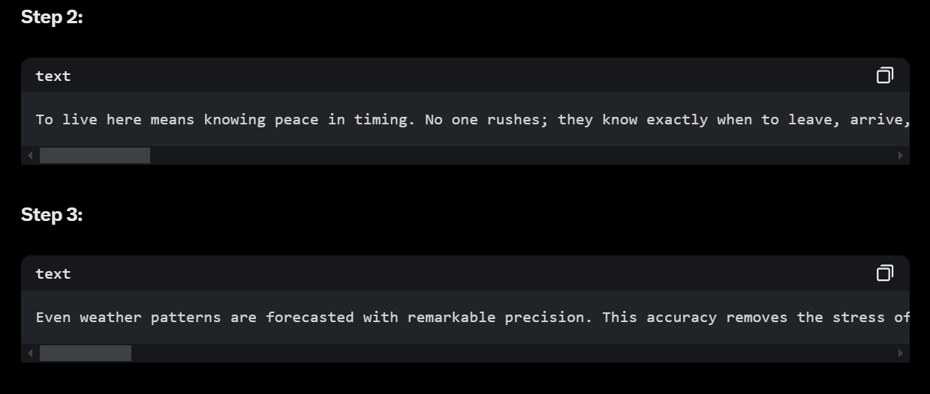
Adas
Similarly, step 4 and step 5 were generated.

Slide 46
The output was copied to a word document and loaded into the main dataframe in the following way:
path = "/content/drive/MyDrive/dm634/story.docx"
doc = docx.Document(path)
sentences = []
for para in doc.paragraphs:
para_sentences = [sentence.strip()
for sentence in para.text.split('.')
if sentence.strip()]
sentences.extend(para_sentences)
sentences = [sentence + '.' if not sentence.endswith('.') else sentence for sentence in sentences]

Slide 47
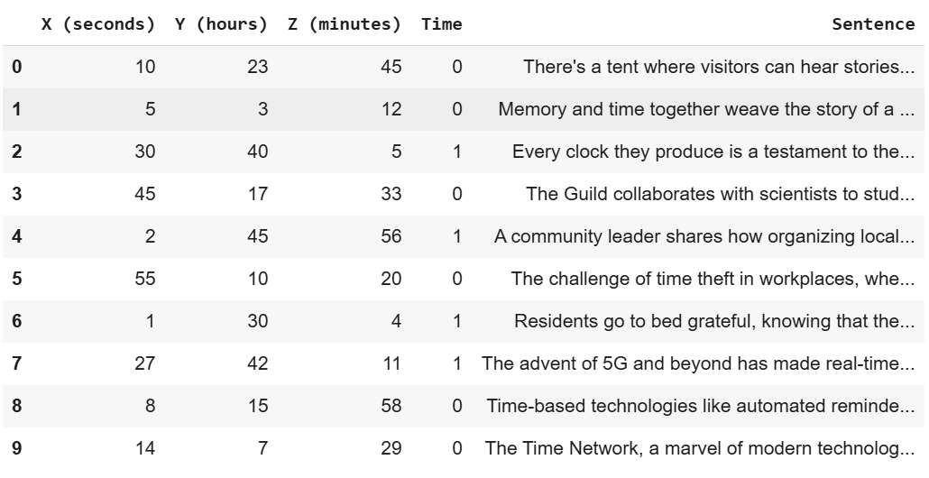
random.shuffle(sentences)
# Assign sentences to DataFrame
df['Sentence'] = [sentences[i % len(sentences)] for i in range(len(df))]
df.head(10)
Fig 20 : Updated Dataframe

Slide 48
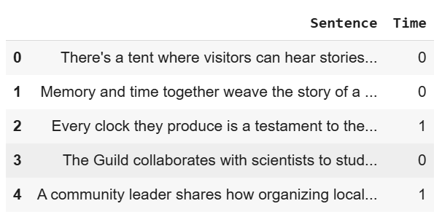
Examining an instance for binary text classification
Consider the following dataframe obtained from the statement:
classificationDf = df[['Sentence','Time']]
Fig 21 : Classification Df

Slide 49
X_train, X_test, y_train, y_test = train_test_split(df['Sentence'], df['Time'], test_size=0.3, random_state=33)
vectorizer = TfidfVectorizer()
X_train_vectorized = vectorizer.fit_transform(X_train)
X_test_vectorized = vectorizer.transform(X_test)
model = LogisticRegression(random_state=33)
model.fit(X_train_vectorized, y_train)

Slide 50
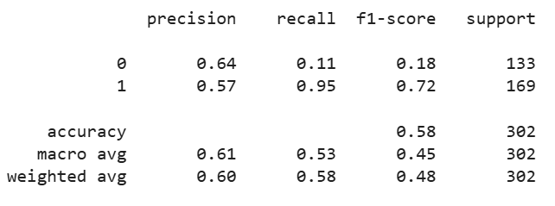
y_pred = model.predict(X_test_vectorized)
print(classification_report(y_test, y_pred))

Slide 51
Examining 301th instance of y_pred
# LIME explainer
explainer = LimeTextExplainer(class_names=['Correct Time', 'Incorrect Time'])
def predict_proba(texts):
return model.predict_proba(vectorizer.transform(texts))
# Explain an instance
idx = 301
exp = explainer.explain_instance(X_test.iloc[idx], predict_proba, num_features=10)

Slide 52
# Display the explanation
print('Document id: %d' % idx)
print('Probability(Time) =', model.predict_proba(X_test_vectorized[idx])[0, 1])
print('True class: %s' % y_test.iloc[idx])
print("Explanation for class Time:")
exp.show_in_notebook(text=X_test.iloc[idx], predict_proba=predict_proba)

Slide 53
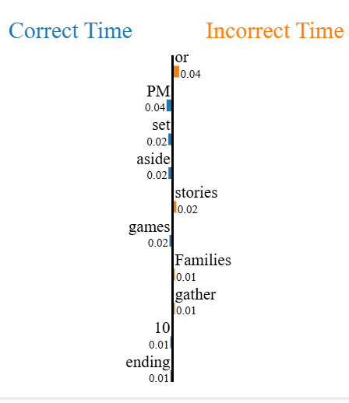
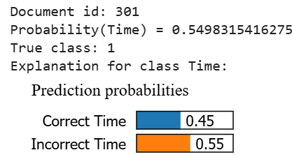
Fig 22 : LIME text tabular (a)

Slide 54
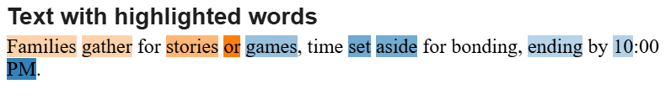
The words ‘or’ and ‘PM’ strongly contributed towards the classification of this sentence. The correspondence of ‘PM’ with the class Correct Time highlights the trustworthiness of the dataframe, despite the fact that they’re instances such as ‘families’, ‘gather’, etc., that suggest otherwise.
Considering another instance with idx = 45

Slide 55
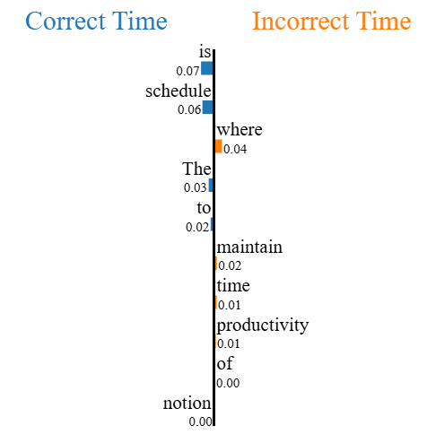
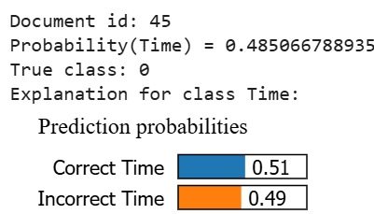
Fig 22 : LIME text tabular (b)

Slide 56
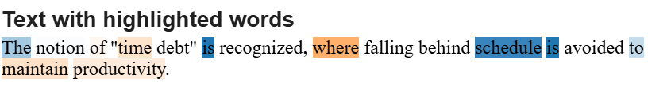
Here, ‘is’ and ‘where’ play critical roles in the classification of the sentence. The words selected along with the classification of this sentence to the minority class highlight the problem in the dataset.

Slide 57
Submodular Picks
While the previous two explanations presented classifications of either class, they were tedious to depict as one needs to find an instance of the minority class in the test set.
Here comes submodular_picks from lime package that selects the best n number of instances for us to examine.
Note: In this case, we arrive at the same conclusions but it in an easier way.
Another point to be noted is that in Fig 23 d, there is an incorrect classification, which we can justify through the model being trained on an imbalanced dataset.This could be because the model ignores the world ‘Time’ (Fig 23 a) in its bag of words but considers other version such as ‘timed’ as shown in the figure.

Slide 58
sp_obj = submodular_pick.SubmodularPick(explainer, X_test.tolist(),
predict_proba,
sample_size=20, # Number of instances to explain
num_features=10, # Number of features to show in each explanation
num_exps_desired=5) # Number of diverse explanations
print(f"Selected {len(sp_obj.sp_explanations)} diverse explanations:")
for i, idx in enumerate(sp_obj.V): # Use .V to get the indices
print(f"\nExplanation {i + 1}:")
print(f"Predicted Probability(Time) = {model.predict_proba(X_test_vectorized[idx].reshape(1, -1))[0, 1]}")
print(f"True class: {y_test.iloc[idx]}")
sp_obj.sp_explanations[i].show_in_notebook(text=X_test.iloc[idx])

Slide 59

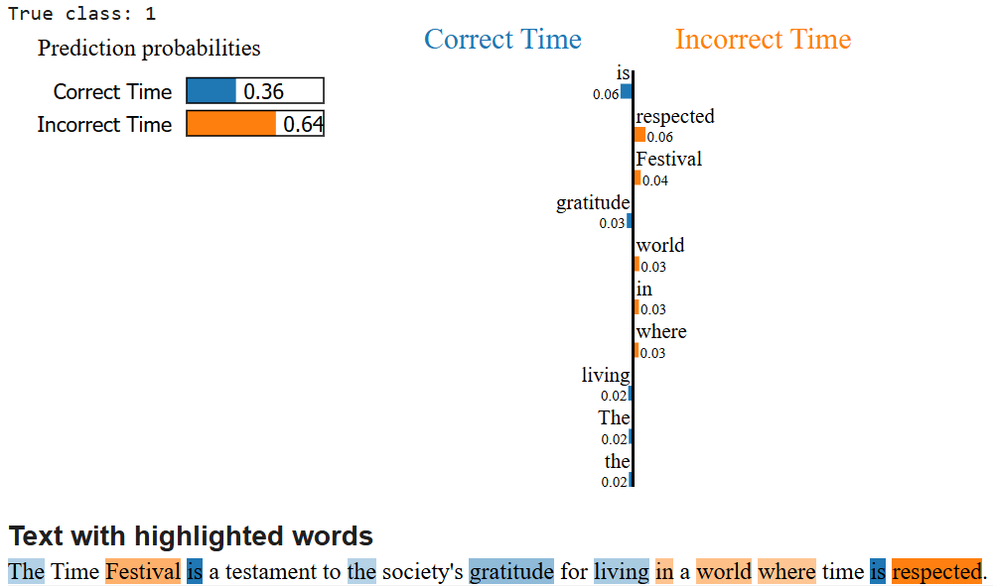
Fig 23 a

Slide 60
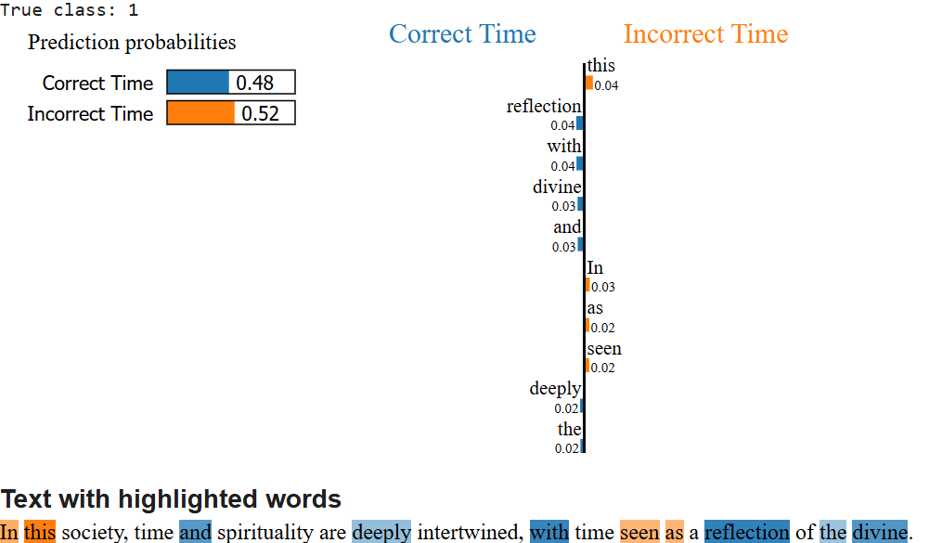
Fig 23 b

Slide 61
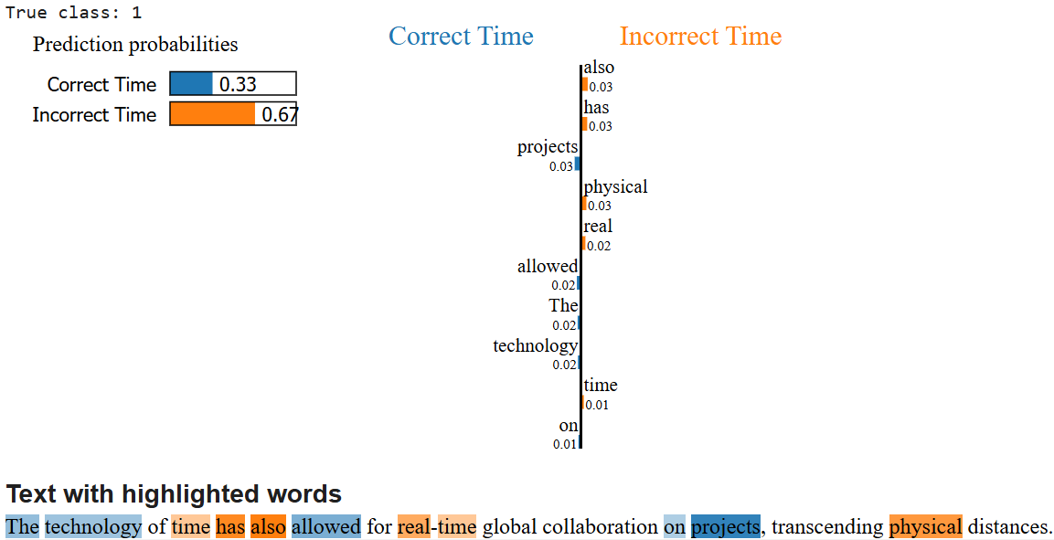
Fig 23 c

Slide 62

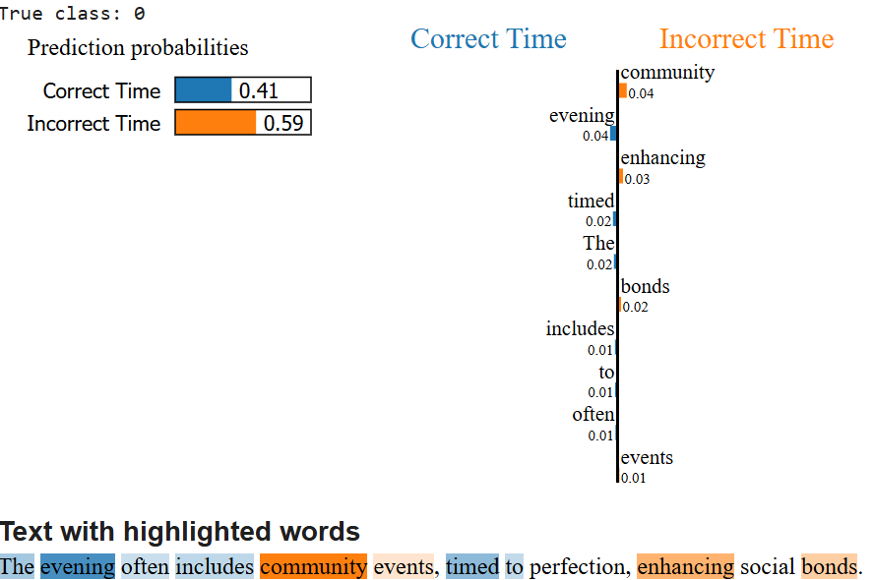
Fig 23 d

Slide 63

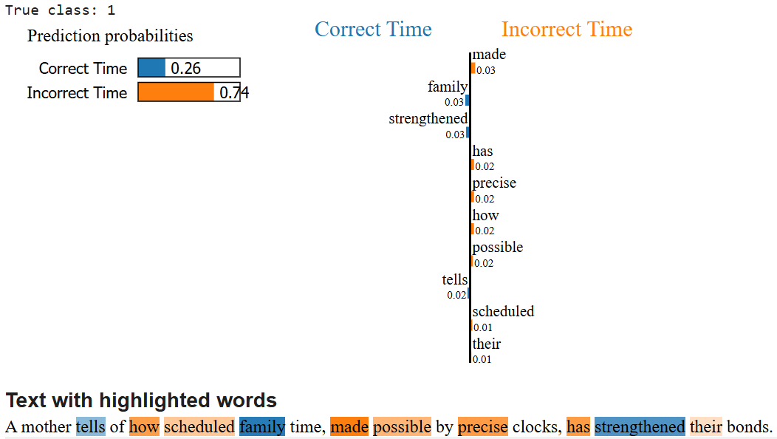
Fig 23 e

Slide 64
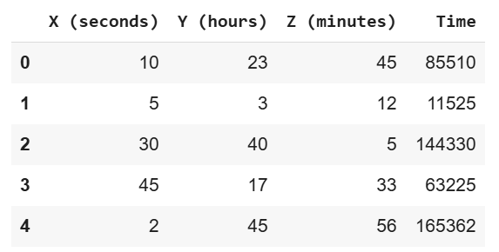
Using LIME for Model Selection
We revert back to the dataframe in Figure 7 using the following statement:
rmDf = df[['X (seconds)','Y (hours)','Z (minutes)','Time']]
rmDf['Time'] = rmDf['Y (hours)'] * 60 * 60 + rmDf['Z (minutes)'] * 60 + rmDf['X (seconds)']
rmDf.head()
Fig 24 : Regression dataframe

Slide 65
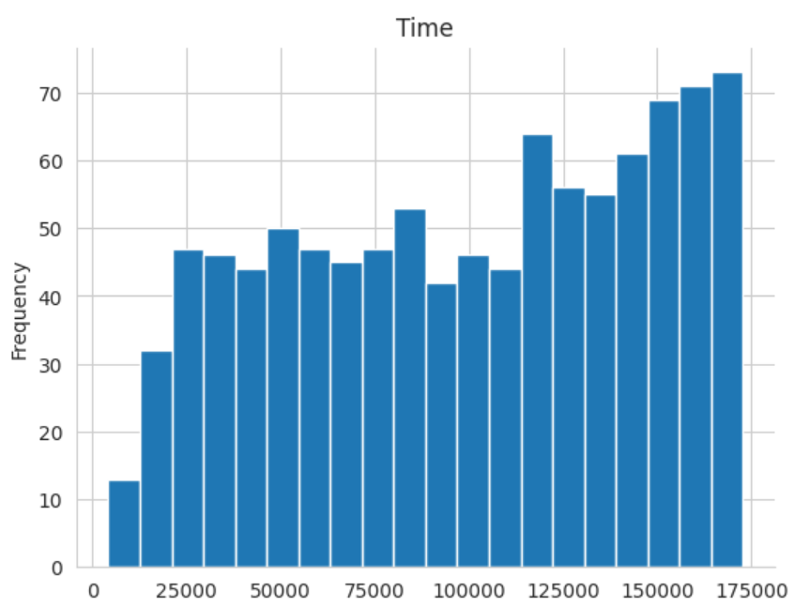
Key Observations
The values of Time and their frequency are almost directly related.
rmDf['Time'].plot(kind='hist', bins=20, title='Time')
Fig 25 : Updated Time

Slide 66
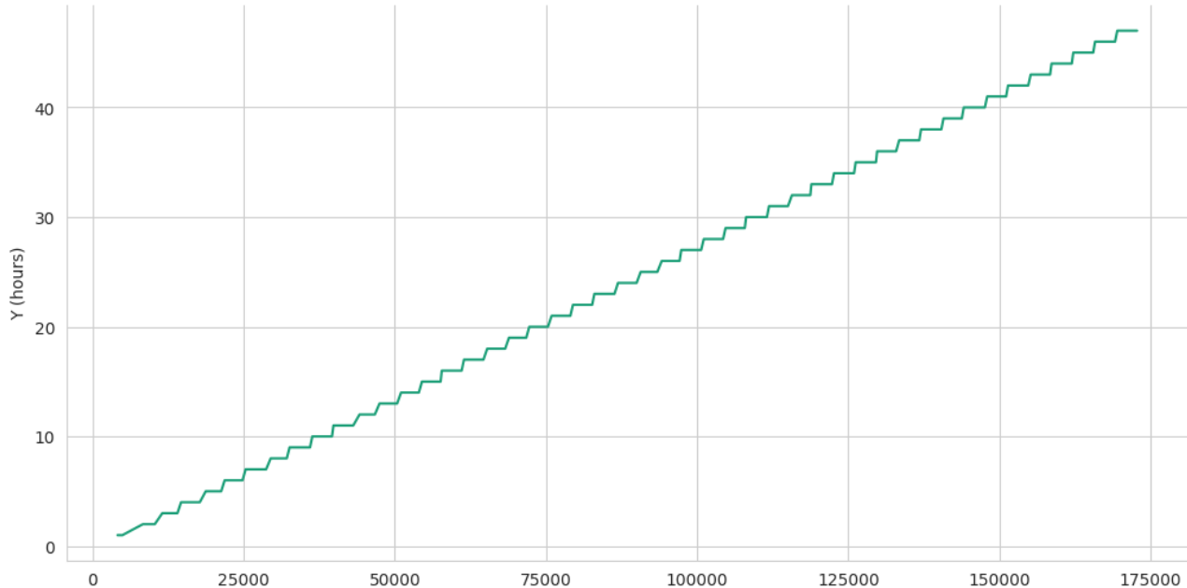
Notable bi-variate analysis
The relationship between Y (hours) and time is a continuously increasing step function.
def _plot_series(series, series_name, series_index=0):
palette = list(sns.palettes.mpl_palette('Dark2'))
xs = series['Time']
ys = series['Y (hours)']
plt.plot(xs, ys, label=series_name, color=palette[series_index % len(palette)])
fig, ax = plt.subplots(figsize=(10, 5.2), layout='constrained')
df_sorted = rmDf.sort_values('Time', ascending=True)
_plot_series(df_sorted, '')
sns.despine(fig=fig, ax=ax)
plt.xlabel('Time')
_ = plt.ylabel('Y (hours)')
Fig 26 : Updated Time vs Hours

Slide 67
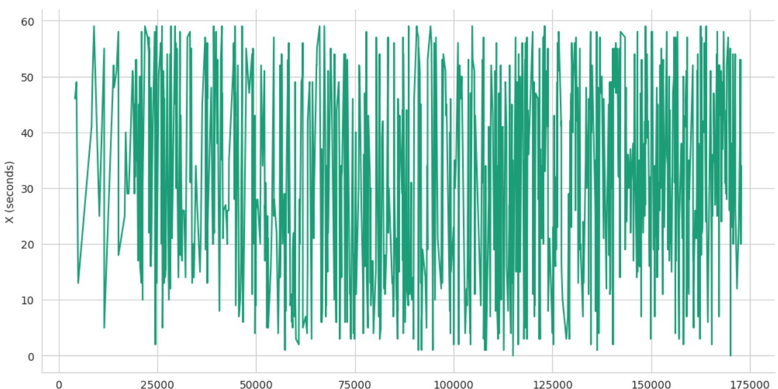
The relationship between X (seconds) and Time is a continuously fluctuating one..
def _plot_series(series, series_name, series_index=0):
palette = list(sns.palettes.mpl_palette('Dark2'))
xs = series['Time']
ys = series['X (seconds)']
plt.plot(xs, ys, label=series_name, color=palette[series_index % len(palette)])
fig, ax = plt.subplots(figsize=(10, 5.2), layout='constrained')
df_sorted = rmDf.sort_values('Time', ascending=True)
_plot_series(df_sorted, '')
sns.despine(fig=fig, ax=ax)
plt.xlabel('Time')
_ = plt.ylabel('Y (hours)')
Fig 26 : Updated Time vs Seconds

Slide 68
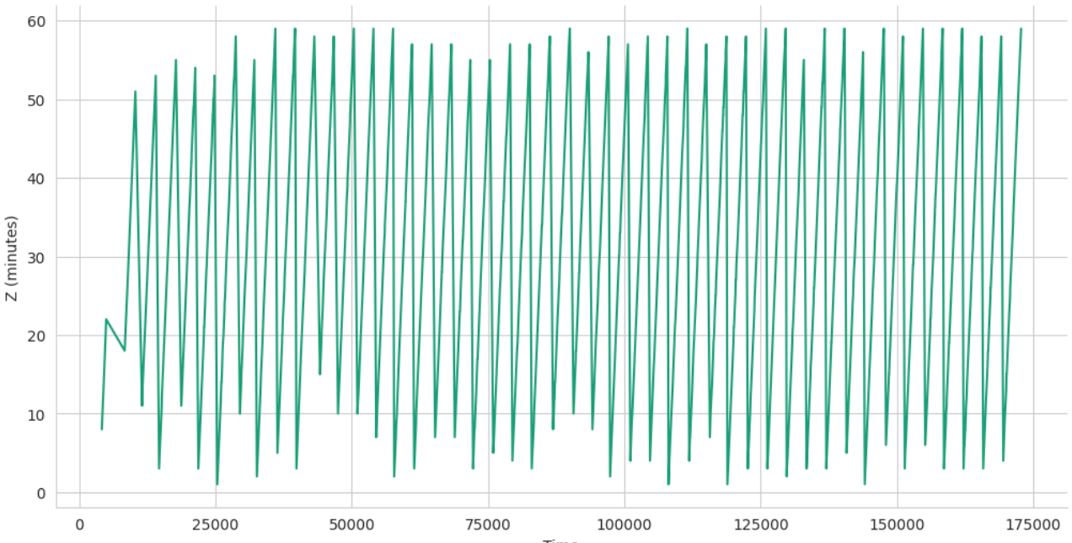
The relationship between Z (minutes) and Time is a continuously fluctuating one with lesser variations than Y..
def _plot_series(series, series_name, series_index=0):
palette = list(sns.palettes.mpl_palette('Dark2'))
xs = series['Time']
ys = series['Z (minutes)']
plt.plot(xs, ys, label=series_name, color=palette[series_index % len(palette)])
fig, ax = plt.subplots(figsize=(10, 5.2), layout='constrained')
df_sorted = rmDf.sort_values('Time', ascending=True)
_plot_series(df_sorted, '')
sns.despine(fig=fig, ax=ax)
plt.xlabel('Time')
_ = plt.ylabel('Y (hours)')
Fig 26 : Updated Time vs Minutes

Slide 69
Split and Scaling
X_train, X_test, y_train, y_test = train_test_split(X, y, test_size=0.25, random_state=33)
scaler = StandardScaler()
X_train_scaled = scaler.fit_transform(X_train)
X_test_scaled = scaler.transform(X_test)

Slide 70
Training
lasso = LassoCV(cv=5, random_state=33) # Lasso does feature selection.
lasso.fit(X_train_scaled, y_train)
selector = SelectFromModel(lasso, prefit=True)
X_train_lasso_selected = selector.transform(X_train_scaled)
X_test_lasso_selected = selector.transform(X_test_scaled)
dt = DecisionTreeRegressor(random_state=33)
dt.fit(X_train_lasso_selected, y_train)

Slide 71
Evaluation
def evaluate_model(y_true, y_pred):
mse = mean_squared_error(y_true, y_pred)
r2 = r2_score(y_true, y_pred)
return mse, r2
# Evaluate Lasso
y_pred_lasso = lasso.predict(X_test_scaled)
mse_lasso, r2_lasso = evaluate_model(y_test, y_pred_lasso)
# Evaluate Decision Tree
y_pred_dt = dt.predict(X_test_lasso_selected)
mse_dt, r2_dt = evaluate_model(y_test, y_pred_dt)

Slide 72

print(f"Lasso Regressor - MSE: {mse_lasso}, R2: {r2_lasso}")
print(f"Decision Tree with Feature Selection - MSE: {mse_dt}, R2: {r2_dt}")
One way opt for Decision Tree Regressor judging by these scores.

Slide 73
Using LIME for Explanation
feature_names = [f"feature_{i}" for i in range(X.shape[1])]
selected_feature_names = [name for idx, name in enumerate(feature_names) if selector.get_support()[idx]]
# LIME for Lasso
explainer_lasso = LimeTabularExplainer(X_train_scaled, mode="regression", feature_names=feature_names)
exp_lasso = explainer_lasso.explain_instance(X_test_scaled[0], lasso.predict, num_features=5)

Slide 74
explainer_dt = LimeTabularExplainer(X_train_lasso_selected, mode="regression", feature_names=selected_feature_names)
exp_dt = explainer_dt.explain_instance(X_test_lasso_selected[0], dt.predict, num_features=5)
# Step 3: Compare Explanations
print("\nLIME Explanation for Lasso Regressor:")
for feature, weight in exp_lasso.as_list():
print(f"{feature}: {weight}")
print("\nLIME Explanation for Decision Tree:")
for feature, weight in exp_dt.as_list():
print(f"{feature}: {weight}")

Slide 75
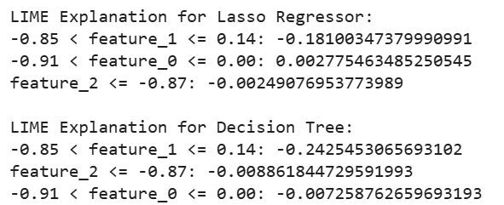

Slide 76
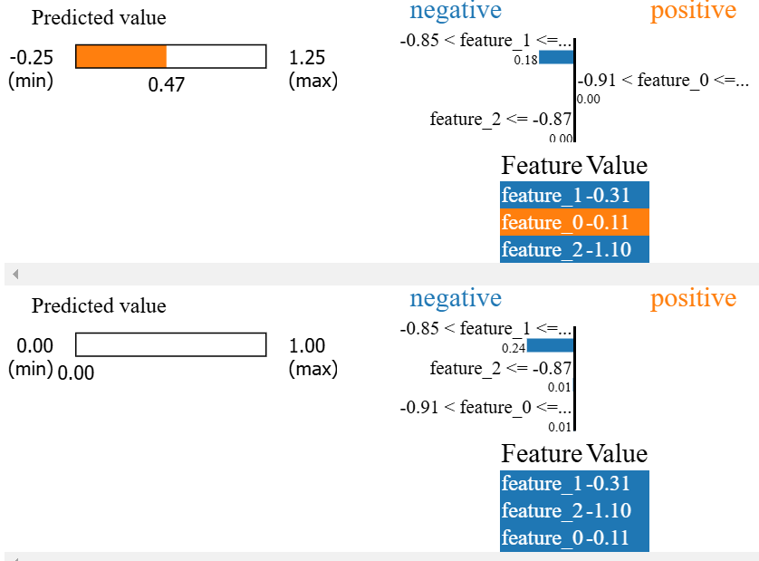
For enhanced visualization
Fig 27 : LIME Explanations

Slide 77
In Figure 27, the upper half represents the explanations for the Lasso Regressor. Here, a nuanced prediction (0.47) within a broader range (-025 to 1.25) is provided, suggesting that it might capture subtler variations in data than Decision Tree Regressor (bottom), which predicts at its minimum value always.
The Lasso Regressor shows a balanced influence of feature, with a wider range, and it more suitable than the other one when deployed in the real with hypothetical timelines. The bottom one, although a more complex model than the top, observes less complexities in its predictions.
Given the complexity differences, the Lasso Regressor is also well suited for decision making.

Slide 78
Closing remarks
Setting up experiment 5.1 and others from the paper with a basic logistic regression and a tree with an embedding layer couldn’t be reproduced because of dropped support (link to the repository, next slide for demo).
LIME provides a granular view - the how - , offering insights into the impact of feature variations on individual predictions, while SHAP - the why - offers a comprehensive analysis, attributing importance to each feature across the entire dataset based on game theory principles. This dual approach not only enhances our comprehension of the model's inner workings but also fosters trust in its decision-making process.

Slide 79
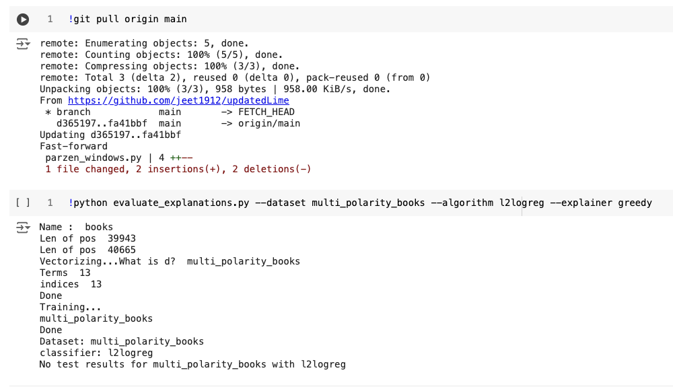

Slide 80
By integrating these explanatory frameworks, we ensure that our model's decisions are not only accurate but also transparent and interpretable, aligning with higher standards of machine learning governance and ethical AI practice, which involves simple data collection and engineering strategies while ensuring authenticity while reporting experimental results on the World Wide Web.
Here’s a link to the notebook for the experiments conducted.

