Slide 1
UNIT:1
Inside the PC: Core Component
1

Slide 2
SYLLABUS
Identify different type and generation of computer, Identify devices required for using laptops, Identify components which makes the system and specify its importance. Identify various types of ports and its connecting devices.
Motherboard: definition, Components/connections in motherboard, functional block diagram
Central Processing Unit (CPU): CPU Speeds, Word Size, Data Path, Internal Cache memory, Slots and sockets, CISC vs RISC processor, CPU chips preprocessors motherboard Types/Form Factors (AT, Baby AT, ATX, LPX, NLX, BTX)
2

Slide 3
Expansion Buses (Definition, Bus Architecture (PC/PC-XT, PC-AT/ISA, EISA, MCA, VESA Local (VL) Bus, PCI, Combination of Bus Systems, AGP – Accelerated Graphics Port, Universal Serial Bus (USB), IEEE 1394 Fire Wire- A Bus Standard
System Controller : Definition
Basic Input Output System :Services, Bios Interaction, CMOS-RAM
Chipsets : Definition, Advantage, North and South Bridge
System Memory : definition, memory sizes, speeds and shapes (DIP, ZIP, SIPP, SIMM, DIMM, RIMM), Memory modules (Dynamic RAM, SDRAM, DDR SDRAM, SLDRAM, DRDRAM, Fast Page Mode (FPM) DRAM, Extended Data Out(EDO) DRAM)
3

Slide 4









1.1 COMPUTER, HARDWARE ,SOFTWARE
Computer:
A computer is an electronic device that:
accepts input
processes data
stores data
produces output
Hardware:
Computer Hardware is the physical part of the computer system, the machinery and equipment.
Parts of the computer “you can see”
4

Slide 5
Firmware
Firmware is a software program permanently etched into a hardware device such as a keyboards, hard drive, BIOS, or video cards. It is programmed to give permanent instructions to communicate with other devices and perform functions like basic input/output tasks.
Firmware is typically stored in the flash ROM (read only memory) of a hardware device. It can be erased and rewritten.
5

Slide 6
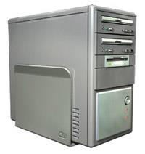
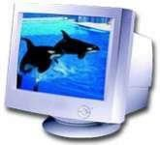
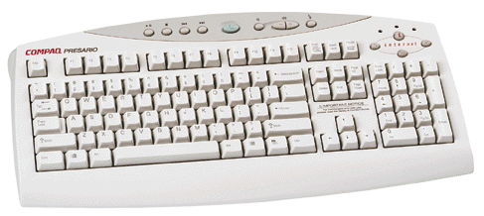
Examples of Computer Hardware
Software:
Computer Software are programs that tell the computer what to do.
Examples
Microsoft Word-word processing program Microsoft PowerPoint-presentation program
Microsoft Excel-work book program used to track,
calculate, and analyze numeric data
6

Slide 7
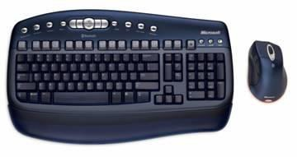

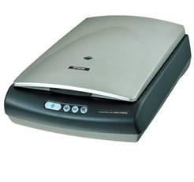

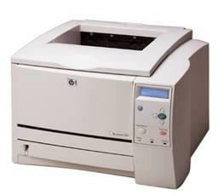
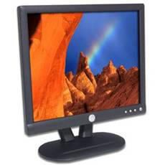


BASIC PART OF COMPUTER SYSTEM
Input Devices: devices that input information into the computer such as a keyboard, mouse, scanner, and digital camera.
Output: devices that output information from the computer such as a printer and monitor
7

Slide 8
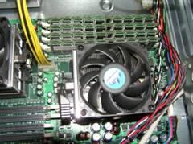

CPU (Central Processing Unit) also called the
Microprocessor or “The Brain” of the Computer.
Processor speed: The speed at which a microprocessor executes instructions. This is usually measured in megahertz (MHz).
Brands of Processors include:
Pentium
Celeron
MAC
AMD
Cyrix
8

Slide 9

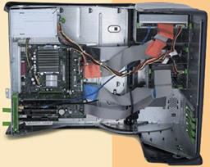

DATA REPRESENTATION
Step 1.
The user presses the capital letter D (shift+D key) on the keyboard.
Step 2.
An electronic signal for the capital letter D is sent to the system unit.
Step 3.
The signal for the capital letter D is converted to its ASCII binary code (01000100) and is stored in memory for processing.
Step 4.
After processing, the binary code for the capital letter D is converted to an image, and displayed on the output device.
9

Slide 10
HISTORY OF COMPUTER SYSTEM
1. First general-purpose computing device
These set of computers made their first appearance between 1940 and 1958. They were very large in size perhaps the size of a room and very expensive to use and maintain. The main memory of these computers was a vacuum tube. Punch cards and magnetic tapes were used as the source of input and for the storage of data. The output was via the print out. They were general purpose computers and they can only perform one function at a time. Examples of some first generations computers are:
Electronic Numerical Integrator and Computer (ENIAC)
Electronic Delay Storage Automatic Computer (EDSAC)
Universal Automatic Computer (UNIVAC)
10

Slide 11
2. Second Generation Computers
The second generation history of computer system is traceable between 1959 and 1966. The memory of these computers uses transistors and magnetic tape to store data. Transistors provided faster operations and generate lesser heat. Early version of high level programming language such as COBOL and FORTRAN were developed at this time.
3. Third Generation Computers
The third generation set of computers' history dated back to between 1964 and 1970. The memories of these sets of computers were made from silicon chips transformed into tiny miniaturized Integrated circuits.
This provided vast internal storage and operated in billionth of a second. Secondary storage magnetic disks were introduced. This solved the problem associated with magnetic tapes in terms of slowness and sequential access to data.
11

Slide 12
4. Fourth Generation Computers
The fourth generation computers made their appearance between 1971 and 1990. These were the first set of computers that use large scale Integrated circuits (LSIC).
The memory of the computers logic circuits that perform logical operations were constituted by these large scale Integrated circuits.
This was the era that birth the invention of the micro processor which provided enormous processing speed. Example of this type of processor was the Intel-4004 which performs about 1 million multiplications per second.
The Intel- 4004 was manufactured by the Intel Corporation in USA and it carried 2250 on a tiny silicon chip. Micro processor when integrated with the Input and Output system of a computer
saw the era of the emergence of Micro computers.
12

Slide 13
TYPE OF COMPUTER SYSTEM
Super computers...are used to process very large amounts of information including processing information to predict hurricanes, satellite images and navigation, and process military war scenarios.
Mainframes Computers...are used by government and businesses to process very large amounts of information.
Mini-Computers...are similar to mainframes...they are used by business and government to process large amounts of information.
Personal Computers...also known as PC’s...are smaller and less powerful than the others. They are used in homes, schools, and small businesses.
Work Station Computer..it is a high-end Micro Computer. In
networking any client computer connected To the network that
access server resources may be called Workstation
13

Slide 14
PC CONFIGURATION
CPU (Central Processing Unit) also called the
Microprocessor or “The Brain” of the Computer.
Computer chip: also called the microprocessor may contain
an entire processing unit.
Computer chips contain millions of transistors. They are small pieces of semi-conducting material (silicon).
An integrated circuit is embedded in the silicon. Computers are made of many chips on a circuit board.
Power Supply it generally located in right corner
of a desktop PC. It convert Ac Power to DC Power & create the various voltages needed to power your computer device.
14

Slide 15
3. Mother Board It is the main circuit board inside the CPU case. It holds the microprocessor, memory and other crucial circuits and components that control the operation of the Personal Computer. Every device inside or connected to a Personal Computer finds it's way to this board.
Memory Module
The mother board takes the input you give it like mouse clicks, and produces output for you like displaying or printing a file.
It can't do this without memory. The PC operating system used by the PC is copied from storage to memory at power up. The OS copy in memory then runs the PC. Memory is volatile which means that when your PC is turned off the contents of memory are lost. It is completely blank and must reloaded each time the PC is powered up.
Output When you send inputs into the PC, it processes them and produces useful output for you. The primary output devices are the video display, printer and speakers.
15

Slide 16
Monitor It is a T.V. like screen used to show pictures and words.
Keyboard & Mouse This device is used to type information into the computer and contains the numbers 0-9. Mouse: a small device, which you move across the top of the desk to move the pointer or cursor on the screen.
Printer it is used to make a paper copy of the information into the computer.
Storage Devices:Storage is non-volatile which means it retains information even when it is powered off. It stores programs which run the PC as well as data, which is a digital form¹⁶ of everything you use like documents, music, pictures, etc

Slide 17

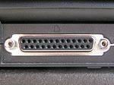
COMPUTER SYSTEM PORTS & CONNECTING DEVICES
Srial Port
serial communication physical interface through which information transfer serial ports to devices such as modems, terminals and various peripherals.
Parallel Port
It is also known as a printer port or Centronics port. It was an industry de facto standard for many years, and was finally standardized as IEEE 1284 in the late 1990s, which defined the Enhanced Parallel Port (EPP) and Extended Capability Port (ECP) bi-directional versions

Slide 18
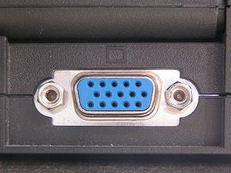


PS/2 port
The PS/2 connector is a 6-pin mini-DIN connector used for connecting some keyboards and mice to a PC compatible computer system. Its name comes from the IBM Personal System/2 series of personal computers
USB Port is play Port is a digital display interface developed by the Video Electronics Standards Association (VESA). The interface is primarily used to connect a video source to a display device such as a computer monitor,
VGA Port A Video Graphics Array (VGA) connector is a three- row 15-pin DE-15 connector. The 15-pin VGA connector is found on many video cards, computer monitors, and high definition television sets. On laptop computers or other small devices, a mini-VGA port is sometimes used in place of the full-sized VGA connector.

Slide 19
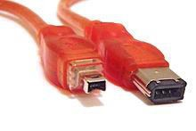
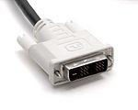
Firewire Port
IEEE 1394 is an interface standard for a serial bus for high- speed communications and isochronous real-time data transfer. It was developed in the late 1980s and early 1990s by Apple, who called it FireWire
Modem Port
Digital Visual Interface (DVI) is a video display interface developed by the Digital Display Working Group (DDWG). The digital interface is used to connect a video source, such as a display controller to a display device, such as a computer monitor. It was developed with the intention
of creating an industry standard for the transfer of
digital video content.

Slide 20

8 . DVI Port
Digital Visual Interface (DVI) is a video display interface developed by the Digital Display Working Group (DDWG). The digital interface is used to connect a video source, such as a display controller to a display device, such as a computer monitor..

Slide 21

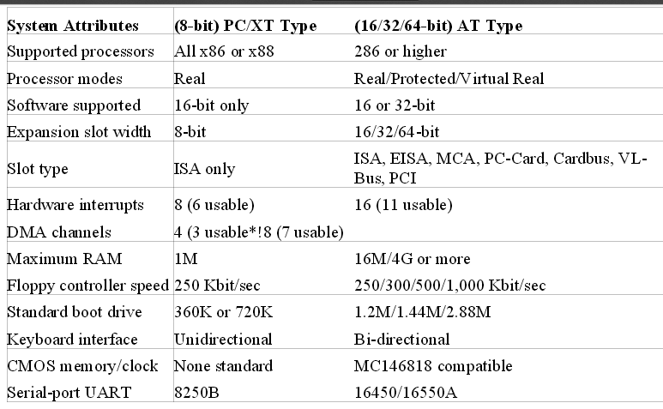
DIFFERENCES BETWEEN PC-AT & PC-XT

Slide 22
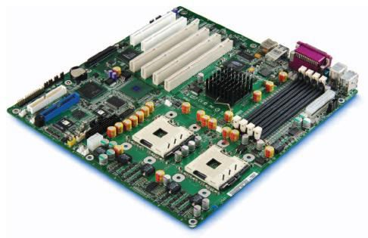
MOTHERBOARD
A motherboard (sometimes alternatively known as the main board, system board, planar board or logic board or colloquially, a mobo) is the main printed circuit board (PCB) found in computers and other expandable systems.
It holds many of the crucial electronic components of the system, such as the central processing unit (CPU) and memory, and provides connectors for other peripherals.
Unlike a backplane, a motherboard contains significant sub- systems such as the processor and other components.

Slide 23
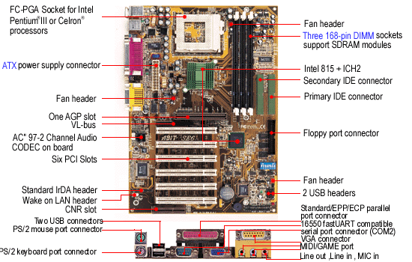

Slide 24
TYPE OF MOTHERBOARD
Non-Integrated Motherboards
Non-integrated Motherboards have assemblies such as the I/O port connectors (serial and parallel ports), hard drive connectors, floppy controllers and connectors, joystick connections etc installed as expansion boards.
This takes up one or more of the motherboard's expansion slots and reduces the amount of free space inside the computer case.
Most of the older motherboards were Non-Integrated.
Some of the later system boards began to integrate some of these assemblies right onto the circuit board.

Slide 25
Integrated Motherboards
Integrated Motherboards have assemblies that are otherwise installed as expansion boards, integrated or built right onto the board.
The serial and parallel ports, the IDE and floppy drive, and joystick all connect directly to the motherboard.
This is now standard on any latest model 486 and above.
It tends to free up some space inside the case and allows for better accessibility and airflow.

Slide 26
Embedded Motherboard
In an effort to reduce the cost (and size) of a computer system even more, manufacturers began integrating (or embedding) technologies such as video, sound, networking and modems right onto the system board.
This dramatically increases the cost of the main board but reduces the cost of the overall system.

Slide 27
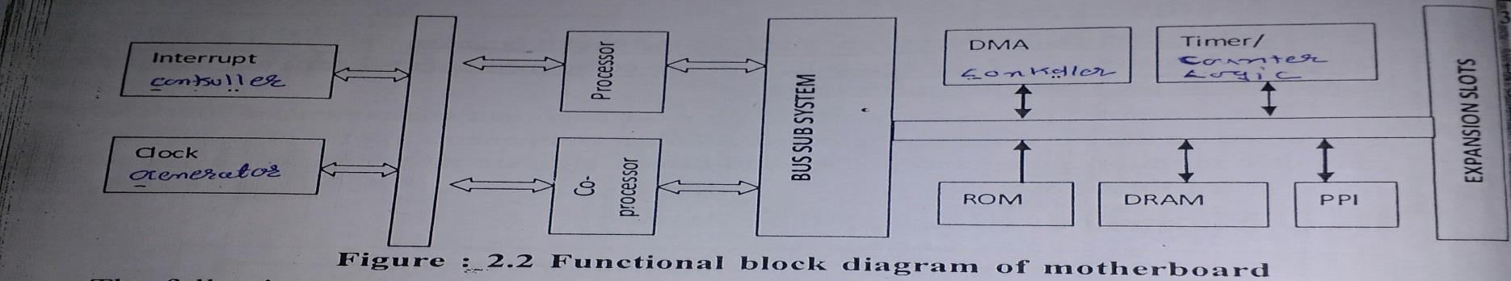
FUNCTION & BLOCK DIAGRAM OF MOTHER
BOARD
1.Processor
2.Co-Processor 3.Clock Generation 4.Bus Sub System 5.Interrupt Controller 6.Rom & Ram Logic 7.Timer/Counter Logic 8.DMA Controller
9.PPI(Peripheral Interface Logic)
27

Slide 28
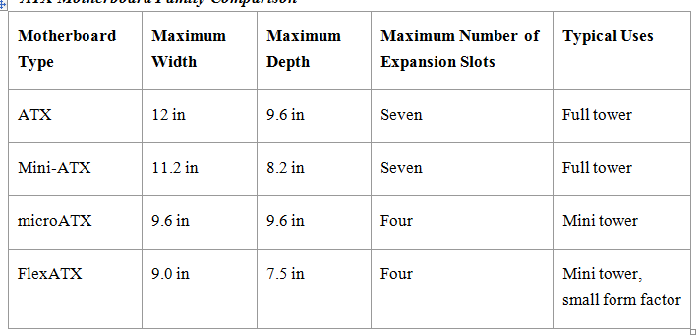
MOTHERBOARD
FROM FACTOR
The ATX family of motherboards has dominated desktop computer designs since the late 1990s. ATX stands for "Advanced Technology Extended," and it replaced the AT and Baby-AT form factors developed in the mid 1980s for the IBM PC AT and its rivals. ATX motherboards have the following characteristics:
ATX Motherboard Family Comparison
28

Slide 29
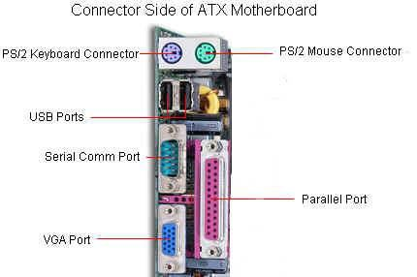
COMPONENTS OF MOTHERBOARD
Mouse & keyboard
USB
Parallel port
CPU Chip
RAM slots
Floppy controller
IDE controller
PCI slot
ISA slot
CMOS Battery
AGP slot
CPU slot
Power supply plug in
29

Slide 30
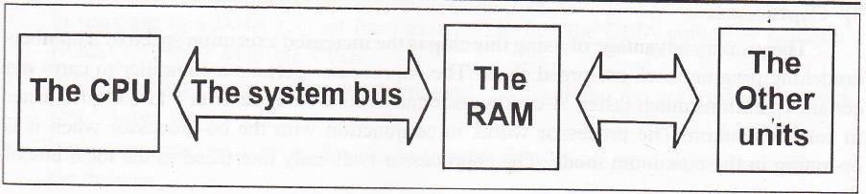
1.2 CPU(CENTRAL PROCESSING UNIT)
The CPU is centrally located on the motherboard.
The data come from the RAM and the units such as keyboard, drives etc.
After processing, the data is send back to RAM and/or the output units.
The CPU receives at least two types of data: Instructions, which to handle the other data and second one is User Data.
30

Slide 31
Six basic elements are used to gauge the performance and capability of a CPU design.
Speed
The maximum number of clock cycles measured in MHz.
The higher the speed, the quicker a command will be
executed.
2. Number of transistors
More switches means more computing power.
3. Registers
The size (in bits) of the internal registers.
The larger the registers. the more complicated the commands that can be processed in one step.
4. External data bus
As data bus size increases, so does the amount and
complexity of code (information) that can be transferred among all devices in the computer.
31

Slide 32
Address bus
The size of the address bus determines the maximum amount of memory that can be addressed by the CPU
Internal cache
The internal cache is high-speed memory built into the processor.
This is a place to store frequently used data instead of sending it to slower devices (speed is relative in computers) such as RAM and hard disk drives.

Slide 33
DIFFERENCE BETWEEN RICS & CISC
CISC
RISC
Emphasis on hardware
Emphasis on software
Includes multi-clock complex instruction.
Single-clock , reduced instruction only
Memory to memory – “LOAD”and “STORE”
incorporated in instructions.
Registerto register- “LOAD”and “STORE” are independent instruction.
Small code size, high cycle per
second
Low cycles per second ,large code
size
Transistors are used for storing Spend more transistor on memory
complex instruction
registers.

Slide 34
1.3 EXPANSION BUSES
The expansion card (also expansion board, adapter card or accessory card) in computing is a printed circuit board that can be inserted into an electrical connector, or expansion slot on a computer motherboard, backplane or riser card to add functionality to a computer system via the expansion bus.
Type of Expansion Buses
1. ISA
2. MCA
3. EISA
4. VESA
5. PCI
6. IEEE1394
7. USB
34

Slide 35
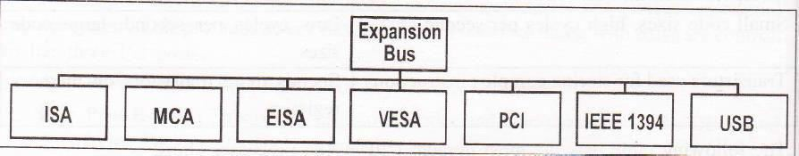
Designers divided the external data bus into two
parts:
System bus. This supports the CPU. RAM. And other motherboard components and runs at speeds that support the CPU.
Expansion bus. This supports any add-on devices by means of the expansion slots and runs at a steady rate, based on the specific bus design.
35

Slide 36
BUS STANDARDS
1.Bus Width
A bus is a channel over which information flows.
The wider the bus the more information can flow over the channel.
For example a wider highway can carry more cars than a narrow one.
2. Bus speed
The speed of the bus reflects how many bits of information can be sent across each wire per second.
This would be analogous to how fast the car is driving on our analogical highway.
3. Bus Bandwidth
Bandwidth also called throughput, refers to the total amount of ₃₆
data that can theoretically be transferred on the bus in a given unit of time.

Slide 37
4. Bus Interfacing
On a system that has multiple buses, circuitry must be provided by the chipset to connect the buses and allow devices on one talk to devices on the other.
This device is called a “bridge”, the same name used to refer to a piece of networking hardware that connects two dissimilar networks.
5. Bus Mastering
On the higher-bandwidth buses, a great deal of information is flowing through the channel every second. Processor is required to control the transfer of this information.
The processor is a “middleman” and it is far more efficient to “cut out” the middleman and perform the transfer directly.
It is done by having capable devices take control of the bus and do the work themselves; devices that can do this are called bus masters.
37

Slide 38
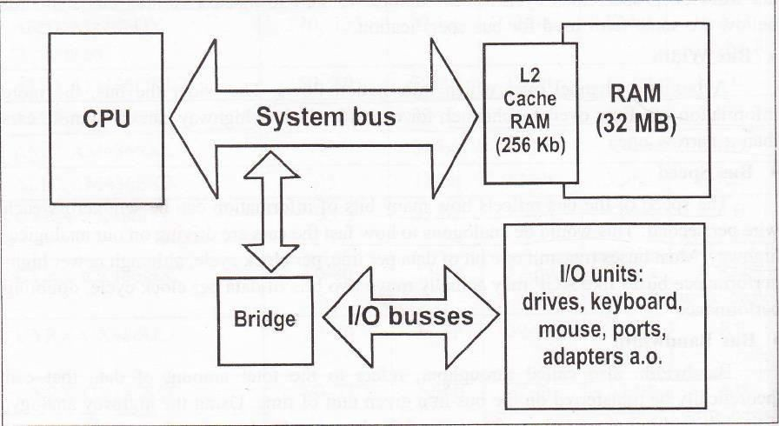
BUS ORGANIZATION
Processor Bus
Cache Bus
Memory Bus
Local I/O Bus
Standard I/O Bus

Slide 39
The Processor bus This is the highest level bus that the chipset
uses to send information to and from the processor.
The Cache Bus Higher level architectures, such as those used by the Pentium Pro and Pentium II employ a dedicated bus for accessing the system cache.
This is sometime called a backside bus.
The Memory Bus This is a second level system bus that connects the memory subsystem to the chipset and the processor. In some systems, the processor and the memory buses are the same thing.

Slide 40
The Local IO Bus This is a high speed input/output bus used for connecting performance critical peripherals to the memory, chipset and processor. For example, video cards, disk storage devices, high speed network interfaces generally use a bus of this sort. The two most common local IO buses are VESA local bus and PCI bus.
The Standard IO Bus This bus is used for slower peripherals like mice, modems, regular sound cards, low speed networking. It is also compatible with older devices.

Slide 41
INDUSTRY STANDARD ARCHITECTURE (ISA)
ISA stands for Industry Standard Architecture which is the most common bus in the PC world.
The ISA bus is still stay in the newest computers. Despite the fact that it is largely unchanged since it was expanded to 16 bits.
The ISA bus eventually became a narrow to performance and was enlarge with additional high- speed buses.
There are still many devices for which the ISA's speed is more than sufficient (an example of standard moderns).

Slide 42
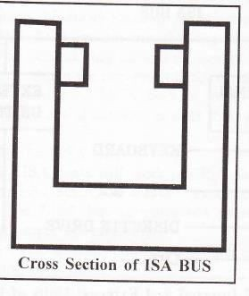
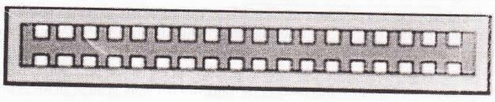
The original ISA bus on the IBM PC was 8 bits wide, reflecting the 8 bit data width of the Intel 8088 processor's system bus, and ran at 4.77 MHz.
With the speed of the first 8088s. The IBM AT was introduced which was use the Intel 80286.
The ISA bus provides reasonable throughput for low- bandwidth devices and virtually assures compatibility with almost every PC on the market.

Slide 43
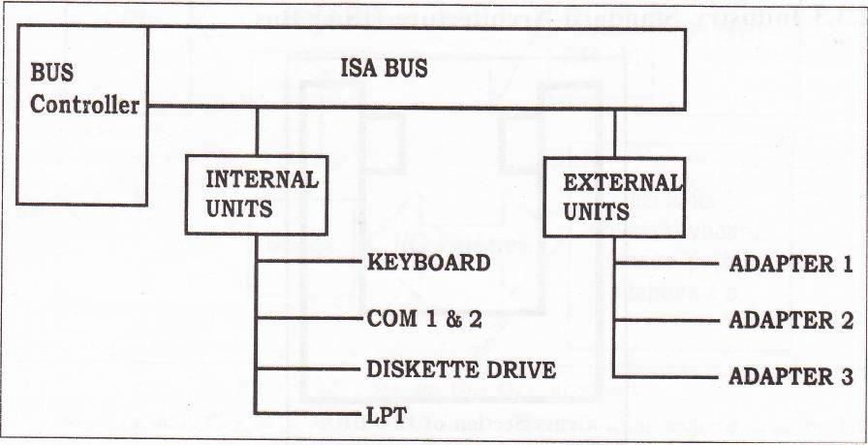

Slide 44
MICRO CHANNEL ARCHITECTURE (MCA) BUS
MCA stands for "Micro Channel Architecture" was IBM's attempt to replace the ISA bus with something bigger and better.
MCA is 32 bits wide and offers several significant improvements over ISA.
It had far superior throughput to the ISA bus. The MCA bus supported bus mastering adapters for greater efficiency, including proper bus arbitration.
MCA automatically configured adapter cards. So there was no need to fiddle with jumpers.
The two main reasons for MCA would be failure in the marketplace.
44

Slide 45
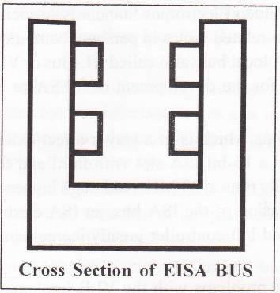
EXTENDED INDUSTRY STANDARD ARCHITECTURE (EISA) BUS
EISA stands for Extended Industry Standard Architecture.
Compaq developed EISA standards bus.
Compaq avoided the two key mistakes that IBM made. First, they made it compatible with the ISA bus. Second. They opened the design to all manufacturers instead of keeping it proprietary, by forming the non-profit EISA committee to manage the design of the standard.

Slide 46
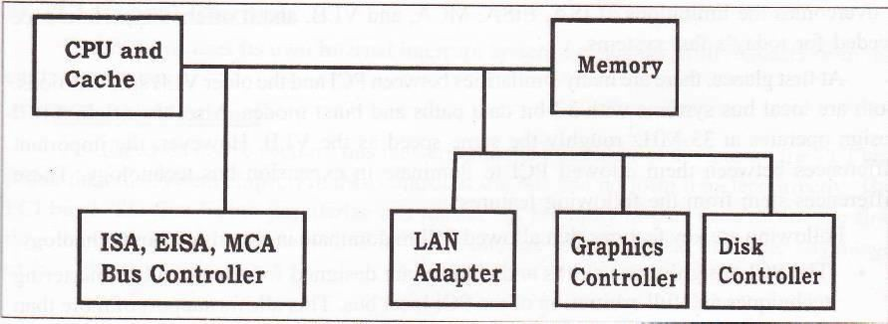
VESA LOCAL BUS (VLB)
VESA stands for the Video Electronics Standards Association, a standards group that was formed to address video-related issues in personal computers.
This is the first local bus to gain popularity.
The VESA local bus (also called VL-Bus or VLB for short) was introduced in 1992.
The major reason for the development of VESA or VLB was to improve video performance in PCs.

Slide 47
PERIPHERAL COMPONENT INTERCONNECT (PCL)
The most popular local I/O bus, the Peripheral Component Interconnect (PCI) bus was developed by Intel and introduced in 1993.
PCI Bus performance-The PCI bus provides superior performance to the VESA local bus. PCI is the highest performance than general I/O bus currently used into PCs. This is clue to several factors:
Burst Mode: The PCI bus can transfer information in a burst mode.
Bus Mastering: PCI supports full bus mastering. which leads to improved performance.
High Bandwidth Options: The PCI bus specification version
2.1 calls for expandability to 64 bits and 66 MHz speed; if implemented this would quadruple bandwidth over the curren₄₇t design.

Slide 48
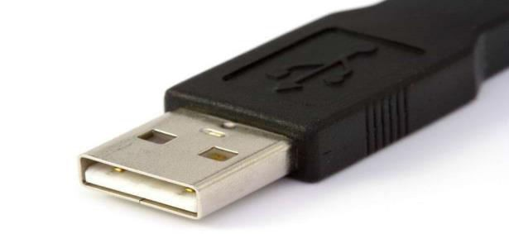
UNIVERSAL SERIAL BUS
The newest addition to the general PC bus collection, the USB connects external peripherals such as mouse devices, printers, modems, keyboards, joysticks, scanners, And digital cameras to the computer.
The USB port is a thin slot, most new motherboards offer two located near the keyboard.
They can also be provided through an expansion card.
USB supports isochronous (time-dependent) and asynchronous (intermittent) data transfers.
Isochronous connections transfer data at a guaranteed fixed rate
of delivery.

Slide 49
1.4 SYSTEM CONTROLLER
The system controller connects the system CPU to system memory, PCI bus. I/0 ports, and external communication links.
While the CPU’s task in the system is to process data.
System controller's main function is to coordinate data movement in the system.
The system controller contains all the major functional modules required for most system on a chip application.
The entire system control function can be easily integrated into a single Programmable Logic Device (PLD).

Slide 50
1.5 BIOS & CMOS
BIOS stands for Basic Input/Output System. It contains basic instructions to interact with various hardware modules such as Motherboard controllers or that of interface cards. BIOS is the software that is run by a computer when first powered on.
BIOS is also known as PC firmware because it is an integral part
of the motherboard.
BIOS means Basic Input Output System. It is the first thing that operates when the computer is turned on, and is separate from the OS, though it interacts with the OS.

Slide 51
BIOS COMPONENT
1. BIOS ROM :
The main hardware component of the system BIOS is the system BIOS ROM itself.
This is normally located in an electrically-erasable read-only memory (EEPROM) chip, which allows it to be updated through software control. This process is commonly called flashing BIOS.
Under normal circumstances, the BIOS ROM is permanent.
2. BIOS CMOS Memory:
CMOS stands for "Complementary Metal Oxide Semiconductor". This is one type of technology, used to make semiconductors (integrated circuits) such as processors, chipset chips, DRAM, etc.
CMOS has the advantage of requiring very little power
compared to some other semiconductor technologies.
51

Slide 52
BOOT FUNCTION OF BIOS
Takes inventory of all hardware in the system and checks to ensure each components' basic operability.
Recognizes and configures new hardware such as hard drives
and floppy drives.
Locates a valid OS and transfers the control of the system to that OS after boot functions have completed.
The BIOS also performs the following tasks during the normal
operation of the system:
Interacts with the OS to configure hardware behavior.
Enables and disables integrated devices.
Interacts with the 'hardware abstraction' layer to ensure compatibility between newer hardware and older applications.
Affects system power properties.
- Provides a level of system security.
52

Slide 53
BASIC FUNCTION OF BIOS
The main functions of the BIOS are:
(i) BIOS power on self Test (POST)
(ii) Bootstrap loader
(iii) BIOS Setup utility program
(iv) System service routines

Slide 54
POST(POWER ON SELF TEST)
When the computer first turns on, a POST is performed to ensure that all critical devices are operating.
Devices checked include memory, drives, cpu, system
timer, chipset, all peripheral cards, and memory.
When all devices are deemed operable, the BIOS passes system control over to the OS.
If a device is malfunctioning, and error code is generated in the form of beep codes and/or text.
During POST, the system BIOS reads peripheral BIOS routines and runs them

Slide 55
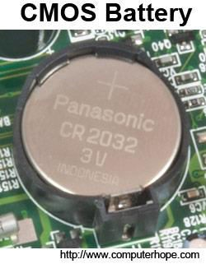
CMOS
Alternatively referred to as a Real-Time Clock (RTC), Non- Volatile RAM (NVRAM) or CMOS RAM, CMOS is short for Complementary Metal-Oxide Semiconductor. CMOS is an on- board semiconductor chip powered by a CMOS battery inside computers that stores information such as the system time and date and the system hardware settings for your computer. The picture shows an example of the most common CMOS coin cell battery used in a computer to power the CMOS memory.

Slide 56
1.6 CHIPSET WITH ITS ADVANTAGES
The specialized chips on a computer's motherboard or expansion card are called chipset.
The chip sets are a bunch of intelligent controller chips.
It controls communications between the processor and external devices. Generally chipset contain more than one chip into single chip.
The chipset manufacturers are generally independent from the manufacturer of the motherboard.
Current manufacturers of chipsets for PC-compatible motherboard include NVIDIA. AMD, VIA Technologies, Sis, Intel, Broadcom etc.

Slide 57
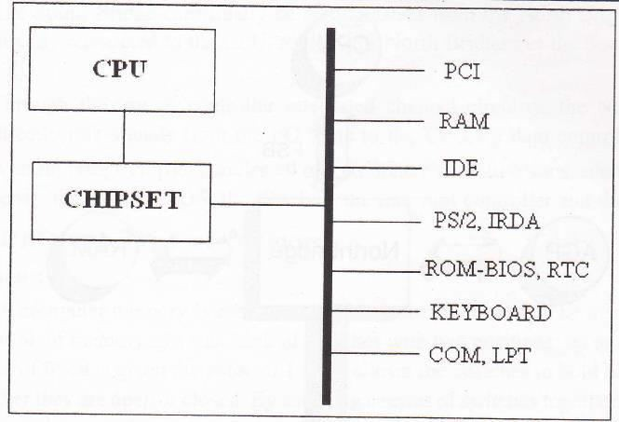
CHIPSET

Slide 58
NORTH BRIDGE & SOUTH BRIDGE
A Northbridge or host bridge is a microchip on some PC motherboards and is connected directly to the CPU (unlike the Southbridge) and thus responsible for tasks that require the highest performance.
The Northbridge is usually paired with a Southbridge, also known as I/O controller hub.
In systems where they are included, these two chips manage communications between the CPU and other parts of the motherboard, and constitute the core logic chipset of the PC motherboard.
The Northbridge typically handles communications among the CPU. in some cases RAM, and PCI Express (or AGP) video cards, and the Southbridge.
58

Slide 59
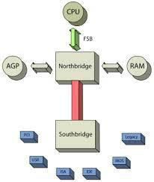
South Bridge:
The South Bridge is one of the two chips in the core logic chipset on a personal computer (PC) motherboard, the other being the North Bridge.
The South Bridge typically implements the slower capabilities of the motherboard in a North Bridge/South Bridge chipset computer architecture.

Slide 60
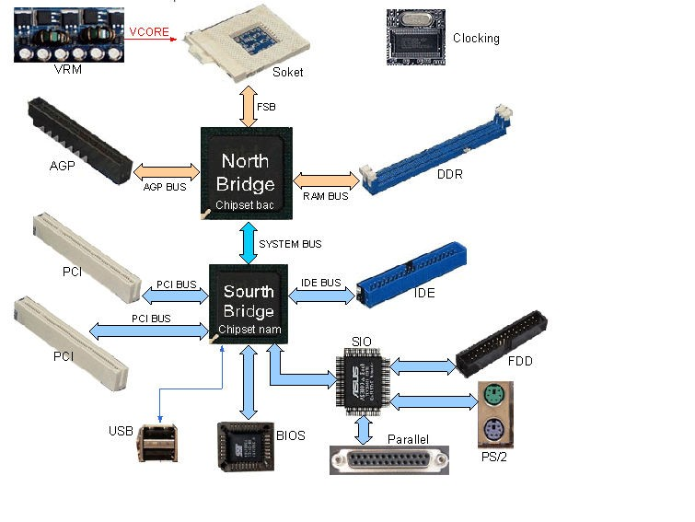

Slide 61
1.7 MEMORY MODULES
Memory modules are printed circuit cards made up of memory chips, and a few other passive components
Permanent Memory (Non-Volatile)- Examples of non-volatile memory include:
ROM
PROM
EPROM
EEPORM
Flash Memory
Computer Storage Devices
Hard Disk
Floppy Disk
CD-RW
DVD
ZIP Drive.

Slide 62
ROM(Read Only Memory)
ROM is typically used to store things that will never change for the life of the computer such as low level portions of an operating system.
Some processors might have RAM and/or ROM built into the same chip as the processor, normally used for processors used in standalone devices, such as arcade video games, ATMs, microwave ovens, car ignition systems, etc.
Computers almost always contain a small amount of read- only memory that holds instructions for starting up the computer.
It is non-volatile which means once you turn off the computer the information is still there.

Slide 63
PROM (PROGRAMMABLE READ ONLY MEMORY)
A PROM is a memory chip on which data can be written only once.
Once a program has been written onto a PROM it remains there forever.
Unlike RAM, PROM's retain their contents when the
computer is turned off.
The difference between a PROM and a ROM (read-only memory) is that a PROM is manufactured as blank memory, whereas a ROM is programmed during the manufacturing process.

Slide 64
EPROM (ERASABLE PROGRAMMABLE READ-ONLY MEMORY)
EPROM is a special type of PROM that can be erased by exposing it to ultraviolet light.
Once it is erased, it can be reprogrammed.
An EEPROM is similar to a PROM, but requires only electricity to be erased.

Slide 65
EEPROM (ELECTRICALLY ERASABLE PROGRAMMABLE READ-ONLY MEMORY)
EEPROM Pronounced double-ee-prom or e-e-prom, an EEPROM is a special type of PROM that can be erased by exposing it to an electrical charge.
Like other types of PROM, EEPROM retains its contents even when the power is turned off.
Also like other types of ROM, EEPROM is not as fast as RAM. EEPROM is similar to flash memory (sometimes called flash EEPROM).
The principal difference is that EEPROM requires data to be written or erased one byte at a time whereas flash memory allows data to be written or erased in blocks. This makes
memory faster.
65

Slide 66
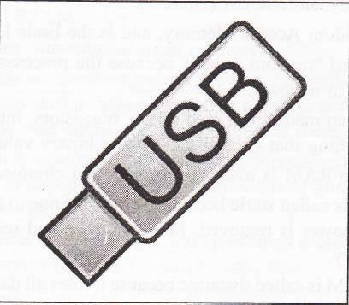
FLASH MEMORY
This is a solid-state, nonvolatile, rewritable memory that functions like RAM and a hard disk combined integrated with a USB (Universal Serial Bus) interface
If power is lost, all data remains in memory.
Because of its high speed, durability, and low voltage requirements, it is ideal for digital cameras, cell phones, printers, handheld computers pagers and audio recorders.

Slide 67
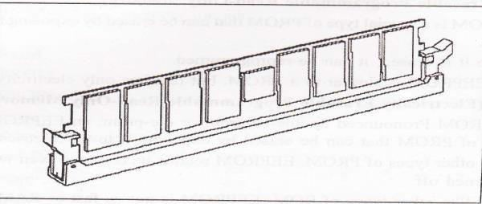
TEMPORARY MEMORY-RANDOM ACCESS MEMORY (RAM)
Volatile memory is computer memory that requires power to maintain the stored information. Most modern semiconductor volatile memory is either Static RAM (SRAM) or dynamic RAM (DRAM).
RAM is Random Access Memory, and is the basic kind of internal memory.
RAM is called "random access" because the processor or computer can access any location in memory.
RAM has been made from reed relays, transistors, integrated circuits. Magnetic core or anything that can hold and store binary values.

Slide 68
CACHE MEMORY
Pronounced cash, a special high speed storage mechanism.
It can be either a reserved section of main memory or an independent high speed storage device.
Two types caching are commonly used in personal
computers.
Memory Caching & Disk Caching

Slide 69

1.7 SYSTEM MEMORY

Slide 70
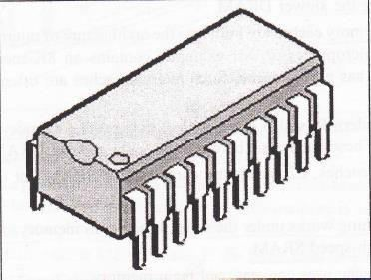
1. DUAL INLINE PACKAGE (DIP)
Early versions of RAM were installed as single chips, usually l-bit-wide DIP (dual inline package)
In some cases, this was soldered right onto the motherboard, but most often it was seated in a socket, offering a simpler method of removal and replacement.

Slide 71
2. ZIP
The Zip drive is a medium-capacity removable floppy disk storage system that was introduced by Iomega in late 1994.
Originally, Zip disks launched with capacities of 100 MB, but later versions increased this to first 250 MB and then 750 MB.
They are stable, inexpensive, and easy to work with.

Slide 72
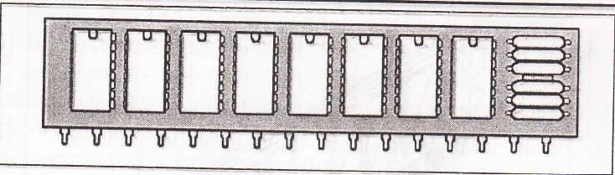
3. SINGLE INLINE PINNED PACKAGE (SIPP)
One of the first module forms of DRAM, the SIPP (single inline pinned package) is a printed circuit board with individual DRAM chips mounted on it.
SIPP module looks like a rectangular card with a single row of pins along one edge.

Slide 73
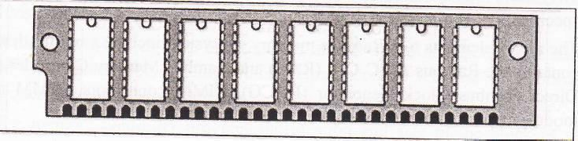
4. SINGLE INLINE MEMORY MODULES (SIMM 30-PIN)
SIMMs (single inline memory modules) quickly replaced SIPPs because they are easier to install.
They are similar to SIPPs with one exception, they require no pins.
30-pin SIMMs has 30 contacts in a single row along the lower edge.

Slide 74
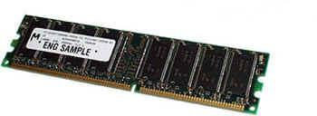
5. DUAL IN-LINE MEMORY MODULES (DIMM)
DIMMs are very similar to SIMMs. The major difference is that a DIMM has two different signal pins on each side of the module as shown in the figure.
One big advantage of DIMM is that only one module can be inserted into the motherboard, whereas you need two SIMMs (paired) when working with 64-bit microprocessors like Pentium II and above. Since SIMM provides only 32-bit bus, you need to use 2-SIMMs paired together with any modern 64-bit processor.

Slide 75
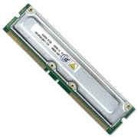
6. RAMBUS IN-LINE MEMORY MODULE (RIMM)
The name is not an acronym, but a trademark of Rambus Inc.
RIMM connectors have a form factor similar to DIMMs and fit within the same board area as the footprint for a DIMM connector.
They have 184 pins compared to a DIMM's 168, but use the same socket specification as a standard 100MHz DIMM.

Slide 76
7. DYNAMIC RAM (DRAM)
DRAM chips are large, rectangular arrays of memory cells with support logic that is used for reading and writing data in the arrays, and refresh circuitry to maintain the integrity of stored data.
Memory arrays are arranged in rows and columns of memory cells called word lines and bit lines, respectively.
Each memory cell has a unique location or address defined by the intersection of a row and a column.
DRAM is cheaper than SRAM and uses half as many
transistors.

Slide 77
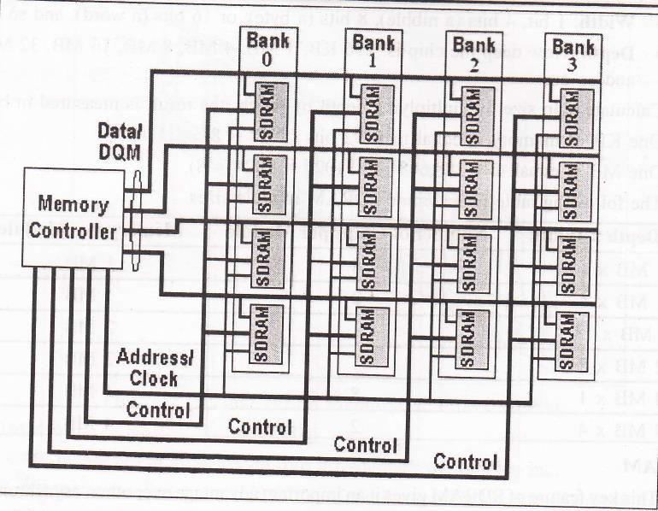
8. SDRAM
This key feature of SDRAM gives it an important advantage over other, asynchronous memory types, enabling data to be delivered off-chip at burst rates of up to 100MHz
Once the burst has started all remaining bits of the burst length
are delivered at a 10ns rate.
With SDRAM an on-chip burst counter allows the column part of the address to be incremented very rapidly which helps speed up retrieval of information in sequential reads considerably.

Slide 78
9. DDR SDRAM
Traditionally, to synchronize logic devices, data transfers would occur on a clock edge.
As a clock pulse oscillates between 1 and 0, data would be output on either the rising edge (as the pulse changes from a 0 to a 1) or on the falling edge.
DDR DRAM works by allowing the activation of output operations on the chip to occur on both the rising and falling edge of the crock, thereby providing an effective doubling of the clock frequency without increasing the actual frequency.
DDR memory chips are commonly referred to by their data transfer rate. This value is calculated by doubling the bus speed to reflect double data rate.

Slide 79
10. SLDRAM (SYNCHRONOUS-LINK DRAM)
SLDRAM boasted higher performance and competed against RDRAM.
SLDRAM was an open standard and did not require licensing fees.
The specifications called for a 64-bit bus running at a 200, 300 or 400 MHz clock frequency.
This is achieved by all signals being on the same line and thereby avoiding the synchronization time of multiple lines.

Slide 80
11. DRDRAM (RAMBUS DYNAMIC RANDOM ACCESS MEMORY)
RDRAM (Rambus Dynamic Random Access Memory) is a memory subsystem that promises to transfer up to 1.6 billion bytes per second.
The subsystem consists of:Random access memory GAM),RAM controller Bus (path) connecting RAM to the microprocessor Devices in the computer that use it.
Direct Rambus (DRDRAM), a technology developed and licensed by the Rambus Corporation, is the latest version and is expected to help accelerate the growth of visually intensive interfaces such as 3-D, interactive games, and streaming multimedia.

Slide 81
12. FPM (FAST PAGE MODE) DRAM
All types of memory are addressed as an array of rows and columns, and individual bits are stored in each cell of the array.
With standard DRAM or FPM DRAM, which comes with access times of 70ns or 60ns, the memory management unit reads data by first activating the appropriate row of the array, activating the correct column, validating the data and transferring the data back to the system.
The column is then deactivated, which introduces an unwanted wait state where the processor has to wait for the memory to finish the transfer.

Slide 82
Some other RAMS are :
(a) EDO (Extended Data Output) RAM : In an EDO RAMs, any memory location can be accessed. Stores 256 bytes of data information into latches. The latches hold next 256 bytes of information so that in most programs, which are sequentially executed, the data are availablewithout wait states.
(b) SDRAM (Synchronous DRAMS), SGRAMs (Synchronous Graphic RAMs) These RAM chips use the same clock rate as CPUuses. They transfer data when the CPU expects them to be ready.
(c) DDR-SDRAM (Double Data Rate – SDRAM) : This RAM transfers data on both edges of the clock. Therefore the transfer rate of the data becomes doubles.

Slide 83
OTHER TYPE OF MEMORY
Conventional Memory
Extended Memory
Expanded Memory
Video Ram
Reserved Memory

Slide 84
JUMPER
Jumpers allow the computer to close an electrical circuit, allowing the electricity to flow certain sections of the circuit board. Jumpers consist of a set of small pins that can be covered with a small plastic box (jumper block) as shown in the illustration to the right. Below the illustration, is a picture of what the jumpers may look like on your motherboard.
In this example, the jumper is the white block covering two of the three gold pins. Next to the pins is a silkscreen description of each of the pin settings.

Slide 85
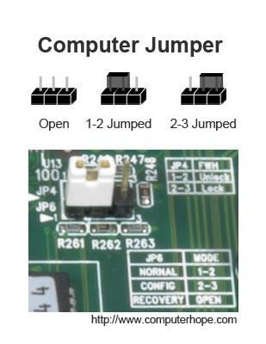
In the picture jump pins 1-2 for Normal mode, 2-3 for config
mode, and when open the computer is in recovery mode.
Jumpers are used to configure the settings for computer peripherals such as the motherboard, hard drives, modems, sound cards, and other components.

