Slide 1
UNIT:2
Hard Disk Drive and Controller, DVD Drives
1

Slide 2
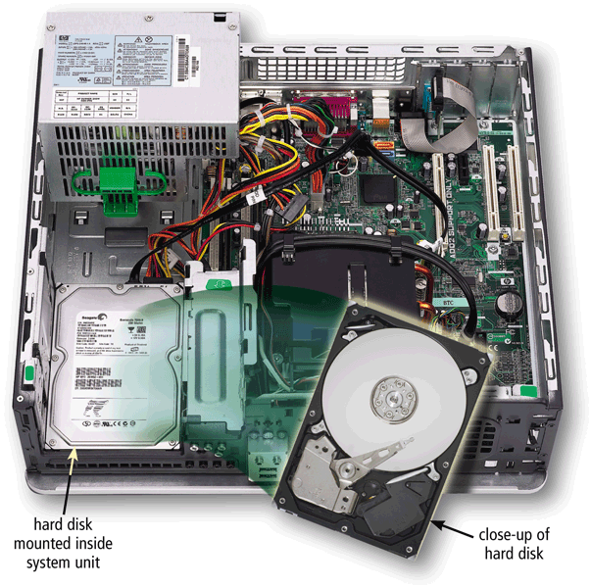
HARD DISKS
A hard disk contains one or more inflexible, circular platters that use magnetic particles to store data, instructions, and information
2

Slide 3
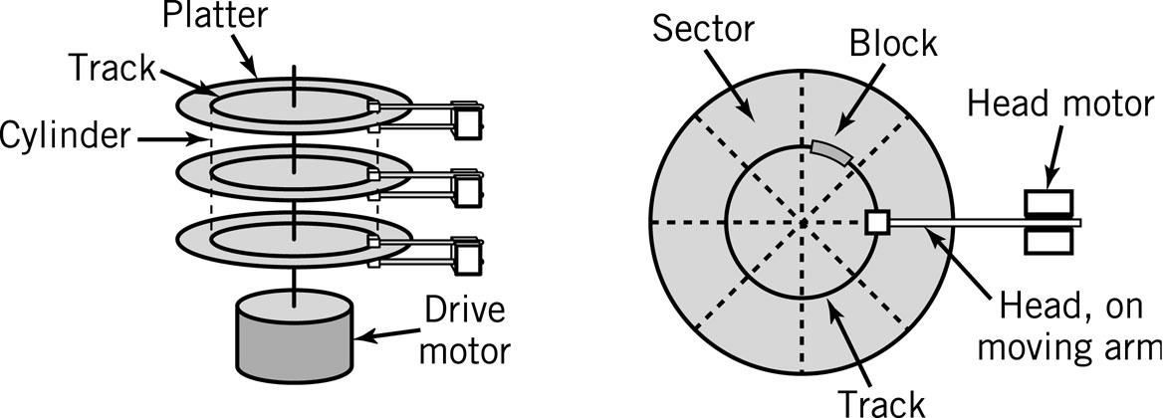
A HARD DISK LAYOUT
3

Slide 4
LOGICAL STRUCTURE OF A HARD DRIVE:
Tracks-
circular areas of the disk
Length of a track one circumference of disk
Over 1000 on a hard disk
Data first written to outer most track
Sectors-
Divides tracks sections
On a floppy 9 sectors exits
Cylinders-
Logical groupings of the the same track on each disk surface in a disk unit
Clusters-
Groups of sectors used by operating system
64 sectors in one cluster
4

Slide 5
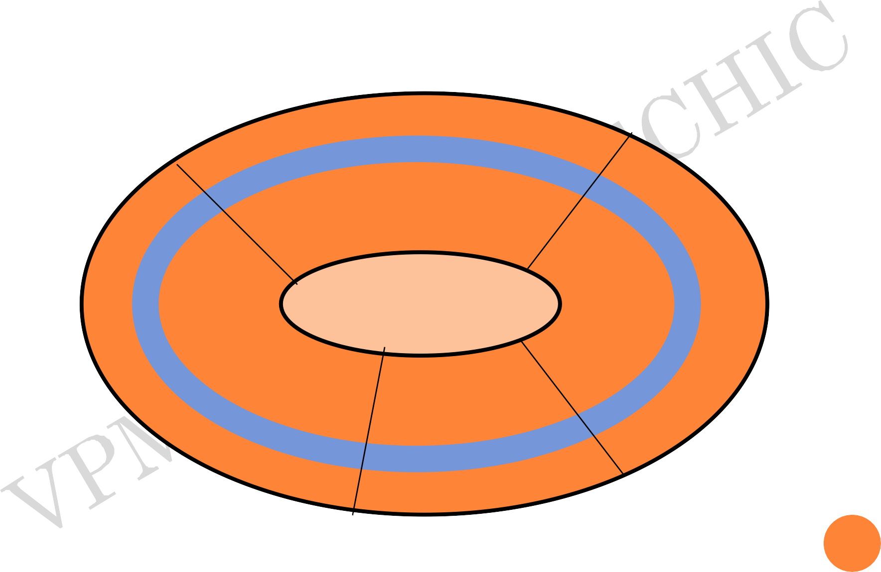
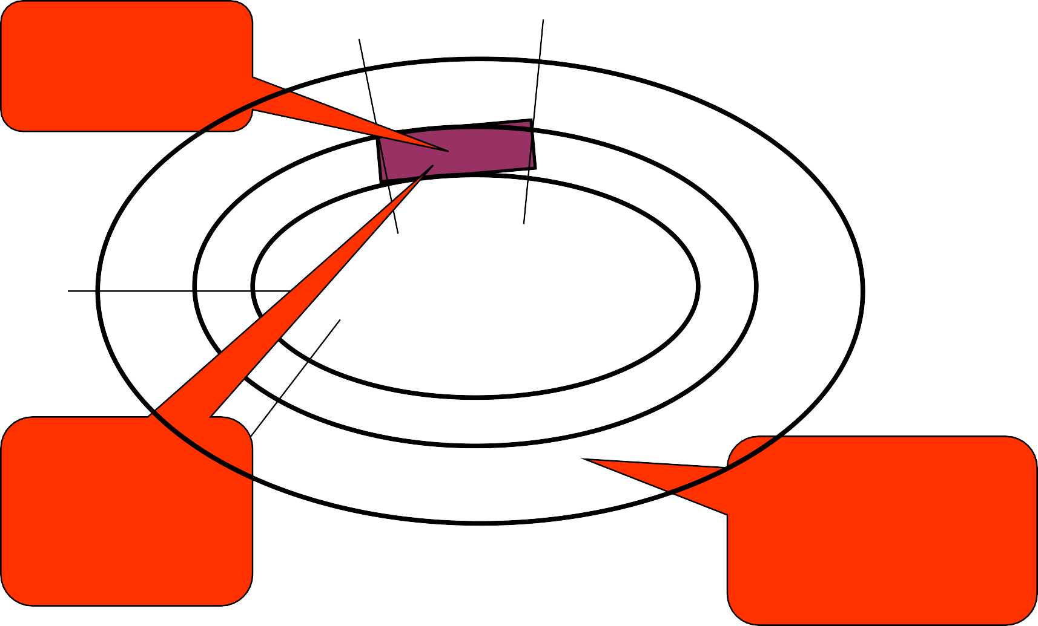
TRACKS AND SECTORS
Can store 512 bytes
Sector = small arc of track
Track= concentric circle
5

Slide 6
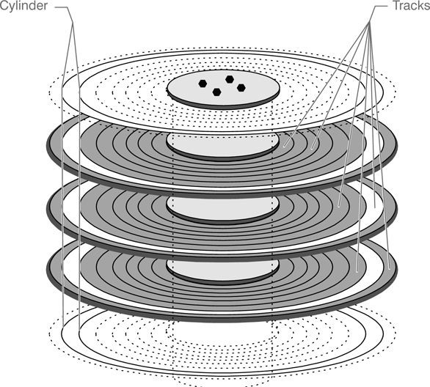
CYLINDER AND TRACKS
6

Slide 7
INTERLEAVING
Allows the read/write head to use the rotation of the disk to its advantage
One sector is written to and the disk skips to several sectors down
7

Slide 8
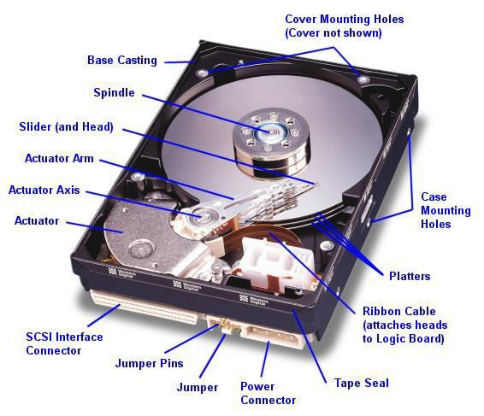
PHYSICAL STRUCTURE
8

Slide 9
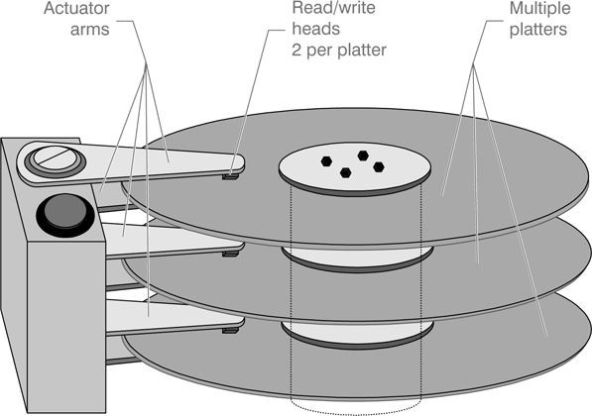
9

Slide 10
The basic physical construction of a hard disk drive consists of spinning disks with heads that move over the disks and store data in tracks and sectors.
The heads read and write data in concentric rings called tracks, which are divided up into segments called sectors, which normally store 512 bytes each.
10

Slide 11
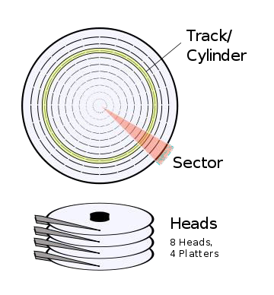
One side of a platter is
called a “head”.
Hard drives can have different numbers of platters, depending on their design and storage capacity.
On the heads, you will see concentric rings (tracks) and pieces of rings (sectors) just like on the floppy disks
11

Slide 12
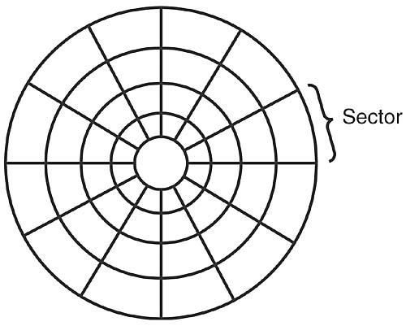
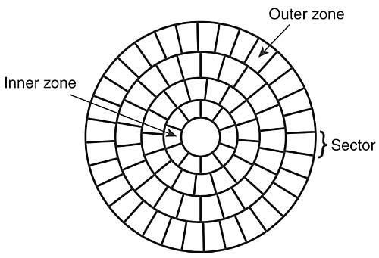
Many hard drives today use a technology called “zone bit recording”
Which enables the hard drive to have more sectors on the outer tracks, where there is more room than on the inner tracks.
This allows more room for storage
12

Slide 13
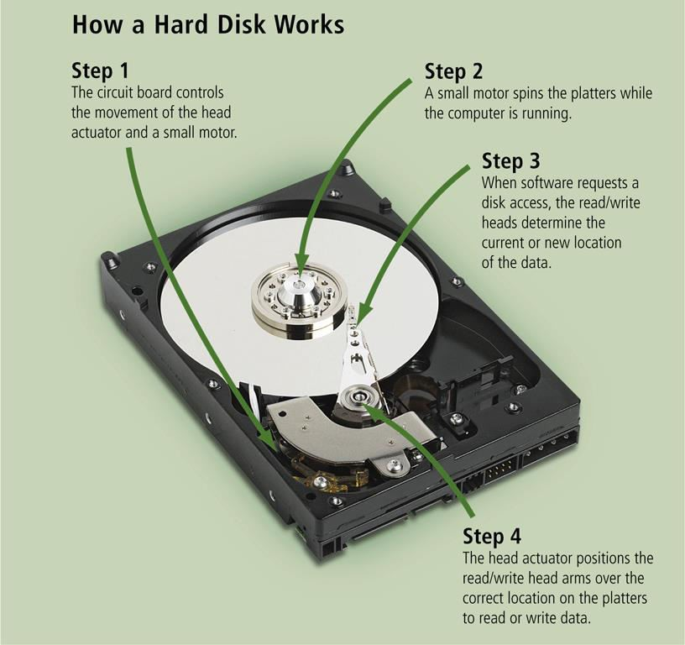
13

Slide 14
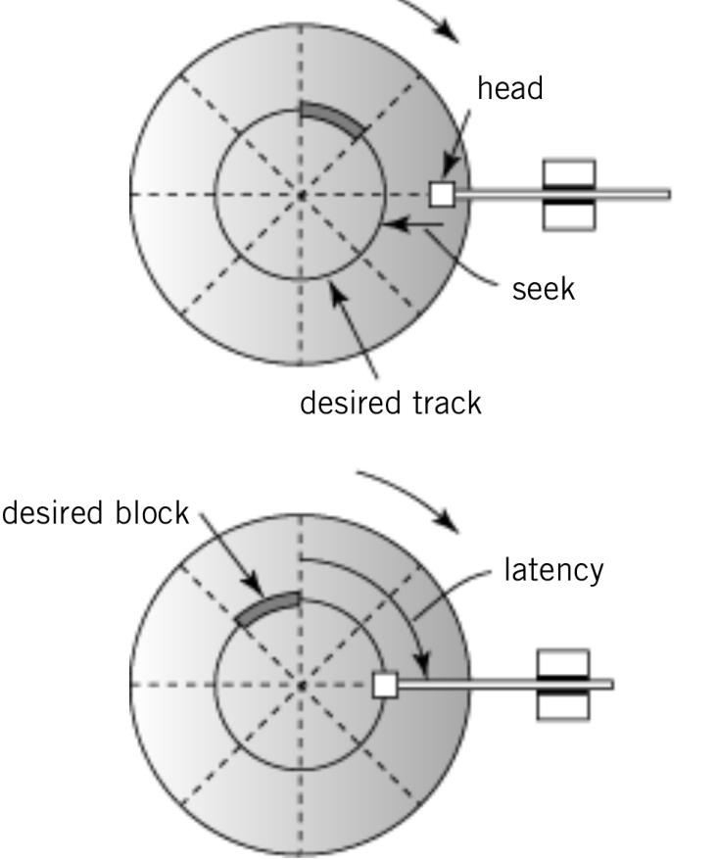
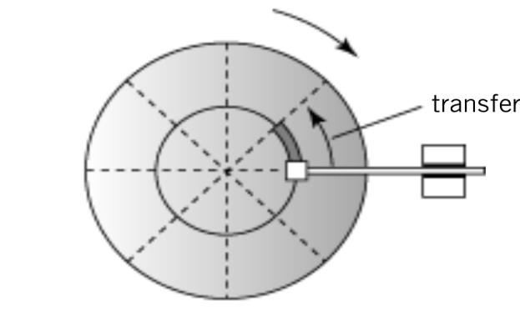
DISC PERFORMANCE CHARACTERISTIC OF
HDD
Average seek time: time required to move from one track to another
Latency: time required for disk to rotate to beginning of correct sector
Transfer time: time required to transfer a block of data to the disk controller buffer
14

Slide 15
DISK ACCESS TIMES
Avg. Seek time
average time to move from one track to another
Avg. Latency time
average time to rotate to the beginning of the sector
Avg. Latency time = ½ * 1/rotational speed
Transfer time
1/(# of sectors * rotational speed)
Total Time to access a disk block
Avg. seek time + avg. latency time + avg. transfer time
15

Slide 16
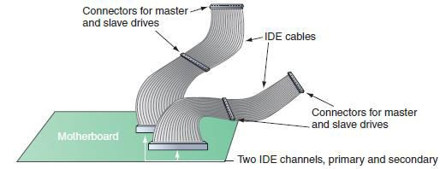
STEPS TO CONFIGURE AND INSTALL A
PARALLEL ATA DRIVE
Configurations for four EIDE devices in a system:
Primary IDE channel, master device
Primary IDE channel, slave device
Secondary IDE channel, master device
Secondary IDE channel, slave device
A motherboard supporting PATA has two IDE channels; each can
support a master and slave drive using a single EIDE cable
16
Courtesy: Course Technology/Cengage Learning

Slide 17
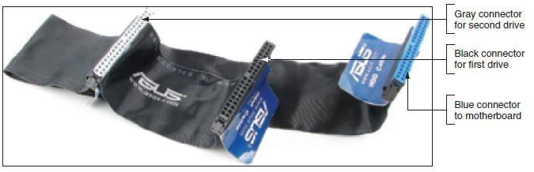
STEPS TO CONFIGURE AND INSTALL A
PARALLEL ATA DRIVE (CONT’D.)
Master or slave designations are made by:
Setting jumpers or DIP switches
Use special cable-select data cable
Color-coded connectors
Blue end connects to motherboard; black end connects to drive
80-conductor cable connectors are color-coded
17
Courtesy: Course Technology/Cengage Learning

Slide 18
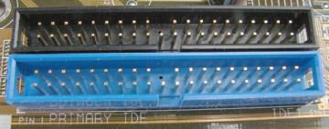
STEPS TO CONFIGURE AND INSTALL A
PARALLEL ATA DRIVE (CONT’D.)
Motherboard color-coding
Primary channel connector: blue
Secondary channel connector: black
Ensures ATA/66/100/133 hard drive installed on the primary IDE channel
The primary IDE channel connector is often color-coded as blue
Courtesy: Course Technology/Cengage Learning
18

Slide 19
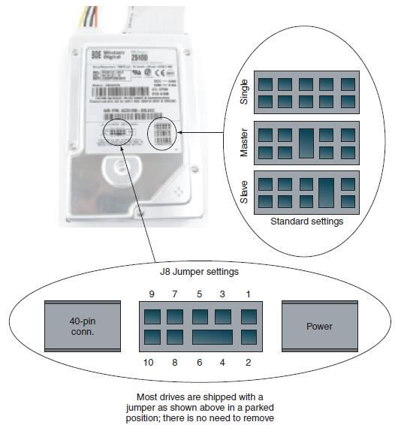
STEPS TO CONFIGURE AND INSTALL A
PARALLEL ATA DRIVE (CONT’D.)
Step 1: Open case, decide how to configure drives
Step 2: Set the jumpers on the drive
A PATA drive most likely will have diagrams of jumper settings for master and slave options printed on the drive housing
Courtesy: Course Technology/Cengage
Learning
19

Slide 20
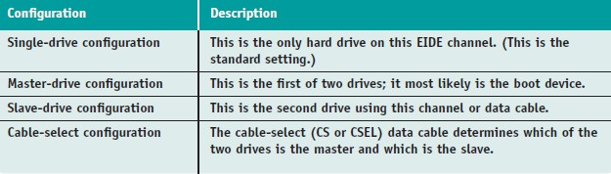
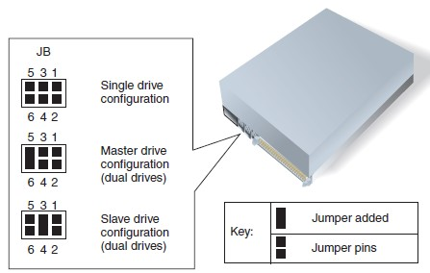
Table 8-4 Jumper settings on a parallel ATA hard drive
Figure 8-37 Jumper settings on a hard drive and their meanings
Courtesy: Course Technology/Cengage Learning
20

Slide 21
STEPS TO CONFIGURE AND INSTALL A
PARALLEL ATA DRIVE (CONT’D.)
A+ Guide to Managing and Maintaining Your
PC, 7e
Step 3: Mount the drive in the bay
Remove bay from case and insert hard drive in bay
Securely mount drive in the bay
Decide whether to connect data cable before or after
inserting bay inside the computer case
Place bay back into position, secure bay with screws
Install a power connection to each drive
Connect data cable to motherboard IDE connector
Connect hard drive light wiring if necessary
Before replacing case cover verify installation
21

Slide 22
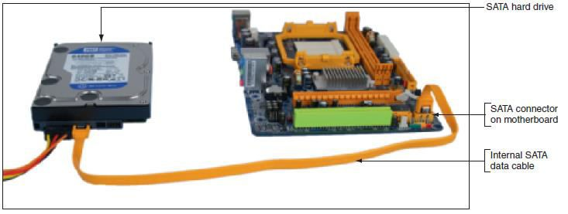
A SATA hard drive subsystem uses an internal SATA data cable
22

Slide 23
RAID
Redundant Array of Independent Disks
RAID: two or more hard drives work together as an array of drives
Improves fault tolerance and performance
10 levels of RAID
3 on test will be:
RAID 0, RAID 3, RAID 5
23

Slide 24
RAID CONTINUED
RAID 0- Striped disk without parity
RAID 3- Parallel transfer with parity
RAID 5- Data striping with parity
24

Slide 25
RAID 0
RAID 0 – Striping
Two or more drives
Writes alternate between drives for speed
Both drives get same drive letter from system
Fast but not safe; one failure and all fails
25
10

Slide 26
RAID 1
RAID 1 (Mirror)
Two drives, one controller
same drive letter
writes are to both drives
Safe, one drive can fail, but slow
RAID 1 (Duplexing)
Two drives, two controllers
Writes are to both drives
Same drive letter
Faster and safer
26

Slide 27
RAID 5
RAID 5 – Striping with Parity
Three or more drives
Writes alternate Data, Data, Parity; Data, Parity, Data; Parity, Data, Data
Any one drive can fail and system can “heal” itself
27
8

Slide 28
INTERFACES / STANDARDS OF HDD
A+ Guide to Managing and Maintaining Your
PC, 7e
Serial ATA
Motherboard or expansion card can provide external SATA (eSATA) ports for external drives
External SATA (eSATA)
Up to six times faster than USB or FireWire
eSATA drives use special external shielded serial ATA cable up to 2 meters long
Purchasing considerations
SATA standards for the drive and motherboard need to match for optimum speed
If no match, system runs at the slower speed

Slide 29
SCSI
Pronounced Scuzzy
Small Computer Systems Interface
For wide range of peripheral devices, including hard disks, tape drives, optical drives, CD- ROMs and disk arrays.
8 devices can connect to a daisy chain
This chain must be terminated at both ends
Each device on chain is assigned unique device ID number that is determined by jumpers or DIP switches

Slide 30
IDE drives-
originally developed as alternative to more expensive SCSI drives.
Modern versions called EIDE drives.
Support up to 4 multigigabyte drives.
If you want more devices, use SCSI or USB
Low-level formatted at the factory

Slide 31
SATA
Serial ATA was designed to replace the older ATA (AT Attachment) standard (also known as EIDE).
It is able to use the same low level commands, but serial ATA host-adapters and devices communicate via a high-speed serial cable over two pairs of conductors.
Serial ATA has distinct key advantages over its predecessor. Cables are very thin with small 7-pin connectors. They can be up to 3 feet (1 meter) in length, and are easily routed to stay out of the way allowing maximum airflow inside the case.
ATA cables limited to 18 inches (46 cm) in length often made connections difficult and also clogged cases blocking airflow, while cooling has become crucial.
SATA also has a far lower power requirement of just 250 mV compared to PATA's 5-volt requirement, and with chip core voltages declining, this speaks well of SATA's future.

Slide 32
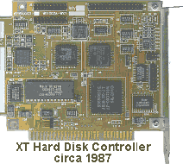
HARD DRIVE CONTROLLERS
hard disks were interfaced to a PC motherboard via an expansion board known as a hard disk controller. The drive did most of the mechanical stuff and performed basic electronic/servo functions; the controller told it in detail what to do.

Slide 33
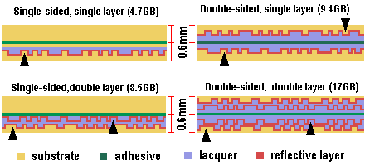
DIFFERENT TYPES OF DVD

Slide 34
SIZES
CDs
5.25 “ – 120 mm
3.15” – 80 mm
Business Card
DVDs
5.25” - 120 mm
Could be different
None so far

Slide 35
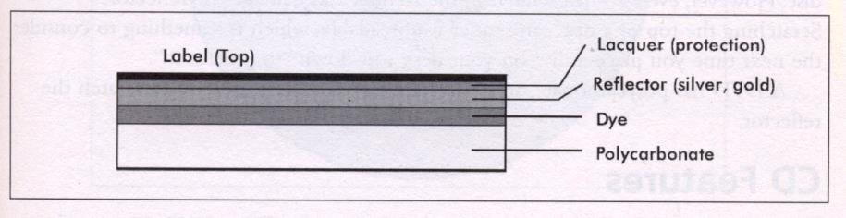
CD CONSTRUCTION

Slide 36
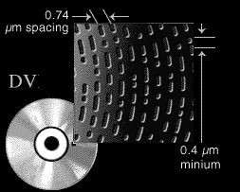
DVD
DVD uses Smaller pit and land dimensions, therefore the laser must me exponentially more accurate than with CD’s.
More closely-spaced tracks, called "track pitch"
A shorter-wavelength laser
36

Slide 37
DVD Players and DVD-ROM drives use a laser that emits high intensity red light at 650 and
635nm vs the 780 nanometers for CD technology
These shorter wavelengths are better at reading
the smaller, densely packed together pits and lands.
The laser assembly has been re-engineered to produce a more tightly focused laser beam
37

Slide 38
LAYERS
As an interesting consequence of using the new lasers and the new DVD design elements, they found that multiple sides and layers could be stacked onto a single DVD disk. A total of 4 configurations were found to be viable:
Single Side, Single Layer
Single Side, Dual Layer
Double Side, Single Layer
Double Side, Dual Layer
38

Slide 39
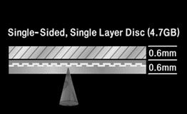
SINGLE SIDE, SINGLE LAYER DVD
Accounts for most
DVD’s
4.7 GB of data capacity
"7 times" the data capacity of today’s music CDs and CD- ROMs
39

Slide 40
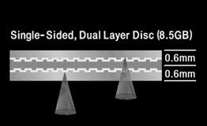
SINGLE SIDE, DUAL LAYER DVD
8.5 GB on one side
additional 3.8 GB on the second layer
more than "13 times" the capacity of today’s music CDs and CD- ROMs

Slide 41

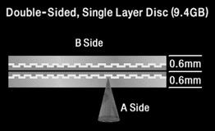
DUAL SIDE, SINGLE LAYER DVD
9.4 GB (4.7 on each side)
provides a little more capacity
Flipping the disc or having a DVD Player capable of two-sided playback is required

Slide 42
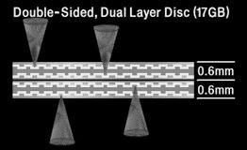
DUAL SIDE, DUAL LAYER DVD
Maximum capacity of 17GB (8.5GB on each side)
Flipping the disc or having a DVD Player capable of two-sided playback is required

Slide 43
CD VERSUS DVD
Both discs are the same physical size (120 mm diameter &
1.2 mm thickness, which makes CDs compatible with DVD players.
Both discs are made with the same basic technology and production processes
Both technologies read discs in the same manner
DVD software can be replicated from existing CD production facilities

Slide 44
ADVANTAGES OF DVD
•.
DVD can hold exponentially more data than a CD can
DVD has Higher density data storage where smaller pits and smaller tracks in DVDs provide seven times storage alone compared to CDs
DVD has less overhead & more area because the DVD’s error-correction scheme is more efficient and requires less storage space that can be used for other information

Slide 45
DVD can have Multi-layer storage whereas CD stores data on one layer on one side of disc. DVD can store up to two layers on up to two sides of the disc

Slide 46
LOGICAL STRUCTURE
Track-at-once
CD – data discs
Disc-at-once
Audio discs
DVDs
Packet writing
Used with drag & Drop writing software
Dangerous for forensic workstations
Non-video DVDs

Slide 47
INTERFACES
ATAPI or SATA
SCSI
USB
1394 Firewire

