Slide 1
Monitor and Display Adapters
UNIT 4

Slide 2
TOPIC TO BE COVERED:
4.1: video Basics(CRT Parameters)
4.2: VGA monitors
4.3: Digital Display Technology- Thin Film
Displays , Liquid Crystal Displays , Plasma Displays Panels, Light Emitting Displays
4.4:Graphics Cards: Components of a card, Accelerated Video Cards , CGA , EGA , VGA

Slide 3
4.1: VIDEO BASICS(CRT PARAMETERS)
Video is a sequence of still images representing scenes in motion.
Video will be “Capturing , recording,
processing , storing , transmitting and
reconstructing “ all done electrically.
4.1.1: Properties of Video
4.1.2: Video format Basics
4.1.3: Video Compression

Slide 4
4.1.1 PROPERTIES OF VIDEO
Frame – Each page or image is called frame
Pixel – it is the smallest addressable screen element in image.
Frame per second(FPS) - no of frame per second is measured by per second.
Color depth – no of bit used to represent the different color is called color depth.
Bit rate or bit per second(BPS) – The number of bits that are conveyed or processed per second. It width *hight * color depth * FPS.
Video size – it can measured by width
*hight*color depth*FPS*runtime in seconds.

Slide 5
4.1.2: VIDEO FORMAT BASICS
Video Standard
Image Dimensions and Aspect Ratio
3)Frame 4)Scanning Method

Slide 6
1)VIDEO STANDARDS
A number of video standards have emerged over the years.
Television Systems Committee)
B)PAL
(A)NTSC(National Phase Alternating Line)
C)SECAM

Slide 7
2)IMAGE DIMENSIONS AND ASPECT RATIO
The horizontal and vertical pixel dimensions of your format determine the frame size and aspect ratio.
Aspect Ratio
The aspect ratio of a video frame is the width
with respect to the height.

Slide 8
3)FRAME RATE
The frame rate of your video determines how quickly frames are recorded and played back.
Following are common frame rates in use:
50 fps: 720p HD
59.94 fps: 720p HD
60 fps: 720p HD

Slide 9
4)SCANNING METHOD
Video frames are composed of individual lines, scanned from the top of the screen to the bottom.
Interlace Scanning.
Interlaced video scans the display twice, using two field, to complete a single frame.
Frame rates lower than 40 fps can cause noticeable flicker.
Progressive Scanning
This process scans every other line of the image, first all the odd lines and then the even lines.

Slide 10
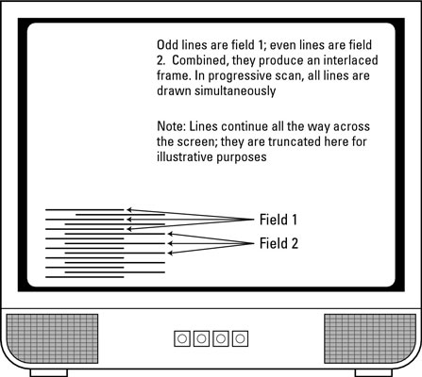

Slide 11
4.1.3: VIDEO COMPRESSION
Code is short for coder-decoder and describes the method in which video data is encoded into a file and decoded when the file is played back.
Lossless Codecs
The simplest encoding algorithm called run length encoding, represents strings of redundant values as a single values and a multiplexer.
Lossy Codecs
Most video codecs are necessarily lossy, because it is usually impractical to store and transmit uncompressed video signals.

Slide 12
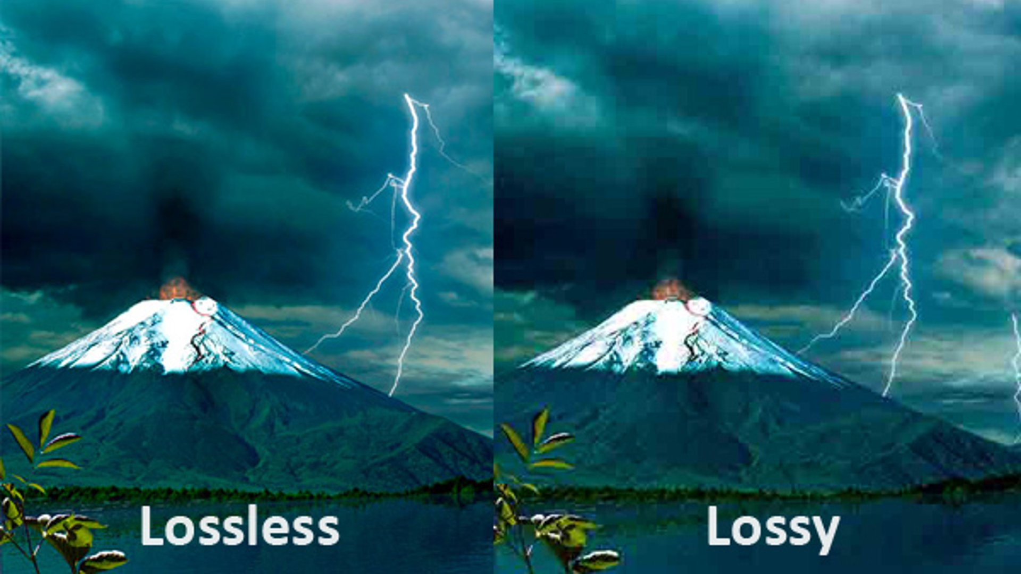

Slide 13



Slide 14
4.2: VGA MONITORS
Short for video Graphics Array , VGA is popular display standard developed by IBM and introduced in 1987,VGA provides 640x480 resolution color display screens with a refresh rate of 60Hz and 16 colors displayed at a time.
If the resolution is lowered to 320 x 200, 256 colors are shown. Many revision s of the standard have been introduced.

Slide 15
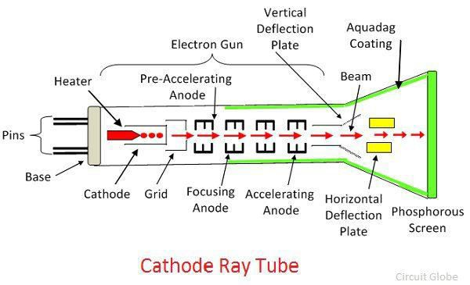
CRT MONITOR
The working of CRT depends on the movement of electrons beams. The electron guns generate sharply focused electrons which are accelerated at high voltage. This high-velocity electron beam when strikes on the fluorescent screen creates luminous spot.
After exiting from the electron gun, the beam passes through the pairs of electrostatic deflection plate. These plates deflected the beams when the voltage applied across it. The one pair of plate moves the beam upward and the second pair of plate moves the beam from one side to another. The horizontal and vertical movement of the electron are independent of each other, and hence the electron beam positioned anywhere on the screen.

Slide 16
CONSTRUCTION OF CRT
1) An Electron Gun: for producing a stream of electrons.
2) Focusing and Accelerating anodes (G3) : for producing a narrow and sharply focused beam of electrons.
3) Horizontal and vertical plates: for moving beam horizontally and vertically for controlling the path.
4) Screen : A glass envelops having a phosphor coated screen at its flared end which produces a bright spot when struck by a high velocity electron beam. it is arranged into an array of millions of tiny cells called dots.

Slide 17
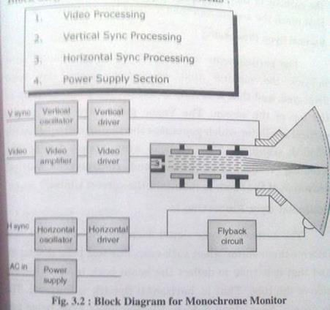
BLOCK DIAGRAM OF CRT MONITOR

Slide 18
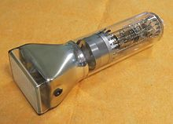

Slide 19
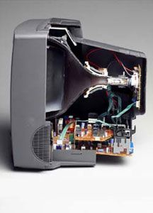

Slide 20
4.3: DIGITAL DISPLAY TECHNOLOGY
4.3.1:Thin Film Display (TFT)
A thin-film transistor is a thin substrate , like glass ,coated with various thin films of metal ,
silicon , or plastic.
The idea is to form a big sheet of very small
switching transistors and capacitors.

Slide 21
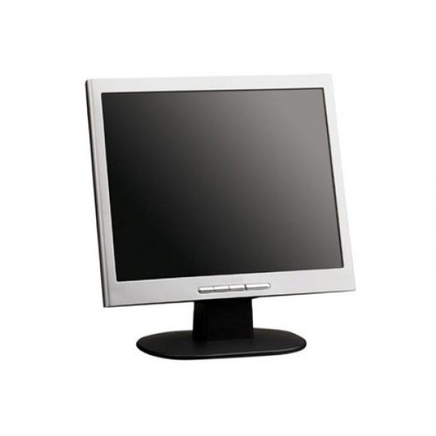

Slide 22
4.3.2:LIQUID CRYSTAL DISPLAY (LCD)
It is used for a wide variety of inexpensive applications ,from digital watches to children’s toys, from pagers and cell phones to ATMs.
The filters are set at a 90-degree angle to each other.
When current is added, the crystals align to the electric field, blocking the transmission of light. Not all LCD panels are created equal.
The greater the twist angle, the higher the contrast and the more responsive the display is to changes in current.
The image is formed by an array of LCDs on a wire grid. The result is a faster response than the passive array.

Slide 23
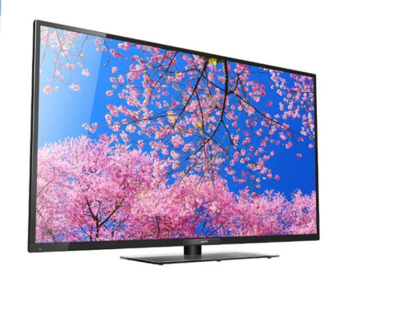

Slide 24
4.3.3:PLASMA DISPLAY PANELS(PDP)
Plasma display panels(PDPs) work much like the fluorescent lights found in most offices by energizing an insert gas.
Phosphor films are used to produce a color image.
This technology is used to manufacture very
large FPDs.
Like fluorescent lights, PDPs are relatively inexpensive to produce, but lower contrast and brightness as well as higher relative power consumption.

Slide 25
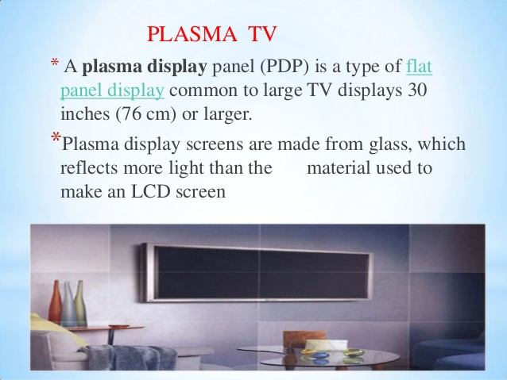

Slide 26
4.3.4:LIGHT EMITTING DISPLAY(LED)
An LED display is a flat panel display, which uses an array of light-emitting diodes as a video display.
Using LEDs typically gives a TV a wider color range, a longer life, and lower power consumption.
The light behind an LCD panel is one of two major varieties. The first is CCFL , a technology that’s sort of like the fluorescent bulbs in your home.
The other type is LED.
Some TVs have LEDs only along the edge , which is less desirable.

Slide 27
4.4:GRAPHICS CARDS
Graphics cards also known as, video cards or display adapter, is a device that interfaces with the computer and the monitor is attached to the video adapter.
4.4.1:Components of a graphic cards 4.4.2:Video Display Standards 4.4.3:Accelerated graphics Port

Slide 28
4.4.1:COMPONENTS OF A GRAPHIC CARDS
The modern PC graphics card consists of four main Components
1)The graphics processor unit(GPU) – it is also occasionally called visual processing unit, is a specialized electronic circuit designed to rapidly manipulate and alter memory to accelerate the creation of images in a frame buffer.
- The team GPU is the most powerful class typically interface with the motherboard by means of an expansion slot such as PCI Express.
2)The video memory – the memory that holds the video image is also referred to as the frame buffer and is usually implemented on the graphics card itself.
The following are six popular types of memory.
- VRAM (video RAM)
- WRAM(windows RAM)
- EDO RAM
- SDRAM
- SGRAM
-DRDRAM
3)The random access memory digital-to-analogue converter (RAMDAC) – the computer data is in
form of digital while monitor work on analog data
The device that does this is called the RAMDAC.
- it is to reads the information on video memory, converts this information and sends it over the video cable to the monitor.
4)The driver software- A modern graphics cards driver software is vitally important when it comes
to performance and features.
- A separate driver is used for each resolution or color depth.

Slide 29
4.4.2:VIDEO DISPLAY STANDARDS
1)Color Graphics Card(CGA)
The CGA standard, introduced in 1981, came with 16 KB
of video memory and supported several different modes:
A)Text mode – it includes 80*25 texts in 16 different colors.
- The resolution however was lower as each character was
made up of 8*8 pixels instead of the MDA’s 9*14 pixels.
B)Monochrome graphics mode – this displayed graphics at 640*200 pixels.
- This was lower than the Hercules card but server the purpose for an initial release and quickly replaced with the EGA standard.
C)Color graphics mode – this came in two flavors :- a 320*200 pixel mode with four colors and lesser used resolution of 160 *200 in 16 colors.
- The four color mode only had two official palettes to choose from : Magenta, cyan, white and background color.

Slide 30
2)ENHANCED GRAPHICS ADAPTER(EGA)
The Enhanced Graphics Adapter (EGA) was introduced by IBM in 1984 as the primary display for the new PC-AT Intel 286-based computer.
A)High-resolution mode – this has 640*350 pixel resolution.
- On any given screen display a total of 16 colors could be displayed.
CGA mode – this is full 16 color versions of the CGA
640*200 and 320*200 graphics modes.
MDA mode – it could be supported to some degree. By setting switches on the card an MDA monitor could be driven by an EGA card however only the 640*350 display could be supported.

Slide 31
3)VIDEO GRAPHICS ARRAY(VGA)
With VGA you see a change in the terminology from adapter to array.
VGA supports both graphics and text modes of operation and can be support most of the EGA,CGA, and MDA modes of operation.
The VGA specification dictated 256KB of video RAM, 256 color modes , a 262,144 color palette.
The most common VGA graphics modes include : 640*480 in 16 colors.
Other supported mode by VGA are 640*350 in 16 colors, 320*200 in 16 colors.

Slide 32
4.4.3:ACCELERATED GRAPHICS PORT
Accelerated graphics Port(AGP) is an advanced port designed for video cards and 3D accelerators.
AGP also supports two optional faster modes, with throughput of 533 MBps and 1.07 GBps.
It also allows 3-D textures to be stored in main
memory rather than video memory.
Each computer with AGP support will either have one AGP slot or on board AGP video.
AGP channel is 32 bit wide and runs at 66 MHz. this translate in to a total bandwidth of 266Mbps, which is much greater than PCI bandwidth up to 133 Mbps

Slide 33
THANK YOU.

