Slide 1
UNIT-1
INTRODUCTION TO JAVA

Slide 2
JDK
(JAVA Development Kit)

Slide 3
JDK
The Java Development Kit (JDK) is a software development environment which is used to develop java applications and applets.
It physically exists.
It contains JRE + development tools.

Slide 4
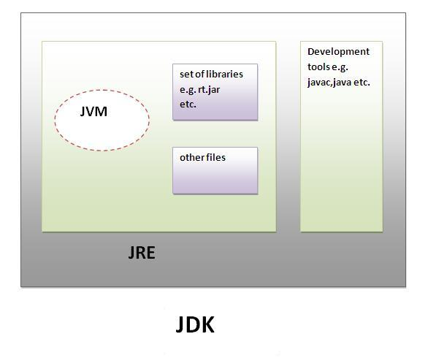

Slide 5
JRE
(JAVA Runtime Environment)

Slide 6
JRE
The Java Runtime Environment is a set of software tools which are used for developing Java applications.
It is used to provide the runtime environment.
It is the implementation of JVM.
It physically exists.
It contains a set of libraries + other files that JVM uses at runtime.

Slide 7
JVM
(JAVA Virtual Machine)

Slide 8
JVM
JVM (Java Virtual Machine) is an abstract machine.
It is called a virtual machine because it doesn't physically exist.
It is a specification that provides a runtime environment in which Java bytecode can be executed.
It can also run those programs which are written in other platfroms and compiled to Java bytecode.

Slide 9
JVM
The JVM performs following operation:
Loads code
Verifies code
Executes code
Provides runtime environment

Slide 10
JVM
JVM provides definitions for the:
Memory area
Class file format
Register set
Garbage-collected heap
Fatal error reporting etc.

Slide 11
Bytecode

Slide 12
Bytecode
Bytecode is intermediate code which is produced by JAVA compiler, by compiling the source code.
It is machine independent code
It’s stored in .class file after compilation of the source code.
Bytecode implementation makes JAVA platform independent programming language.

Slide 13
