Slide 1
UNIT-1
INTRODUCTION TO JAVA

Slide 2
Features of JAVA

Slide 3
Simple
Secure
Portable
Object-oriented
Platform - independent
Robust
Multithreaded
Architecture-neutral
Interpreted
High- performance
Distributed
Dynamic

Slide 4
Simple
Java is Easy to write and more readable
Java has an easy syntax to learn and use.
Most of the concepts are drew from C++ thus making Java learning simpler.
Java remove confusing concepts like explicit pointers, operator overloading etc.
There is no need to remove unreferenced objects because there is Automatic Garbage Collection in java.

Slide 5
Secure
Java provides secure way to access web applications.
No use of explicit pointer
Java Programs run inside java virtual machine
Use many security algorithms for security perspective

Slide 6
Portable
Java is portable because it use bytecode.
It doesn't require any type of implementation specification.
Java programs can execute in JVM.
Java programs can be run on any platform (Linux,Window,Mac)

Slide 7
Object-oriented
Java programming is object-oriented programming language.
Like C++ java provides most of the object oriented features. But Java is pure OOP Language, while C++ is semi object oriented
Everything in Java is an object. It means any software in JAVA is a combination of function and data.

Slide 8
Object-oriented
Object
Class
Inheritance
Polymorphism
Abstraction
Encapsulation

Slide 9
Platform-independent
Other programming languages such as C, C++ etc which are compiled into platform specific machines. Java is guaranteed to be write-once, run-anywhere(WORA) language.
Java program is compiled into bytecode.
This bytecode is platform independent and can be run on any machine, plus this bytecode format also provide security.
Any machine with Java Runtime Environment can run Java Programs.

Slide 10
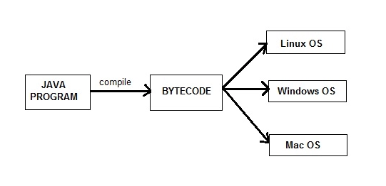
Platform-independent

Slide 11
Robust
Robust simply means strong. Java is robust because:
It uses strong memory management.
There are lack of pointers that avoids security problems.
There is automatic garbage collection in java which runs on the Java Virtual Machine to get rid of objects which are not being used by a Java application anymore.
There is exception handling and run time checking mechanism in java.

Slide 12
Multi-threaded
A thread is like a separate program, executing concurrently. We can write Java programs that deal with many tasks at once by defining multiple threads.
Benefit of multithreading is that it utilizes same memory and other resources to execute multiple threads at the same time, like While typing, grammatical errors are checked along.

Slide 13
Architecture-neutral
Compiler generates bytecodes, which have nothing to do with a particular computer architecture, hence a Java program is easy to interpret on any machine.
Ex:- it doesn't matter if your operating system is 32-bit or 64-bit, the Java byte code is exactly the same. You don't have to recompile your Java source code for 32-bit or 64-bit. (So, "architecture" refers to the CPU architecture).

Slide 14
Architecture-neutral
No implementation of dependent features
Example: the size of an int does not vary based on platform.

Slide 15
Interpreted
JAVA is both compiled and interpreted language. The source code in JAVA program is compiled to byte code (instead of native machine code as we see in C/C++ or other languages).
At run time, JVM interprets the byte code and executes them.

Slide 16
Interpreted
As JAVA use JAVA compiler, it’s compilation speed increase in the application. But, the problem was found in the interpretation. As compared to java compiler interpreter’s speed becomes slow down the application.
JIT (Just In Time) compiler used to interpret the bytecode to increase speed. It makes the execution faster.

Slide 17
High- performance
Java is faster than other traditional interpreted programming languages because Java bytecode is "close" to native code.
It is still a little bit slower than a compiled language (e.g. C++). Java is an interpreted language that is why it is slower than compiled languages e.g. C, C++ etc.
Java is an interpreted language, so it will never be as fast as a compiled language like C or C++. But, Java enables high performance with the use of just-in-time compiler.

Slide 18
Distributed
Java is a distributed language which means that the program can be design to run on computer networks.
Java provides an extensive library of classes for communicating ,using TCP/IP protocols such as HTTP and FTP. This makes creating network connections much easier than in C/C++.

Slide 19
Distributed
It’s easy to read and write objects on the remote sites via URL with the same ease that programmers which are used when read and write data from and to a file.
This helps the programmers at remote locations to work together on the same project.
Example: RMI (Remote Method Invocation)

Slide 20
Dynamic
Java is dynamic language because it is capable of linking in new class libraries, methods and objects.
It support native methods(methods which is written in another language like c/c++).Native methods are linked dynamically at runtime.

Slide 21
Dynamic
Java programs carry with them substantial amounts of run-time type information that is used to verify and resolve accesses to objects at run time.
Dynamic binding of objects

