Slide 1
Graph

Slide 2

graph
Graph is a collection of nodes called vertices, and the connections between them called edges.

Slide 3
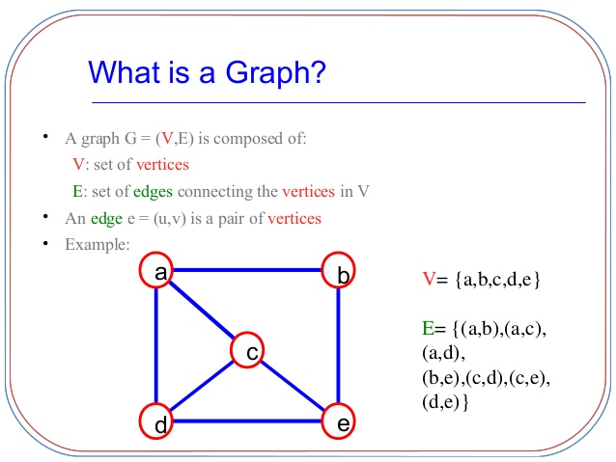

Slide 4
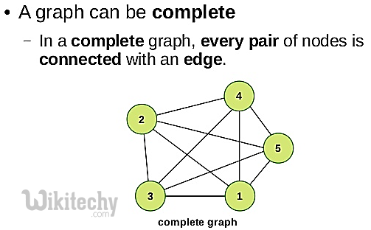

Slide 5
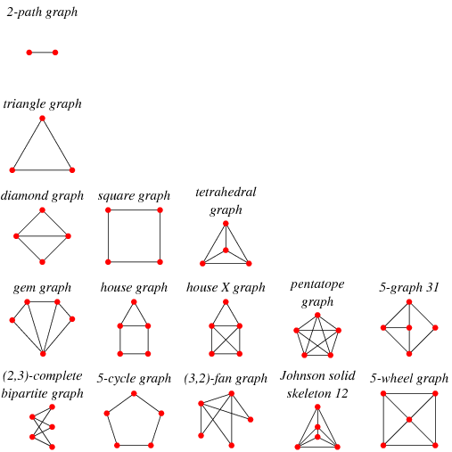

Slide 6
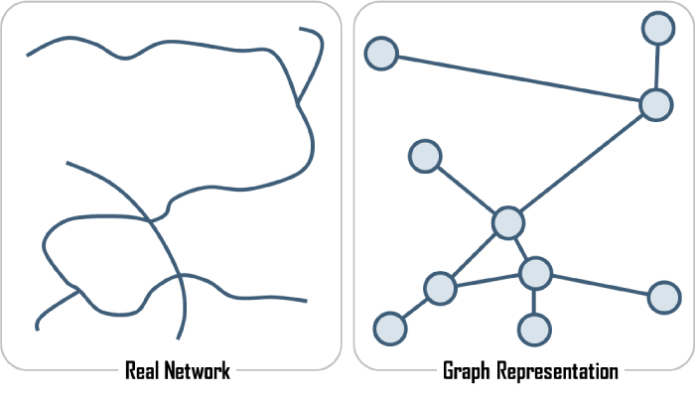

Slide 7
