Slide 1
Sorting algorithm

Slide 2
Introduction to Sorting
Sorting is nothing but arranging the data in ascending or descending order. The term sorting came into picture, as humans realised the importance of searching quickly.
Different Sorting Algorithms
Bubble Sort
Insertion Sort
Selection Sort
Quick Sort
Merge Sort
Becket Sort
Shell Sort

Slide 3
Bubble Sort
Bubble Sort is a simple algorithm which is used to sort a given set of n elements provided in form of an array with n number of elements.
Bubble Sort compares all the element one by one and sort them based on their values.
This sorting algorithm is based on comparing and exchanging pairs of adjecent element in array. The bubble sort method derives it name from the fact that the smallest data item bubbles up to the top of the array.

Slide 4
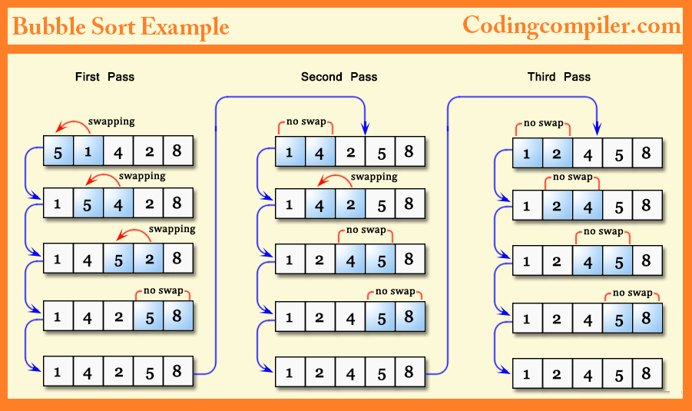

Slide 5
Bubble sort algo.
Step-1 [initialize]
i=0 , j=0
Step-2 Repeat through step-6 while (i=n-1)
Step-3 Repeat through step-5 while (j<i)
Step-4 if(a[j]>a[i+1])
t=a[j];
a[j]=a[j+1]
a[j+1]=t;
Step-5 j=j+1
Step-6 i=i-1
Step-7 exit

Slide 6
Insertion Sort
they are sorted, or arranged in the ascending order of their numbers.
Its space complexity is less. Like bubble Sort, insertion sort also requires a single additional memory space.
Insertion sort is a simple algorithm that is relatively efficient for small and mostly sorted list, and often Is used as part of more sophisticated algorithms.
It works by taking element from the list one by one and inserting them in their correct position into a new sorted list. Insertion sort works just like its name suggest – it inserts each element into its proper place in the final list.

Slide 7
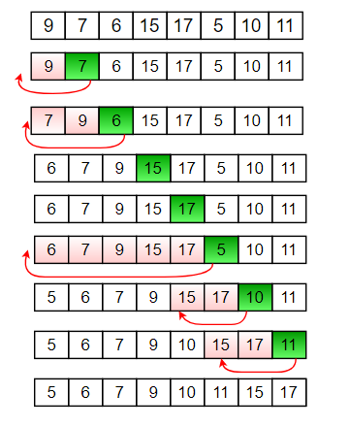

Slide 8
Insertion sort algo
Step-1 [initialize]
i=0 , t=0
Step-2 Repeat through step-8 for while (i<size)
Step-3 j=0
Step-4 Repeat through step-7 for while (j<i)
Step-5 if(a[j]>a[i] then
t=a[j];
a[j]=a[i]
k=i;
Repeat through step-8 while (k>j)
a[k]=a[k-1]
step-6 k--
Step-7 j=j+1
Step-8 i=i-1
Step-9 exit

Slide 9
Selection Sort
Selection sort is conceptually the most simplest sorting algorithm.
This algorithm will first find the smallest element in the array and swap it with the element in the first position,
then it will find the second smallest element and swap it with the element in the second position,
and it will keep on doing this until the entire array is sorted.

Slide 10
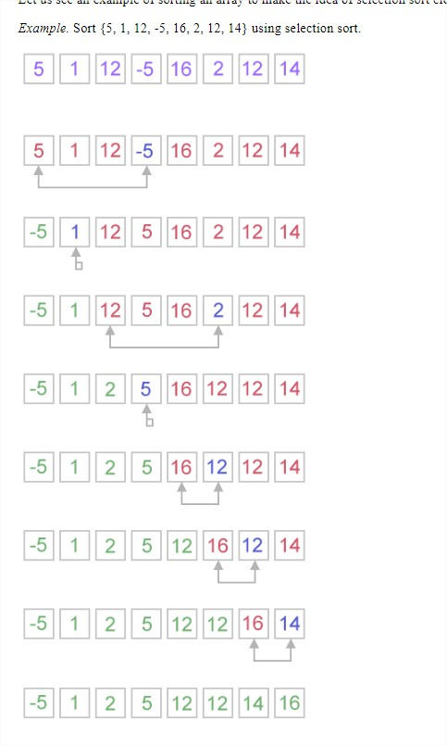
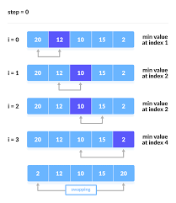
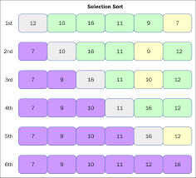

Slide 11
SElection sort algo
Step-1 [initialize]
i=0 ,j=0, t=0
Step-2 Repeat through step-6 for while (i<size)
Step-3 Repeat through step-5 for while (j<size)
Step-4 if(a[i]>a[j] then
t=a[i];
a[i]=a[j]
a[j]=t
step-5 j=j+1
Step-6 i=i+1
Step-7 exit

Slide 12
Merge sort
Merge Sort is a Divide and Conquer algorithm.
It divides input array in two halves, calls itself for the two halves and then merges the two sorted halves.
The merge() function is used for merging two halves.

Slide 13
Marge sort algo
Step-1 [initialize]
i=0,j=0,k=0
Step-2 Repeat through step-9 while (i<n)
Step-3 Repeat through step-8 while (j<i)
Step-4 if(a[j] > a[i])
t=a[j]
a[j]=a[i]
Step-5 Repeat through step-7 while (k>j)
Step-6 a[k]=a[k-1]
a[k+1=t;
Step-7 K- -
Step-8 j=j+1
Step-9 i=i+1
Step-10 exit

Slide 14
Quick sort
Quick sort is a highly efficient sorting algorithm and is based on partitioning of array of data into smaller arrays.
This algorithm is quite efficient for large-sized data sets as its average and worst case complexity are of Ο(n²), where n is the number of items.

Slide 15
Quick_sort algo.
Quick_sort(a,first,last)
Step-1 [initialize]
low=first, high=last, pivot=a[(first+last)/2]
Step-2 Repeat through step-7 while (low<=high)
Step-3 Repeat through step-4 while (a[low]<pivot)
Step-4 low=low+1
Step-5 Repeat through step-6 while (a[high]>pivot)
Step-6 high=high-1
Step-7 If(low<=high)
t=a[low] a[low]=a[high]
a[high]=t low=low+1 high=high-1
Step-8 If(first < high)
quick_sort(a,first,high)
Step-9 if(low<last)
quick_sort(a,low,last)
Step-10 exit

Slide 16
Linear search algorithm
Linear(a,n)
Where a→ Represent the unsorted list
n→found the key from the list
Step-1 [initialize]
i=0 , found=0
Step-2 repeat step-4 for i<size
Step-3 if a[i]=key)
--found=1
--o/p→search is successful
--o/p→key is searching at position(i+1)
Step-4 i=i+1
Step-5 if found=0
--o/p→no searching
Step-6 exit

Slide 17
Binary search algorithm
Binary_search(a,n)
Where a→ represents unsorted list.
n→search the key
Step-1 [intialize]
low=0 , high=n-1 , flag=0
Step-2 Repeat through step-4 while (low<=high)
Step-3 mid=(low+high)/2
Step-4 if(n<arr[mid]) then
high=mid-1
else if (n>arr[mid]) then
low=mid+1
else if(n==arr[mid])
o/p--search successful location element “mid+1“
flag=1
Step-5 if flag==0 then
o/p—search is un-successful
Step-6 exit

