Slide 1





MCCJ 525 · CYBERCRIMES AND SECURITY
Locked or Leaked?
Assessing the security features of five online platforms
Ahnaf Akif · Roll 24
Notes:
Opening. The lock on the right keeps moving: it opens (amber, leaked) and snaps shut (cyan, locked). Introduce yourself and the title: Locked or Leaked? Assessing the security features of five online platforms.

Slide 2
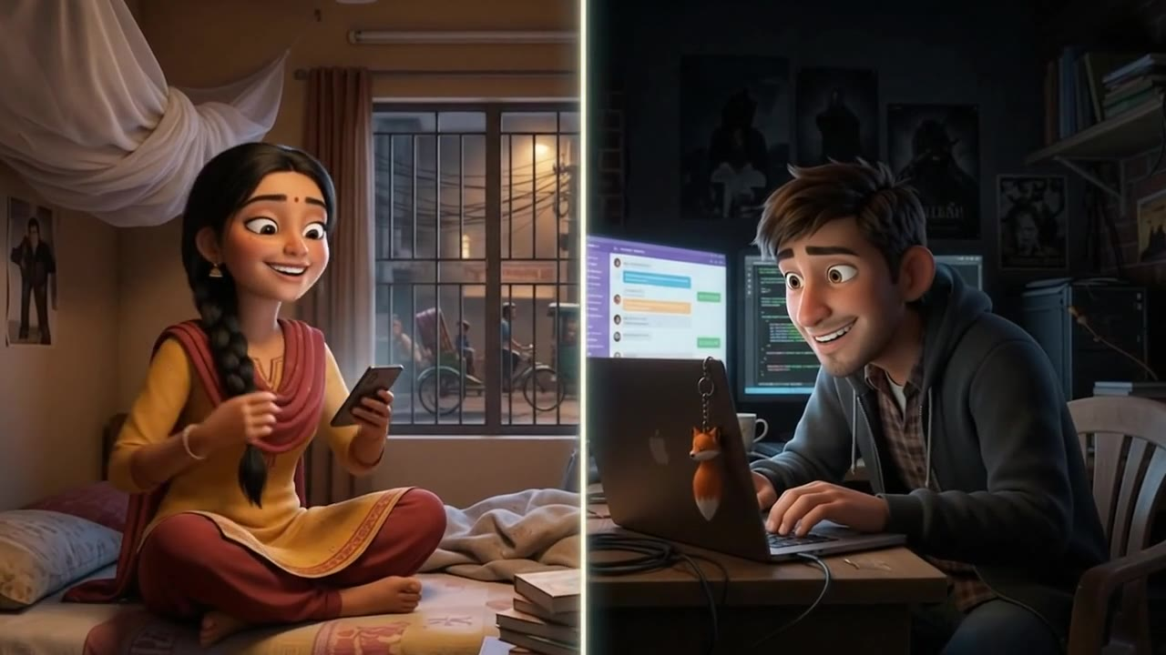
THE STORY · TONIGHT IN DHAKA
MEET Sparrow, a 21-year-old student · Fox, a hacker she has never met
Notes:
SPEAKER: AHNAF AKIF (Roll 24) · about 12 seconds
▶ THE STORY · TONIGHT IN DHAKA
Tonight’s story has two characters: Sparrow, a 21-year-old student in Dhaka, and Fox, a hacker she has never met. Both are code names, but every step of their night happens to real students.

Slide 3
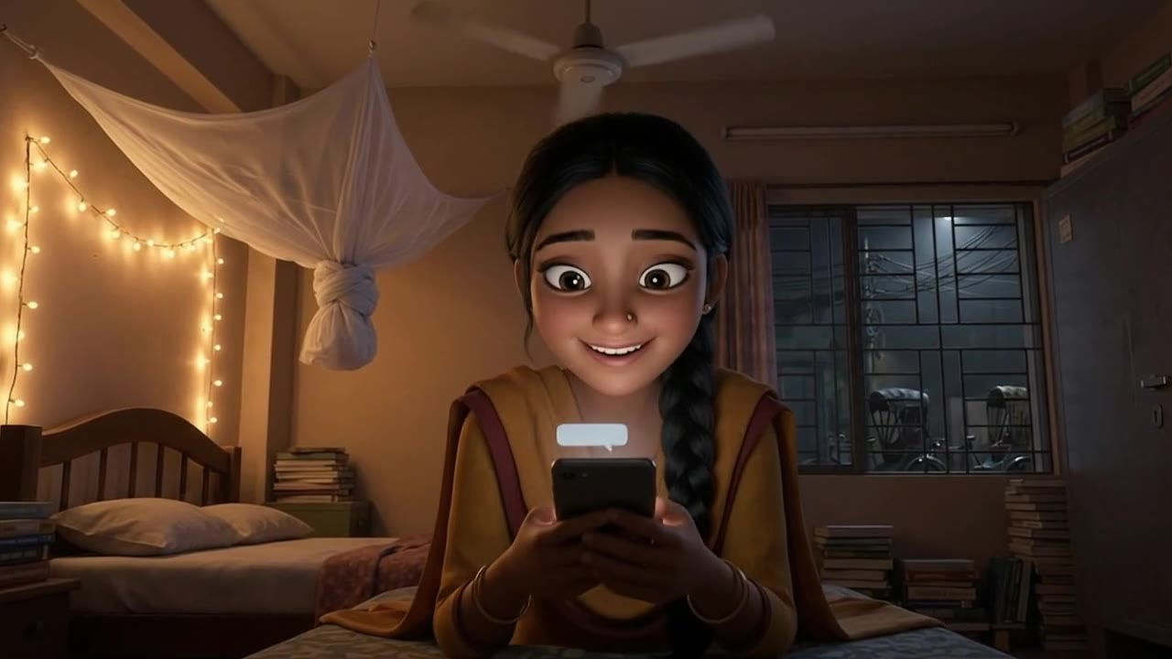
SCENE 1 · 11:47 PM · SPARROW
?
+880 1712-•••512
unknown number
Hi, it’s your classmate! I sent a 6-digit code to your number by mistake.
Can you send it to me? It’s urgent!
482 915 ✓✓
SPARROW A message from an unknown number asks for a code. She sends it.
Notes:
SPEAKER: AHNAF AKIF (Roll 24) · about 12 seconds
▶ SCENE 1 · 11:47 PM · SPARROW
It is 11:47 PM. Sparrow gets a WhatsApp message from an unknown number: “Hi, it’s your classmate. I sent a code to your number by mistake. Can you send it to me?” She types the code and sends it.

Slide 4
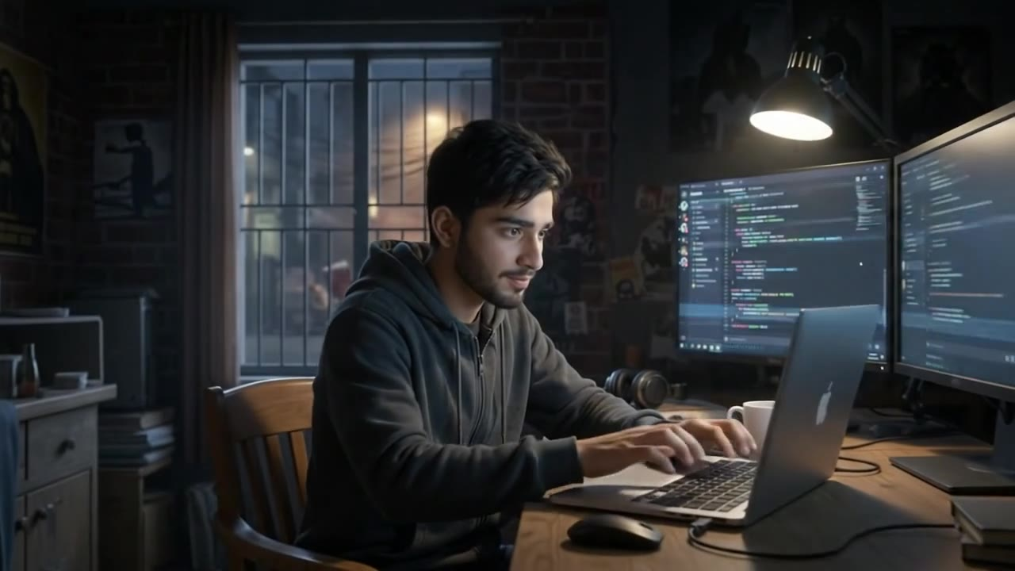
SCENE 2 · 11:48 PM · FOX
FOX · 11:48 PM
> Register Sparrow’s number on my phone
> Waiting for the 6-digit code…
< Code from Sparrow: 482 915
> Entering code… verified ✓
SPARROW’S WHATSAPP IS NOW ON MY PHONE
FOX Her code arrives on his screen. He types it in, and her WhatsApp moves to his phone.
Notes:
SPEAKER: AHNAF AKIF (Roll 24) · about 12 seconds
▶ SCENE 2 · 11:48 PM · FOX
On the other side of the city, Fox is waiting. He has asked WhatsApp to move Sparrow’s number to his own phone. All he needs is the code. The moment she sends it, he types it in.

Slide 5
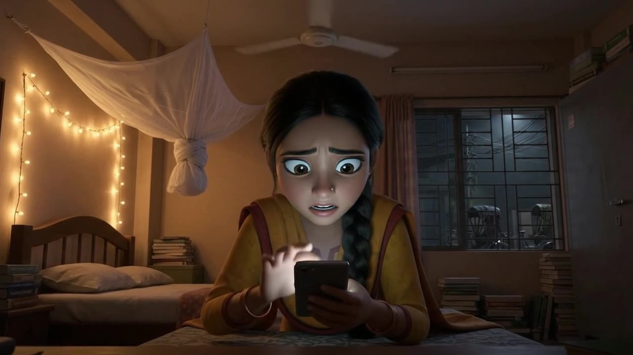
SCENE 3 · 11:49 PM · SPARROW
?
WhatsApp
this phone
Your phone number is no longer registered with WhatsApp on this phone.
It was verified on another phone at 11:49 PM.
Verify again
SPARROW Two minutes later, she is logged out of her own WhatsApp.
Notes:
SPEAKER: AHNAF AKIF (Roll 24) · about 12 seconds
▶ SCENE 3 · 11:49 PM · SPARROW
Two minutes later, Sparrow’s phone tells her that her number is no longer registered on this phone. Her WhatsApp now belongs to Fox.

Slide 6

?
+880 1712-•••512
unknown number
11:47 PM · DHAKA · AN ORDINARY WEEKNIGHT
11:47 PM
One message.
One night.
Five doors.
Hi, it’s your classmate! I sent a 6-digit code to your number by mistake. Can you send it to me? It’s urgent!
482 915 11:49 ✓✓
Sparrow, a 21-year-old student, gets a message from an unknown number pretending to be a classmate. She sends the code.
Your WhatsApp account is now registered on another phone.
Sparrow has been logged out.
Sparrow is not a real person, but what happens to her tonight happens to real students in Bangladesh every week.
Notes:
[Speak slowly.] So that is how it starts. It is 11:47 on a normal weeknight in Dhaka. One message from an unknown number, pretending to be a classmate: “I sent a six-digit code to your number by mistake. Can you send it to me?” It looks harmless, so Sparrow sends the code. Two minutes later, her WhatsApp is no longer hers. [Pause.] Sparrow is not a real person, but everything that happens to her tonight happens to real students in Bangladesh every week. Over the next few minutes, we follow Fox, the hacker who sent that message, through five doors into her life: WhatsApp, Gmail, Facebook, Instagram and bKash. At each door I ask one question: was the lock strong, or did it leak?

Slide 7
In 81 minutes, one shared code cost Sparrow four accounts
11:49 PM
11:58 PM
12:20 AM
12:35 AM
1:10 AM
WhatsApp
Shares the code. No two-step PIN, so WhatsApp is hijacked
bKash
Her aunt gets an “urgent” bKash money request
Gmail
A fake “copyright” page steals her reused password
Facebook
Password reset through Gmail; recovery details swapped
Instagram
Private messages read and used for blackmail
81 minutes · 4 accounts
59% of hacking victims were women
78.78% were aged 18 to 30
Only 12% went to the police
Cyber Crime Awareness Foundation study, 2024 (Dhaka Tribune, 2024)
Notes:
Here is how Sparrow’s night unfolded. [Follow the timeline left to right.] 11:49: she shares the code. She never set a two-step PIN, so Fox takes her WhatsApp. 11:58: her aunt receives a message from “Sparrow” asking her to send bKash money urgently. 12:20: Fox sends her a fake “Facebook copyright violation” link. She logs in on the fake page, and she uses the same password for Gmail. 12:35: from her Gmail, Fox resets her Facebook password and replaces her recovery email and phone number. 1:10: Instagram falls next, and her private messages are used to blackmail her. 81 minutes. Four accounts. [Point to the bottom row.] And this is not just a story. In the Cyber Crime Awareness Foundation’s 2024 study, hacking was the most common cybercrime. 59 percent of victims were women, 78.78 percent were aged 18 to 30, and only 12 percent went to the police.

Slide 8
I retraced Fox’s path and tested every lock
BREACHED
BREACHED
BREACHED
BREACHED
AT RISK
WhatsApp
Gmail
Facebook
Instagram
bKash
11:49 PM
12:20 AM
12:35 AM
1:10 AM
11:58 PM
FIVE LOCK TESTS · EACH SCORED 1 TO 5 · A PERFECT DOOR SCORES 25
1
2
3
4
5
Login protection
Is a stolen password enough?
Encryption by default
Can the company read it?
Threat alerts
Will it warn me?
Recovery safety
Can I be locked out for good?
Privacy controls
Can strangers reach me?
Notes:
So I became an investigator. I retraced Fox’s path through Sparrow’s five accounts, the five doors you see at the top. Four were breached that night. The fifth, bKash, was put at risk: Fox used her hacked WhatsApp to ask her friends for bKash money. For each platform, I opened the security settings on my own phone and checked them against official help pages and recent news. Then I tested each door with the same five lock tests. [Point to the bottom row.] Can a stolen password alone get in? Can the company read my messages? Will it warn me about an attack? Can a hacker lock me out permanently? And can strangers find and contact me? Each test is scored from 1 to 5, so a perfect door scores 25. Let us start where the attack started: WhatsApp, at 11:49.

Slide 9

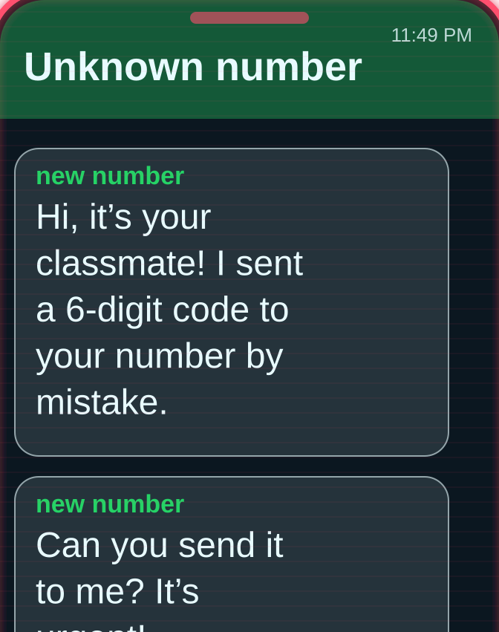
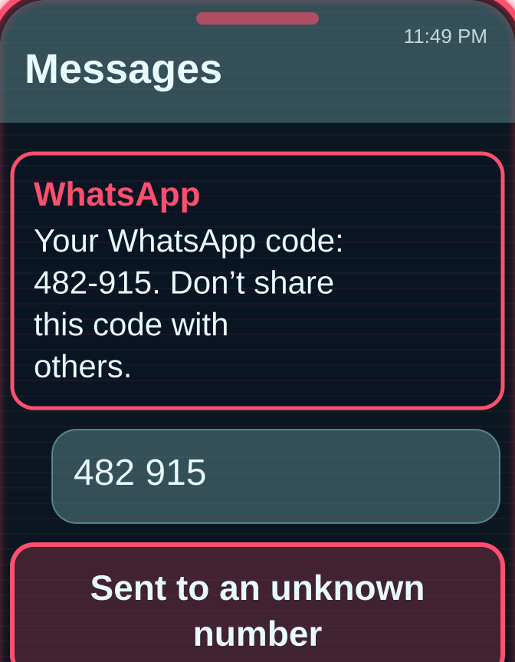
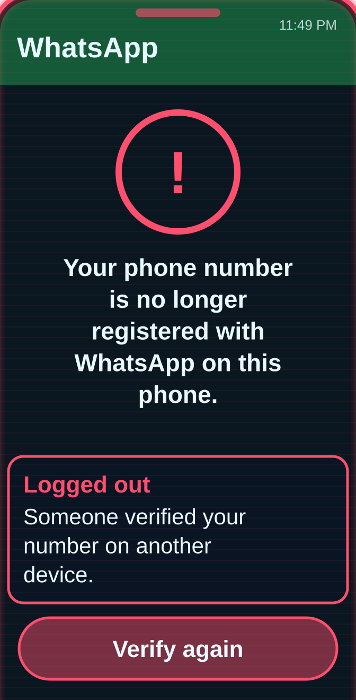
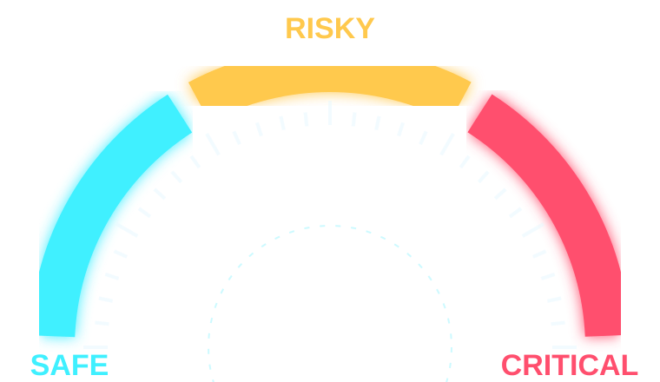

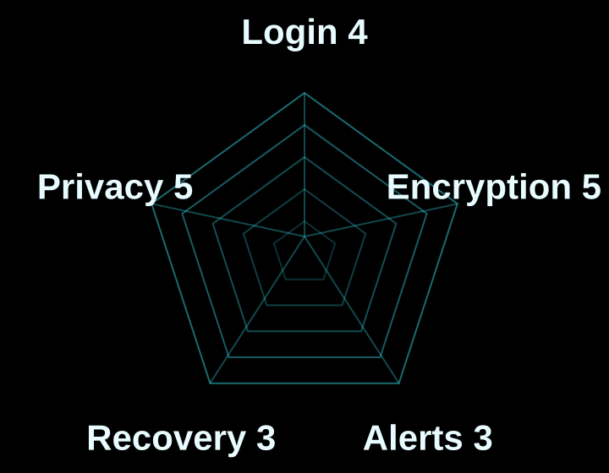

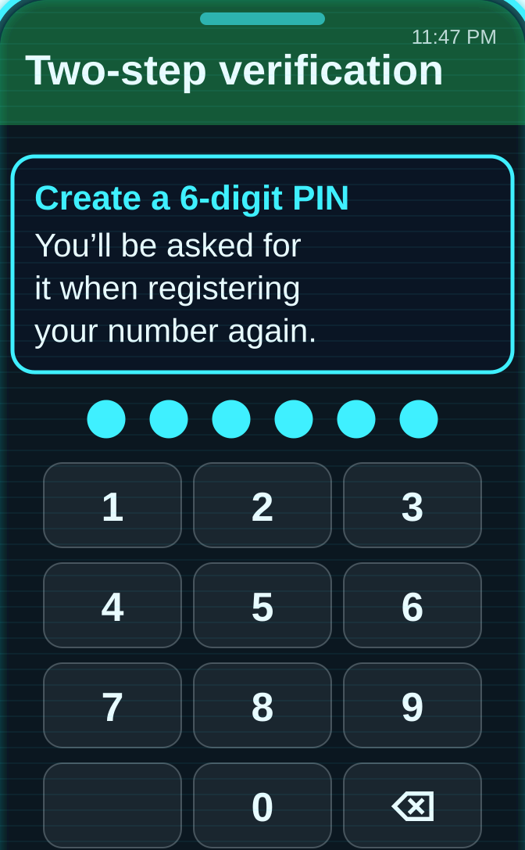
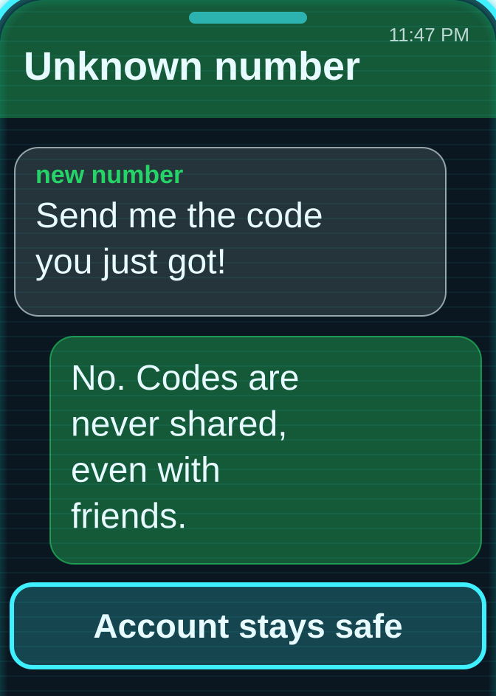
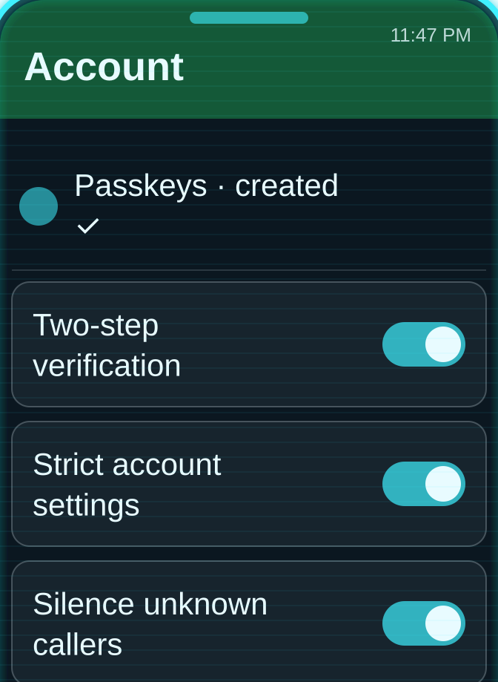
Door 1 – WhatsApp: the strongest lock, opened from the inside
HOW IT WAS HACKED · 11:49 PM
THREAT LEVEL
01
02
03
CRITICAL · hacked at 11:49 PM
An unknown number asks for the code
Sparrow sends the code
No PIN set: WhatsApp moves to his phone
SAFE · after the fixes
SECURITY RADAR · 20 / 25
HOW TO SECURE IT
01
02
03
Set a two-step PIN
Never share a code, even with friends
Add a passkey + Strict Account Settings
Platform fix: a Bangla warning whenever a code is requested, and a two-step PIN for every new account
Notes:
Door one: WhatsApp, 11:49 PM. Score: 20 out of 25, joint highest. [Red boxes 01–03: how it was hacked.] Here is the irony. WhatsApp has the strongest lock of all five. Every personal chat and call is end-to-end encrypted by default; not even WhatsApp can read them. That encryption never broke. Sparrow opened the door from the inside by handing over the code. [Cyan boxes 01–03: how to secure it.] And WhatsApp offered more locks she never used: a six-digit two-step PIN, which would have stopped this attack completely; passkeys; passkey-protected backups since October 2025; and since January 2026, Strict Account Settings, a one-tap lockdown. [Platform fix strip.] My recommendation: when someone requests a registration code, show a clear warning in Bangla, and make the two-step PIN mandatory for new accounts. With WhatsApp gone, Fox moved to the master key.

Slide 10
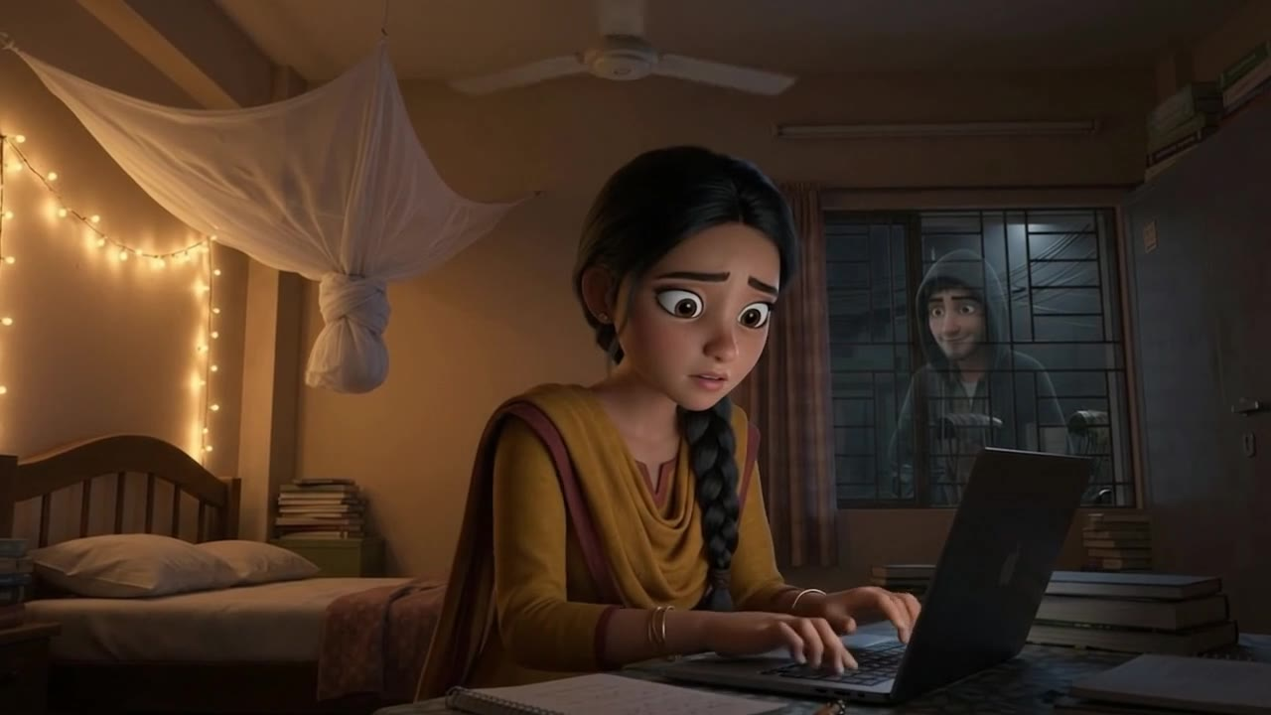
SCENE 4 · 12:20 AM · SPARROW
faceb00k-appeal-center.net
⚠ Not secure faceb00k-appeal-center.net/copyright
Copyright Appeal Center
⚠ Copyright violation: your page will be removed in 24 hours. Log in to appeal.
Email
sparrow.21@gmail.com
Password
●●●●●●●●●●●
Log in to appeal
SPARROW A fake “copyright” page asks her to log in. She types her password.
Notes:
SPEAKER: AHNAF AKIF (Roll 24) · about 12 seconds
▶ SCENE 4 · 12:20 AM · SPARROW
At 12:20, an email warns of a copyright violation on her page. She clicks the link and logs in on a fake page, using the same password she uses for Gmail.

Slide 11

SCENE 5 · 12:20 AM · FOX
FOX · FAKE PAGE · NEW LOGIN
● New login captured · 12:20 AM
Email: sparrow.21@gmail.com
Password: sparrow2003
> Trying the same password on Gmail…
✓ It works. 2-Step Verification: OFF
GMAIL: OPEN
FOX He sees her password the moment she types it. It also opens her Gmail.
Notes:
SPEAKER: AHNAF AKIF (Roll 24) · about 12 seconds
▶ SCENE 5 · 12:20 AM · FOX
The fake page belongs to Fox. The moment Sparrow presses log in, her email and password appear on his screen. He tries the same password on Gmail. It works, and 2-Step Verification is off.

Slide 12
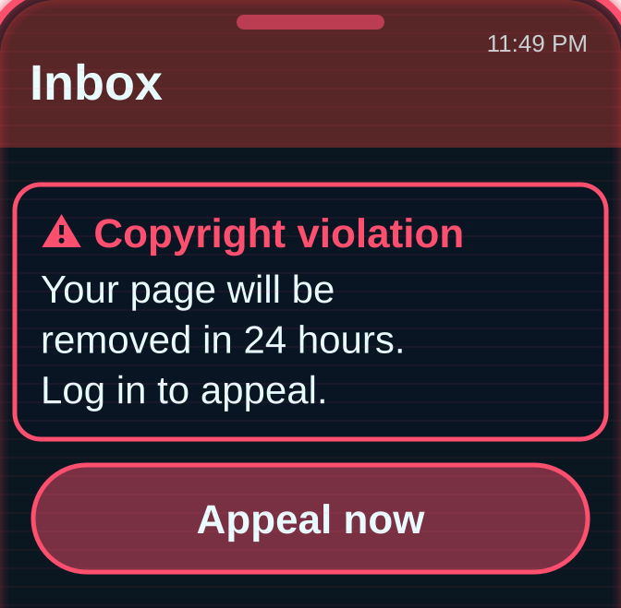
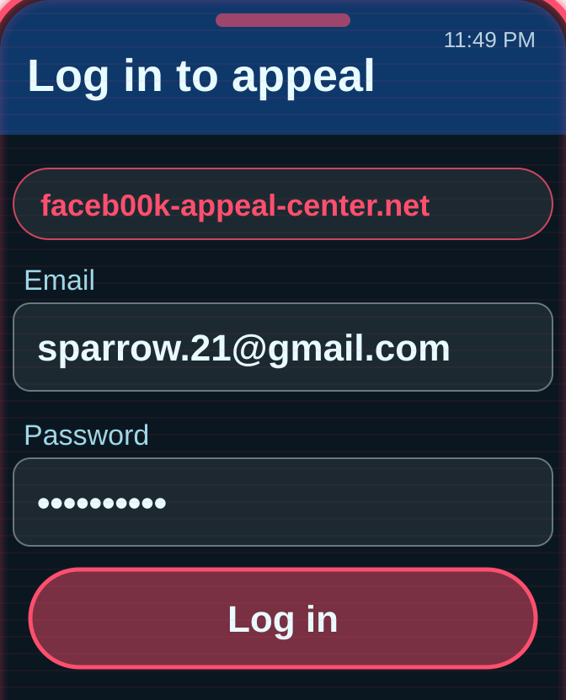
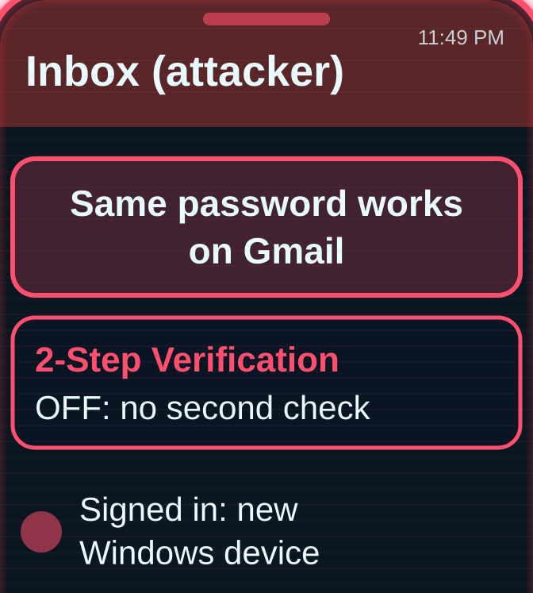
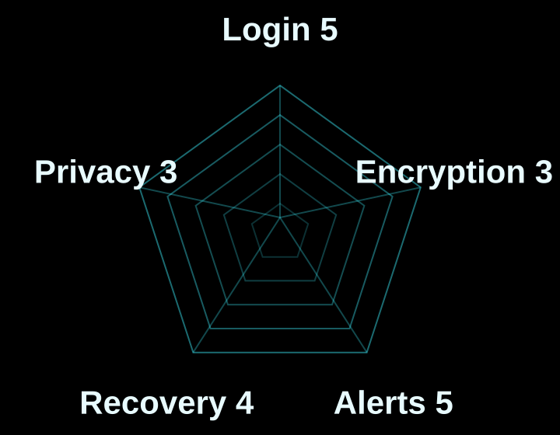

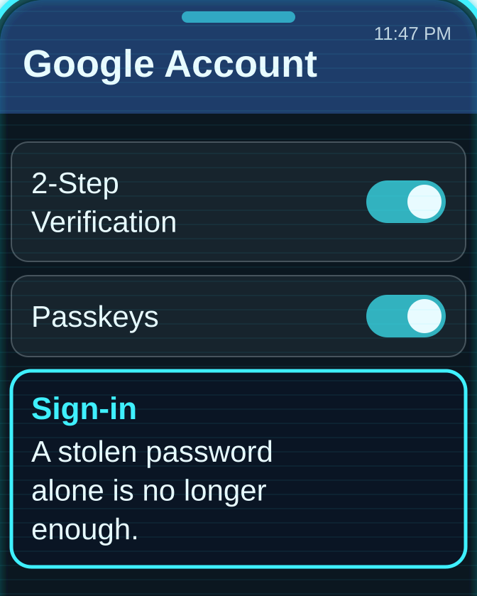
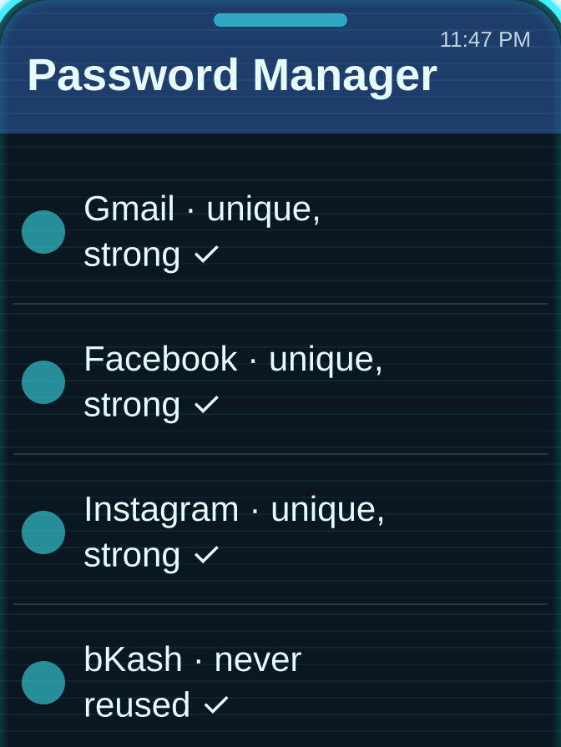
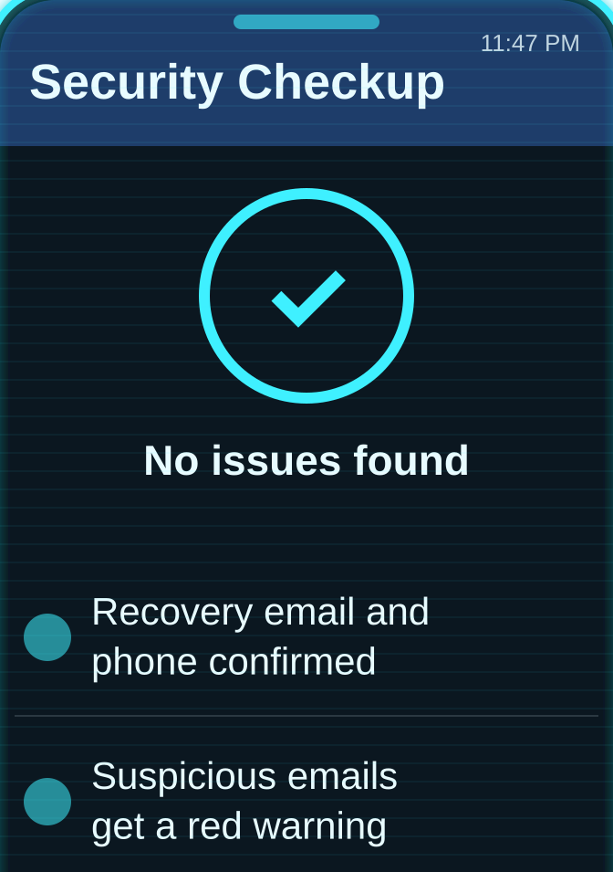
Door 2 – Gmail: the master key that opens every other door
HOW IT WAS HACKED · 12:20 AM
THREAT LEVEL
01
02
03
CRITICAL · hacked at 12:20 AM
A fake “copyright” page asks her to log in
She types her reused password
No 2-Step Verification: he is in
SAFE · after the fixes
SECURITY RADAR · 20 / 25
HOW TO SECURE IT
01
02
03
Turn on 2-Step Verification or a passkey
A different password for every account
Run Google’s Security Checkup
Platform fix: warnings for fake bKash, Nagad and bank emails, because Gmail can reset every other account
Notes:
Door two: Gmail, 12:20 AM. Score: 20 out of 25, tied for first. [Red boxes 01–03: how it was hacked.] Fox sent Sparrow a fake “copyright violation” page. She typed in her password, the same password she used for Gmail. She had never switched on 2-Step Verification. [Cyan boxes 01–03: how to secure it.] That is painful, because Gmail has the best login protection I tested. Passkeys have been the default sign-in since October 2023. There is 2-Step Verification, an Advanced Protection Program, and Google says Gmail blocks more than 99.9 percent of phishing and malware. Why does Gmail matter so much? Because every “forgot password” link, for Facebook, Instagram, even bKash, goes to your email. Gmail is the master key. [Platform fix strip.] I recommend warnings for emails imitating bKash, Nagad or local banks. And with the master key, the next door opened easily.

Slide 13
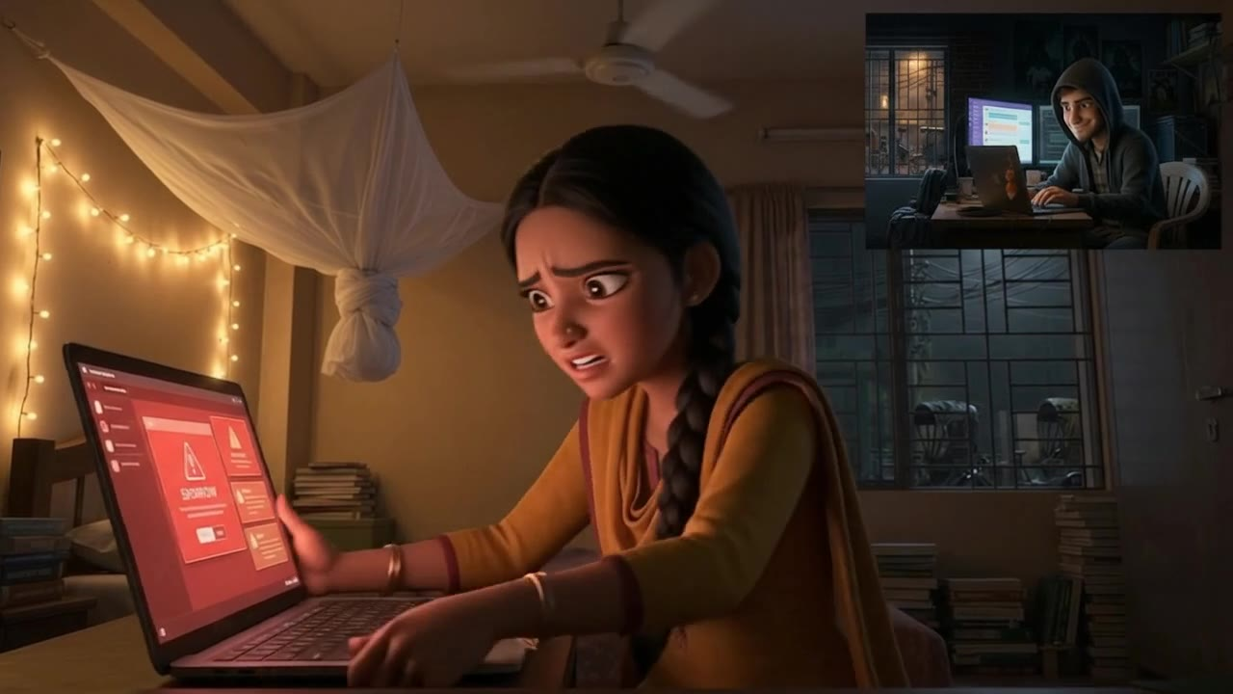
SCENE 6 · 12:35 AM · SPARROW
Facebook · Log in
⚠ Not secure facebook.com/login
Email
sparrow.21@gmail.com
Password
●●●●●●●●●●●
The password you’ve entered is incorrect.
Recovery email changed to f0x•••@mail.com at 12:35 AM
Sparrow is locked out of her own account.
SPARROW Fox resets her Facebook password and changes her recovery email.
Notes:
SPEAKER: AHNAF AKIF (Roll 24) · about 12 seconds
▶ SCENE 6 · 12:35 AM · SPARROW
At 12:35, Fox uses her Gmail to reset her Facebook password, then changes her recovery email. When Sparrow tries to log in, she is locked out.

Slide 14
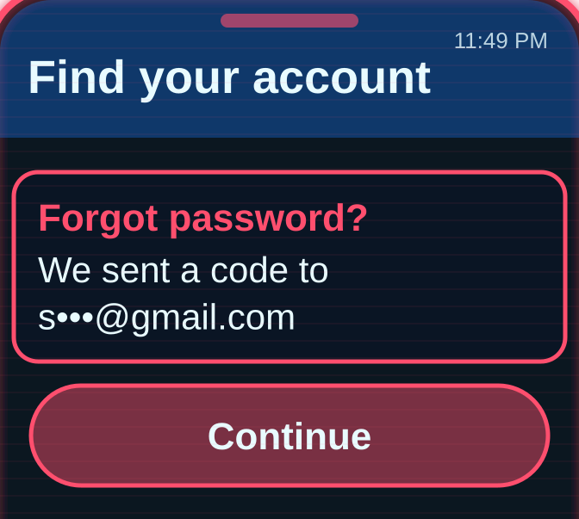
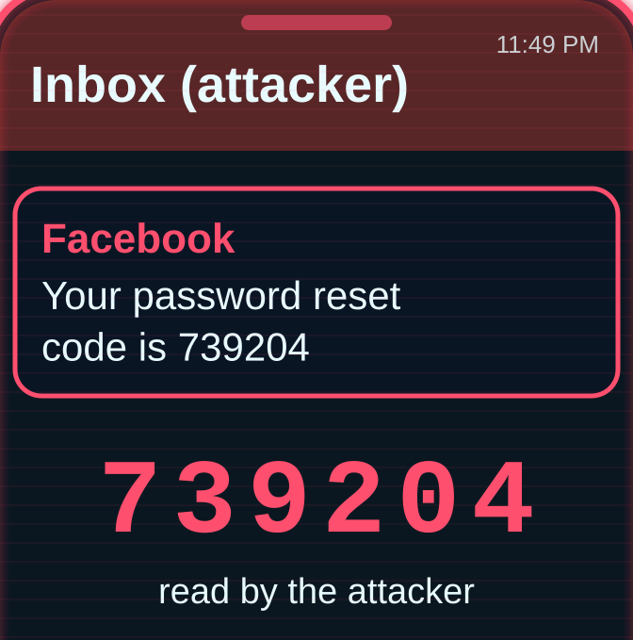
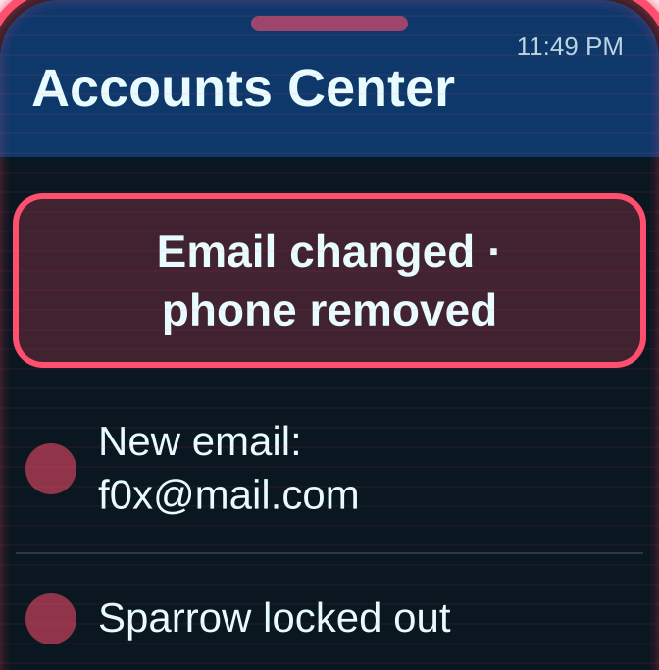
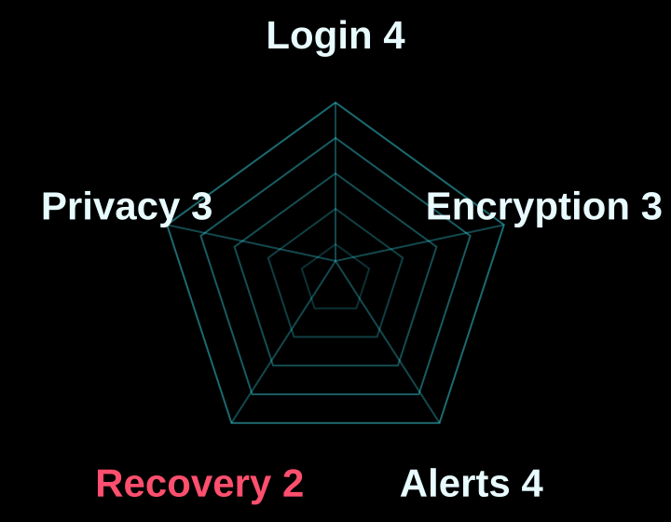

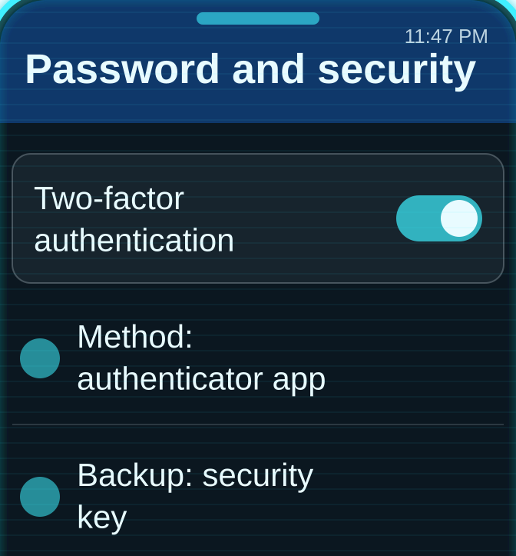
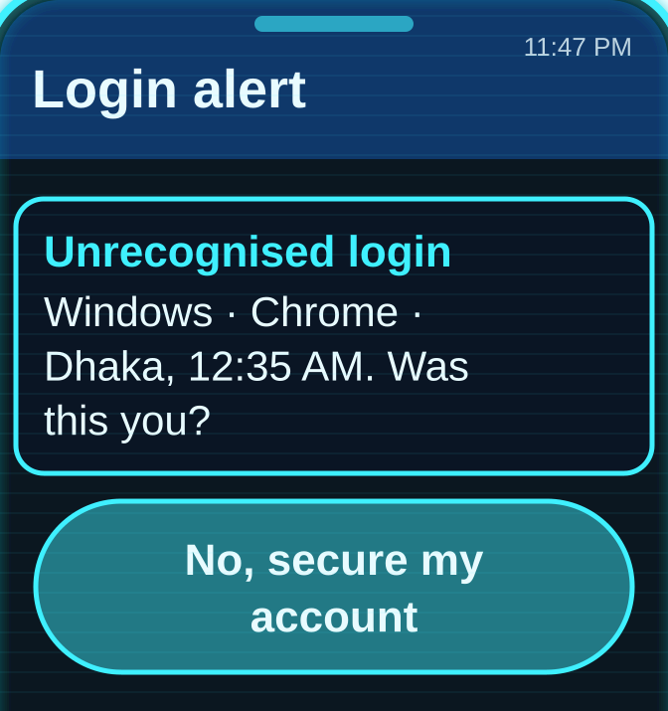
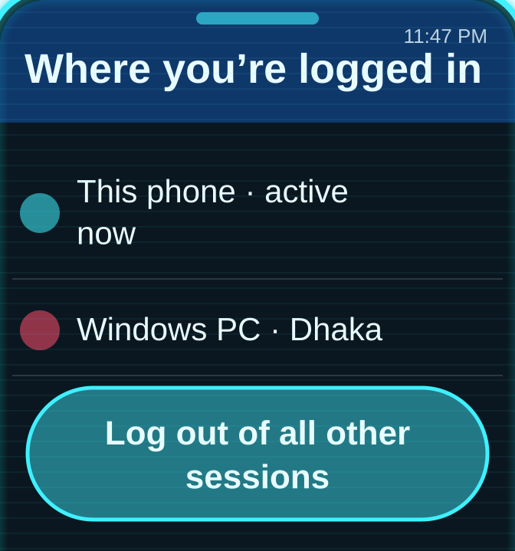
Door 3 – Facebook: strong locks, but Fox changed them
HOW IT WAS HACKED · 12:35 AM
THREAT LEVEL
01
02
03
CRITICAL · hacked at 12:35 AM
“Forgot password” link goes to hacked Gmail
He resets the Facebook password
Recovery email and phone are swapped
SAFE · after the fixes
SECURITY RADAR · 16 / 25
HOW TO SECURE IT
01
02
03
2FA with an app or a security key
Login alerts + “Where you’re logged in”
Keep recovery email and phone up to date
Platform fix: a 48-hour wait before a new email, phone number or 2FA change takes effect
Notes:
Door three: Facebook, 12:35 AM. Score: 16 out of 25. [Red boxes 01–03: how it was hacked.] With Gmail in hand, Fox clicked “forgot password” on Facebook, received the reset link, and then did what every attacker does first: replaced Sparrow’s recovery email and phone number. By morning, Facebook believed he was Sparrow. [Cyan boxes 01–03: how to secure it.] Facebook actually has good locks: two-factor authentication through SMS, an app or a security key; login alerts; “Where you’re logged in”; Security Checkup; and passkeys. But a lock only helps if it is switched on. [Score bars.] Its weakest score is recovery safety, just 2 out of 5, shown in red. Changing recovery details takes minutes; getting your account back can take weeks. [Platform fix strip.] I propose a 48-hour wait before a new email, phone number or 2FA change takes effect.

Slide 15
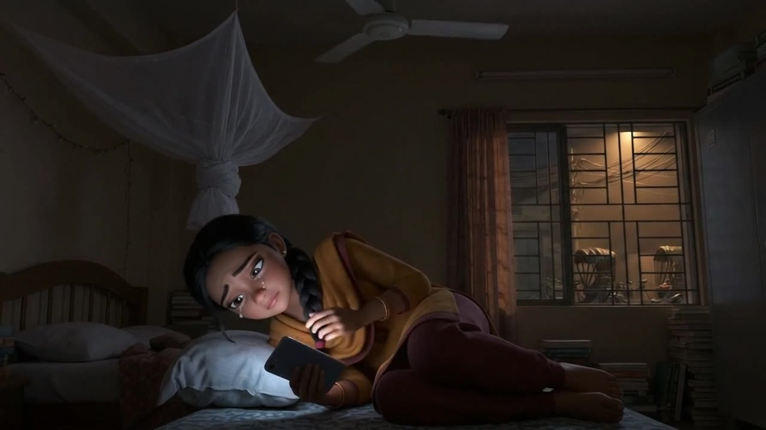
SCENE 7 · 1:10 AM · SPARROW
?
unknown_account
Instagram · message
I have all your private chats.
Send 20,000 tk, or I share them with everyone.
This is blackmail. Don’t pay. Report it.
SPARROW Fox reads her private messages and threatens to share them.
Notes:
SPEAKER: AHNAF AKIF (Roll 24) · about 12 seconds
▶ SCENE 7 · 1:10 AM · SPARROW
At 1:10, Fox opens her Instagram, reads her private messages, and threatens to share them unless she pays.

Slide 16
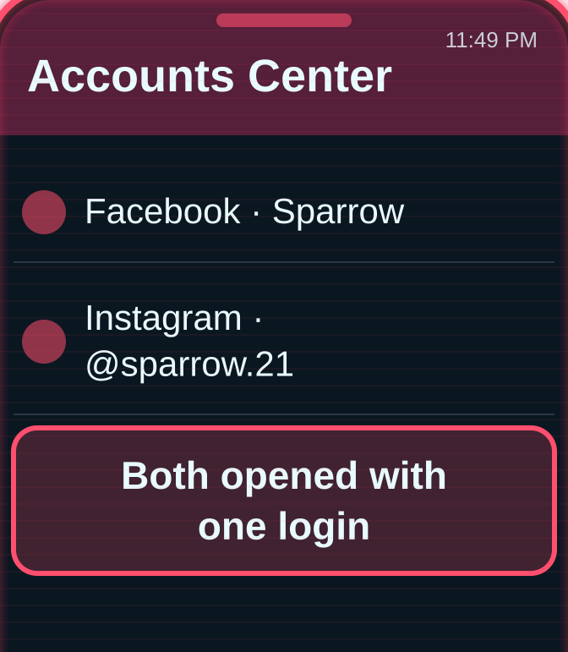
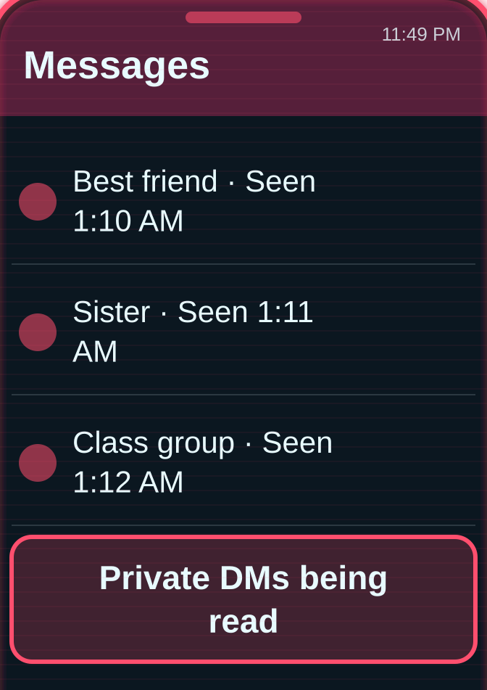
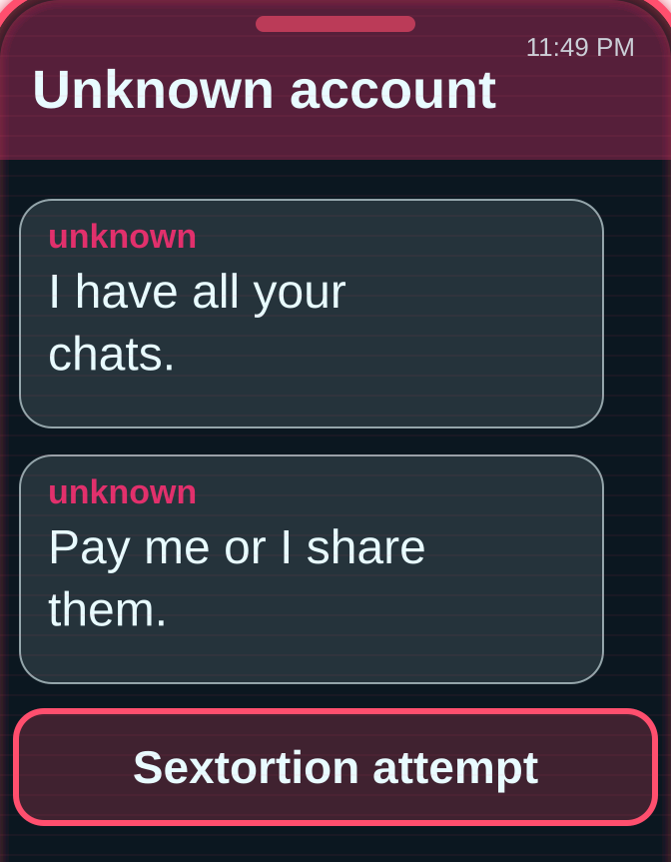
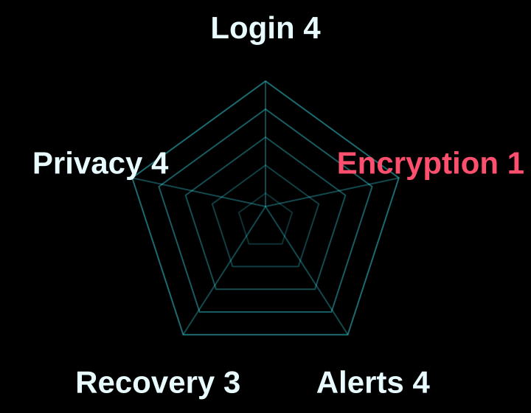

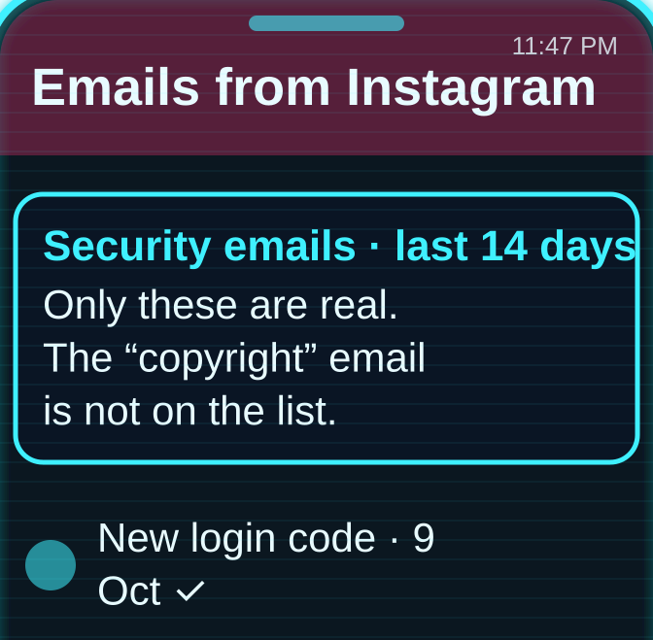
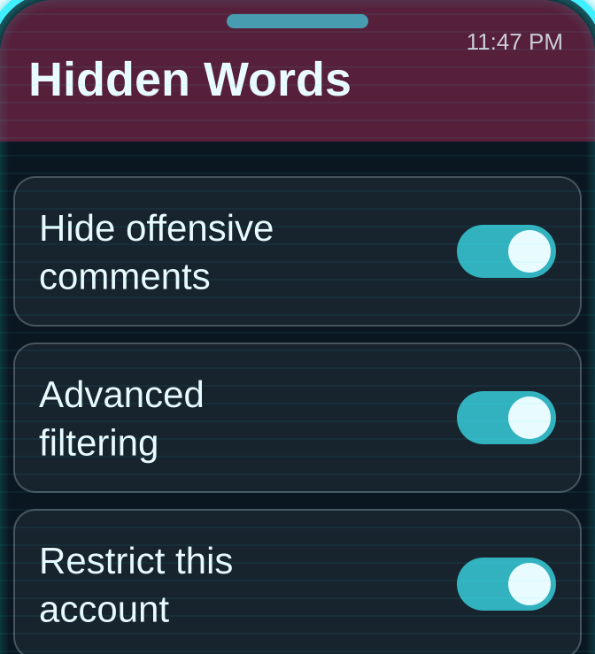
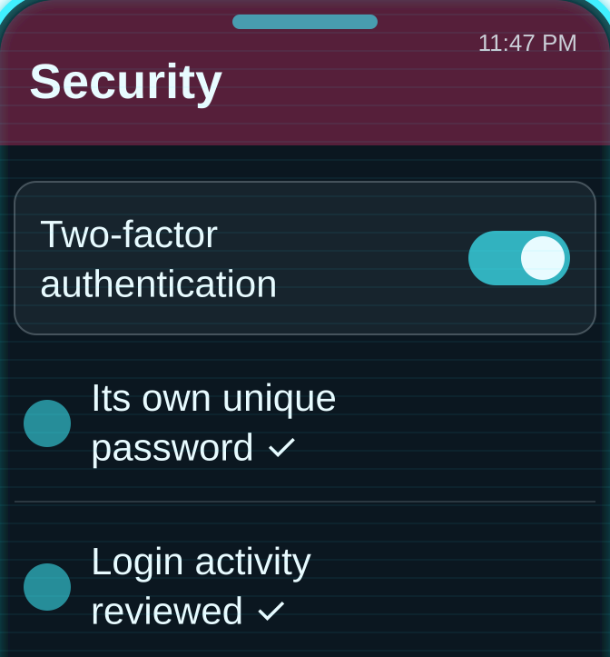
Door 4 – Instagram: her private messages were never truly private
HOW IT WAS HACKED · 1:10 AM
THREAT LEVEL
01
02
03
CRITICAL · hacked at 1:10 AM
Linked to Facebook through Accounts Center
Her private DMs are read
The messages are used for blackmail
SAFE · after the fixes
SECURITY RADAR · 16 / 25
HOW TO SECURE IT
01
02
03
Check “Emails from Instagram” for real alerts
Use Restrict and Hidden Words
Its own password + 2FA
Platform fix: end-to-end encrypted DMs by default, and blurred explicit images
Notes:
Door four: Instagram, 1:10 AM. Score: 16 out of 25. [Red boxes 01–03: how it was hacked.] Sparrow’s Instagram was linked to her Facebook through Meta’s Accounts Center, so it fell next. Fox scrolled through her private messages, and those messages became blackmail material. This is how sextortion usually begins. [Score bars.] Look at encryption: 1 out of 5, in red. On 8 May 2026 Meta removed even the optional encrypted chats, so Meta can access the content of private messages. [Cyan boxes 01–03: how to secure it.] To be fair, Instagram has useful tools. My favourite is “Emails from Instagram”: it lists the real security emails Instagram sent in the last 14 days. Remember the fake “copyright” email at 12:20? This feature would have exposed it. [Platform fix strip.] My recommendation: end-to-end encrypted DMs by default, and blurred explicit images.

Slide 17
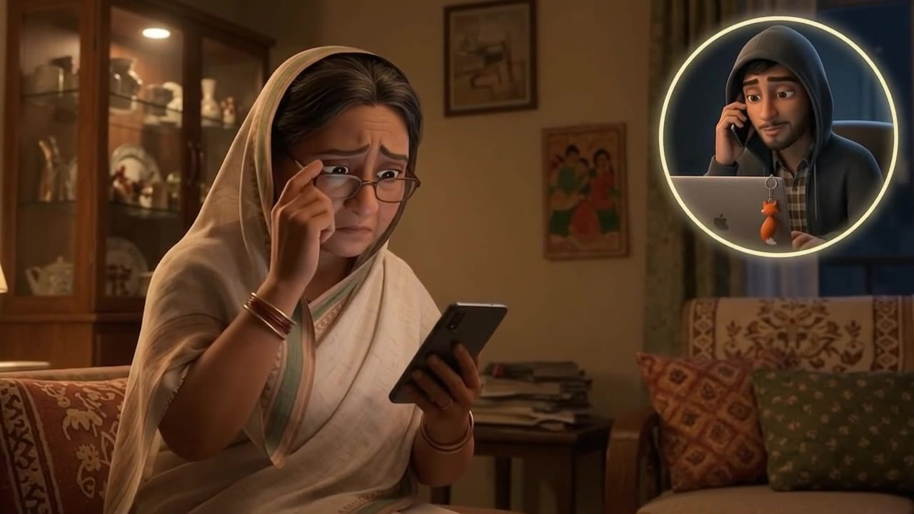
SCENE 8 · 11:58 PM · HER AUNT
S
Sparrow
online
Khala, urgent! Please send 5,000 tk to this bKash number: 01•••-••••47
I’ll return it tomorrow. Please don’t call, I’m in class.
Written by Fox, from Sparrow’s hacked WhatsApp
HER AUNT A message “from Sparrow” asks for bKash money. It was Fox.
Notes:
SPEAKER: AHNAF AKIF (Roll 24) · about 12 seconds
▶ SCENE 8 · 11:58 PM · HER AUNT
And back at 11:58, using her hacked WhatsApp, Fox messaged her aunt as Sparrow: urgent, please send 5,000 taka on bKash.

Slide 18
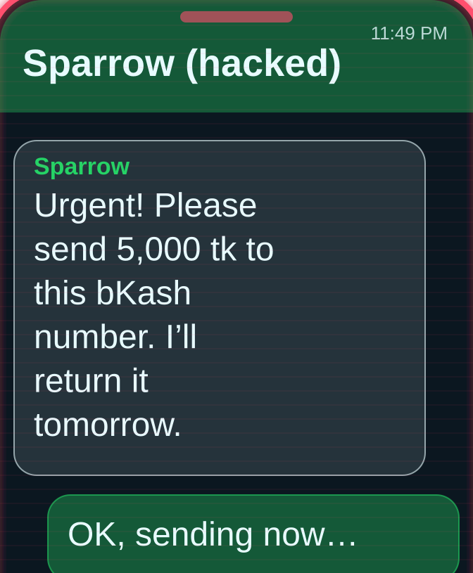
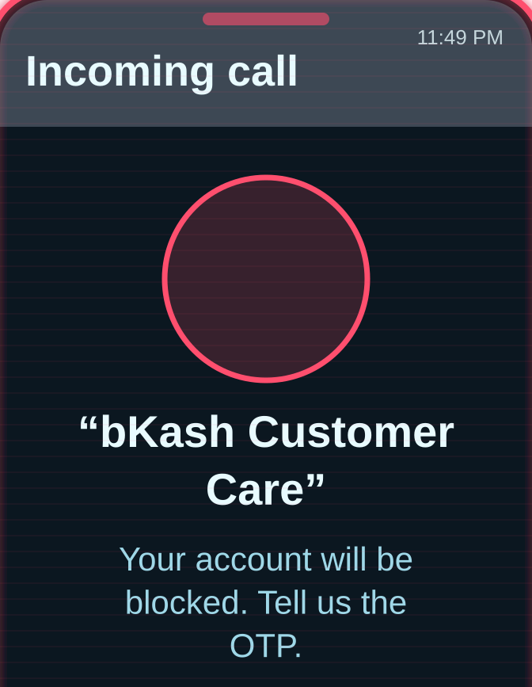
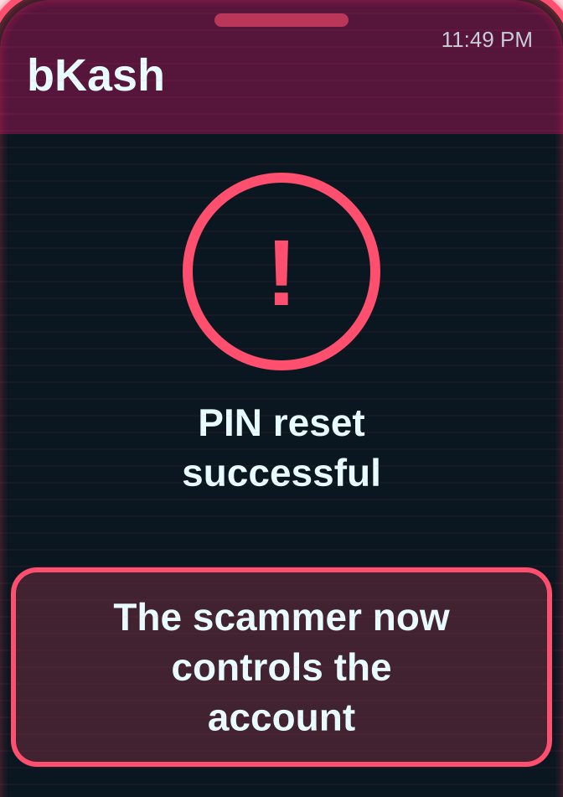


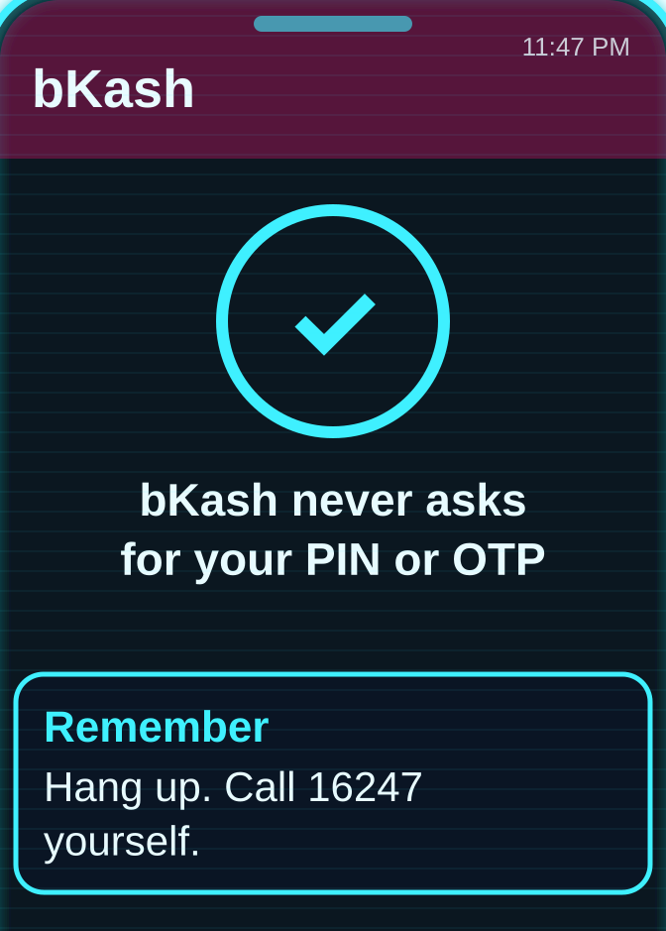
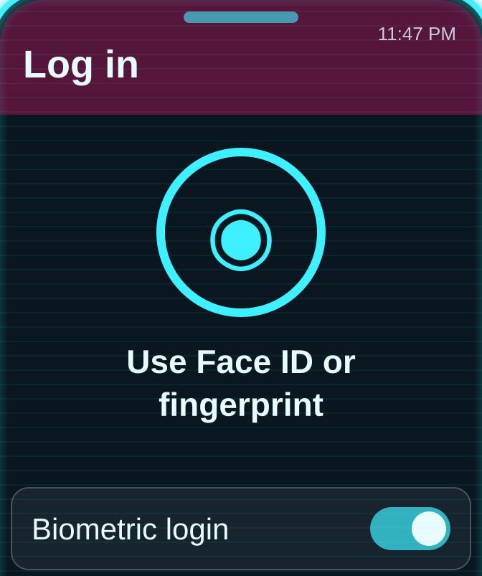
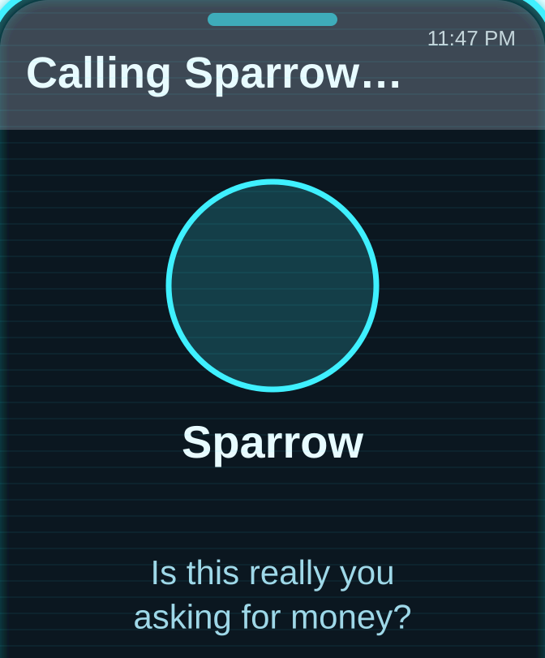
Door 5 – bKash: a strong lock, but the scammer asks you for the key
HOW THE SCAM WORKS · 11:58 PM
THREAT LEVEL
01
02
03
HIGH RISK · scam at 11:58 PM
Hacked WhatsApp asks friends for bKash money
A call “from bKash” asks for her OTP
Reading out the OTP lets him reset her PIN
SAFE · after the fixes
SECURITY RADAR · 15 / 25
HOW TO SECURE IT
01
02
03
Never share an OTP or PIN: bKash never asks
Log in with Face ID or fingerprint
Call friends back before sending money
Platform fix: a separate warning for PIN-reset codes, and a short hold on transfers after a PIN reset code is sent
Notes:
Door five: bKash. Score: 15 out of 25, the lowest. [Red boxes 01–03: how it was hacked.] At 11:58, while Sparrow was still locked out, her aunt and friends started getting “urgent” messages from her WhatsApp asking them to send bKash money. Then a call came “from bKash”, asking her to read out an OTP. [Cyan boxes 01–03: how to secure it.] bKash itself has a solid lock: an OTP on first login, a PIN for every login and transaction, and Face ID and fingerprint login since December 2023. Its biggest weakness is the user: scammers pretend to be an agent or a bKash official and trick people into reading out the OTP code. Police have arrested gangs running exactly these scams. [Platform fix strip.] I recommend a separate warning when a PIN-reset code is requested, and a short hold on transfers after a reset code is sent, so scammers cannot empty the account in minutes.

Slide 19
Rewind: which locks held? WhatsApp is the most secure by default
WhatsApp
20
Most secure by default: WhatsApp
Encryption is on from install; it was never broken
Gmail
20
Facebook
16
Protect first: Gmail
The master key: once it fell, two more doors followed
Instagram
16
bKash
15
Lowest: bKash
Scammers target the user, not the app
Total score out of 25
Not a single lock was broken. Every door was opened from the inside.
Notes:
Let us rewind the night and put all five doors side by side. [Chart.] WhatsApp and Gmail tie at the top with 20. Facebook and Instagram score 16, and bKash is last with 15. So which platform is the most secure for an ordinary person? I chose WhatsApp. Its strongest lock, end-to-end encryption, is switched on from the moment you install it, with no setup. In Sparrow’s story, it was never broken; she opened it herself. [Second card.] Gmail deserves the most protection, because it is the master key. Once it fell at 12:20, Facebook and Instagram followed within an hour. [Third card.] And bKash reminds us that scammers target the user, not the app. [Banner.] Here is the most important finding: in Sparrow’s story, not a single lock was broken. Every door was opened because a lock was switched off, or a code was handed over.

Slide 20
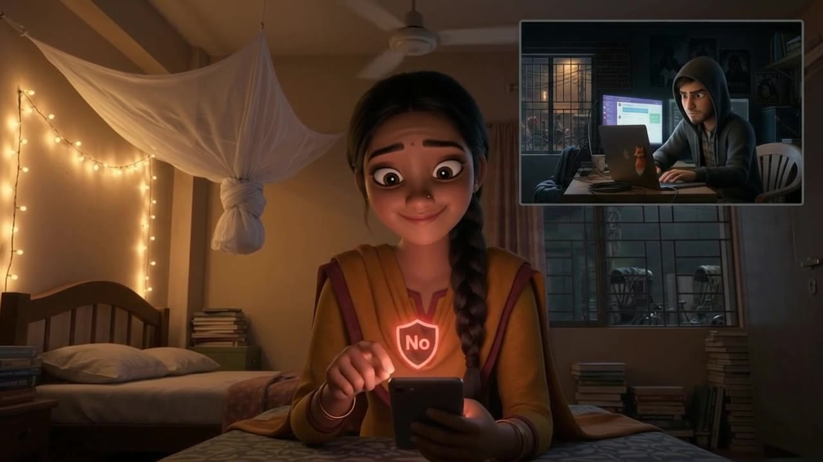
REPLAY · 11:47 PM · SAME NIGHT
?
+880 1712-•••512
unknown number
Hi, it’s your classmate! Can you send me the 6-digit code? It’s urgent!
No. I never share codes, not even with friends.
Two-step verification PIN: ON ✓
SPARROW Same message. This time she says no, and her two-step PIN is on.
Notes:
SPEAKER: AHNAF AKIF (Roll 24) · about 12 seconds
▶ REPLAY · 11:47 PM · SAME NIGHT
Now replay the night. Same message, same time. This time, Sparrow says no, and her two-step PIN is on. Fox gets nothing.

Slide 21
Replay the night: same night, different ending
BREACHED
11:49 PM
Set a WhatsApp two-step PIN
HIJACK BLOCKED
BREACHED
11:49 PM
Never share a code, even with friends
DOOR STAYS SHUT
BREACHED
12:20 AM
A unique password and a passkey on Gmail
MASTER KEY SAFE
BREACHED
12:35 AM
Check recovery email and phone; keep alerts on
TAKEOVER SPOTTED
BREACHED
1:10 AM
Log out devices you do not recognise
ATTACKER REMOVED
11:47 PM. The message arrives. This time, Sparrow says no.
The most secure app is the one you set up.
Notes:
So let us replay the night, with five small changes. [The red stamps flip one by one.] 11:49: if Sparrow had a two-step PIN on WhatsApp, the code alone would be useless. Hijack blocked. 11:49: if she knew never to share a code, not even with someone who says they are a classmate, the door stays shut. 12:20: with a unique password and a passkey on Gmail, the fake page steals nothing. The master key is safe. 12:35: with up-to-date recovery details and login alerts on, the takeover is spotted immediately. 1:10: by logging out of devices she does not recognise, she removes Fox. Each of these takes less than five minutes, and all of them already exist in the apps on your phone. [Pause. Let the line type itself out.] 11:47 PM. The message arrives. This time, Sparrow says no. The most secure app is the one you set up. Thank you; I am happy to take your questions.

