Slide 1














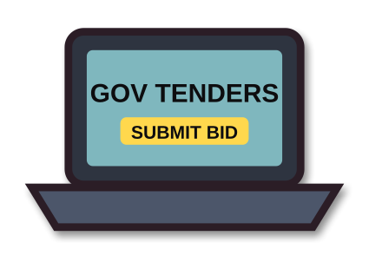





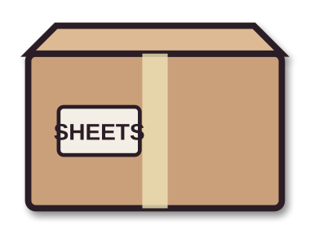



ACT I · THE HUSTLE · ▶ PLAYBACK
“They don’t fight the war. They just sell to it.”
SCENE 1 · MIAMI
SCENE 2 · AEY INC.
SCENE 3 · JORDAN → IRAQ
SCENE 4 · HIGH LIFE
A baby on the way… and no money.
UNSOLD · RETURNED
AEY INC. · MIAMI
DAVID
EFRAIM
NARRATOR
EFRAIM
DAVID
My bedsheet business flopped… and we have a baby on the way.
The Pentagon posts its “crumbs” online. Small contracts the big firms ignore. Join me.
Pistols stuck in Jordan. They fly out, hire local fixers and drive the shipment into Iraq.
New office, new cars. Welcome to the arms business, bro.
(to himself) …and I can’t tell Iz what we really sell.
Notes:
MEMBER 2 – Roll 08 – Jesmin Naher Sweety (about 38 seconds · no clicks)
[HOW IT PLAYS] Everything is automatic. Start reading as soon as the slide opens; each scene's animation starts by itself at the time shown, paced to a 38-second reading. If you run ahead or behind, just keep going: it catches up on the next scene. The dialogue box shows dramatised paraphrases, not quotes from the film.
[0:00 · Scene 1 plays]
Thank you, Nabin. Act One: the Hustle. Scene one: David is a broke massage therapist in Miami. His bedsheet business has failed, and his girlfriend is pregnant. He needs money, fast.
[≈ 0:10 · Scene 2 starts by itself]
Scene two: he meets his old friend Efraim, whose company AEY bids online for the "crumbs" of military procurement: small contracts the big defence companies ignore. David joins him.
[≈ 0:19 · Scene 3 starts by itself]
Scene three: a shipment of pistols gets stuck in Jordan, so they fly out, use local fixers and drive it into Iraq. It works, and they get paid.
[≈ 0:29 · Scene 4 starts by itself]
Scene four: the money flows. New office, new cars. And David starts lying to his partner about what he really does.
[When the yellow quote appears, pause.] Now let's freeze the frame.
[When you finish, CLICK ▶ next slide]

