Slide 1
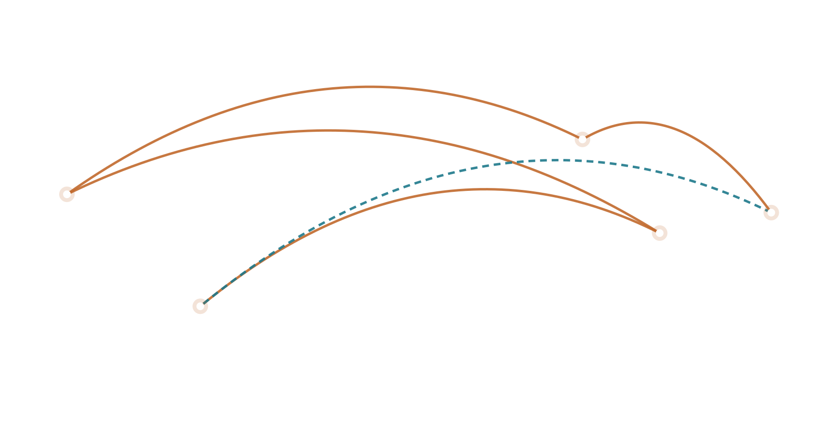
MCCJ 527 · ORGANIZED CRIME AND CORRUPTION
Follow the Bullet
War Dogs (2016) and the grey arms trade, one stop at a time
━━ the bullet ┅┅ the money
GROUP 6
Roll 27 · Roll 8 · Roll 37 · Roll 33 · Roll 24 · Roll 21
Department of Criminology, University of Dhaka
Notes:
MEMBER 1 – Roll 27 – [Name] (about 50 seconds)
[Hold up an imaginary bullet between two fingers.] Imagine one bullet. It was made in China decades ago, stored in a depot in Albania, sold through a broker on a terrorist watch list, repackaged to hide where it came from, and finally handed to a soldier in Afghanistan. And the money for it flowed all the way back to two young men in Miami.
Good morning. We are Group 6, and our film is War Dogs, from 2016. Today, instead of retelling the movie, we are going to follow the bullet, and follow the money, stop by stop. At every stop we will pause at a "criminology checkpoint" to see which concepts from our course are at work.
Let me show you the route.

Slide 2
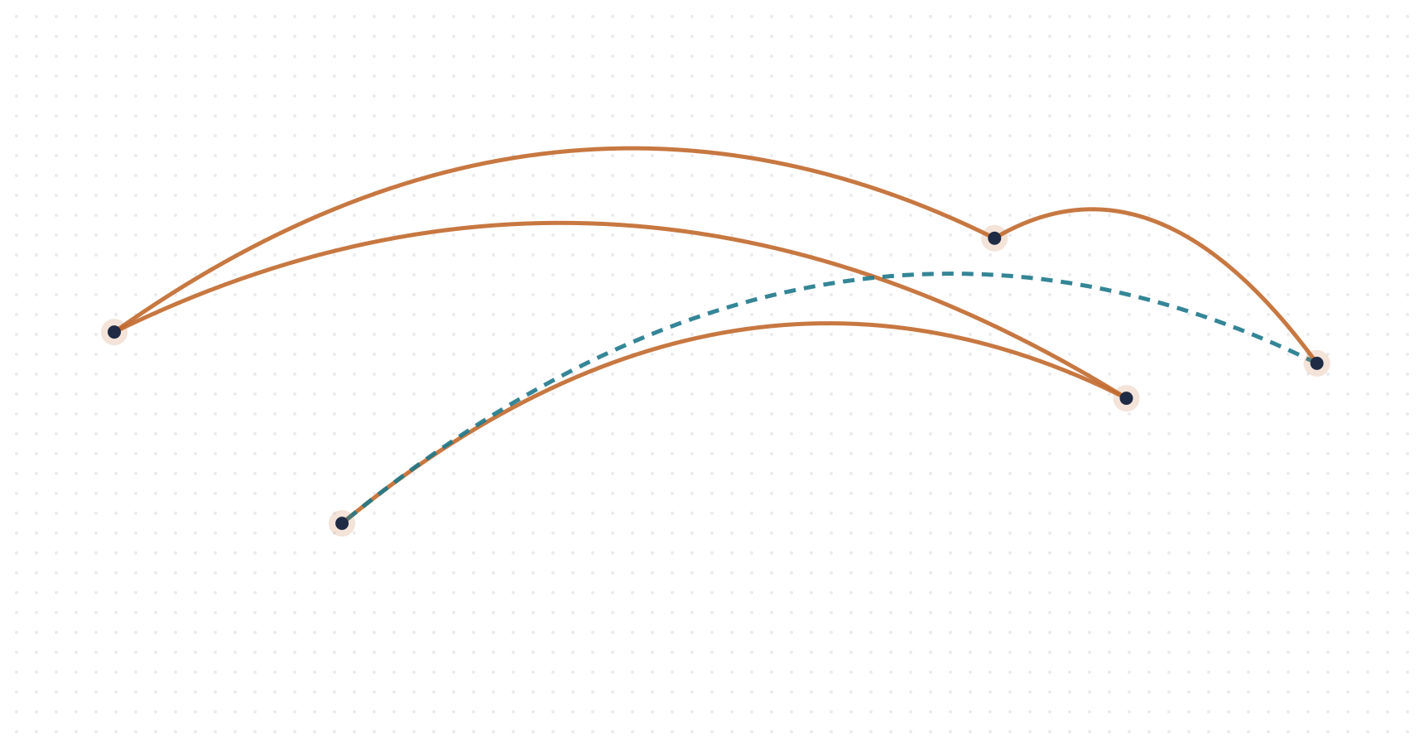
Five countries, two young men, one $298M contract
ROUTE OVERVIEW · BEFORE WE DEPART
THE FILM
War Dogs (2016)
Dir. Todd Phillips · Warner Bros.
CAST
Jonah Hill (Efraim), Miles Teller (David), Ana de Armas, Bradley Cooper
GENRE · SOURCE
Crime comedy-drama based on Guy Lawson’s reporting (2011, 2015)
THEME
Profiting from war without fighting it
4–5 Albania
3 Las Vegas
6 Kabul
2 Jordan → Iraq
1 Miami · 7 Court
Copper line: the bullet’s journey. Dashed teal line: the money returning to Miami. Map is schematic.
Notes:
MEMBER 1 – Roll 27 – [Name] (about 50 seconds)
Here is our route. [Trace the copper line.] Stop one, Miami, where the story begins. Stop two, Jordan and Iraq, the first risky deal. Stop three, Las Vegas, where they meet the broker. Stops four and five, Albania, where the ammunition is found, and hidden. Stop six, Kabul, where it ends up. And the dashed teal line is the money, flowing back to Miami, and finally into a courtroom.
[Right panel.] The film is War Dogs, from 2016, directed by Todd Phillips and starring Jonah Hill and Miles Teller. It is a crime comedy, but it is based on the true story reported by Guy Lawson. Its theme: people who profit from war without ever fighting it.
[Member 2], take us to stop one.

Slide 3




Stop 1: demand meets desperation in Miami
STOP 1 OF 7 · MIAMI
Miami Beach, Florida
The starting point
CRIMINOLOGY CHECKPOINT
Strain and institutional anomie
Merton (1938); Messner & Rosenfeld (1994)
WHAT HAPPENS HERE
David, a broke massage therapist with a baby on the way, reunites with childhood friend Efraim. Efraim’s company, AEY, bids online for the “crumbs” of Pentagon procurement: small contracts the big defence firms ignore.
David accepts the goal of wealth but lacks legitimate means, so he “innovates”. Money starts to override family.
Differential association
Sutherland (1940)
David learns the techniques and the justifications of the trade from Efraim, his close friend.
THE BULLET
Not yet bought
THE MONEY
Pentagon posts tenders online
Notes:
MEMBER 2 – Roll 8 – [Name] (about 50 seconds)
Thank you, [Member 1]. Stop one: Miami. [Point to the tracker.]
David is a broke massage therapist with a baby on the way. He meets his childhood friend Efraim, whose company AEY bids online for the crumbs of Pentagon procurement: small contracts that big companies ignore. At this point, the bullet hasn't been bought yet. The money is simply sitting in public tenders.
[Checkpoint.] Two theories explain why David joins. Merton's strain theory: he accepts the goal of wealth but has no legitimate way to reach it, so he "innovates". Messner and Rosenfeld would add that money starts to override family values. And Sutherland's differential association: David learns both the methods and the excuses from Efraim.
Next stop: the Middle East.

Slide 4
Stop 2: a grey run through Jordan into Iraq
STOP 2 OF 7 · JORDAN → IRAQ
Amman, Jordan → Iraq
The first big risk
CRIMINOLOGY CHECKPOINT
Enterprise model
Smith (1980)
WHAT HAPPENS HERE
A shipment of pistols for the Iraqi police is stuck in Jordan. Instead of losing the contract, the pair fly to Amman, rely on local fixers and drive the cargo through dangerous territory into Iraq. They get paid, and bigger contracts follow.
Legal and illegal business sit on one spectrum. Here AEY slides from legal bidding into grey dealing to keep a contract.
Rational choice
Cornish & Clarke (1986)
A calculated gamble: high reward, risks they judge worth taking. Success rewards the next, bigger risk.
THE BULLET
Pistols stuck at the border
THE MONEY
Fixers paid to move the cargo
Notes:
MEMBER 2 – Roll 8 – [Name] (about 50 seconds)
Stop two: Jordan and Iraq. A shipment of pistols for the Iraqi police is stuck at the border in Jordan. Instead of losing the contract, David and Efraim fly to Amman, use local fixers, and drive the cargo into Iraq themselves. It works, they get paid, and bigger contracts follow.
[Checkpoint.] This is Smith's enterprise model in action. Legal and illegal business sit on one spectrum, driven by the same market. AEY started with legal bidding; now it has slid into grey dealing with fixers.
And it is classic rational choice: a calculated gamble with a high reward. And because the gamble pays off, it encourages the next, bigger one.
[Member 3], take us to Las Vegas.

Slide 5
Stop 3: the broker who cannot trade in his own name
STOP 3 OF 7 · LAS VEGAS
Las Vegas, Nevada
At an arms fair
CRIMINOLOGY CHECKPOINT
Network model and brokerage
Morselli (2009)
WHAT HAPPENS HERE
The pair meet Henry Girard, an arms dealer on a terrorist watch list who cannot sell to the US directly. He has access to about 100 million rounds in Albania. AEY needs supply; Henry needs a clean American front. A deal is born.
Power belongs to brokers who connect worlds that cannot reach each other: the Pentagon on one side, Balkan stockpiles on the other.
Patron–client and crime–terror nexus
Albini (1971)
Henry trades access for a share of profits. A watch-listed actor stays in the market by borrowing a clean company’s name.
THE BULLET
Located: ~100M rounds in Albania
THE MONEY
Henry wants his cut
Henry Girard is a composite character inspired by the real broker Heinrich Thomet.
Notes:
MEMBER 3 – Roll 37 – [Name] (about 50 seconds)
Thank you, [Member 2]. Stop three: Las Vegas. At an arms fair, the pair meet Henry Girard, played by Bradley Cooper. Henry is on a terrorist watch list, so he cannot sell to the US government directly. But he has access to about 100 million rounds of ammunition in Albania. AEY needs supply; Henry needs a clean American front.
[Checkpoint.] This is Morselli's network model: power belongs to brokers who connect worlds that cannot reach each other. It is also Albini's patron–client model: Henry offers access in exchange for a share. And it shows the crime–terror nexus: someone barred from legal trade simply borrows a clean name.
[Bottom note.] Henry is a composite character, inspired by a real Swiss broker.

Slide 6
Stop 4: an Albanian stockpile and a chain of hands
STOP 4 OF 7 · ALBANIA
Tirana, Albania
The source of supply
CRIMINOLOGY CHECKPOINT
Corruption
Transparency International (n.d.)
WHAT HAPPENS HERE
The ammunition sits in old state depots. To reach it, AEY works through local intermediaries and officials, each of whom takes a share. Pressure grows as Efraim tries to cut Henry out of the profits.
The abuse of entrusted power for private gain: officials and intermediaries profit from controlling access to state stock.
Klitgaard’s formula: C = M + D − A
Klitgaard (1988)
Monopoly (Henry’s access) plus discretion (officials, fixers) minus accountability (weak wartime oversight) equals corruption.
THE BULLET
Old stock in state depots
THE MONEY
Officials and middlemen skim
Not in the film: Albania’s Gërdec depot explosion of March 2008 killed 26 people and led to charges against senior officials (Al Jazeera, 2008).
Notes:
MEMBER 3 – Roll 37 – [Name] (about 50 seconds)
Stop four: Albania. The ammunition sits in old state depots. To reach it, AEY has to work through local intermediaries and officials, and each one takes a share. Meanwhile, Efraim starts trying to cut Henry out.
[Checkpoint.] This is where corruption enters. Transparency International defines it as the abuse of entrusted power for private gain. And Klitgaard's formula explains why it flourishes here: corruption equals monopoly plus discretion minus accountability. Henry has a monopoly on access. Officials and fixers have wide discretion. And in wartime, accountability is weak.
[Bottom note.] One thing the film leaves out: in March 2008, an explosion at the Gërdec ammunition depot in Albania killed 26 people, and senior officials were charged.
[Member 4], to the repack.

Slide 7
Stop 5: the repack that turned a deal into a fraud
STOP 5 OF 7 · THE REPACK
Albania, a warehouse
The point of no return
CRIMINOLOGY CHECKPOINT
White-collar crime and fraud
Sutherland (1940)
WHAT HAPPENS HERE
David discovers the ammunition was made in China, which is banned under a US arms embargo and by the contract itself. Instead of disclosing it, AEY has the rounds repackaged to remove the Chinese markings and passes them off as Albanian.
Respectable businessmen commit crime in the course of their work: deceiving the government to protect a contract.
Techniques of neutralization
Sykes & Matza (1957)
Excuses such as “the troops still get working bullets” (denial of injury) and “the government does it too” silence their conscience.
THE BULLET
“Made in China” markings removed
THE MONEY
$298M contract at stake
Repackaging is documented in the real case (Lawson, 2015). Quoted excuses are our paraphrases.
Notes:
MEMBER 4 – Roll 33 – [Name] (about 50 seconds)
Thank you, [Member 3]. Stop five: the repack. This is the point of no return. David discovers that the ammunition was made in China, which is banned under a US arms embargo, and by the contract itself. Instead of reporting it, they have the rounds repackaged to remove the Chinese markings, and pass them off as Albanian. This really happened.
[Checkpoint.] This is white-collar crime in Sutherland's sense: respectable businessmen committing crime in the course of their work.
And how do they live with it? Sykes and Matza's techniques of neutralization. "The troops still get working bullets", that's denial of injury. "The government buys from shady sources too", that's condemning the condemners. These are our paraphrases of their attitudes.

Slide 8
Stop 6: Kabul, where the bullets and the victims meet
STOP 6 OF 7 · KABUL
Kabul, Afghanistan
The end user
CRIMINOLOGY CHECKPOINT
UNTOC definition: yes, organized crime
UNODC (2004), Article 2
WHAT HAPPENS HERE
The decades-old ammunition is delivered to the Afghan National Army. The victims are not on screen for long: soldiers relying on old rounds, and taxpayers who funded the contract. So is the group behind it “organized crime”?
A structured group of 3+ persons (Efraim, David, financier, Henry, suppliers), existing over time, committing serious crime for material benefit.
Transnational organized crime
UNODC (2004)
The scheme crossed the US, Jordan, Iraq, Albania and Afghanistan, exploiting gaps between national laws and weak record-keeping.
THE BULLET
Decades-old rounds issued to soldiers
THE MONEY
US taxpayers pay the bill
Notes:
MEMBER 4 – Roll 33 – [Name] (about 50 seconds)
Stop six: Kabul. The decades-old ammunition is delivered to the Afghan National Army. The victims barely appear on screen: soldiers relying on old ammunition, and taxpayers who paid for the contract.
[Checkpoint.] So, having followed the whole chain: is this organized crime? Under Article 2 of the UN Convention against Transnational Organized Crime, yes. It is a structured group of three or more people: Efraim, David, their financier, Henry and the suppliers. It existed over time, and it committed serious crime for material benefit.
And it is transnational organized crime: it crossed five countries, exploiting the gaps between their laws.
[Member 5], take us to the final stop.

Slide 9
Stop 7: a Miami courtroom, and why AEY is not the mafia
STOP 7 OF 7 · COURTROOM
Federal court, Miami
The end of the line
CRIMINOLOGY CHECKPOINT
Abadinsky’s attributes: mostly not met
Abadinsky (2013)
WHAT HAPPENS HERE
Greed and betrayal destroy the partnership, journalists expose AEY, and the government investigates. In the film, as in reality, Efraim is sentenced to 4 years in prison and David, who cooperates, to 7 months of house arrest.
No hierarchy, no exclusive membership, no code, and it collapsed once its leaders were charged. It is not the mafia.
Our classification
Sutherland (1940); Kramer et al. (2002)
Organized white-collar crime, made possible by state-corporate failure: war outsourced to the lowest bidder with weak vetting.
THE BULLET
AEY’s supplies exposed (2008)
THE MONEY
Profits lost; prison and house arrest
Sentences: Lawson (2015).
Notes:
MEMBER 5 – Roll 24 – [Name] (about 50 seconds)
Thank you, [Member 4]. Stop seven: a federal courtroom in Miami. Greed and betrayal break the partnership, journalists expose AEY, and the government investigates. In the film, as in real life, Efraim is sentenced to four years in prison, and David, who cooperates, to seven months of house arrest.
[Checkpoint.] But here is the twist. If we use Abadinsky's classic attributes of organized crime, AEY mostly fails the test. No hierarchy, no exclusive membership, no code, and it collapsed the moment its leaders were charged. It is not the mafia.
So our classification is organized white-collar crime, made possible by what Kramer and colleagues call state-corporate crime: a government outsourcing war to the lowest bidder, with weak vetting.

Slide 10
Which model explains the whole journey? Enterprise and network
ARRIVAL · LOOKING BACK AT THE WHOLE ROUTE
Enterprise
Smith (1980)
Strong fit
Stops 1–5: AEY slides from legal bidding to fixers to fraud as demand grows.
Network
Morselli (2009)
Strong fit
Stops 3–4: brokers bridging the Pentagon and Balkan stockpiles hold the power.
Patron–client
Albini (1971)
Partial fit
Stop 3: Henry trades access to supply for a share of the profits.
Hierarchical
Cressey (1969)
Weak fit
Stop 7: no ranks, no code, no family; the group collapses after arrests.
Fit ratings are the group’s assessment.
Notes:
MEMBER 5 – Roll 24 – [Name] (about 50 seconds)
We've arrived. Now let's look back at the whole route and ask which model of organized crime explains it best.
[Top row.] Smith's enterprise model fits strongly: across stops one to five, AEY slides from legal bidding, to fixers, to fraud, as demand grows.
[Second row.] Morselli's network model also fits strongly: at stops three and four, power sits with the brokers bridging the Pentagon and the Balkan stockpiles.
[Third row.] Albini's patron–client model fits partly: Henry trades access for a share.
[Bottom row.] And Cressey's hierarchical model, the mafia model, fits weakly: there are no ranks and no code, and the group collapses after the arrests.
[Member 6] will give our final evaluation.

Slide 11


Accurate in substance, exaggerated in style
THE VERDICT · IS THE FILM ACCURATE?
WHAT IT GETS RIGHT
WHAT IT GETS WRONG
Breaks the mafia stereotype: crime as a business with invoices
Comedy glamorizes the money and softens the fraud
Fits the UN definition and the enterprise and network models
Henry is a composite; the Albanian threats are invented
Offenders who never see themselves as criminals
Blames two young men, not the system that let them in
Real facts: the $298M contract, the repack, the sentences
Leaves out real victims, including the 26 killed at Gërdec
Sources: Lawson (2015); Al Jazeera (2008). Verdict is the group’s assessment.
Notes:
MEMBER 6 – Roll 21 – [Name] (about 50 seconds)
Thank you, [Member 5]. So, after following the bullet all the way, is the film accurate? Our verdict: accurate in substance, exaggerated in style.
[Left.] What it gets right: it breaks the mafia stereotype and shows crime as a business. It fits the UN definition and the enterprise and network models. Its characters never see themselves as criminals. And the core facts are real: the 298-million-dollar contract, the repackaging and the sentences.
[Right.] What it gets wrong: the comedy glamorizes the money. Henry is a composite and the Albanian threats were invented. It blames two young men rather than the system that let them in. And it leaves out real victims, including the 26 people killed in the Gërdec explosion.

Slide 12
END OF THE LINE
Follow the bullet and you find a business. Follow the money and you find the system.
THE ANSWER
Organized crime under the UN definition, but not the mafia: organized white-collar crime.
THE LESSON FOR BANGLADESH
Large procurement relies on middlemen too. Vet contractors, disclose real owners, and check where goods come from.
Thank you. Questions?
Notes:
MEMBER 6 – Roll 21 – [Name] (about 50 seconds)
So here is where our journey ends. [Read slowly.] Follow the bullet, and you find a business. Follow the money, and you find the system.
Our answer: AEY is organized crime under the UN definition, but it is not the mafia. It is organized white-collar crime, best explained by the enterprise and network models, and made possible by weak oversight.
And the lesson for Bangladesh: our own large procurement projects also rely on middlemen. Vetting contractors, disclosing who really owns a company, and checking where goods come from is not just paperwork. It is crime prevention.
Thank you. We are happy to take your questions.

