Slide 1


NOW SHOWING · MCCJ 525 CYBERCRIMES AND SECURITY
LOCKED OR LEAKED?
A Cybercriminologist’s Director’s Cut
One message. One night. Five doors. Which lock held?
PRESENTED BY
Ahnaf Akif · Roll 24
MCCJ 525 Cybercrimes and Security
Department of Criminology, University of Dhaka
Notes:
SPEAKER: AHNAF AKIF (Roll 24) · about 40 seconds
Good morning. I am Ahnaf Akif, Roll 24, and my topic for MCCJ 525 is: Locked or Leaked? Assessing the security features of five online platforms.
But I am not going to give you a list of settings. I am going to show you a cybercriminologist’s director’s cut: one night in the life of a student we will call Sparrow, and a hacker we will call Fox. Both are code names, and the story is fictional, but every step of it happens to real students in Bangladesh.
We will play the night in three acts, and at key moments I will press pause and explain the security and the criminology behind each scene. One question runs through it all: which lock held, and which one leaked?

Slide 2
THE TRAILER · BEFORE WE PRESS PLAY
Account hacking is Bangladesh’s most common cybercrime
21.65%
≈59%
THE THESIS
The strongest lock fails when the user opens the door.
of cybercrime victims had an account hacked: the #1 crime
of victims are women
THE CAST · CODE NAMES
78.78%
12%
SPARROW 21, university student, the target
ROBIN her friend, account already hijacked
FOX the hacker hiding behind Robin
are aged 18–30: the age of this room
ever went to the police
Source: Cyber Crime Awareness Foundation (2024), reported by Dhaka Tribune. Sparrow, Robin and Fox are fictional code names.
Notes:
SPEAKER: AHNAF AKIF (Roll 24) · about 50 seconds
First, the facts behind the story. [Stat cards.] In the Cyber Crime Awareness Foundation’s 2024 study, having an account hacked was the most common cybercrime in Bangladesh, at 21.65 percent. About 59 percent of victims were women, 78.78 percent were aged 18 to 30, the age of this room, and only 12 percent went to the police.
[Thesis.] Here is my thesis: the strongest lock fails when the user opens the door.
[Cast.] Meet the cast. Sparrow, a 21-year-old student. Robin, her friend, whose WhatsApp has already been hijacked. And Fox, the hacker hiding behind Robin’s account. Let us press play on Act One.

Slide 3
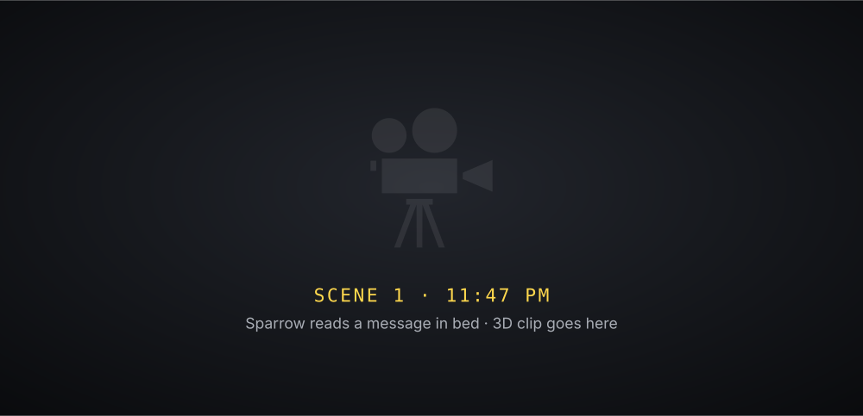


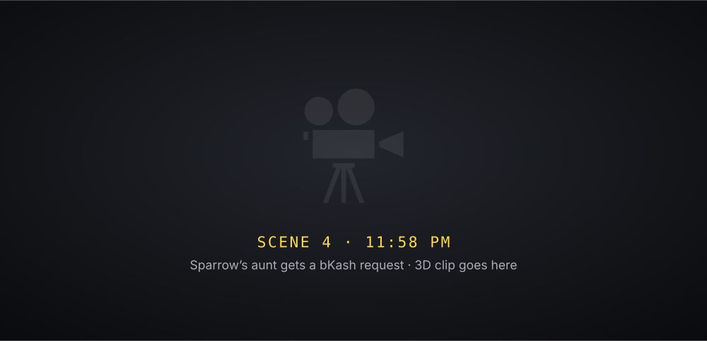

ACT I · THE MESSAGE · ▶ PLAYBACK
“She didn’t lose a password. She gave away a code.”
SCENE 1 · 11:47 PM
SCENE 2 · 11:49 PM
SCENE 3 · FOX
SCENE 4 · 11:58 PM
SOCIAL ENGINEERING
CODE SHARED → ACCOUNT HIJACKED
FAKE REQUEST
ROBIN
NARRATOR
FOX
“SPARROW”
Hey! I sent a 6-digit code to your number by mistake. Can you send it to me? It’s urgent!
She sends the code. Two minutes later, her WhatsApp is registered on another phone.
(to himself) Her lock is unbreakable. So I asked her for the key.
Urgent! Please send 5,000 tk to this bKash number. I’ll return it tomorrow.
Notes:
SPEAKER: AHNAF AKIF (Roll 24) · about 49 seconds
▶ 0:03 SCENE 1
Act One: the Message. It is 11:47 on a normal weeknight in Dhaka. Sparrow, a 21-year-old student, is scrolling in bed when her friend Robin writes: I sent a six-digit code to your number by mistake. Can you send it to me? It is urgent.
▶ 0:21 SCENE 2
It looks harmless. It is her friend. She sends the code. Two minutes later, her WhatsApp is registered on another phone, and she is logged out.
▶ 0:31 SCENE 3
Because it was never Robin. It was Fox, a hacker who had already taken over Robin’s account, and now he has hers.
▶ 0:40 SCENE 4
At 11:58, her friends and her aunt start receiving messages from her number: urgent, please send bKash money. Let us pause here.

Slide 4




PAUSED
END OF ACT I · HOW DID THE DOOR OPEN?
WhatsApp’s lock never broke: Sparrow opened it
ROUTINE ACTIVITY THEORY · COHEN & FELSON (1979)
THE SOCIAL ENGINEERING SCRIPT
1
TRUST A friend’s name: “Robin”
MOTIVATED OFFENDER
Fox, hiding behind Robin
2
URGENCY “It’s urgent!”
3
THE ASK “Send me the code”
CRIME
4
THE TAKE WhatsApp moves to Fox’s phone
SUITABLE TARGET
Sparrow: young, online, trusting
NO CAPABLE GUARDIAN
No two-step PIN, no warning
THE FIX A six-digit two-step PIN makes the code useless. Codes are never shared, not even with friends.
Notes:
SPEAKER: AHNAF AKIF (Roll 24) · about 60 seconds
[Freeze-frame.] What happened in Act One? [Triangle.] Cohen and Felson’s routine activity theory says a crime happens when three things meet: a motivated offender, a suitable target, and no capable guardian. Fox is the offender. Sparrow is the target: young, always online, and trusting a friend’s name. And the guardian was missing: no two-step PIN, and no warning that a code was being requested.
[Right side.] This is social engineering, and it follows a script. Trust: the message comes from Robin. Urgency: it is urgent. The ask: send me the code. And the take: WhatsApp moves to Fox’s phone.
Here is the irony: WhatsApp has the strongest lock of all five platforms. Every chat is end-to-end encrypted by default. That encryption never broke. [Fix.] A six-digit two-step PIN would have made the code useless, and so would one simple rule: codes are never shared, not even with friends. Let us press play on Act Two.

Slide 5
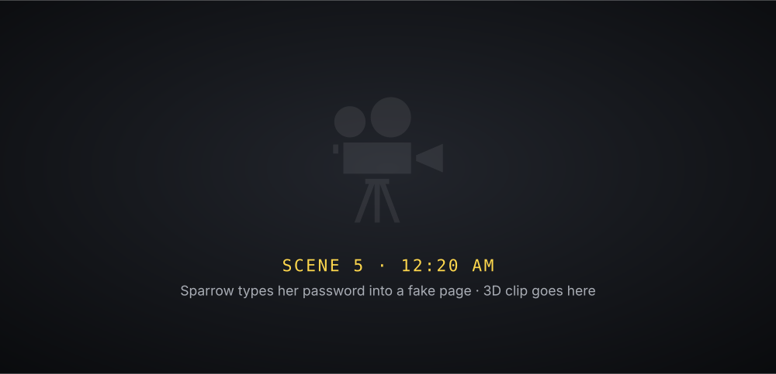
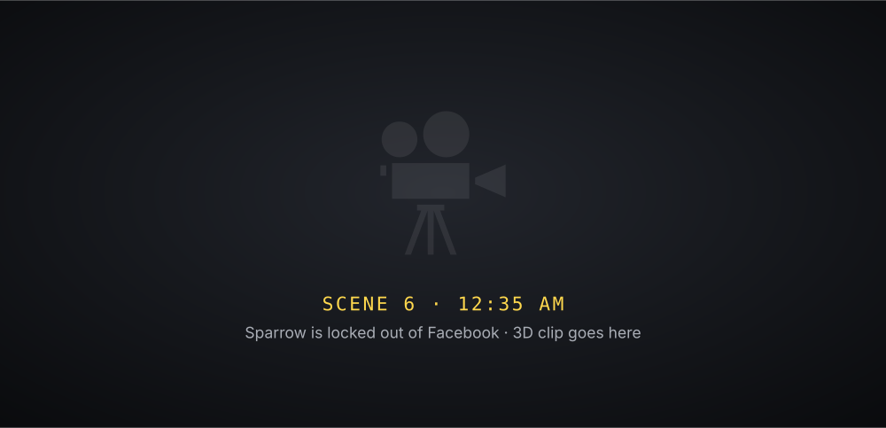
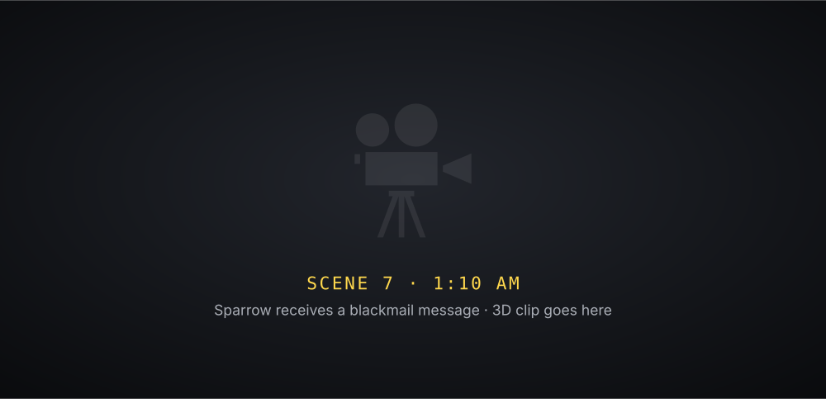

ACT II · THE TAKEOVER · ▶ PLAYBACK
“81 minutes. One shared code. Four accounts.”
SCENE 5 · 12:20 AM
SCENE 6 · 12:35 AM
SCENE 7 · 1:10 AM
LOCKED OUT
PASSWORD STOLEN
SEXTORTION
FAKE EMAIL
NARRATOR
FOX
⚠ Copyright violation: your page will be removed in 24 hours. Log in to appeal.
From her Gmail, Fox resets her Facebook password and swaps her recovery email and phone.
I have all your private chats. Pay me, or I share them.
Notes:
SPEAKER: AHNAF AKIF (Roll 24) · about 37 seconds
▶ 0:03 SCENE 1
Act Two: the Takeover. At 12:20, Fox sends Sparrow a fake copyright warning. She logs in on the fake page with the same password she uses for Gmail, and Gmail has no second check switched on.
▶ 0:17 SCENE 2
At 12:35, Fox opens her Gmail, clicks forgot password on Facebook, and swaps her recovery email and phone number. By morning, Facebook believes he is Sparrow.
▶ 0:27 SCENE 3
At 1:10, Instagram falls through the linked accounts. Fox reads her private messages and turns them into blackmail. Eighty-one minutes. One shared code. Four accounts.

Slide 6




PAUSED
END OF ACT II · WHY DID EVERYTHING FALL?
Gmail is the master key: once it fell, every door followed
11:49 PM
12:20 AM
12:35 AM
1:10 AM
WhatsApp
Gmail
Facebook
Instagram
Code shared
Password reused
Reset link + recovery swapped
Linked account opened
THE MASTER KEY
Every “forgot password” link (Facebook, Instagram, even bKash) lands in your email. Steal the inbox and you can reset everything.
THE WEAK SPOTS
Facebook recovery: 2/5, details swapped in minutes. Instagram encryption: 1/5, so stolen DMs became blackmail.
81 MINUTES · 4 ACCOUNTS
Notes:
SPEAKER: AHNAF AKIF (Roll 24) · about 60 seconds
[Freeze-frame.] Why did everything fall in just 81 minutes? Because the doors were chained together. [Follow the cards left to right.] 11:49, WhatsApp: a code was shared. 12:20, Gmail: a reused password was stolen by a fake page, with no 2-Step Verification. 12:35, Facebook: the reset link went to the stolen Gmail, and Fox swapped the recovery email and phone. 1:10, Instagram: it was linked to Facebook, so it opened too.
[Yellow box.] Gmail is the master key. Every forgot-password link goes to your email. The painful part: Gmail has the best login protection I tested, with passkeys as the default since October 2023, but a lock only helps if it is switched on.
[Red box.] And two weak spots made it worse: Facebook’s recovery safety scores just 2 out of 5, and Instagram’s private messages are not end-to-end encrypted, so stolen DMs became blackmail material. That is how sextortion usually begins.

Slide 7
PAUSED
THE INVESTIGATION · FIVE DOORS, FIVE LOCK TESTS
I tested every lock: WhatsApp is the most secure by default
LOGIN
ENCRYPTION
ALERTS
RECOVERY
PRIVACY
TOTAL / 25
WhatsApp
4
5
3
3
5
20
Gmail
5
3
5
4
3
20
Facebook
4
3
4
2
3
16
Instagram
4
1
4
3
4
16
bKash
4
3
3
2
3
15
Not one lock was broken that night. Every door was opened because a lock was switched off, or a code was handed over.
Notes:
SPEAKER: AHNAF AKIF (Roll 24) · about 60 seconds
So I became an investigator. For each platform I opened the security settings on my own phone, checked them against the official help pages and recent news, and scored five lock tests from 1 to 5. [Column headings.] Login: can a stolen password alone get in? Encryption: can the company read my messages? Alerts: will it warn me? Recovery: can a hacker lock me out for good? Privacy: can strangers find and contact me?
[Rows.] WhatsApp and Gmail tie at the top with 20 out of 25. Facebook and Instagram score 16, and bKash is last with 15: its PIN is strong, but scammers simply ask the user for the OTP.
So which platform is the most secure for an ordinary person? I chose WhatsApp, because its strongest lock, end-to-end encryption, is on from the moment you install it, with no setup. [Bottom line.] And here is the most important finding: not one lock was broken that night. Every door was opened because a lock was switched off, or a code was handed over. So let us replay the night.

Slide 8


ACT III · THE REPLAY · ▶ PLAYBACK
“The most secure app is the one you set up.”
SCENE 8 · 11:47 PM AGAIN
BLOCKED
ROBIN
SPARROW
Send me the code you just got! It’s urgent!
No. Codes are never shared, not even with friends.
Notes:
SPEAKER: AHNAF AKIF (Roll 24) · about 17 seconds
▶ 0:03 SCENE 1
Act Three: the Replay. Same night, same message, 11:47. But this time Sparrow has a two-step PIN, and she knows one rule: codes are never shared, not even with friends. She says no. Fox gives up.

Slide 9
PAUSED
THE REPLAY · FIVE SMALL CHANGES
Five settings, five minutes: every door stays shut
11:49
Set a six-digit two-step PIN on WhatsApp
BREACHED
HIJACK BLOCKED
11:49
Never share a code, not even with a friend
BREACHED
DOOR STAYS SHUT
12:20
A unique password and a passkey on Gmail
BREACHED
NOTHING TO STEAL
12:35
Keep recovery details current, turn on login alerts
BREACHED
TAKEOVER SPOTTED
1:10
Log out of every device you don’t recognise
BREACHED
FOX REMOVED
Each takes under five minutes, and every one already exists in the apps on your phone.
Notes:
SPEAKER: AHNAF AKIF (Roll 24) · about 50 seconds
[The red stamps flip one by one.] So let us replay the night with five small changes. 11:49: with a two-step PIN on WhatsApp, the code alone is useless. Hijack blocked. 11:49: if she never shares a code, not even with a friend, the door stays shut. 12:20: with a unique password and a passkey on Gmail, the fake page steals nothing. The master key is safe. 12:35: with up-to-date recovery details and login alerts, the takeover is spotted immediately. 1:10: by logging out of devices she does not recognise, she removes Fox.
Each of these takes less than five minutes, and all of them already exist in the apps on your phone.

Slide 10


THE CRITICS’ VERDICT · FIVE PLATFORMS RATED
Which lock held? The ratings
WhatsApp
20 / 25
Most secure by default: end-to-end encryption with no setup
Gmail
20 / 25
The master key: best login protection, guard it hardest
Facebook
16 / 25
Good locks, but recovery details can be swapped in minutes
Instagram
16 / 25
Private messages are not end-to-end encrypted
bKash
15 / 25
Strong PIN, but scammers ask the user for the OTP
Notes:
SPEAKER: AHNAF AKIF (Roll 24) · about 50 seconds
So, the critics’ verdict. [Row by row.] WhatsApp: four stars, 20 out of 25, the most secure by default. Gmail: four stars, 20, but it is the master key, so guard it hardest. Facebook: three stars, 16: good locks, but recovery details can be swapped in minutes; I recommend a 48-hour wait before new recovery details take effect. Instagram: three stars, 16: private messages are not end-to-end encrypted; they should be, by default. And bKash: three stars, 15: a strong PIN, but scammers ask the user for the OTP; I recommend a separate warning when a PIN-reset code is requested, and a short hold on transfers after a reset.

Slide 11
THE FINAL CUT
The most secure app is the one you set up.
CREDITS
Written, investigated & presented by
Ahnaf Akif · Roll 24
Course
MCCJ 525 Cybercrimes and Security
THE ANSWER
WhatsApp is the most secure by default; Gmail needs the most protection, because it is the master key.
Cast (fictional code names)
Sparrow · Robin · Fox
Data
Cyber Crime Awareness Foundation (2024)
Theory
Cohen & Felson (1979)
THE LESSON FOR BANGLADESH
The threat is social engineering, not code-breaking: Bangla warnings for code requests, mandatory PINs, and alerts for fake bKash calls.
Evidence
WhatsApp, Google, Meta and bKash help centres
Thank you · Questions?
Notes:
SPEAKER: AHNAF AKIF (Roll 24) · about 40 seconds
[Read slowly.] The most secure app is the one you set up.
The answer to my question: WhatsApp is the most secure platform by default, and Gmail needs the most protection, because it is the master key to everything else.
And the lesson for Bangladesh: the real threat is not code-breaking, it is social engineering. Platforms should warn users in Bangla when a code is requested, make the two-step PIN mandatory, and warn about fake bKash calls. And all of us can close every door in five minutes tonight.
That is the final cut. Thank you, and I am happy to take your questions.

