Slide 1

IN THE CYBER SECURITY TRIBUNAL
Case No. MCCJ-525/2026
The People v. Your Apps
A security trial of Facebook, Instagram, WhatsApp, Gmail and bKash
Presented by Ahnaf Akif · Roll 24 · MCCJ 525 Cybercrimes and Security
ALL RISE
Notes:
(about 1 minute)
[Stand up straight, speak with authority. Optional: tap the desk like a gavel.]
All rise! The Cyber Security Tribunal is now in session. Case number MCCJ-525: The People versus Your Apps.
[Normal voice.] Good morning. I am Ahnaf Akif, Roll 24. Today, five apps that live on almost every phone in this room stand trial: Facebook, Instagram, WhatsApp, Gmail and bKash.
Every day we hand them our photos, our conversations, and even the OTPs for our mobile banking. They promise to keep us safe. Today we ask: did they keep that promise?
I will play every role today: clerk, prosecutor and judge. For each app, the court sees the evidence for the prosecution, meaning exactly how the account was broken into, and the evidence for the defence, meaning the security features that would have stopped it. Then the court delivers its verdict.
But first, the court must hear why this case matters.

Slide 2
EXHIBIT 1 · STATEMENT OF HARM
Account hacking is Bangladesh’s most common cybercrime
21.65%
≈59%
78.78%
12%
had an account hacked: the most common cybercrime
of victims are women
are aged 18–30: the age of this room
ever reported it to the police
“With ≈64 million Bangladeshis on Facebook, attackers no longer break into computers. They walk into accounts.”
Sources: Cyber Crime Awareness Foundation (2024), reported by Dhaka Tribune (2024); Statista (2025).
THE PEOPLE v. YOUR APPS · CASE NO. MCCJ-525/2026 · AHNAF AKIF, ROLL 24
2
Notes:
(about 1 minute)
The court enters Exhibit 1: the statement of harm. These figures come from the Cyber Crime Awareness Foundation's 2024 study of cybercrime victims in Bangladesh.
[First card.] Social media and online account hacking was the most common cybercrime, affecting 21.65 percent of victims.
[Second card.] About 59 percent of victims were women, often facing leaked photos, blackmail and harassment.
[Third card.] 78.78 percent of victims were aged 18 to 30, the same age as everyone in this room.
[Fourth card.] And only 12 percent ever reported the crime to the police.
[Bottom quote.] Around 64 million Bangladeshis use Facebook. Criminals no longer need to hack a computer; they simply take over an account.
So the question before this court is serious: are these platforms doing enough to protect us? I now call the first prosecutor to read the charge.

Slide 3
CHARGE SHEET · THE SECURITY CODE
The charge: failing to protect the accounts of their users
THE SECURITY CODE · 1–5 PER AREA · MAXIMUM 25
THE CHARGE
That each defendant failed to adequately protect the accounts of its users in Bangladesh against cyber attacks.
1
Login protection
Can a stolen password alone get in?
1–5
2
Encryption by default
Are messages readable on the servers?
1–5
HOW THE EVIDENCE WAS GATHERED
3
Threat alerts
Is the owner warned about a break-in?
1–5
Every security setting checked on my own phone
Cross-checked with official help pages and news reports
20/25 or more: not guilty. Below 20: guilty on the weakest count
4
Recovery safety
Can an attacker lock the owner out?
1–5
5
Privacy controls
Can strangers find and message the user?
1–5
THE PEOPLE v. YOUR APPS · CASE NO. MCCJ-525/2026 · AHNAF AKIF, ROLL 24
3
Notes:
(about 1 minute)
Thank you. Your Honour, the charge against all five defendants is the same. [Read the charge slowly.] "That each defendant failed to adequately protect the accounts of its users in Bangladesh against cyber attacks."
How did we gather the evidence? We reviewed every security setting on our own accounts, and cross-checked what we found with official help pages and recent news.
[Right side.] Each defendant is judged against our Security Code, five sections:
Section 1, login protection: can a stolen password alone get someone in?
Section 2, encryption by default: can the company read my messages?
Section 3, threat alerts: will it warn me of an attack?
Section 4, recovery safety: can a hacker lock me out for good?
Section 5, privacy controls: can strangers find and contact me?
Each section is scored from 1 to 5, a maximum of 25. Our standard: 20 or more is adequate; below 20, the defendant is guilty on its weakest count.
The prosecution calls its first defendant: Facebook.

Slide 4
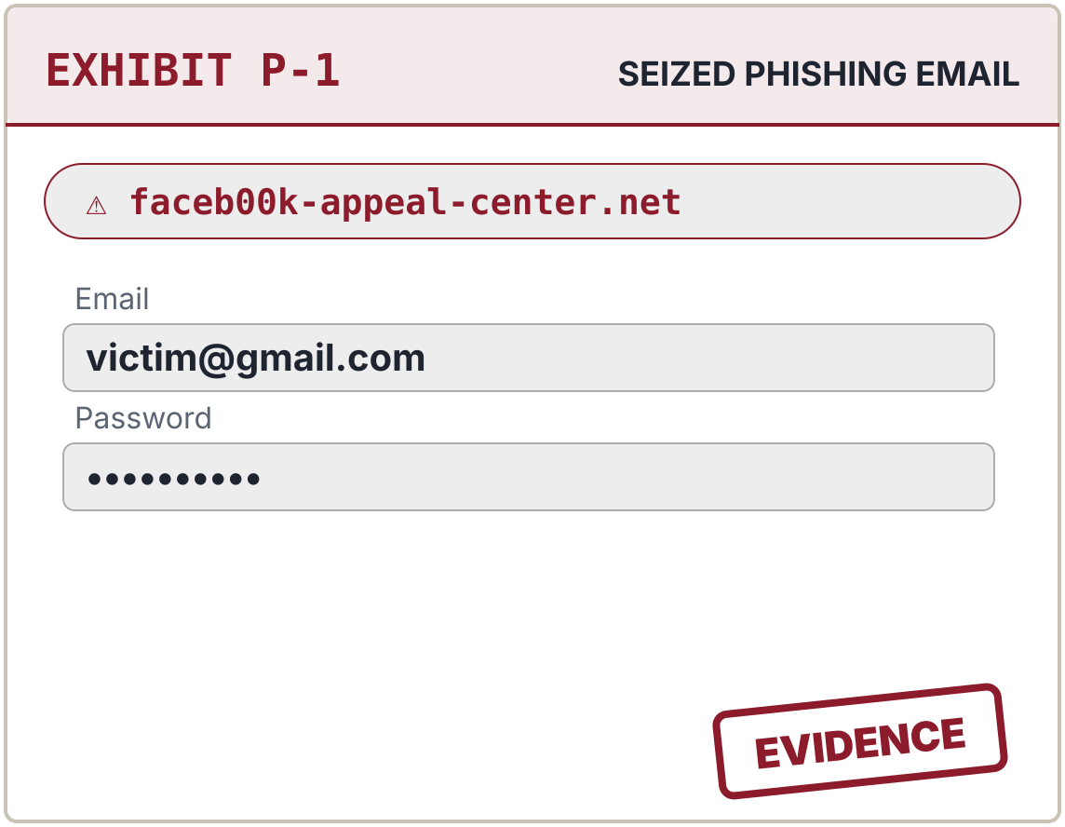
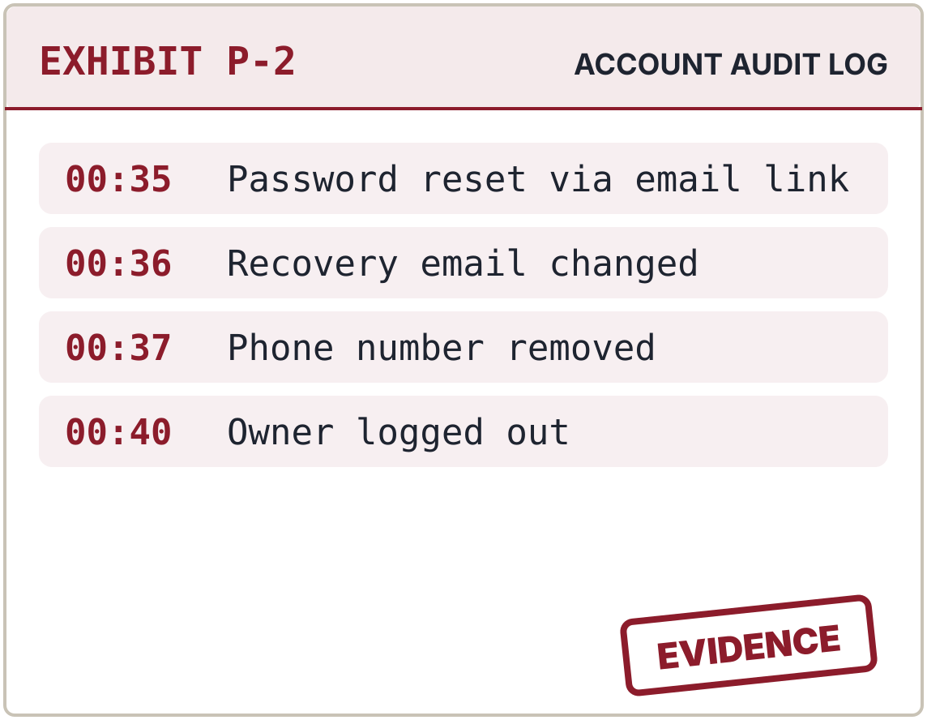
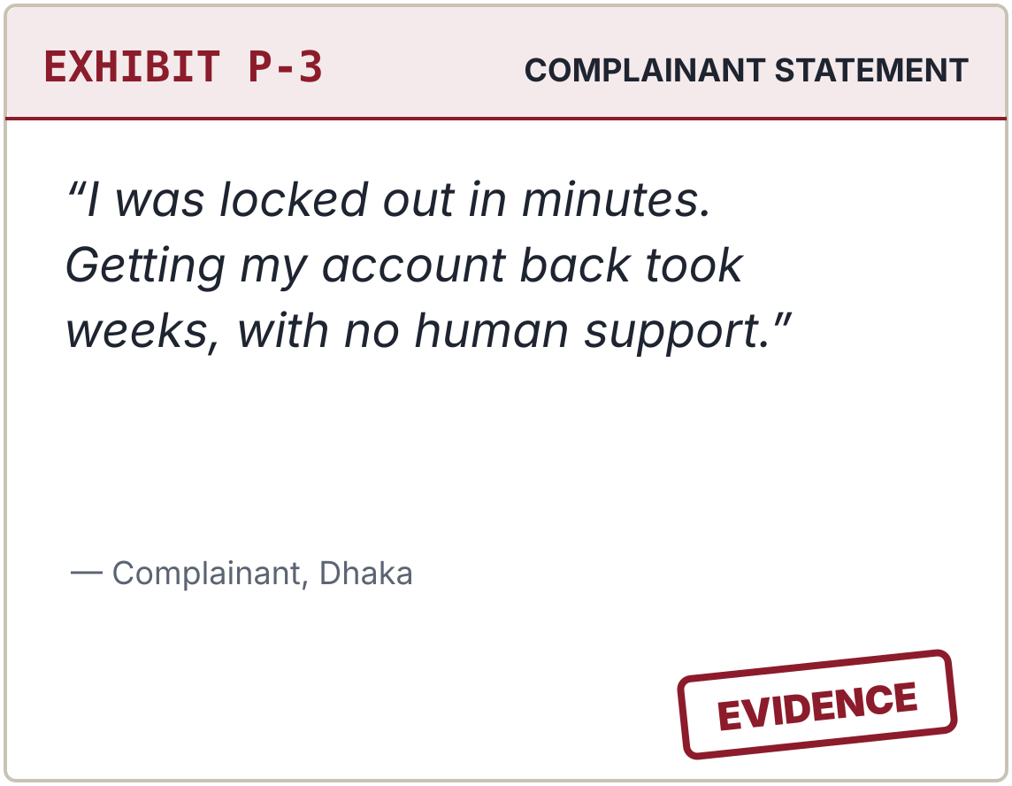
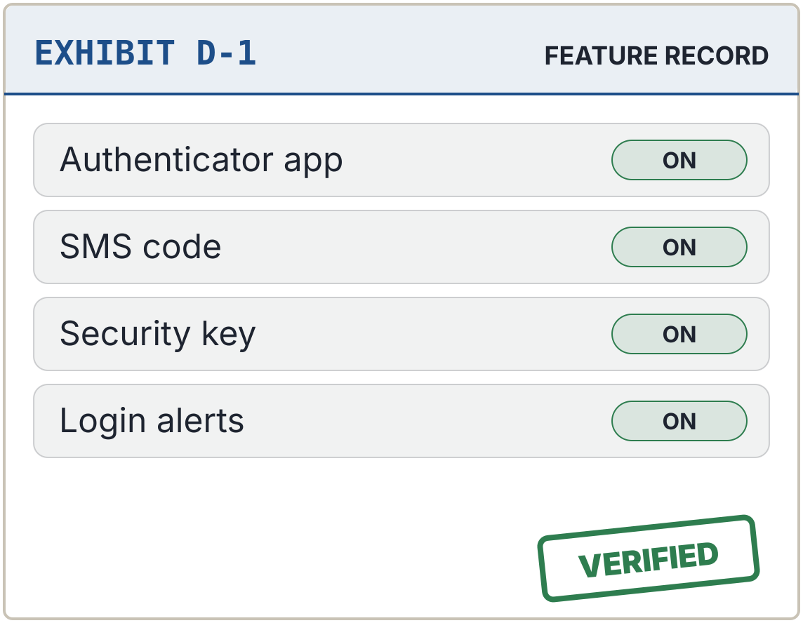
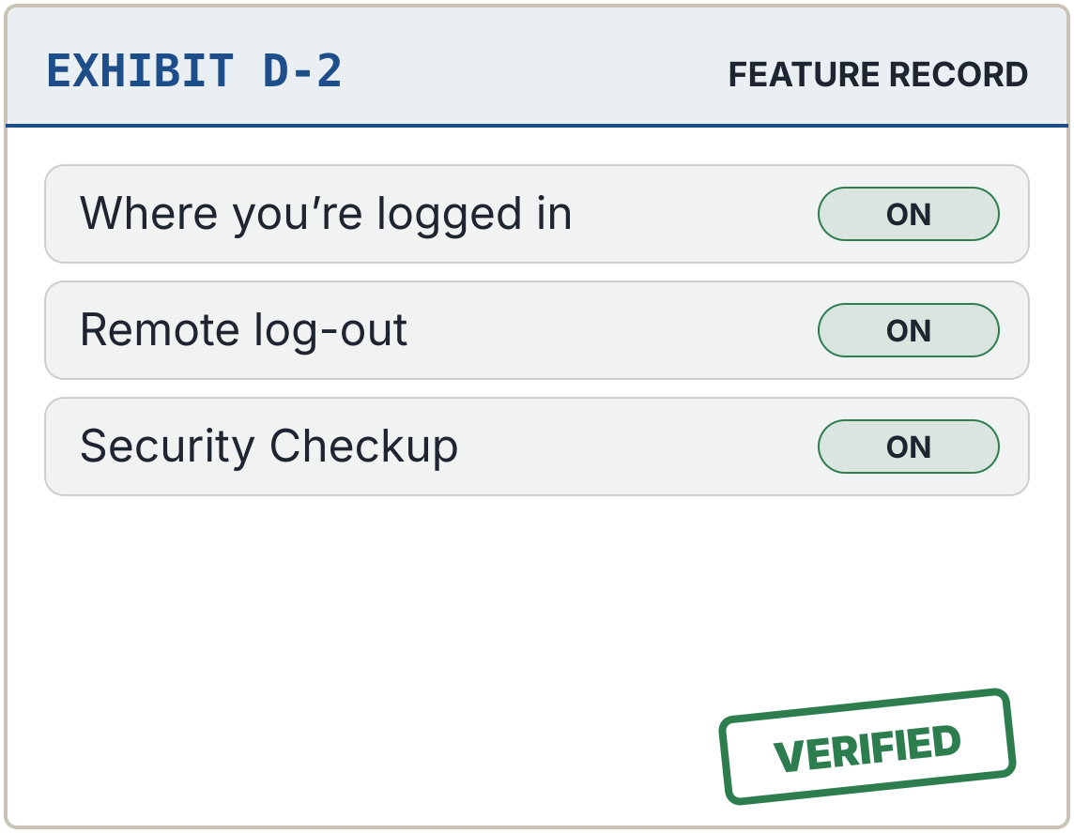
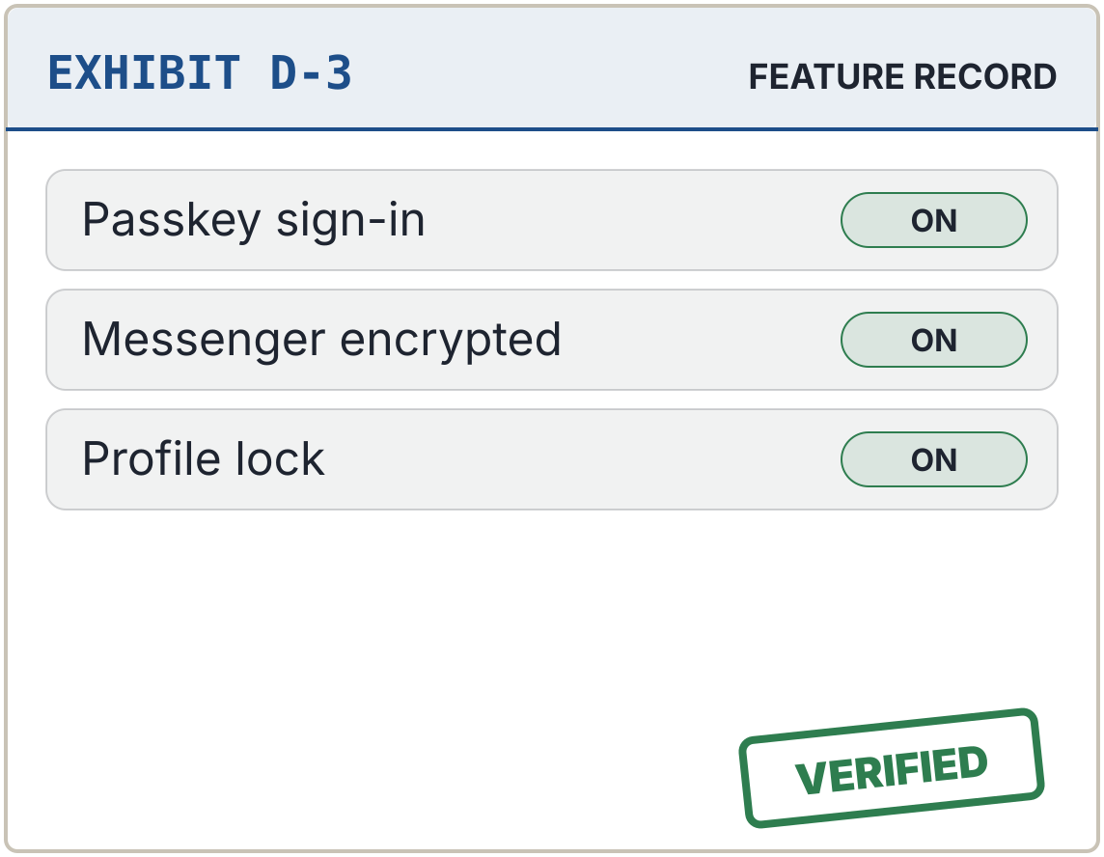
CASE 1 OF 5 · THE PEOPLE v. FACEBOOK
Case 1 of 5 – Facebook: guilty of leaving account recovery unguarded
PROSECUTION EXHIBITS · HOW THE ACCOUNT FELL
FINDINGS OF THE COURT
Login protection
4 / 5
Encryption by default
3 / 5
Threat alerts
4 / 5
Recovery safety
2 / 5
A fake “copyright” notice with a look-alike link
Recovery details changed within minutes of the reset
Getting the account back took weeks
Privacy controls
3 / 5
DEFENCE EXHIBITS · LOCKS THAT WOULD HAVE HELD
TOTAL SCORE
GUILTY
16 / 25
SENTENCE
A 48-hour wait before a new email, phone number or 2FA change takes effect.
Two-factor authentication offered three ways
Unknown sessions can be ended remotely
Passkeys since June 2025
THE PEOPLE v. YOUR APPS · CASE NO. MCCJ-525/2026 · AHNAF AKIF, ROLL 24
4
Notes:
(about 1 minute)
Case 1: The People versus Facebook. Score: 16 out of 25.
[Defence exhibits, bottom row.] In fairness, the defence has strong evidence. Exhibit A: two-factor authentication through an app, SMS or a physical security key. Exhibit B: login alerts and remote log-out. Exhibit C: passkeys since June 2025. Exhibit D: profile lock. Exhibit E: Messenger chats encrypted by default since December 2023.
[Prosecution exhibits, top row.] But the prosecution's case is this: once a hacker gets in, they can change the recovery email and phone number within minutes. Recovery for the real owner is slow and automated. Facebook scored just 2 out of 5 on recovery safety.
[Verdict.] The court finds Facebook guilty of leaving account recovery unguarded.
[Sentence.] The sentence we request: a 48-hour cool-down before recovery details can change, alerts to the old email and phone, and real human support in Bangla.
I hand over to my colleague for the next defendant.

Slide 5
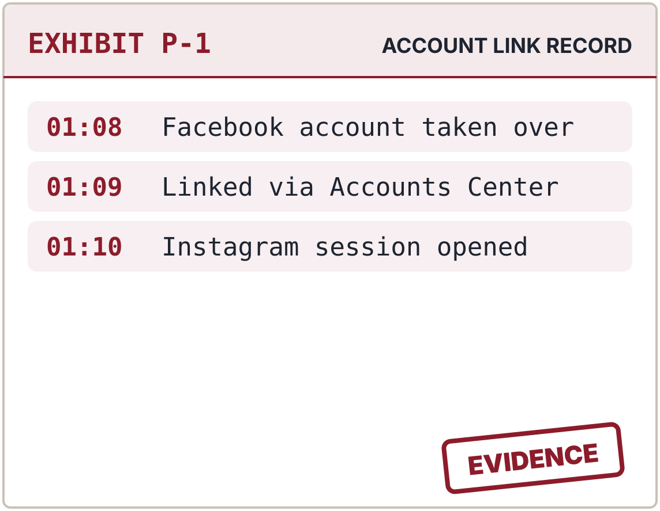
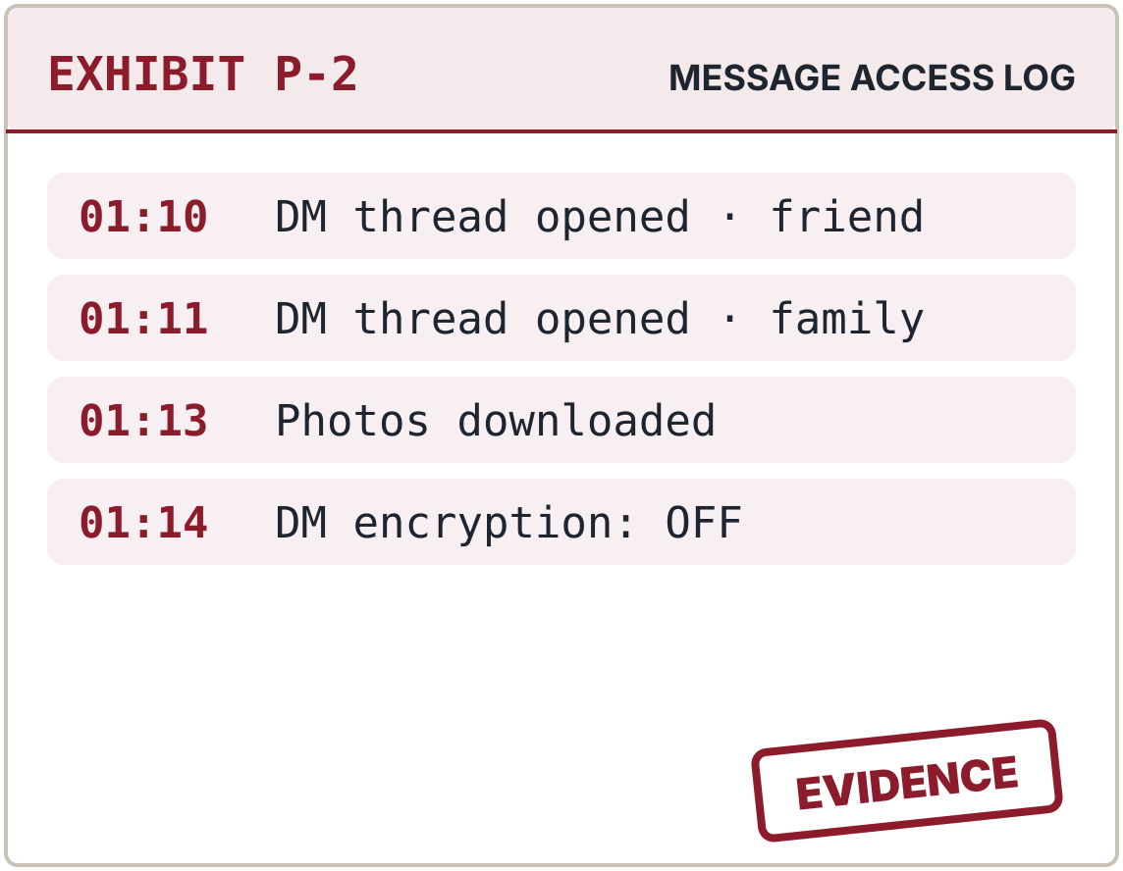
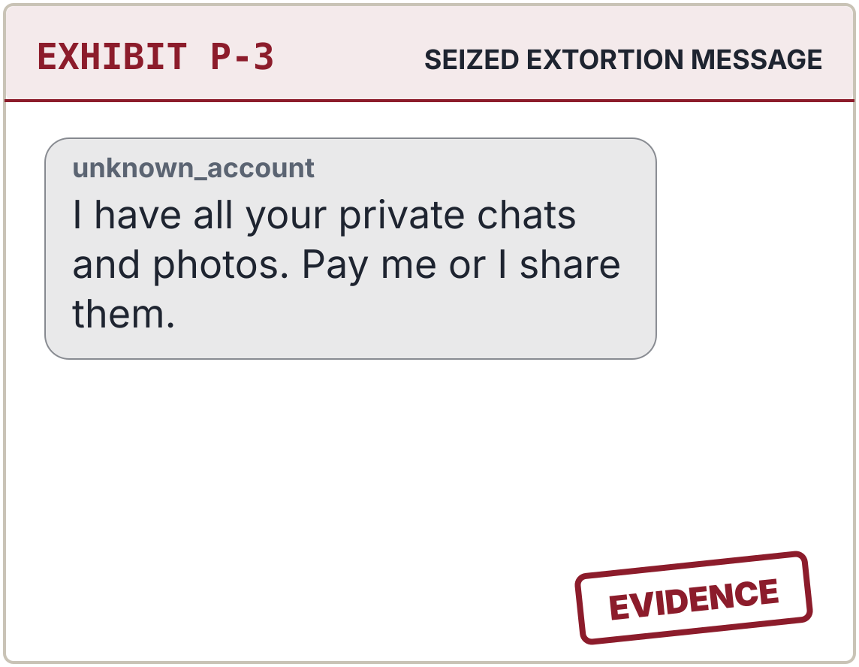
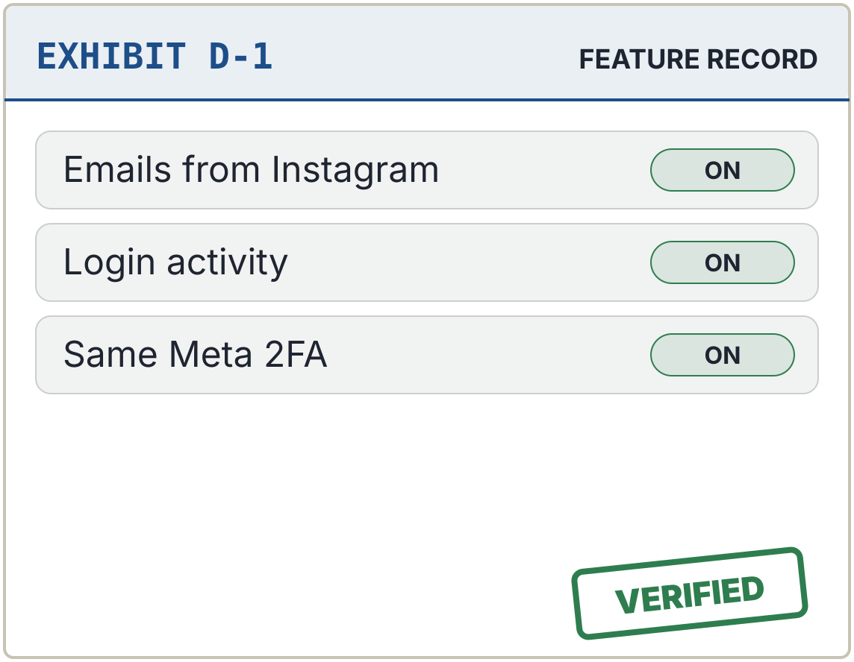
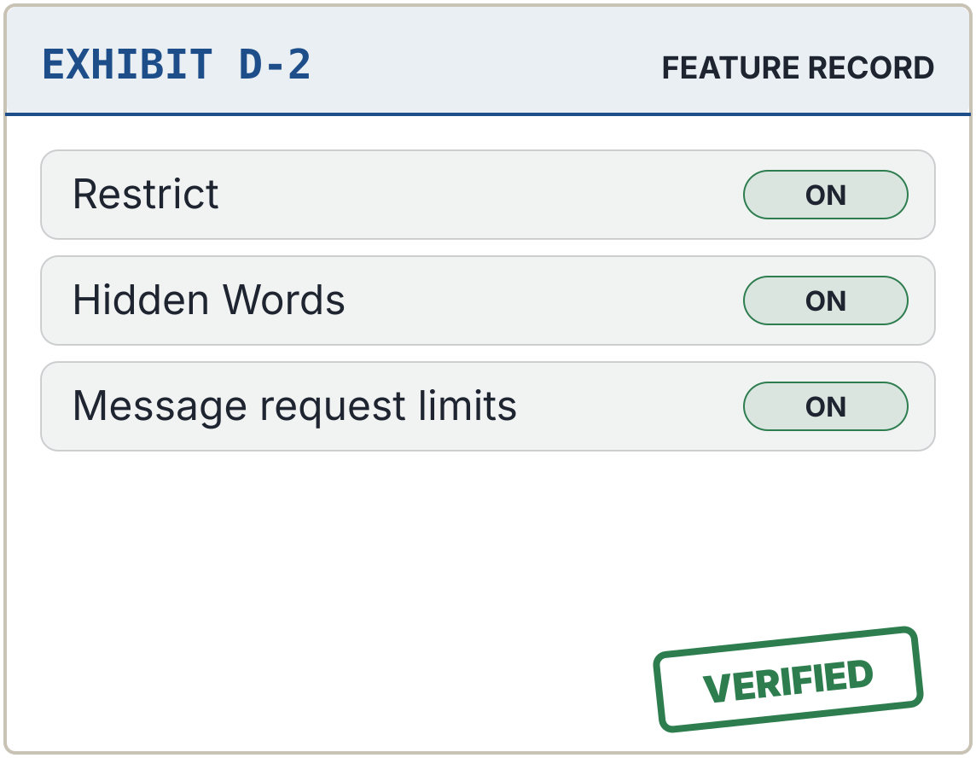
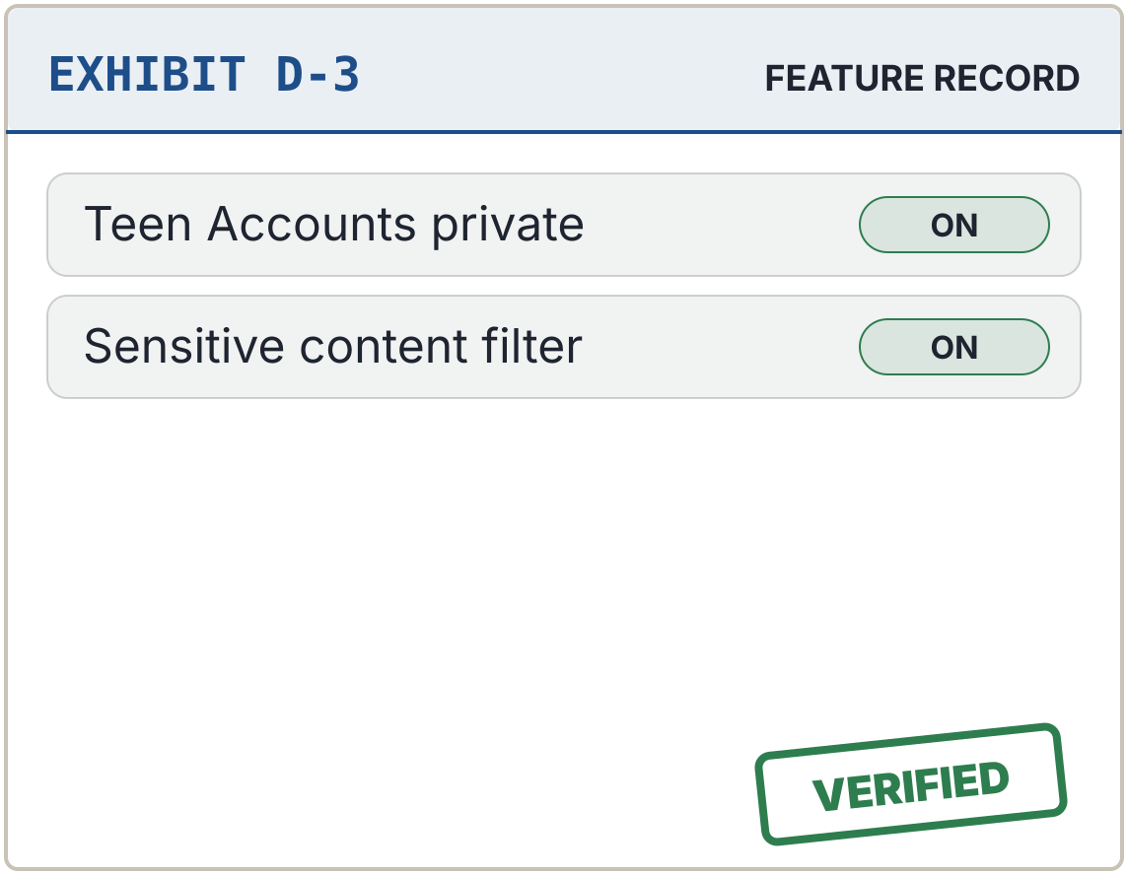
CASE 2 OF 5 · THE PEOPLE v. INSTAGRAM
Case 2 of 5 – Instagram: guilty of leaving private messages unencrypted
PROSECUTION EXHIBITS · HOW THE ACCOUNT FELL
FINDINGS OF THE COURT
Login protection
4 / 5
Encryption by default
1 / 5
Threat alerts
4 / 5
Recovery safety
3 / 5
One stolen login opened both accounts
Private DMs were readable: no default encryption
The DMs became blackmail material
Privacy controls
4 / 5
DEFENCE EXHIBITS · LOCKS THAT WOULD HAVE HELD
TOTAL SCORE
GUILTY
16 / 25
SENTENCE
End-to-end encrypted DMs by default, and blurred explicit images.
“Emails from Instagram” lists real security emails
Harassment controls
Teen Accounts private by default
THE PEOPLE v. YOUR APPS · CASE NO. MCCJ-525/2026 · AHNAF AKIF, ROLL 24
5
Notes:
(about 1 minute)
Thank you. Case 2: The People versus Instagram. Score: 16 out of 25.
[Defence exhibits, bottom row.] The defence presents Meta's two-factor authentication and login alerts, plus a feature we found impressive: "Emails from Instagram", which lists every genuine security email sent in the last 14 days, so users can expose fake ones. It also offers Restrict, Hidden Words, and private-by-default Teen Accounts.
[Prosecution exhibits, top row.] But here is the prosecution's key evidence. Instagram's direct messages were never end-to-end encrypted by default, and on 8 May 2026 Meta removed even the optional encrypted chats. That means Meta can technically access users' private messages. On encryption, Instagram scored just 1 out of 5. And sextortion usually begins in DMs.
[Verdict.] The court finds Instagram guilty of leaving private messages unencrypted.
[Sentence.] We request that encrypted DMs be restored as the default, and that unsolicited explicit images be blurred for all users, not only teenagers.

Slide 6
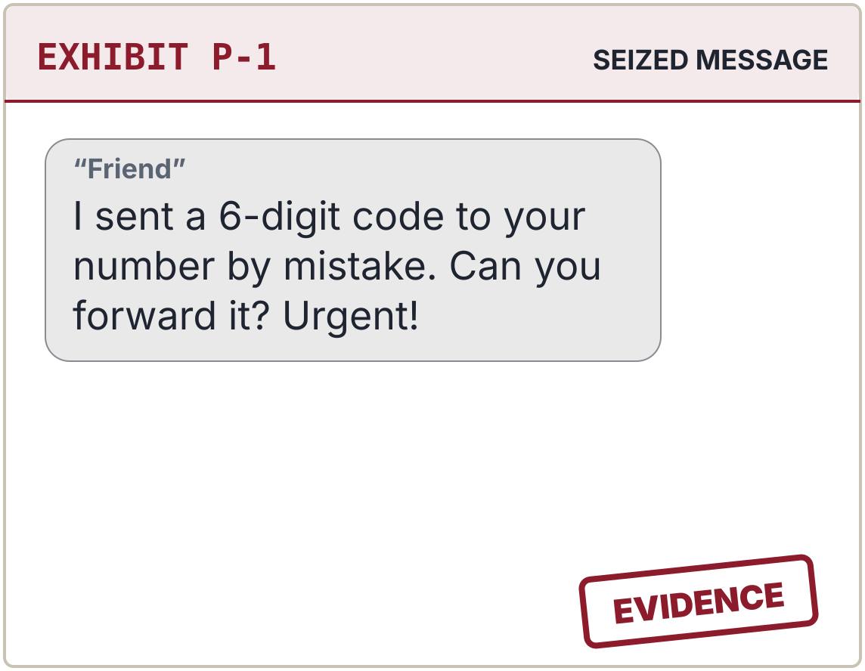
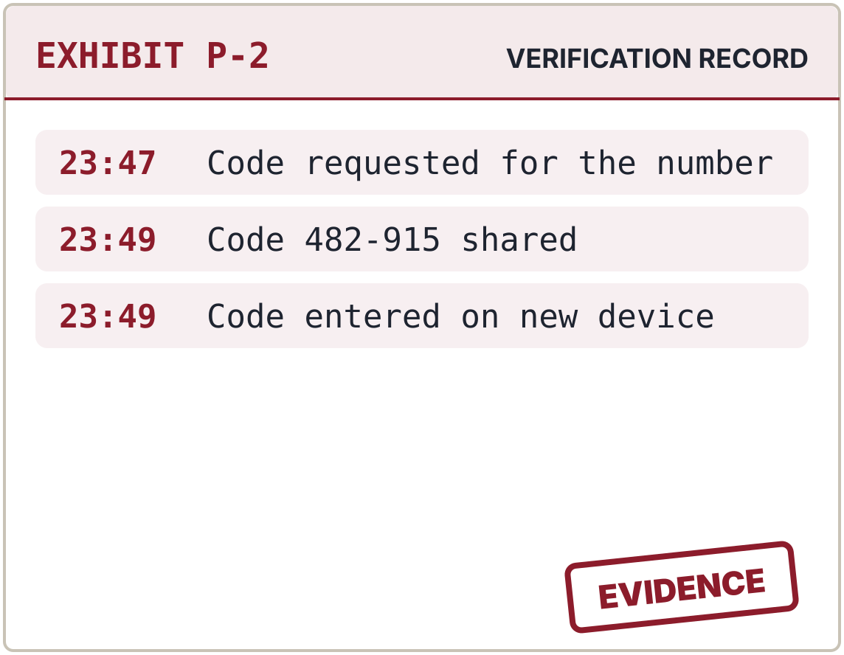
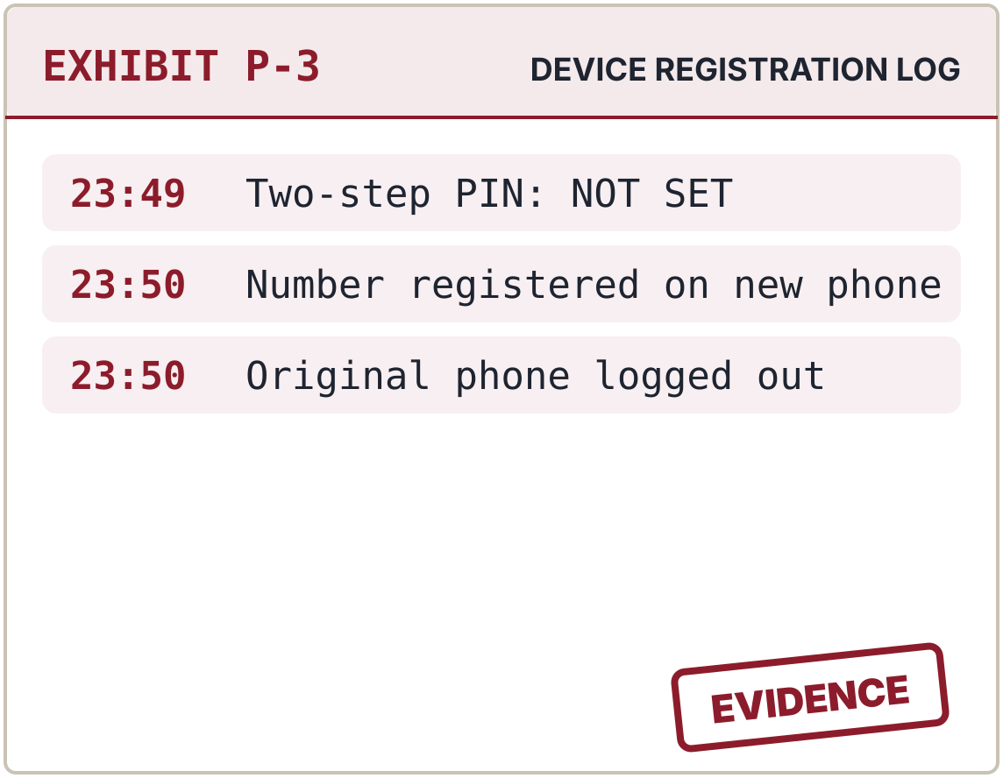
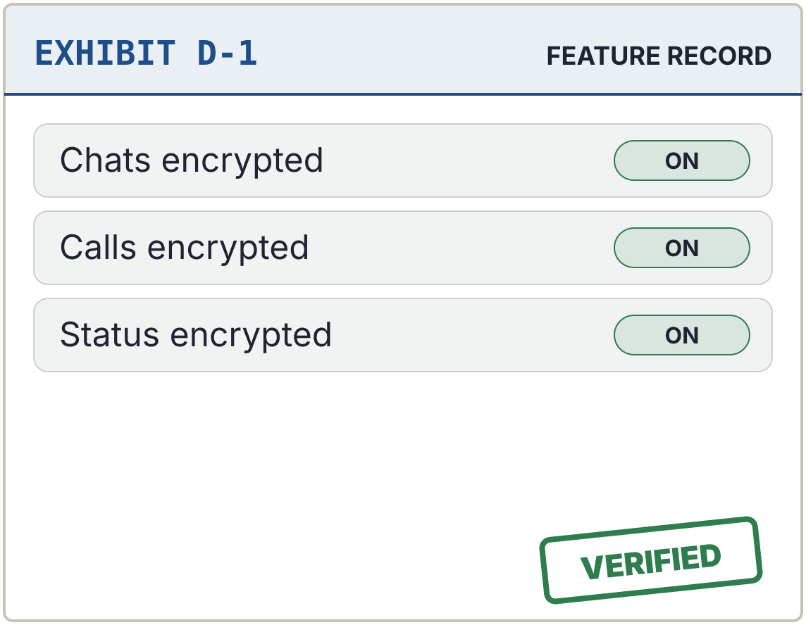
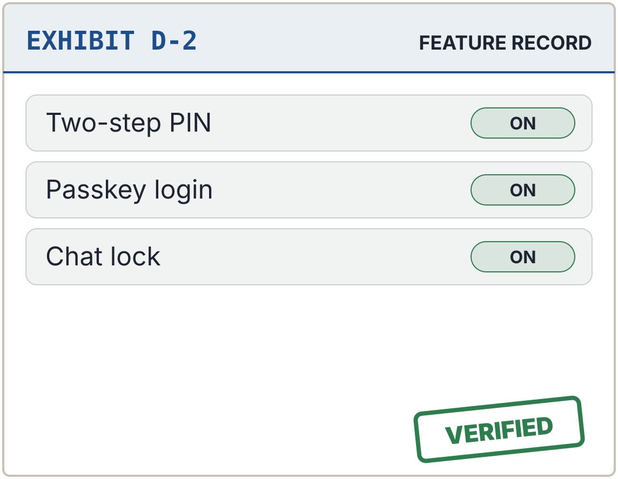
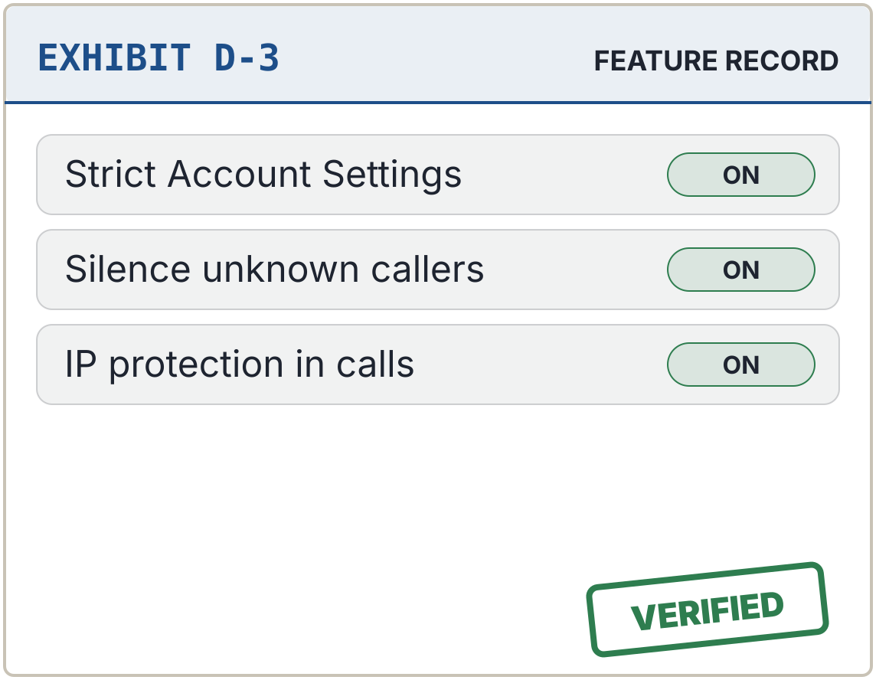
CASE 3 OF 5 · THE PEOPLE v. WHATSAPP
Case 3 of 5 – WhatsApp: not guilty, but its users are being tricked
PROSECUTION EXHIBITS · HOW THE ACCOUNT FELL
FINDINGS OF THE COURT
Login protection
4 / 5
Encryption by default
5 / 5
Threat alerts
3 / 5
Recovery safety
3 / 5
A “friend” asks for the registration code
The code was entered on a new device
No two-step PIN: the account moved
Privacy controls
5 / 5
DEFENCE EXHIBITS · LOCKS THAT WOULD HAVE HELD
TOTAL SCORE
NOT GUILTY
20 / 25
COURT’S ADVICE
A Bangla warning whenever a code is requested, and a two-step PIN for every new account.
End-to-end encryption on by default
A two-step PIN would have stopped it
Strict Account Settings (January 2026)
THE PEOPLE v. YOUR APPS · CASE NO. MCCJ-525/2026 · AHNAF AKIF, ROLL 24
6
Notes:
(about 1 minute)
Case 3: The People versus WhatsApp. Score: 20 out of 25.
[Prosecution exhibits, top row.] The prosecution charged WhatsApp with allowing account hijacking. In Bangladesh, a common scam goes like this: "I sent my code to your number by mistake, please forward it." The victim sends it, and the account is gone.
[Defence exhibits, bottom row.] But the defence evidence is overwhelming. Every personal chat and call is end-to-end encrypted by default; not even WhatsApp can read them. There is a six-digit two-step PIN, which defeats the code scam entirely; passkey login and passkey-protected backups since October 2025; and since January 2026, Strict Account Settings, a one-tap lockdown.
[Verdict.] The court finds WhatsApp not guilty. The locks exist; users are being tricked into opening them.
[Advice.] However, the court advises a clear warning in Bangla whenever a registration code is requested, and making the two-step PIN mandatory.
My colleague will present the next case.

Slide 7

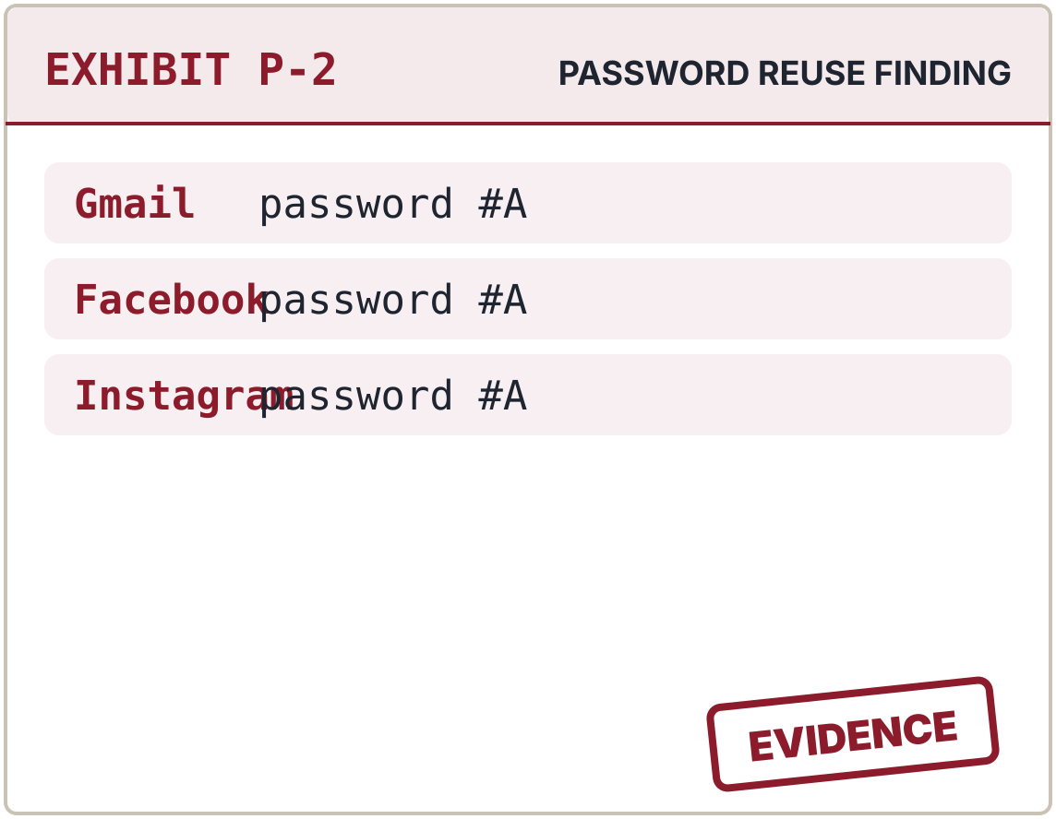
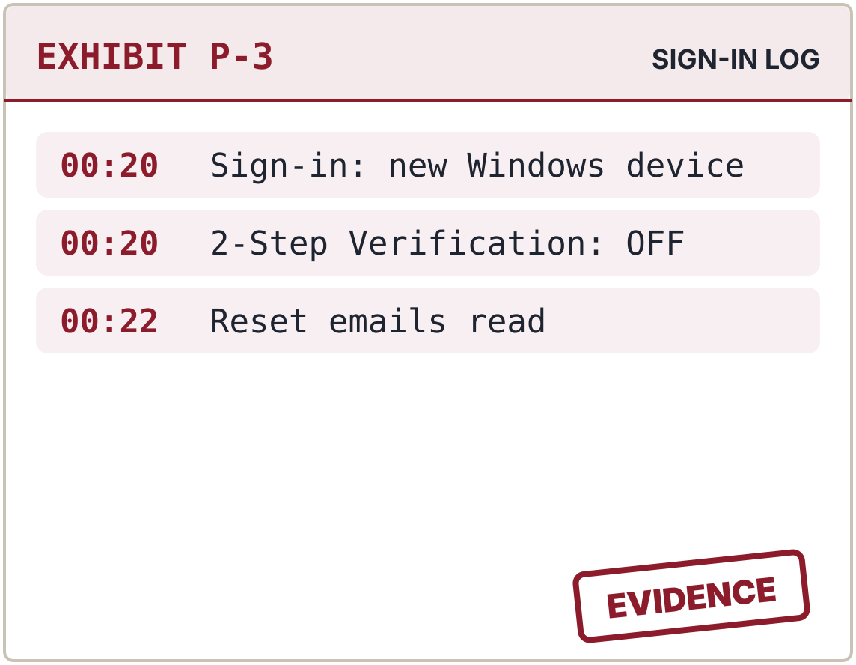
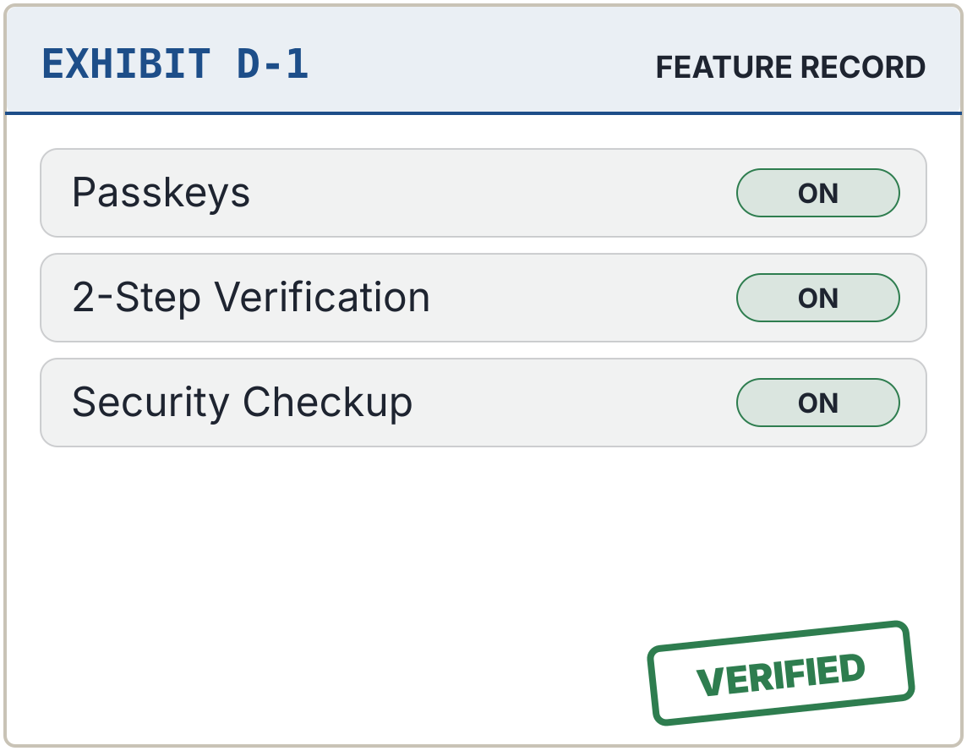
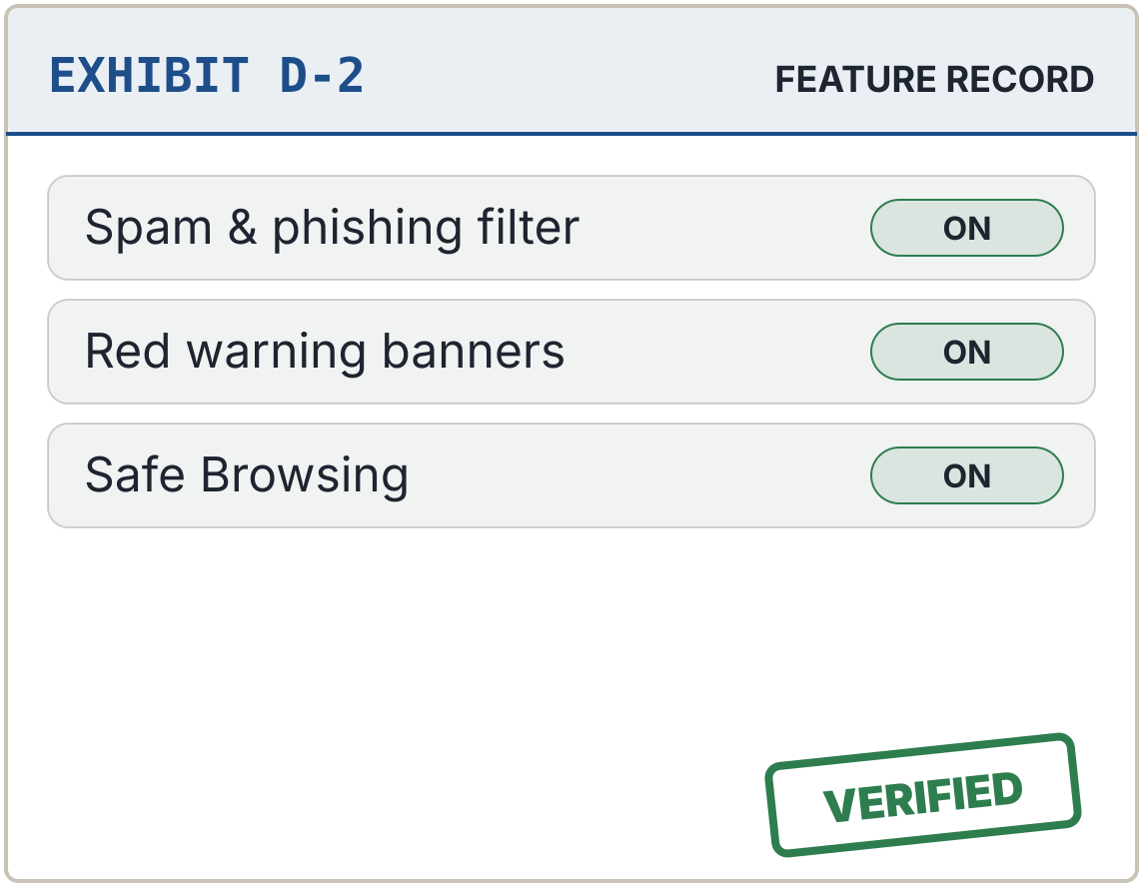
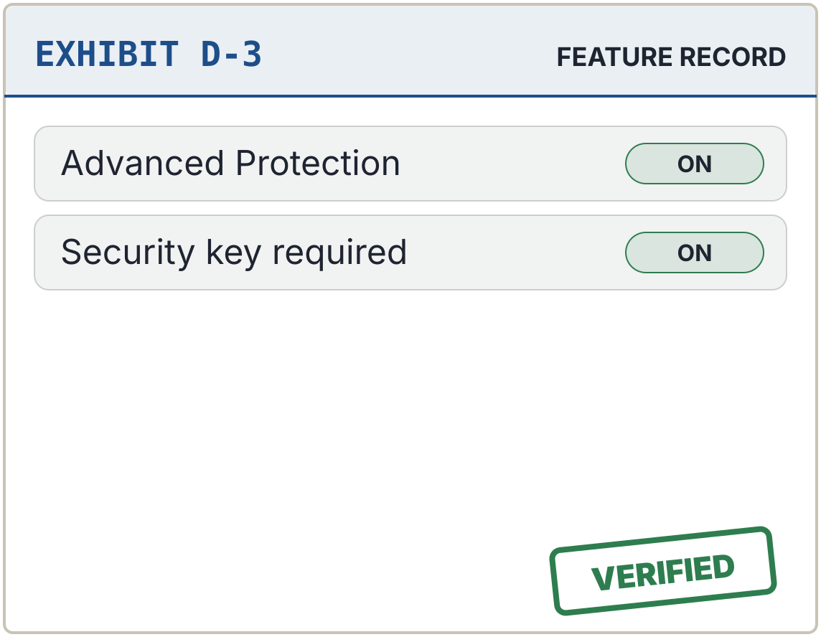
CASE 4 OF 5 · THE PEOPLE v. GMAIL
Case 4 of 5 – Gmail: not guilty, and the best-guarded account on trial
PROSECUTION EXHIBITS · HOW THE ACCOUNT FELL
FINDINGS OF THE COURT
Login protection
5 / 5
Encryption by default
3 / 5
Threat alerts
5 / 5
Recovery safety
4 / 5
A look-alike login page harvested the password
The same password guarded several accounts
No second check was required
Privacy controls
3 / 5
DEFENCE EXHIBITS · LOCKS THAT WOULD HAVE HELD
TOTAL SCORE
NOT GUILTY
20 / 25
COURT’S ADVICE
Warnings for fake bKash, Nagad and bank emails, because Gmail can reset every other account.
Passkeys default since October 2023
Filters block 99.9% of phishing and malware
Advanced Protection for high-risk users
THE PEOPLE v. YOUR APPS · CASE NO. MCCJ-525/2026 · AHNAF AKIF, ROLL 24
7
Notes:
(about 1 minute)
Thank you. Case 4: The People versus Gmail. Score: 20 out of 25, tied for the highest.
[Prosecution exhibits, top row.] The prosecution's concern: personal Gmail is not end-to-end encrypted, so Google can scan message content. And Gmail is the master key. Every "forgot password" link, for Facebook, Instagram, even bKash, goes to your email. If Gmail falls, everything falls.
[Defence exhibits, bottom row.] But the defence has the strongest login protection of any defendant. Passkeys have been the default sign-in since October 2023. There is 2-Step Verification, a Security Checkup and critical sign-in alerts. Google reports that its filters block over 99.9 percent of phishing and malware. And the Advanced Protection Program protects high-risk users with hardware keys.
[Verdict.] The court finds Gmail not guilty.
[Advice.] Still, the court advises optional end-to-end encryption for personal accounts, and special warnings for emails imitating bKash, Nagad or local banks.

Slide 8
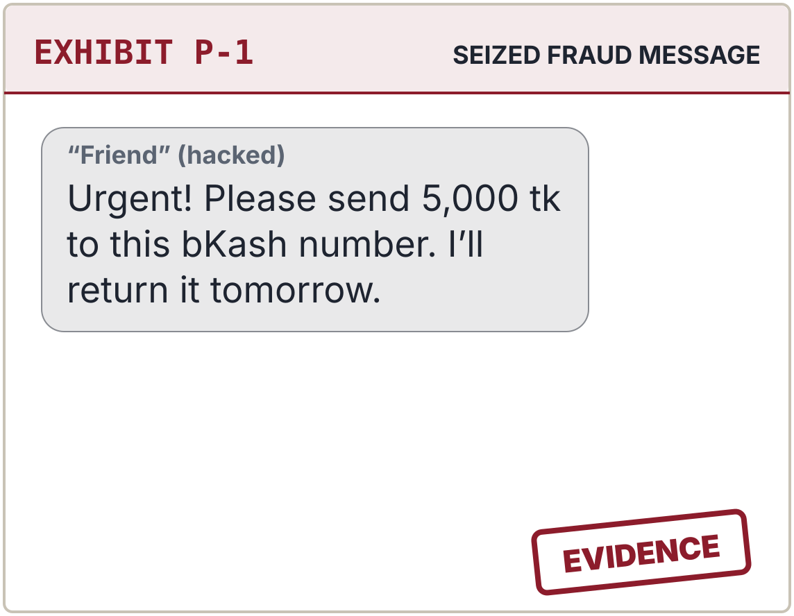
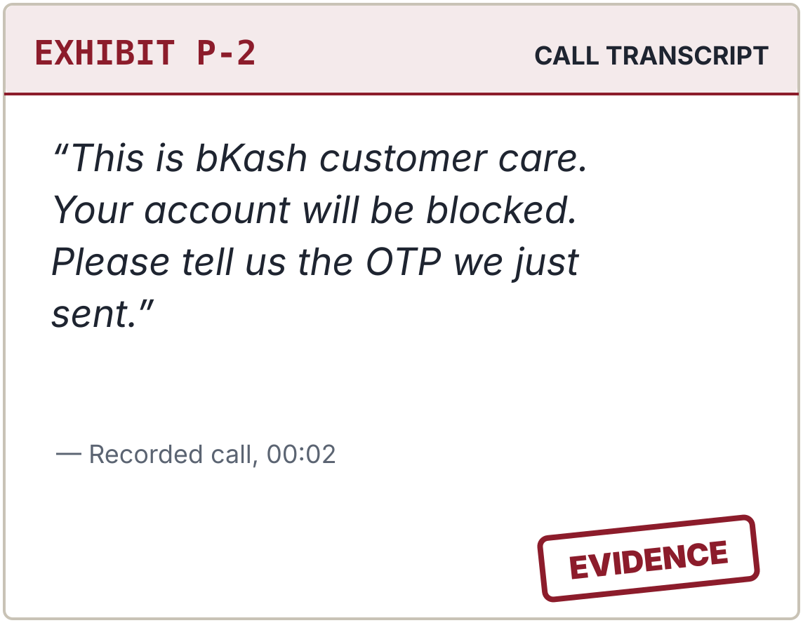
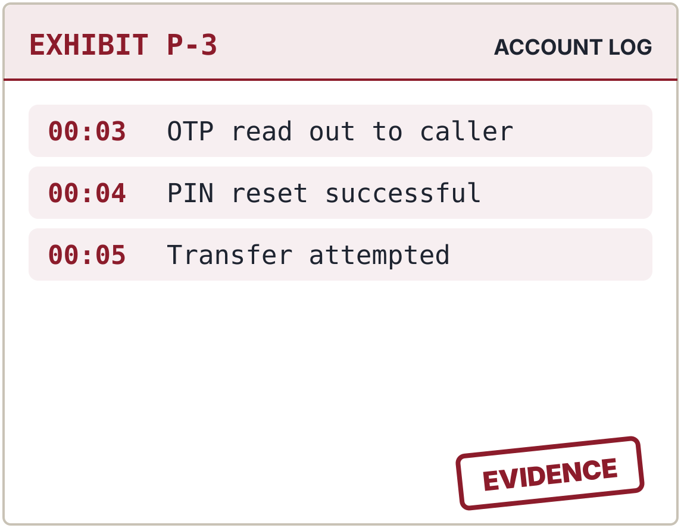
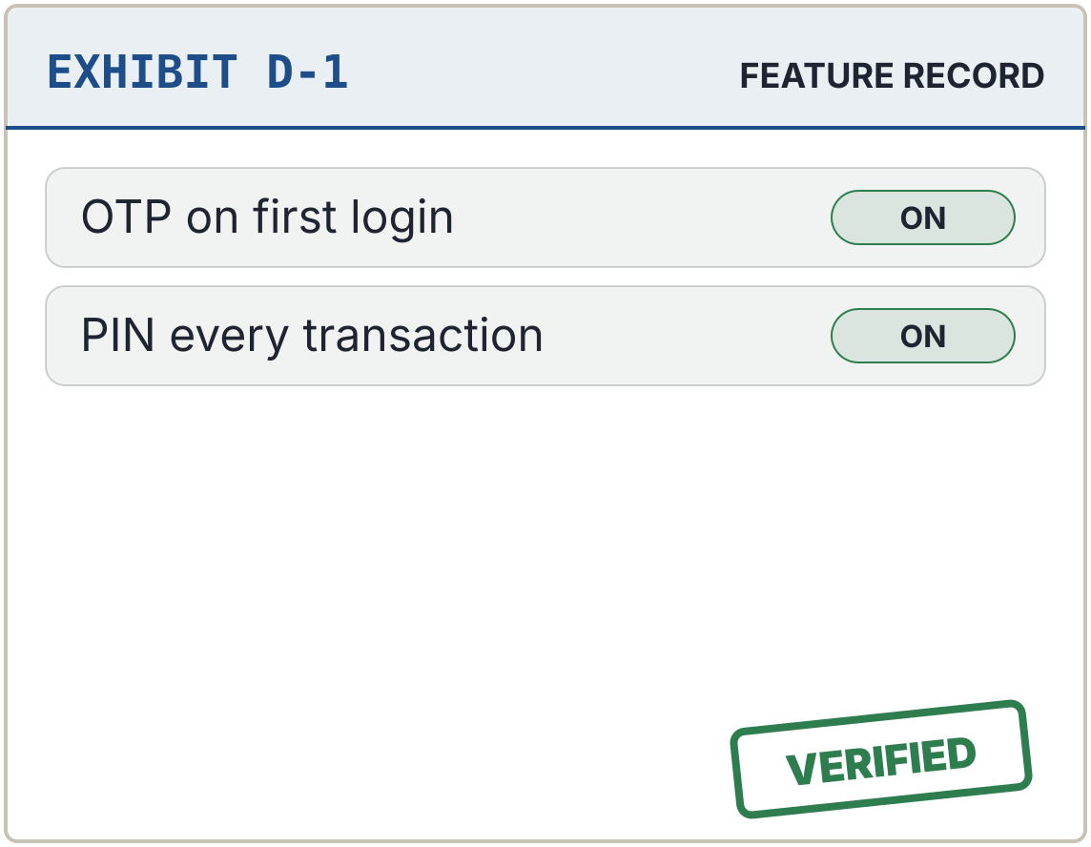
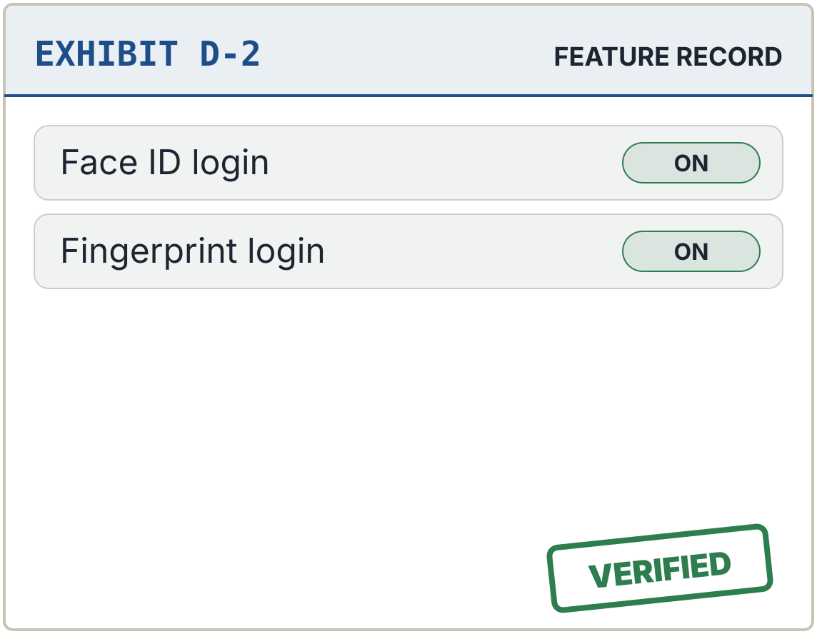
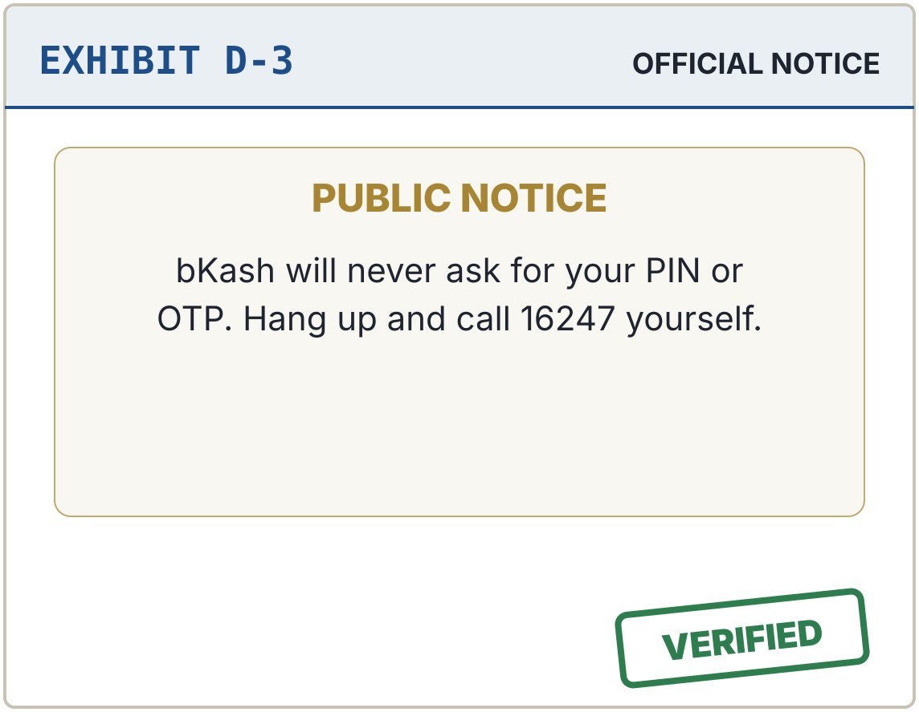
CASE 5 OF 5 · THE PEOPLE v. BKASH
Case 5 of 5 – bKash: guilty of leaving PIN recovery open to scammers
PROSECUTION EXHIBITS · HOW THE ACCOUNT FELL
FINDINGS OF THE COURT
Login protection
4 / 5
Encryption by default
3 / 5
Threat alerts
3 / 5
Recovery safety
2 / 5
A hacked WhatsApp asked friends for money
A fake “bKash” agent asked for the OTP
The OTP was used to reset the PIN
Privacy controls
3 / 5
DEFENCE EXHIBITS · LOCKS THAT WOULD HAVE HELD
TOTAL SCORE
GUILTY
15 / 25
SENTENCE
A separate warning for PIN-reset codes, and a short hold on transfers after a reset code is sent.
An OTP and a PIN guard every login
Face ID and fingerprint (December 2023)
bKash never asks for a PIN or OTP
THE PEOPLE v. YOUR APPS · CASE NO. MCCJ-525/2026 · AHNAF AKIF, ROLL 24
8
Notes:
(about 1 minute)
Case 5: The People versus bKash. Score: 15 out of 25, the lowest.
bKash protects money, so its front door is strong. [Defence exhibits, bottom row.] An OTP on first login, a PIN for every login and transaction, and Face ID or fingerprint login since December 2023.
[Prosecution exhibits, top row.] But the prosecution shows how scammers walk around that lock. A hacked WhatsApp asks friends for “urgent” bKash money. A call “from bKash” asks the victim to read out an OTP. And that OTP lets the scammer reset the PIN. Recovery safety scores just 2 out of 5.
[Findings of the court.] Five security areas, each scored out of five: 15 out of 25 in total.
[Verdict.] The court finds bKash guilty on its weakest count: recovery. Police have arrested gangs running exactly these scams.
[Sentence.] The court orders a separate warning whenever a PIN-reset code is requested, and a short hold on transfers after a reset code is sent.
The prosecution rests, Your Honour.

Slide 9
FINAL JUDGMENT · CASE NO. MCCJ-525/2026
The court finds WhatsApp the most secure for individuals
SCORES OUT OF 25
RULINGS
WhatsApp
20
NOT GUILTY
MOST SECURE: WHATSAPP
Its strongest lock, end-to-end encryption, works from installation with no setup.
Gmail
20
NOT GUILTY
Facebook
16
GUARD IT HARDEST: GMAIL
Best login protection, and the master key to every other account.
GUILTY
Instagram
16
GUILTY
bKash
15
LOWEST: bKASH
Scammers target the user, not the app: never read out an OTP.
GUILTY
Not-guilty line: 20
THE PEOPLE v. YOUR APPS · CASE NO. MCCJ-525/2026 · AHNAF AKIF, ROLL 24
9
Notes:
(about 1 minute)
[Speak slowly and formally.] Thank you to the prosecution. The court has heard all five cases and is ready to deliver its final judgment.
[Point to the ranking.] WhatsApp and Gmail each score 20 out of 25 and are found not guilty. Facebook and Instagram score 16 and are found guilty on their weakest counts: recovery and encryption. bKash scores 15, the lowest, and is found guilty on recovery.
[Right side.] On the question of which platform is the most secure for an individual user, the court finds in favour of WhatsApp. Its strongest protection, end-to-end encryption, works the moment you install it. You do not need to change a single setting.
The court also rules that Gmail must be guarded hardest, because it is the master key to every other account.
And bKash reminds us that scammers target the user, not the app.
But this court has one final order, and it is addressed not to the apps, but to you.

Slide 10

ORDERS OF THE COURT · EFFECTIVE TONIGHT
The most secure app is the one you set up
I
ORDER 1 Turn on two-factor authentication or a passkey on every account
II
ORDER 2 Set a two-step verification PIN on WhatsApp
III
ORDER 3 Never share an OTP or a six-digit code, with anyone
IV
ORDER 4 Confirm your recovery email and phone number
V
ORDER 5 Log out of any device you do not recognise
Court is adjourned. Thank you. Questions from the gallery?
THE PEOPLE v. YOUR APPS · CASE NO. MCCJ-525/2026 · AHNAF AKIF, ROLL 24
10
Notes:
(about 1 minute)
Our biggest finding is this: almost every attack we studied succeeded not because a lock was broken, but because a lock was never switched on, or a code was handed over.
So this court issues five orders to everyone in this room, effective tonight. [Go through the cards.]
Order 1: enable two-factor authentication or a passkey on every account, starting with your email.
Order 2: set a two-step verification PIN on WhatsApp. It takes thirty seconds.
Order 3: never share an OTP or six-digit code with anyone. Not a friend, not "Facebook support", not "bKash". Genuine companies never ask.
Order 4: confirm your recovery email and phone number still belong to you.
Order 5: log out of any device you do not recognise.
[Pause.] The most secure app is the one you set up.
[Optional: tap the desk like a gavel.] Court is adjourned. Thank you, and we welcome questions from the gallery.

