Slide 1





MCCJ 525 / CYBERCRIMES AND SECURITY
Think Like a Hacker
Five platforms through the offender’s eyes, and the guardians that stop them
Ahnaf Akif · Roll 24 · MCCJ 525
TARGET ACQUIRED
Notes:
(about 1 minute)
[Start by looking around the room slowly.]
Imagine, for the next ten minutes, that you are not a student. You are a cybercriminal. You are sitting in a small room with a laptop, and every account in this room is a possible target.
Which one would you go after first? The one with the most money? The most followers? No. You would go after the easiest one.
Good morning. I am Ahnaf Akif, Roll 24, and our presentation is called "Think Like a Hacker." To understand how secure Facebook, Instagram, WhatsApp, Gmail and bKash really are, we decided to look at them the way an offender does: not "what features does this app have?", but "what stands between me and this account?"
As criminology students, we have a theory for exactly this question. Let me show you.

Slide 2




01 / THE THEORY · ROUTINE ACTIVITY (COHEN & FELSON, 1979)
Crime happens when three things meet in the same place
I can’t remove the offenders, and we can’t stop being targets. The one corner we control is the guardian.
MOTIVATED OFFENDER
Scammers, hackers, extortionists
CRIME
21.65%
78.78%
12%
had an account hacked
are aged 18–30
reported it to police
SUITABLE TARGET
≈64M Facebook users in Bangladesh
NO CAPABLE GUARDIAN
Weak or switched-off security
Sources: Cohen & Felson (1979); Cyber Crime Awareness Foundation (2024), reported by Dhaka Tribune; Statista (2025).
Notes:
(about 1 minute)
This is Routine Activity Theory, from Cohen and Felson, 1979. It says a crime happens when three things meet: [point to each corner] a motivated offender, a suitable target, and the absence of a capable guardian.
Online, the offenders are scammers, hackers and extortionists. The targets are us: around 64 million Bangladeshis on Facebook alone.
[Right side.] The numbers prove it. In the Cyber Crime Awareness Foundation's 2024 study, account hacking was the number one cybercrime, affecting 21.65 percent of victims. 78.78 percent of victims were aged 18 to 30. And only 12 percent reported it to the police.
Here is the key idea of our presentation. We cannot remove the offenders, and we cannot stop being targets. The one corner we control is the guardian: the security features on our accounts, and whether we switch them on.

Slide 3
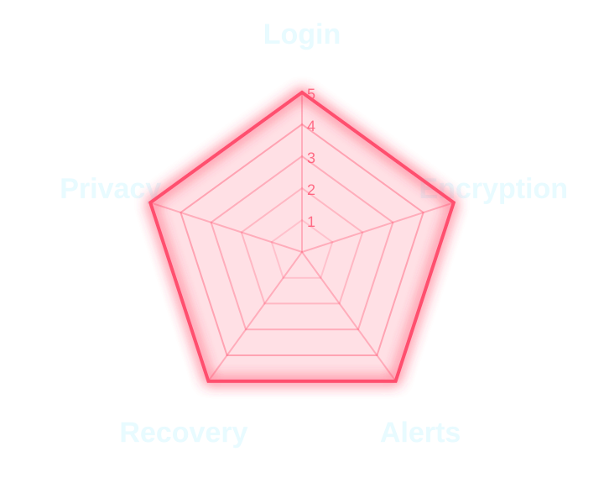
02 / THE OFFENDER’S CHECKLIST
A hacker sizes up every account with five questions
“Can I get in with just a stolen password?”
Login protection
SCORED 1–5 · MAX 25
01
02
“Can messages be read on the company’s servers?”
Encryption by default
03
“Will the owner be warned that I’m in?”
Threat alerts
04
“Can I lock the real owner out?”
Recovery safety
05
“Can I find and message the victim?”
Privacy controls
Targets ranked the way a hacker would: softest first.
Notes:
(about 1 minute)
So how does a hacker decide which account to attack? We believe they ask five questions. [Read the red questions in a hacker's voice.]
"Can I get in with just a stolen password?"
"Can the messages be read on the company's servers?"
"Will the owner be warned that I'm in?"
"Can I lock the real owner out?"
"Can I find and message the victim?"
[Point to the blue column.] Each question is answered by a guardian: login protection, encryption by default, threat alerts, recovery safety and privacy controls. We scored each guardian from 1 to 5, so the strongest possible platform scores 25.
We gathered the evidence from the security settings on our own accounts, and checked it against official help pages and recent news.
And instead of going alphabetically, we will go the way a hacker would: from the softest target to the hardest. The softest target is the one that holds your money: bKash.

Slide 4
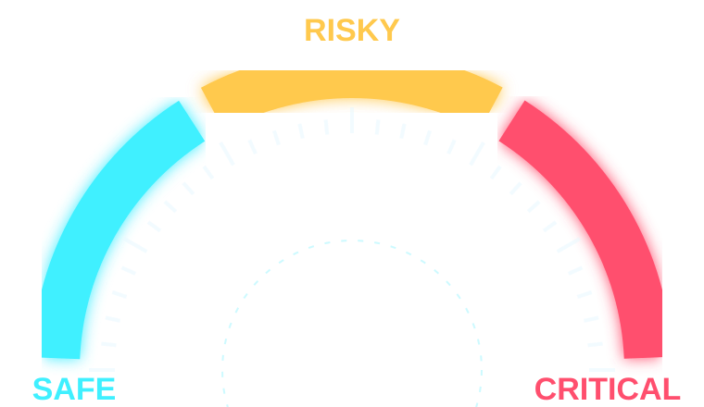

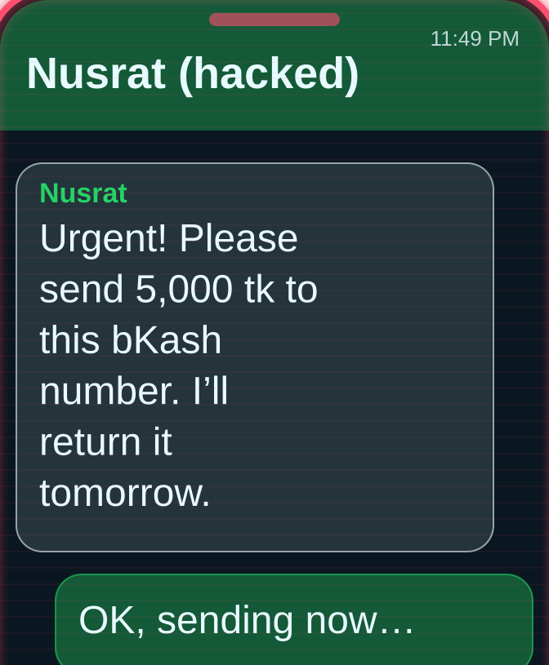
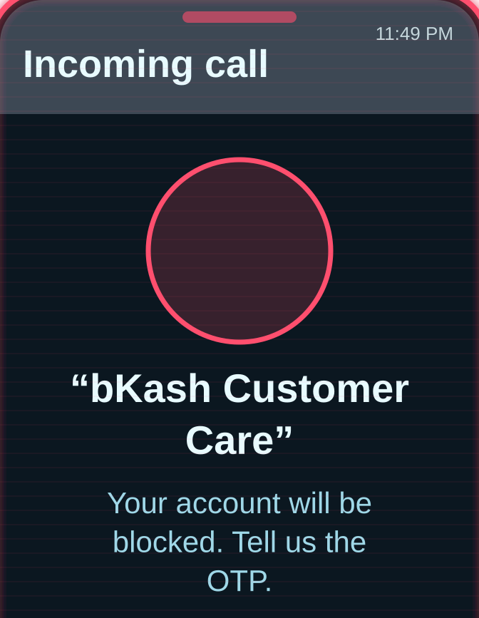
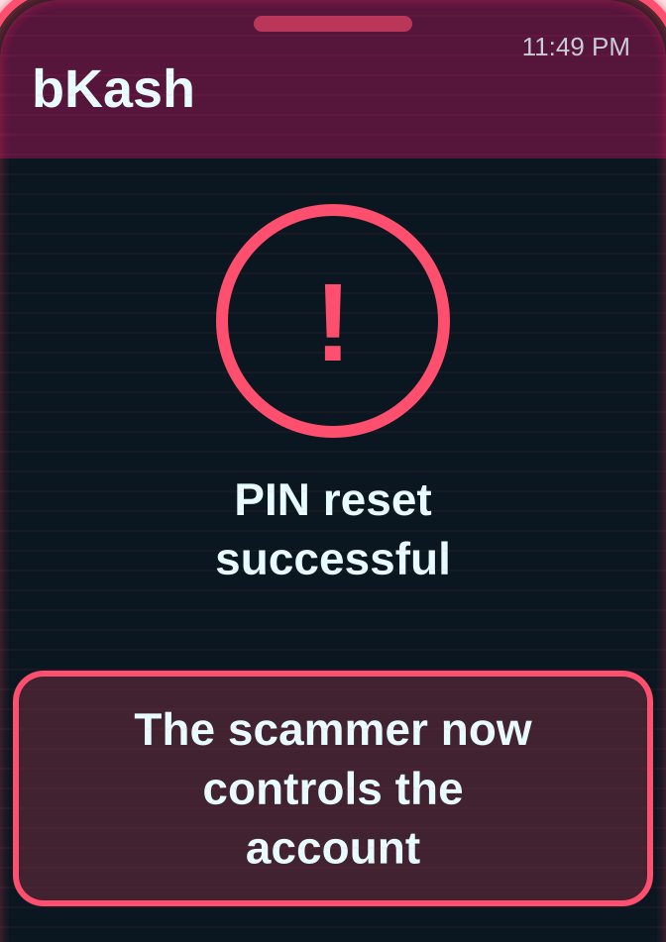
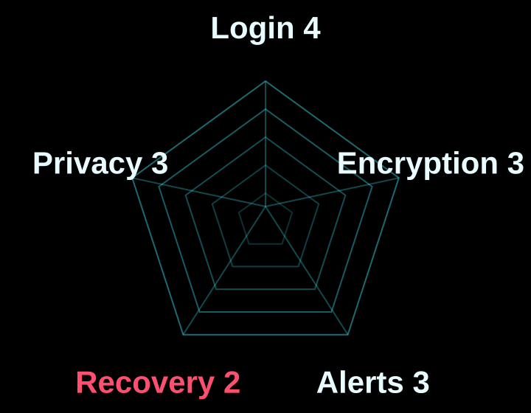

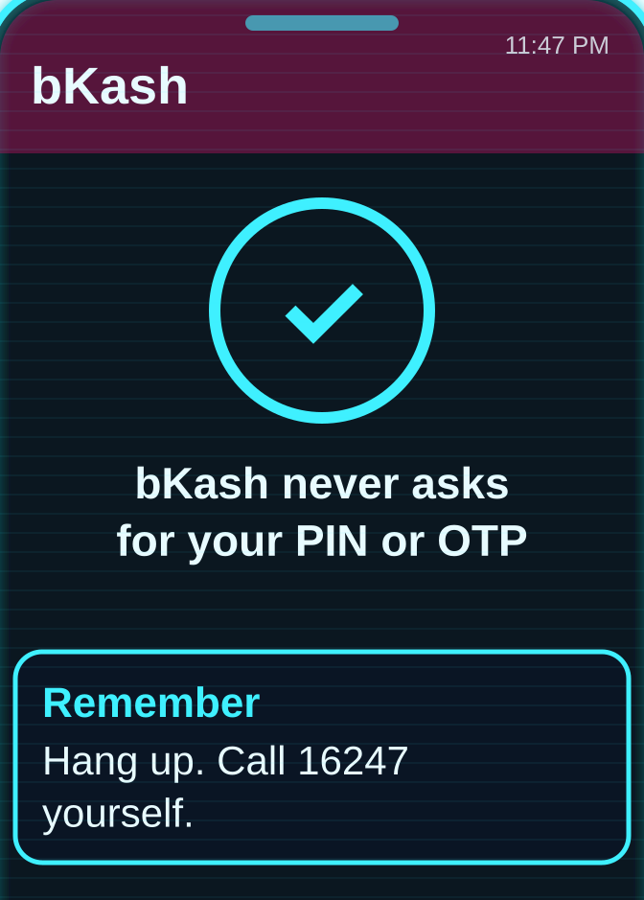
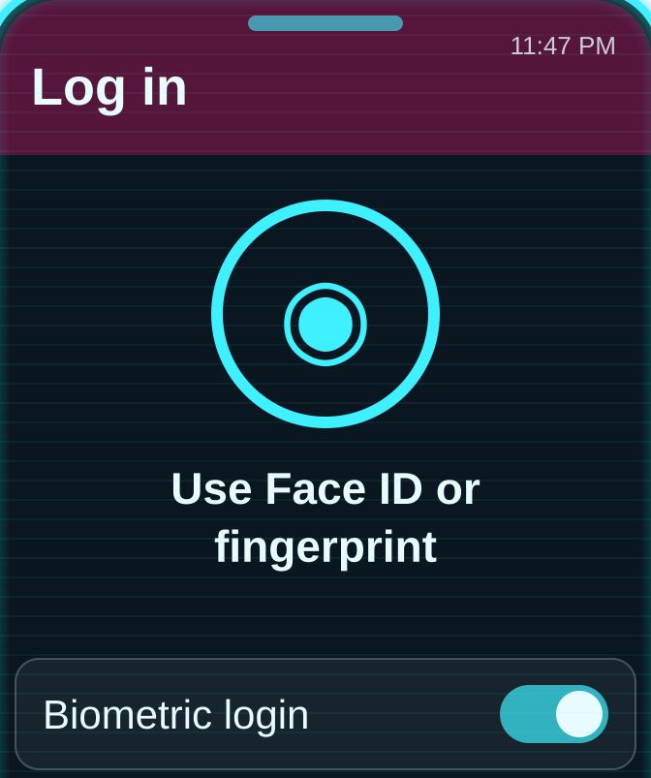
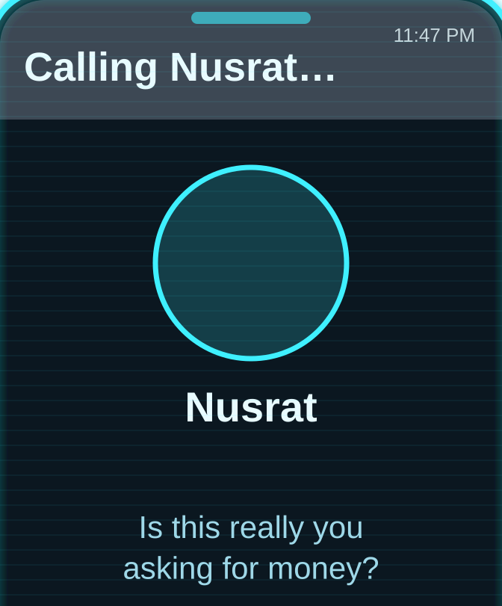
03 / SOFTEST TARGET / BKASH
Target 1 – bKash: the softest target, because I ask you for the key
THE HACKER’S PLAN “I don’t hack bKash. I call you, say I’m from bKash, and you read me the OTP.”
THREAT LEVEL
THE ATTACK · HOW I GET IN
01
02
03
NO GUARDIANS: CRITICAL
WITH GUARDIANS: 15/25 · SOFT TARGET
Hacked WhatsApp asks friends for bKash money
A call “from bKash” asks for the OTP
Reading out the OTP lets him reset the PIN
GUARDIAN RADAR · 15 / 25
GUARDIANS IN THE WAY · WHAT STOPS ME
01
02
03
Never share an OTP or PIN: bKash never asks
Log in with Face ID or fingerprint
Call friends back before sending money
Guardian to add: a separate warning for PIN-reset codes, and a short hold on transfers after a reset code is sent
Notes:
(about 1 minute)
[Switch into "hacker voice" for the red quote.] "I don't hack bKash. I call you, say I'm from bKash, and you read me the OTP."
[Normal voice.] Target one: bKash. Guardian strength: 15 out of 25, the softest target.
[Red screenshots, the attack.] First I use a hacked WhatsApp to ask the victim's friends for urgent bKash money. Then I call pretending to be bKash customer care and ask for the OTP. Once it is read out, I reset the PIN, and the account is mine. Recovery safety: 2 out of 5.
[Cyan screenshots, the guardians.] The guardians are real: bKash never asks for your PIN or OTP, Face ID or fingerprint login, and calling your friend back before you send money.
[Meter and radar.] Without guardians the needle hits critical; with them, bKash is still only in the risky zone.
[Guardian to add.] A separate warning for PIN-reset codes, and a short hold on transfers after a reset code is sent.

Slide 5
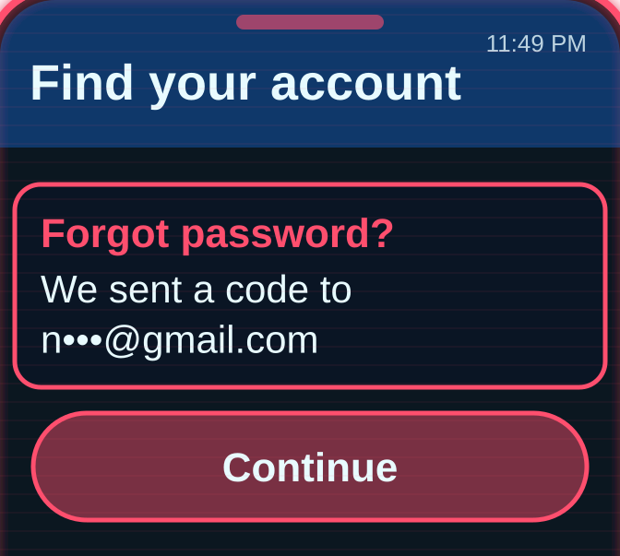
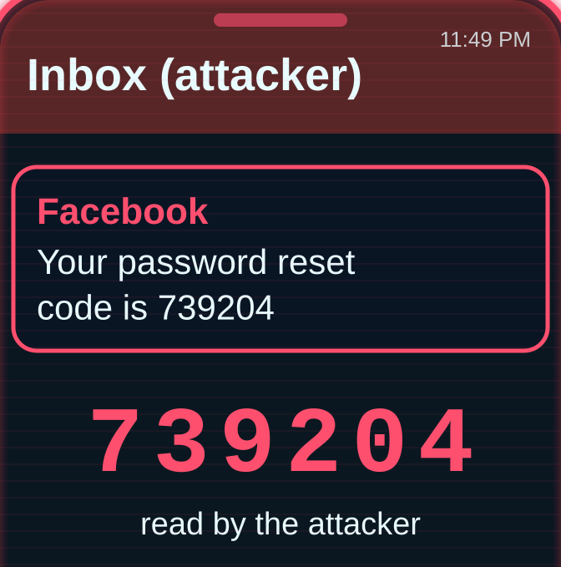
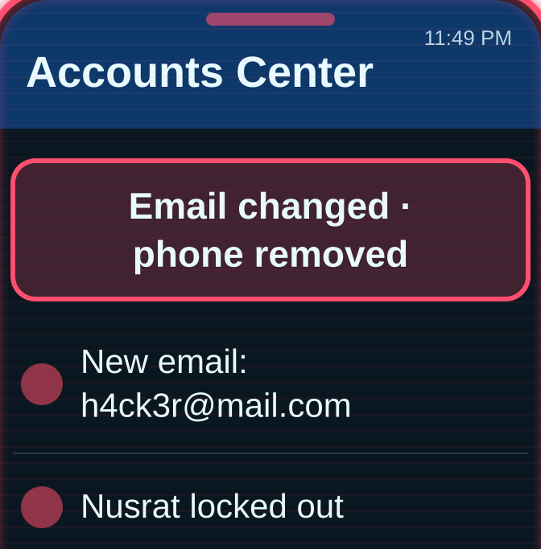


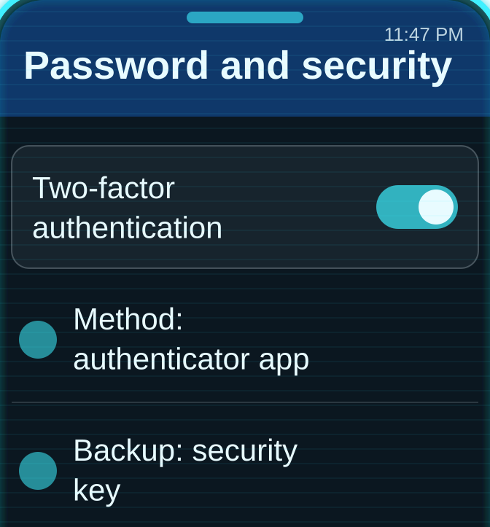
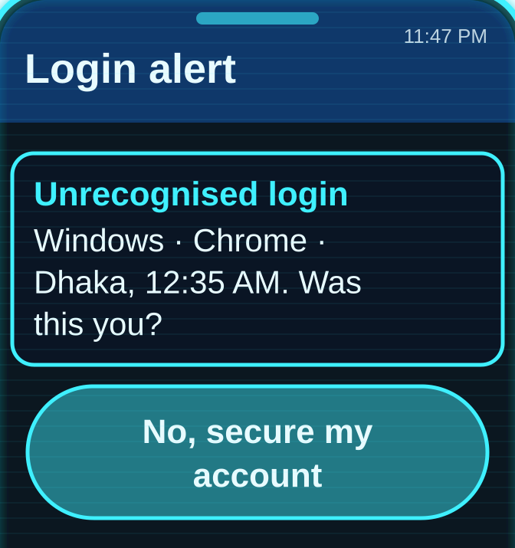
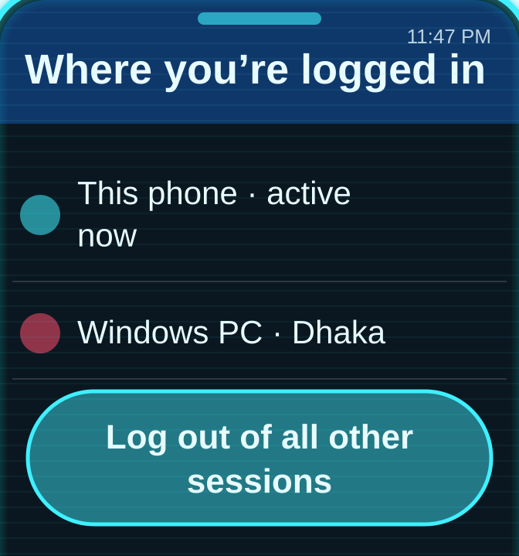
04 / TARGET 2 / FACEBOOK
Target 2 – Facebook: strong locks, but the back door is recovery
THE HACKER’S PLAN “I phish the password with a fake ‘copyright violation’ notice, then swap the recovery email and phone before the owner wakes up.”
THREAT LEVEL
THE ATTACK · HOW I GET IN
01
02
03
NO GUARDIANS: CRITICAL
WITH GUARDIANS: 16/25 · SOFT TARGET
“Forgot password” link goes to hacked Gmail
He resets the Facebook password
Recovery email and phone are swapped
GUARDIAN RADAR · 16 / 25
GUARDIANS IN THE WAY · WHAT STOPS ME
01
02
03
2FA with an app or a security key
Login alerts + “Where you’re logged in”
Keep recovery email and phone up to date
Guardian to add: a 48-hour wait before a new email, phone number or 2FA change takes effect
Notes:
(about 1 minute)
[Hacker voice.] "I phish the password with a fake copyright violation notice, then swap the recovery email and phone before the owner wakes up."
[Normal voice.] Target two: Facebook. Guardian strength: 16 out of 25.
Facebook's front door is well guarded: two-factor authentication through an app, SMS or a security key, login alerts, remote log-out, passkeys since June 2025, profile lock, and Messenger chats encrypted by default.
[Red weak spot.] But the back door is recovery. Once a hacker is in, they can change the recovery email and phone number within minutes, while the real owner waits days or weeks to get the account back. Recovery safety scored just 2 out of 5. [Point to the meter.]
[Blue card.] The guardian we would add: a 48-hour cool-down before recovery details can change, alerts to the old email and phone, and real human support in Bangla.

Slide 6
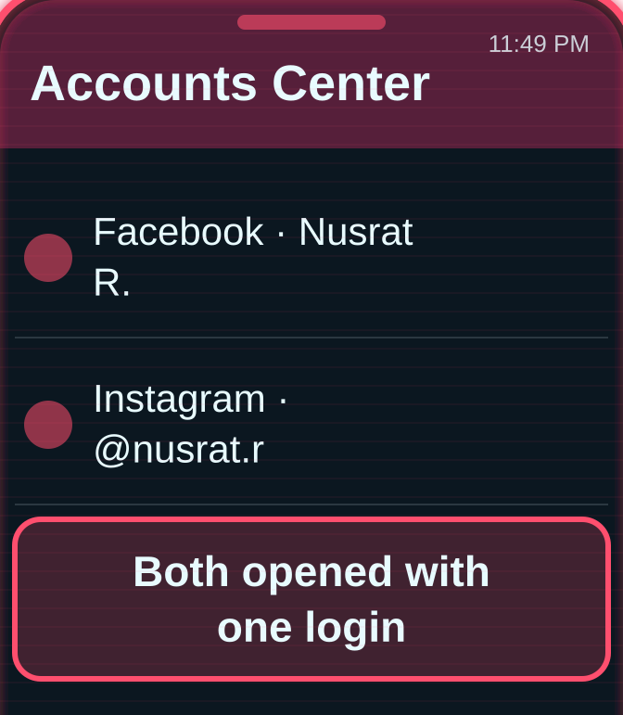
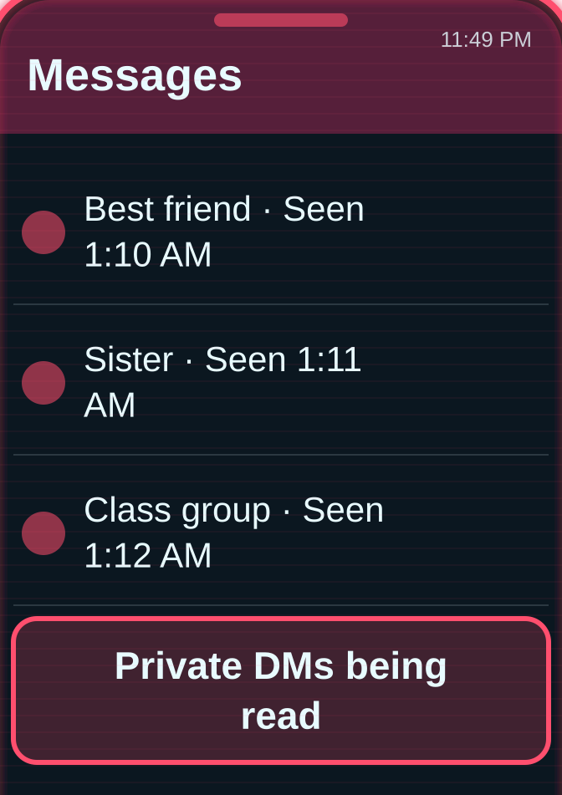
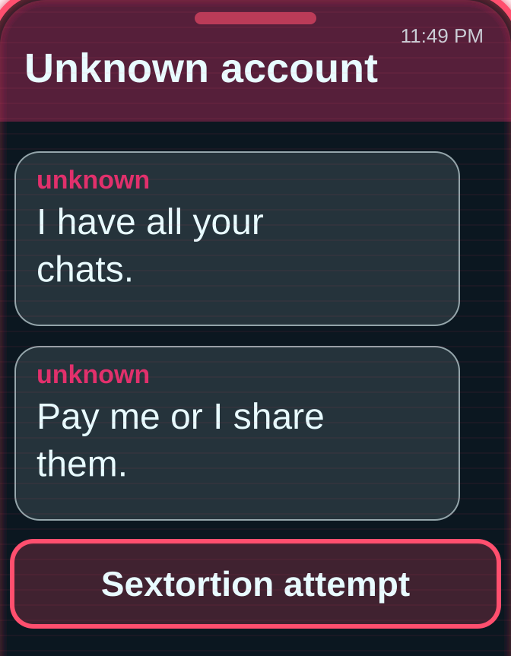
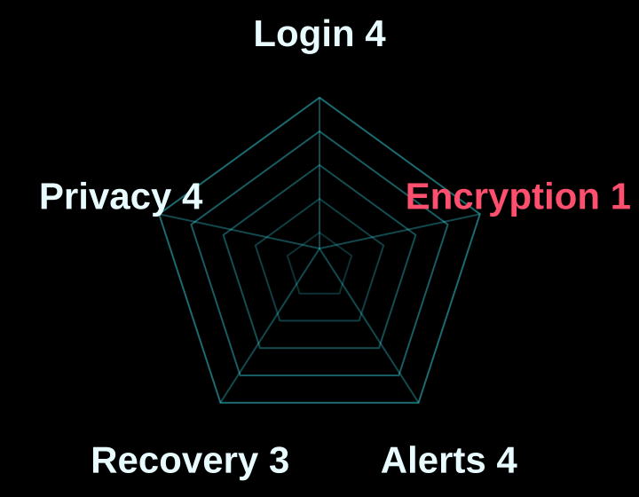

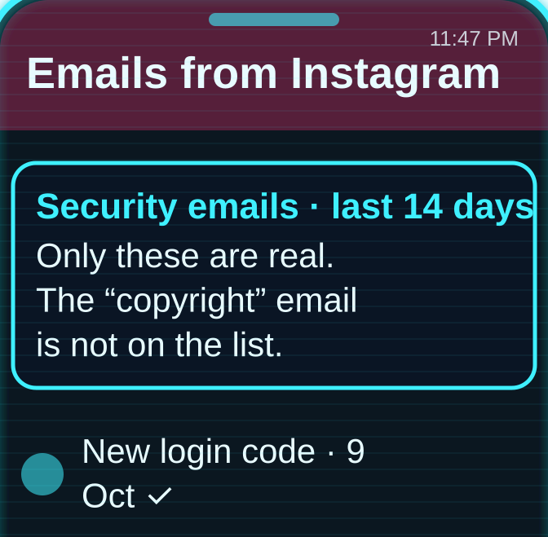
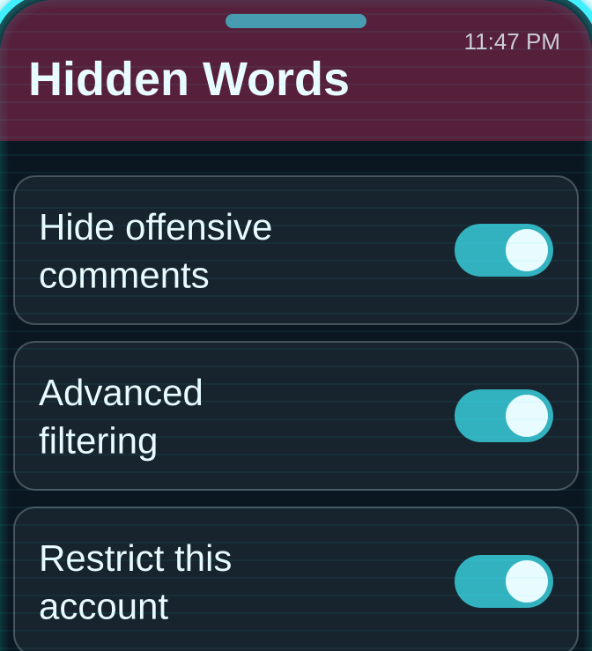
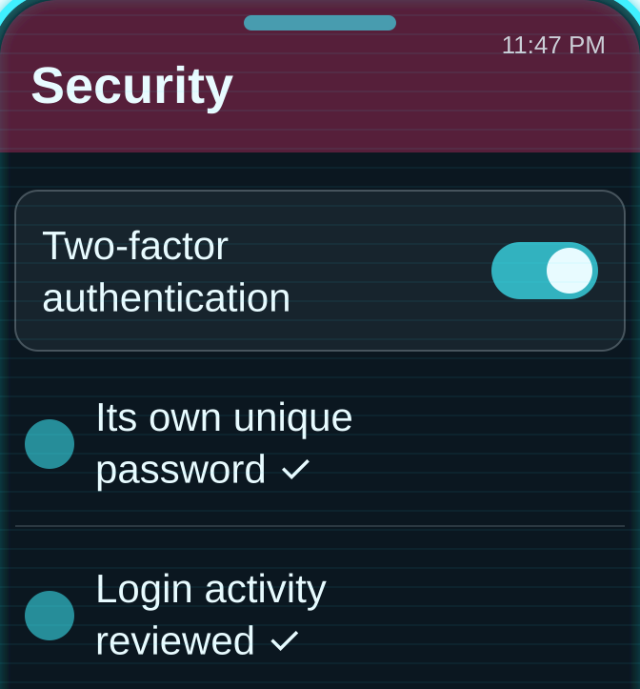
05 / TARGET 3 / INSTAGRAM
Target 3 – Instagram: once inside, the DMs are an open book
THE HACKER’S PLAN “I get in through linked Meta accounts and read the DMs. They aren’t end-to-end encrypted, so private photos become my leverage.”
THREAT LEVEL
THE ATTACK · HOW I GET IN
01
02
03
NO GUARDIANS: CRITICAL
WITH GUARDIANS: 16/25 · SOFT TARGET
Linked to Facebook through Accounts Center
Her private DMs are read
The messages are used for blackmail
GUARDIAN RADAR · 16 / 25
GUARDIANS IN THE WAY · WHAT STOPS ME
01
02
03
Check “Emails from Instagram” for real alerts
Use Restrict and Hidden Words
Its own password + 2FA
Guardian to add: end-to-end encrypted DMs by default, and blurred explicit images
Notes:
(about 1 minute)
[Hacker voice.] "I get in through linked Meta accounts and read the DMs. They aren't end-to-end encrypted, so private photos become my leverage."
[Normal voice.] Target three: Instagram. Guardian strength: 16 out of 25.
That quote describes how sextortion often begins. Instagram DMs were never end-to-end encrypted by default, and on 8 May 2026 Meta removed even the optional encrypted chats. On encryption, Instagram scored just 1 out of 5. [Point to the meter.]
[Cyan screenshots.] The other guardians are decent: Meta's two-factor authentication and login alerts, Restrict and Hidden Words against harassment, private-by-default Teen Accounts, and a clever one: "Emails from Instagram", which lists every real security email from the last 14 days, so you can expose a fake one.
[Blue card.] The guardian we would add: restore encrypted DMs as the default, and blur unsolicited explicit images for every user, not just teenagers.

Slide 7
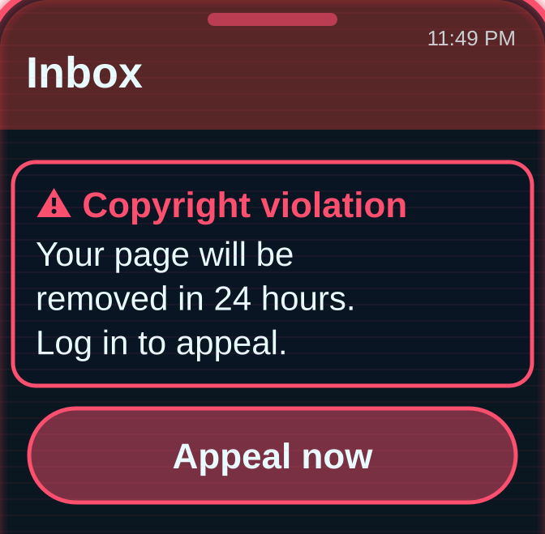
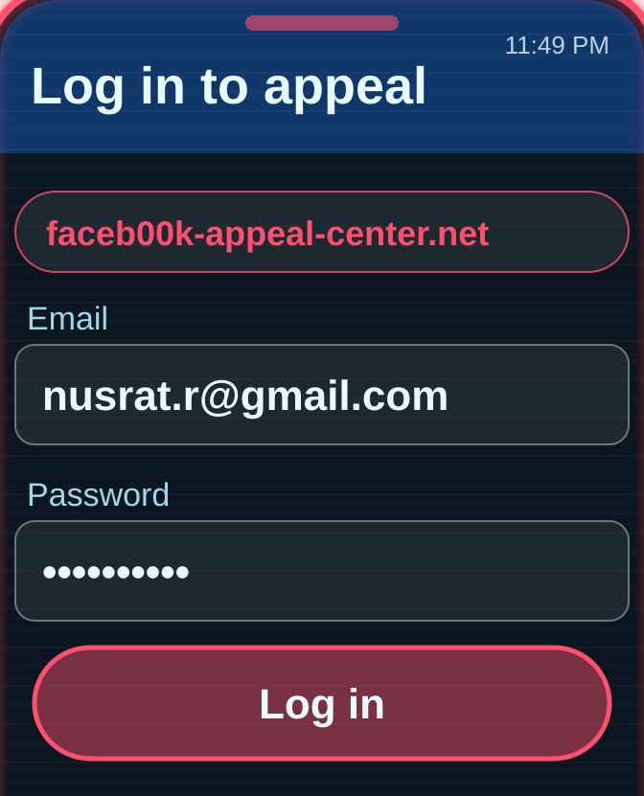
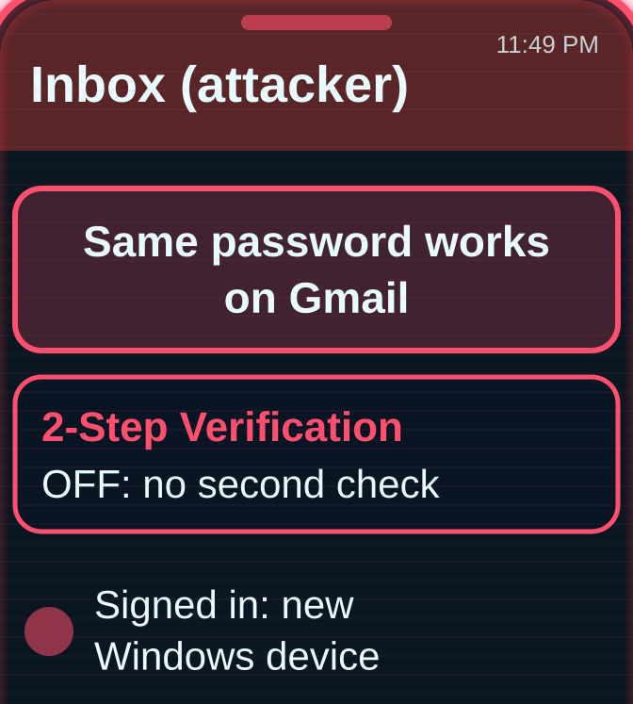
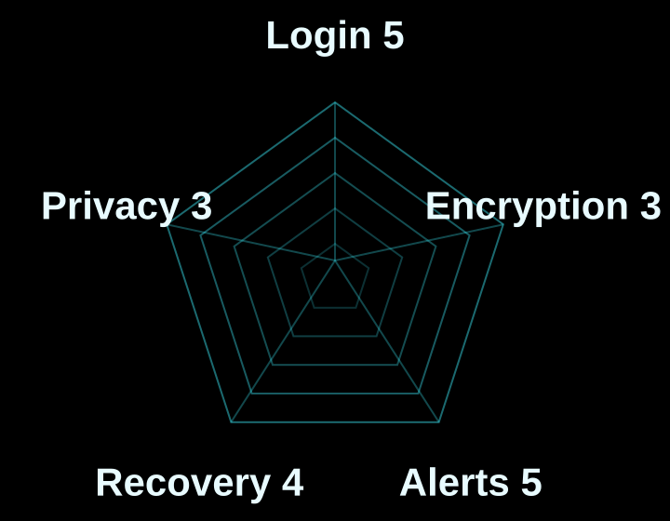

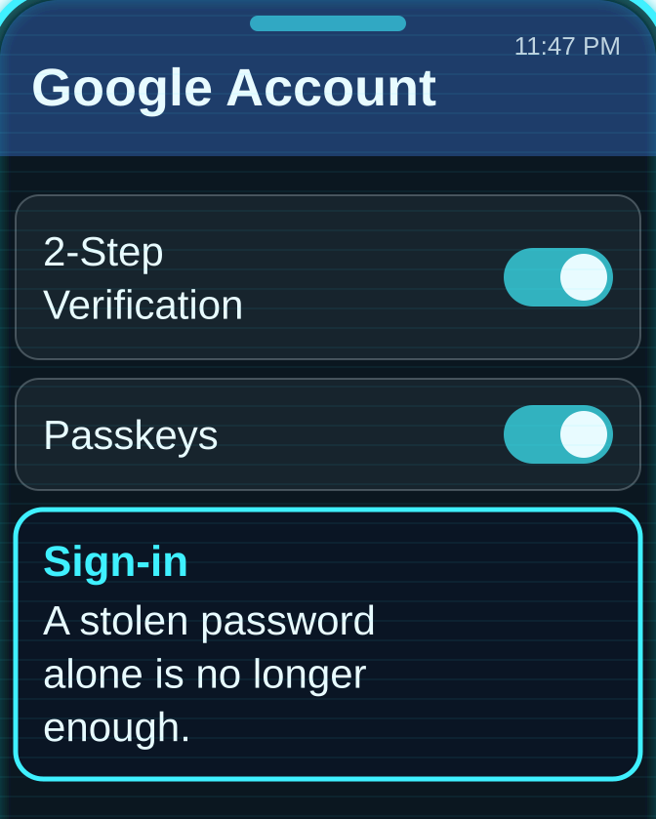
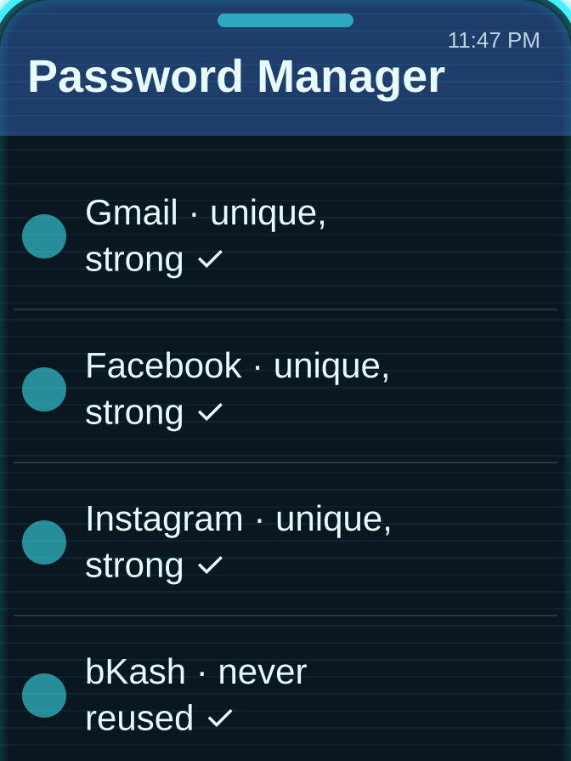
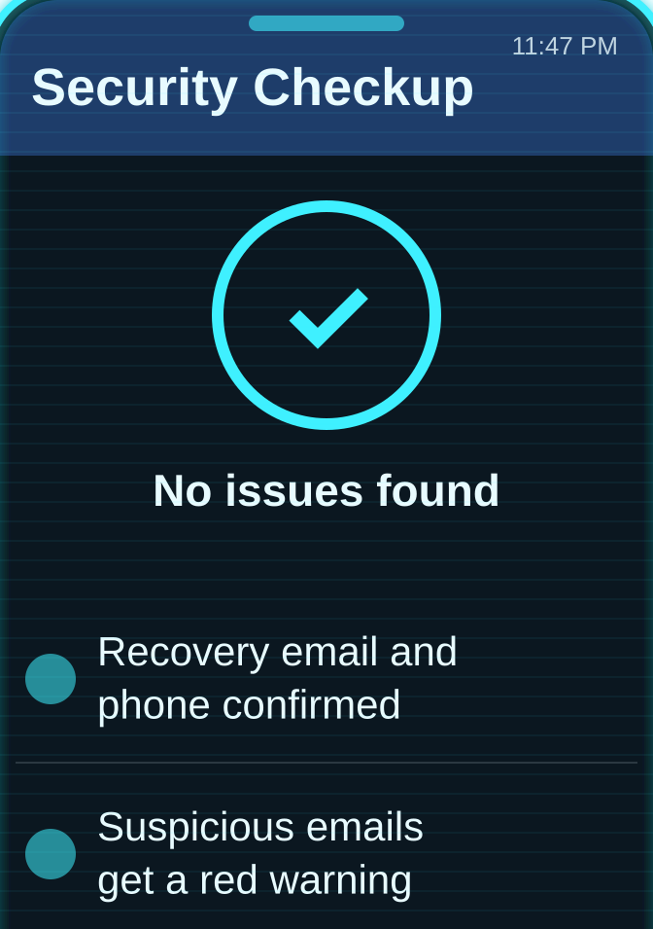
06 / TARGET 4 / GMAIL
Target 4 – Gmail: the prize every hacker wants, and the hardest to steal
THE HACKER’S PLAN “Gmail is the master key: every reset link lands here. But with a passkey, there is no password for me to phish.”
THREAT LEVEL
THE ATTACK · HOW I GET IN
01
02
03
NO GUARDIANS: CRITICAL
WITH GUARDIANS: 20/25 · HARD TARGET
A fake “copyright” page asks for a login
A reused password is typed in
No 2-Step Verification: he is in
GUARDIAN RADAR · 20 / 25
GUARDIANS IN THE WAY · WHAT STOPS ME
01
02
03
Turn on 2-Step Verification or a passkey
A different password for every account
Run Google’s Security Checkup
Guardian to add: warnings for fake bKash, Nagad and bank emails, because Gmail can reset every other account
Notes:
(about 1 minute)
[Hacker voice.] "Gmail is the master key: every reset link lands here. But with a passkey, there is no password for me to phish."
[Normal voice.] Target four: Gmail. Guardian strength: 20 out of 25, joint highest.
Think about it: when you click "forgot password" on Facebook, Instagram or even bKash, where does the link go? Your email. That is why hackers want Gmail most.
[Cyan screenshots.] And that is why Google guards it so heavily: passkeys as the default sign-in since October 2023, 2-Step Verification, a Security Checkup, critical sign-in alerts, and filters that Google says block over 99.9 percent of phishing and malware.
[Red weak spot.] The weak spot is us: people who reuse passwords and never switch on 2-Step Verification. Also, personal Gmail is not end-to-end encrypted.
[Blue card.] We would add optional end-to-end encryption, and warnings for emails imitating bKash, Nagad or local banks.

Slide 8
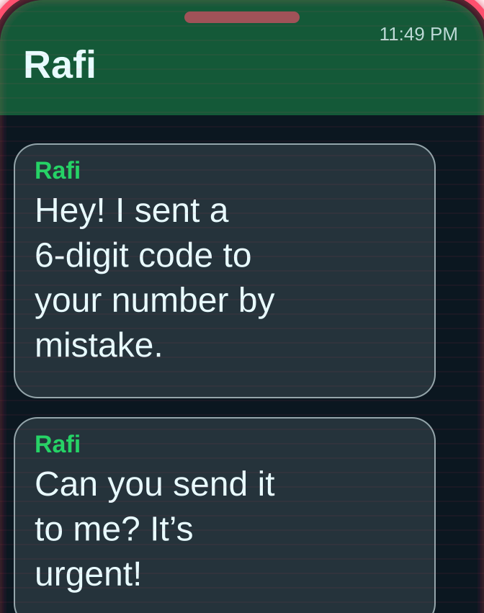
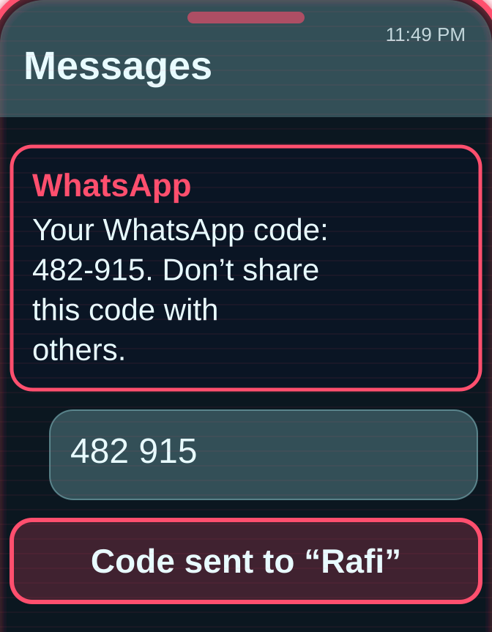
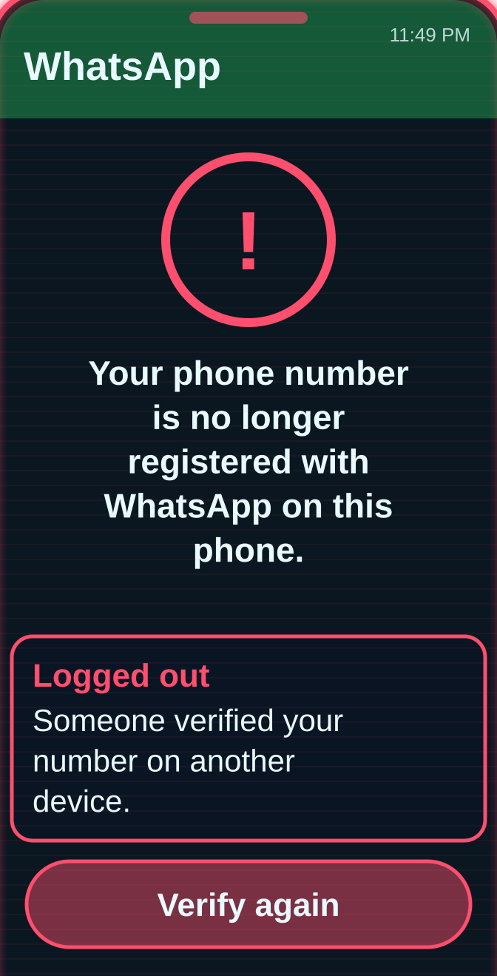
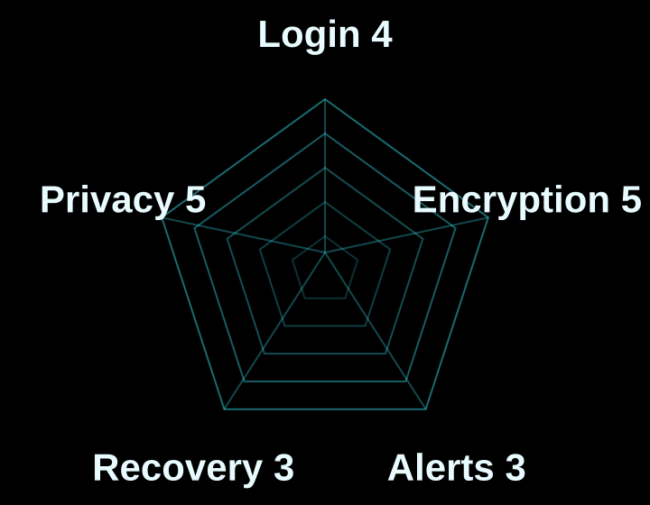

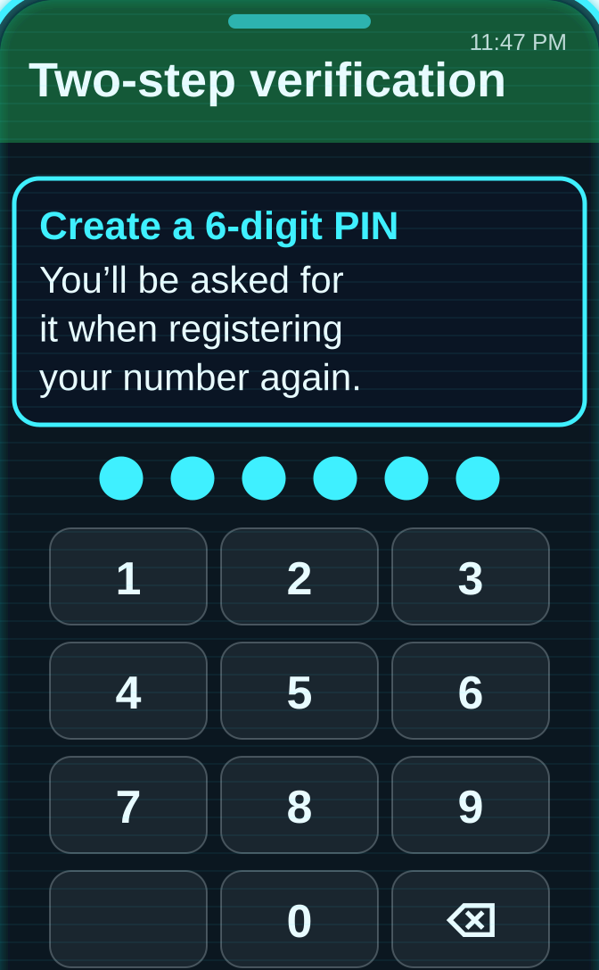
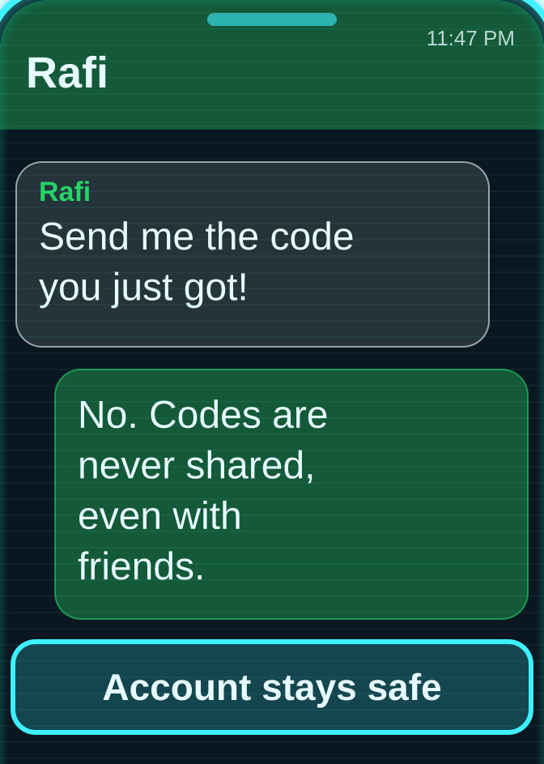
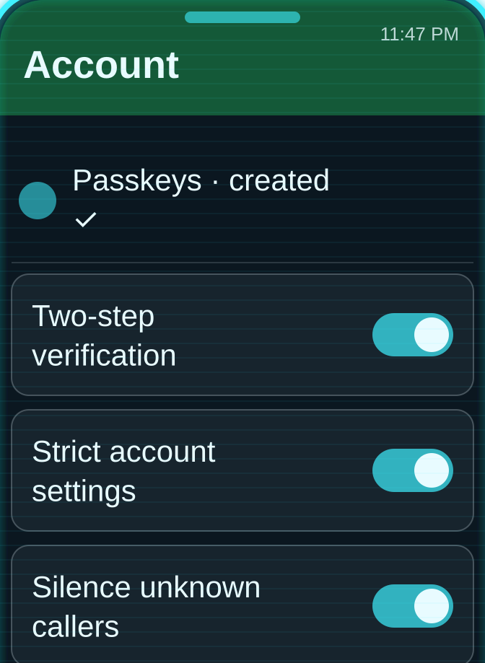
07 / HARDEST TARGET / WHATSAPP
Target 5 – WhatsApp: the hardest target, so hackers attack the person
THE HACKER’S PLAN “I can’t break the encryption, so I break the person: ‘I sent my code to you by mistake, please forward it.’”
THREAT LEVEL
THE ATTACK · HOW I GET IN
01
02
03
NO GUARDIANS: CRITICAL
WITH GUARDIANS: 20/25 · HARD TARGET
“Rafi” asks for the 6-digit code
The code is sent back
No PIN set: WhatsApp moves to his phone
GUARDIAN RADAR · 20 / 25
GUARDIANS IN THE WAY · WHAT STOPS ME
01
02
03
Set a two-step PIN
Never share a code, even with friends
Add a passkey + Strict Account Settings
Guardian to add: a Bangla warning whenever a code is requested, and a two-step PIN for every new account
Notes:
(about 1 minute)
[Hacker voice.] "I can't break the encryption, so I break the person: I sent my code to you by mistake, please forward it."
[Normal voice.] Target five: WhatsApp, the hardest target. Guardian strength: 20 out of 25.
Every personal chat and call on WhatsApp is end-to-end encrypted by default; not even WhatsApp can read them. It has a six-digit two-step PIN, passkeys, passkey-locked backups since October 2025, and since January 2026, Strict Account Settings, a one-tap lockdown.
[Red weak spot.] So hackers don't attack the technology. They attack the human. Many of us have seen this exact message. Without a two-step PIN, one shared code hands over the whole account.
[Blue card.] The guardian we would add: a clear Bangla warning whenever a registration code is requested, and a mandatory two-step PIN.

Slide 9
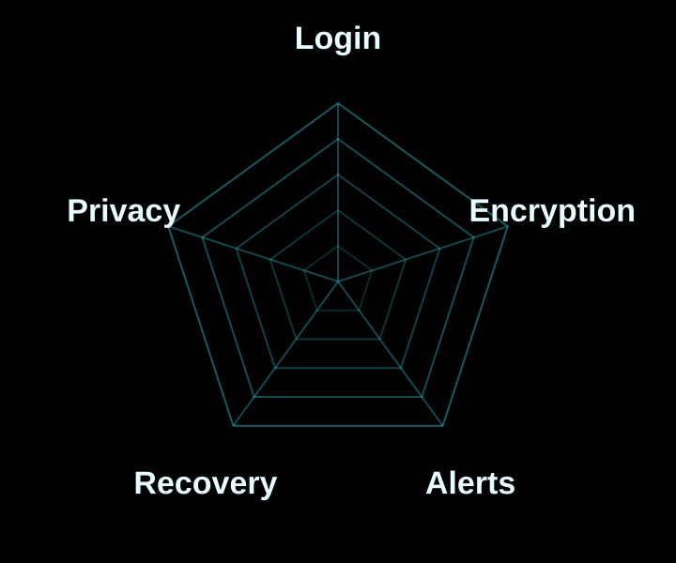



08 / THE HACKER’S VERDICT
WhatsApp is the hardest target, and the most secure for you
15
16
16
20
20
bKash · SOFTEST
Facebook
Instagram
Gmail
WhatsApp · HARDEST
GUARDIAN RADAR
HARDEST TO HACK: WHATSAPP
Its strongest guardian, end-to-end encryption, is on from day one with no setup.
THE PRIZE TO GUARD: GMAIL
The master key to every other account: protect it with a passkey.
SOFTEST TARGET: bKASH
Scammers go after the person, not the app: never read out an OTP.
● WhatsApp ● Gmail ● bKash
Notes:
(about 1 minute)
So, if you were the hacker, which account would you go after? [Point left to right.]
bKash is the softest target at 15. Facebook and Instagram follow at 16. Gmail and WhatsApp are the hardest, both at 20.
Our verdict: WhatsApp is the most secure platform for an individual user. Not because it has the most features, but because its strongest guardian, end-to-end encryption, is switched on from day one. You don't need to do anything. That matters, because most people never open their settings.
Gmail is the prize every hacker wants, because it is the master key to every other account. Protect it with a passkey or 2-Step Verification.
And bKash teaches us that scammers go after the person, not the app.
But notice what the hacker did on almost every slide: they didn't break the technology. They went around it, through a weak password, a shared code, or a setting that was never switched on.

Slide 10
09 / BE THE CAPABLE GUARDIAN
Make yourself the target hackers skip
01
Turn on 2FA or a passkey everywhere · Stolen passwords stop working
02
Set a WhatsApp two-step PIN · The code scam fails
03
Never share an OTP with anyone · No one can “borrow” your account
04
Check recovery email and phone · No silent takeovers
05
Log out unknown devices · Intruders get kicked out
GUARDIAN 100%
Hackers look for the easiest target. Don’t be it. Thank you · Questions?
Notes:
(about 1 minute)
Remember the triangle from Routine Activity Theory? Offender, target, guardian. We cannot remove the offenders. We cannot stop being targets. But each of us can become a capable guardian, tonight, in five minutes. [Go through the cards.]
One: turn on two-factor authentication or a passkey everywhere, and stolen passwords stop working.
Two: set a WhatsApp two-step PIN, and the code scam fails.
Three: never share an OTP with anyone. Not a friend, not "Facebook support", not "bKash".
Four: check your recovery email and phone, so no one can take over silently.
Five: log out of devices you don't recognise.
[Pause. Read the last line slowly.] Hackers look for the easiest target. Don't be it.
Thank you. We are happy to take your questions.

