Slide 1

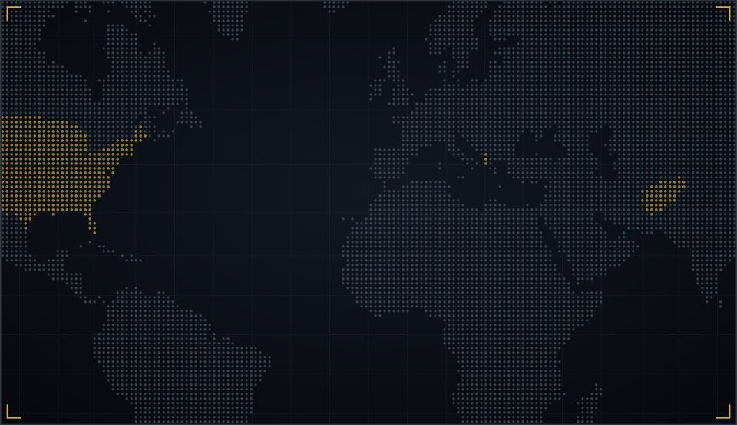





NOW SHOWING · MCCJ 527 ORGANIZED CRIME AND CORRUPTION
WAR DOGS
A Criminologist’s Director’s Cut
Three acts. Five crimes. One question: is this organized crime?
PRESENTED BY GROUP 6
27 Minhaz Ahamed Khan Nabin · 08 Jesmin Naher Sweety
37 Md. Abir Mahmud Jakaria · 33 Imran Mridha
24 Ahnaf Akif · 21 Nishit Kumer
Department of Criminology, University of Dhaka
Submitted to: Md. Rezaul Karim Shohag, Assistant Professor
Notes:
MEMBER 1 – Roll 27 – Minhaz Ahamed Khan Nabin (about 50 seconds)
[Dim the lights if you can. Speak like a movie trailer.] In a world where wars are fought with contracts... two young men from Miami... win almost 300 million dollars to arm an army they will never meet.
[Normal voice.] Good morning. We are Group 6, and today we present War Dogs, the 2016 film. But we are not going to review it like movie critics. We are going to show you a criminologist's director's cut.
We will play the story in three acts: the Hustle, the Deal and the Fall. And at key moments, we will press pause, and explain the organized crime and corruption concepts hiding inside the scene. Our one big question: is this really organized crime?

Slide 2
A buddy comedy that hides a real organized fraud
THE TRAILER · BEFORE WE PRESS PLAY
DIRECTOR
Todd Phillips
OUR THESIS
Organized crime doesn’t always carry guns. Sometimes it sells them, with a government contract.
YEAR · STUDIO
2016 · Warner Bros.
GENRE
Crime comedy-drama (based on true events)
STARRING
Jonah Hill · Miles Teller · Ana de Armas · Bradley Cooper
SOURCE
Guy Lawson, Rolling Stone (2011); Arms and the Dudes (2015)
$298M real Pentagon contract won by AEY Inc., 2007
Notes:
MEMBER 1 – Roll 27 – Minhaz Ahamed Khan Nabin (about 50 seconds)
First, the trailer facts. War Dogs was directed by Todd Phillips, the director of The Hangover, and released by Warner Bros. in 2016. It stars Jonah Hill as Efraim Diveroli and Miles Teller as David Packouz, with Ana de Armas and Bradley Cooper. It is a comedy, but it is based on a true story, first reported by journalist Guy Lawson in Rolling Stone.
[Right panel.] Here is our thesis: organized crime doesn't always carry guns. Sometimes it sells them, with a government contract. The real company, AEY, won a contract worth 298 million dollars from the Pentagon in 2007.
Let's press play on Act One. Sweety, roll the film.

Slide 3
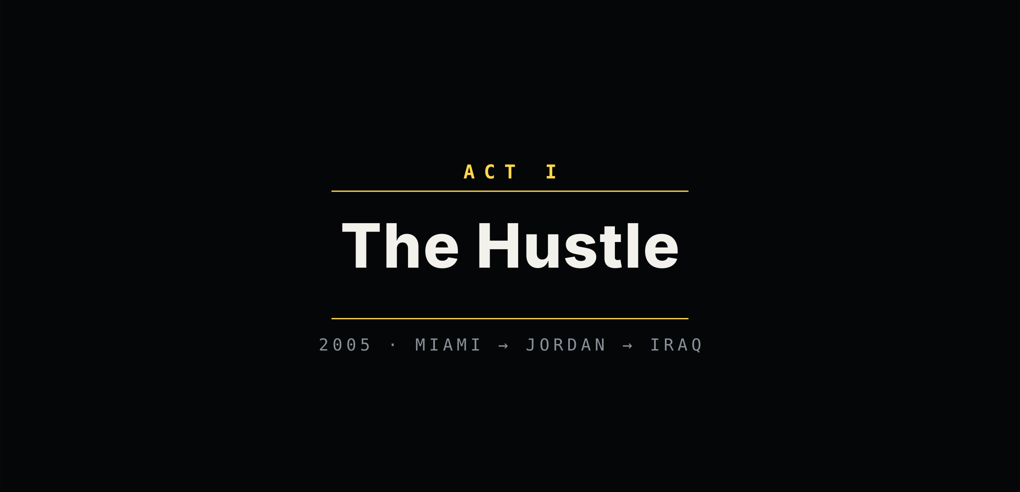
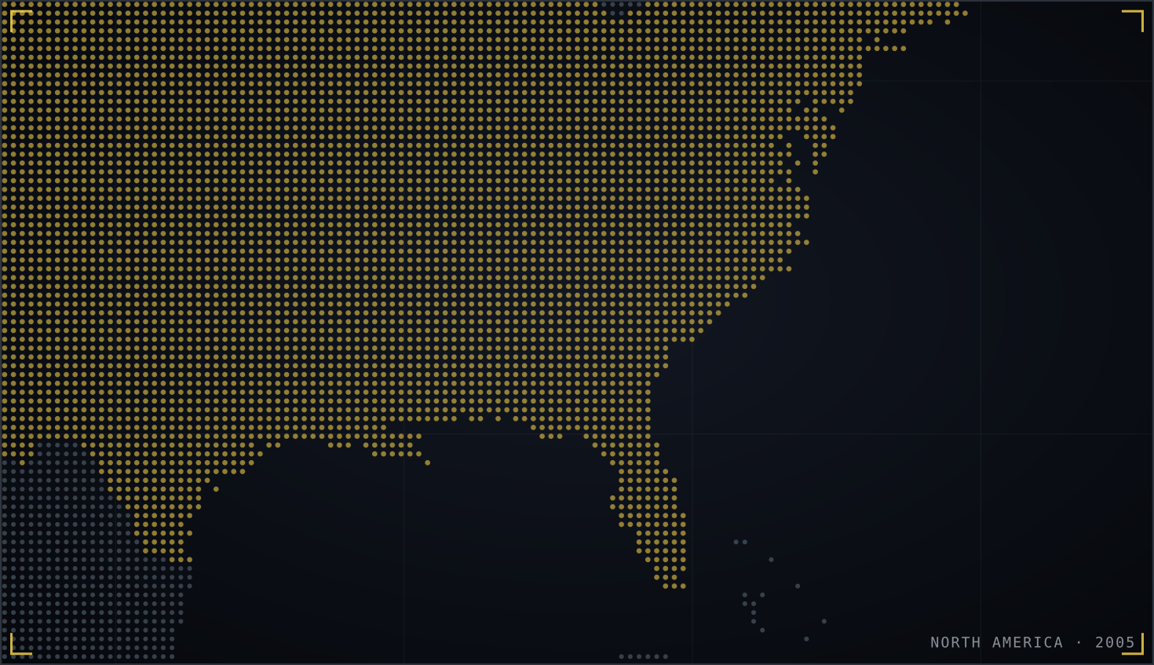

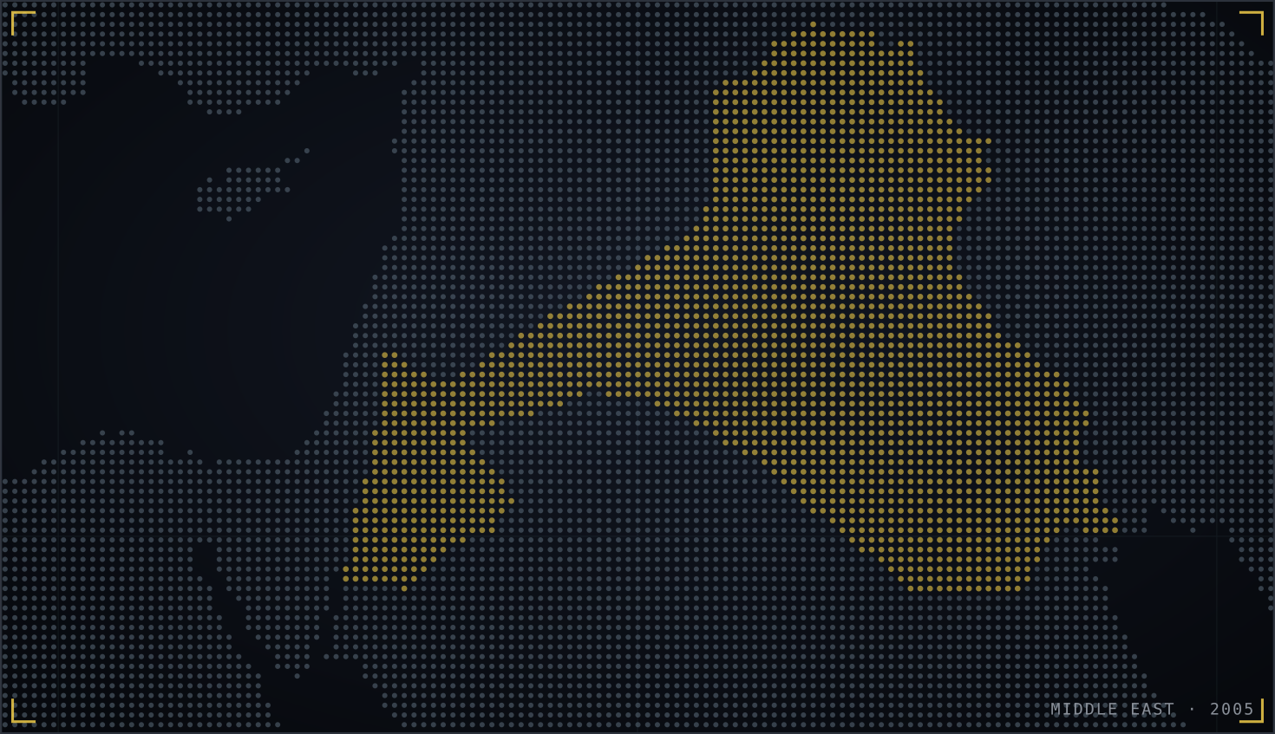

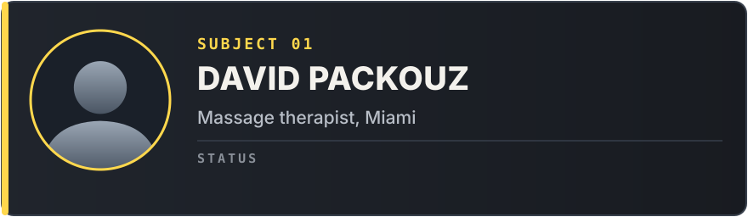

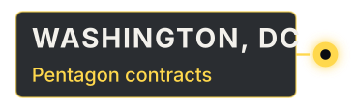
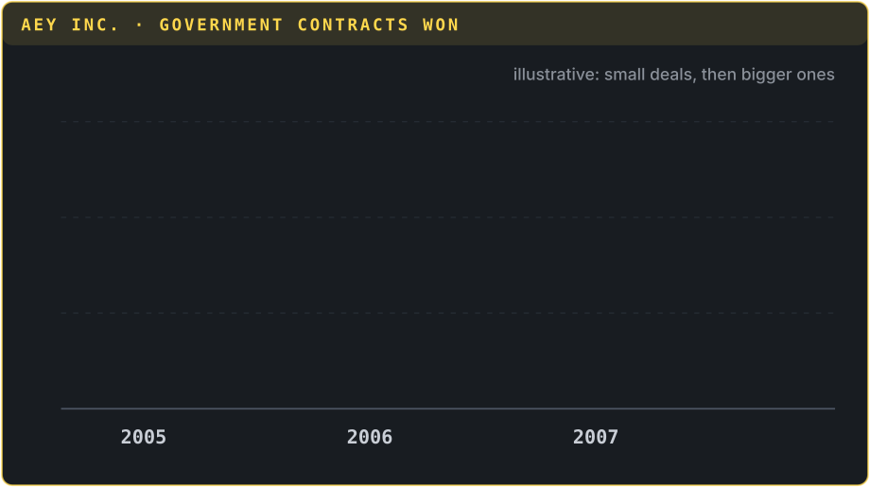
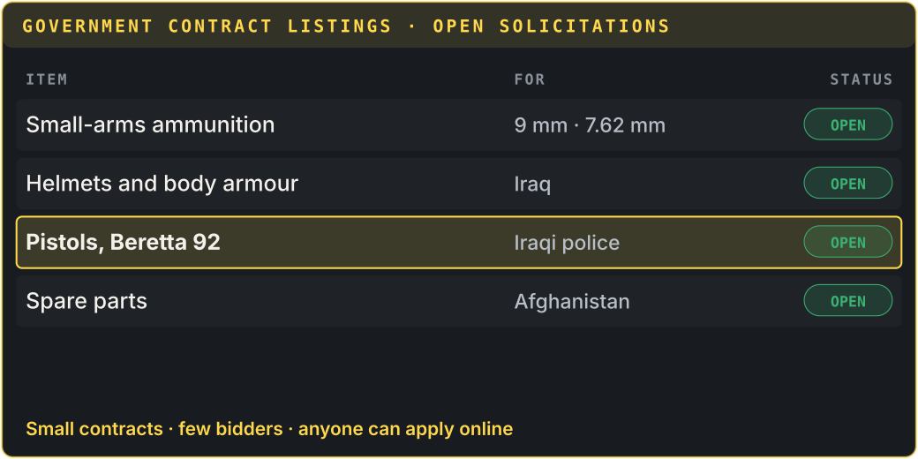

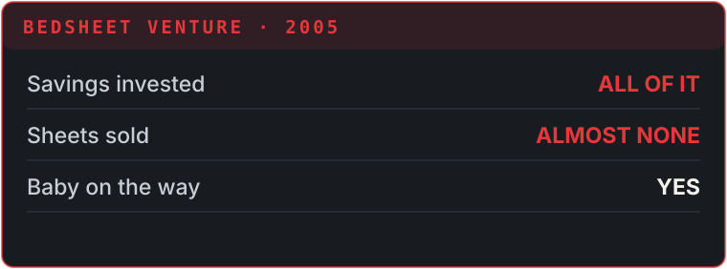

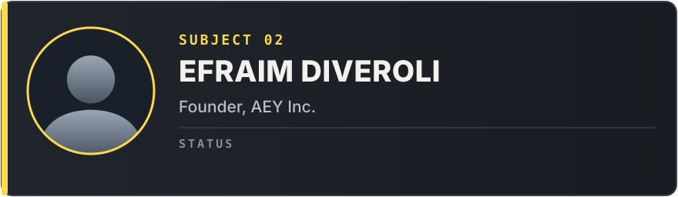
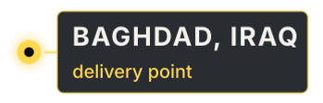

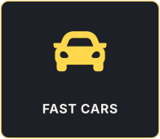
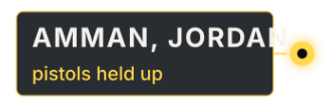


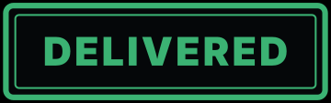

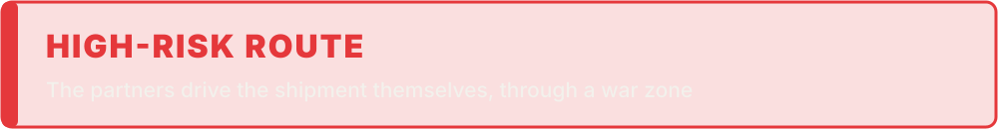
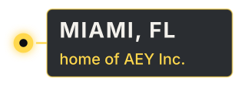
ACT I · THE HUSTLE · ▶ PLAYBACK
SCENE 1 · MIAMI · 2005
SCENE 2 · AEY INC.
SCENE 3 · JORDAN → IRAQ
SCENE 4 · HIGH LIFE
BROKE · BABY ON THE WAY
PARTNER · AEY INC.
HIDING THE TRUTH FROM IZ
ARMS DEALER · AEY INC.
“They don’t fight the war. They just sell to it.”
DAVID
EFRAIM
NARRATOR
EFRAIM
DAVID
My bedsheet business flopped… and we have a baby on the way.
The Pentagon posts its “crumbs” online. Small contracts the big firms ignore. Join me.
Pistols stuck in Jordan. They fly out, hire local fixers and drive the shipment into Iraq.
New office, new cars. Welcome to the arms business, bro.
(to himself) …and I can’t tell Iz what we really sell.
Notes:
MEMBER 2 – Roll 08 – Jesmin Naher Sweety (about 50 seconds · no clicks)
[HOW IT PLAYS] Everything is automatic. Start reading as soon as the slide opens; each scene's animation starts by itself at the time shown, paced to a 50-second reading. If you run ahead or behind, just keep going: it catches up on the next scene. The subtitle bar shows dramatised paraphrases, not quotes from the film.
[0:00 · Scene 1 plays]
Thank you, Nabin. Act One: the Hustle. Scene one: David is a broke massage therapist in Miami. His bedsheet business has failed, and his girlfriend is pregnant. He needs money, fast.
[≈ 0:13 · Scene 2 starts by itself]
Scene two: he meets his old friend Efraim, whose company AEY bids online for the "crumbs" of military procurement: small contracts the big defence companies ignore. David joins him.
[≈ 0:26 · Scene 3 starts by itself]
Scene three: a shipment of pistols gets stuck in Jordan, so they fly out, use local fixers and drive it into Iraq. It works, and they get paid.
[≈ 0:38 · Scene 4 starts by itself]
Scene four: the money flows. New office, new cars. And David starts lying to his partner about what he really does.
[When the yellow quote appears, pause.] Now let's freeze the frame.
[When you finish, CLICK ▶ next slide]

Slide 4

From legal bidding to grey deals: the enterprise model
PAUSED
END OF ACT I · WHAT IS HAPPENING HERE?
LEGAL BUSINESS
ILLEGAL ENTERPRISE
Bidding on “crumbs”
Fixers in Jordan
Repackaging banned ammo (Act III)
Smith (1980): legal and illegal businesses sit on one spectrum and respond to the same market demand. AEY slides along it as profits grow.
Strain / anomie
Merton (1938); Messner & Rosenfeld (1994)
Differential association
Sutherland (1940)
Rational choice
Cornish & Clarke (1986)
Broke with a baby on the way, David “innovates”: legitimate goal, illegitimate means.
David learns the methods and the excuses of the trade from Efraim.
Each step is a calculation: big reward, small chance of being caught.
Notes:
MEMBER 2 – Roll 08 – Jesmin Naher Sweety (about 50 seconds)
[Freeze-frame.] What is happening in Act One?
[Spectrum.] Dwight Smith's enterprise model says legal and illegal business sit on one spectrum, driven by the same market demand. Watch AEY move along it: from legal bidding on crumbs, to grey deals with fixers in Jordan, and later, in Act Three, to outright fraud.
[Bottom cards.] Three theories explain why. Strain theory: David is broke with a baby coming. In Merton's terms he "innovates": he keeps the goal of wealth but uses illegitimate means. Differential association: he learns both the methods and the excuses from Efraim. And rational choice: every step is a calculation, a big reward against a small chance of being caught.
Press play. Jakaria, Act Two.

Slide 5
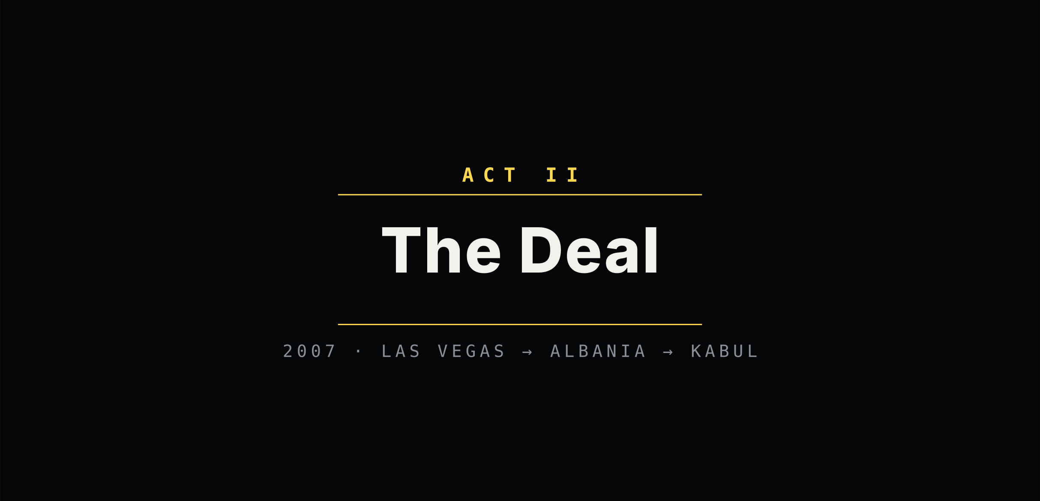
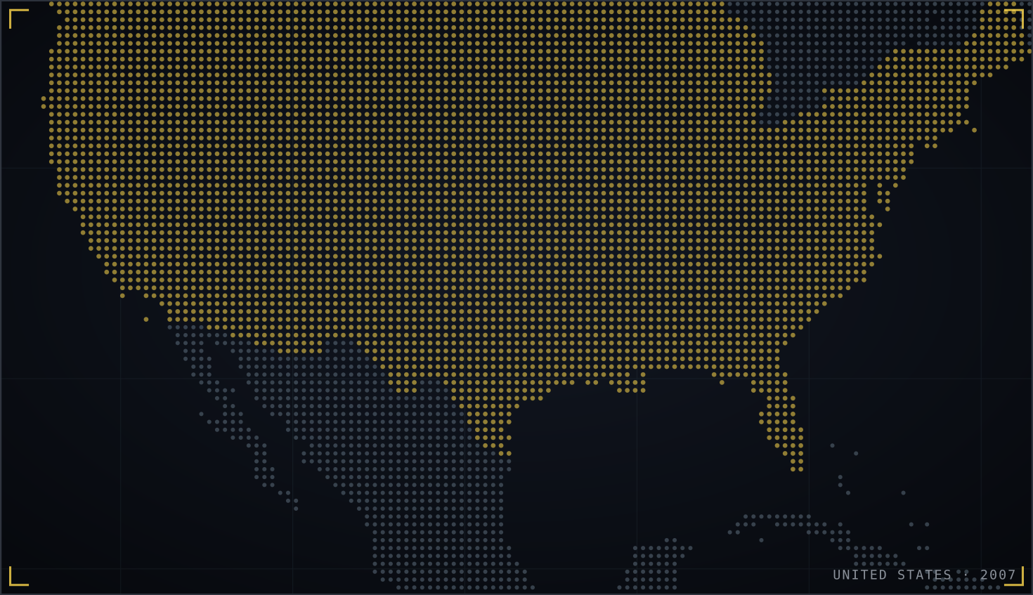
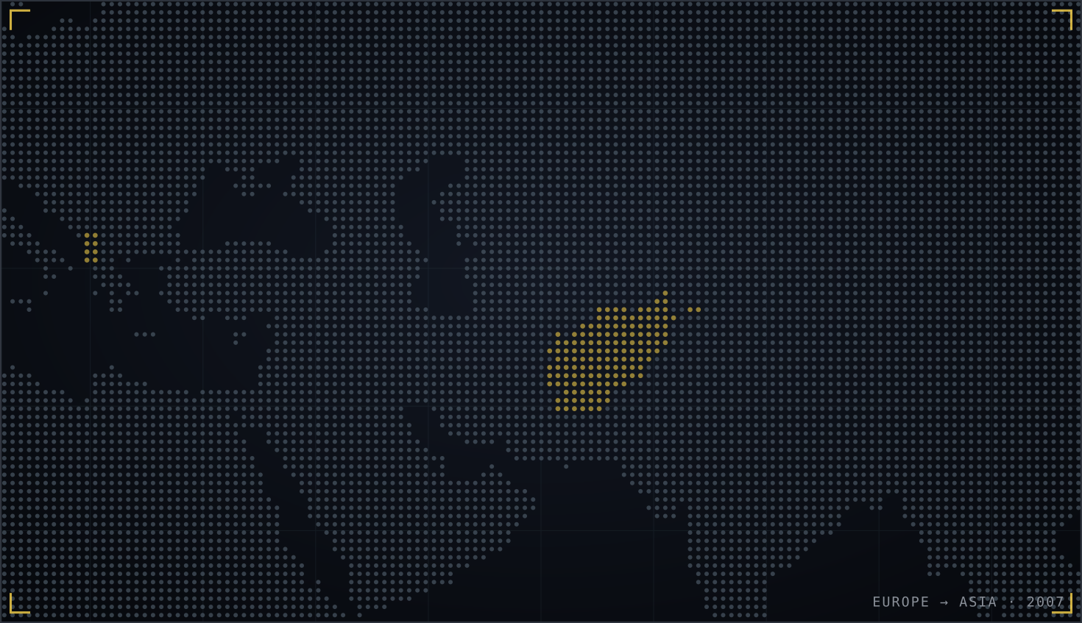

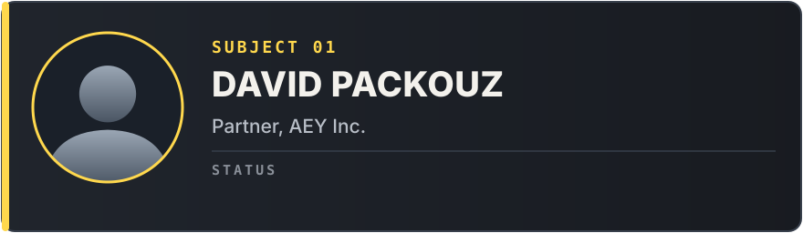
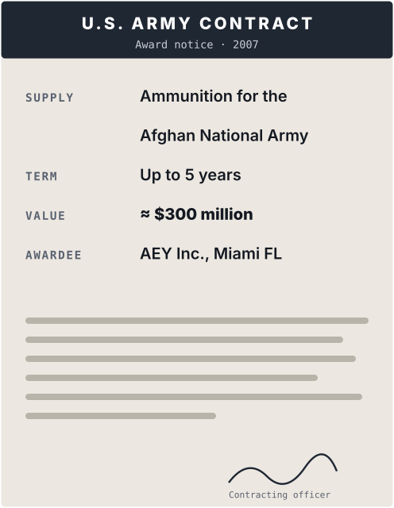
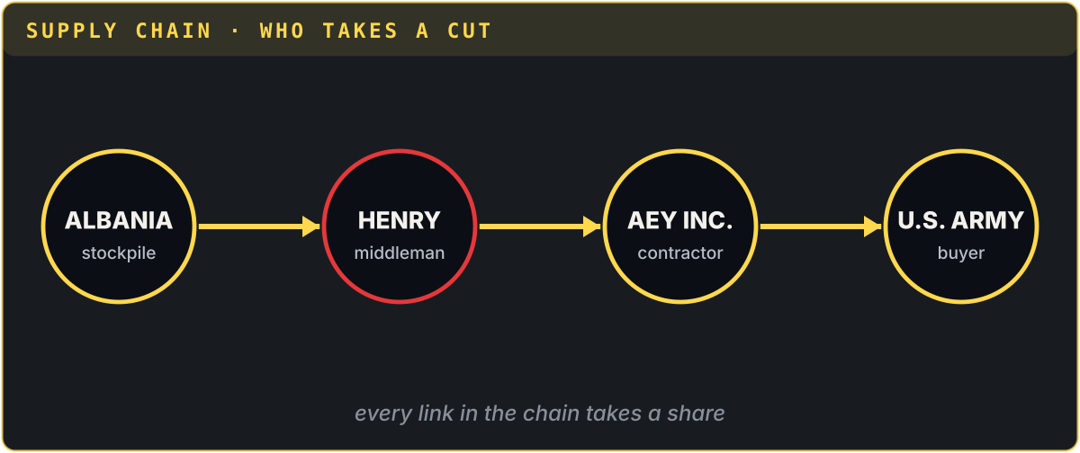
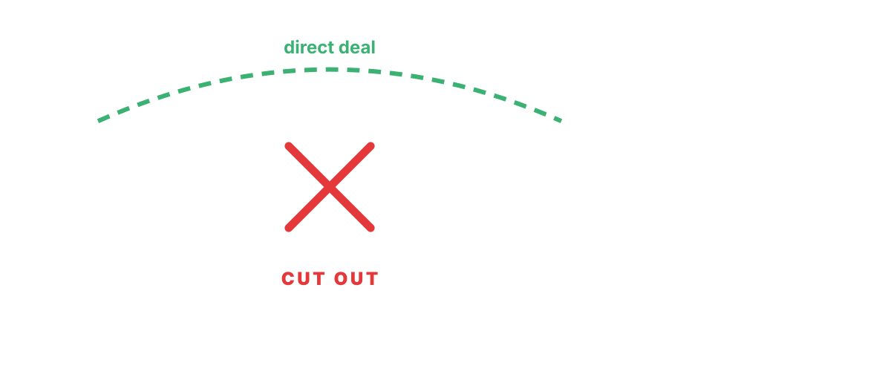
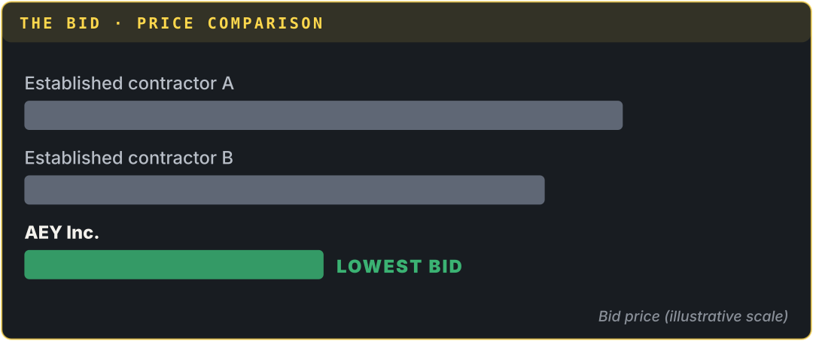
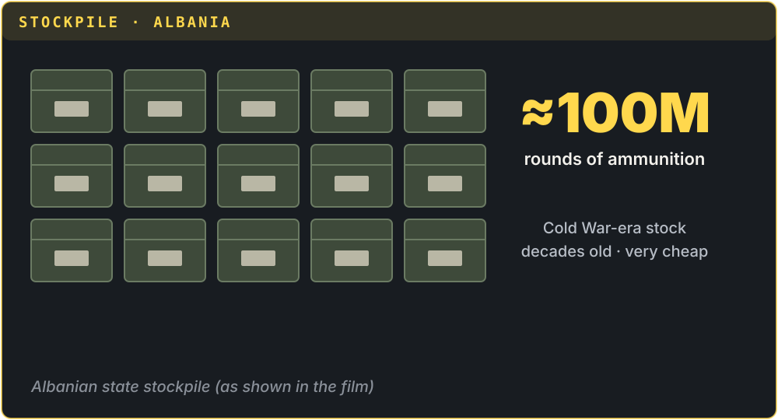
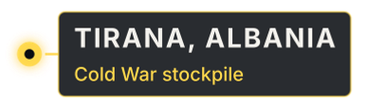
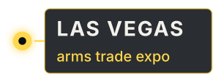
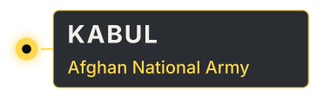

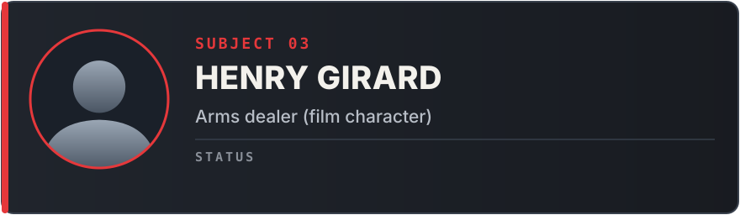
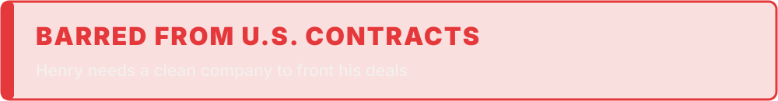
ACT II · THE DEAL · ▶ PLAYBACK
SCENE 5 · LAS VEGAS · 2007
SCENE 6 · ALBANIA
SCENE 7 · THE BID
SCENE 8 · THE SPLIT
WINS $300M CONTRACT
“Everybody in the chain takes a cut.”
ON A GOVERNMENT WATCH LIST
CUT OUT OF THE DEAL
HENRY
HENRY
EFRAIM
EFRAIM
EFRAIM
I’m on a watch list, so I can’t sell to the U.S. government. Your clean little company can.
A hundred million old rounds, sitting in Albania. Cheap.
Cheap supply means we underbid everyone… and win the Afghan army contract.
Three hundred million dollars! We’re in the big league now.
(whispering) …and we don’t need Henry anymore.
Notes:
MEMBER 3 – Roll 37 – Md. Abir Mahmud Jakaria (about 50 seconds · no clicks)
[HOW IT PLAYS] Everything is automatic. Start reading as soon as the slide opens; each scene's animation starts by itself at the time shown, paced to a 50-second reading. If you run ahead or behind, just keep going: it catches up on the next scene. The subtitle bar shows dramatised paraphrases, not quotes from the film.
[0:00 · Scene 5 plays]
Thank you, Sweety. Act Two: the Deal.
Scene five: at an arms fair in Las Vegas, they meet Henry Girard, played by Bradley Cooper. Henry is on a terrorist watch list, so he cannot sell to the US government directly. He needs a front.
[≈ 0:19 · Scene 6 starts by itself]
Scene six: Henry has access to about 100 million rounds of old rifle ammunition sitting in Albania.
[≈ 0:27 · Scene 7 starts by itself]
Scene seven: with this cheap supply and a financier behind them, AEY underbids everyone and wins the Afghan army contract, worth around 300 million dollars.
[≈ 0:38 · Scene 8 starts by itself]
Scene eight: Efraim, greedy as ever, starts planning to cut Henry out of his share.
So let's pause again. Is this group actually organized crime?
[When you finish, CLICK ▶ next slide]

Slide 6


The UN says yes. Abadinsky’s mafia model says mostly no
PAUSED
ACT II · IS THIS ORGANIZED CRIME?
UNTOC, ARTICLE 2 (UNODC, 2004)
ABADINSKY’S (2013) ATTRIBUTES
3+ persons in a structured group
Efraim, David, financier, Henry, suppliers
Hierarchy and ranks
Does not fit
Existing for a period of time
Several years of operation
Exclusive membership and rituals
Does not fit
Committing serious crime
Fraud, conspiracy, embargo breach
Survives arrest of leaders
Does not fit
For material benefit
Millions in profit
Profit-driven, specialized roles
Fits
Our verdict: organized white-collar crime, a legal company committing organized, transnational fraud
Notes:
MEMBER 3 – Roll 37 – Md. Abir Mahmud Jakaria (about 50 seconds)
[Freeze-frame.] Is AEY organized crime? It depends on the definition.
[Left.] The UN Convention against Transnational Organized Crime says an organized criminal group is three or more persons, structured, existing over time, committing serious crime for material benefit. AEY ticks every box: Efraim, David, their financier, Henry and the suppliers, operating for years, committing fraud and conspiracy for millions.
[Right.] But Abadinsky's classic attributes describe the mafia: hierarchy, exclusive membership, rituals, and an organization that survives when its leaders are arrested. AEY had none of that. It collapsed the moment the founders were charged.
[Bottom.] So our verdict: AEY is organized white-collar crime. A legal company, committing organized and transnational fraud. Imran will show you how the network worked.

Slide 7






The brokers in the middle held the power
PAUSED
ACT II · WHO HOLDS THE POWER?
Network model Morselli (2009)
Power belongs to brokers who connect worlds that can’t reach each other.
Afghan army
End user · victim
US Army
Open online tenders
Henry Girard
BROKER · watch-listed
Patron–client Albini (1971)
Henry trades access to supply for a share of the profits.
AEY (Efraim + David)
BROKER · clean US name
Hierarchical model Cressey (1969)
Does not fit: no ranks, no code, no “family”.
Financier
Funds the deal
Albanian stockpile
Supply + officials
Notes:
MEMBER 4 – Roll 33 – Imran Mridha (about 50 seconds)
Thank you, Jakaria. [Freeze-frame.] Who holds the power in this deal? Look at the network. [Trace the yellow lines.]
On one side is the US Army, buying through open online tenders. On the other is a stockpile in Albania. They can't connect directly. In the middle sit two brokers: AEY, with a clean American name, and Henry, who has the supply but is on a terrorist watch list.
[Right cards.] This is exactly Morselli's network model: power belongs to the brokers who connect separate worlds. Albini's patron–client model fits too: Henry trades access to supply for a share of the profits.
But Cressey's hierarchical model does not fit at all. There is no boss, no ranks, no family. Next, the corruption that made it all possible.

Slide 8
Corruption = Monopoly + Discretion − Accountability
PAUSED
ACT II · WHERE IS THE CORRUPTION?
Klitgaard (1988). Corruption: the abuse of entrusted power for private gain (Transparency International).
M
D
A
MONOPOLY
DISCRETION
LOW ACCOUNTABILITY
Henry controls the only access to cheap Balkan ammunition, so everyone must pay him.
Officials, fixers and border agents in Jordan and Albania decide with little scrutiny; middlemen skim.
Wartime urgency: a company run by a man in his early twenties passes the Pentagon’s vetting.
State-corporate crime (Kramer et al., 2002): the harm grew from a government policy of outsourcing war logistics to the lowest bidder. The crime–terror nexus appears too: a watch-listed dealer simply borrows a clean company name.
Notes:
MEMBER 4 – Roll 33 – Imran Mridha (about 50 seconds)
[Freeze-frame.] Where is the corruption? Transparency International defines corruption as the abuse of entrusted power for private gain. And Robert Klitgaard gives a formula: corruption equals monopoly, plus discretion, minus accountability.
[Cards.] Monopoly: Henry controls the only access to cheap Balkan ammunition, so everyone must pay him. Discretion: officials, fixers and border agents decide with little scrutiny, and middlemen skim money. And low accountability: in wartime urgency, a company run by a man in his early twenties passes the Pentagon's vetting.
[Bottom.] This is state-corporate crime: the harm came from a government policy of outsourcing war to the lowest bidder. And we also see the crime–terror nexus: a watch-listed dealer simply borrows a clean company's name.
Akif, Act Three.

Slide 9
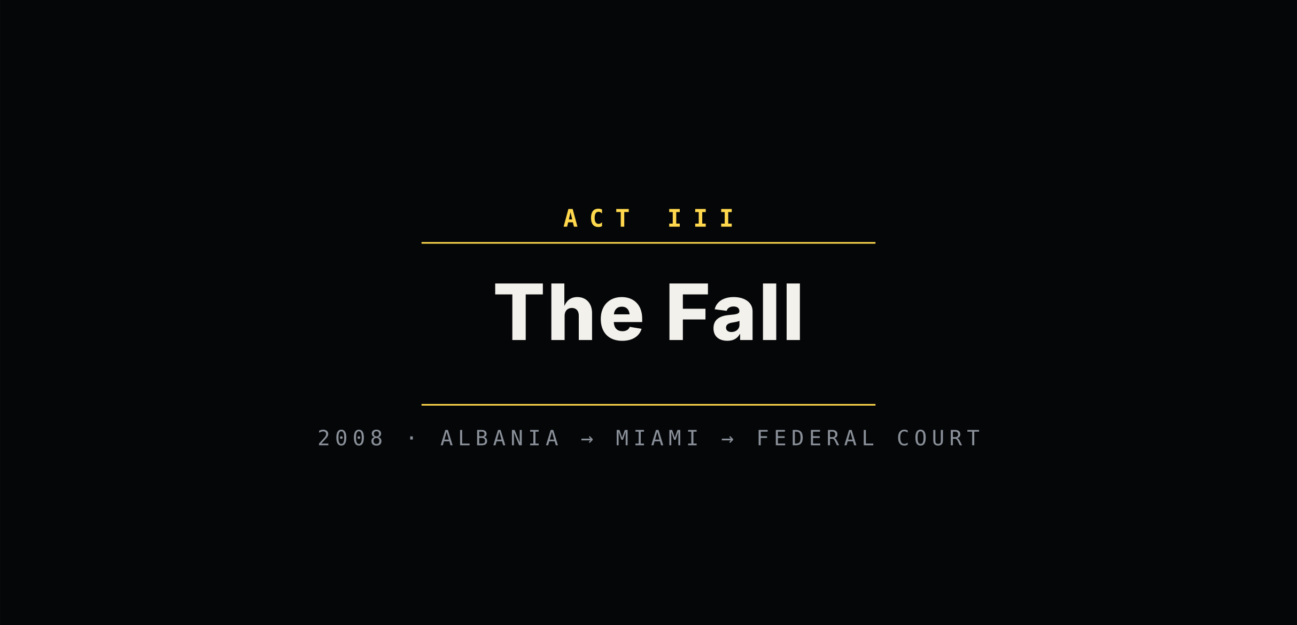
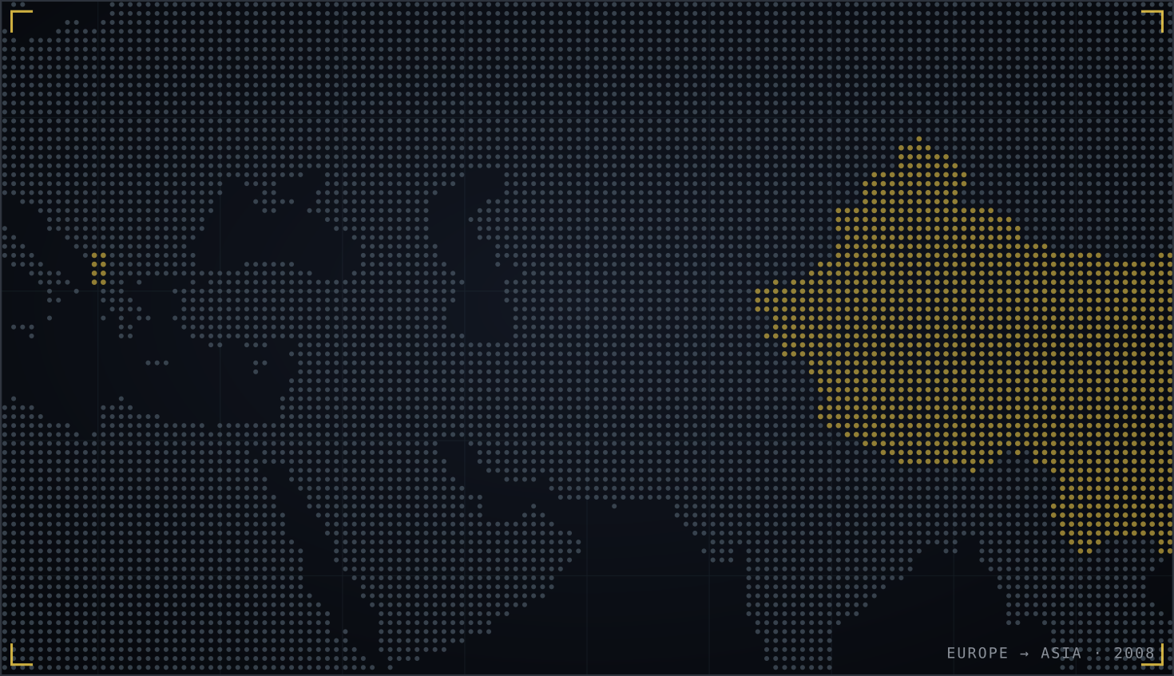
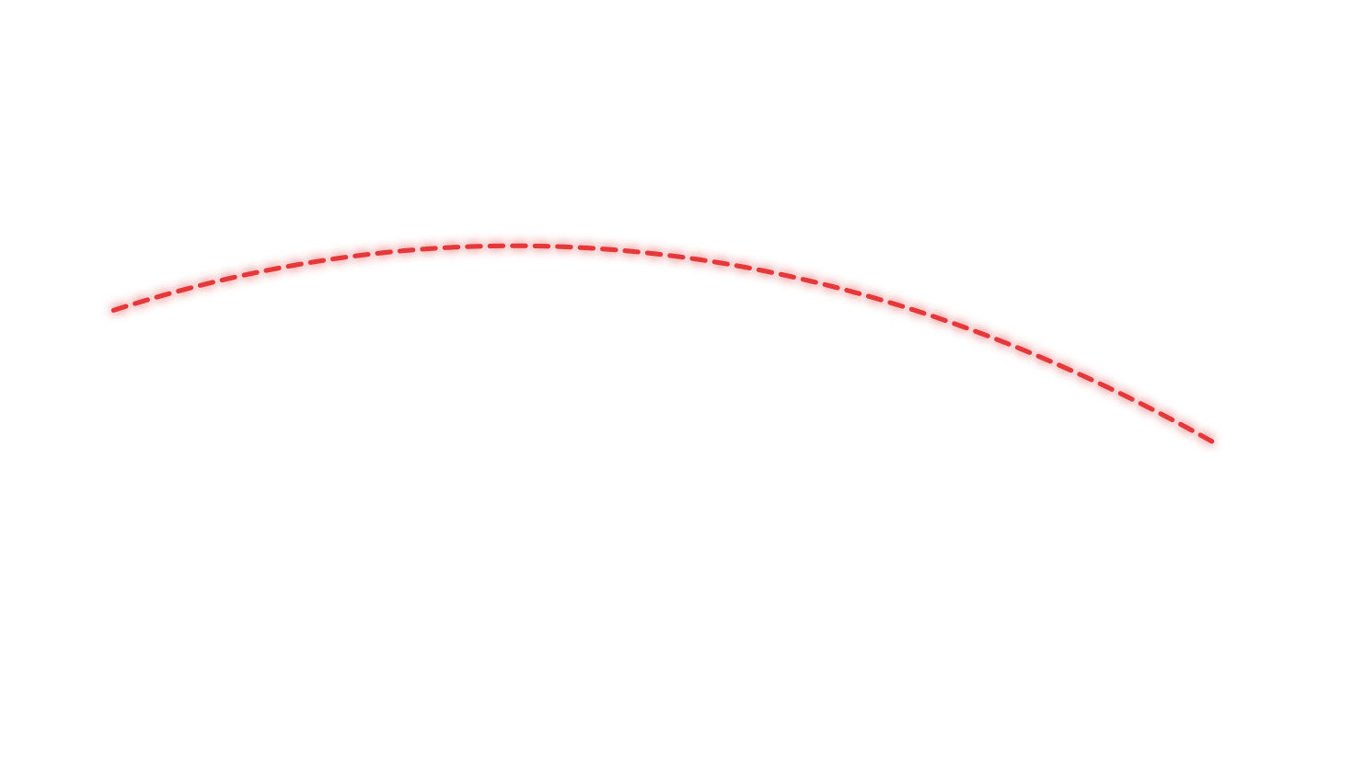
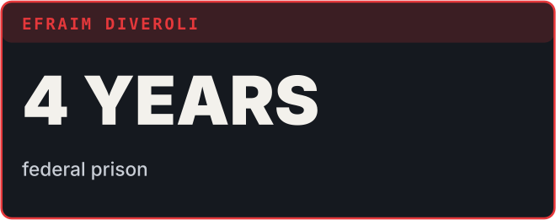
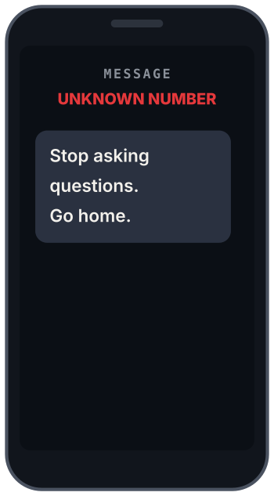
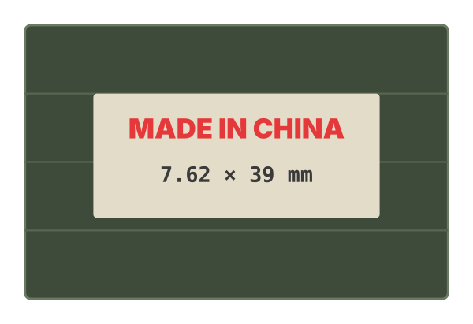
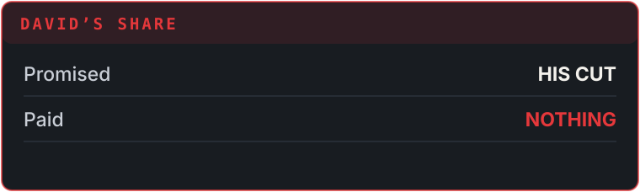
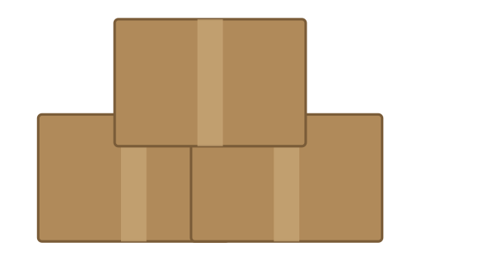
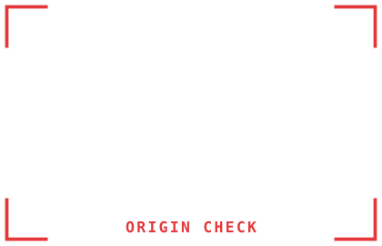
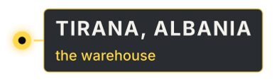

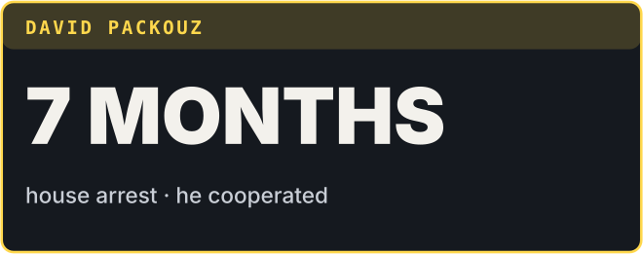

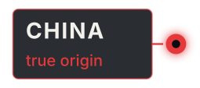

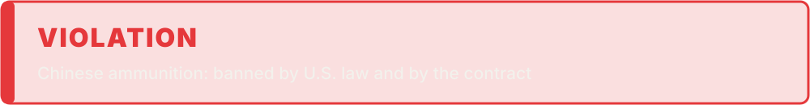
ACT III · THE FALL · ▶ PLAYBACK
SCENE 9 · DISCOVERY
SCENE 10 · COVER-UP
SCENE 11 · BETRAYAL
SCENE 12 · VERDICT
INSPECTING STOCK · ALBANIA
FINDS CHINESE ORIGIN
THREATENED · UNPAID
COOPERATED · 7 MONTHS
ORDERS REPACKAGING
SENTENCED · 4 YEARS
The real case: exposed by journalists in 2008, prosecuted for fraud and conspiracy
DAVID
EFRAIM
NARRATOR
NARRATOR
NARRATOR
These rounds were made in China. That’s banned under the embargo… and in our contract!
So we repack them in plain boxes. Who’s going to check?
In Albania, David is threatened. Back home, Efraim cheats him out of his money.
The friendship collapses.
Federal court: Efraim gets 4 years in prison. David cooperates: 7 months of house arrest.
Notes:
MEMBER 5 – Roll 24 – Ahnaf Akif (about 50 seconds · no clicks)
[HOW IT PLAYS] Everything is automatic. Start reading as soon as the slide opens; each scene's animation starts by itself at the time shown, paced to a 50-second reading. If you run ahead or behind, just keep going: it catches up on the next scene. The subtitle bar shows dramatised paraphrases, not quotes from the film.
[0:00 · Scene 9 plays]
Thank you, Imran. Act Three: the Fall.
Scene nine: David discovers the ammunition was made in China, which is banned under a US arms embargo, and by the contract itself.
[≈ 0:13 · Scene 10 starts by itself]
Scene ten: instead of reporting it, they have the rounds repacked to remove the Chinese markings. This really happened.
[≈ 0:21 · Scene 11 starts by itself]
Scene eleven: David is threatened in Albania, Efraim cheats him out of his money, and their friendship collapses.
[≈ 0:29 · Scene 12 starts by itself]
Scene twelve: the federal government steps in. In real life, the case was exposed by journalists in 2008. Efraim was sentenced to four years in prison, and David, who cooperated, to seven months of house arrest.
[Pause.] One last freeze-frame. How did they justify all this to themselves?
[When you finish, CLICK ▶ next slide]

Slide 10
Neutralization: how offenders silence their conscience
PAUSED
ACT III · HOW DID THEY JUSTIFY IT?
Sykes & Matza (1957): offenders know the rules, but use excuses to switch them off. In the film, every excuse sounds like normal business talk.
DENIAL OF INJURY
CONDEMNATION OF THE CONDEMNERS
“The troops still get bullets that work. Who is harmed?”
“The government buys from shady sources too.”
DENIAL OF RESPONSIBILITY
APPEAL TO HIGHER LOYALTIES
“We didn’t make the bullets. We just moved them.”
“I’m doing this for my family.”
Quotes paraphrase the characters’ attitudes; they are not verbatim lines.
Notes:
MEMBER 5 – Roll 24 – Ahnaf Akif (about 50 seconds)
[Freeze-frame.] How do two ordinary young men commit fraud on this scale without feeling like criminals? Sykes and Matza call it techniques of neutralization. Offenders know the rules, but use excuses to switch their conscience off.
[Read each yellow line like a subtitle.]
Denial of injury: "The troops still get bullets that work. Who is harmed?"
Condemnation of the condemners: "The government buys from shady sources too."
Denial of responsibility: "We didn't make the bullets, we just moved them."
Appeal to higher loyalties: "I'm doing this for my family."
These are our paraphrases of the characters' attitudes, not exact lines. And notice: every excuse sounds like normal business talk. That is exactly what makes white-collar crime so hard to see.
Nishit will give the critics' verdict.

Slide 11


Accurate in substance, exaggerated in style
THE CRITICS’ VERDICT · OUR RATINGS
Conceptual accuracy
4/5
Fits UNTOC, enterprise and network models closely
Factual accuracy
4/5
Contract, repackaging and sentences are true
Realism of tone
2/5
Comedy glamorizes fraud; threats in Albania invented
Systemic insight
2/5
Blames two men; skips state failure and Gërdec (26 killed)
Ratings are the group’s assessment. Sources: Lawson (2015); Al Jazeera (2008). Henry Girard is a composite inspired by broker Heinrich Thomet.
Notes:
MEMBER 6 – Roll 21 – Nishit Kumer (about 50 seconds)
Thank you, Akif. So what is our critics' verdict? Accurate in substance, exaggerated in style.
[Go row by row.] Conceptual accuracy: four stars. The film fits the UN definition, the enterprise model and the network model very closely.
Factual accuracy: four stars. The contract, the repackaging and the sentences are all true. Henry Girard is a composite character, inspired by a real Swiss broker.
But realism of tone: only two stars. The comedy glamorizes the money and makes fraud look harmless, and the threats in Albania were invented.
And systemic insight: two stars. The film blames two young men, but skips the failure of the system, and real victims, like the 26 people killed in the Gërdec depot explosion in Albania in 2008.

Slide 12
THE FINAL CUT
Organized crime doesn’t always carry guns. Sometimes it sells them, with a government contract.
CREDITS
OPENING & TRAILER · ROLL 27
Minhaz Ahamed Khan Nabin
ACT I · ROLL 08
Jesmin Naher Sweety
ACT II: DEFINITIONS · ROLL 37
Md. Abir Mahmud Jakaria
THE ANSWER
AEY is organized crime under the UN definition, but not the mafia: it is organized white-collar crime.
ACT II: NETWORK & CORRUPTION · ROLL 33
Imran Mridha
ACT III · ROLL 24
Ahnaf Akif
THE LESSON FOR BANGLADESH
Big procurement relies on middlemen too. Vet contractors, disclose real owners, check where goods come from.
VERDICT & FINAL CUT · ROLL 21
Nishit Kumer
Thank you · Questions?
Notes:
MEMBER 6 – Roll 21 – Nishit Kumer (about 50 seconds)
So here is our final cut. [Read slowly.] Organized crime doesn't always carry guns. Sometimes it sells them, with a government contract.
The answer to our big question: AEY is organized crime under the UN definition, but it is not the mafia. It is organized white-collar crime, best explained by the enterprise and network models.
And a lesson for Bangladesh. Our own large procurement projects also depend on middlemen and intermediaries. Vetting contractors, disclosing who really owns a company, and checking where goods come from are not just paperwork. They are crime prevention.
[Point to the credits.] That's a wrap from Group 6. Thank you, and we're happy to take your questions.

