Slide 1

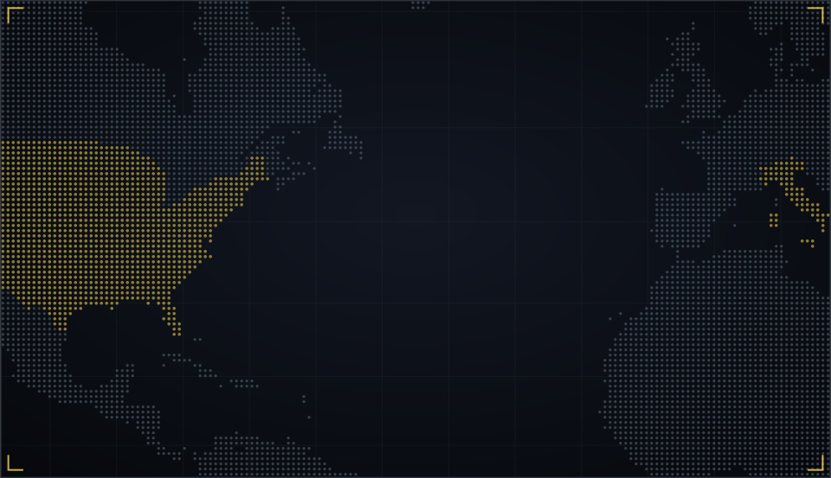





NOW SHOWING · MCCJ 527 ORGANIZED CRIME AND CORRUPTION
THE GODFATHER
A Criminologist’s Director’s Cut
Three acts. One family. One question: how does a mafia family really work?
PRESENTED BY GROUP 5
38 Md. Akram Hossain Rifat · 09 Naznin Akhter
22 Nafiul Hoque Kingshuk · 31 Khadiza Akter Munni
15 Jarin Tasnim Labonno · 04 Tasnim Ferdous Ali
__ [7th member: roll printed as “2431” in the brief]
Department of Criminology, University of Dhaka
Submitted to: Md. Rezaul Karim Shohag, Assistant Professor
Notes:
MEMBER 1 – Roll 38 – Md. Akram Hossain Rifat (about 50 seconds)
[Dim the lights if you can. Speak like a movie trailer.] In a world where justice can be bought... one family sells it... with a favour you can never refuse.
[Normal voice.] Good morning. We are Group 5, and today we present The Godfather, the 1972 film. But we are not going to review it like movie critics. We are going to show you a criminologist's director's cut.
We will play the story in three acts: the Family, the Heir and the Don. And at key moments, we will press pause, and explain the organized crime and corruption concepts hiding inside the scene. Our one big question: how does a mafia family really work?

Slide 2
A family saga that is really a study of organized crime
THE TRAILER · BEFORE WE PRESS PLAY
DIRECTOR
Francis Ford Coppola
OUR THESIS
The mafia calls itself a family. Underneath, it is a business that governs through favours and fear.
YEAR · STUDIO
1972 · Paramount Pictures
GENRE
Crime drama (fiction, adapted from a novel)
STARRING
Marlon Brando · Al Pacino · James Caan · Robert Duvall · Diane Keaton
SOURCE
Mario Puzo, The Godfather (1969 novel)
3 Oscars incl. Best Picture, 1973
Notes:
MEMBER 1 – Roll 38 – Md. Akram Hossain Rifat (about 50 seconds)
First, the trailer facts. The Godfather was directed by Francis Ford Coppola and released by Paramount Pictures in 1972. It stars Marlon Brando as Don Vito Corleone and Al Pacino as his son Michael, with James Caan, Robert Duvall and Diane Keaton. It is fiction, adapted from Mario Puzo's 1969 novel, but it draws on the real Italian-American crime families of New York.
[Right panel.] Here is our thesis: the mafia calls itself a family. Underneath, it is a business that governs through favours and fear. The film won three Oscars, including Best Picture.
Let's press play on Act One. Naznin, roll the film.

Slide 3
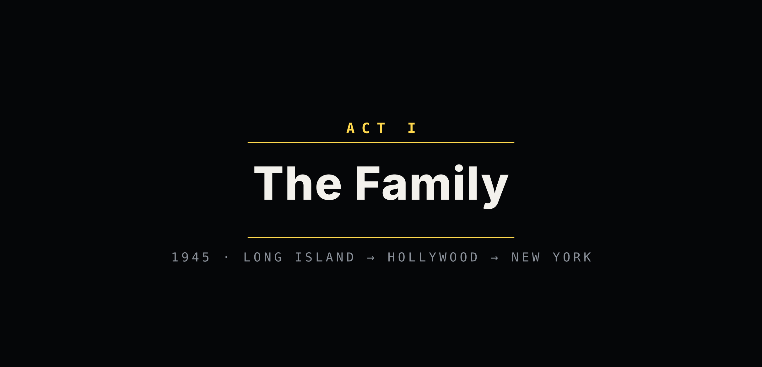
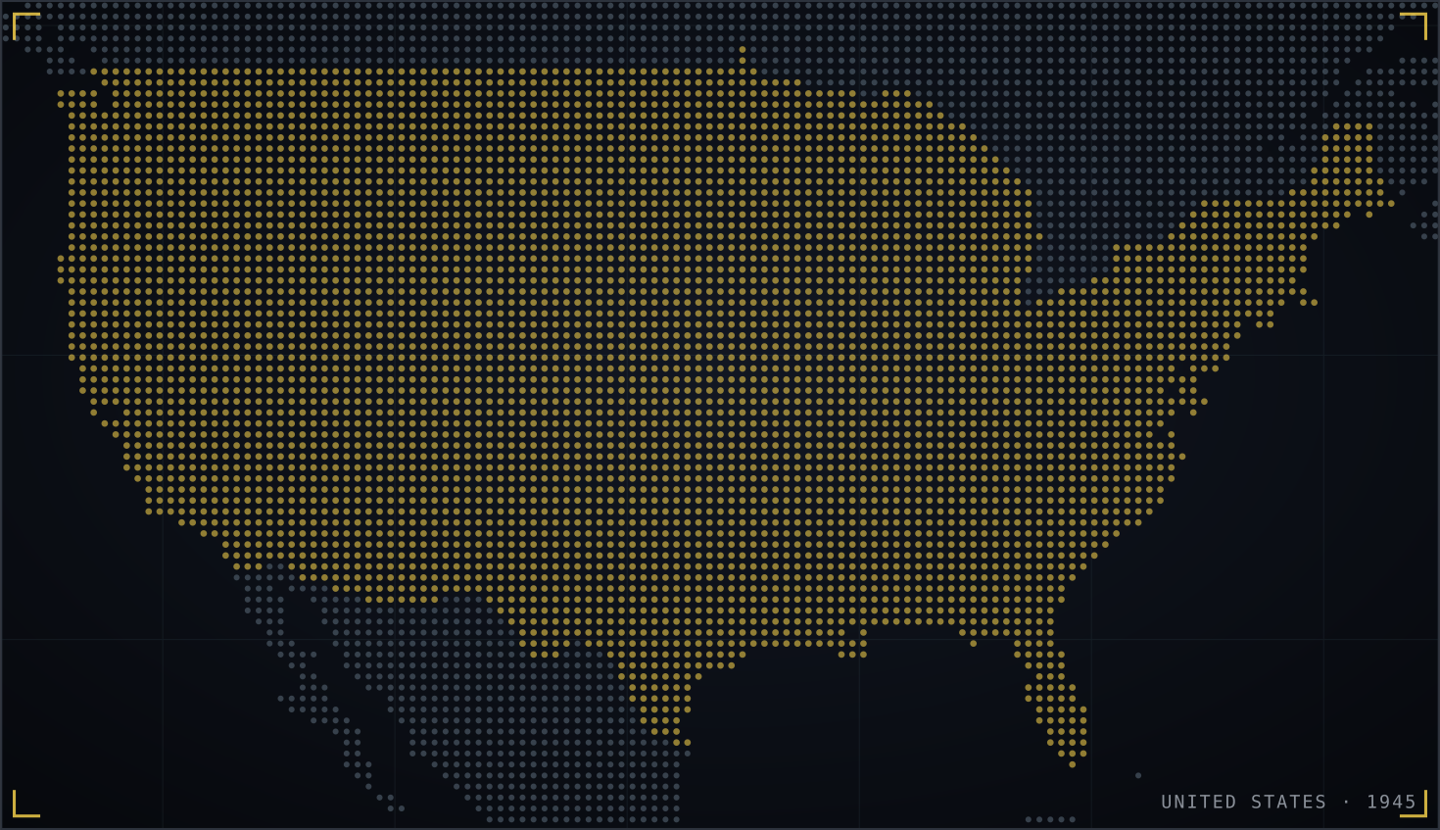


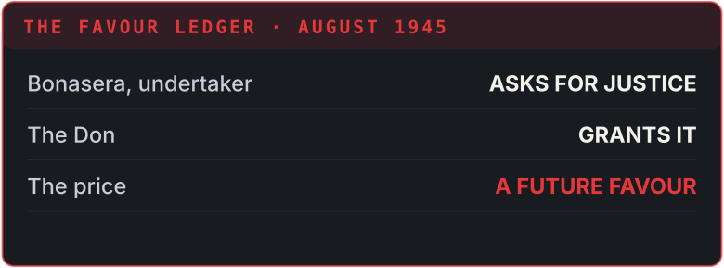
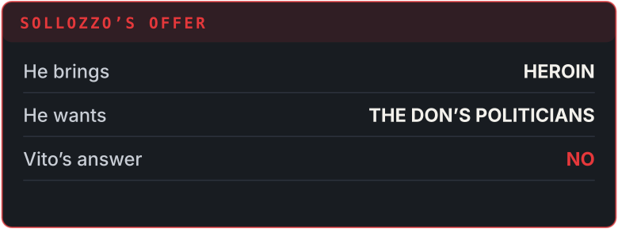
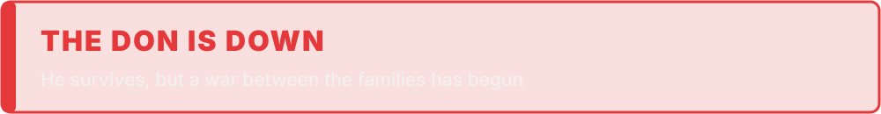



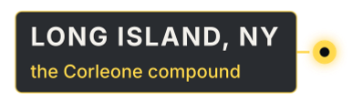

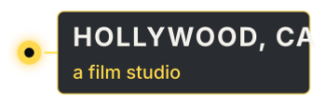

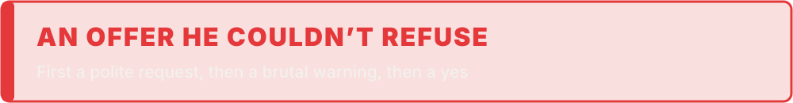
ACT I · THE FAMILY · ▶ PLAYBACK
SCENE 1 · THE WEDDING · 1945
SCENE 2 · HOLLYWOOD
SCENE 3 · THE OFFER
SCENE 4 · THE STREET
GRANTS FAVOURS
REFUSES THE DRUG DEAL
SHOT · IN HOSPITAL
SENT TO HOLLYWOOD
“Every favour is a debt. Every refusal is a war.”
BACKED BY A RIVAL FAMILY
VITO
HAGEN
NARRATOR
SOLLOZZO
VITO
NARRATOR
You come to me for justice. One day I may ask you for a favour in return.
The Don asks one favour: give his godson the part in your film.
The producer refuses. He wakes up to a brutal warning in his own bed, and the singer gets the part.
I bring the heroin. You bring your judges and politicians.
No. My friends in politics will not stay my friends if I deal in drugs.
Days later, Vito is shot five times in the street. He survives, but the war has begun.
Notes:
MEMBER 2 – Roll 09 – Naznin Akhter (about 61 seconds · no clicks)
[HOW IT PLAYS] Everything is automatic. Start reading as soon as the slide opens; each scene's animation starts by itself at the time shown. If you run ahead or behind, just keep going: it catches up on the next scene. The subtitle bar shows dramatised paraphrases, not exact quotes from the film.
[0:00 · Scene 1 plays]
Thank you, Rifat. Act One: the Family.
Scene one: August 1945, the wedding of the Don’s daughter on Long Island. By tradition, no one can be refused a favour today. An undertaker, Bonasera, asks the Don for justice. Vito grants it, but now Bonasera owes him.
[≈ 0:18 · Scene 2 starts by itself]
Scene two: Tom Hagen, the family’s adviser, flies to Hollywood to ask a producer to give the Don’s godson a film part. The producer refuses, and wakes up to a brutal warning in his bed. The singer gets the part.
[≈ 0:34 · Scene 3 starts by itself]
Scene three: Sollozzo, a drug dealer backed by a rival family, wants the Don’s protection for a heroin business. Vito says no: his judges and politicians would not tolerate drugs.
[≈ 0:46 · Scene 4 starts by itself]
Scene four: days later, Vito is shot in the street. He survives, but a war between the families has begun.
[When the yellow quote appears, pause.] Now let’s freeze the frame.
[When you finish, CLICK ▶ next slide]

Slide 4

From outsiders to insiders: crime as a ladder to power
PAUSED
END OF ACT I · WHAT IS HAPPENING HERE?
IMMIGRANT OUTSIDERS
INSIDE POLITICAL POWER
Genco Olive Oil: a legal front
Gambling, unions, protection
Judges and politicians on his side
Bell (1953): for groups shut out of legitimate routes, organized crime is a “queer ladder of social mobility”. The Corleones climb it from a street business to political power.
Ethnic succession
Bell (1953); Ianni (1972)
Private protection
Gambetta (1993)
Patron–client
Albini (1971)
An immigrant family climbs through crime, built on kinship and trust, while planning a legal future.
The Don sells what the state failed to give Bonasera: justice, protection and guarantees.
Every favour creates a debt. The Don’s real power is a ledger of people who owe him.
Notes:
MEMBER 2 – Roll 09 – Naznin Akhter (about 50 seconds)
[Freeze-frame.] What is happening in Act One?
[Ladder.] Daniel Bell called organized crime a "queer ladder of social mobility": groups shut out of legitimate routes climb through crime. Watch the Corleones climb it: from an olive oil company used as a front, to gambling, unions and protection, and finally to judges and politicians on their side.
[Bottom cards.] Three ideas explain the Don's power. Ethnic succession: Francis Ianni showed that Italian-American crime families are built on kinship and trust. Private protection: Diego Gambetta argues the mafia is an industry that sells protection. Bonasera goes to the Don because the courts failed him. And patron–client: Joseph Albini shows that every favour creates a debt. The Don's real power is a ledger of people who owe him.
Press play. Kingshuk, Act Two.

Slide 5
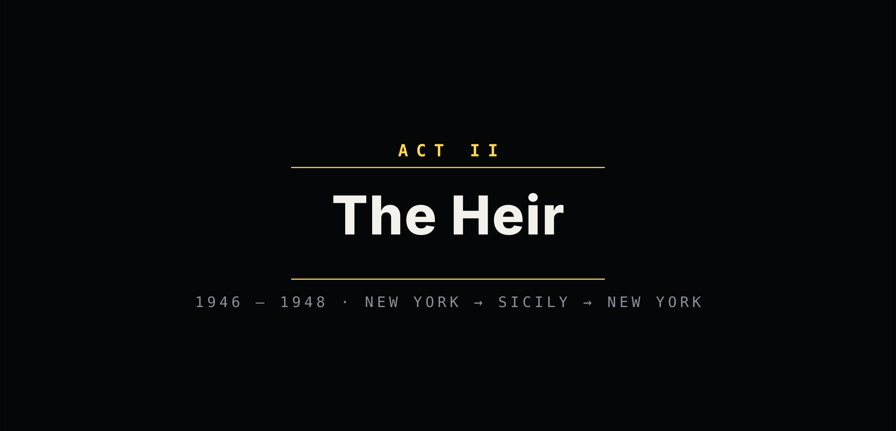

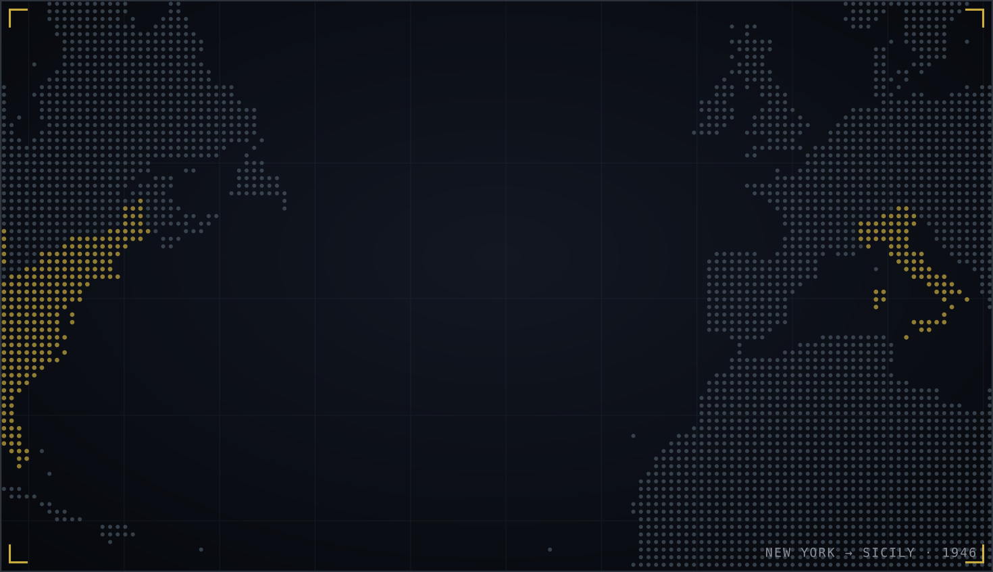


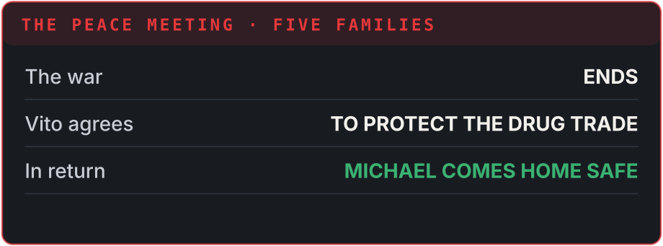











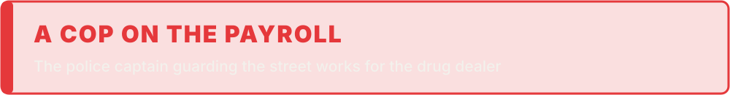
ACT II · THE HEIR · ▶ PLAYBACK
SCENE 5 · THE HOSPITAL
SCENE 6 · THE RESTAURANT
SCENE 7 · WAR OF THE FIVE FAMILIES
SCENE 8 · THE PEACE MEETING
OUTSIDE THE BUSINESS
KILLS SOLLOZZO + CAPTAIN
HIDING IN SICILY
ON SOLLOZZO’S PAYROLL
KILLED · RESTAURANT
“Even the mafia has a board meeting.”
LEADS THE WAR
KILLED AT A TOLL BOOTH
NARRATOR
MICHAEL
NARRATOR
NARRATOR
VITO
NARRATOR
Michael finds his father’s guards gone. He saves him, and a police captain breaks his jaw.
They want to talk peace? Then I will go to the meeting myself.
A gun hidden in the restroom. Michael kills Sollozzo and the captain, then flees to Sicily.
Open war between the Five Families. Then Sonny, the hot-headed heir, is ambushed at a toll booth.
I will not take revenge for my son. But if anything happens to Michael, I will hold you responsible.
And Vito sees the truth: Barzini was behind it all along.
Notes:
MEMBER 3 – Roll 22 – Nafiul Hoque Kingshuk (about 64 seconds · no clicks)
[HOW IT PLAYS] Everything is automatic. Start reading as soon as the slide opens; each scene's animation starts by itself at the time shown. If you run ahead or behind, just keep going: it catches up on the next scene. The subtitle bar shows dramatised paraphrases, not exact quotes from the film.
[0:00 · Scene 5 plays]
Thank you, Naznin. Act Two: the Heir.
Scene five: Michael, the youngest son and a war hero, has stayed outside the family business. At the hospital he finds his father’s guards gone. He saves him, but a police captain, McCluskey, breaks his jaw. The captain is on the drug dealer’s payroll.
[≈ 0:20 · Scene 6 starts by itself]
Scene six: Sollozzo and the captain ask for a peace meeting at a restaurant. Michael goes himself, with a gun hidden in the restroom. He kills them both, and flees to Sicily.
[≈ 0:33 · Scene 7 starts by itself]
Scene seven: open war between the Five Families of New York. Sonny, the hot-headed eldest son, is ambushed and killed at a toll booth.
[≈ 0:43 · Scene 8 starts by itself]
Scene eight: Vito calls the heads of the families together and makes peace. He agrees to protect their drug trade, so that Michael can come home safely. And he realizes Barzini was behind it all.
So let’s pause again. Is this family organized crime, by the textbook?
[When you finish, CLICK ▶ next slide]

Slide 6

The UN says yes. Abadinsky says yes too: a textbook mafia
PAUSED
ACT II · IS THIS ORGANIZED CRIME?
UNTOC, ARTICLE 2 (UNODC, 2004)
ABADINSKY’S ATTRIBUTES OF ORGANIZED CRIME
3+ persons in a structured group
Don, underboss, consigliere, captains, soldiers
Hierarchy and ranks
Don → underboss → captains → soldiers
Existing for a period of time
Decades, and it outlives the Don
Exclusive membership, a code of silence
Kinship, loyalty and omertà
Committing serious crime
Murder, extortion, bribery, illegal gambling
Survives the loss of its leaders
Vito is shot, then dies; the family goes on
For material benefit
Gambling, unions, casinos
Violence and bribery as tools
Threats, killings, a captain on the payroll
Our verdict: the Corleones fit every definition. This is the classic mafia model of organized crime
Notes:
MEMBER 3 – Roll 22 – Nafiul Hoque Kingshuk (about 50 seconds)
[Freeze-frame.] Is the Corleone family organized crime? This time, the answer is easy.
[Left.] The UN Convention against Transnational Organized Crime says an organized criminal group is three or more persons, structured, existing over time, committing serious crime for material benefit. The Corleones tick every box: a structured family, operating for decades, committing murder, extortion, bribery and illegal gambling, for profit.
[Right.] And Howard Abadinsky's classic attributes fit too: a hierarchy of ranks, exclusive membership held together by kinship and a code of silence, omertà, an organization that survives the loss of its leader, and the use of violence and bribery as tools.
[Bottom.] So our verdict: the Corleones are the textbook mafia. Munni will show you how the family is organized.

Slide 7






A pyramid of ranks, protected from the top
PAUSED
ACT II · WHO HOLDS THE POWER?
Hierarchical model Cressey (1969)
Fits closely: clear ranks and a chain of command, run like a corporation.
The Don
Vito → Michael
Politicians, judges, police
PROTECTION · bought with favours
Patron–client Albini (1971)
Fits too: the Don trades favours for loyalty, inside and outside the family.
Consigliere
Tom Hagen · adviser
Underboss
Sonny · second in command
Network model Morselli (2009)
Only partly: deals between the Five Families and with officials.
Caporegime
Clemenza · captain
Caporegime
Tessio · captain
Soldiers
Do the street work
Notes:
MEMBER 4 – Roll 31 – Khadiza Akter Munni (about 50 seconds)
Thank you, Kingshuk. [Freeze-frame.] Who holds the power? Look at the pyramid. [Trace the lines from the top.]
At the top is the Don: first Vito, then Michael. Beside him is the consigliere, Tom Hagen, the adviser. Below is the underboss, Sonny, then the captains, the caporegimes Clemenza and Tessio, and under them the soldiers who do the street work.
[Right cards.] This is exactly Donald Cressey's hierarchical model: clear ranks and a chain of command, like a corporation. Albini's patron–client model fits too: the Don trades favours for loyalty. The network model fits only partly, in the deals between the Five Families.
[Point to the dashed line.] And notice who protects the top: politicians, judges and police. Next, the corruption that makes it all possible.

Slide 8
Corruption = Monopoly + Discretion − Accountability
PAUSED
ACT II · WHERE IS THE CORRUPTION?
Klitgaard (1988). Corruption: the abuse of entrusted power for private gain (Transparency International).
M
D
A
MONOPOLY
DISCRETION
LOW ACCOUNTABILITY
Vito controls the judges and politicians everyone needs. That is why Sollozzo wants his protection.
Captain McCluskey decides whom the police protect, and sells that choice to a drug dealer.
After the restaurant killings, friendly reporters print stories about the captain’s corruption, and the case fades.
Political–criminal nexus (Chambliss, 1978): organized crime survives because officials, police and business people are part of the network. The Don’s real weapon is not the gun; it is protection from the state.
Notes:
MEMBER 4 – Roll 31 – Khadiza Akter Munni (about 50 seconds)
[Freeze-frame.] Where is the corruption? Transparency International defines corruption as the abuse of entrusted power for private gain. And Robert Klitgaard gives a formula: corruption equals monopoly, plus discretion, minus accountability.
[Cards.] Monopoly: Vito controls the judges and politicians everyone needs. That is exactly why Sollozzo wants his protection. Discretion: Captain McCluskey decides whom the police protect, and sells that decision to a drug dealer. And low accountability: after the restaurant killings, friendly reporters print stories about the captain's corruption, and the case quietly fades.
[Bottom.] William Chambliss called this the political–criminal nexus: organized crime survives because officials, police and business people are part of the network. The Don's real weapon is not the gun. It is protection from the state.
Labonno, Act Three.

Slide 9
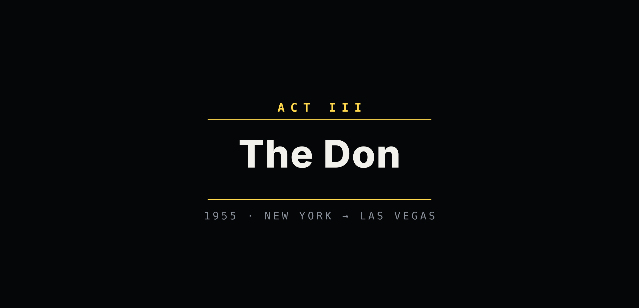



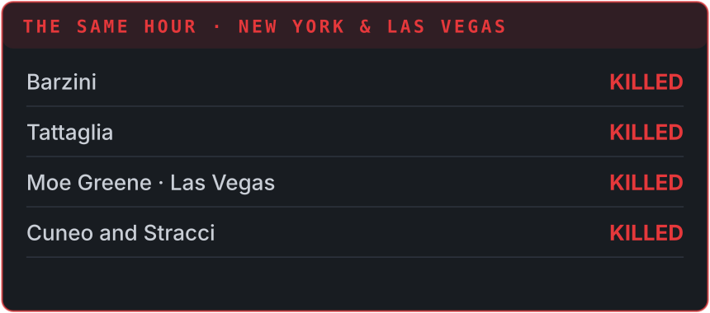



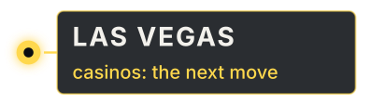

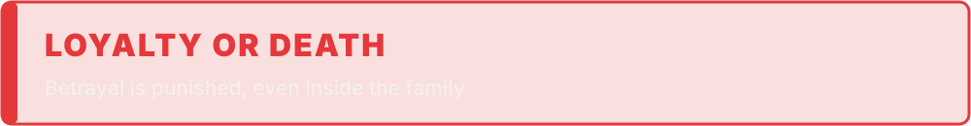
ACT III · THE DON · ▶ PLAYBACK
SCENE 9 · THE SUCCESSION · 1955
SCENE 10 · THE BAPTISM
SCENE 11 · THE TRAITORS
SCENE 12 · THE DOOR CLOSES
TAKES OVER THE FAMILY
GODFATHER AT A BAPTISM
THE NEW DON
DIES IN HIS GARDEN · 1955
“The Don dies. The family business goes on.”
OFFERS A “PEACE” MEETING
TRAITOR · TAKEN AWAY
VITO
NARRATOR
PRIEST
NARRATOR
NARRATOR
KAY
NARRATOR
Whoever comes to you with a peace meeting is the traitor. Remember that.
Soon after, Vito dies of a heart attack in his garden.
Do you renounce Satan? MICHAEL: I do renounce him.
At that very moment, his men kill the heads of the rival families.
Tessio, who offered the “peace” meeting, is taken away. Carlo, who helped set up Sonny’s murder, is killed.
Is it true? MICHAEL: No.
His captains kiss his hand: Don Corleone. And the door closes on his wife.
Notes:
MEMBER 5 – Roll 15 – Jarin Tasnim Labonno (about 60 seconds · no clicks)
[HOW IT PLAYS] Everything is automatic. Start reading as soon as the slide opens; each scene's animation starts by itself at the time shown. If you run ahead or behind, just keep going: it catches up on the next scene. The subtitle bar shows dramatised paraphrases, not exact quotes from the film.
[0:00 · Scene 9 plays]
Thank you, Munni. Act Three: the Don.
Scene nine: 1955. Michael has come home and taken over the family, with Vito as his adviser. They plan a move into the casinos of Las Vegas. Vito warns him: whoever brings you a peace meeting is the traitor. Soon after, Vito dies in his garden.
[≈ 0:21 · Scene 10 starts by itself]
Scene ten: Michael stands as godfather at his nephew’s baptism. As he renounces Satan in church, his men kill the heads of the rival families, in New York and in Las Vegas.
[≈ 0:34 · Scene 11 starts by itself]
Scene eleven: the traitors. Tessio, who offered the peace meeting, is taken away. Carlo, who helped set up Sonny’s murder, is killed.
[≈ 0:43 · Scene 12 starts by itself]
Scene twelve: his wife Kay asks if it is true. Michael lies: no. His captains kiss his hand, Don Corleone, and the door closes on her.
[Pause.] One last freeze-frame. How do they justify all this to themselves?
[When you finish, CLICK ▶ next slide]

Slide 10
Neutralization: how a killer keeps a clean conscience
PAUSED
ACT III · HOW DO THEY JUSTIFY IT?
Sykes & Matza (1957): offenders know the rules, but use excuses to switch them off. In the film, murder is described as business, duty and family.
DENIAL OF RESPONSIBILITY
CONDEMNATION OF THE CONDEMNERS
“It’s not personal. It’s strictly business.”
“My father is no different from any senator or president.”
DENIAL OF THE VICTIM
APPEAL TO HIGHER LOYALTIES
“The captain was corrupt. He had it coming.”
“Everything I do, I do for the family.”
Quotes paraphrase the characters’ attitudes; they are not exact lines from the film.
Notes:
MEMBER 5 – Roll 15 – Jarin Tasnim Labonno (about 50 seconds)
[Freeze-frame.] How does a man like Michael order murders and still feel like a good son and a good father? Sykes and Matza call it techniques of neutralization. Offenders know the rules, but use excuses to switch their conscience off.
[Read each yellow line like a subtitle.]
Denial of responsibility: "It's not personal. It's strictly business."
Condemnation of the condemners: "My father is no different from any senator or president."
Denial of the victim: "The captain was corrupt. He had it coming."
Appeal to higher loyalties: "Everything I do, I do for the family."
These are our paraphrases of the characters' attitudes. And notice: every killing is described as business, duty or family. That is how violence becomes normal inside the mafia.
Tasnim will give the critics' verdict.

Slide 11


Accurate in structure, romantic in tone
THE CRITICS’ VERDICT · OUR RATINGS
Conceptual accuracy
5/5
Hierarchy, the Commission, omertà and political protection
Factual grounding
4/5
Fiction, but based on New York’s real crime families
Realism of tone
2/5
Romanticizes the Don as honourable; his anti-drug code is a myth
Systemic insight
3/5
Shows corrupt police and politics, but hides the victims
Ratings are the group’s assessment. Real context: the Commission (1931), Joseph Valachi’s Senate testimony (1963), the RICO Act (1970).
Notes:
MEMBER 6 – Roll 04 – Tasnim Ferdous Ali (about 50 seconds)
Thank you, Labonno. So what is our critics' verdict? Accurate in structure, romantic in tone.
[Go row by row.] Conceptual accuracy: five stars. The hierarchy, the Commission of the Five Families, the code of silence and political protection are all real features of the American mafia.
Factual grounding: four stars. The story is fiction, but it is based on New York's real crime families. In 1963, the mobster Joseph Valachi described the same structure to the US Senate.
But realism of tone: only two stars. The film makes the Don look honourable. His refusal to deal drugs is largely a myth: real families were deep in the heroin trade.
And systemic insight: three stars. It shows corrupt police and politicians, but we almost never see the victims.
[Name] will give our final cut.

Slide 12
THE FINAL CUT
The mafia calls itself a family. It is really a business that governs through favours and fear.
CREDITS
OPENING & TRAILER · ROLL 38
Md. Akram Hossain Rifat
ACT I · ROLL 09
Naznin Akhter
ACT II: DEFINITIONS · ROLL 22
Nafiul Hoque Kingshuk
THE ANSWER
A mafia family works as a hierarchy (Cressey) that sells protection (Gambetta) and is shielded by corrupt officials (Chambliss).
ACT II: STRUCTURE · ROLL 31
Khadiza Akter Munni
ACT III · ROLL 15
Jarin Tasnim Labonno
CRITICS’ VERDICT · ROLL 04
Tasnim Ferdous Ali
THE LESSON FOR BANGLADESH
Our newspapers also call politically protected crime bosses “godfathers”. Cut the political protection, and the godfather loses his power.
FINAL CUT · ROLL __
[7th member]
Thank you · Questions?
Notes:
MEMBER 7 – Roll __ – [7th member: roll printed as “2431” in the brief] (about 40 seconds)
Thank you, Tasnim. So here is our final cut. [Read slowly.] The mafia calls itself a family. It is really a business that governs through favours and fear.
The answer to our big question: a mafia family works as a hierarchy, as Cressey described, that sells protection, as Gambetta argues, and it is shielded by corrupt officials, the political–criminal nexus that Chambliss described. In real life, it took the RICO Act of 1970, and the Commission trial of the 1980s, to break the New York families.
And a lesson for Bangladesh. Our own newspapers also use the word "godfather" for crime bosses protected by political power. Cut that protection, and the godfather loses his power.
[Point to the credits.] That's a wrap from Group 5. Thank you, and we're happy to take your questions.

