Slide 1
University of Science and Technology Meghalaya
SOFTWARE ENGINEERING PROJECT PRESENTATION
on
“E-Learning Software(NovaLearn)"
Guided by:
Sir. Abdul Kayum Ali
Asst. Professor CSE
Presented by-
Bhargab Das
Roll Number-2023/BCSE/0065
Computer Science Engineering 2026
1

Slide 2
CONTENTS
1. INTRODUCTION
5. CONCLUSION
A. Introduction
B. Problem Statement
6. REFERENCES
C. Objectives
2. ANALYSIS AND DESIGN
A. SDLC Model
B. E-R Diagram
C. Data Flow Diagram
D. Data Dictionary
3. SYSTEM DIAGRAMS
A. Use Case Diagram
B. Use Case Description
C. Class Diagram
D. Sequence Diagram
4. TESTING AND RESULTS
A. Testing (Black Box)
B. Snapshot Of Interfaces
2

Slide 3
INTRODUCTION
E-learning has revolutionized the educational landscape, offering unprecedented accessibility and flexibility to students worldwide. However, standard video delivery platforms often lack the specialized interactive tools required for deep, retention-focused learning. NovaLearn is a comprehensive, full-stack e-learning web application designed to bridge the gap between passive video consumption and active student engagement. It provides a structured environment where educators can build rich courses and students can learn through interactive video players, assignments, quizzes, and a unique time-stamped note-taking system.
3

Slide 4
PROBLEM STATEMENT
Traditional video-based learning systems suffer from several critical drawbacks:
Passive Learning: Students consume content passively without effective, synchronized ways to record their thoughts. Standard note-taking happens outside the platform, losing the context of the video timestamp.
Lack of Role Separation: Many rudimentary platforms do not strictly separate the creator's workspace from the consumer's workspace, leading to cluttered interfaces and data privacy risks.
Fragmented Assessment: Course delivery, assignment submission, and grading often occur across disparate, non-integrated platforms.
4

Slide 5
OBJECTIVE
To develop a robust, secure authentication system with strict role-based access control (rbac) differentiating students and teachers.
To build an interactive video player that allows users to create, save, and jump to time-stamped notes, enabling active learning.
To design a comprehensive teacher dashboard for seamless course creation, video uploading, and assignment management.
To implement a flexible media delivery system that supports both external youtube embeds and secure local video file uploads.
To create an integrated assignment submission and review portal, allowing teachers to efficiently evaluate and print student work.
To build a scalable and stateless backend rest api using node.Js, express, and sequelize orm to ensure rapid data retrieval.
To provide an intuitive, responsive, and modern ui/ux for students to easily track their enrolled courses and learning progress.
5

Slide 6
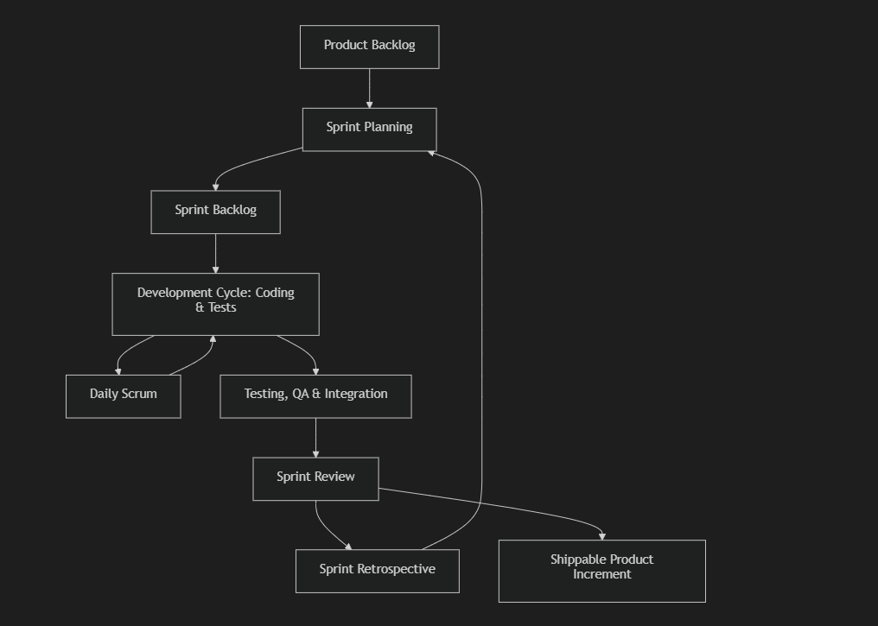
SDLC MODEL
Agile Model
6

Slide 7
SDLC MODEL
The Agile Methodology
For the development of NovaLearn, the Agile Software Development Life Cycle (SDLC) was chosen. Unlike the rigid Waterfall model, Agile promotes iterative development, continuous feedback, and rapid adaptation to changing requirements. The project was broken down into manageable "sprints," allowing for functional modules to be designed, developed, and tested concurrently.
Application of Agile in NovaLearn
The development was structured into the following sprints:
Sprint 1 (Foundation): Setup of the MySQL database using Sequelize, Express server initialization, and core user authentication (JWT).
Sprint 2 (Core Features): Development of the Student Dashboard, Course catalogue, and basic Video playback.
Sprint 3 (Interactive Elements): Implementation of the time-stamped note-taking system synchronized with the React video player.
Sprint 4 (Instructor Portal): Architecting the Teacher Dashboard, course creation flows, custom local video uploads, and assignment grading systems.
7

Slide 8
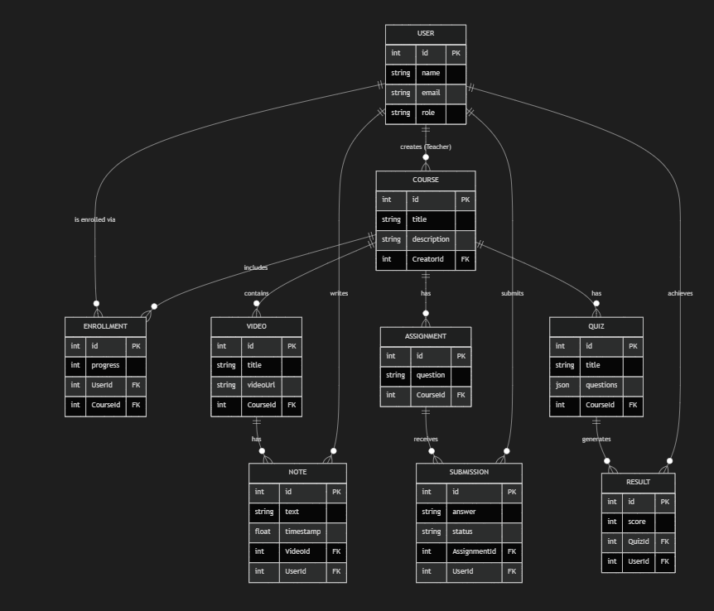
E-R DIAGRAM
9

Slide 9
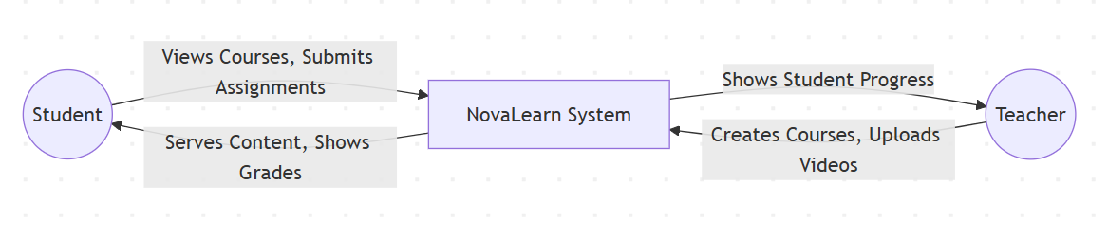
Diagram 1: Level 0 DFD – Context Diagram
2

Slide 10
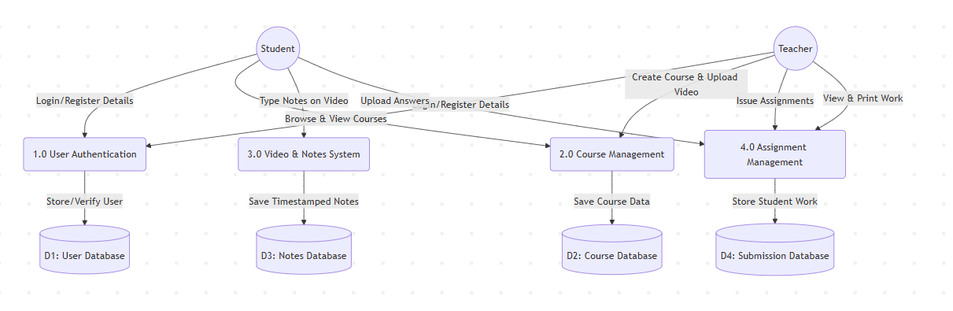
Diagram 2: Level 1 DFD – Main Processes
Chapter 4.1.2
3

Slide 11
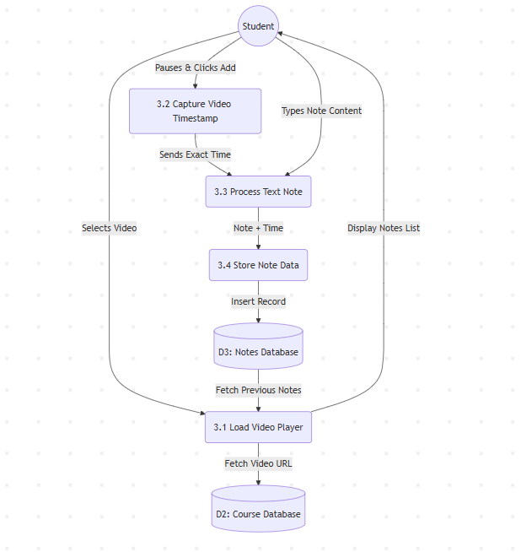
Diagram 3: Level 2 DFD
Chapter 4.1.3
4

Slide 12
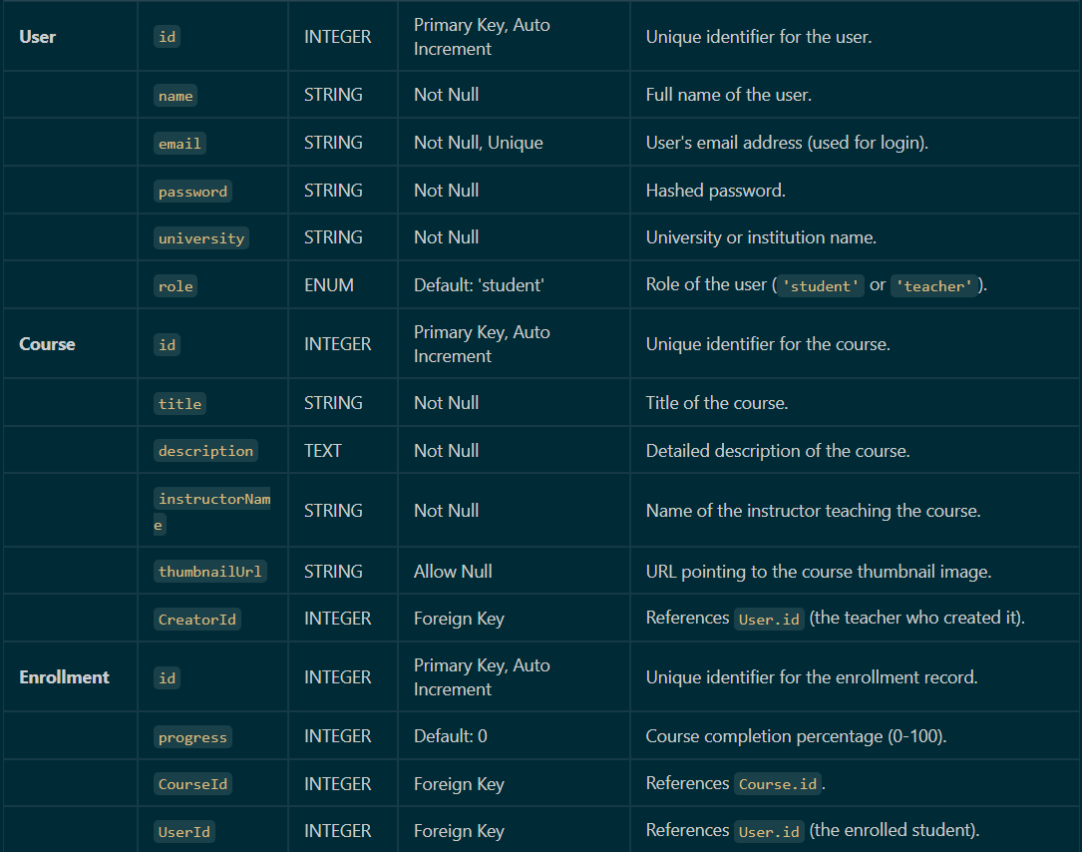
DATA DICTIONARY
11

Slide 13
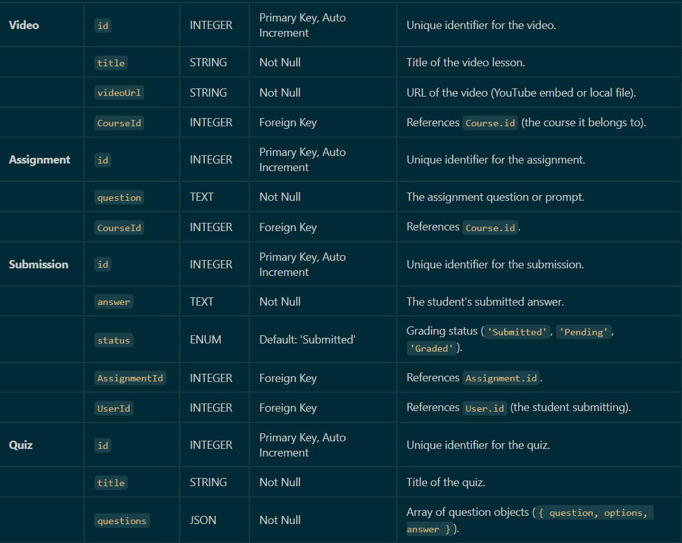
DATA DICTIONARY
11

Slide 14
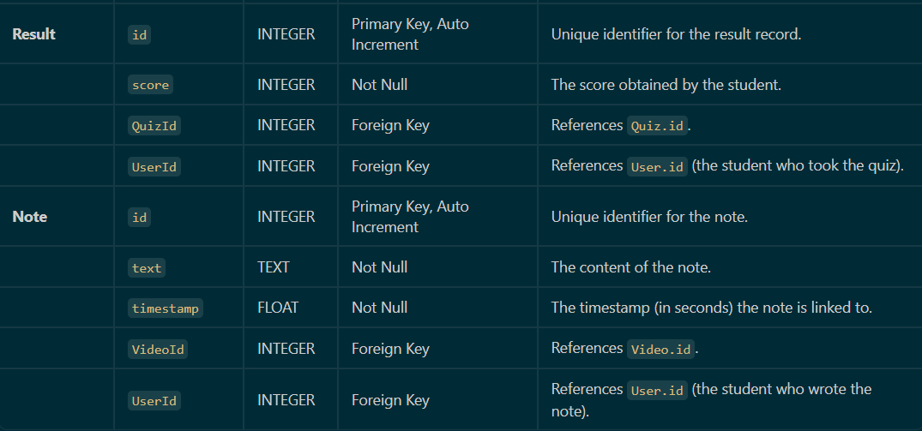
DATA DICTIONARY
11

Slide 15
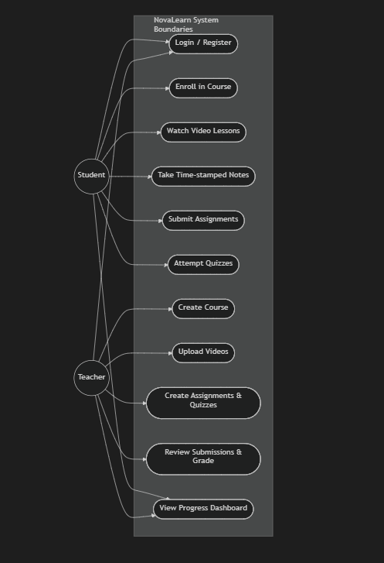
USE CASE DIAGRAM
13

Slide 16
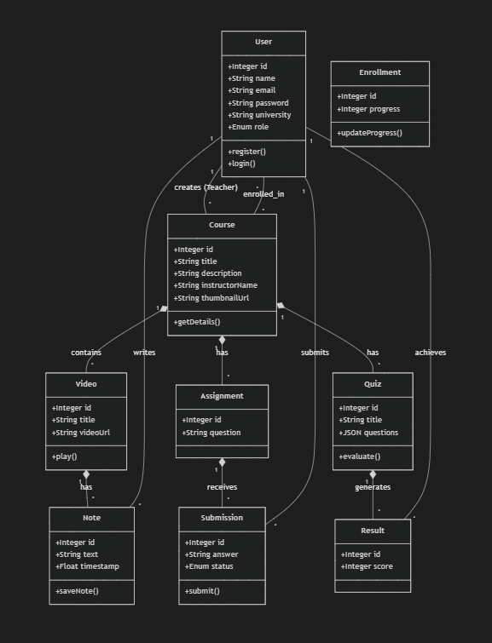
CLASS DIAGRAM

Slide 17
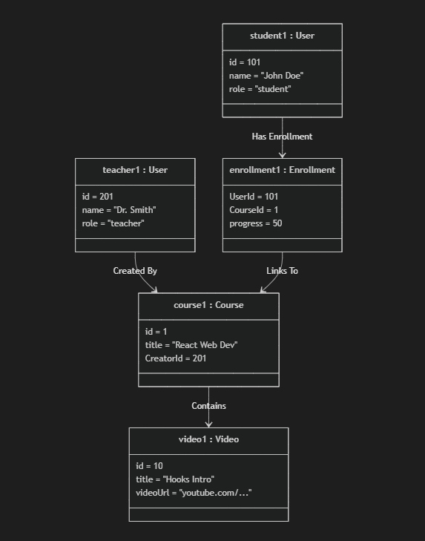
Object Diagram

Slide 18
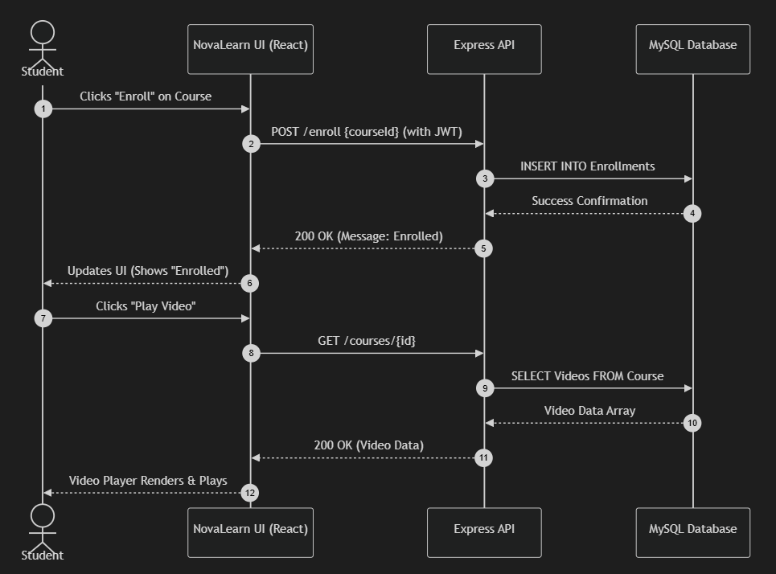
Sequence Diagram
7

Slide 19
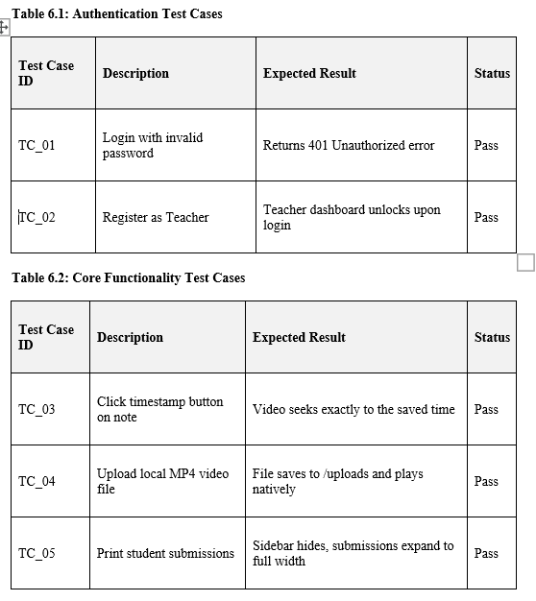
TESTING
17

Slide 20
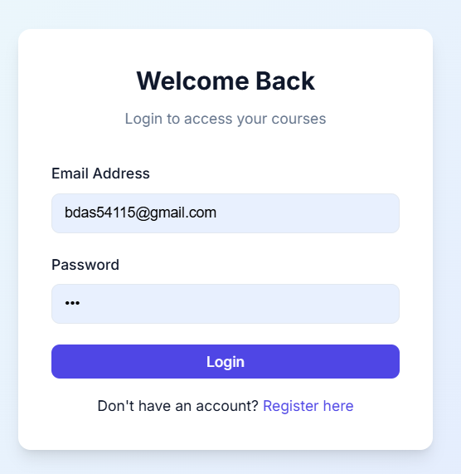
SNAPSHOTS OF INTERFACES
Login Form
18

Slide 21
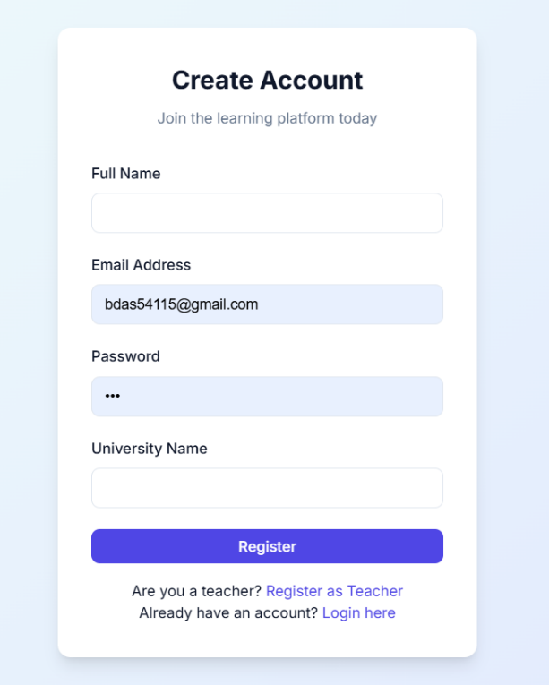
SNAPSHOTS OF INTERFACES
Student Sign Up:
18

Slide 22
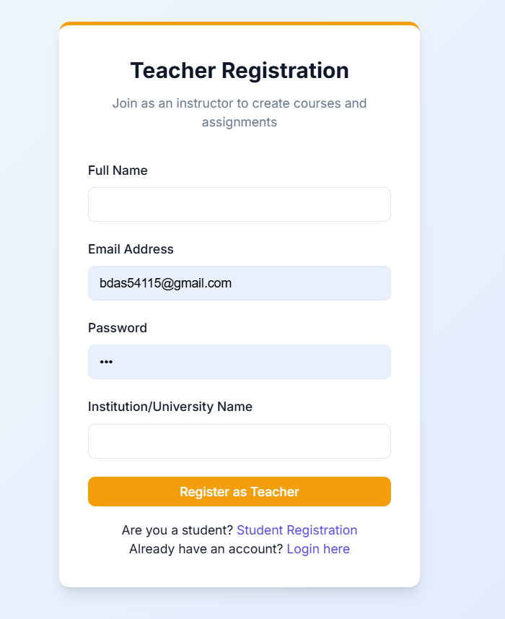
SNAPSHOTS OF INTERFACES
Teachers Sign Up:
18

Slide 23
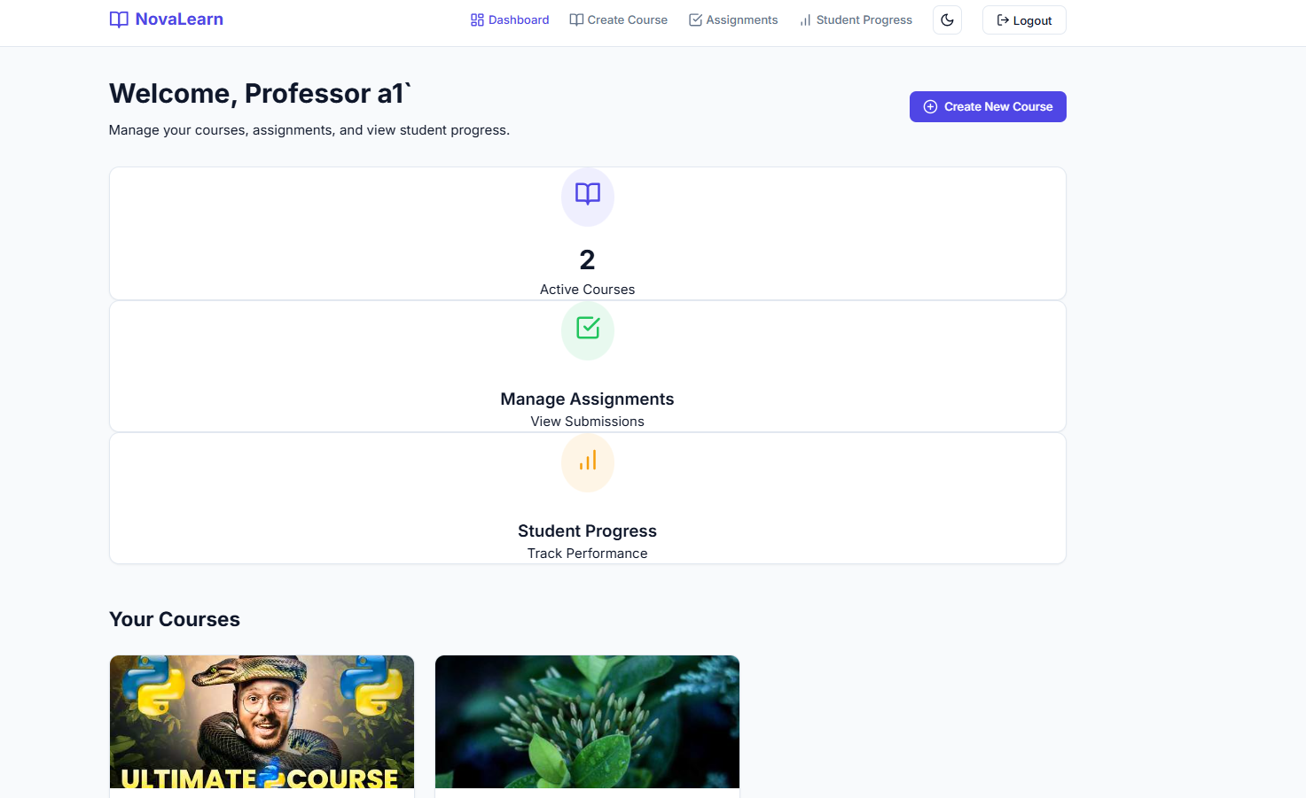
SNAPSHOTS OF INTERFACES
Teachers Dashboard:
18

Slide 24
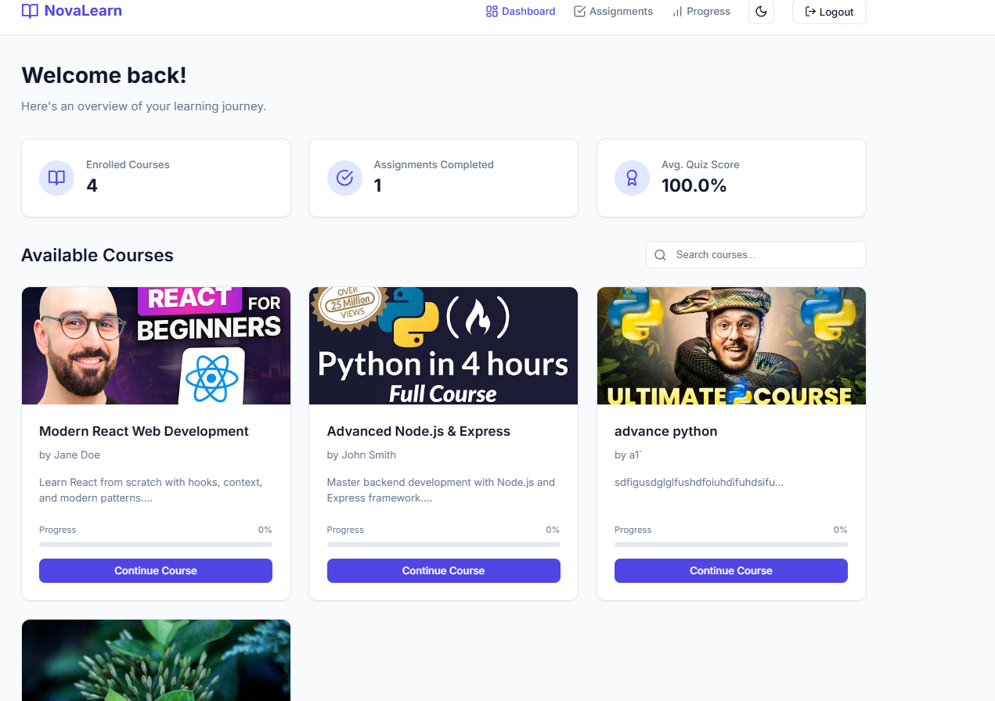
SNAPSHOTS OF INTERFACES
Students Dashboard:
18

Slide 25
CONCLUSION
Developing NovaLearn provided deep, practical insights into full-stack web development. Key learnings included:
Architecting relational databases using Sequelize ORM to handle complex associations (Users, Courses, Videos, Notes).
Implementing secure, role-based access control using JSON Web Tokens.
Handling multipart/form-data for file uploads using Multer.
Managing complex React state and interacting with DOM APIs for video synchronization.
19

Slide 26
REFERENCES
React Documentation. (n.d.). React – A JavaScript library for building user interfaces. Retrieved from https://reactjs.org/
Node.js Foundation. (n.d.). Node.js. Retrieved from https://nodejs.org/
Sequelize. (n.d.). Sequelize: The Node.js ORM. Retrieved from https://sequelize.org/
Express.js. (n.d.). Fast, unopinionated, minimalist web framework for Node.js. Retrieved from https://expressjs.com/
React-YouTube Library. (n.d.). NPM Registry. Retrieved from https://www.npmjs.com/package/react-youtube
20

