Slide 1


Semester : 8th Cloud Project Presentation On Cloud-Based Learning Platform
Babu Madhav Institute of Information Technology
~Using AWS Cloud Services
Group Members:
1. Jeet H. Chalthanwala 202206100110109
2. Dhruvin Prajapati 202206100110178
Guide Name : Dr. Bhumika Patel

Slide 2
Introduction
This project is a cloud-based learning platform
Enables faculty to upload courses and students to access them
Built using modern technologies (React + FastAPI)
Deployed fully on AWS cloud infrastructure
Focus on scalability, availability, and real-world architecture

Slide 3
CLOUD SERVICES USED
Amazon S3
Used for hosting frontend (React build)
Amazon EC2
Used to host backend (FastAPI server)
Amazon DynamoDB
Used as NoSQL database for users and courses
IAM (Identity & Access Management)
Used for secure permissions and roles

Slide 4
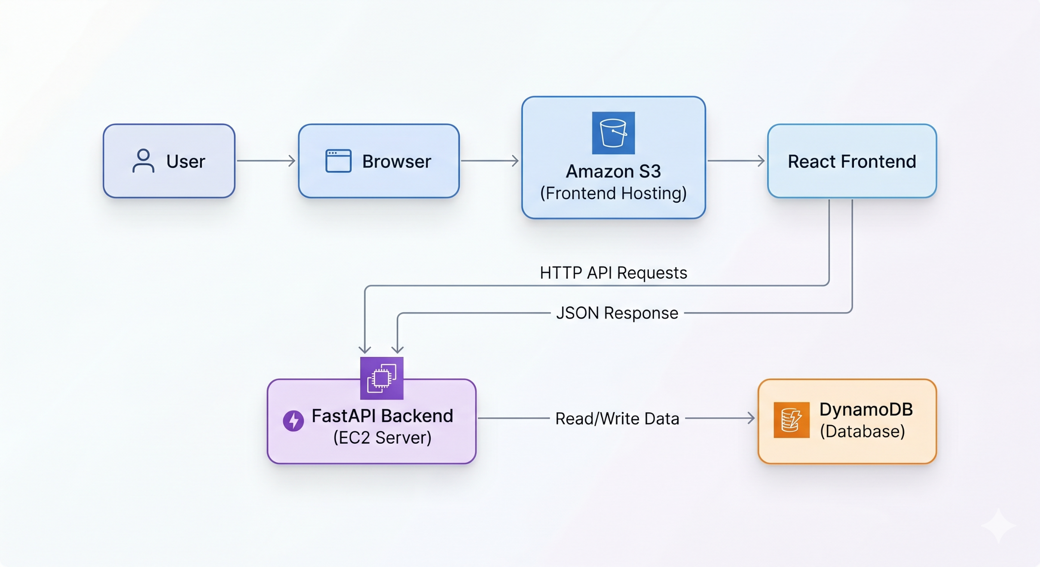
Cloud Services Integration

Slide 5
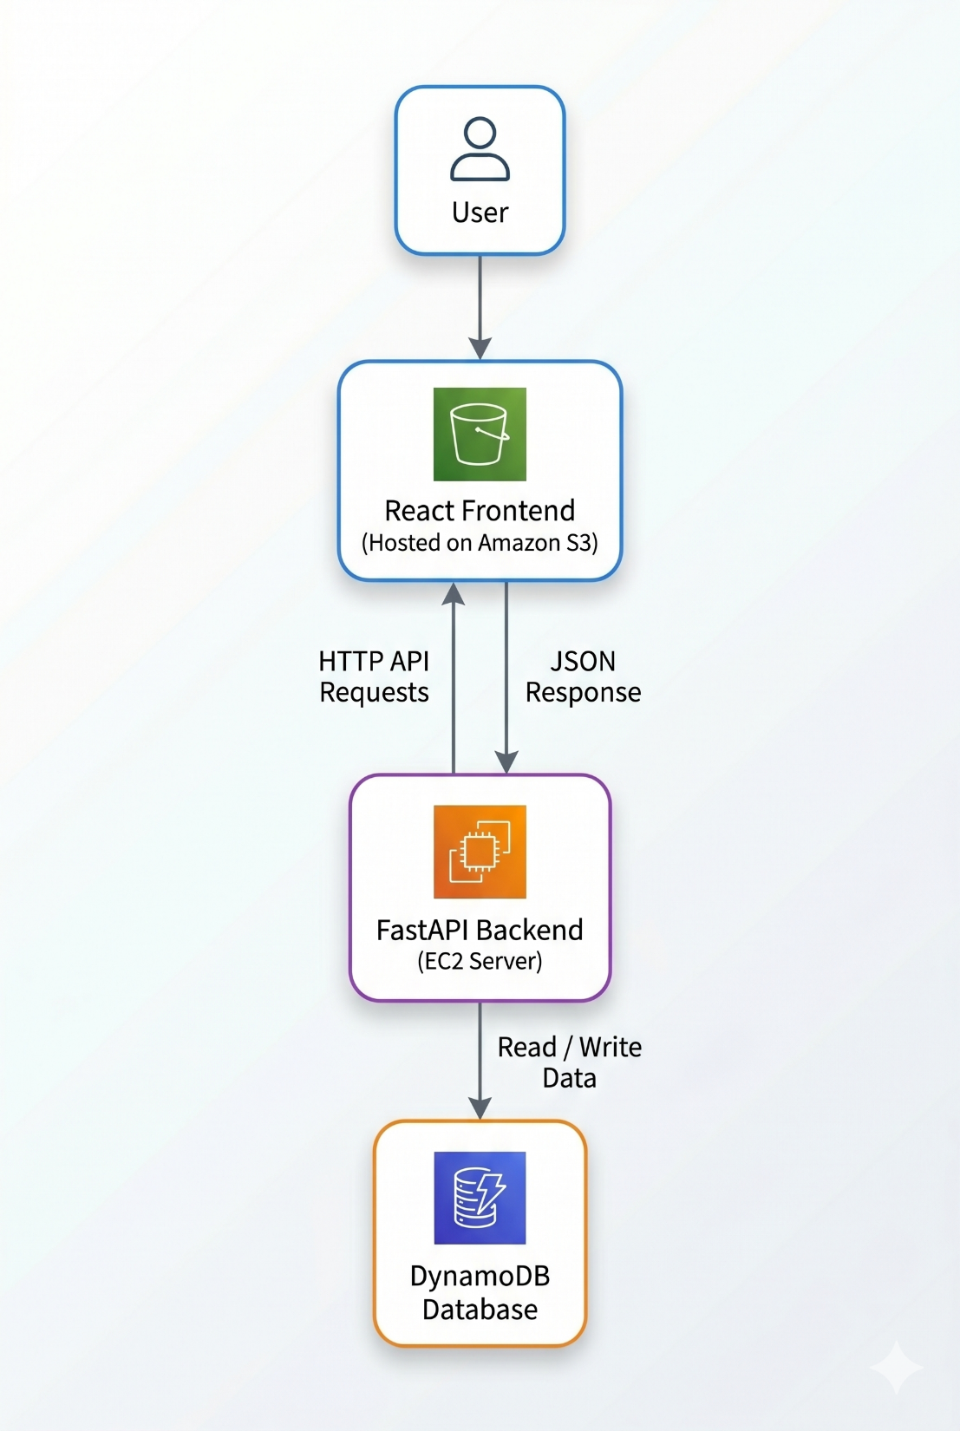
Architecture Design

Slide 6
Component Explanation
Frontend (React):
UI for login/signup
Dashboard for faculty & students
API communication
Backend (FastAPI):
Handles authentication
Manages courses
Connects to DynamoDB

Slide 7
Component Explanation
Database (DynamoDB):
Stores users
Stores course data
Highly scalable NoSQL database

Slide 8
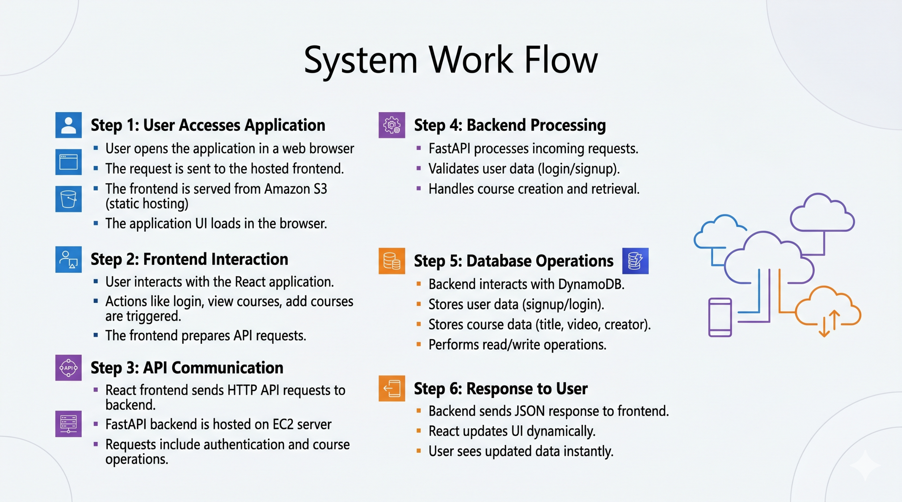
System Workflow

Slide 9
Thank you

