Slide 1
IBM University Engagement Project Submission
“Exploring the Power of Agentic AI with IBM Granite and LangFlow”

Slide 2

Project Tile – SaltGuard AI
Domain of Project – Healthcare
Student Name | Recent Passport Photo | Email ID | Mobile number [WhatsApp]
Soni Pratham Hardikkumar |  | 25BEITM072@SVITVASAD.AC.IN | 8128576288

Slide 3
Problem Statement :
Salt pan workers (Agariyas) in the Little Rann of Kutch work in extreme and isolated conditions with limited access to healthcare, fair salt pricing, and government welfare schemes. This creates health risks, economic vulnerability, and difficulty accessing essential support.
The Objective:
- Build an AI-powered Agariya Worker Welfare Platform that provides accessible health assistance, fair-price guidance, and personalized welfare-scheme support.
Key Problems
Limited access to healthcare and immediate health guidance
Risk from extreme heat and harsh working conditions
Lack of awareness about preventive health and safety
Exploitation through unfair salt prices and middlemen
Limited awareness of applicable government welfare schemes
Difficulty accessing reliable information in remote locations

Slide 4
Proposed Solution :
The proposed solution is an AI-powered welfare platform for Agariya salt pan workers, built using IBM watsonx.ai, IBM Granite, Langflow, Python, and Streamlit. It provides AI-driven support for health safety, fair salt pricing, and government welfare schemes.
Key Modules
Health & Hazard Triage – Analyzes symptoms, heat index, and working hours to provide severity assessment, first-aid, and referral guidance.
Salt Fair-Price Advisor – Evaluates salt grade, quantity, and offered price to identify unfair pricing and exploitation.
Welfare Scheme Matcher – Matches workers with suitable government schemes based on their personal and work profile.
Langflow Agent Pipeline – Handles general health, pricing, and welfare queries, with IBM Granite as a fallback.
The platform uses a Streamlit dashboard with IBM Granite through the watsonx.ai API, while Langflow manages the AI workflow.
Overall: One AI platform for safer workers, fairer prices, and better access to welfare benefits.

Slide 5
Technology Used
Langflow – For designing and orchestrating the AI agent workflow.
IBM watsonx.ai – For AI model integration and cloud-based inference.
IBM Granite / AI Model – For natural language understanding and generating intelligent responses.
IBM Cloud – Provides the cloud infrastructure and watsonx.ai services
.
Python – Core programming language used to build the application and AI integrations.
Streamlit – Used to create the interactive web dashboard for all welfare modules.
Watsonx API Key (.env) – Securely manages IBM API credentials and project configuration.
REST API – Connects the Streamlit application with the Langflow agent pipeline.

Slide 6
Langflow component Used :
Chat Input – Accepts user queries related to worker health, salt pricing, safety, and welfare schemes.
IBM Granite / AI Model – Processes user queries and generates intelligent, context-aware responses.
Prompt / Agent Logic – Guides the AI to provide health triage, fair-price analysis, and welfare scheme recommendations.
Chat Output – Displays AI-generated responses and recommendations to the user.
API Integration – Connects the Streamlit application with the Langflow saltguard-agent pipeline.
IBM Granite Fallback – Automatically uses IBM Granite directly when the Langflow pipeline is unavailable.
Environment Variables (.env) – Securely manages IBM watsonx.ai API credentials and project configuration.

Slide 7
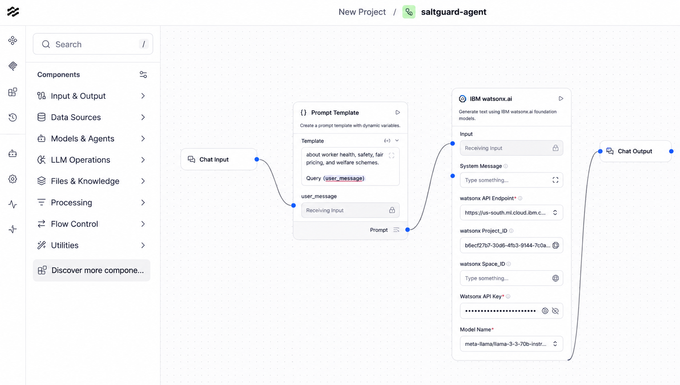
Langflow workflow -

Slide 8
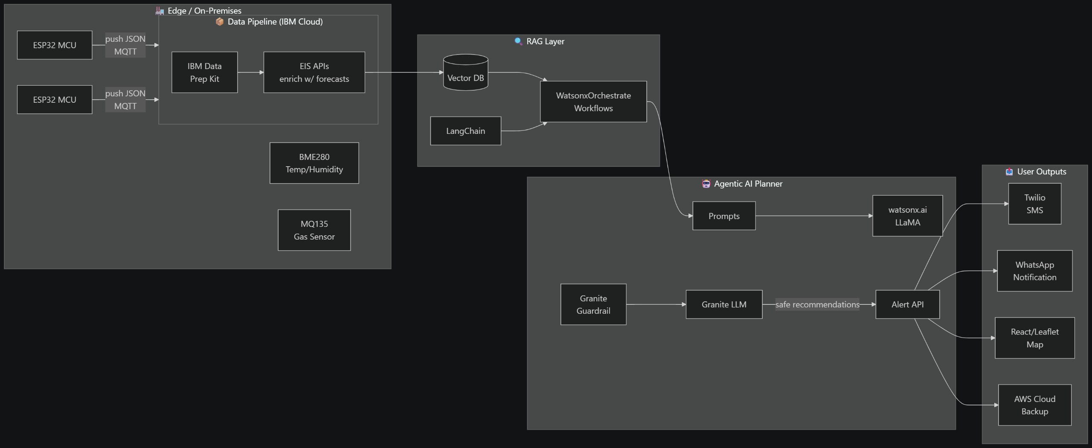
Architecture blueprint

Slide 9

Role of Agentic AI in the solution
Agentic AI makes SaltGuard AI an intelligent welfare assistant rather than a simple chatbot.
Health Agent – Assesses symptoms and heat-related risks.
Price Agent – Identifies unfair salt pricing.
Welfare Agent – Finds suitable government schemes.
Langflow Agent – Orchestrates AI workflows.
Context-Aware AI – Provides personalized, actionable recommendations.
Overall: Agentic AI enable]s intelligent decision-making for Agariya worker welfare.

Slide 10
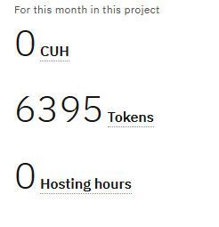
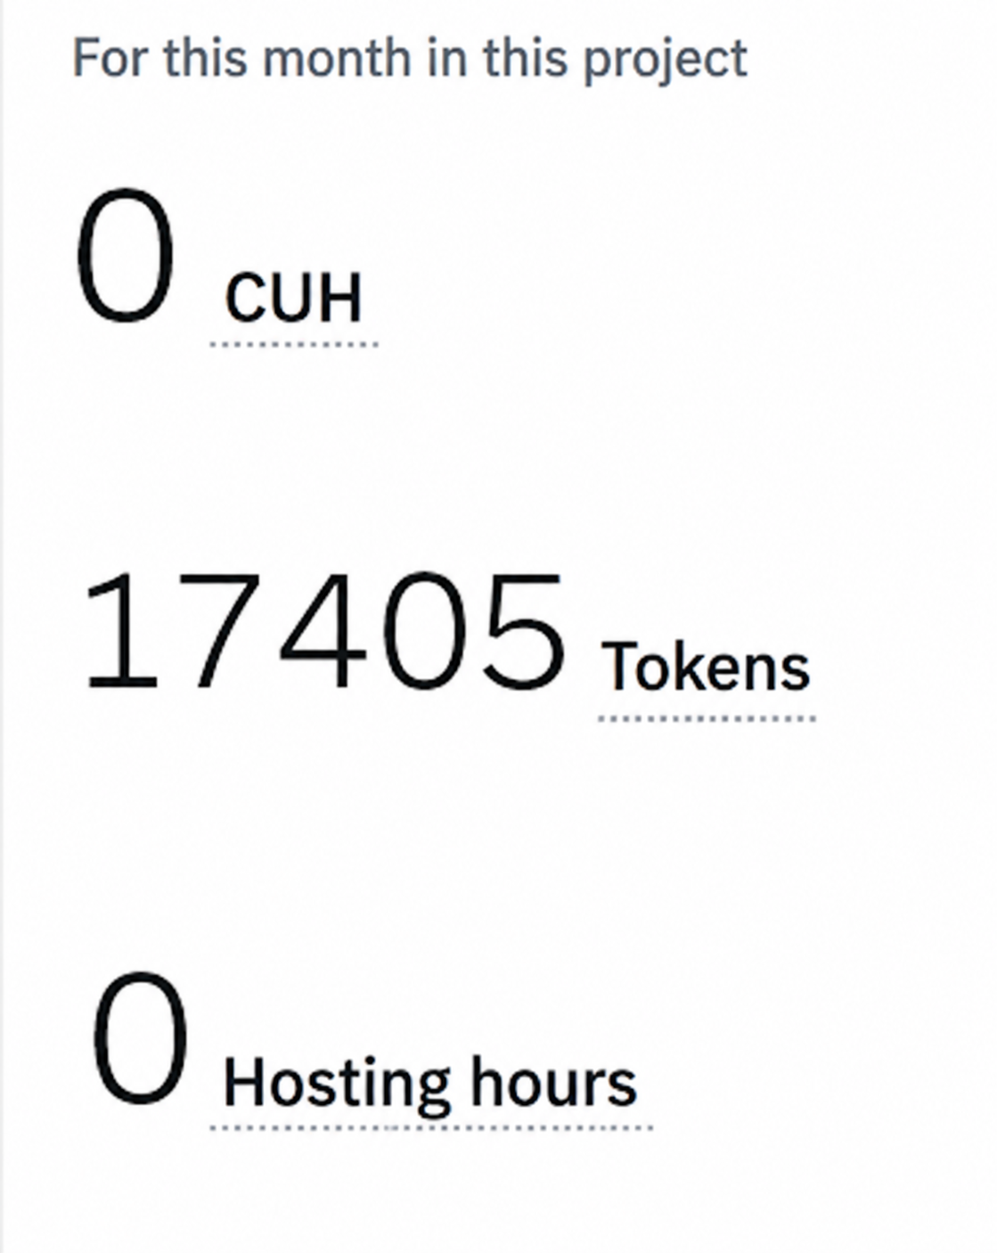
Token Usage
11,761 token are used
Before Prompt
After the Prompt
·
·
·

Slide 11
Novelty and Uniqueness
SaltGuard AI stands out by combining Agentic AI, IBM Granite, Langflow, and personalization into a single welfare platform.
Multi-Agent Intelligence – Specialized agents for health, pricing, and welfare.
AI-Powered Health Triage – Provides quick risk assessment and first-aid guidance.
Fair-Price Intelligence – Helps identify unfair salt prices and exploitation.
Personalized Welfare Matching – Finds schemes based on individual worker profiles.
Multilingual Support – Accepts English, Hindi, and Gujarati inputs.
Langflow + Granite Integration – Combines workflow orchestration with AI-powered responses.
Fallback Architecture – IBM Granite can respond when Langflow is unavailable.
Overall: A unified, context-aware AI platform focused specifically on Agariya worker welfare.

Slide 12
Git Hub Link
Please create public github repository (Enable Add README button while creating repository) with format –
Please test and Paste the working Github URL – https://github.com/jeetlohe/SaltGuardAI.git
Make sure you have Uploaded following three files into your github repository 1) app.json file , 2) yourproblemstatement.pdf file 3) your projectpresntation.pptx file 4)any other files
·
·
·

Slide 13
Future Scope
1. Wearable & Health Device Integration - Integrate smartwatches and health devices to collect real-time data such as heart rate, activity, and heat exposure for better health-risk monitoring.
2. AI Voice & Multilingual Support - Add a voice-based AI assistant with support for Gujarati, Hindi, and other regional languages to make SaltGuard AI more accessible to Agariya workers.
3. Real-Time Alerts & Monitoring - Provide early warnings for heat stress, dehydration, and other workplace health risks based on worker conditions.
4. Expanded Welfare Services - Extend the platform with more government schemes, local healthcare services, and direct welfare assistance.
·
·
·

Slide 14
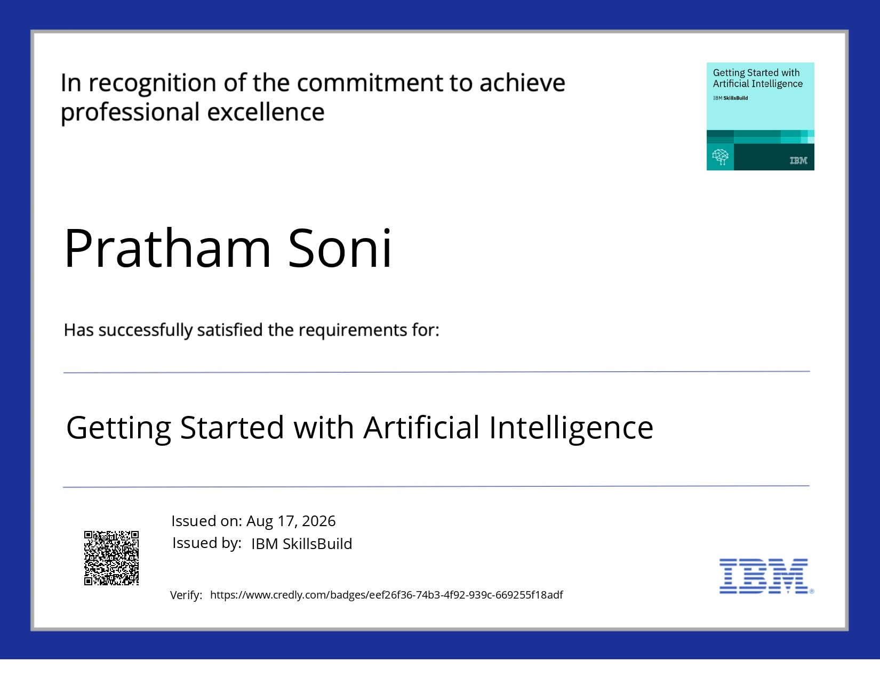
Certificates Earned:
Please add your credly certificate

Slide 15
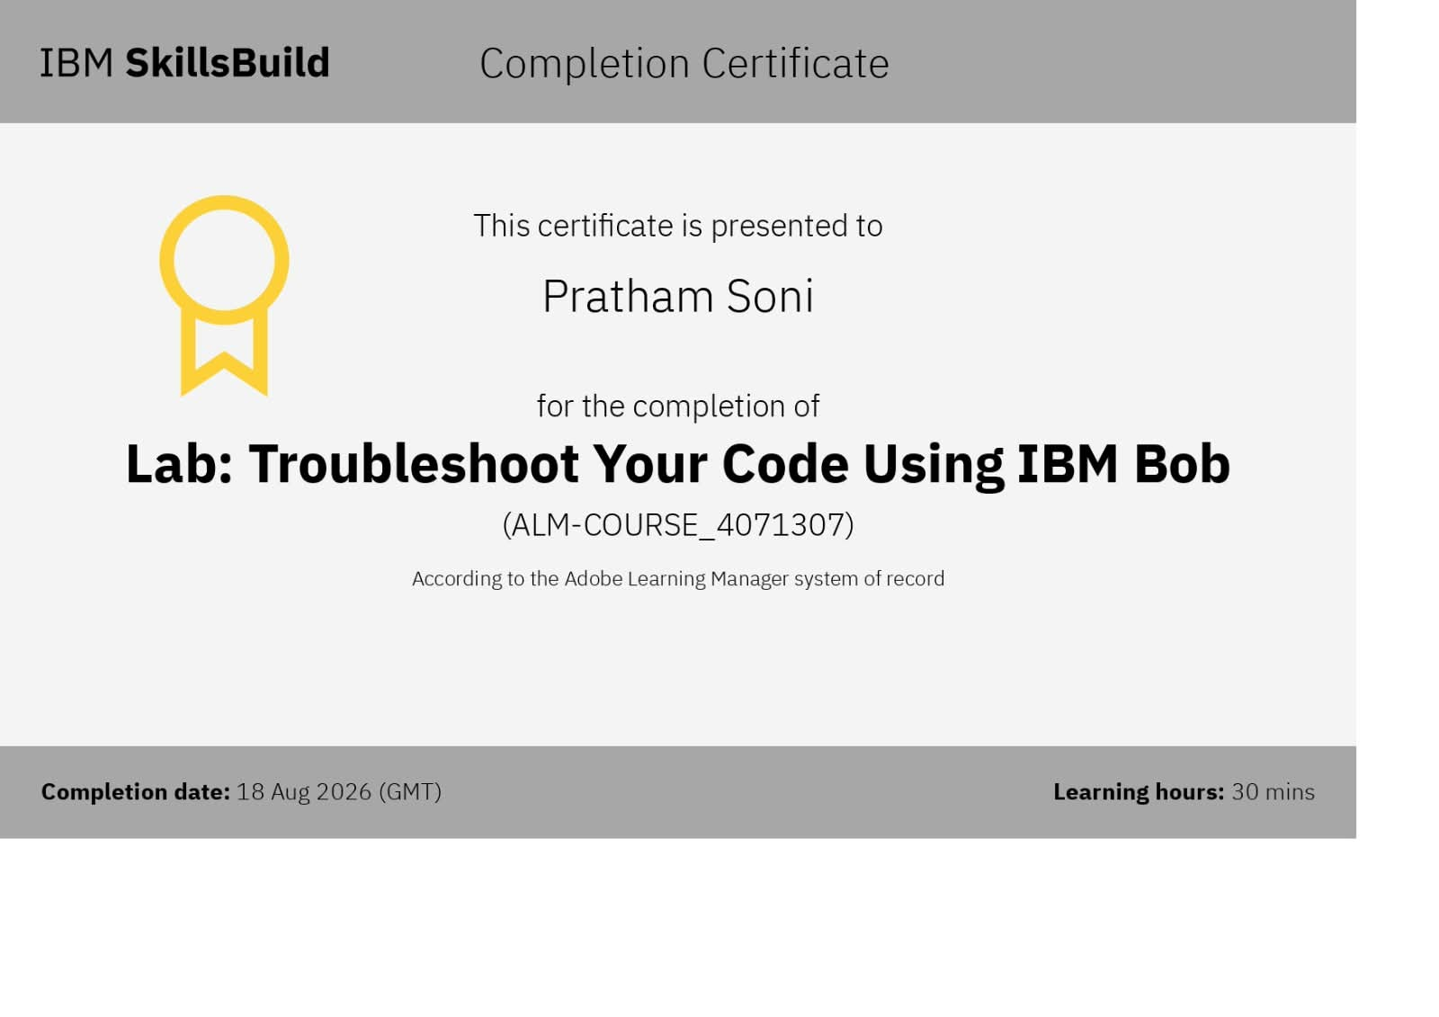
Certificates Earned:​
Add your IBM BOB Certificate

Slide 16


