Slide 1

Introduction to Spring Data
By :- Jitendra & Dhanendra

Slide 2
Agenda
What is Spring Data?
Spring Data Configuration
Spring Data Repositories
Custom Repositories

Slide 3
What is Spring Data ?
Spring Data is an umbrella project consisting of independent projects. It's mission is to provide a familiar and consistent, Spring-based programming model for data access while still retaining the special traits of the underlying data store.
http://projects.spring.io/spring-data/

Slide 4
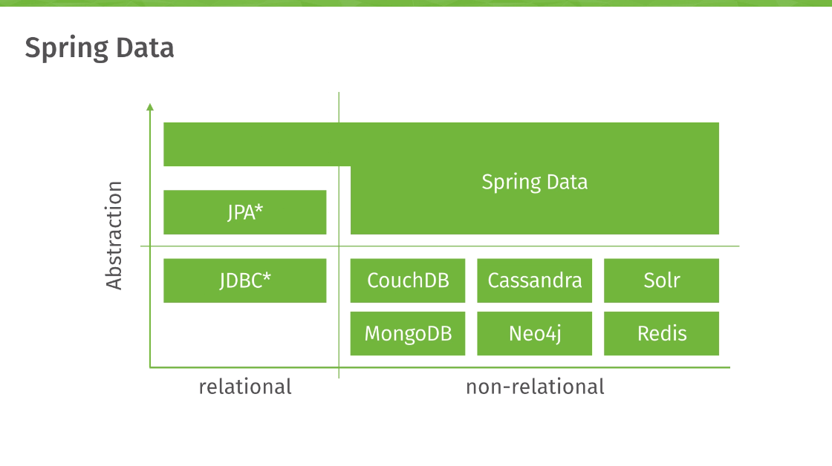
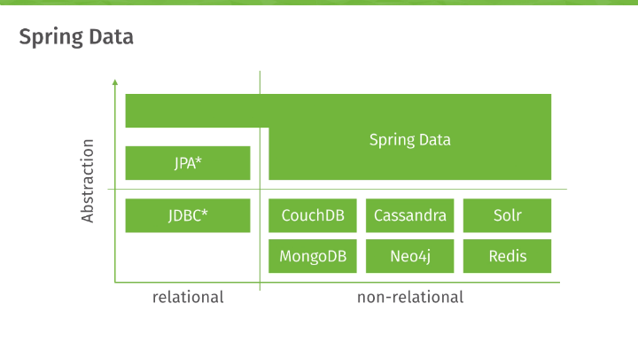
http://zeroturnaround.com/wp-content/uploads/2015/06/spring-data-tech-stack.png

Slide 5
Spring Data Main Modules:
Spring Data Commons
Spring Data JPA
Spring Data MongoDB
Spring Data Redis
Spring Data Solr
Spring Data Gemfire
Spring Data KeyValue
Spring Data REST

Slide 6
Spring Data Community modules:
Spring Data Aerospike
Spring Data Cassandra
Spring Data Couchbase
Spring Data DynamoDB
Spring Data Elasticsearch
Spring Data Neo4j

Slide 7
Spring Data MongoDB configuration
Idea InteliJ Time :P

Slide 8
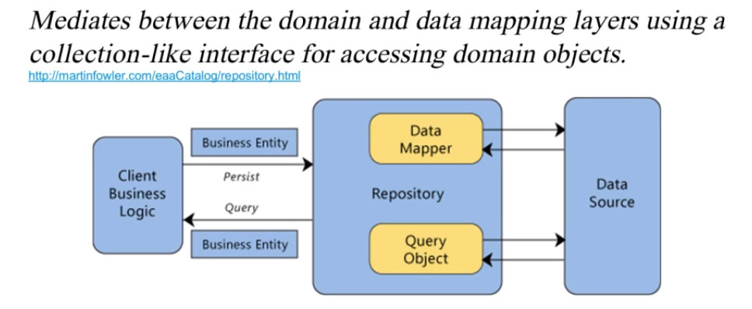
Repository
http://blog.pivotal.io/wp-content/uploads/2013/06/spring-data-gemfire-repository.jpg

Slide 9
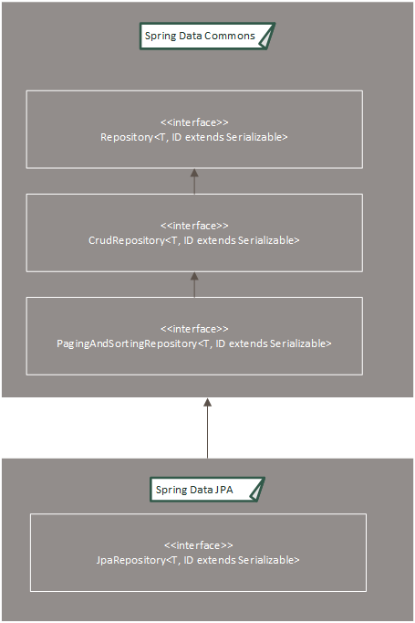
Spring Data Repositories
http://cdn.javabeat.net/wp-content/uploads/2015/09/Drawing1.png

Slide 10
Supported keywords for query methods
http://docs.spring.io/spring-data/data-mongo/docs/1.8.2.RELEASE/reference/html/#mongodb.repositories.queries

Slide 11


