Slide 1
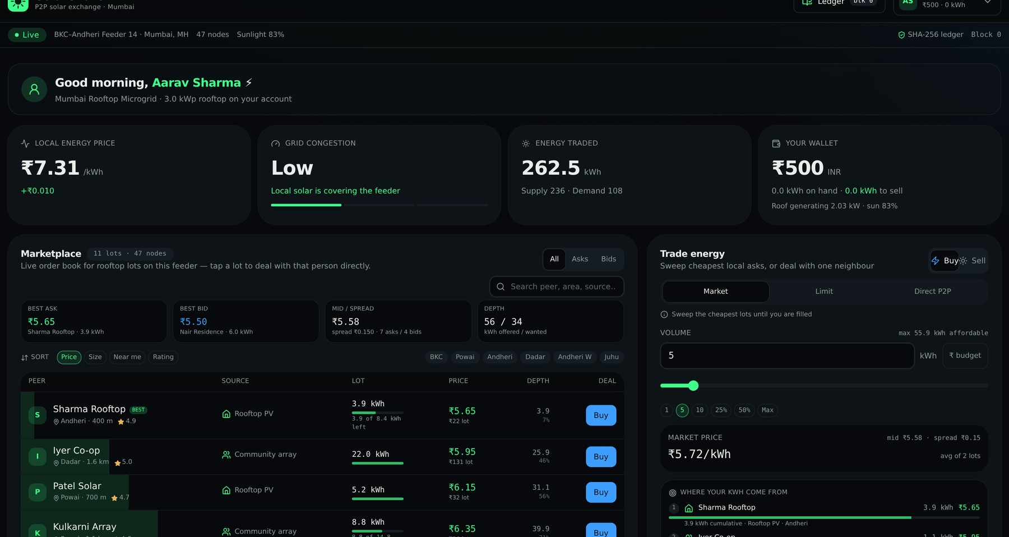
TEAM DATA FORGE
SOLARSHARE · P2P ENERGY EXCHANGE
solarshare · mumbai rooftop microgrid
Trade the sun next door.
Peer-to-peer rooftop solar for Indian households — priced in ₹, settled on real Postgres, and stamped into a SHA-256 hash-chained ledger you can verify in one click.
₹500
3.0 kWp
₹5.5–13.5
₹8.50
105
1 click
welcome credit on sign-up
simulated rooftop per account
live band, Feeder 14
market base price / kWh
unit tests passing
verify chain from genesis
6 slides · ~6 minutes · live demo of the running app
BUILT BY
Jeet Patel
Shlok Vaghasiya
Dhruvit Vadukiya
ledger + trading engine
marketplace UI + deal flow
data layer, tests, demo
Live web app — real accounts, real SQL, real hash chain. Optional read-only bridge: Polygon Amoy testnet (chainId 80002)
Notes:
HOOK (20s): 'Your roof exports power at a fixed government rate. Your neighbour buys that same energy back at retail. Both of you lose, and nobody in between captures the value. We built that market.'
Introduce Data Forge: Jeet (ledger + engine), Shlok (marketplace UI), Dhruvit (data + tests + demo).
Set expectations: 'Everything you see is a running app, not mockups — and I will name exactly which parts are simulated.'

Slide 2
THE PROBLEM
Rooftop solar has no market — only a meter
You generate 3 kW on your roof and ₹0 on your terms: surplus leaves at a fixed feed-in rate while the flat next door buys it back at retail.
01
02
03
Locked surplus
Neighbours never meet
'Blockchain energy' that isn't
Net metering exports your daytime over-generation at a fixed feed-in tariff, settled monthly. You choose no price, no buyer, no timing — while your evening peak is billed at full retail.
A producer and a buyer on the same feeder, 400 m apart, cannot trade: no shared order book, no per-peer identity, no settlement rail, no record of who owed whom.
Most demo projects ship a mockup and a logo. Judges and utilities ask one question — where is the record? A ledger you cannot re-hash from raw rows is a slide, not a system.
Sell into a curve, not a market.
Same wire. No meeting point.
Trust needs proof.
WHY NOW
Residential rooftop is the fastest-growing solar segment
Retail solar P2P value trades roughly ₹4–₹12 / kWh
Every kWh traded peer-to-peer keeps that margin inside the feeder
DATA FORGE · SolarShare — peer-to-peer solar exchange, priced in ₹
2 / 6
Notes:
About 60s. Walk the three cards left to right, then the WHY NOW strip. Do not read slides verbatim.
Card 3 plants slide 5: 'in a minute I'll show you the actual hash chain, and I'll verify it in front of you.'
Market honesty: say 'the app prices inside the ₹4–12/kWh band Indian retail solar trades in'. Never invent a TAM on stage.

Slide 3
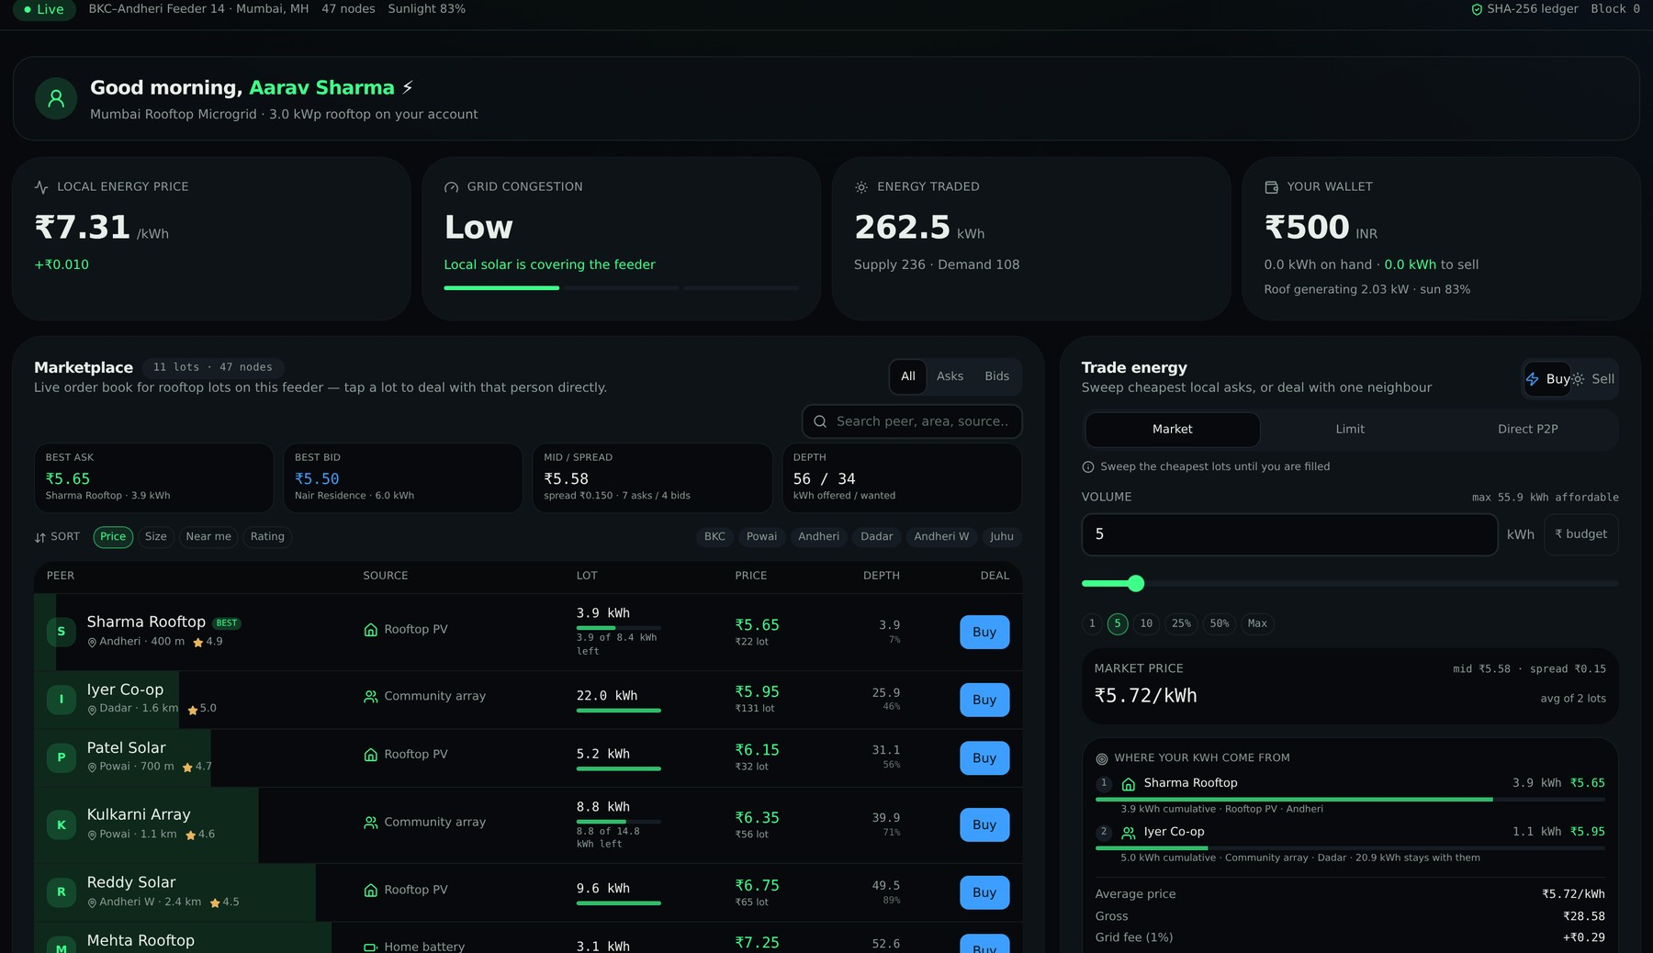
THE PRODUCT
One wallet. Two directions. Zero roles.
Every account can Buy kWh and Sell kWh — ₹ balances, a real order book, a live route preview. This is the running app, not a mockup.
solarshare · mumbai rooftop microgrid
SAME WALLET, BOTH SIDES
₹ first, always
Prices, balances and ledger totals are INR. Base ₹8.5/kWh, live band ₹5.5–13.5, IST solar curve for Mumbai, BKC–Andheri Feeder 14.
Sign up → trade in 30 s
Email + password lands in real SQL tables. New profiles get ₹500 credit and a 3 kWp rooftop that keeps generating through the day.
No producer/consumer tag
Surplus accumulates from the panel curve and can be sold into the book the same minute you need to buy.
UPI rails for money in and out
Top-up and withdraw against stored payment methods; each movement is a ₹ row plus a minted block.
THE 60-SECOND DEMO
Live order book — peer, area, distance, reliability, lot left · best ask ₹5.65 · Trade panel with the complete route before you sign.
sign up → ₹500 → pick a lot → sign → wallet and chain head move together
DATA FORGE · SolarShare — peer-to-peer solar exchange, priced in ₹
3 / 6
Notes:
THIS SLIDE IS THE DEMO. If you can, alt-tab to the running app: sign up, ₹500 appears, sweep 5 kWh, watch ₹ go down and kWh go up in the same instant.
Read one book row aloud: 'Sharma Rooftop, Andheri, 400 metres, 3.9 of 8.4 kWh left, ₹5.65, rating 4.9.' Specificity is what makes it credible.
If the projector dies: this screenshot is from the same build, so the pitch survives without the demo.

Slide 4
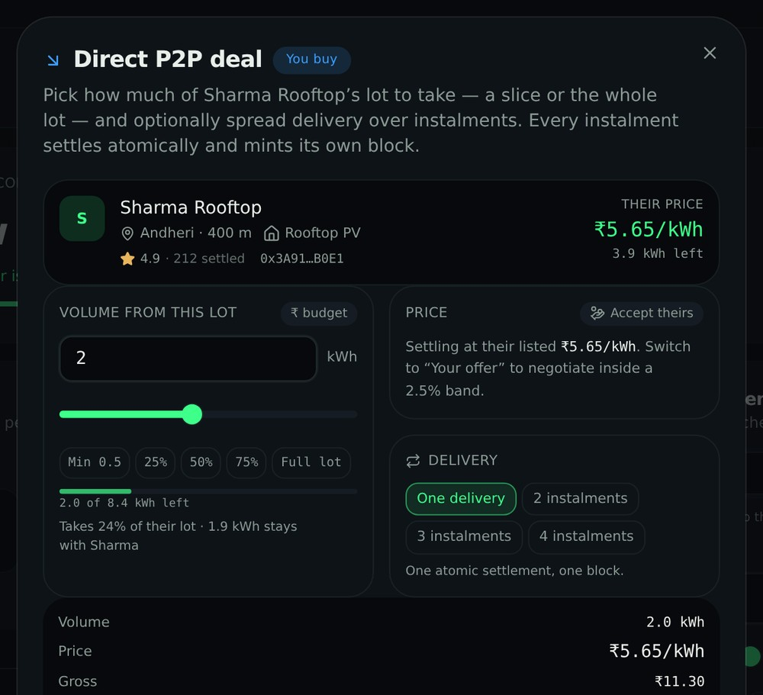
HOW TRADING WORKS
Three ways to trade — all quoted before you sign
src/lib/deal.ts is a pure TypeScript engine: no React, no network, no DB. The same maths drives the preview and the settlement.
solarshare · mumbai rooftop microgrid
MARKET SWEEP
routeFill()
Walk the cheapest asks (or richest bids) until you are filled — across as many neighbours as it takes. One order can produce several legs, and one leg can take part of a lot.
LIMIT ORDER
rests on the book
Set your own price with an explicit margin versus the mid. The unfilled remainder stays on the order book as your order; a match settles it atomically.
DIRECT P2P DEAL
directDeal() · splitInstalments()
One named neighbour, any slice from their minimum up to the whole lot, an offer inside a ±2.5% band (accepted or countered), and delivery split into instalments — each one its own block.
EVERY QUOTE SHOWS BEFORE YOU SIGN
Direct P2P deal sheet: a slice of one neighbour's lot, offer band, instalments, margin vs mid, blocks to mint.
average price
gross
grid fee 1%
you pay
slippage vs best
margin vs mid
blocks minted
DATA FORGE · SolarShare — peer-to-peer solar exchange, priced in ₹
4 / 6
Notes:
Depth slide for the technical judge: 'The engine is pure and unit-tested, so what the UI quotes is exactly what the database settles — there is no second implementation to disagree with.'
Human moment: 'Can I buy just 2 of Sharma's 3.9 kWh now and the rest next week?' Yes — and it becomes four verifiable blocks instead of one promise.
Money question: 'Nothing settles silently. Grid fee, slippage and margin versus the mid price are on screen before you sign.'

Slide 5
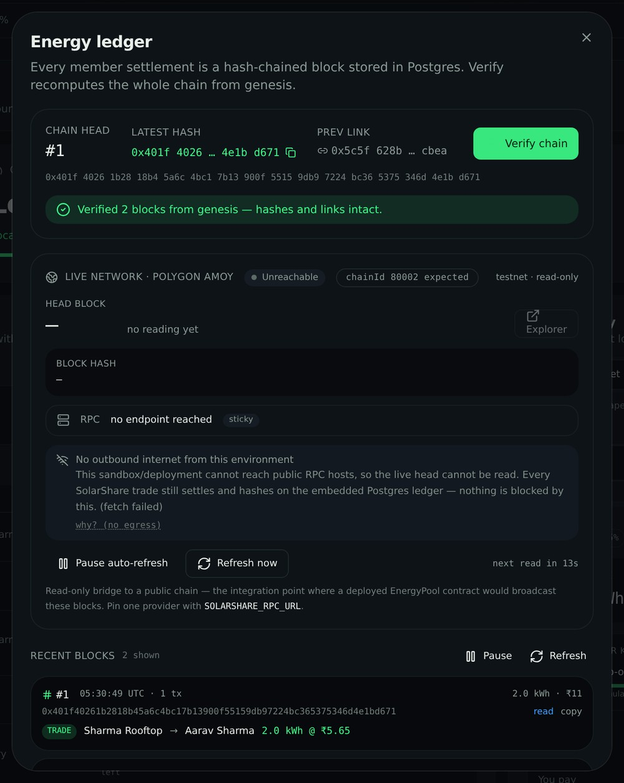
THE TRUST LAYER
Every trade mints a block — and you can re-hash the chain
Not a whitepaper promise: a SHA-256 hash chain stored in the same Postgres as your balance.
What a block is
Block n carries the SHA-256 of its canonical payload — block number, previous hash, timestamp, transactions — and links to block n−1. Genesis is deterministic.
What mints one
Top-up, buy, sell, order listing, withdrawal. A 3-instalment deal is 3 blocks, so 'first some kWh, then the next some' is three auditable records, not one.
verifyChain()
Recomputes every hash from raw DB rows and reports the first bad block: edited transaction → hash mismatch, deleted block → broken link, changed prev hash → broken link.
Live, no reloads
ledger-feed.ts folds each poll into the list: unchanged blocks keep object identity so rows never re-render, new blocks queue and land one at a time, inserts above you are scroll-anchored, polling pauses while the tab hides.
A real chain, read live
JSON-RPC to public Polygon Amoy endpoints, chainId verified before a reading is accepted, last healthy endpoint kept sticky, and an honest reason shown when the sandbox has no egress.
Energy ledger dialog: chain head, verification banner, recent blocks.
DATA FORGE · SolarShare — peer-to-peer solar exchange, priced in ₹
5 / 6
Notes:
Your moat slide. Most teams cannot answer 'show me the record'.
Say the distinction so nobody calls it an overclaim: 'The SolarShare chain is an application ledger BUILT like a blockchain — hash-chained, verifiable, tamper-evident. Amoy is a genuine external chain we read from; we are not claiming to run consensus ourselves.'
Demo if possible: open Ledger → Verify chain → 'Verified N blocks from genesis — hashes and links intact'. Then: 'edit any row by hand in Postgres and this turns red at that exact block.'
If asked about Merkle trees or PoS: 'No Merkle tree, no validator set — PoA-shaped. The payload is already canonical, so anchoring the head hash on-chain is a next step, not a rewrite.'

Slide 6
WHAT'S REAL · WHAT'S NEXT
Shipped today — and defensible in Q&A
We would rather hand you the exact boundary of what is simulated than be caught inflating it.
STACK
PROOF ON THE RECORD
Frontend
React 19 · TanStack Start + Router with SSR · Tailwind 4 · Recharts · Radix
105 / 105
app tests pass — ledger core, live feed, trading engine, network bridge
Server
createServerFn + bearer-token middleware → SQL in the same request path
6 + 14
tests on the chain (deterministic hashing, genesis, tamper) and on the live ledger list
Auth
better-auth email+password → user/session/account, bcrypt-scrypt, httpOnly cookies
1 E2E
HTTP smoke mirroring the browser: sign-up → ₹500 → top-up → buy → list → verify → withdraw
Data
PGLite (embedded PostgreSQL 16) or Neon via DATABASE_URL · migrations 0001–0003
SSR
dashboard renders server-side — ₹ balances, market, wallet, all in the HTML
Ledger
ledger-core.ts (pure hashing) · ledger.server.ts (mint/verify) · ledger-feed.ts (live UI)
HONEST
LIMITS
PGLite is in-memory per process (swap in Postgres for durability) · neighbour lots and ambient activity are simulated client-side · the chain is PoA-shaped, not a consensus network · live Amoy reads depend on egress
Chain read
testnet.server.ts → Polygon Amoy, read-only, chainId-guarded, graceful offline
NEXT, IN ORDER
Thank you — DATA FORGE · Jeet Patel · Shlok Vaghasiya · Dhruvit Vadukiya
1 · Persist
2 · Share
3 · Anchor
4 · Comply
managed Postgres + real UPI payout and settlement records
server-side order book so neighbours are real members, with disputes
deploy EnergyPool on Amoy; anchor each block head hash on-chain
feeder-level P2P within net-metering rules · WhatsApp / UPI-lite reach
DATA FORGE · SolarShare — peer-to-peer solar exchange, priced in ₹
6 / 6
Notes:
Close honest and get credit for it: 'Working app, real accounts, real SQL, real hash chain — and here is exactly the part we simulated.'
Then the ask: 'Give us real feeder data and one pilot housing society and we run this for real.'
Q&A prep — (1) Is this legal? We assume open-access / net-metering rules, which is why Comply is step 4. (2) Why not just net-metering? It prices nothing and matches nobody. (3) What if someone edits the database? verifyChain() re-hashes from raw rows and names the first broken block. (4) Why was Amoy unreachable? No egress from the sandbox — the app marks the head stale with a reason instead of faking it.

