Slide 1

Customer Shopping Behavior Analysis
Analyzing 3,900 transactions across product categories to uncover spending patterns, customer segments, and strategic growth opportunities.

Slide 2
Dataset at a Glance
3,900
18
37
Transactions
Features
Missing Values
Rows in the dataset
Columns tracked
In Review Rating only
Customer Data
Purchase Behavior
Age, Gender, Location
Subscription Status
Item, Category, Amount
Discount, Promo Code, Frequency, Review Rating, Shipping Type

Slide 3

Data Preparation in Python
01
Load & Explore
Imported via pandas; used df.info() and .describe() for structure and summary stats.
02
Clean Missing Data
Imputed 37 missing Review Rating values using median rating per product category.
03
Standardize & Engineer
Renamed columns to snake_case; created age_group and purchase_frequency_days; dropped redundant promo_code_used.
04
Database Integration
Loaded cleaned DataFrame into PostgreSQL for SQL analysis.

Slide 4
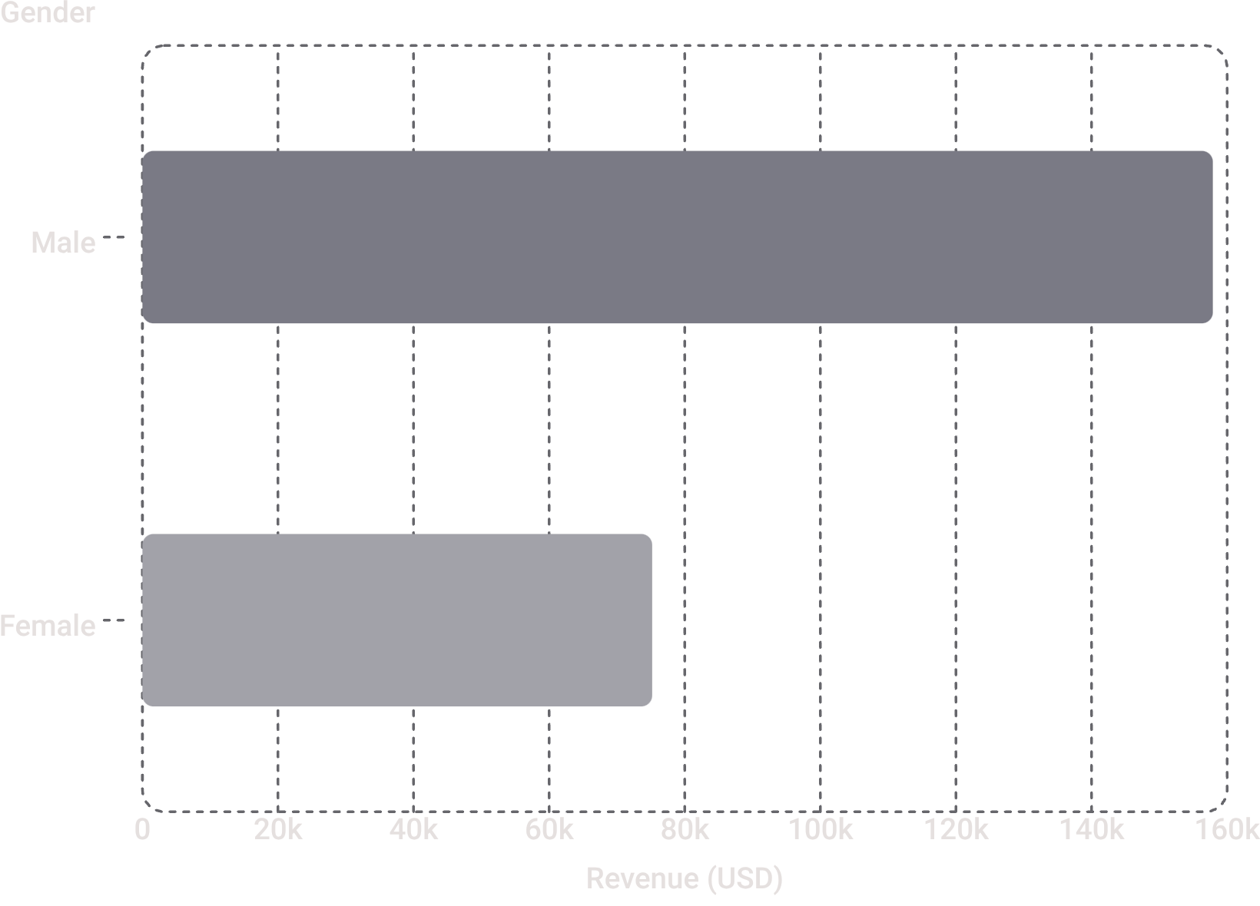
Revenue & Spending Insights
Revenue by Gender
Male customers generated $157,890 — over twice the revenue of female customers ($75,191).
Shipping Comparison
Express shipping averaged $60.48 vs. Standard at $58.46 — a modest but consistent premium.

Slide 5
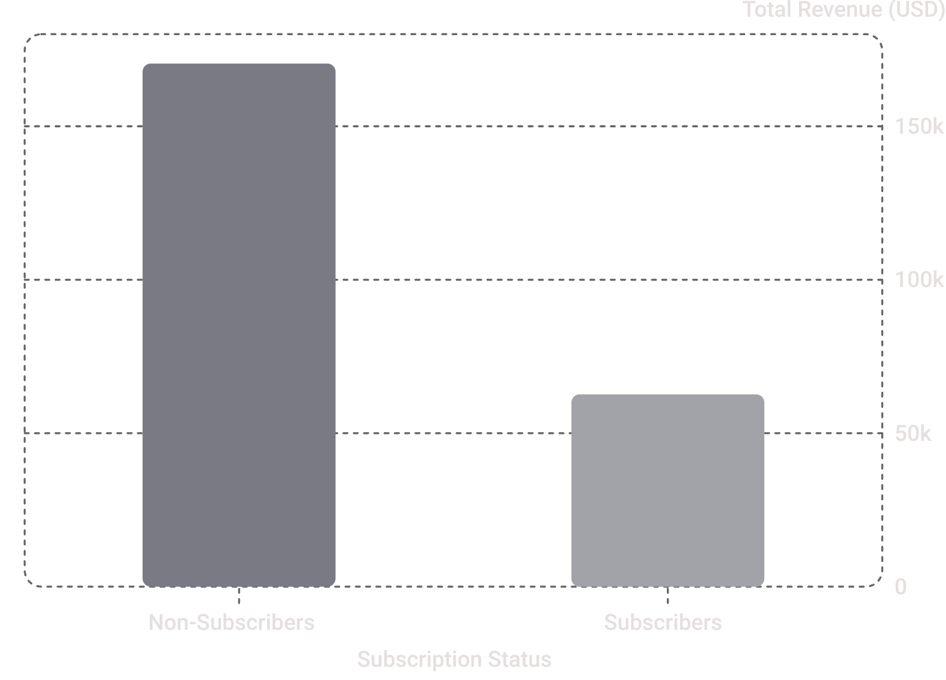

Subscribers vs. Non-Subscribers
Key Findings
Non-subscribers: 2,847 customers, avg spend $59.87, total revenue $170,436
Subscribers: 1,053 customers, avg spend $59.49, total revenue $62,645
Repeat buyers (>5 purchases): 2,518 non-subscribers vs. 958 subscribers
Despite similar average spend, subscribers represent only 27% of customers but show strong repeat-buyer potential.

Slide 6
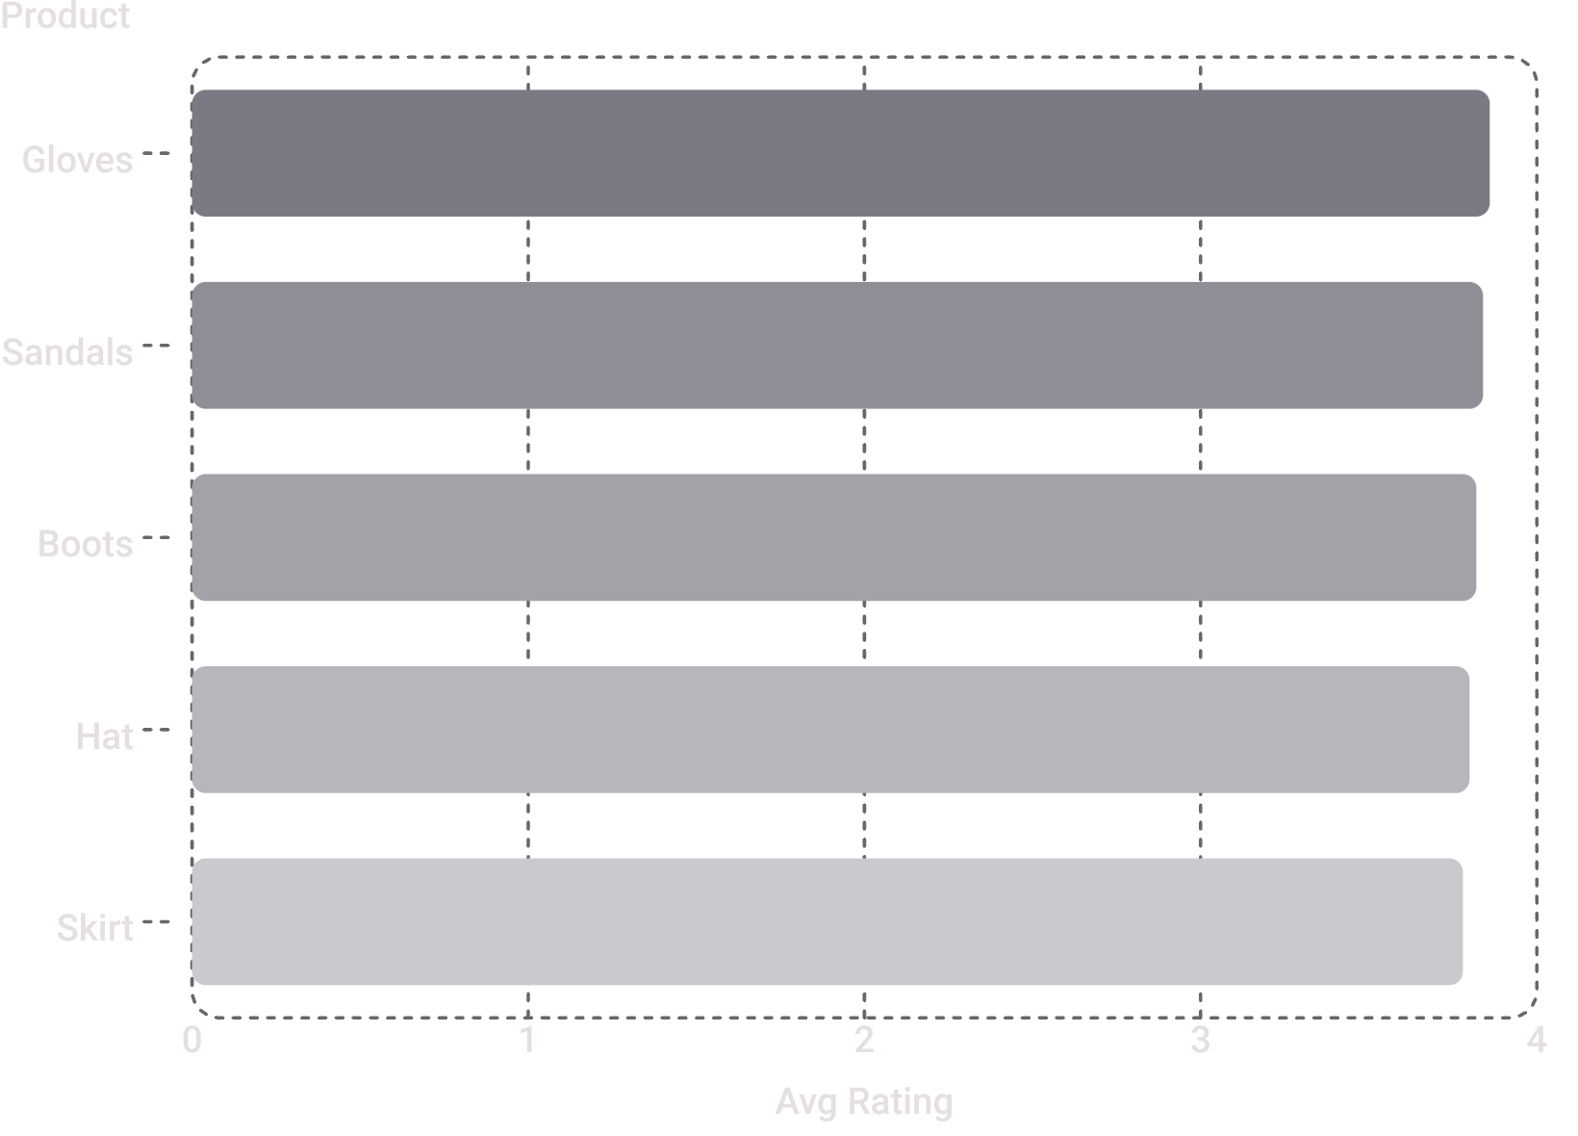
Top Products by Category & Rating
Top 3 Products per Category
Top 5 Products by Rating
Category | Product | Orders
Accessories | Jewelry | 171
Clothing | Blouse | 171
Footwear | Sandals | 160
Outerwear | Jacket | 163

Slide 7
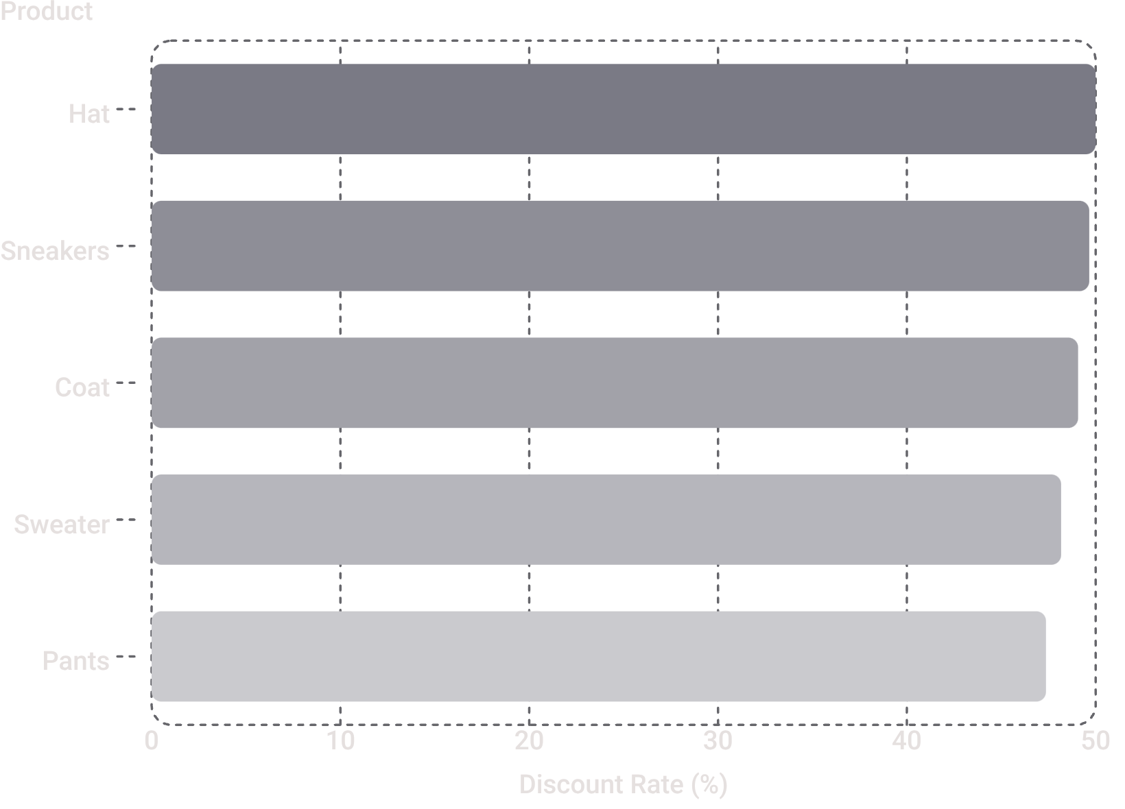

Discount-Dependent Products
What the Data Shows
These five products have the highest percentage of discounted purchases, ranging from 47% to 50%.
Hats lead at exactly 50% discount rate, suggesting strong price sensitivity in outerwear and footwear categories.
Review discount policy to balance sales volume with margin control on these items.

Slide 8

Customer Segmentation
🏆 Loyal
🔄 Returning
3,116 customers — the dominant segment, representing the core repeat buyer base.
701 customers — engaged but not yet fully loyal; prime candidates for retention programs.
🆕 New
83 customers — smallest segment; opportunity to convert through onboarding incentives.

Slide 9
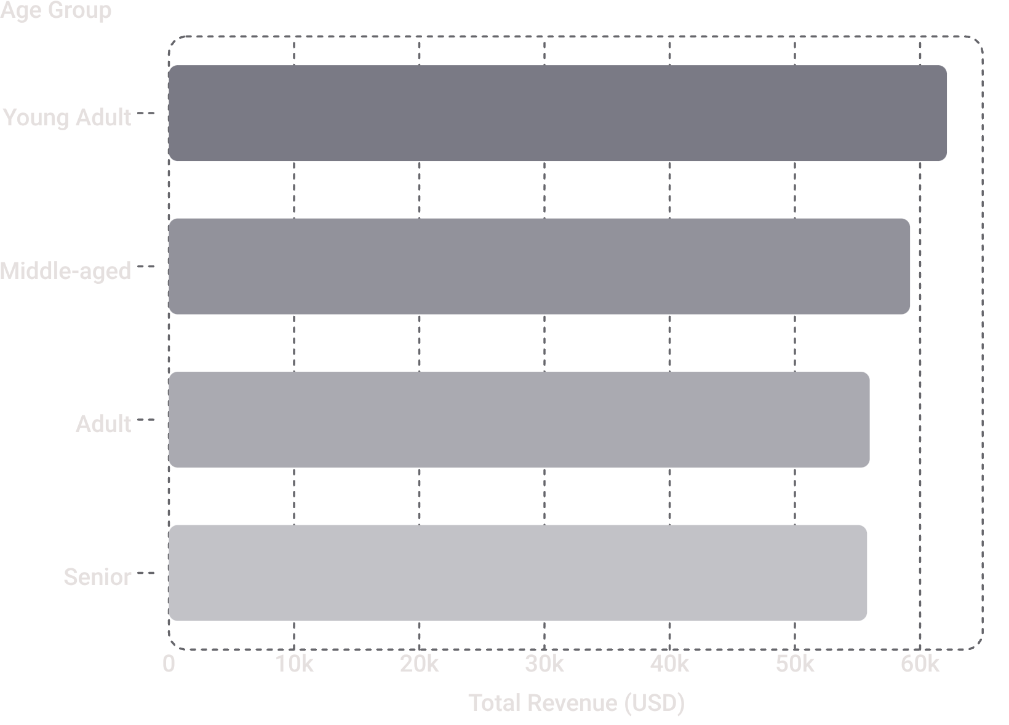
Revenue by Age Group
Key Takeaway
Young Adults lead in revenue contribution at $62,143, with a gradual decline across older groups.
Revenue distribution is relatively balanced — no single age group dominates, suggesting broad market appeal across demographics.

Slide 10
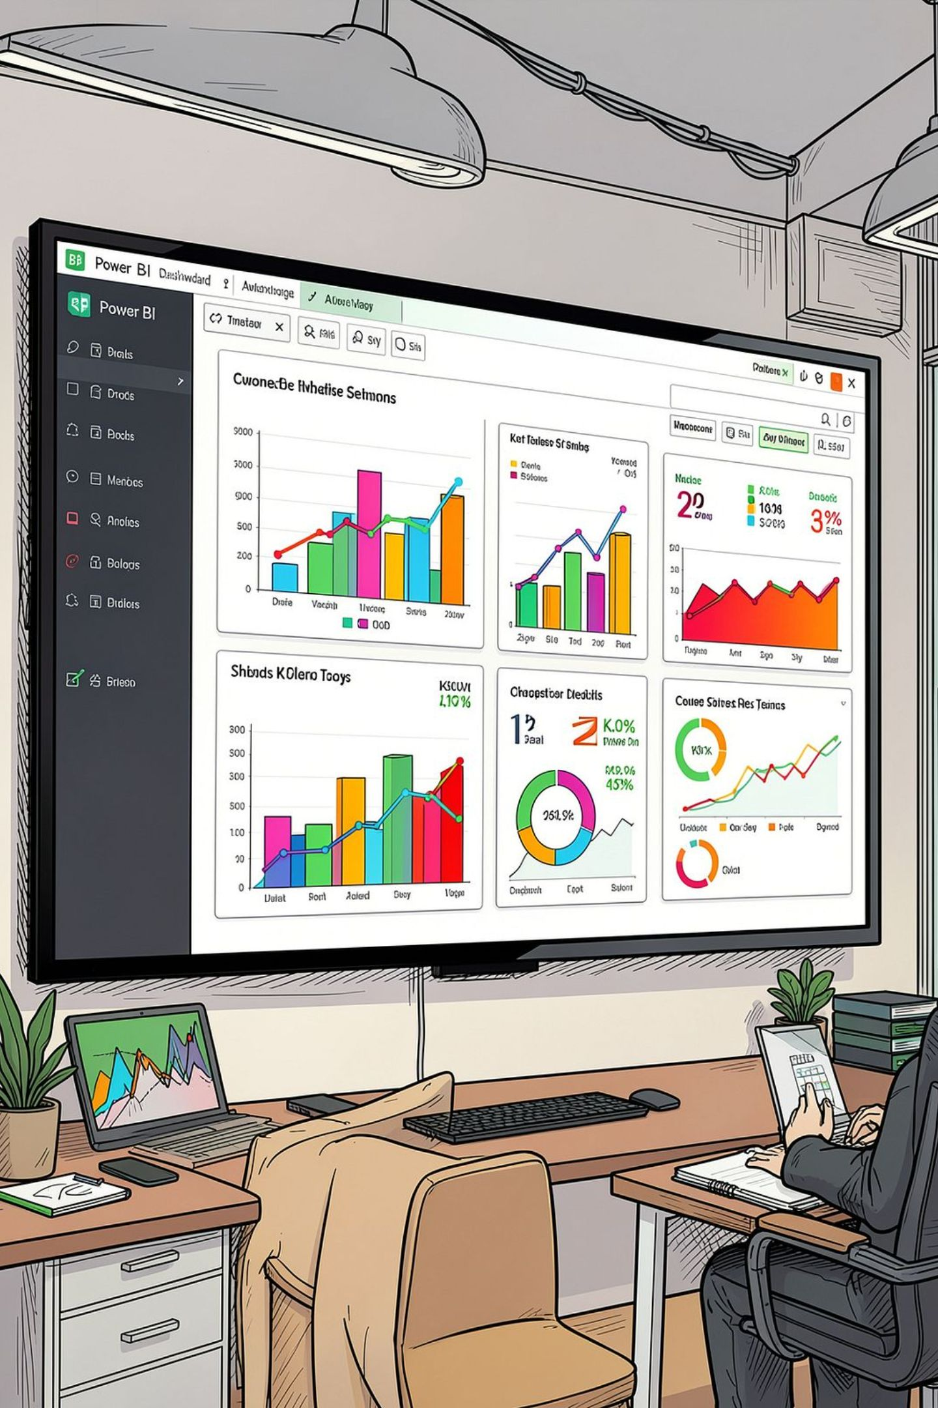




Dashboard & Business Recommendations
An interactive Power BI dashboard presents key metrics: 3.9K customers, avg purchase $59.76, avg rating 3.75 — with filters for subscription, gender, category, and shipping.
Boost Subscriptions
Promote exclusive subscriber benefits to grow the 27% base.
Loyalty Programs
Reward repeat buyers to move Returning customers into Loyal segment.
Review Discount Policy
Balance sales boosts with margin control on discount-heavy products.
Targeted Marketing
Focus on high-revenue age groups and express-shipping users.

