Slide 1


Slide 2
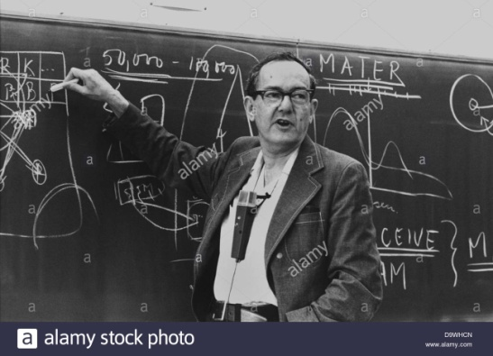
What is Machine Learning ??
“Learning is an process by which a system improves performance from experince.”
-Herbert Alexander Simon
H. A. Simon
“Machine Learning is concerned with computer programs that automatically improve their performance through experince.”

Slide 3
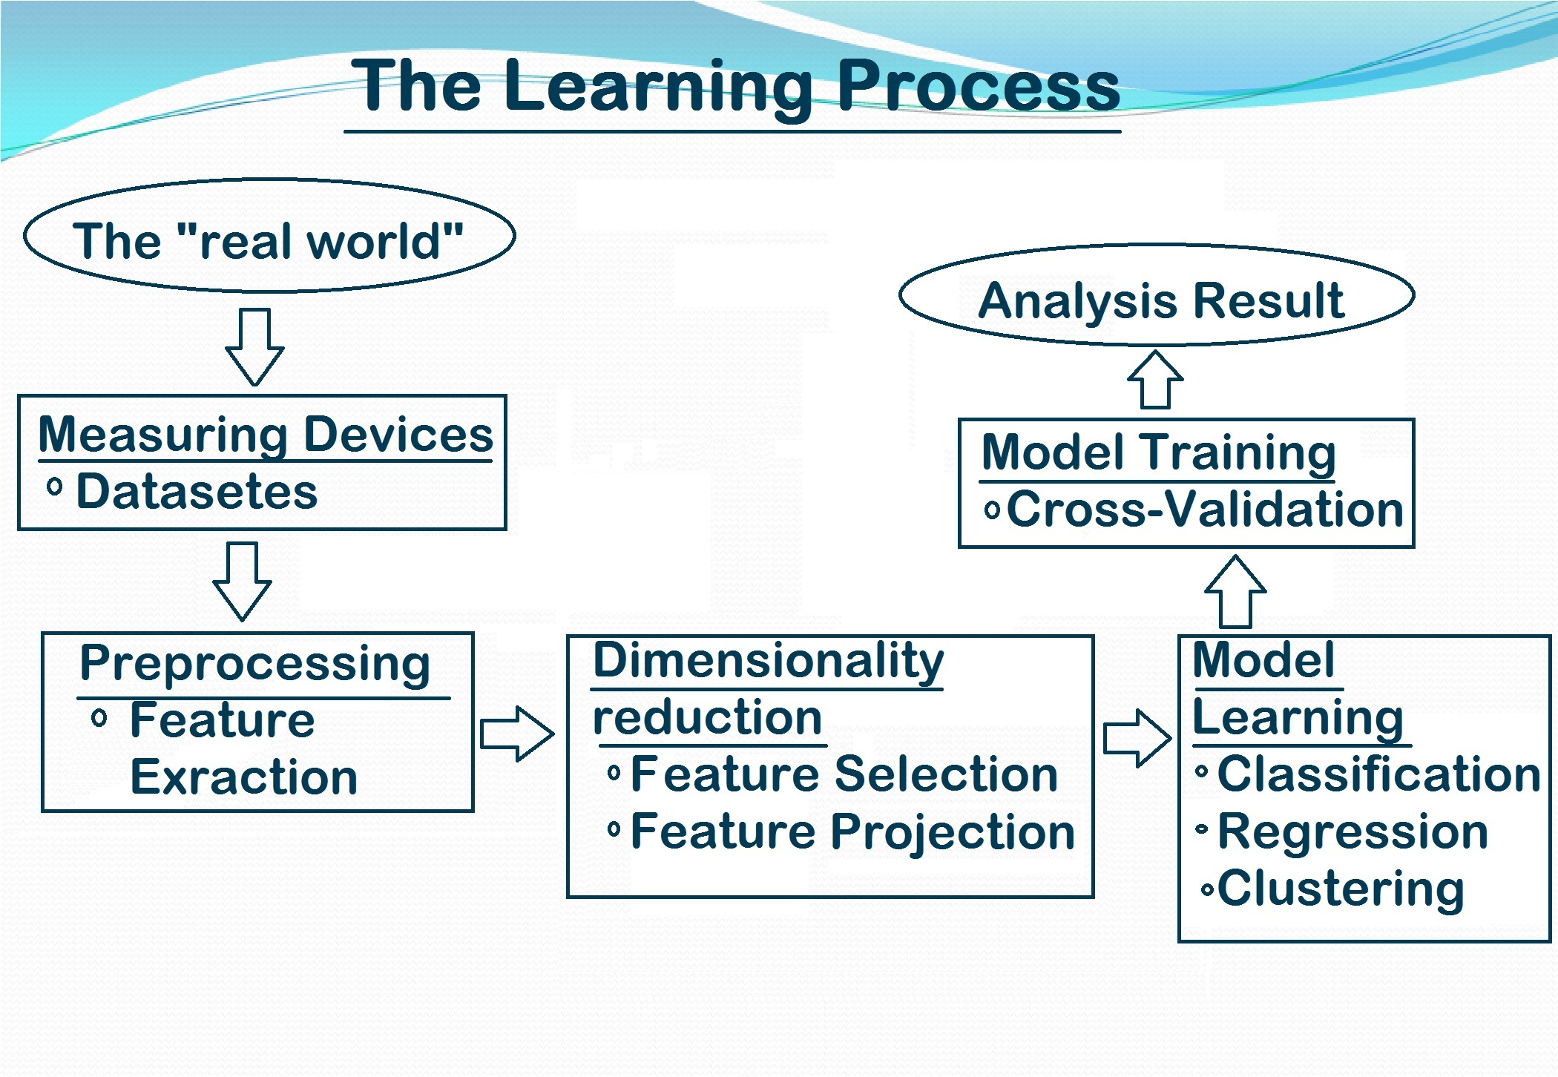

Slide 4
Model Fitting :
The term ML model refers to the model artifact that is created by the training process.
Different types method of fitting Model :
#Logistic Regression
# Decision Trees
# Naïve Bayes
# K-NN

Slide 5
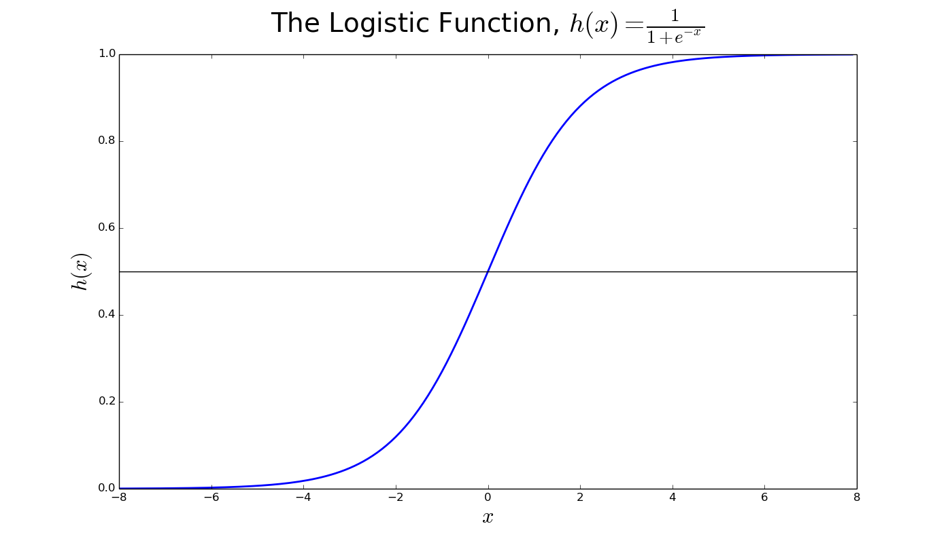
Logistic Regression :
Logistic regression is a statistical method for analyzing a dataset in which there are one or more independent variables that determine an outcome. The outcome is measured with a dichotomous variable (in which there are only two possible outcomes).

Slide 6
Decision Trees :
Decision tree learning uses a decision tree to go from observations about an item (represented in the branches) to conclusions about the item's target value (represented in the leaves). It is one of the predictive modelling approaches used in machine learning. Tree models where the target variable can take a discrete set of values are called classification trees; in these tree structures, leaves represent class labels and branches represent conjunctions of features that lead to those class labels. Decision trees where the target variable can take continuous values (typically real numbers) are called regression trees.

Slide 7
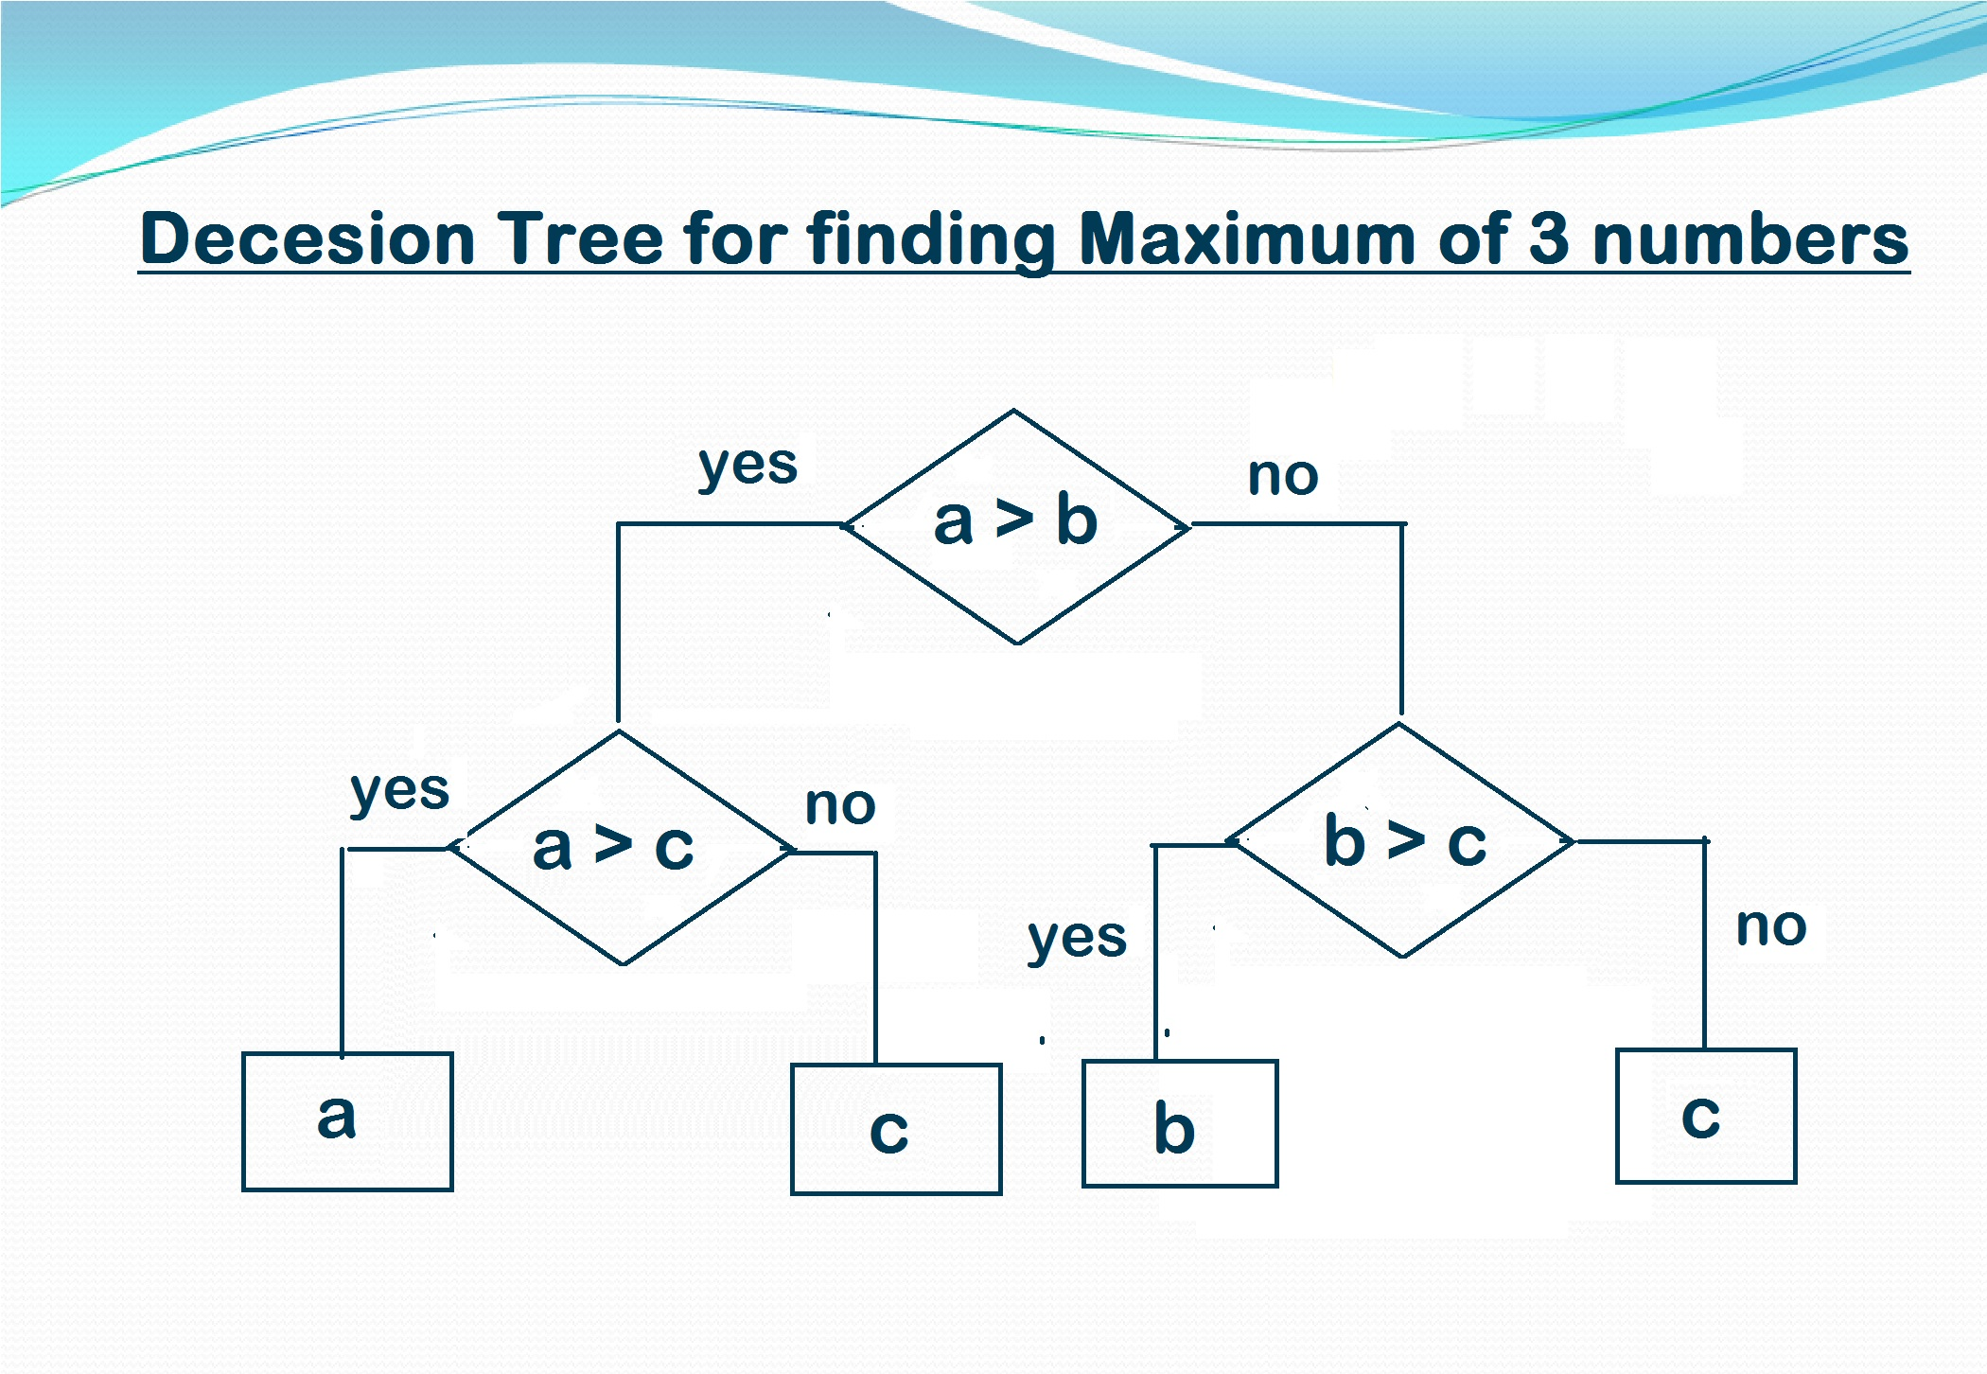

Slide 8
Naïve Bayes :
In machine learning, naive Bayes classifiers are a family of simple probabilistic classifiers based on applying Bayes' theorem with strong (naive) independence assumptions between the features. Naive Bayes has been studied extensively since the 1950s. The first supervised learning method we introduce is the multinomial Naive Bayes or multinomial NB model, a probabilistic learning method.

Slide 9
K-NEAREST NEIGHBORS CLASSIFICATION :
K nearest neighbors is a simple algorithm that stores all available cases and classifies new cases based on a similarity measure (e.g., distance functions). KNN has been used in statistical estimation and pattern recognition already in the beginning of 1970’s as a non-parametric technique.
A case is classified by a majority vote of its neighbors, with the case being assigned to the class most common amongst its K nearest neighbors measured by a distance function. If K = 1, then the case is simply assigned to the class of its nearest neighbor.

Slide 10
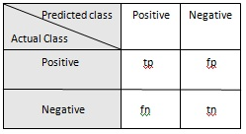
Basic thing about Result Analysis :
# Confusion Matrix : This helps to find out any type of misclassification due to the classifier.
True positive (tp) is the number of ‘positive’ instances categorized as ‘positive’.
False positive (fp) is the number of ‘negative’ instances categorized as ‘positive’.
False negative (fn) is the number of ‘positive’ instances categorized as ‘negative’.
True negative (tn) is the number of ‘negative’ instances categorized as ‘negative’.

Slide 11
Accuracy
Accuracy is defined as a ratio of sum of the instances classified correctly to the total number of instances.
Precision
Precision is defined as the ratio of correctly classified data in positive class to the total number of data classified as to be in positive class.
Recall
Recall or TP rate is defined as the ratio of tp to the total number of instances classified under positive class.

Slide 12

Predict Outcome of a Tennis Match
Our project had two main objectives. First, we wanted to use historical tennis match data to predict the outcomes of future tennis matches. Next, we wanted to use the predictions from our resulting model to beat the current betting odds.

Slide 13
DATA PROCESSING AND FEATURE SELECTION
#MODELS
We have designed three models from our given tennis dataset, those are predicting the winner based on historical data, predicting the winner based on in-game results & predicting the winner without using any Learning Algorithms simply comparing their win percentage with respect to each surface.

Slide 14
#PREPROCESSING
We figured out all those attributes which are essential for our prediction. Considering those attributes if any attributes have categorical values we converted them into encoded integer values using LabelEncoder library function of the Preprocessing library of Scikit-Learn. If any attributes have special characters then label encoding was not possible for those attributes. Instead we encoded them by counting the unique entries and map each entries with the unique counts. There were some missing values in some attributes. We calculated the median of those attributes and replaced those missing values with the median value. The dataset was divided into training set(80% records) & testing set(20% records).

Slide 15
Feature Selection
#Model Based On Historical Data
We filtered out only the columns like winner name, winner age, winner hand, winner height, winner rank, winner rank points & all the respective columns for loser also including the surface column.
We created two different records for winner & loser. In the winner record all the winner attributes were labelled as ‘player’ & all the loser attributes were labelled as ‘opponent’ & a new attribute was added as ’win’ containing all entries as ‘1’ . And for the loser record all the winner attributes were labelled as ‘opponent & all the loser attributes were labelled as ‘player & a new attribute was added as ’win’ containing all entries as ‘0’ .
Then both the winner & record were merged together to form our new dataset. Here our target variable is the ‘win’ attribute.

Slide 16
#Model Based On In-game Result
Here in this model we have considered only those columns which reflects the in-game results of each match. This kind of model is helpful for betting odds.
We figured out all the unique players from the dataset and counted the frequency of their data in the dataset. Based on that count values we consider only 5-10 players with highest frequencies and retrieved all the records of those players and prepared a separate dataset.
Now considering a single player suppose, ‘Roger Federer’ , predicting that if that player wins or not.

Slide 17
#Model Based On Comparison
Here in this model we calculated the win parcentage of every players with respect to each surface type and stored those percentage values in some matrices.
Now comparing those win percentage of each player we got our final prediction. This model includes the following steps: n= total no. of players m= total type of surface now consider arr, win, per are 3 matrices of dimension nxm arr holds total no. of match played by each player on each surface. win holds total no. of match won by each player on each surface.
Pre=arr/win , i.e. it holds y=the win percentage of each player on each surface.
Now for predicting the result we need three attribute player opponent & surface.
Then we fetched the win percentage of individual player and stored it(suppose in a) and similarly for the opponent in b.
Now if a is greater than b then we assign ‘1’ to win otherwise we assign ‘0’ to win.

Slide 18
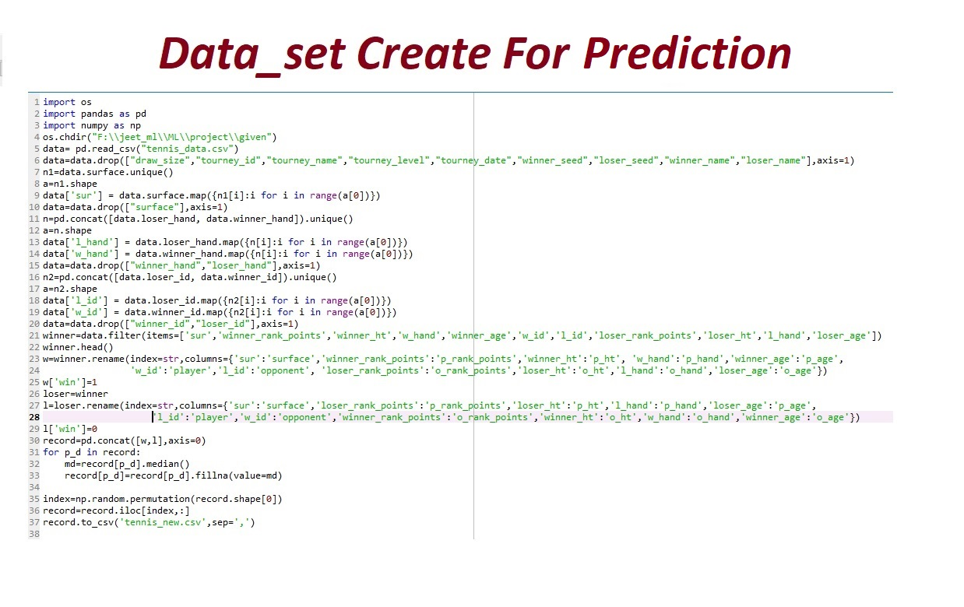

Slide 19
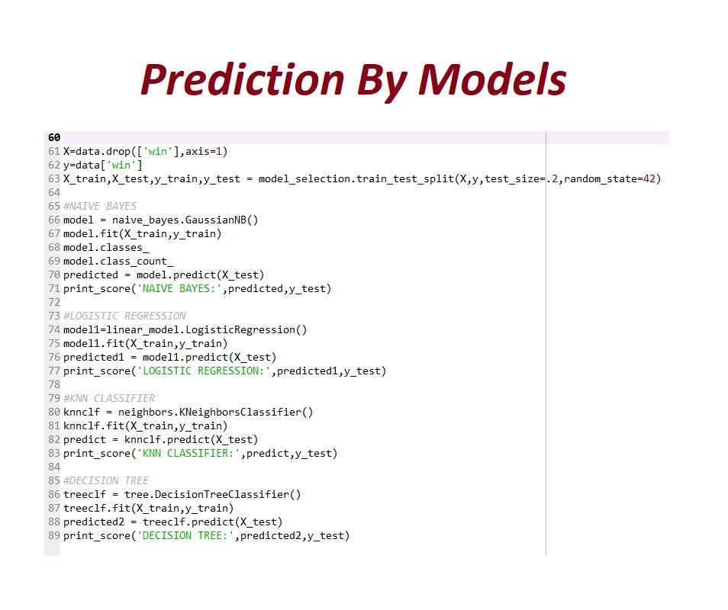

Slide 20
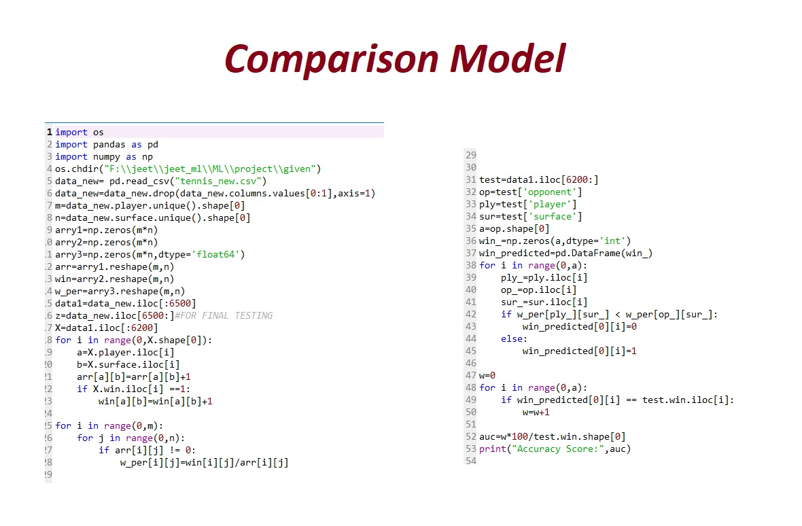

Slide 21
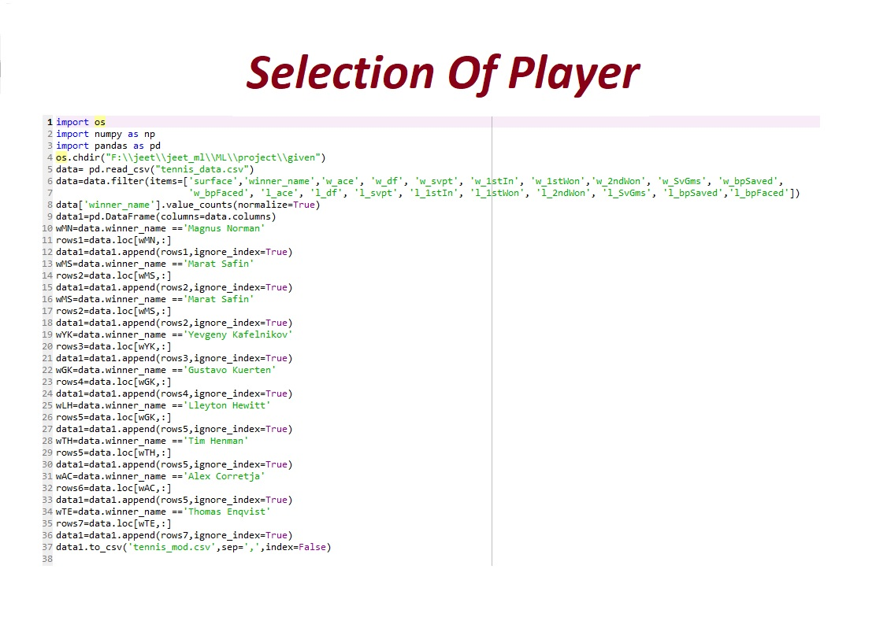

Slide 22
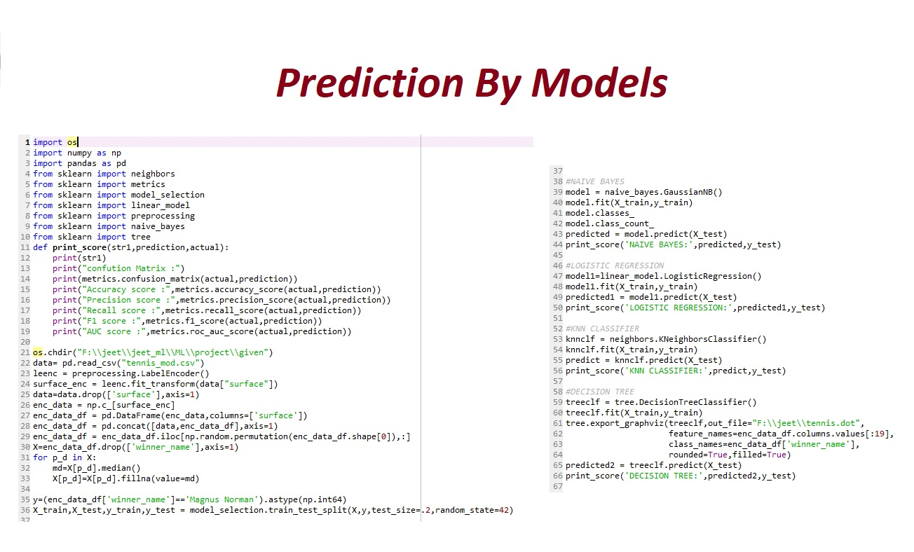

Slide 23
Accuracy Score :
MODEL | LOGISTIC REGRESSION | K-NN | NAÏVE-BAYES | DECISION TREE | COMPARISON
HISTORICAL DATA | 62% | 59% | 60% | 55% | 73%
IN-GAME RESULT | 89% | 85% | 86% | 83%

Slide 24
Graph representation of the Accuracy Scores :

Slide 25
Future Scope of Improvements :
#it could produce better results are using only the top tournaments for training data, experimenting with more kernels and larger ranges of parameters, as well as using data from farther in the past.
#it may also be feasible to actually use a boosting algorithm using our baselines as the weak learners to obtain better results.
#the stats of a player.
The data here we get is actually not so large. It only consist the information of the tennis matches played in one single year. We know it is not so easy to predict a the match result before the match start. But although we get the accuracy near about 60%. If the data is more large and hold the records of a long time period then I am sure that our model we able to predict more than 75%.

Slide 26


