Slide 1

E-commerce Customer Segmentation & Prediction
Name of Capstone Project
A Clustering & Machine Learning Analysis of Online Retail Data
Capstone Project — Data Science & Artificial Intelligence

Slide 2
Agenda
Introduction
Dataset Overview
Data Cleaning
Exploratory Data Analysis
Feature Engineering
Outlier Handling
Clustering: K-Means, Hierarchical, DBSCAN
Segment Visualization
Segment Profiles
Segment Table
Predictive Modeling: Logistic Regression, Random Forest, XGBoost
Feature Importance with SHAP
Business Recommendations
Conclusion

Slide 3
Introduction
E-commerce businesses struggle to decode diverse customer purchasing behaviors, resulting in generic marketing, decreased retention, and inefficient inventory management. A data-driven segmentation approach is needed to classify customers by their purchasing patterns, enabling personalized marketing, maximized retention, and optimized resource allocation.
The business challenge
Different customers have different needs. Understanding these differences helps businesses spend marketing money wisely and keep valuable customers.
Project objective
Segment customers by real purchasing behavior, then build a model that can classify any customer into the right segment.
Approach
Feature engineering → Clustering → Segment Profiling → Supervised Prediction → SHAP explainability
Deliverable
Actionable, data-driven customer segments with targeted marketing and retention strategies

Slide 4
Dataset Overview
541,909 raw transaction line items
4,372 unique customers across 38 countries
Date range: December 1, 2010 – December 9, 2011 (~1 year of activity)
Key Fields:
Column | Description | Data Type
InvoiceNo | Unique identifier for each invoice/transaction | Object
StockCode | Unique product code | Object
Description | Name/description of the product | Object
Quantity | Number of items purchased | Integer
InvoiceDate | Date and time of the transaction | Object
UnitPrice | Price per unit of the product | Float
CustomerID | Unique identifier for each customer | Float
Country | Country where the transaction occurred | Object

Slide 5
Data Cleaning
Parse InvoiceDate properly, handled both with a small helper function.
Removed rows with missing CustomerID. We can't assign a segment to an unknown customer, and these rows can't be fixed.
Removed cancelled orders (InvoiceNo starting with "C"), as they represent cancelled or returns rather than purchases and would distort spending and frequency calculations.
Removed rows with non-positive Quantity or UnitPrice values, as these typically represent returns or free/zero-value items.
Removed duplicate rows.
Created a TotalPrice column (Quantity × UnitPrice) to calculate the actual amount spent on each transaction line.
Result: Dataset reduced from 541,909 transaction lines to 392,692 clean transaction lines and 4,372 customers to 4,338 unique customer.

Slide 6
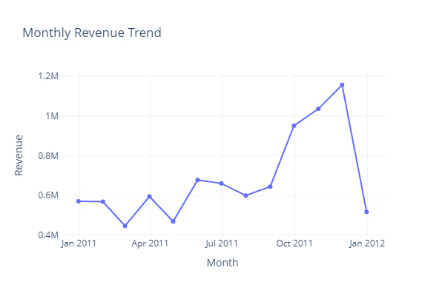
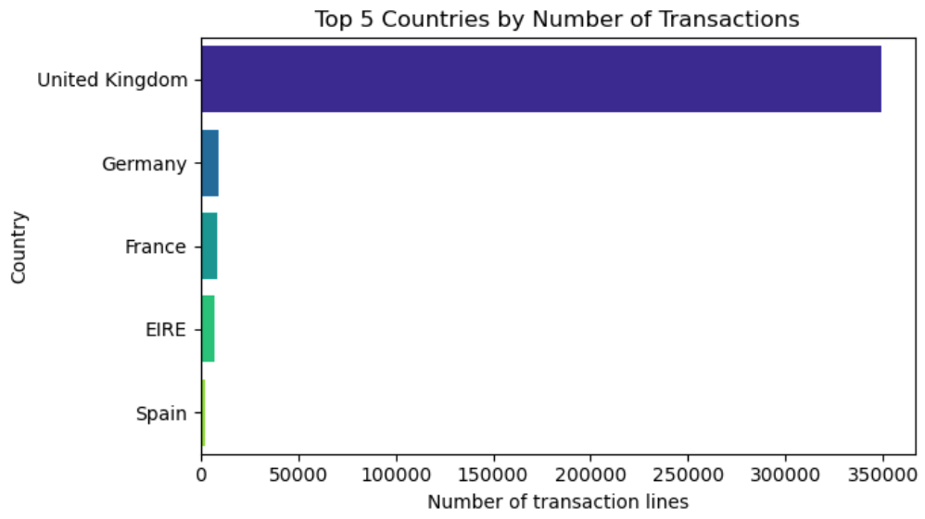
Exploratory Data Analysis
Where & When Customers Buy?
The UK accounts for the large majority of transactions
Revenue peaks Sep–Nov ahead of the holiday season.

Slide 7
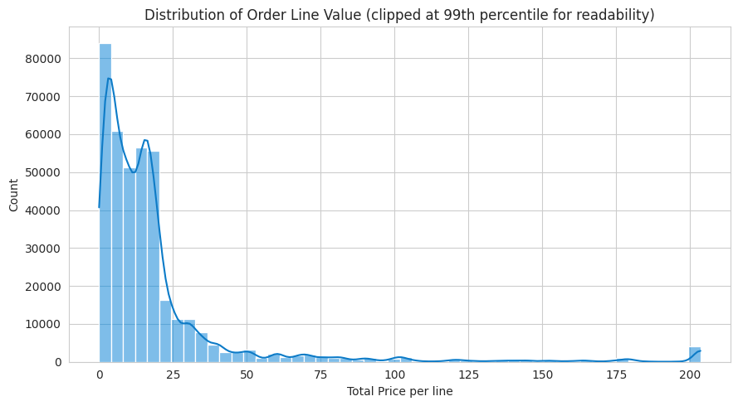
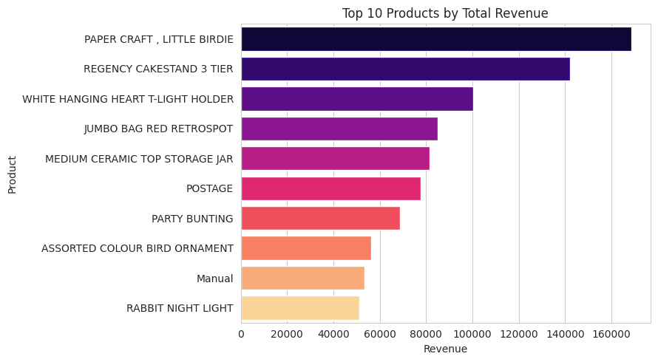
Exploratory Data Analysis
What & How Much They Buy?
Order values are heavily right-skewed — a small number of very large orders motivate outlier capping before clustering.

Slide 8






Feature Engineering
Engineered an RFM Table.
RFM stands for Recency, Frequency, Monetary is a customer segmentation technique used to analyze customer purchasing behavior based on three key metrics:
Recency
Frequency
Monetary
Days since the customer's last purchase. Lower is better (more recently active).
Total number of distinct orders placed. Higher indicates greater loyalty.
Total amount spent across all transactions. Higher means more valuable.
Avg: 93 days
Avg: 4 orders
Avg: £2,049

Slide 9
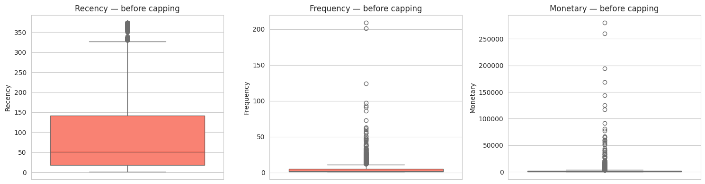
Outlier Handling
The Outlier Problem
Retail data typically features severe right-skewness (e.g., wholesalers). Deleting these removes valuable business data, but leaving them distorts distance-based clustering algorithms.

Slide 10
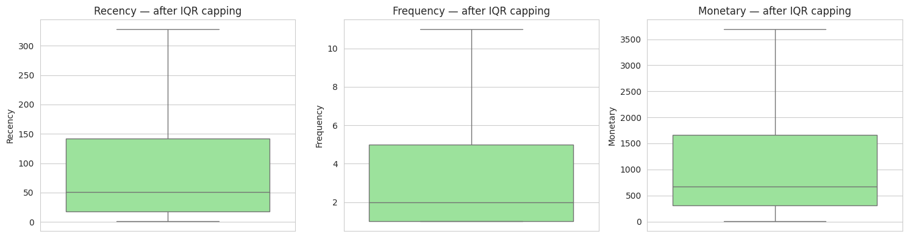
Outlier Handling
The Solution: IQR Capping
Instead of deletion, we capped extreme values at the Interquartile Range (IQR) bounds.
Lower = Q1 – 1.5 * IQR
Upper = Q3 + 1.5 * IQR
Feature | Capped Customers
Recency | 155
Frequency | 285
Monetary | 425

Slide 11
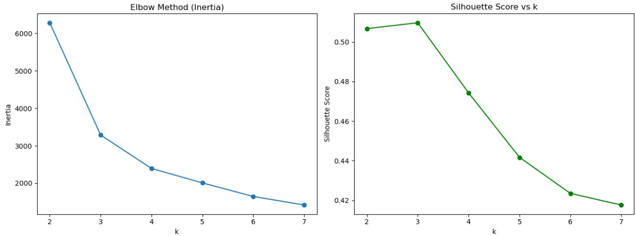
Clustering
K-Means: Selecting the Optimal Number of Clusters
Elbow Method: Inertia decreases sharply from k = 2 to k = 3, then the reduction becomes more gradual.
Silhouette Score: k = 3 achieves the highest score (~0.51), indicating the best cluster separation and cohesion.
Final Selection: k = 3 was selected as the optimal number of clusters.
Validation: Both the Elbow Method and Silhouette Score support the choice of 3 clusters.
Business Fit: Three clusters provide a clear and interpretable customer segmentation.

Slide 12
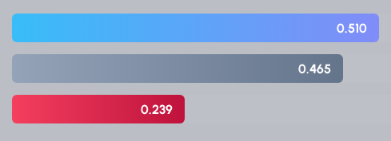
Clustering
Three clustering algorithms were tested and compared using the Silhouette Score(-1 to 1, higher = better clusters)
K-Means — Partitions customers into k compact groups
Hierarchical (Ward linkage) — Builds a tree of nested groupings
DBSCAN — Density-based, flags outliers as noise instead of forcing them into a cluster
K-Means (k=3)
Hierarchical (k=3)
DBSCAN
K-Means outperformed the others.

Slide 13
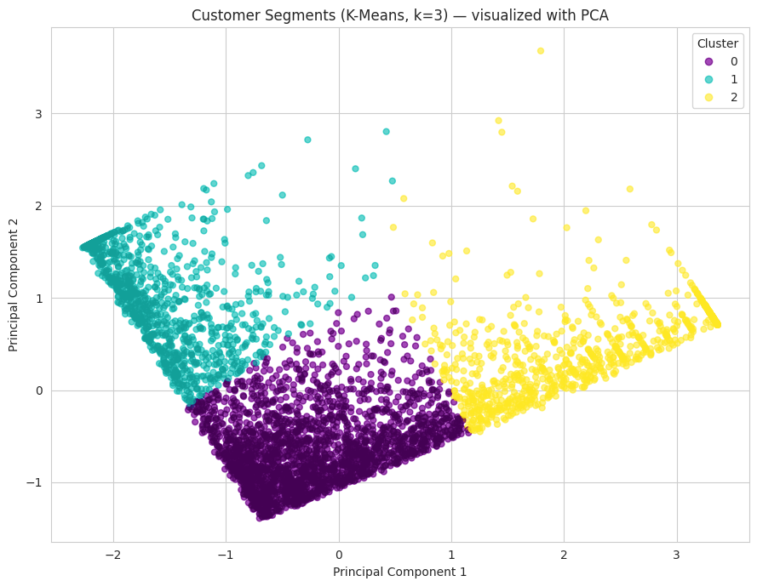
Segment Visualization
PCA – Principal Component Analysis
Purpose: Reduce 3 RFM features (Recency, Frequency, Monetary) to 2 dimensions for visualization while retaining maximum information.
Principal Components:
PC1: [-0.466, 0.631, 0.620] → Customer Value
How valuable is the customer? Driven mainly by Frequency & Monetary
PC2: [0.883, 0.288, 0.371] → Customer Recency
How valuable is the customer? Driven mainly by Recency
Variance Explained: 94.2% by the first two components.
Key Insight: PCA visualization showed three distinct and well-separated customer clusters, confirming a clear segmentation structure.

Slide 14
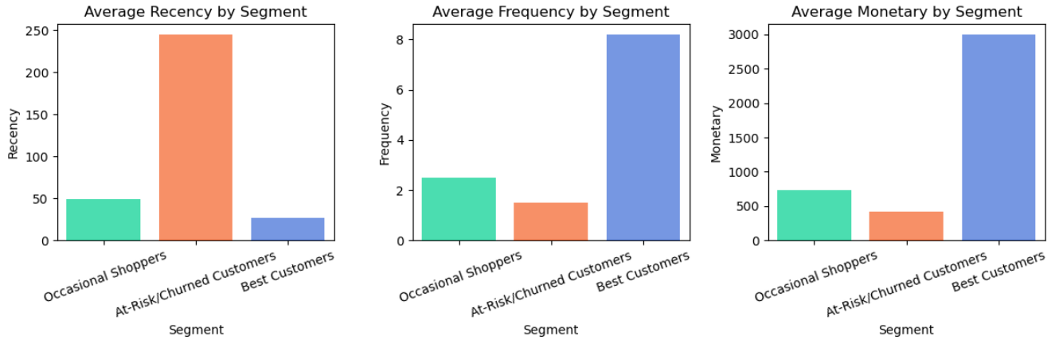
Segment Profiles
K-Means (k=3):
Best Customers — 964 customers (22.2%)
Occasional Shoppers— 2,328 customers (53.7%)
At-Risk/Churned Customers — 1,046 customers (24.1%)

Slide 15

Segment Table
Segment | Avg Recency | Avg Frequency | Avg Monetary | Customer
Best Customers | 27 days | 8.2 | £2,999.1 | 964 (22%)
Occasional Shoppers | 49 days | 2.5 | £726.1 | 2,328 (54%)
At-Risk / Churned | 245 days | 1.5 | £426.6 | 1,046 (24%)

Slide 16
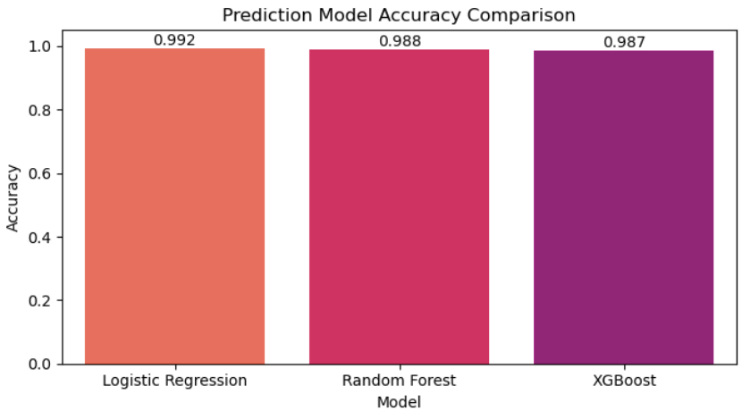
Predictive Modeling: Approach & Results
We treated the K-Means cluster labels as ground truth and trained supervised models (80/20 split) to classify new customers on the fly.
Why so high? The Clusters are highly distinct . This confirms our segments are clear, consistent and well-defined, not random noise.

Slide 17
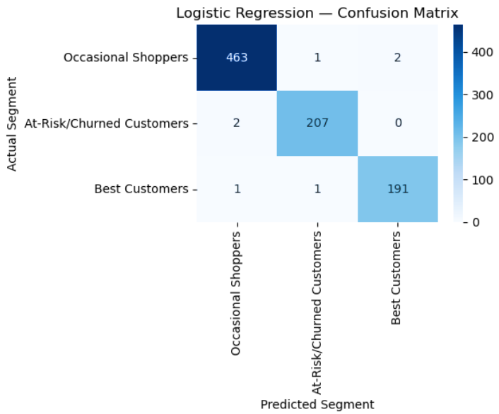
Predictive Modeling:
Logistic Regression – Confusion Matrix
High classification accuracy: Most predictions fall on the diagonal, indicating correct classifications.
Occasional Shoppers: 463/466 correctly classified.
At-Risk/Churned Customers: 207/209 correctly classified.
Best Customers: 191/193 correctly classified.
Very few misclassifications: Only 6 out of 868 customers were incorrectly classified.
Key Insight: The model distinguishes the three customer segments extremely well, with minimal overlap between classes.

Slide 18
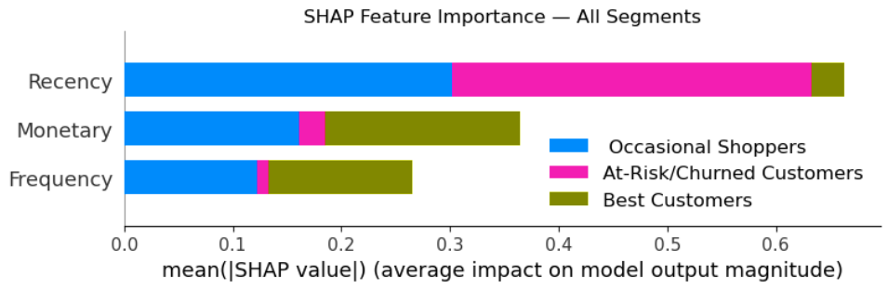
Feature Importance with SHAP
SHAP (SHapley Additive exPlanations) is a game-theoretic method that explains how each feature influences a model’s predictions.
Overall Feature Importance:
🥇 Recency: Most important feature — strongest influence on model predictions.
🥈 Monetary: Second most important — strong influence, especially for Best Customers.
🥉 Frequency: Least important overall — comparatively smaller influence.
Segment-wise Contribution:
Recency: Mainly identifies At-Risk/Churned Customers, with a significant contribution to Occasional Shoppers.
Monetary: Mainly identifies Best Customers, with smaller contributions to the other segments.
Frequency: Also contributes mainly to Best Customers, with smaller contributions to the other segments.
Key Insight: Recency is the strongest predictor, while Monetary and Frequency are more influential in identifying Best Customers.

Slide 19
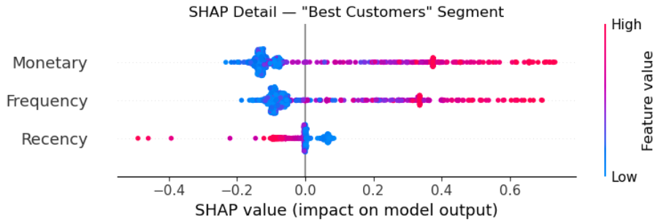
Feature Importance with SHAP
How to Read the Chart:
Each dot = one customer
Red: High feature value | Blue: Low feature value
Right: Pushes prediction toward Best Customer
Left: Pushes prediction away from Best Customer
Key Insights:
Monetary: Strongest driver
High spenders strongly push the prediction toward Best Customer; low
spenders push it away.
Frequency: Second strongest driver
Frequent buyers are more likely to be classified as Best Customers, while infrequent buyers push the prediction away.
Recency: Different pattern
Recent buyers (blue) push toward Best Customer, while long-lapsed customers (pink) push away. Most effects are close to zero, with a few highly inactive customers showing a strong negative impact.
Key Takeaway: High spending and frequent purchases strongly indicate Best Customers, while recent activity also supports the classification.

Slide 20
Business Recommendations
Best Customers — Recent, frequent, high-spending
Enroll in VIP/loyalty programs
Offer early access and personalized rewards
Focus on retention, not just upselling
Occasional Shoppers — Moderate RFM values
Use targeted cross-sell and personalized offers
Provide incentives such as “Spend X more to unlock Y”
Goal: Increase purchase frequency → Best Customers
At-Risk / Churned Customers — Low recency, frequency & spending
Launch win-back campaigns with discounts and “We Miss You” offers
Re-engage high-potential customers first
For long-dormant, low-value customers, optimize marketing spend
General Recommendation: Since Recency and Monetary matter most, marketing should focus on two goals:
Get them to buy sooner: Send reminders and limited-time offers so they don't slip away into the "At-Risk" group.
Get them to spend more: Offer product bundles and upsells to turn them into "Best Customers."

Slide 21
Conclusion & Next Steps
Summary of what we did:
Cleaned transaction-level retail data (handled mixed date formats, cancellations, missing customer IDs).
Engineered an RFM (Recency, Frequency, Monetary) profile per customer.
Capped outliers using the IQR method rather than deleting them.
Compared three clustering algorithms (K-Means, Hierarchical, DBSCAN) using Silhouette Score, and found K-Means (k=3) performed best on this data.
Turned the 3 clusters into named, actionable business segments.
Trained three supervised models (Logistic Regression, Random Forest, XGBoost) to predict segment membership from RFM values — all performed strongly, confirming the segments are well-separated and consistent.
Used SHAP to explain exactly which features drive each segment's classification.
Translated all of this into concrete marketing/retention recommendations.
Possible next steps:
Bring in additional features (e.g. product category preferences, average discount usage, return rate) to enrich the segmentation beyond pure RFM.
Re-run this pipeline periodically (e.g. monthly) to track how customers migrate between segments over time.
A/B test the recommended retention campaigns per segment and measure actual impact on Recency/Frequency/Monetary in the following period.

Slide 22
Questions ?

Slide 23
Thank You

