Slide 2
Purpose of this pitch deck
Delete this slide before submission
The purpose of this deck is to open your evaluators and communities minds to your vision and get them excited to know more. You want to give enough information to grab their interest, but not too much as to overwhelm them or have your story lose clarity & focus.
Evaluation criteria's.
Each idea will be evaluated against the following criteria:
(25%) Desirability - Would this idea be inspiring and drive adoption with the target audience?
(25%) Viability – What is the value for your target group and SAP?
(25%) Technical Feasibility - Solutions should allow for a minimum viable product that can likely be implemented with limited resources.
(25%) Community voting: Amount of votes by our community
Feel free to upload your idea pitch deck even if it not 100% perfect. You have the chance to refine your submission as often as you like until 01/24/2016. Our coaches can help you refine it. The earlier you submit the better your outcome might be.
Agenda
Value proposition
Team setup
Target group
Business relevance
Solution idea
Business model
Technology
Mockup
If you have any questions regarding the competition check out our FAQ section: https://ideas.sap.com/ct/b.bix?c=8E92AE7D-53F7-4DE2-9891-54FBC063DF91

Slide 3
Get to work faster, easier, and happier.
Li-Mei
For SAP employees struggling with their commute, the app will help you find the fastest route, notify when you should leave location, and find you a ride with someone near you, making life easier and better.

Slide 4
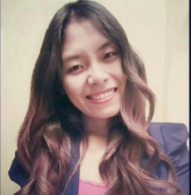
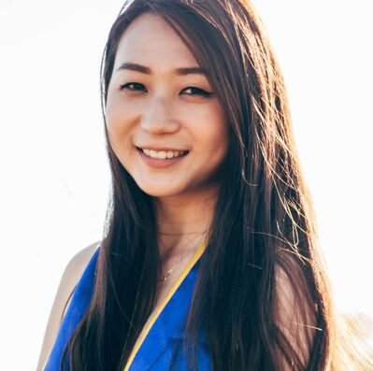
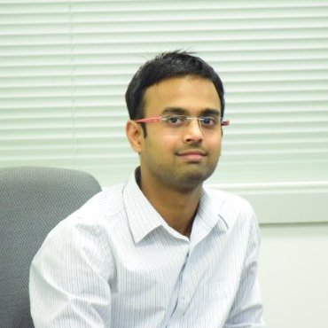
Feasible-Role: Your Technology Expert within the team. He/ She is your guru when it comes to technical realization. He/She make sure your idea is not just a futuristic vision but can be developed with the defined technologies. He/she is your Scotty on this journey.
Viable-Role: Your Business Expert within this team. He/ she brings the business value to the idea and makes sure the value is higher than the costs. He/She is the rational medium in your team. He/she is your Spock on this journey.
Desirable-Role: Your Target Group expert within your team. He/ She can explain why your selected target group will be thrilled to use your solution and will shape the user experience. He/ she is your Kirkon this journey.
Annie Suantak Niangneihoi
Li-Mei Situ
Jitendra Sharma
Desirable
Viable Role
Product Development
UI/UX, Web & Mobile Development, Full Stack, Product Management
Product Marketing, Visual Design, UI/UX
Software Design and Development Intern at SAP
https://www.linkedin.com/in/anniest16
www.linkedin.com/in/limeisitu
https://www.linkedin.com/in/jitendrasharma2411

Slide 5
Dennis
Frustrations / Pain Points
Motivations / Needs
Success factors

Slide 6
Jitendra
As we know Commute is an essential part of life at SAP.

Slide 7
Annie
Every user has a commuter profile: Home and Work locations saved
DRIVER
CARPOOLER
PUBLIC TRANSPORT COMMUTER
Real-time notifications for traffic updates on different routes between home and work.
Alerts for available parking spots
Carpoolers can either be drivers offering their vehicle for carpool, or commuters looking for a driver & vehicle.
Users can be mixed and matched based on their profile type (driver/ passenger), home location & preferred commute time
Real-time notifications for updates on bus/train shuttles based on destination locations & routes.
SOLUTIONS
Users can know when to leave from home or office to avoid much traffic, and also know the fastest routes to take. Finding parking spots will also be easier.
Users can commute faster by using the carpool lane. It also saves space on the road, gas, money & is environment friendly
Users can know when their mode of public transport leaves/arrives, what bus/train they need to take in order to reach on time & avoid more commute time
BENEFITS

Slide 8
Together
Target Group
Problem
Solution
Competitors and Advantage
Costs Structure
Revenue Streams
Success Measurement

Slide 9
Wendy

