Slide 1
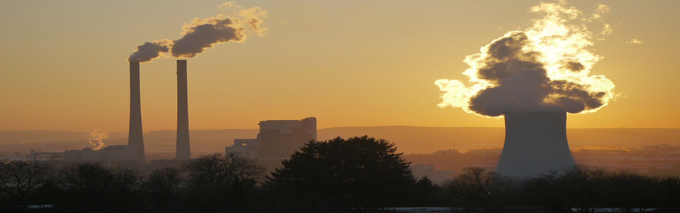
Air quality monitoring system Graphic Era deemed to be University Dehradun
Guided By: Submitted By :
Dr.Sachin Sharma Jeet Tewatia
Associate Professor Roll no. : 2011716
GEU Dehradun Sem. : 5th

Slide 2
Why to check air quality?
People with asthma.
People with lung disease.
People with cardiovascular (heart) disease.

Slide 3
Common Air Pollutants
Particulate matter (PM10 and PM2.5)
Ozone (O3)
Nitrogen dioxide (NO2)
Carbon monoxide (CO)
Sulphur dioxide (SO2)

Slide 4
Components Required:
Arduino Uno
16x2 LCD
MQ135 gas sensor
ESP8266 module
Breadboard
Connecting wires

Slide 5
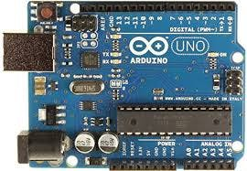
Hardware
Arduino Uno

Slide 6
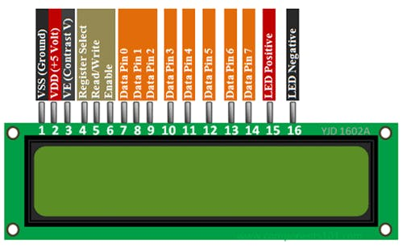
16X2 Character LCD

Slide 7
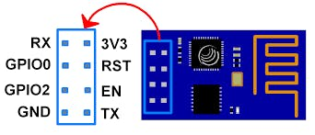
ESP8266 Wi-Fi Module

Slide 8
The pinout is as follows for the common ESP-01 module:
VCC, Voltage (+3.3 V; can handle up to 3.6 V)
GND, Ground (0 V)
RX, Receive data bit X
TX, Transmit data bit X
CH_PD, Chip power-down
RST, Reset
GPIO 0, General-purpose input/output No. 0
GPIO 2, General-purpose input/output No. 2

Slide 9
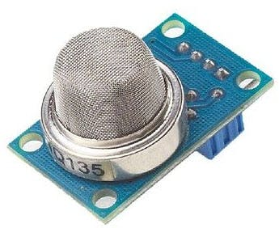
MQ-135 Gas sensor

Slide 10
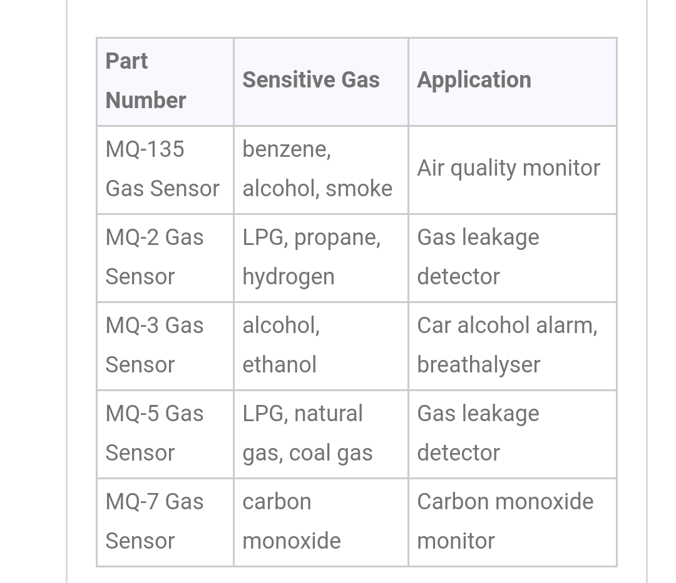
Selection Guide:

Slide 11
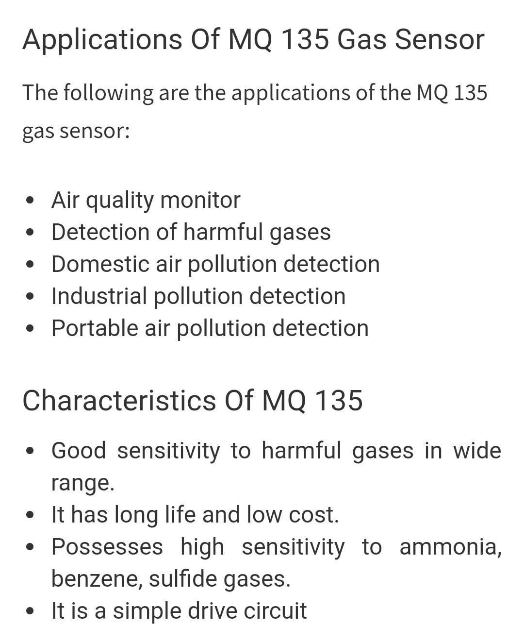

Slide 12
Software Required
Arduino IDE
IBM Watson IoT Platform

Slide 13
Working Principle
Sensor senses the quality index.
Sensor analog data is conveted into digital data by Arduino Uno.
This Digital data is sent to the cloud by using wifi module ESP 8266-01
The following data can be further processed.

Slide 14
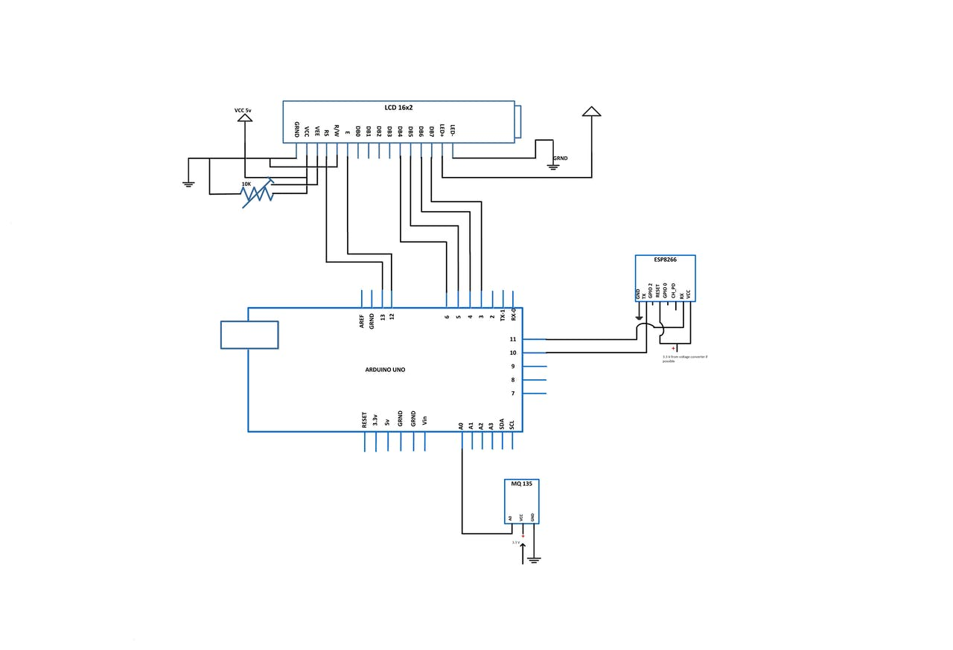
Circuit Diagram

Slide 15
Connections:
Arduino ==> LCD
GND ==> GND
5 V ==> Vcc
D13 ==> RS
GND ==> R/W
D12 ==> Enable
D6 ==> DB4
D5 ==> DB5
D4 ==> DB6
D3 ==> DB7
5V ==> LED+
GND ==> LED-
Arduino ==> Gas sensor
GND ==> GND
3.3 V ==> Vcc
Analog0 ==> A0
Arduino ==> ESP8266
D10 ==> Tx
D11 ==> Rx

Slide 16
USE OF SETUP FOR DISEASE ANALYSIS
This setup can be used to determine if which gas is the major cause for a particular disease. (With the help of various gas sensors)

Slide 17
USE OF SETUP IN RESEARCH
Analysing the data to find the major cause of pollution in certain region.
Finding major contributers (various gases).

Slide 18
THANK YOU....

