Slide 1
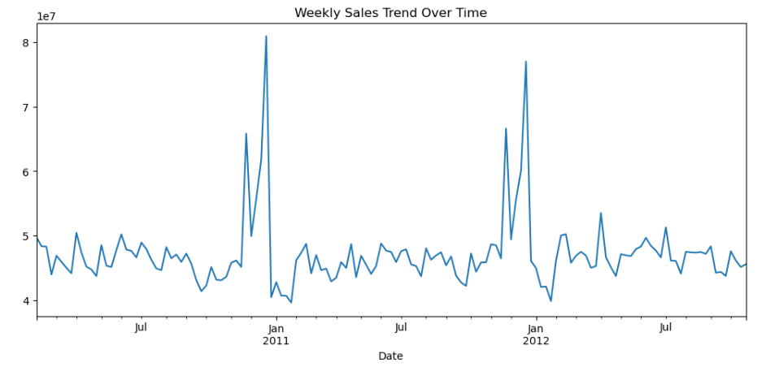
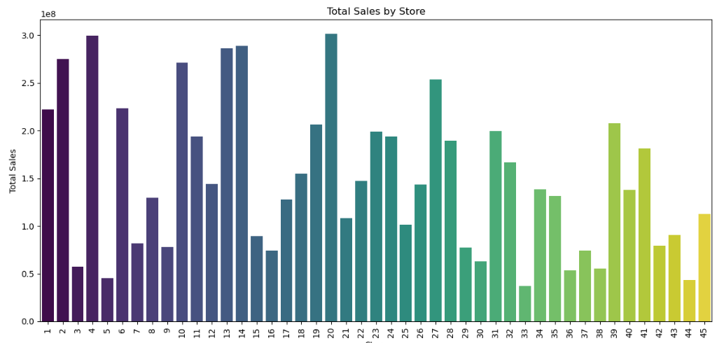
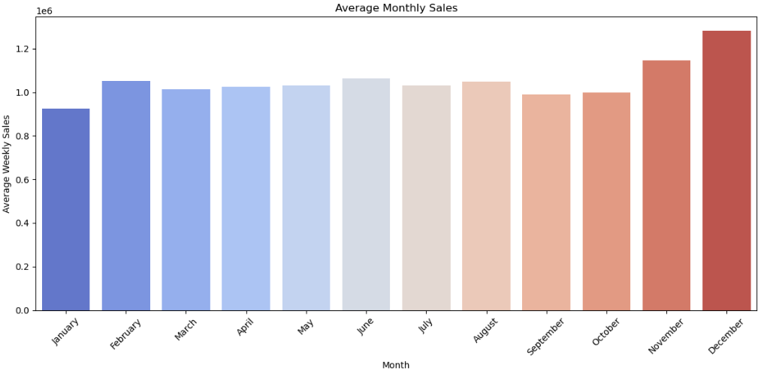
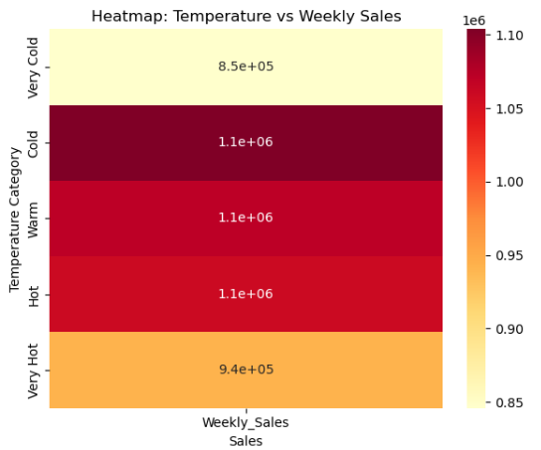
Walmart Sales Dashboard
💰 Total Sales | 📈 Avg Weekly Sales | 🏆Best store | ⚠️Weakest store | 🎉Holiday boost sales $ 95.50M $ 1.04M Store 20 Store 33 $1.58M (avg)
Line Chart – Weekly Sales Trend :
Total Sales by Store :
Average Monthly Sales :
Temperature vs Weekly Sales :

