Slide 1
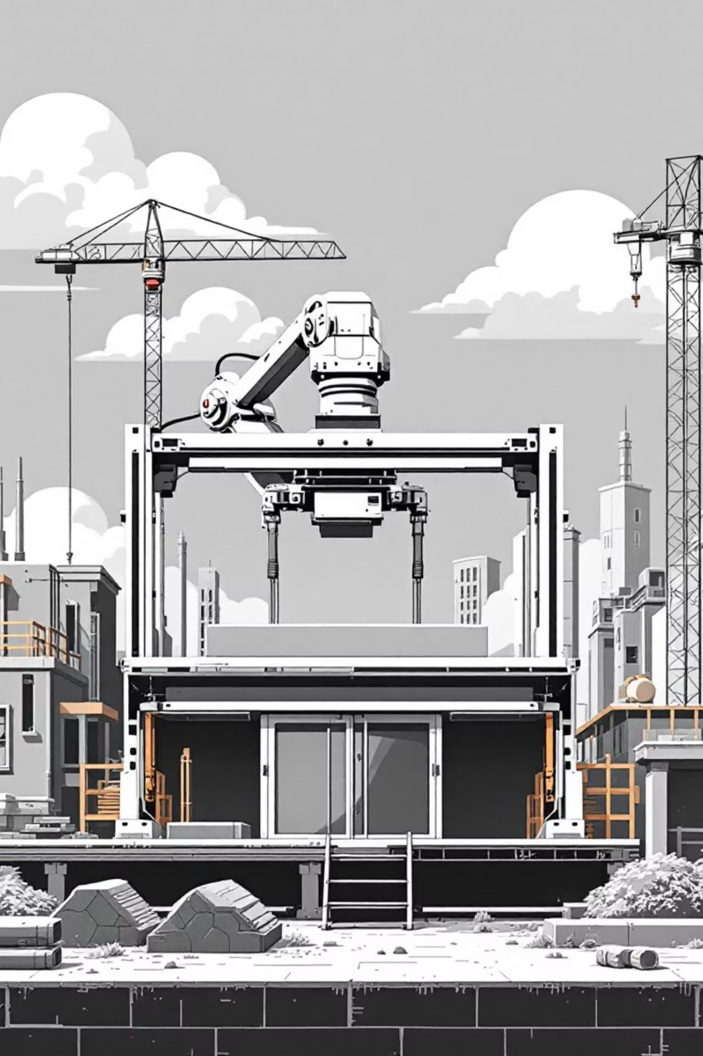
Intelligent 3D Concrete Printing
Layer Deformation Monitoring and Shrinkage Prediction Using Machine Learning
A research initiative by Jeetu Kumar, Sagar Hiremath, and Dr. Sowmya Kamath S from the Department of Information Technology, National Institute of Technology Karnataka, Surathkal

Slide 2
The Challenge: Transforming Construction
Traditional Construction
3D Concrete Printing Potential
Time-consuming and labour-intensive
50–60% cost reduction
Heavy reliance on formwork
Eliminates formwork requirements
Limited architectural freedom
Complex geometries enabled
High material waste
Minimised material waste

Slide 3

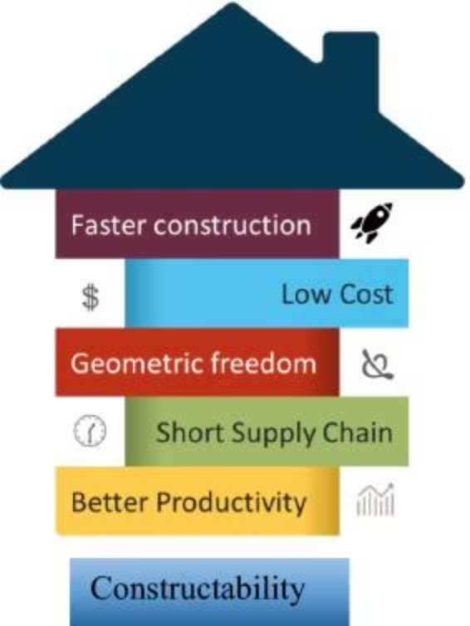
What is 3D Concrete Printing?
An additive manufacturing process that fabricates concrete structures layer-by-layer through controlled extrusion of specially formulated cementitious material, eliminating formwork and enabling unprecedented design freedom.
01
Digital Model
Design specifications converted to machine instructions.
02
Material Extrusion
Cementitious material deposited layer-by-layer through nozzle.
03
Automated Construction
Robotic systems build complex structures without formwork.
04
Quality Finishing
Integrated trowels smooth surfaces for paint-ready finish.

Slide 4
Critical Challenges in 3DCP
Layer Stability
Process Control
Durability Issues
Maximum printable layers before lower layers deform under weight of subsequent layers.
Precise calibration of nozzle diameter, extrusion pressure, print speed, and layer height required.
Shrinkage and crack formation threaten long-term structural integrity and interlayer bonding.

Slide 5
Research Objectives
1. Maximum Layer Stability
Determine the maximum number of layers printable before lower-layer deformation exceeds acceptable limits.
2. Real-time ML Control
Develop machine learning system to detect local deformations and dynamically adjust print speed.
3. Shrinkage and Crack Prediction
Predict shrinkage and crack formation using process, material, and environmental data

Slide 6
Data Foundation: Input Features
Material Composition
Process Parameters
Cement, water, silica fume, fly ash, aggregates, fibres, and admixtures (kg/m³).
Print speed, nozzle area, layer height, interlayer time, extrusion pressure.
Environmental Conditions
Rheological Properties
Ambient temperature and relative humidity affecting setting time and drying shrinkage.
Yield stress, plastic viscosity, buildability index, and deformation rate indicators.

Slide 7
Predictive Outputs: What We Measure
Compressive Strength
Flexural Strength
Tensile Strength
Load-bearing capacity (MPa)
Bending resistance (MPa)
Interlayer bonding quality (MPa)
Layer Deformation
Shrinkage Strain
Crack Propagation
Vertical settlement (mm)
Dimensional instability (%)
Width and rate (mm/s)

Slide 8
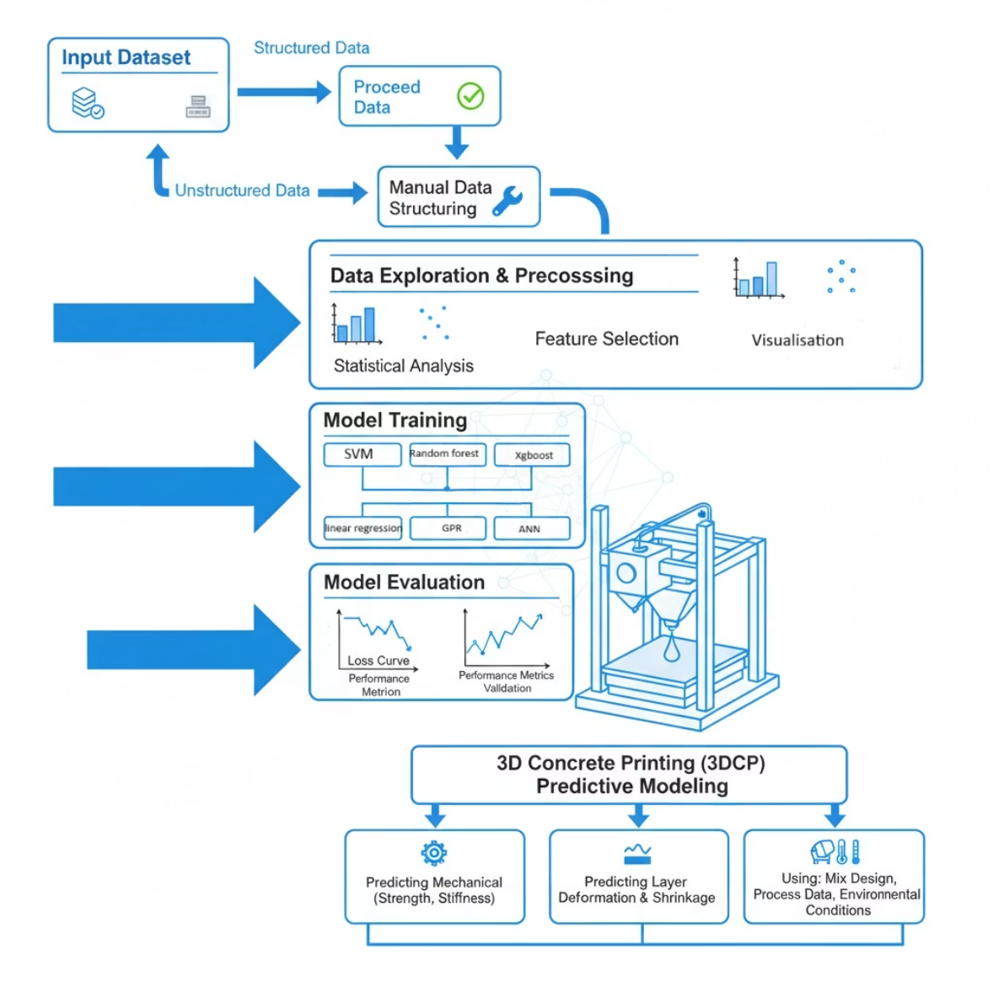
Machine Learning Approach
Leveraging advanced ML algorithms including SVM, XGBoost, random forests, and neural networks to model complex non-linear relationships between material composition, process parameters, and structural performance.
Predictive Models
SVM, XGBoost, ensemble methods for deformation and shrinkage prediction.
Real-time Monitoring
Adaptive control adjusting print speed based on detected deformations.
Performance Validation
High correlation coefficients demonstrating model reliability and accuracy

Slide 9
Project Deliverables and Impact
Curated Datasets
Comprehensive layer deformation, material properties, and environmental condition records from NITK 3DCP Laboratory.
Predictive ML Models
Validated models for layer deformation and shrinkage/crack initiation prediction.
Decision Support System
Analysis and visualizations guiding optimal printing parameters and mix design decisions.
Industry Transformation
Enhanced reliability, structural performance, and efficiency enabling wider 3DCP adoption in modern construction.

Slide 10
Thank you

