Slide 1
Strategic Recommendation for Lexus Company
Name

Slide 2
Introduction about Lexus
In automotive industry Japanese automaker Toyota Motor Corporation introduced the new company is the Lexus company.
This company provided the automotive financing services and this company provided the good brand of the vehicle products to the customers.
In marketing the essential operation is the management of the good brand image and it will useful for the financial growth of the company in market.

Slide 3
Lexus Brand Management Details
The success of the organization is depends on the brand name in the market and if the organization have good brand image, many of the customers are trusted the company provided services and company sales are improved with the good brand image in market.
In manufacturing of the luxury vehicles the Toyota introduced this subsidiary company is Lexus company.

Slide 4
Lexus Brand Management Details
In Lexus company from past days changed the activities in brand management and happened some changes previous for getting of good brand name in the market.
The Lexus company need some brand management changes for increasing of the customer trust in Lexus company provided products and services.
The brand management changes will helpful for the increase of the Lexus company profits and sales in market.

Slide 5
Lexus Brand Management Changes
The Lexus company need to do some changes on the company products marketing strategies.
Need to conduct competitor analysis and required to improve the product quality and try to increase the customers for products sales by proving of the good features with reasonable cost to the customers.
Now the brand name and logo is identified by customers and need to do some changes on packaging, pricing, and products related operations.

Slide 6
Proposal about Brand Strategy
This company present manufactured the products for high-end markets and the manufacturing cost of the products high and so products cost also increased and due to the high prices, all categories of the customers are unable to buy the products in market.
The main weakness of the Lexus company is high pricing models and need to overcome this with the design and development of models for all category of the customers like low and medium category class of customers and try to reduce the price of models in market.

Slide 7
Proposal about Brand Strategy
The Lexus company need to expand the market in United States and US and European countries and increase the market.
In present days the vehicle automotive marketing having the more renowned brands.
The competition is increased with the more renowned brands in market, so need to work on the brand strategy proposals and company try to exposure the market in other countries as well.

Slide 8
Brand Elements of Lexus
The brand elements of Lexus company is good and with that company have the good name in local and international markets.
The company required to work on making of high standard products for achieving of top brand in market.
Required to identify the right customer groups in market and try to attract that customers for improvement of brand image in market.

Slide 9
Brand Recommendation Details
The company need to increase the marketing campaigns for the increase of the company products promotions and publicity about the products in market.
The customer recognisability need to increase with the more marketing strategies and product promotions in market.
The company required to increase promotions on countries are like south Asia, South America, and Africa.

Slide 10
Brand Recommendation Details
The high competition in the countries are American and European markets and need to improve the brand name and brand image in these markets.
The company required to follow the latest trending brand strategies and try to improve the brand image in above mentioned markets and it will helpful for the improvement of the Lexus brand name and image in the international market also.

Slide 11
Marketing Strategies of Lexus
In manufacturing wise design and make the high end products like cars for the very high-end consumers.
Required to known about the ordinary customers like low or middle class customers and try to make the models for the ordinary customers with reasonable price.
The brand performance is depends on the products price and need to do work on the pricing strategies for better growth in market.

Slide 12
Marketing Strategies of Lexus
The one more market strategy is need to establish the market in different places and increase the market.
In global market or international wide market need to expand the Lexus market and try to increase the global customers.

Slide 13
Marketing Strategies of Lexus
In marketing strategies promotions is one of the strategy. For improvement of sales of company products, need to do the more promotions in market like local and global markets.
The Lexus company required to do more promotions with more promotional budget and try to attract the customers with the variety and trendy promotions and it will helpful for the improvement of the products sales in market.

Slide 14
Lexus Brand Value Chain Analysis
The Lexus company need to conduct the Brand value chain analysis and it will useful for the improvement of performance of the brand in market.
This analysis is different stages and the stages are marketing program investment, the customer mindset, market performance, and the shareholder value details.
The multiplies are included in the analysis are program quality, marketplace conditions, and the investor sentiment and need to work on all these things in the brand value analysis.

Slide 15
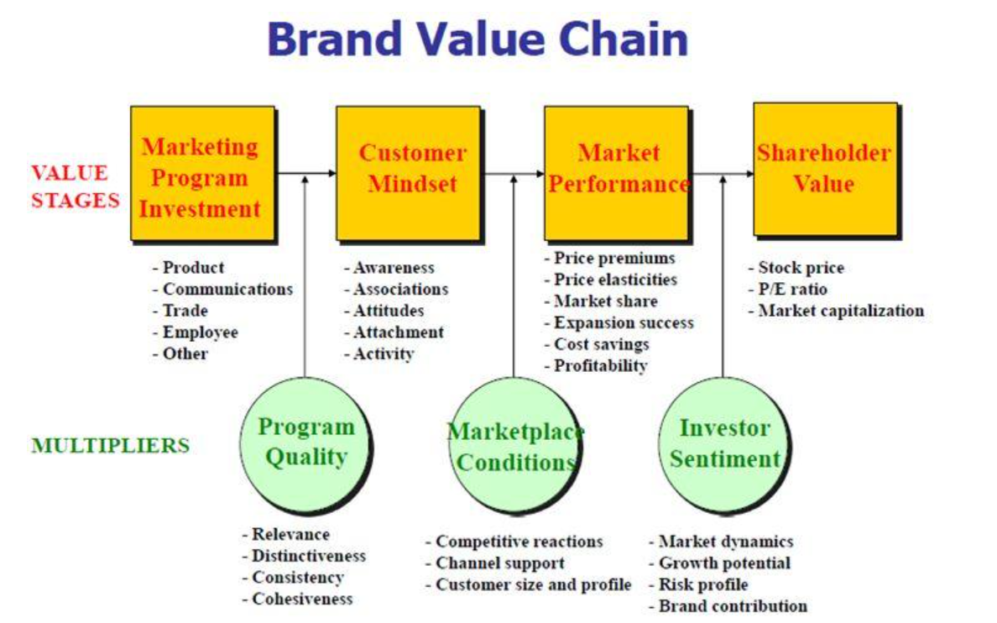
Lexus Brand Value Chain Analysis

Slide 16
Lexus Customer-based Brand Equity (CBBE) Model
The brand development is required for the improvement of brand performance of the Lexus company in market.
The brand development having the stages are
Relationship
Response
Meaning
Identity

Slide 17
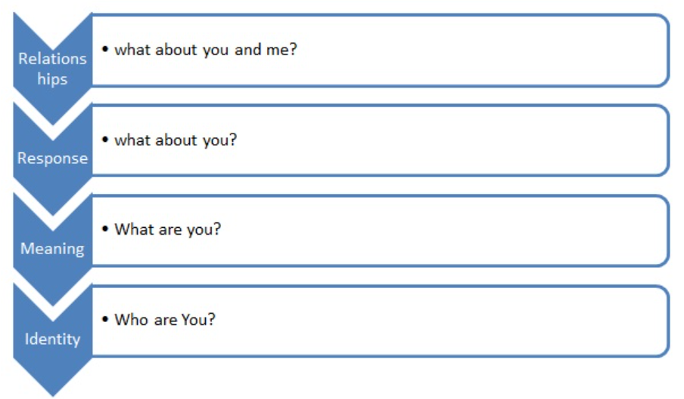
Lexus Customer-based Brand Equity (CBBE) Model

Slide 18
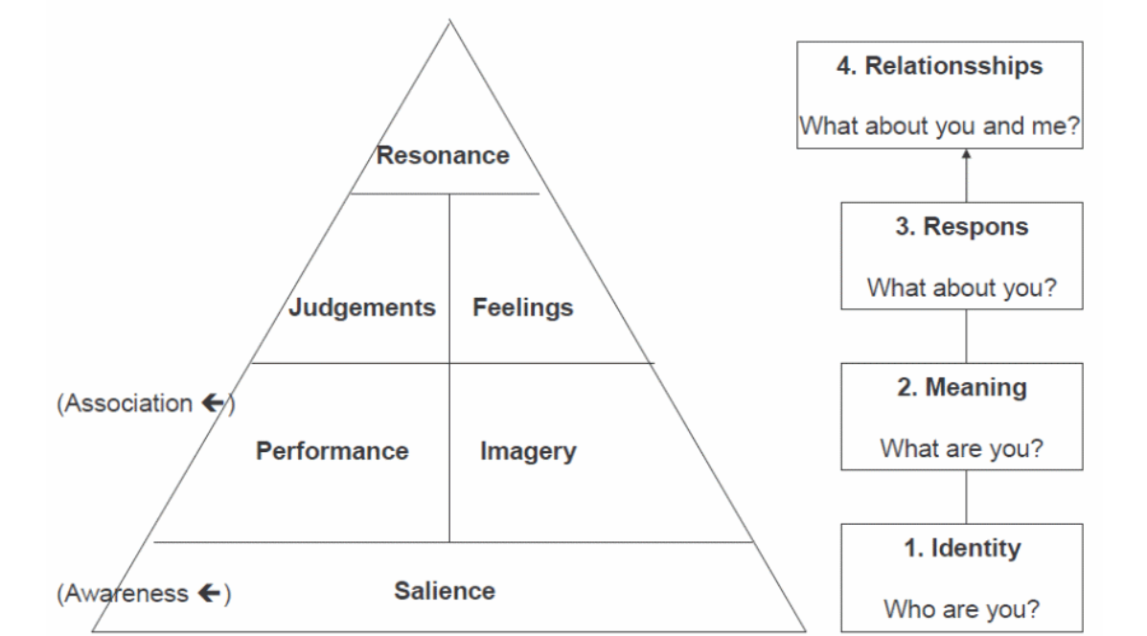
Lexus Brand Strength Improvement

Slide 19
Conclusion
The Lexus company need to work on the improvement of the marketing strategies and improvement of the brand performance in market.
We discussed about the different types of the strategies recommendations for better growth of the Lexus company brand image in different markets like local and global markets.
These strategies will helpful for the increase of Lexus company profits and sales

Slide 20
References
Osaki, T.. (2011). A study on premium marketing: The case of Lexus in Japan. 5. 55-58.

