Slide 1
JEEVANANTHAM V
Nmid: 08F2BD9C2C7BD2F941B49EB18D629546
Madras Institute of Technology campus, Anna University
Final Project
Fashion Set Classification Based On ANN classifier(MNIST dataset)

Slide 2
PROJECT TITLE
Fashion Set Classification Based On ANN classifier (MNIST dataset)
3/21/2024 Annual Review

Slide 3


AGENDA
The agenda of the project is to develop an fashion set classification system using artificial neural networks trained on the Fashion MNIST dataset.
This involves preprocessing the dataset, designing and training a neural network model, evaluating its performance, and deploying it for practical use.
3/21/2024 Annual Review

Slide 4
PROBLEM STATEMENT
The task is to accurately classify grayscale images of apparel into one of the ten categories:
T-shirt/top
Trouser
Pullover
Dress
Coat
The challenge lies in building a model that can effectively learn and generalize patterns from the image data to make accurate predictions.
Sandal
Shirt
Sneaker
Bag
Ankle boot
3/21/2024 Annual Review

Slide 5
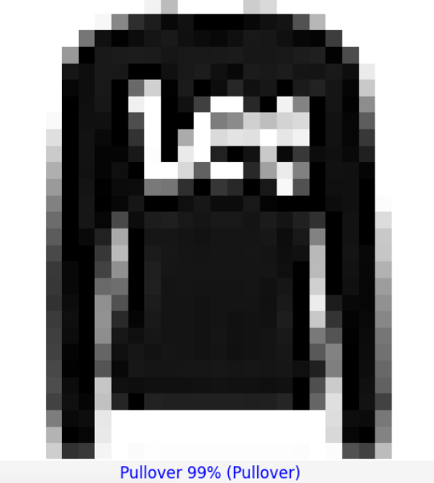
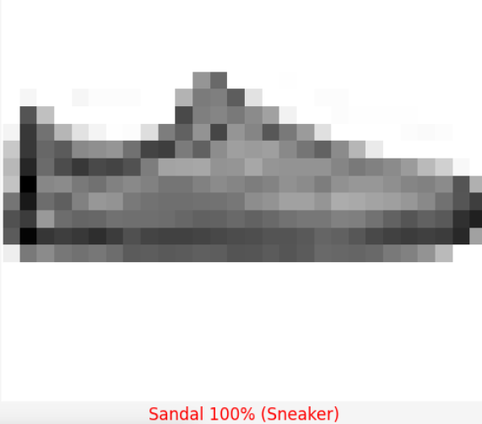
PROJECT OVERVIEW
The project utilizes the Fashion MNIST dataset, consisting of 70,000 grayscale images of apparel items across ten categories.
It employs 60,000 images for training the neural network and reserves 10,000 images for evaluation.
The goal is to develop a robust neural network model capable of accurately classifying unseen apparel images.
3/21/2024 Annual Review

Slide 6

WHO ARE THE END USERS?
Apparel manufacturers: To automate the process of categorizing apparel items in their inventory.
Online retailers: To enhance user experience by providing accurate product categorization and search functionalities.
Fashion enthusiasts: To identify and explore trends in apparel classification technology.
Researchers and developers: To study and improve upon the methods used in artificial intelligence for image classification tasks.
3/21/2024 Annual Review

Slide 7
YOUR SOLUTION AND ITS VALUE PROPOSITION
The value proposition lies in the accuracy and efficiency of the classification system, which offers benefits such as:
Improved inventory management: By automating apparel classification, businesses can streamline inventory tracking and management processes.
Enhanced user experience: Online platforms can provide more accurate search results and recommendations, leading to higher customer satisfaction
Proposed Model Accuracy:
0.895
3.Time and cost savings: Automation reduces manual effort and associated costs in categorizing large volumes of products.
4.Versatility and scalability: The model can be adapted and scaled to accommodate larger datasets or extended to classify other types of images beyond apparel.
3/21/2024 Annual Review

Slide 8
THE WOW IN YOUR SOLUTION
High accuracy: The neural network model achieves impressive accuracy in classifying apparel items, providing reliable results for practical use.
Robustness: The model demonstrates resilience against variations in input data, ensuring consistent performance across different apparel images.
Fast inference: The trained model can classify images rapidly, enabling real-time or near-real-time applications such as online product searches.
Interpretability: The model can provide insights into the features and characteristics it uses for classification, aiding in understanding its decision-making process and potential improvements
3/21/2024 Annual Review

Slide 9
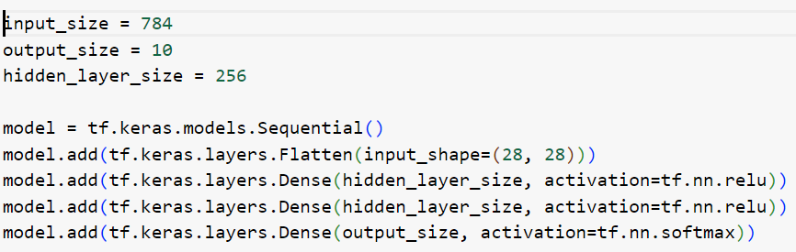
MODELLING
Building the neural network model:
Using Tensorflow and keras
3/21/2024 Annual Review

Slide 10
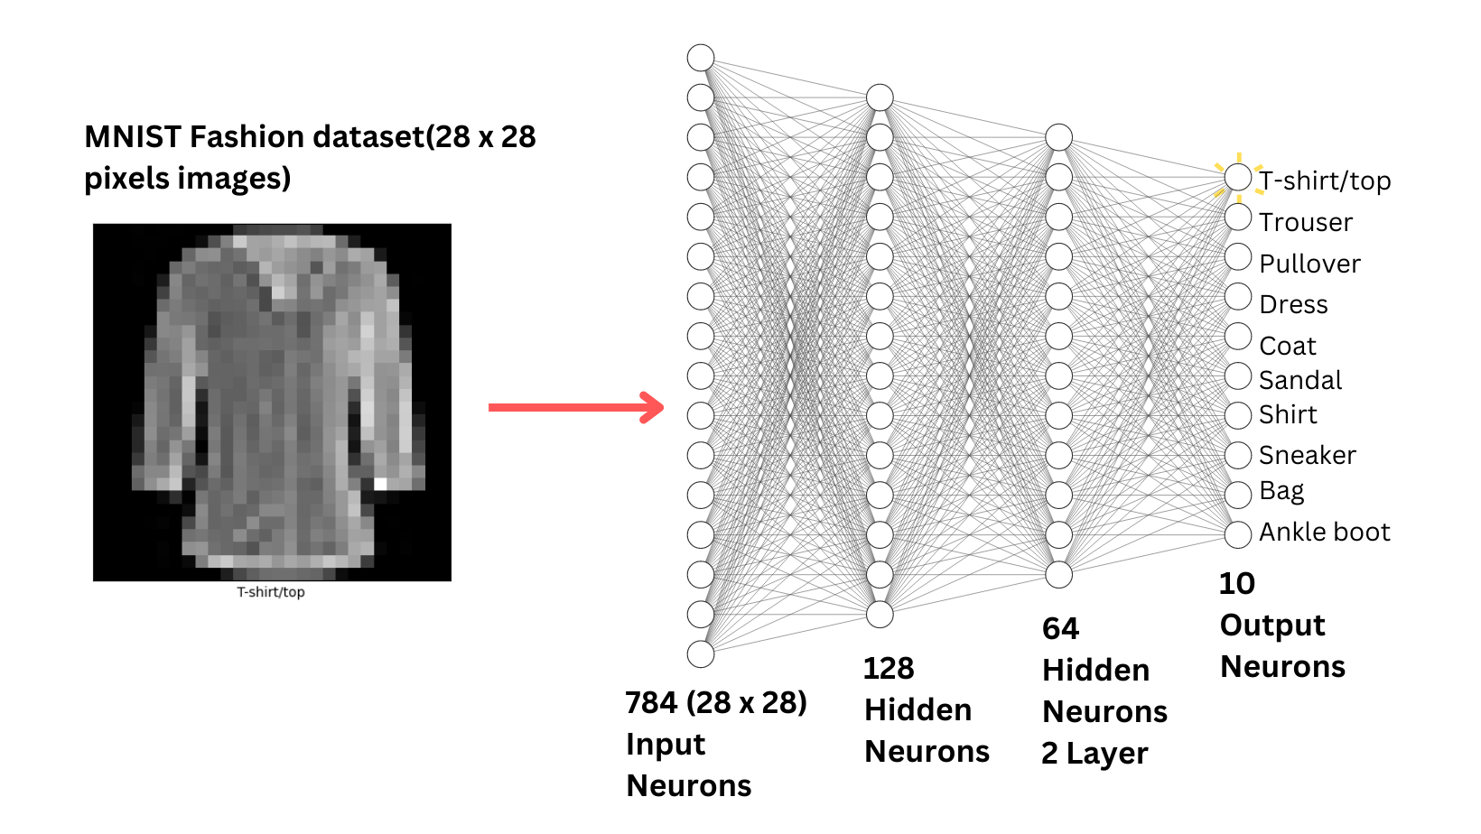

Slide 11
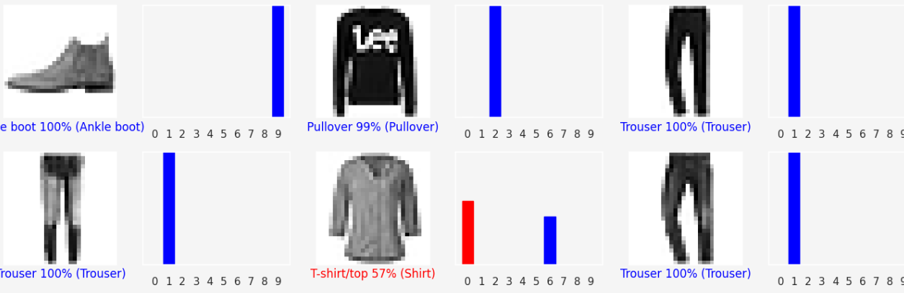
RESULTS
Obtained Model Accuracy:
0.887
Demo video link
https://drive.google.com/file/d/1gYMrTSHlfTjfszlUJ0gAa1RIaLUEKQ4i/view?usp=sharing
3/21/2024 Annual Review

Slide 12
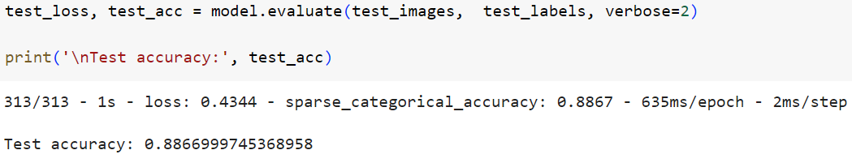
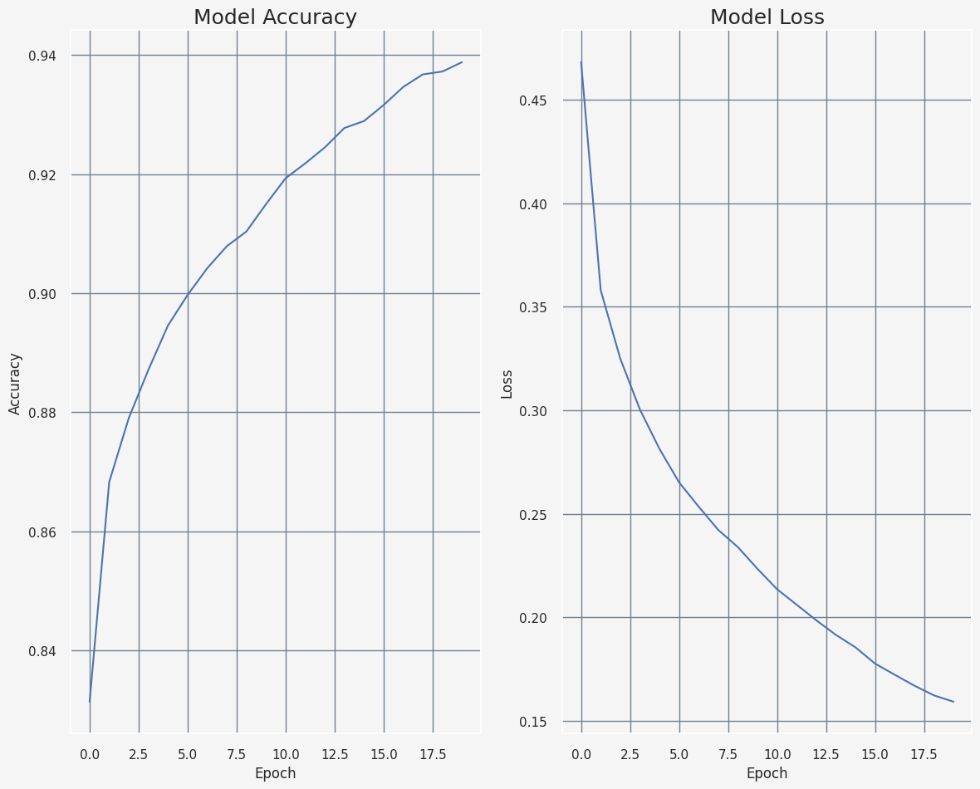
Accuracy of the model

