Slide 1



STUDENT DETAILS
Name: JEEVAN S
Skillsbuild Email Id: 1da20cs051.cs@drait.edu.in
College Name: DR AMBEDKAR INSTITUTE OF TECHNOLOGY
College State: Karnataka
Domain: Artificial Intelligence
Start Date & End Date: 18 Aug 2023 to 30 Sep 2023

Slide 2
SENTIMENTAL ANALYSIS OF RESTAURANT REVIEWS
Social media exerts significant influence in the realm of restaurants and food businesses. These platforms are harnessed by eateries to promote their offerings, engage with customers, and exhibit their culinary creations. Natural Language Processing (NLP) technology plays a pivotal role in this context. NLP-powered sentiment analysis tools comb through the vast reservoir of food-related content on social media, aiding establishments in comprehending customer feedback. By scrutinizing the sentiments conveyed in food reviews and social media posts, restaurants can glean actionable insights into customer preferences and dislikes, enabling them to customize menus, enhance service, and nurture brand loyalty. Thus, the convergence of social media, gastronomy, and NLP is reshaping how the food industry approaches customer satisfaction and business triumph.

Slide 3
AGENDA
discussion. The agenda will encompass essential aspects of the project, including data gathering and preparation, techniques for feature extraction, methods for labeling sentiment, and the process of selecting an appropriate model. We will explore the intricacies of model training and evaluation, with the goal of extracting valuable insights from the sentiment analysis findings.
Our discussion will also cover future steps, action items, timelines, and open discussions to provide a holistic perspective, promoting collaboration and guaranteeing the advancement of the project. This meeting is designed to guide the project towards actionable outcomes within the restaurant and food service industry.

Slide 4
Project Overview
Purpose: The purpose of this project is to harness the power of Natural Language Processing (NLP) technology to revolutionize customer satisfaction and business performance within the restaurant and food service industry. By employing sentiment analysis on social media and review data, our aim is to extract invaluable insights into customer preferences and critiques.
Scope: The scope of this project encompasses a multifaceted approach. It begins with the comprehensive collection and meticulous preprocessing of relevant social media and review data linked to restaurants and food businesses.
Objectives: Our project's core objectives revolve around data-driven decision-making and synergy among participants

Slide 5
WHO ARE THE USERS?
Restaurant Owners/Managers: Restaurant owners and managers can utilize the sentiment analysis insights to tailor their menus, improve customer service, and enhance the overall dining experience based on customer feedback.
Food Critics/Reviewers: Food critics and reviewers can benefit from the project by gaining a deeper understanding of public sentiment, which can inform their reviews and recommendations.
Marketing Teams: Marketing teams within food businesses can use sentiment analysis to refine their marketing strategies and campaigns, focusing on aspects that resonate positively with customers.
Data Analysts: Data analysts can leverage the project's data collection and analysis methods to extract valuable insights, helping restaurants make data-driven decisions.
Customers: Customers can indirectly benefit from the project as restaurants make improvements based on their feedback, leading to better dining experiences.
Investors: Investors in the restaurant and food service industry can use sentiment analysis results to make informed decisions regarding potential investments and portfolio management.

Slide 6
SOLUTION
In the context of Natural Language Processing (NLP), the assessment of restaurant reviews, spanning the spectrum from glowing to critical, assumes a pivotal role. In the case of favorable reviews, NLP algorithms demonstrate their expertise by discerning and categorizing them through sentiment analysis, effectively pinpointing content characterized by positive sentiment. These algorithms exhibit proficiency in identifying recurring keywords and phrases employed by patrons to articulate their contentment. Additionally, NLP techniques can be employed for predictive analysis, forecasting high ratings by scrutinizing the textual elements of these positive reviews.

Slide 7
CUSTOMIZATION
Versatile
Expandable
Significantly High Rate
Enhanced Precision
Volume of Feedback
Precision

Slide 8
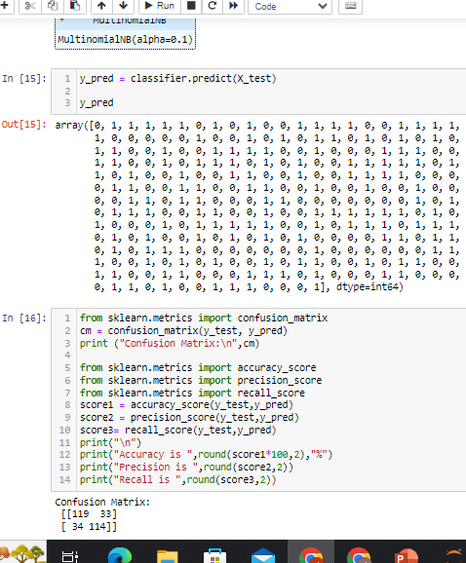
MODELING
Naïve Bayes: This straightforward probabilistic model proves efficient and excels in text classification duties, such as sentiment analysis. Its simplicity is an advantage, and it shines in binary sentiment classification tasks, effectively discerning between positive and negative sentiments.
Logistic Regression: Logistic regression, a linear model, finds utility in sentiment analysis. Its ease of implementation makes it an attractive choice, capable of handling both binary and multiclass sentiment classification with clarity.
Support Vector Machines (SVM): SVMs represent a potent tool in text classification, including sentiment analysis. These machines excel by identifying a hyperplane that optimally segregates data into distinct sentiment categories, making them valuable for intricate sentiment classification tasks.
Decision Trees and Random Forests: Decision trees and their ensemble counterpart, random forests, find application in sentiment analysis. Random forests, in particular, are adept at mitigating overfitting issues.

Slide 9
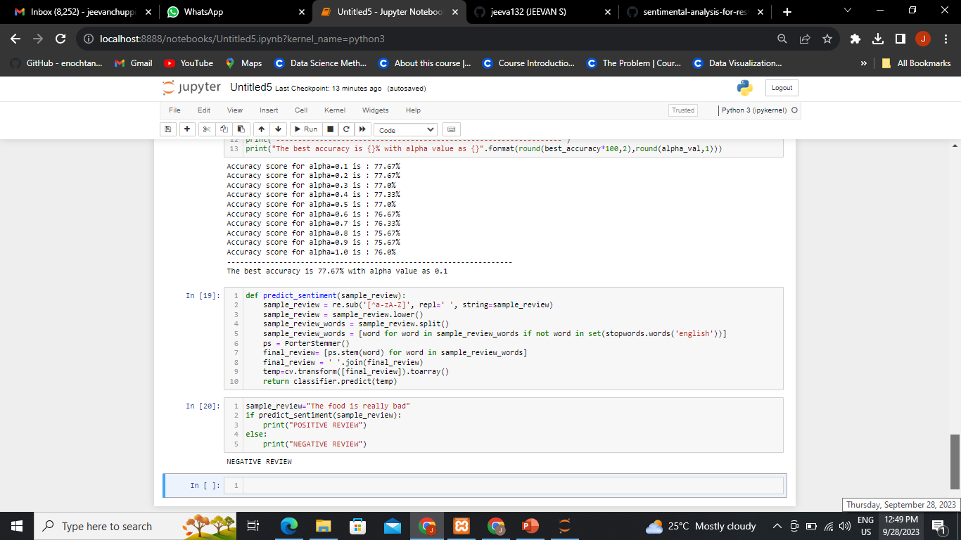
RESULTS
Based on our results for 7 inputs we get positive feedback of 75% and Negetive feedback of 25%

Slide 10

LINKS

Slide 11
THANK YOU

