Slide 1
KEYLOGGER project
CAPSTONE PROJECT
Presented By:
1.NAME- B.JEEVA
COLLEGE NAME- Priyadarshini engineering college
DEPARTMENT- Computer science and engineering

Slide 2
OUTLINE
Problem Statement
Proposed System/Solution
System Development Approach
Algorithm & Deployment
Result (Output Image)
Conclusion
Future Scope
References

Slide 3
Problem Statement
In today's digital age, where cybersecurity threats loom large, one of the significant concerns is the proliferation of keyloggers, stealthy software tools designed to monitor and record keystrokes on a user's computer without their knowledge. Keyloggers pose a severe threat to individuals and organizations as they can capture sensitive information such as passwords, credit card details, and other personal data, leading to identity theft, financial loss, and privacy breaches.

Slide 4
Proposed Solution
We can construct software keyloggers instead of physical keyloggers to solve the
above-mentioned problem.
The proposed model offers a technique that alleviates the challenges of installing the keylogger in the target system.
Because software keyloggers can be deployed remotely and do not require physical access to the target system, they are very popular.
The proposed software is capable of installing itself in a targeted system when the user, for example, clicks on a malicious link sent to him via email or social media, and then captures all of the user's keystrokes.
while logged into the system, saves the logs in a folder, or sends the logs directly to the
third party's email address.

Slide 5
System Approach
Hardware Keylogger are easy to use as they are placed in the internal hardware of the computer itself or it can be secretly inserted in between the CPU and the keyboard wire. But to plant the hardware Keylogger, the cybercriminal has to have physical access to the computer system while no one is watching.

Slide 6
Algorithm & Deployment
Capture Keystrokes:
Implement a mechanism to capture keystrokes made by the user. You can achieve this by utilizing platform-specific libraries or modules.
Record Keystrokes:
Store the captured keystrokes in a secure and persistent manner. You might choose to log them into a file, a database, or transmit them to a remote server, depending on your project requirements.
Documentation: Document the keylogger's functionality, usage instructions, and any other relevant information for future reference.

Slide 7
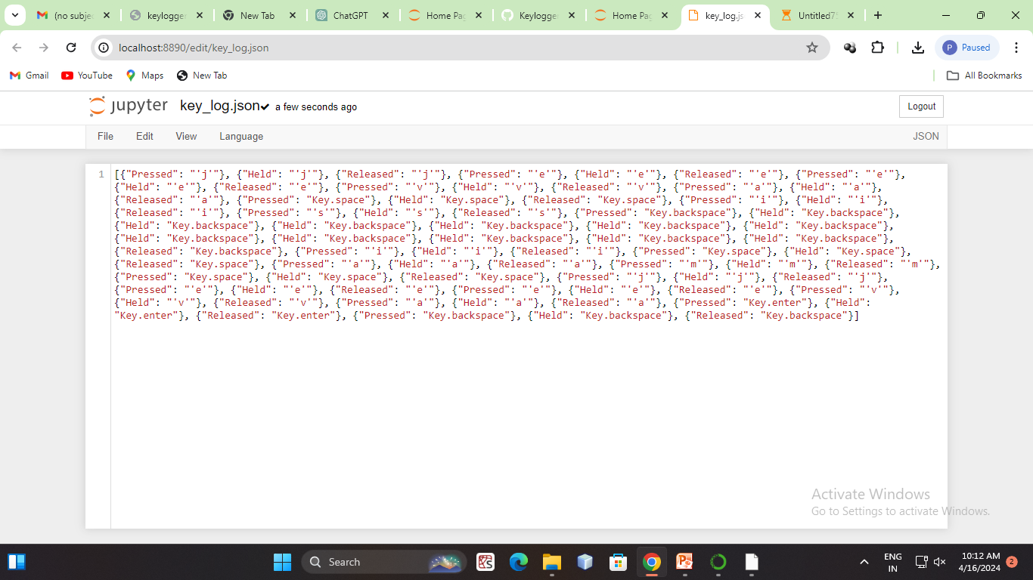
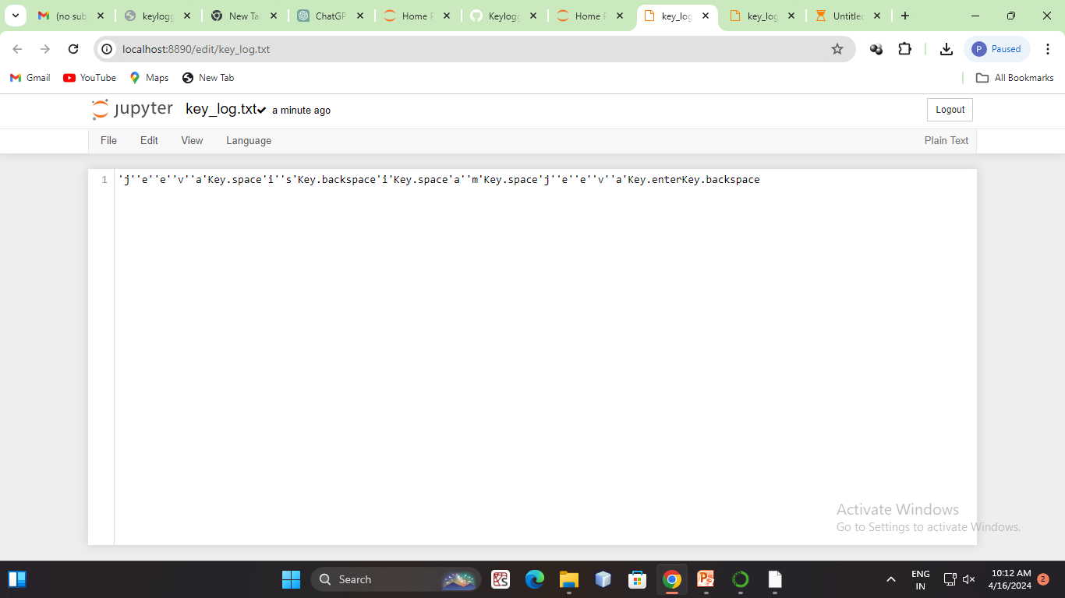
Result

Slide 8
Conclusion
Keyloggers are sophisticated tools that can access not only the platform, but also the user's private information like their name, password, pin, card and bank statement. While some keyloggers are utilized in a legal manner, the creators of many keyloggers do so unlawfully. The most frequent keylogger types and strategies used to hide themselves while subverting a user's PC were examined in this study. In addition, we looked at the present situation of keyloggers and the methods through which they spread Finally, we looked into existing detection methods and made some recommendations for prevention.

Slide 9
Future scope
Improved Stealth and Security: Implement advanced techniques to make the Keylogger more discreet and resistant to detection by antivirus software and anti-keylogging tools. Enhanced Logging: Add features to capture additional types of data, such as screenshots, clipboard contents, and web camera footage, to provide a more comprehensive overview of user activity. Remote Monitoring: Develop the ability to remotely access and monitor the logged data, possibly through a web-based interface or mobile application, allowing users to view activity from anywhere. Encryption and Data Protection: Integrate encryption algorithms to secure the logged data and implement secure methods for transmitting it to a designated server or storage location.

Slide 10
References
Use of legal software products for computer monitoring, keylogger.org.
V. W. Berninger (Ed., 2012), Past, present, and future contributions of
cognitive writing research to cognitive psychology. New York/Sussex: Taylor
& Francis. ISBN 9781848729636.
John Leyden (2000-12-06). "Mafia trial to test FBI spying tactics: Keystroke
logging used to spy on mob suspect using PGP". The Register. Retrieved
2009-04-19.
Andrew Kelly (2010-09-10). "Cracking Passwords using Keyboard Acoustics
and Language Modeling".
Sarah Young (14 September 2005). "Researchers recover typed text using
audio recording of keystrokes". UC Berkeley NewsCenter.

Slide 11
THANK YOU

