Slide 1
Secure data hiding in image using steganography
CAPSTONE PROJECT
Presented By: JEEVA B
Student Name : JEEVA B
College Name & Department : M.Kumarasamy College Of Engineering & Electronics and Communication Engineering

Slide 2
OUTLINE
Problem Statement
Technology used
Wow factor
End users
Result
Conclusion
Git-hub Link

Slide 3
Problem Statement
With the increasing exchange of sensitive data over digital platforms, the need for secure communication has become essential. Traditional encryption methods are often targeted by hackers, making them vulnerable to attacks. This project aims to develop a robust image steganography technique to conceal confidential information within images, ensuring data security without compromising image quality.

Slide 4
Technology used
Language: Python
Platform: Windows
Libraries Used
Image Processing:
OpenCV – Used for image manipulation and pre processing
PIL (Pillow) — To deal with various image types
Steganography Techniques:
Stegano – To perform LSB (Least Significant Bit) steganography
Handle Data & More:
NumPy – To deal with pixel arrays efficiently
Matplotlib – For visualizing how the images change

Slide 5
Wow factors
Provides a dual layer of security by combining encryption and image steganography.
Uses advanced steganography techniques to embed data without noticeable distortion.
Ensures that hidden data remains undetectable, even under analysis.
Suitable for secure communication, financial transactions, and confidential data storage.

Slide 6
End users
Cybersecurity professionals for secure communication.
Government agencies for classified data transmission.
Financial institutions to protect sensitive transaction details.
General users who require privacy in personal and business communications.

Slide 7
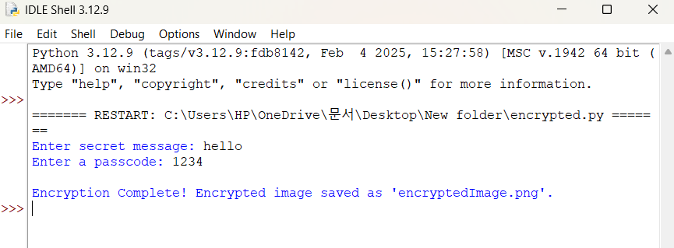
Results

Slide 8
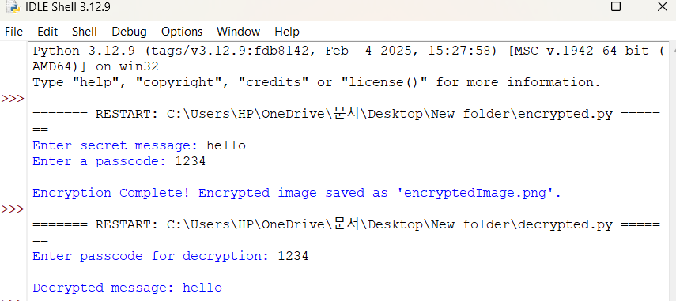

Slide 9
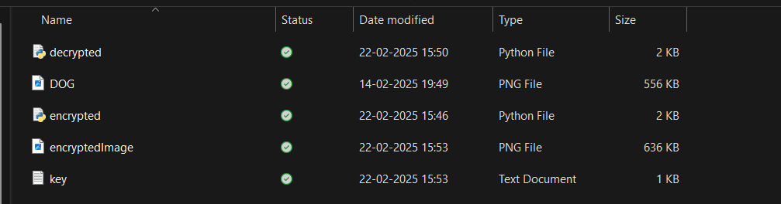

Slide 10
Conclusion
This project provides a secure and efficient method for hiding sensitive data within images using steganography. By ensuring minimal impact on image quality while maintaining confidentiality, the proposed approach enhances data security and reduces the risk of unauthorized access.

Slide 11
GitHub Link
https://github.com/jeevab06/jeeva06edunet

Slide 12
THANK YOU

