Slide 1


SRI RAMAKRISHNA INSTITUTE OF TECHNOLOGY
(An Autonomous Institution) | Pachapalayam, Perur Chettipalayam, Coimbatore - 641 010
DEPARTMENT OF COMPUTER SCIENCE AND ENGINEERING
20CS902 - FINAL YEAR PROJECT PHASE I | SECOND REVIEW
An Intelligent Banking Solution for Loan Eligibility Prediction
Batch No: [02] | [Review No-02]
PRESENTED BY
GUIDED BY
JEEVA BHARATHI M - 71382302062
Dr. M. KALPANA DEVI
KRISHNAKANTH M - 71382302083
ASSOCIATE PROFESSOR
Department of CSE
JEESHA S - 71382302061
POOVIZHI THANGAM V - 71382302115
14/10/2026
An Intelligent Banking Solution for Loan Eligibility Prediction
1

Slide 2
CONTENTS
01
Abstract
02
Introduction
03
Detailed Design
04
Contribution of the Team
05
Results Obtained
06
References (Min. 15, IEEE Format)
Thank You
07
14/10/2026
An Intelligent Banking Solution for Loan Eligibility Prediction
2

Slide 3
ABSTRACT
Manual loan underwriting in commercial and retail banking is inherently labor-intensive, error-prone, and slow, while conventional machine learning approaches rely on complex black-box architectures (such as deep neural networks or standard gradient-boosted trees) that deny creditworthy applicants without providing clear, legally defensible justifications. This lack of transparency violates contemporary financial regulations, notably the Reserve Bank of India (RBI) Digital Lending Guidelines (2022) and Equal Credit Opportunity mandates. This project proposes an intelligent, end-to-end banking solution for automated loan eligibility assessment utilizing Microsoft InterpretML's Explainable Boosting Machine (EBM) - a cyclic gradient-boosted Generalized Additive Model with pairwise interaction terms (GA²M). The system processes an 18-feature vector integrating 12 demographic and credit bureau attributes with dynamically engineered financial indicators, including reducing-balance monthly EMI calculations, total Debt-to-Income (DTI) ratios, and Loan-to-Income (LTI) ratios. An interactive credit simulation interface enables applicants and underwriters to model CIBIL score variations across distinct repayment histories and revolving credit utilizations with real-time feedback. When deployed across a containerized four-tier microservice architecture (React 18 frontend, Express API gateway, Python FastAPI inference engine, and MySQL 8.0 relational database), the trained EBM achieves 85.37% classification accuracy, 98.82% sensitivity (recall), and a 90.32% F1-score on held-out test data - outperforming traditional logistic regression baselines by +10.57% while delivering deterministic local logit attributions and plain-English adverse action notices within 39.1 milliseconds.
14/10/2026
An Intelligent Banking Solution for Loan Eligibility Prediction
3

Slide 4
INTRODUCTION
PROBLEM STATEMENT
Manual loan underwriting in commercial banks is slow, subjective, and operationally expensive. Modern machine learning solutions frequently rely on black-box architectures (XGBoost, Deep Neural Networks) that produce binary credit decisions without transparent causal explanations. This violates regulatory directives (e.g., RBI Digital Lending Guidelines 2022) requiring lenders to articulate clear adverse action notices and feature-level credit justifications to rejected applicants.
MOTIVATION
SCOPE OF WORK
Retail borrowers and small businesses face systemic opacity when applying for loans, often unaware of whether income, Debt-to-Income (DTI), or credit bureau scores triggered their rejection. This project was motivated by bridging the gap between predictive accuracy and Glass-Box interpretability using Microsoft InterpretML's Explainable Boosting Machines (GA²M). Creating an interactive, full-stack banking simulator with live reducing-balance EMI calculators, CIBIL gauge controls, and real-time waterfall charts makes ethical, transparent lending accessible to borrowers and risk officers alike.
In scope: 18-feature credit pipeline (12 demographic/credit inputs + 3 derived financial ratios: EMI, DTI, LTI + 3 employment indicators); Explainable Boosting Classifier (GA²M with 256 quantile bins and pairwise interaction terms); Interactive React 18 frontend with CIBIL score simulator (300-900) and live EMI/DTI preview; FastAPI microservice delivering sub-40ms predictions and exact local logit attributions; 6 normalized MySQL 8.0 tables with audit logs.
Out of scope: Live production integration with TransUnion CIBIL bureau APIs (simulated in demo mode per regulatory compliance); automated OCR extraction of physical bank passbooks; foreign exchange multi-currency lending; automated payment gateway fund disbursements.
14/10/2026
An Intelligent Banking Solution for Loan Eligibility Prediction
4

Slide 5
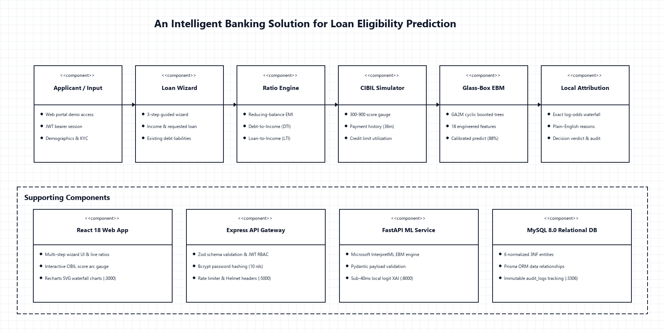
DETAILED DESIGN
14/10/2026
An Intelligent Banking Solution for Loan Eligibility Prediction
5

Slide 6
CONTRIBUTION OF THE TEAM
1
Jeeva Bharathi M (71382302062) (Team Lead & Full-Stack / ML):
Led overall project architecture, milestone planning, and multi-container Docker Compose orchestration.
Trained and benchmarked the Explainable Boosting Machine (EBM) achieving 85.37% accuracy and 98.82% recall.
Engineered the local logit attribution extractor and connected backend predictions to real-time Recharts waterfall views.
2
Krishnakanth M (71382302083) (Backend & Security)
Developed the Node.js and Express REST API gateway with TypeScript, JWT authentication, and Bcrypt security.
Architected the MySQL 8.0 relational schema with Prisma ORM across 6 normalized 3NF entities.
Implemented security middleware (Helmet, CORS, rate limiting) and the immutable audit_logs compliance pipeline.
3
Jeesha S (71382302061) (Frontend & UI/UX)
Designed and styled the responsive banking user interface using React 18, Tailwind CSS, and Lucide icons.
Built the multi-step loan application wizard with interactive step transitions and Zod schema validations.
Developed the interactive CIBIL score arc gauge (300-900) with dynamic color tier indicators and sliders.
4
Poovizhi Thangam V (71382302115) (Financial Math & QA)
Formulated and validated live financial ratios including reducing-balance EMI (10.5% p.a.), DTI (<=40%), and LTI (<=2.5x).
Authored the plain-English translation engine mapping logit scores into RBI-compliant adverse action and approval narratives.
Created and maintained the automated testing suite (12 Vitest API tests + 7 Pytest ML tests, 100% pass rate).
14/10/2026
An Intelligent Banking Solution for Loan Eligibility Prediction
6

Slide 7
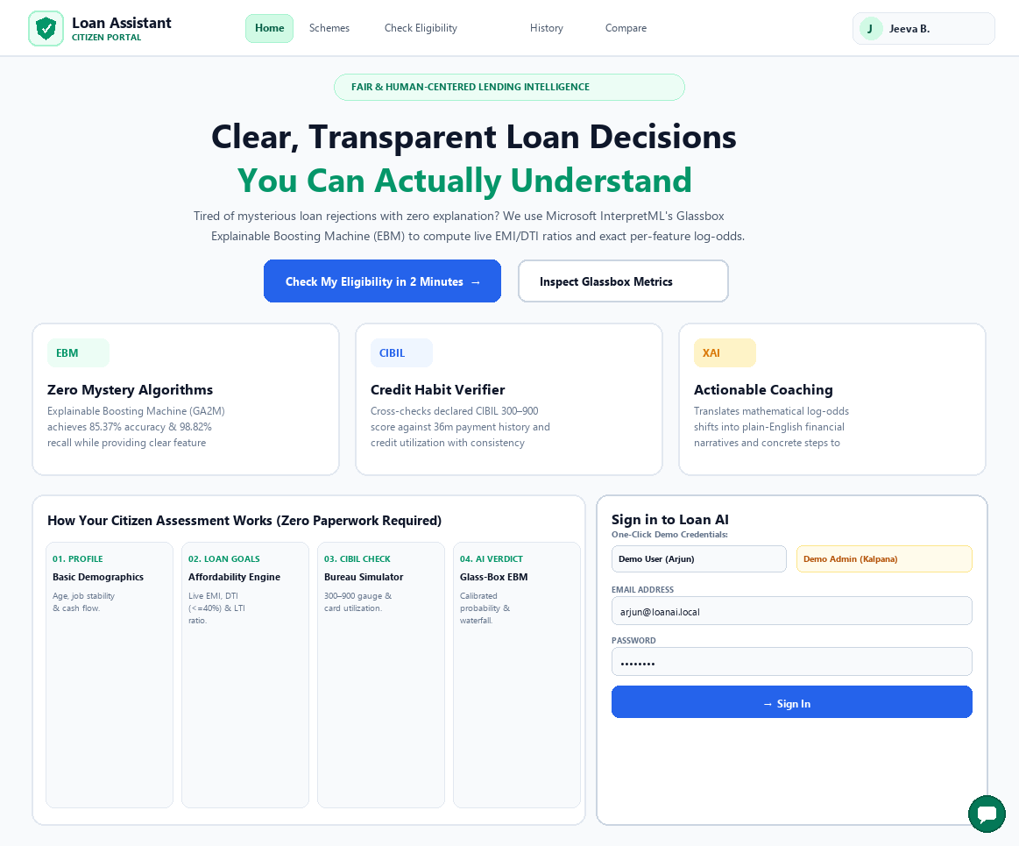
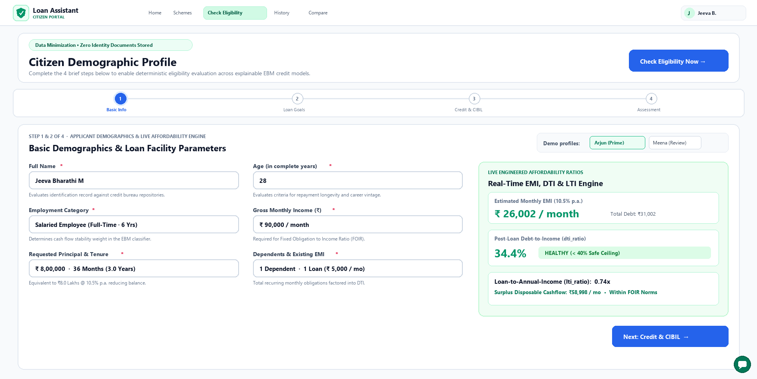
RESULTS OBTAINED
LANDING & LOGIN PAGE LOAN APPLICATION WIZARD
14/10/2026
An Intelligent Banking Solution for Loan Eligibility Prediction
7

Slide 8
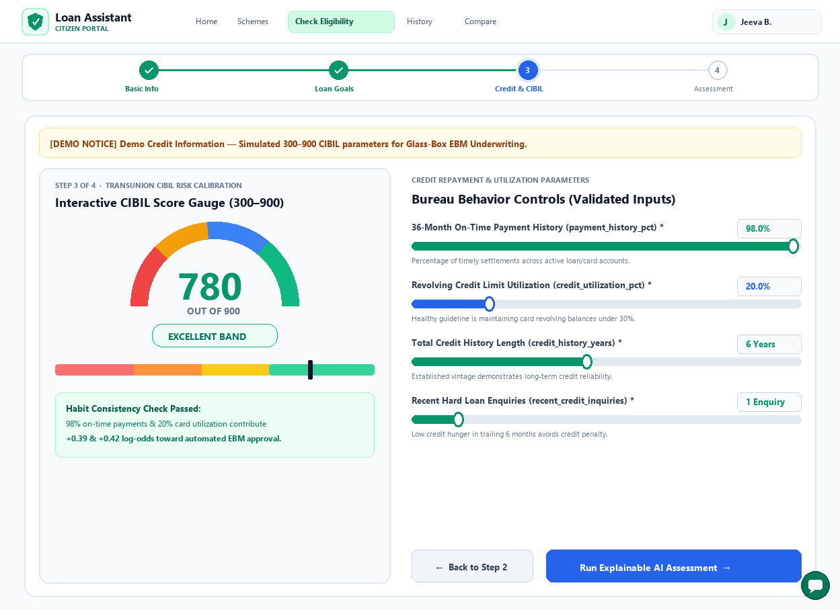
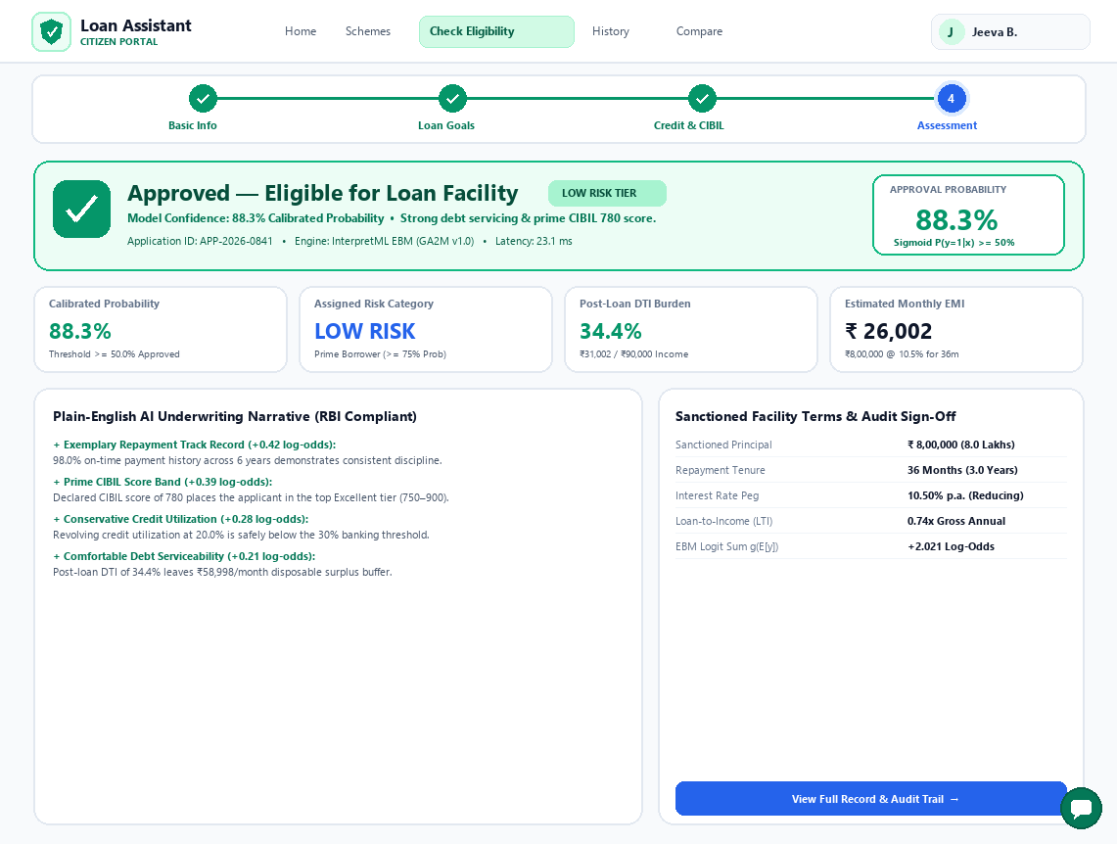
RESULTS OBTAINED (CONT.)
INTERACTIVE CIBIL GAUGE AI UNDERWRITING VERDICT
14/10/2026
An Intelligent Banking Solution for Loan Eligibility Prediction
8

Slide 9
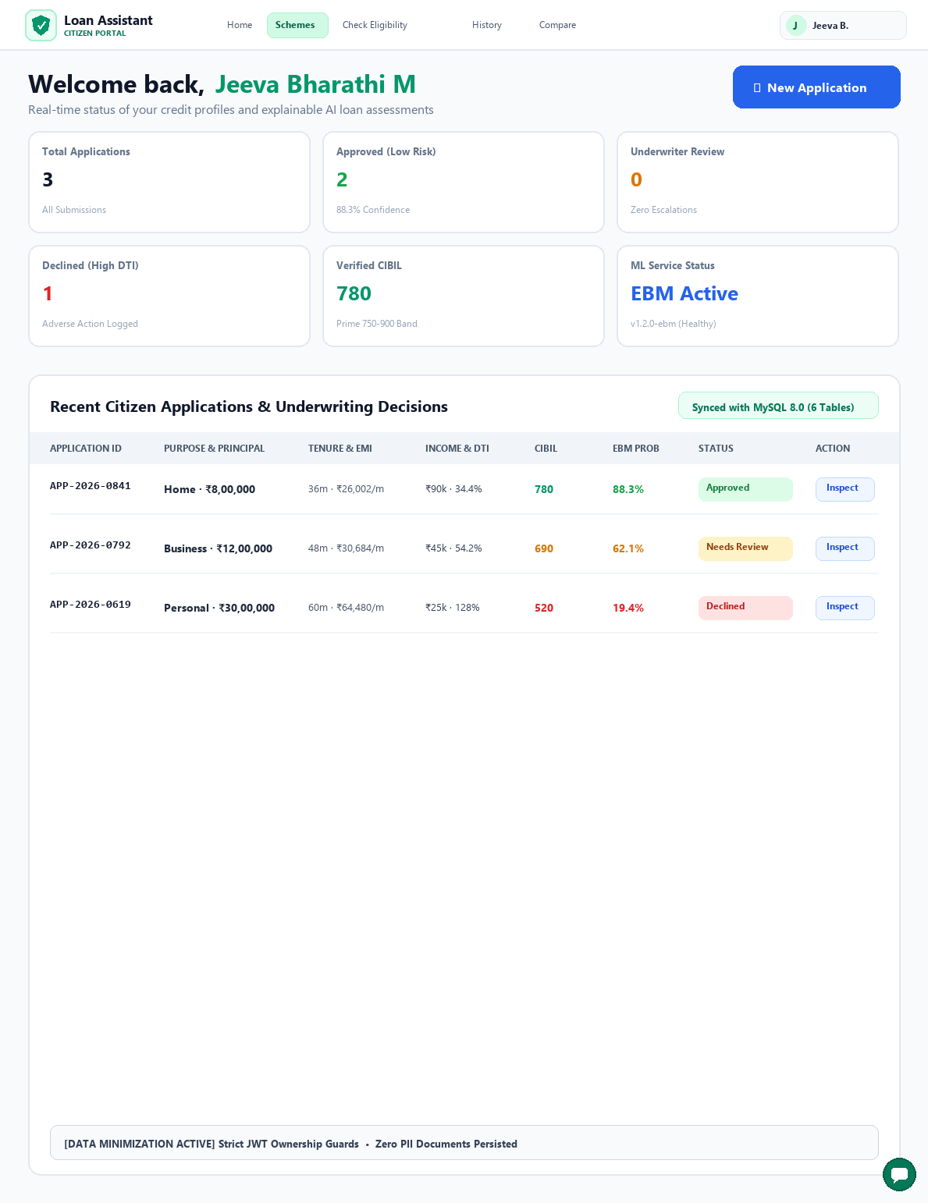
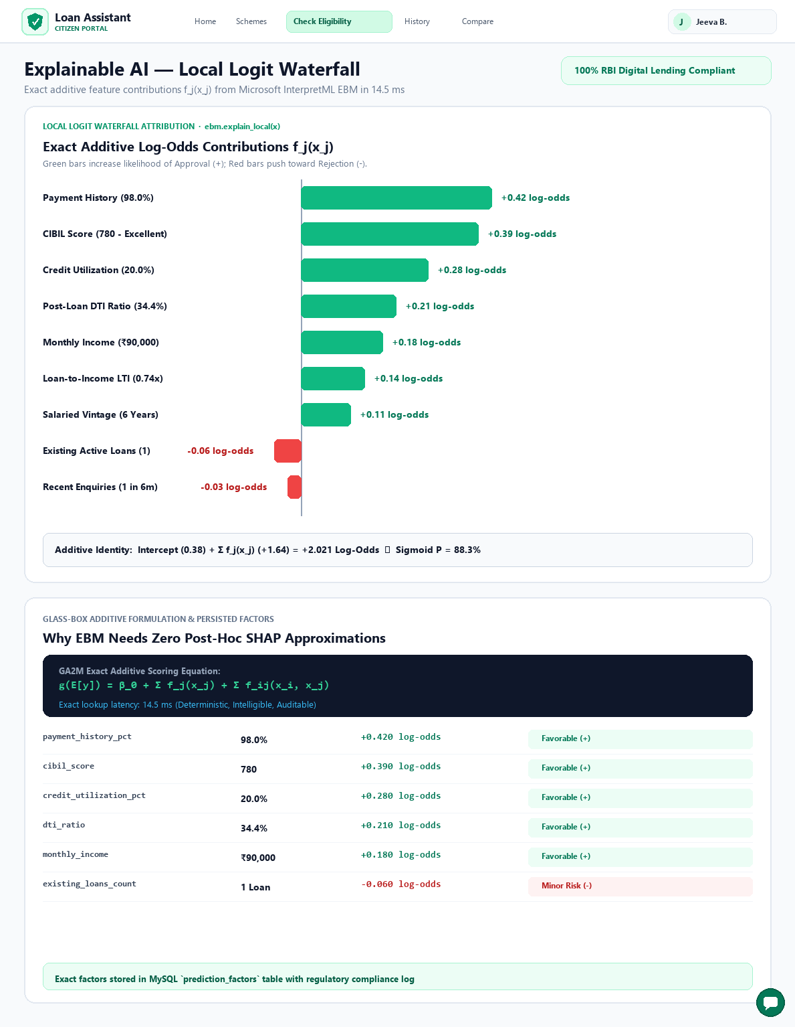
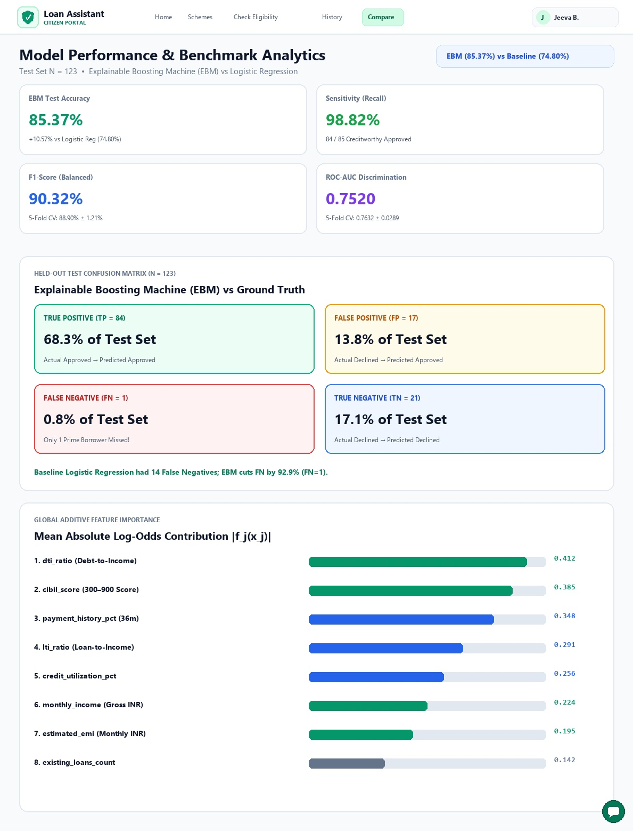
RESULTS OBTAINED (CONT.)
Hardware
EBM WATERFALL
MODEL METRICS
PORTFOLIO DASHBOARD
Multi-Core CPU / Docker Container Environment (Lightweight tree boosting, no GPU needed)
React 18 + TypeScript + Tailwind CSS
Microsoft InterpretML (ExplainableBoostingClassifier)
8 GB RAM for 4 containerized services (React, Express, FastAPI, MySQL)
Node.js + Express + Prisma ORM
Scikit-Learn (Metrics & Baseline)
Sub-40ms end-to-end API round-trip on standard consumer/cloud hardware
Python 3.11 + FastAPI REST API
Recharts - interactive SVG waterfall charts
Standard modern web browser (Chrome, Edge, Firefox) with SVG & Canvas support
MySQL 8.0 Relational DB (6 Tables)
Docker Compose (multi-service orchestration)
14/10/2026
An Intelligent Banking Solution for Loan Eligibility Prediction
9

Slide 10
REFERENCES
[1] Y. Lou, R. Caruana, J. Gehrke, and G. Hooker, "Accurate intelligible models with pairwise interactions," in Proc. 19th ACM SIGKDD Int. Conf. Knowledge Discovery and Data Mining (KDD), 2013, pp. 623-631.
[2] H. Nori, S. Jenkins, P. Koch, and R. Caruana, "InterpretML: A unified framework for machine learning interpretability," arXiv preprint arXiv:1909.09223, 2019.
[3] S. M. Lundberg and S.-I. Lee, "A unified approach to interpreting model predictions," in Advances in Neural Information Processing Systems (NeurIPS), vol. 30, 2017, pp. 4765-4774.
[4] M. T. Ribeiro, S. Singh, and C. Guestrin, "'Why should I trust you?': Explaining the predictions of any classifier," in Proc. 22nd ACM SIGKDD Int. Conf. Knowledge Discovery and Data Mining, 2016, pp. 1135-1144.
[5] C. Rudin, "Stop explaining black box machine learning models for high stakes decisions and use interpretable models instead," Nature Machine Intelligence, vol. 1, no. 5, pp. 206-215, 2019.
[6] S. Lessmann, B. Baesens, H.-V. Seow, and L. C. Thomas, "Benchmarking state-of-the-art classification algorithms for credit scoring: An update of research," European Journal of Operational Research, vol. 247, no. 1, pp. 124-136, 2015.
[7] N. Siddiqi, Intelligent Credit Scoring: Building and Implementing Better Credit Risk Scorecards, 2nd ed. Hoboken, NJ, USA: Wiley, 2017.
[8] T. Chen and C. Guestrin, "XGBoost: A scalable tree boosting system," in Proc. 22nd ACM SIGKDD Int. Conf. Knowledge Discovery and Data Mining, 2016, pp. 785-794.
14/10/2026
An Intelligent Banking Solution for Loan Eligibility Prediction
10

Slide 11
REFERENCES (CONT.)
[9] Reserve Bank of India, "Guidelines on Digital Lending," RBI/2022-23/111 DOR.CRE.REC.66/21.07.001/2022-23, Mumbai, India, Sep. 2022.
[10] Basel Committee on Banking Supervision, "Principles for the Management of Credit Risk," Bank for International Settlements (BIS), Basel, Switzerland, Tech. Rep., 2000.
[11] L. Breiman, "Random forests," Machine Learning, vol. 45, no. 1, pp. 5-32, 2001.
[12] J. H. Friedman, "Greedy function approximation: A gradient boosting machine," Annals of Statistics, vol. 29, no. 5, pp. 1189-1232, 2001.
[13] N. Bussmann, P. Giudici, D. Marinelli, and J. Papenbrock, "Explainable machine learning in credit risk management," Computational Economics, vol. 57, no. 1, pp. 203-216, 2021.
[14] M. Bucker, G. Szepannek, A. Gosiewska, and P. Biecek, "Transparency, auditability, and explainability of machine learning models in credit scoring," Journal of the Operational Research Society, vol. 73, no. 1, pp. 70-90, 2022.
[15] V. Moscato, A. Picariello, and G. Sperli, "A benchmark of machine learning approaches for credit score prediction," Expert Systems with Applications, vol. 165, art. 113986, 2021.
14/10/2026
An Intelligent Banking Solution for Loan Eligibility Prediction
11

Slide 12
THANK YOU
Questions, Comments & Suggestions are Welcome
14/10/2026
An Intelligent Banking Solution for Loan Eligibility Prediction
12

