Slide 1
Graph Connectivity
Miriyala Jeevan Kumar(18111041)
Nuka Siva Kumar (18111069)
Parallel Graph Connectivity in Log Diameter Rounds Andoni,Stein,Song,Wang,Zhong 2018

Slide 2
What is graph connectivity ?
12
11
14
3
7
15
0
1
2
9
5
8
16
4
6
10
13
Parallel machines
(14,12) (7,11) (9,16)..
[14,0] [12,0] [9,1] ..
Input Edges
output [vertex,color]
(16,13) (9,4) (2,4)..
[14,0] [7,1] ..

Slide 3
Previous Work
Best Known solutions : log(n) rounds
Using Leader Contraction Frame Work

Slide 4
An algorithmic framework
Input G = (V,E)
Initialize i ← 1 , G₁ = (V₁ , E₁) ← G
In i-th iteration, if Eᵢ = ɸ , stop the procedure
Randomly choose some vertices from Vᵢ as the leaders for Gᵢ
For each non-leader vertex v ∈ Vᵢ , if ∃ a leader u which is a neighbour of v in Gᵢ , then contract v to u.
(If there are multiple choices of u , choose an arbitrary one)
Let Gᵢ₊₁ = (Vᵢ₊₁ , Eᵢ₊₁) be the contracted graph and i ← i + 1
At the end of procedure for each v ∈ V if v is finally contracted to u then assign v the color of u.

Slide 5
Example
Iteration 1
12
11
14
3
7
15
0
1
2
9
5
8
16
4
6
10
13

Slide 6
Example
Iteration 1
12
11
14
3
7
15
0
1
2
9
5
8
16
4
6
10
13

Slide 7
Example
Iteration 2
11
12
7
15
0
5
8
16
4
6
10

Slide 8
Example
Iteration 2
11
12
7
15
0
5
8
16
4
6
10

Slide 9
Example
Iteration 3
11
12
15
0
6

Slide 10
Example
Iteration 3
12
11
0
15
6
Iteration 4(stop the procedure)
6
0
11

Slide 11
Number of rounds ?
# of vertices is Gᵢ₊₁ = # of leaders in Gᵢ + # of non leader which have no leader neighbour.
How to choose leaders ?
Choose each vertex with probability 0.5
𝛉(logn) rounds

Slide 12
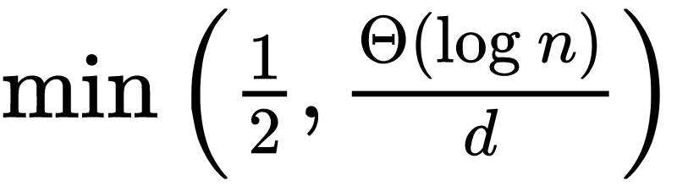
Leader Selection for High Degree Graphs
Consider a special case of n vertex graphs where each vertex has degree at least d
If we choose each vertex with probablity
Then with high probability
# of leaders will be O(n/d)
Every non leader will have atleast one leader neighbour
Only O(1/d) fraction vertices will survive

Slide 13
Leader Selection for High Degree Graphs

Slide 14
Leader Selection for High Degree Graphs
After one round
Rounds will be reduced

Slide 15
Convert input graph into High degree graph
Goal : input graph G → a new Graph Gٰ s.t
Each vertex in Gٰ will have degree at least d
Gٰ preserves the connected components of G
Neighbour Increment Procedure :
Gٰ = NEIGHBOURINCREMENT(G,d)
Gٰ preserves the connectivity and each vertex has degree atleast d
O(logD) rounds

Slide 16
Neighbour Increment Procedure
Algorithm :
Initialization i ← 1 , ∀v ∈ V , Ʈᵢ( v ) = Ʈ( v ) ⋃ {v}
In the ith round ∀v ∈ V , |Ʈᵢ( v )| ≥ d stop the procedure.
For v ∈ V
If |Ʈᵢ( v )| ≥ d then Ʈᵢ₊₁( v ) ←Ʈᵢ( v )
Else if ∃u ∈ Ʈᵢ( v ), |Ʈᵢ( u )| ≥ d then Ʈᵢ₊₁( v ) ←Ʈᵢ( v ) ⋃ Ʈᵢ( u )
Else Ʈᵢ₊₁( v ) ← ⋃ ∀u∈ Ʈᵢ( v ) Ʈᵢ( u )
Total rounds : O(logn)

Slide 17
Improved Algorithm
Input G = (V,E)
Initialize i ← 1 , G₁ = (V₁ , E₁) ← G
In i-th iteration, if Eᵢ = ɸ , stop the procedure
Set dᵢ = (m / nᵢ)^(1/2)
Gٰ ᵢ = NEIGHBOURINCREMENT(Gᵢ,dᵢ)
Choose each vertex from Vᵢ as a leader for Gٰ ᵢ with probablity Θ(1/dᵢ)
For each non-leader vertex v ∈ Vᵢ , if ∃ a leader u which is a neighbour of v in Gᵢ , then contract v to u.
(If there are multiple choices of u , choose an arbitrary one)
Let Gᵢ₊₁ = (Vᵢ₊₁ , Eᵢ₊₁) be the contracted graph and i ← i + 1
At the end of procedure for each v ∈ V if v is finally conrtacted u then assign v the color of u.
Total rounds : O(log D . loglogm/n n)

Slide 18
Work Done → Leader Contraction
V vertices , E edges , N processes
Step1 : distribute the edges among n processes ie. every process will have E/N edges and also maintain V/N vertices information.
Step2 : Every process will select leader from their vertices with probablity 0.5. And gather other leader information from other processes.
Step3 : Every process will select possible contracting edges and send it to respective process which contain that vertex.
Step4 : Every process will select one of the possible contracting edge for each non leader vertex and try to contract it.
Step5 : Adjust the graph and go to Step2 if edges are not empty.

Slide 19
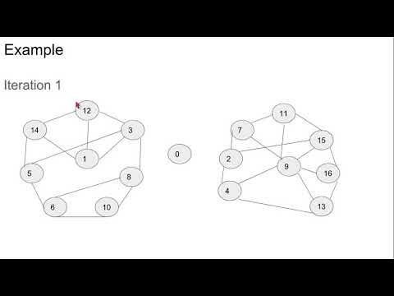
Demo

Slide 20
References
https://arxiv.org/abs/1805.03055
https://www.youtube.com/watch?v=8_OWKux3iW4
https://www.youtube.com/watch?v=YYPLqN8buqA&t=2552s

