Slide 1
HTML Overview
Presented by:Jeevan kumar

Slide 2
TOPICS
1.Tag & Document structure
2.Text formatting
3.Page formation
4.Lists
5.Tag attributes
6.Hyperlinks
7.Image
8.Colors
9.Tabels

Slide 3
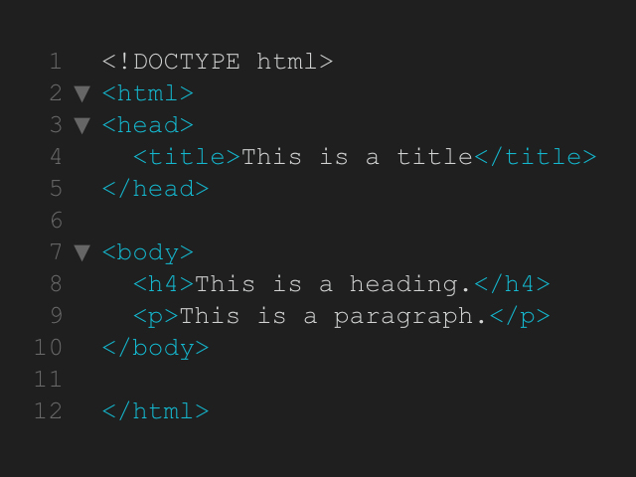
HTML structure

Slide 4
Thank you
Presenter name: JEEVAN KUMAR
Email address:jeevanpalapati@gmail.com

