Slide 1
Support Vector Machines
Prerequisites
Vector Algebra
Differential Equations

Slide 2
Group 1
Y axis
+
+
+
+
Black lines are good
separators
-
-
-
-
Group 2
A2
B2
X axis
A1
B1

Slide 3


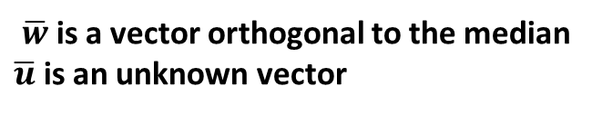
$\overline{w}$is a vector orthogonal to the median
$\overline{u}$ is an unknown vector
median
+
+
+
+
$$\overline{u}$$
-
-
-
$$\overline{w}$$
-
B2
B1
is for generalization

Slide 4
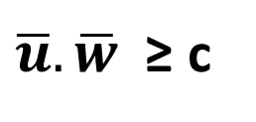
$\overline{u}.\overline{w}$ ≥ c
+
+
+
+
$$\overline{u}$$
-
-
-
$$\overline{w}$$
-
B2
B1

Slide 5

$\overline{u}.\overline{w}$ ≥ c
Dot Product
+
+
+
+
Magnitude of vector u in the
Direction of vector w =
Magnitude of vector u*cos(angle)
Angle between vectors u and w
$$\overline{u}$$
-
-
-
$$\overline{w}$$
-
B2
B1
Dot product of vector u and vector w = Magnitude of u* Magnitude of w * cos(angle)

Slide 6

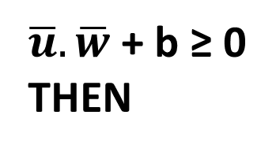
Equation 1 →
$\overline{u}.\overline{w}$+ b ≥ 0
THEN
+
+
+
+
+
DECISION RULE
$$\overline{u}$$
-
-
-
$$\overline{w}$$
-
B2
B1
Taking c = -b, in the previous equation

Slide 7



median
+
+
$$\overline{x+}$$
+
+
We have generalized our decision
Rules for group 1 and 2
-
-
-
$$\overline{x−}$$
-
B2
B1

Slide 8
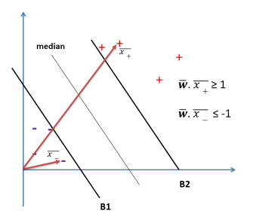
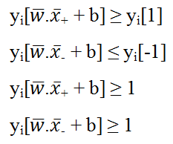
We multiply the two equations by y_{i} such
that:
y_{i} = +1 for + samples
y_{i} = -1 for - samples
Xxx
xxx
Y_{i} as -1 multiplied by -1 gives +1

Slide 9
Support Vector
+
+
+
+
Any vector touching data points
[on the MARGIN]
Called support vector
-
-
-
-
A2
B2
A1
B1

Slide 10
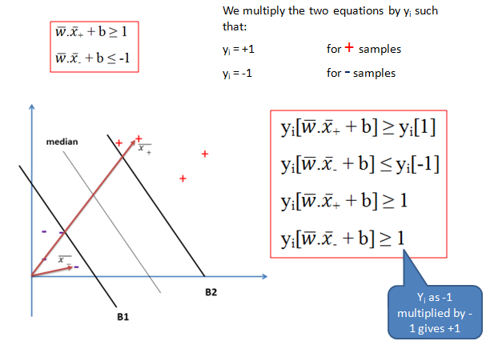

Vector x_{i} is representing x₊ and x₋ vectors
These two equations are
Converted into ONE equation
For ease in further computation
+1 of right hand side is brought left side, thus, sign changed to -

Slide 11

This equation holds true for all vectors including on margin
and away from margin
Equation 2 →
This equation is only for Support Vectors

Slide 12



Yellow vector is difference between blue vector (+) and
Green vector (-). We always write the vector first, at which
Difference vector ends.
+
+
$$\overline{x+} − \overline{x−}$$
+
+
$$\overline{x−}$$
-
This is one of the support vectors for group 1 (case +)
$$\overline{x+}$$
This is one of the support vectors for group 2 (case -)
-
-
-
A2
B2
A1
B1
This is perpendicular to B1

Slide 13

Unit Vector:
Unit vector is a vector with magnitude 1
Vector u
Magnitude of Vector u

Slide 14
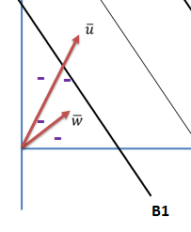

Magnitude of u on w = u.cos(angle)
Dot product of vector u and vector w = u.w.cos(angle)
We wish to avoid angle in computation for obvious reasons.
We will arrive at (a) using (b)
Unit vector in the direction of vector w =
If we take dot product of vector u and unit vector in the direction of w, we get
Magnitude of vector u in the direction of w = = u.1.cos(angle)
Hence, we can use red circle expression for Magnitude of u on w without angle!

Slide 15
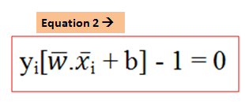
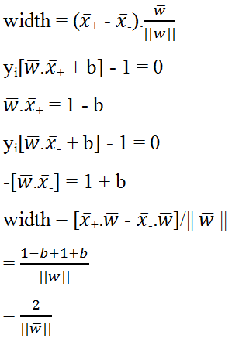
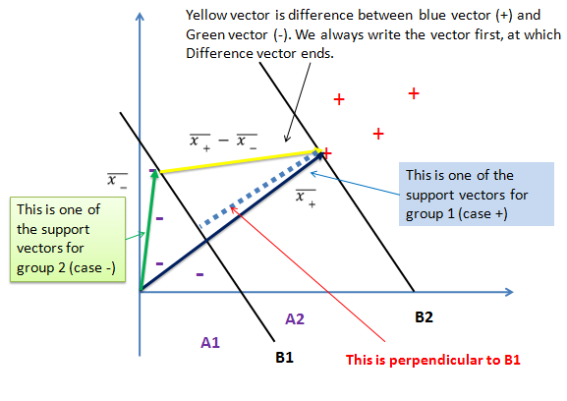

Slide 16



We need to maximize width (LHS) or minimize
Vapnik found that minimizing was more mathematically convenient
Lagrange multipliers help us to find the extremum of a function with constraints
Without worrying about the constraints. The following is our Lagrange expression
With as Lagrange multipliers which are NON ZERO ONLY FOR SUPPORT VECTORS

Slide 17
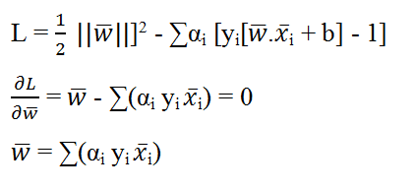
Partial differentiation of L wrt vector w

Slide 18
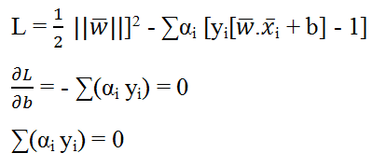
Partial differentiation of L wrt b

Slide 19
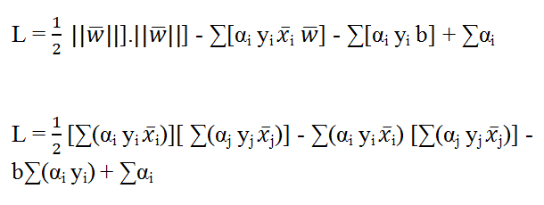
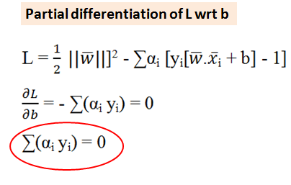

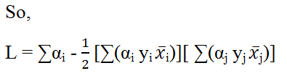

Slide 20
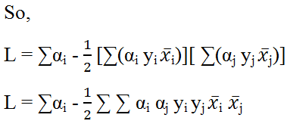
We see that the optimization depends on the dot product of the pairs of vectors and to maximize the width, we need to maximize this very quantity.

Slide 21
