Slide 1
PCA - Face Recognition using Eigenfaces
Jeevan Ravi Kumar
Phani Abhiram Raju
Thanay Geeshpathy Narayanamurthy

Slide 2
Why?
In traditional facial recognition, Eigenfaces is among the simplest and most established face recognition techniques. Despite being straightforward, it functions rather effectively. And because of its simplicity, it is a fantastic method to comprehend how facial recognition and dimensionality reduction work.

Slide 3
Dimensionality Reduction Techniques
Dimensionality reduction is a technique used to reduce the number of dimensions or features in a data set.
This can be useful in many applications, such as reducing the storage and computational requirements of a model, improving the interpretability of the data, or making the data easier to visualize.
There are many different dimensionality reduction techniques, including principal component analysis (PCA), singular value decomposition (SVD), and independent component analysis (ICA).
These techniques work by identifying and removing redundancy or irrelevant information from the data, so that the data can be represented more efficiently in a lower-dimensional space.
Other dimensionality reduction techniques include feature selection, which involves selecting a subset of the most relevant features from the data, and feature extraction, which involves creating new features from the existing data.

Slide 4
Principal Component Analysis
Principal component analysis (PCA) is a statistical technique that is used to analyze the variability of a data set.
It is a way of reducing the dimensionality of the data by transforming the data from a high-dimensional space into a lower-dimensional space while still retaining as much information as possible.
The principal components of the data are the directions in the data that explain the greatest amount of variability.
By projecting the data onto these principal components, we can reduce the dimensionality of the data and make it easier to analyze and visualize.
PCA is commonly used in fields such as machine learning and data mining, where it can be used to reduce the complexity of the data and make it easier to work with.

Slide 5
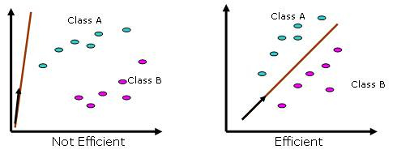

Slide 6
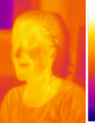
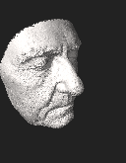
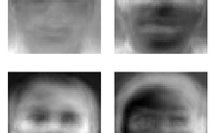
Facial Recognition
Facial recognition is a technology that uses AI algorithms to analyze and identify individuals from digital images or video frames of their face.
Commonly used in security and surveillance, identity verification, and marketing.
Facial recognition systems work by first extracting facial features from the image or video and then comparing them to a database of known faces to find a match.
The accuracy of facial recognition technology varies depending on the quality of the images and the algorithms used, but it has improved significantly in recent years.
Some concerns have been raised about the potential for misuse of facial recognition technology, such as invasion of privacy and discrimination.

Slide 7
Idea behind implementation
The big idea is that we want to find a set of images (called Eigenfaces, which are nothing but Eigenvectors of the training data) that if we weigh and add together should give us back an image that we are interested in.
The way we weigh these basis images (i.e the weight vector) could be used as a sort of a code for that image-of-interest and could be used as features for recognition.

Slide 8
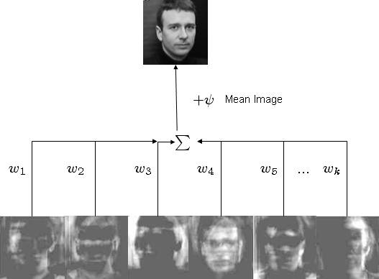
This can be represented using a figure

Slide 9
Encoding Technique
First off, the Eigenfaces concept views face recognition as a 2-D recognition problem based on the presumption that most faces will be frontal and upright at the time of recognition.
As a result, comprehensive 3-D information on the face is not required. This significantly lessens complexity.
A group of faces that will best distinguish the faces are used to encode the most important face information in Eigenfaces, which is an approach inspired by information theory.
The face photos are converted into a set of basis faces, which are essentially the main parts of the face images.

Slide 10
Encoding Technique
In essence, the Principal Components (or Eigenvectors) look for ways to describe the data that are more effective. This is especially helpful for cutting down on computational effort.
Let's assume we have 60 such directions. Of these, around 40 may be inconsequential, while only 20 may significantly represent the variation in the data. Accordingly, for computations, it would be best to use the 20 and ignore the rest.
Each Eigenvector has a contribution from EACH face used in the training set when we determine the main components or Eigenvectors of the picture set.
As a result, the Eigenvectors also resemble faces. These are ghost pictures or Eigenfaces, which have a ghostly appearance.
The weighted linear combination of these basis faces may be used to represent each picture in the training set.

Slide 11
Algorithm

Slide 12
Assumptions
Let there be M images in training set
Then there will be K most significant Eigenfaces using which we can satisfactorily approximate a face. K < M.
All images are N x N matrices, that can be represented by N² x 1 dimensional vectors

Slide 13
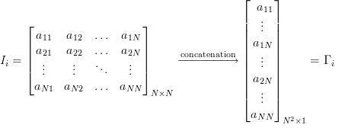

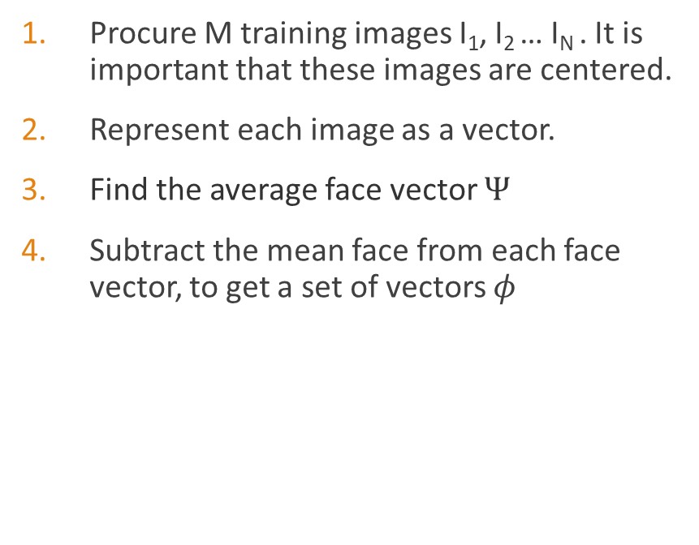
Algorithm
Procure M training images I₁, I₂ … I_{N} . It is important that these images are centered.
Represent each image as a vector.
Find the average face vector $Ψ$
Subtract the mean face from each face vector, to get a set of vectors $φ$
Notes:
-The aim of this step is to standardize the range of the continuous initial image variables so that each one of them contributes equally to the analysis.

Slide 14
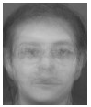
Algorithm
Here is a sample of mean face:

Slide 15

Algorithm
Covariance Matrix Computation:
Notes:
-The aim of this step is to understand how the variables of the input image data set are varying with respect to each other, or in other words, to see if there is any relationship between them. Because sometimes, variables are highly correlated in such a way that they contain redundant information. So, in order to identify these correlations, we compute the covariance matrix.

Slide 16
Algorithm
6. Compute the Eigen vectors and eigen values of the covariance matrix to identify the principal components.
-PCA is a mathematical procedure that uses an orthogonal transformation to convert a set of values of possibly correlated M variables (face images) into a set of values of K uncorrelated variables called "Principal Components" (Eigenfaces).
-The method used - "numpy.linalg.eig(matrix)"
No. of principal components < No. of original variables
Notes:
-Eigenvectors and eigenvalues are the linear algebra concepts that we need to compute from the covariance matrix in order to determine the principal components of the data.
-the eigenvalues represent the magnitude of the spread in the direction of the principal components in PCA.

Slide 17
Algorithm
Notes:
-Geometrically speaking, principal components represent the directions of the data that explain a maximal amount of variance, that is to say, the lines that capture most information of the data.
-The relationship between variance and information here, is that, the larger the variance carried by a line, the larger the dispersion of the data points along it, and the larger the dispersion along a line, the more information it has.
-From the above scatter plot of a data set, we can see the first principal component is the line that matches the purple marks because it goes through the origin and it’s the line in which the projection of the points (blue dots) is the most spread out.
-The second principal component is calculated in the same way, with the condition that it is uncorrelated with (i.e., perpendicular to) the first principal component and that it accounts for the next highest variance.
-This continues until a total of p principal components have been calculated, equal to the original number of variables.
-Now that we understand what we mean by principal components, let’s go back to the algorithm.

Slide 18
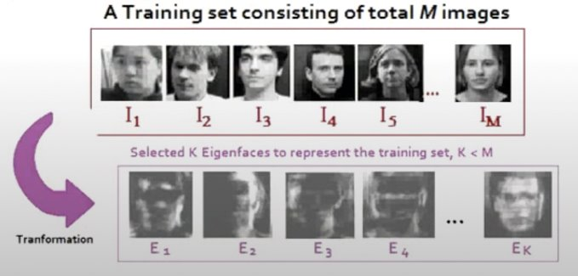
Algorithm

Slide 19
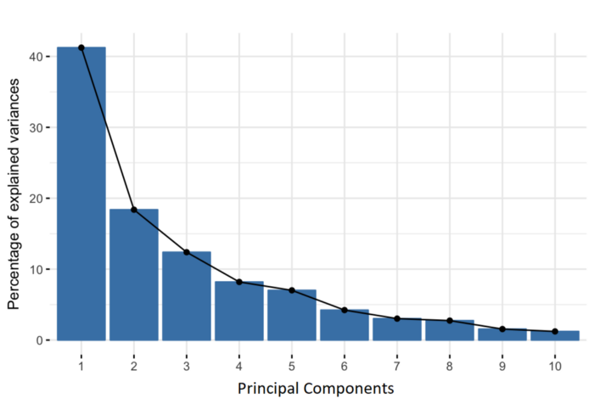
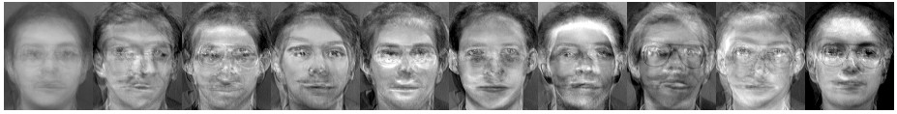
Algorithm
Principal component information
Notes:
-Principal components are new variables that are constructed as linear combinations or mixtures of the initial variables.
-These combinations are done in such a way that the new variables (i.e., principal components) are uncorrelated and most of the information within the initial variables is squeezed or compressed into the first components.
-So, the idea is let's say we have 10D's. 10-dimensional data gives us 10 principal components, but PCA tries to put maximum possible information in the first component, then maximum remaining information in the second and so on, until having something like shown in the scree plot below.
-Organizing information in principal components this way, will allow you to reduce dimensionality without losing much information, and this by discarding the components with low information and considering the remaining components as your new variables.

Slide 20

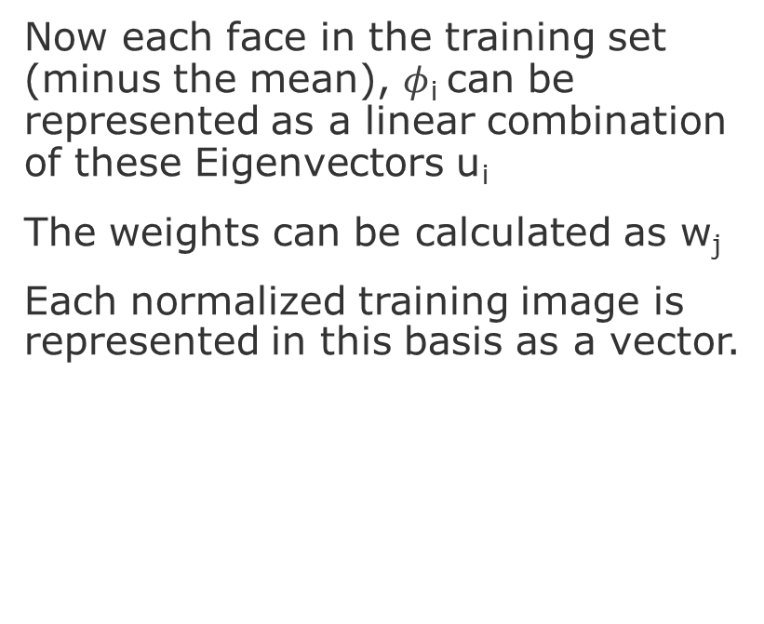
Finding the weights
Now each face in the training set (minus the mean), $φ$_{i} can be represented as a linear combination of these Eigenvectors u_{i}
The weights can be calculated as w_{j}
Each normalized training image is represented in this basis as a vector.

Slide 21
Finding the weights
Notes:
-Weights are the proportions (or percentages) of each principal component which make the original image.

Slide 22
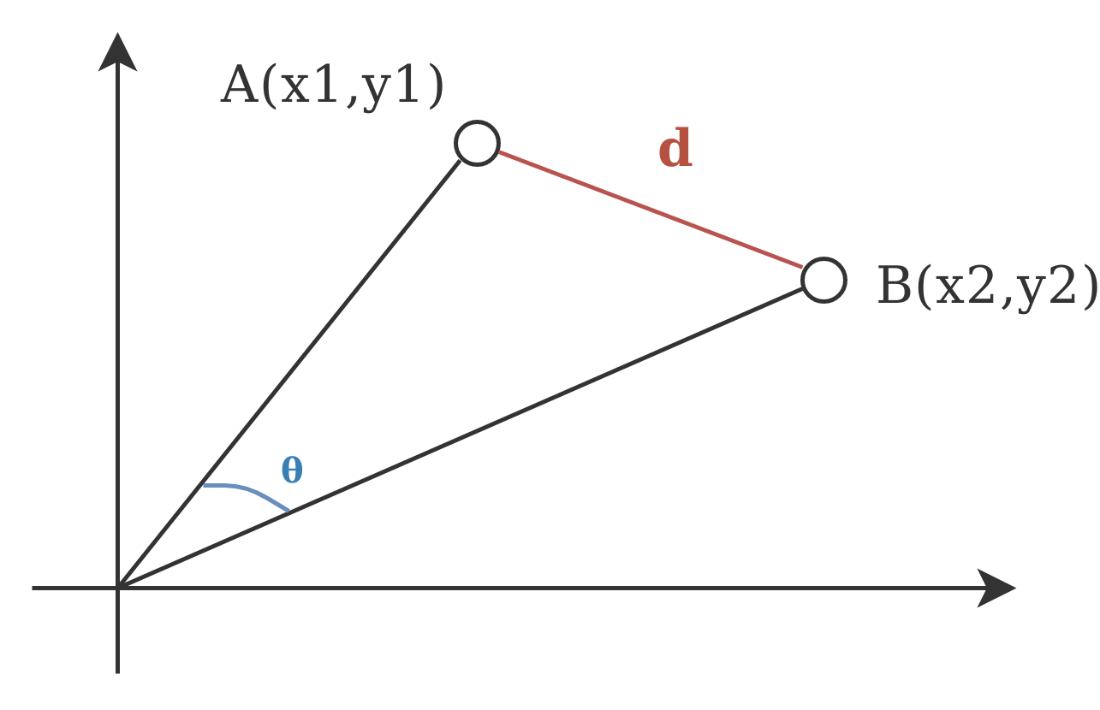
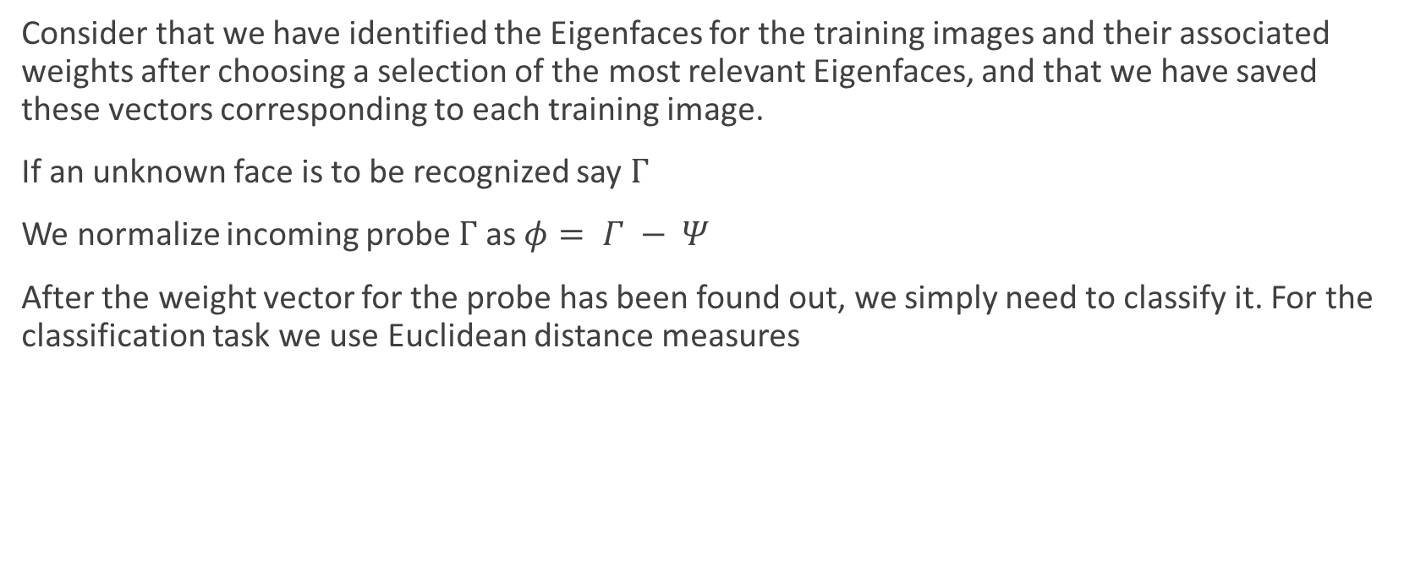
Recognition Task
Consider that we have identified the Eigenfaces for the training images and their associated weights after choosing a selection of the most relevant Eigenfaces, and that we have saved these vectors corresponding to each training image.
If an unknown face is to be recognized say $Γ$
We normalize incoming probe $Γ$ as $φ= Γ − Ψ$
After the weight vector for the probe has been found out, we simply need to classify it. For the classification task we use Euclidean distance measures
e_{r}
Finding the weights

Slide 23








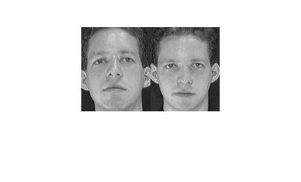
Result
Faces Database:
Test Image
Match Found
Notes:
-Eigenfaces (Ghostly Images) are an orthogonal basis set from which most (or all) faces can be constructed.
-The idea is that anyone’s face can be reconstructed from a suitable linear combination of eigenfaces. Your face would be 7% Face A, 3.4 % Face B, and so on, while someone else’s face would have a different combination of those same eigenfaces.

Slide 24
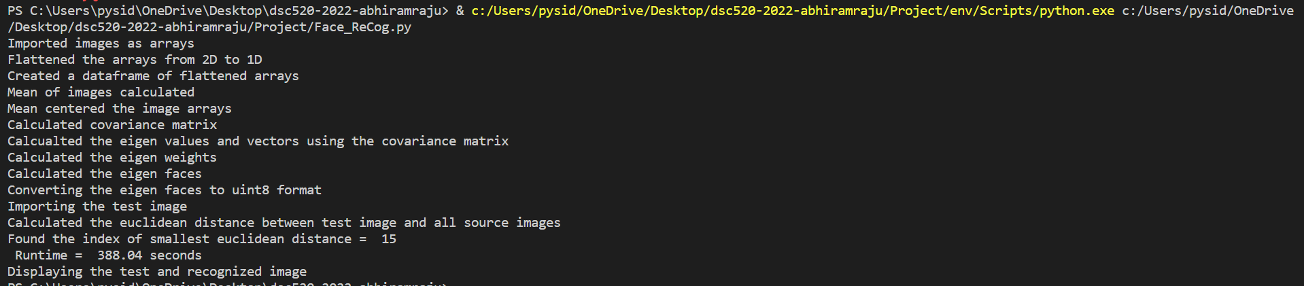
Serial code output

Slide 25
Parallelization of the Code

Slide 26




Parallelization Attempts

Slide 27

Region to be parallelized
This part of the code, to calculate the eigen values and eigen vectors, is taking an average runtime of 5 minutes which is more than 90% of the total runtime
Reason –
The covariance matrix ‘image_cov’ is a square matrix and is a float64 datatype
As the size and number of source images increase, the covariance matrix also scales up in size owing to longer time to compute the eigenvalues and eigenvectors

Slide 28
I. multiprocessing module from python
This method spawns N number of pools (cores) to compute the code to be parallelized.
But each pool runs the whole code individually without batching the computation. i.e, A function f() will run 4 times if the number of spawned pools are 4.
Parallel runtime (overhead + pool management + computing + gathering results) > normal runtime
Thereby, not effectively reducing the code’s runtime.
Reference – multiprocessing docs

Slide 29
II. threading module from python
This method uses Thread function to wrap a function which accept at least one iterable arguments (lists, tuple, series)
Our function numpy.linalg.eig() accepts only one argument of a symmetric matrix
As a result, the function cannot be parallelized as it being invoked only once and does not have iterable arguments
Reference - threading — Thread-based parallelism — Python 3.11.1 documentation

Slide 30
III. CuPy – CUDA for NumPy
CuPy is a NumPy/SciPy-compatible array library for GPU-accelerated computing with Python
GPU at hand – NVIDIA GeForce RTX 3060
Has similar NumPy and SciPy routines
But it only has cupy.linalg.eigh function, which only computes eigenvalues and eigenvectors for complex Hermitian matrices, which is not the same as numpy.linalg.eig
Reference – CuPy documentation for cupy.linalg.eigh()

Slide 31
IV. Numba
Numba is a just-in-time compiler for Python that works best on code that uses NumPy arrays and functions, and loops
We tried three approaches - @jit, @njit and @vectorize
Each one is decorators used by Numba to generates optimized machine code for CPU (default) and GPU hardware from pure Python code using the low-level virtual machine compiler infrastructure
@jit and @njit never execute the code completely with no error output - basically just freezes the command
@vectorize did not help too as we were trying to 'universalize' a function that cannot be pickled to a GPU
Reference – Numba documentation for jit compilation

Slide 32
V. Ray
Ray is an open-source project for parallel and distributed Python. Its still in beta
Scales python and AI applications from a laptop to a cluster
Faced the same issue as @vectorize – does not allow pickling of a function (to a cluster in this case)
Reference – Ray documentation on identifying pickling

Slide 33
MATLAB Implementation
Lastly, we transformed the python code into MATLAB compatible code and executed the same
We found significant improvement in the runtime (especially while calculating the eigenvalues and eigenvectors)
Runtime in python = 388 seconds
Runtime in MATLAB = 2.87 seconds

Slide 34
Linear Regression with Bootstrap Resampling - Reason
Bootstrap resampling is a method of sampling data with replacement i.e., data can be scaled up while maintaining the statistical parameters
Bootstrapping a regression model gives insight into how variable the model parameters are when influenced by changes in the given data set
But it does not perform any bias correction as it can only work with the information available in the original dataset
Hence, we cannot improve the accuracy or fitness of the model using bootstrapping

Slide 35
References
1.Face Recognition Using Eigenfaces, Matthew A. Turk and Alex P. Pentland, MIT Vision and Modeling Lab, CVPR ’91.
2. Eigenfaces Versus Fischerfaces : Recognition using Class Specific Linear Projection, Belhumeur, Hespanha, Kreigman, PAMI ’97.
3. Eigenfaces for Recognition, Matthew A. Turk and Alex P. Pentland, Journal of Cognitive Neuroscience ’91.
4. https://builtin.com/data-science/step-step-explanation-principal-component-analysis
5. https://www.geeksforgeeks.org/ml-face-recognition-using-eigenfaces-pca-algorithm/
6. http://staff.ustc.edu.cn/~zwp/teach/MVA/pcaface.pdf
7. https://www.ncbi.nlm.nih.gov/pmc/articles/PMC3859039/#b40-sensors-13-12830

Slide 36
Pickling
Pickle in Python is primarily used in serializing and deserializing a Python object structure.
In other words, it’s the process of converting a Python object into a byte stream to store it in a file/database, maintain program state across sessions, or transport data over the network
Python pickling: What it is and how to use it securely | Synopsys

