Slide 1

SplitFlow
A Bit-Shift product

Slide 2
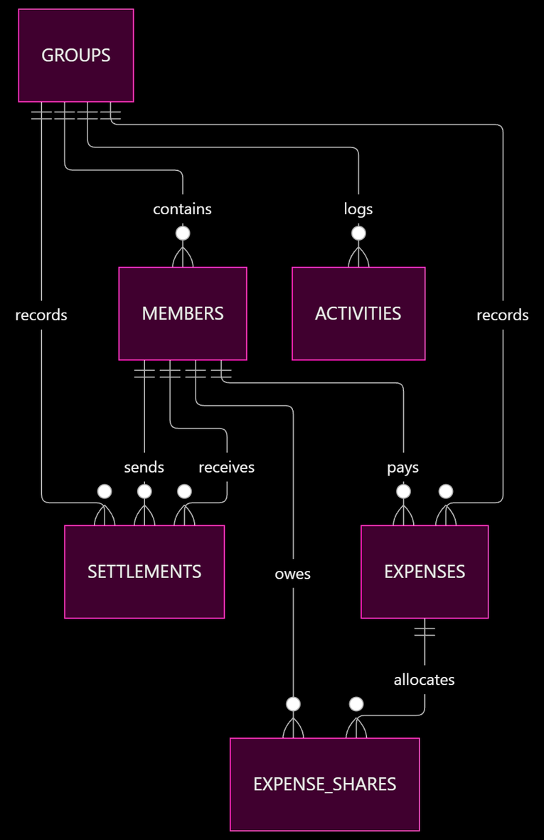
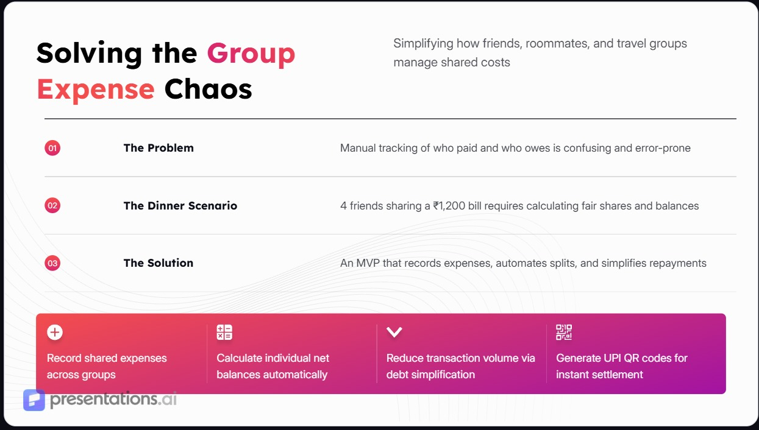
Solving the Group
Expense Chaos
Simplifying how friends, roommates, and travel groups manage shared costs

Slide 3
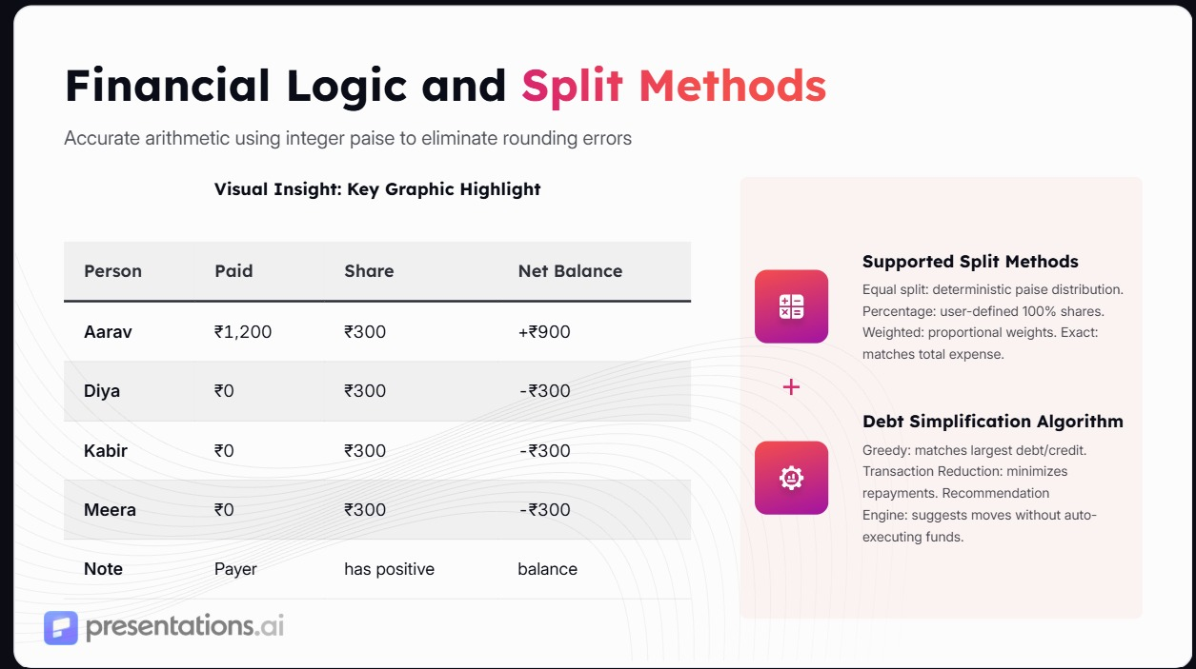

Slide 4
Full-Stack Technical Architecture
A modular 3-layer system built for reliability and financial precision
1
3
Backend
FastAPI
Frontend
VUE 3
2
Database
SQLite

Slide 5
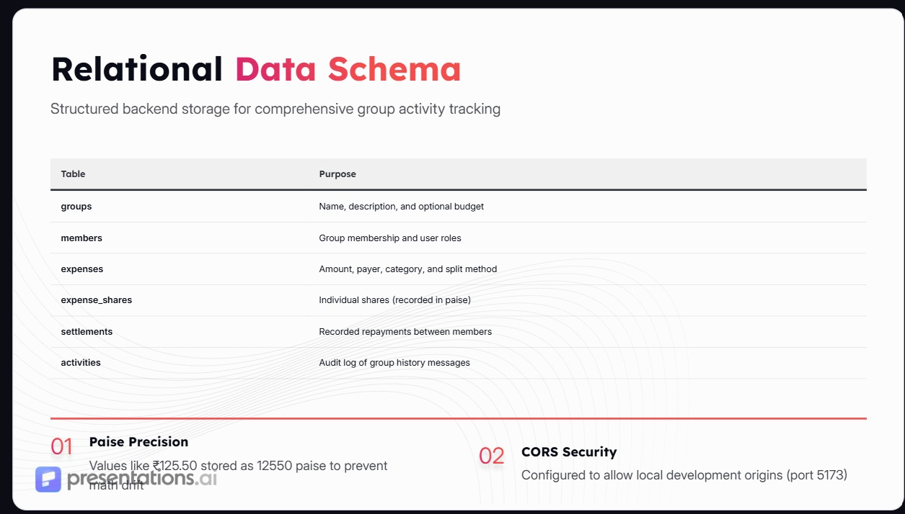
1
Paise Precision
2
CORS Security
Values like ₹125.50 stored as 12550 paise to prevent math drift
Configured to allow local development origins (port 5173)

Slide 6
