Slide 1

PREDICTING PASSENGER SURVIVABILITY USING SUPERVISED MACHINE LEARNING
By:
Jeevan Kumar Banoth
Hanuma venkata Vijay Kamal Konduri
Vicky
Sai Charan

Slide 2

MOTIVATION
To develop a more thorough understanding of the ML concepts learned in MTH522
Develop and hone skills concerning data wrangling with a special focus on Feature Engineering to make the data either analyzable or to introduce new variables for analysis.
Get familiar with Kaggle’s submission formats and, thus, modify the final output accordingly

Slide 3
ABSTRACT
Machine Learning methodologies are the talk of the town these days and rightfully so as they can be used to decipher patterns and thus, solve a lot of (previously) incomprehensible problems
Machine Learning methods can be broken down into two main groups -> Supervised and Unsupervised
In this project, I’ll be using Supervised methods, namely Logistic Regression and Classification Trees to predict the survival status of the passengers on the Titanic
The methodologies will primarily be judged basis of their accuracies. However, we’ll also be looking at metrics like Specificity, Sensitivity, etc. for Logistic and the Accuracy of the pruned and unpruned classification trees

Slide 4
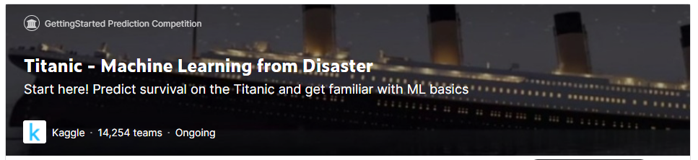
DATASET
For this project, I’ll be using the Titanic dataset from Kaggle.
The competition entails predicting the survival of passengers in one of the best-known shipwrecks in the world.

Slide 5
DATASET – VARIABLES OVERVIEW
Variable | Definition | Key
survival | Survival Status | 0 = Died, 1 = Survived
pclass | Ticket class | 1 = 1st, 2 = 2nd, 3 = 3rd
sex | Gender of the passenger
Age | Age in years
sibsp | # of siblings / spouses aboard the Titanic
parch | # of parents / children aboard the Titanic
ticket | Ticket number
fare | Passenger fare
cabin | Cabin number
embarked | Port of Embarkation | C = Cherbourg, Q = Queenstown, S = Southampton

Slide 6
DATASET – VARIABLES OVERVIEW (Contd.)
pclass: A proxy for socio-economic status (SES)
1st = Upper
2nd = Middle
3rd = Lower
age: Age is fractional if less than 1. If the age is estimated, is it in the form of xx.5
sibsp: The dataset defines family relations in this way...
Sibling = brother, sister, stepbrother, stepsister
Spouse = husband, wife
parch: The dataset defines family relations in this way...
Parent = mother, father
Child = daughter, son, stepdaughter, stepson
Some children traveled only with a nanny, therefore parch=0 for them.

Slide 7
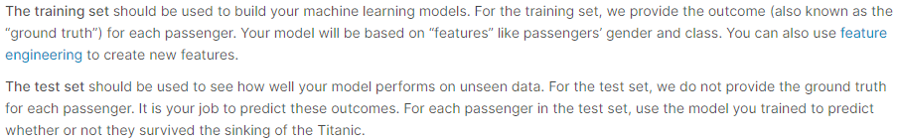
DISCLAIMER
The Kaggle Test dataset does not originally have the target variable i.e. Survived
Henceforth, the remainder of my analysis has been done by generating a pseudo-randomized binary entry to the created Survived field on the Test dataset.
However, I have also submitted my outputs to Kaggle for evaluation and the scores by Kaggle should be considered as the final score.
Doing the analysis, without access to the ground truth, will yield 100% accuracy for the test set which is not the true picture

Slide 8
METHODOLOGY
Logistic Regression is particularly useful in this case as the Target/Dependent variable by the name of “Survived” has a binary 0-1 encoding.
0 -> Did not survive; 1 -> Survived
Decision/Classification and Regression Trees will also be used to determine the fate of the passengers.
Cross-Validation will be used to prune the Decision Trees accordingly.

Slide 9
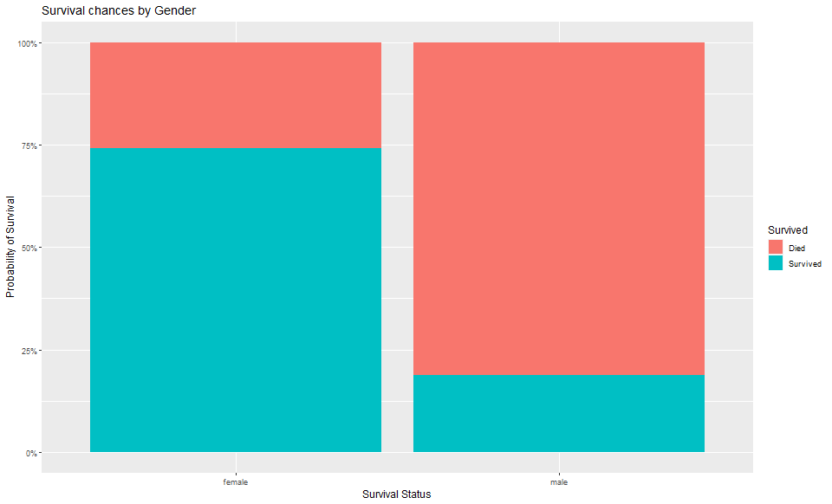
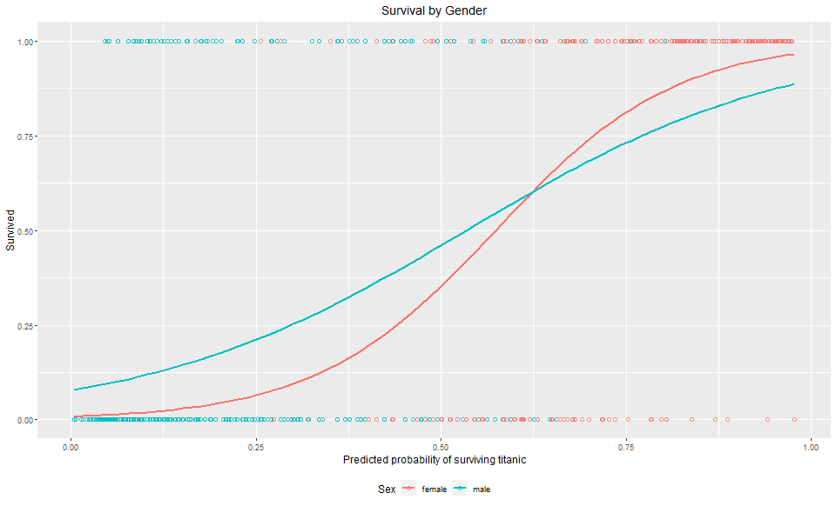
LOGISTIC REGRESSION

Slide 10
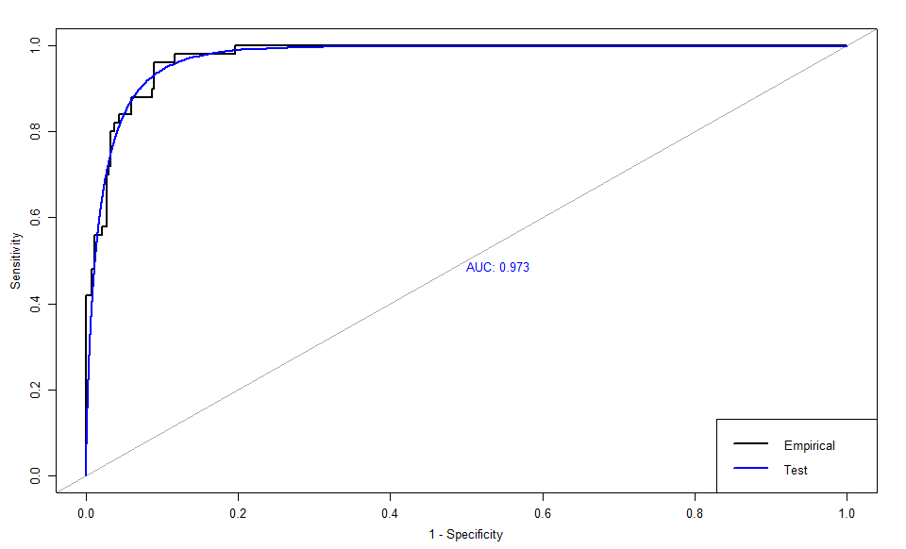
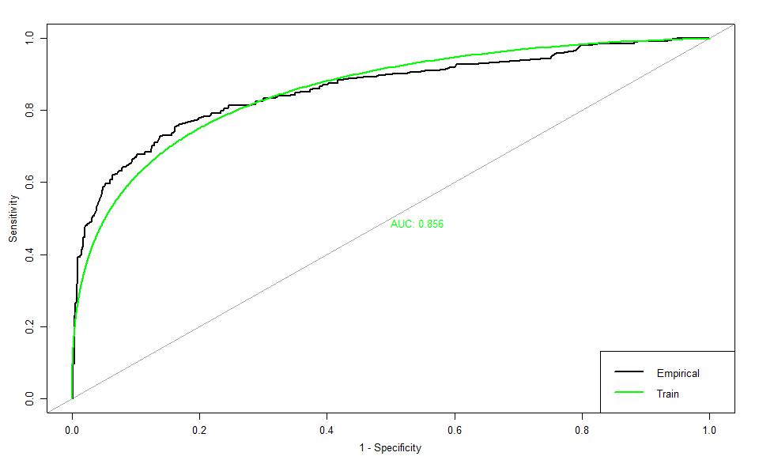
LOGISTIC REGRESSION (Contd.)

Slide 11
LOGISTIC REGRESSION: EVALUATION
Metric | Testing | Training
Accuracy | 0.746 | 0.805
Sensitivity | 0.711 | 0.865
Specificity | 1 | 0.710
PPV | 1 | 0.827
NPV | 0.320 | 0.766
AUC | 0.973 | 0.856

Slide 12
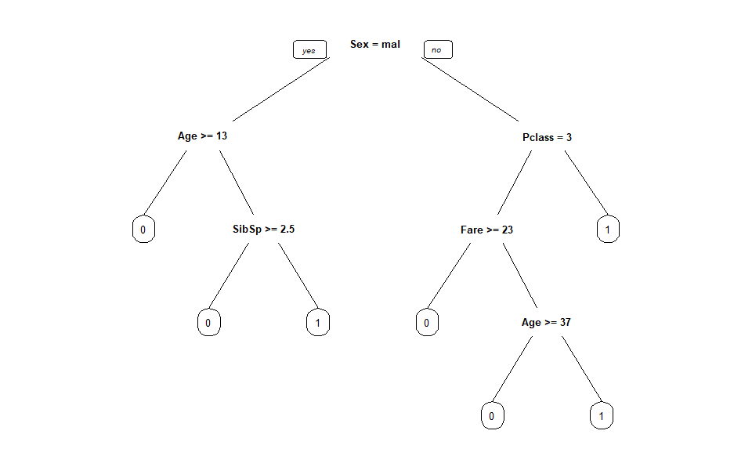
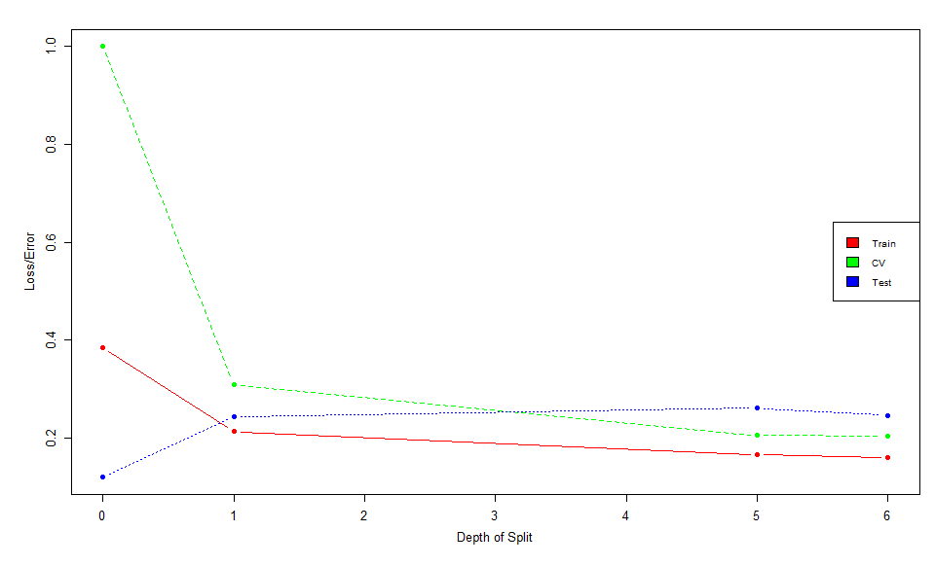
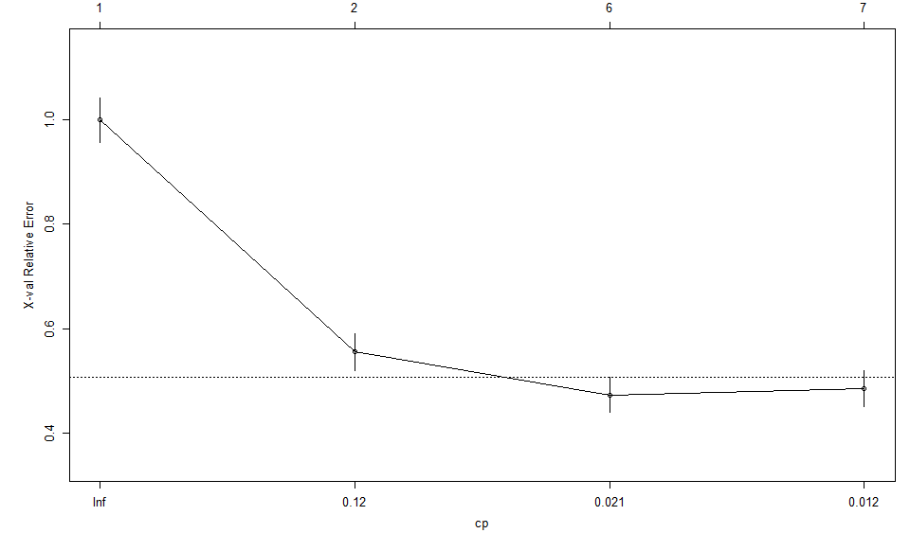
CLASSIFICATION TREE

Slide 13
CLASSIFICATION TREE: EVALUATION
 |  | Unpruned Tree | Pruned Tree
Tree Size |  | 6 | 6
Accuracy | Train | 0.839 | 0.839
 | Test | 0.753 | 0.753
 | All (Cross-validated) | 0.810 | 0.810

Slide 14
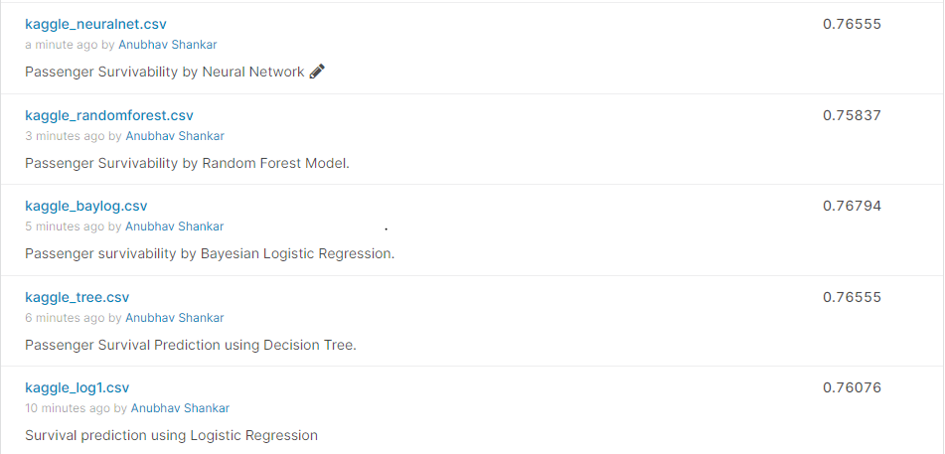
ADDITIONAL STEP
The following are the results from running multiple models using the “caret” package and submitting them on Kaggle.

Slide 15
CONCLUSION & ADDITIONAL SCOPE
The performance of both the Logistic and Classification Tree models are near about similar
Classification trees, though seem to be working a tad bit better for this dataset as can be seen from the Test set accuracies in both caret and non-caret models.
I really enjoyed making a pseudo-randomized dataset for the analysis and the performance of my modeling was near about similar with respect to having access to the ground truth.
The model can definitely be improved by using more advanced methods like Xgboost, Random Forest, and more pertinent feature engineering
Possible scope of using unsupervised methods like Support Vector Machines.

Slide 16
REFERENCES
https://www.r-bloggers.com/2021/01/machine-learning-with-r-a-complete-guide-to-logistic-regression/
https://rpubs.com/zheshuen/596809
https://www.kaggle.com/competitions/titanic/discussion
https://www.r-bloggers.com/2013/09/roc-curves-and-classification/
https://online.stat.psu.edu/stat462/node/207/
https://www.wolframalpha.com/input?i=sigmoid%28x%29
https://stats.stackexchange.com/questions/105501/understanding-roc-curve/105577#105577
https://towardsdatascience.com/predicting-whos-going-to-survive-on-titanic-dataset-7400cc67b8d9
https://machinelearningmastery.com/logistic-regression-tutorial-for-machine-learning/
https://www.datacamp.com/community/tutorials/decision-trees-R

