Slide 1

Sentiment Analysis of Movie Reviews Using AWS BY: Group#15 Jeevan Kumar Banoth (Roll no: 5)
Chakravarthi Boora (Roll no: 7)
Uday Reddy Polepally (Roll no: 44)
A Big Data Project

Slide 2
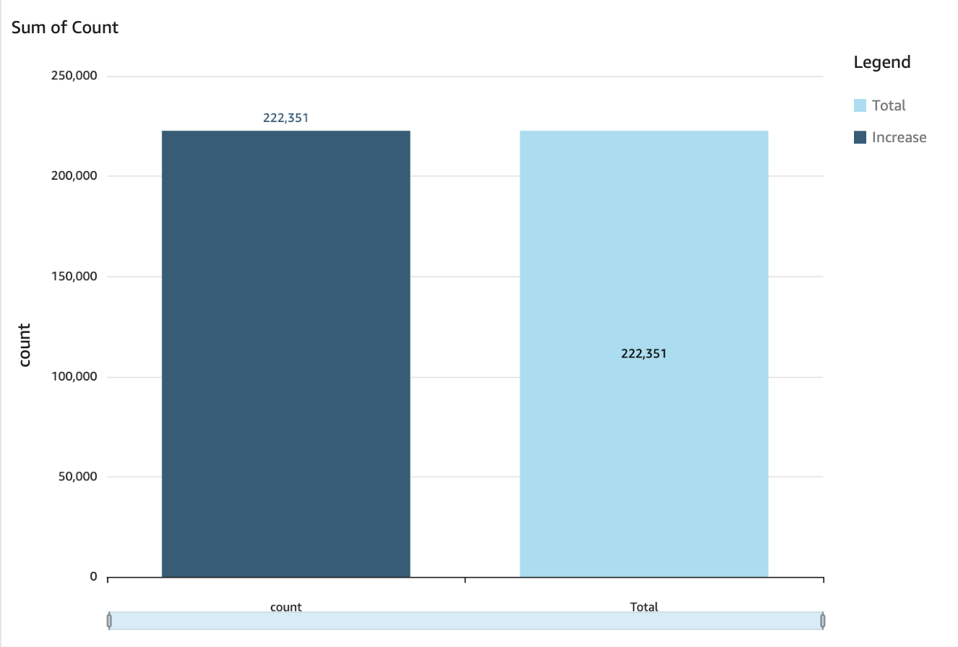
Project Objectives
Analyze movie reviews to determine sentiment (positive, negative, neutral) using AWS services
Collect and preprocess movie reviews data
Perform sentiment analysis using NLP techniques
Utilize AWS services for data storage, processing, and visualization
Create a dashboard to display sentiment analysis results

Slide 3
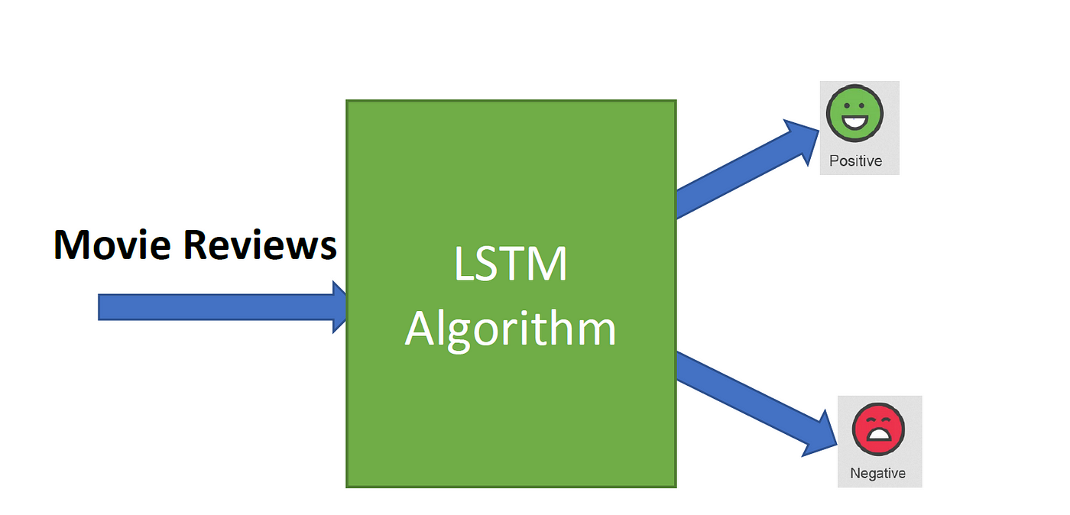
Methodology
Data Collection: Download dataset and upload it to AWS S3
Data Preprocessing: Using AWS Lambda to clean and preprocess data
Sentiment Analysis: Train and deploy a model using AWS SageMaker
Data Processing: Use AWS Glue for ETL operations
Data Visualization: Create visualizations using Azure Data Studio

Slide 4
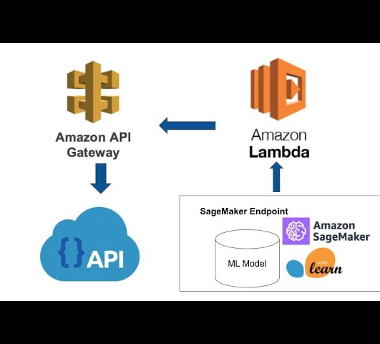
S3: Data storage for movie reviews and processed data
Lambda (Alternative Tools): Data preprocessing (with alternative solutions if Lambda is unavailable)
SageMaker: Training and deploying sentiment analysis models
Glue: Data processing and ETL operations
AWS Services Used

Slide 5
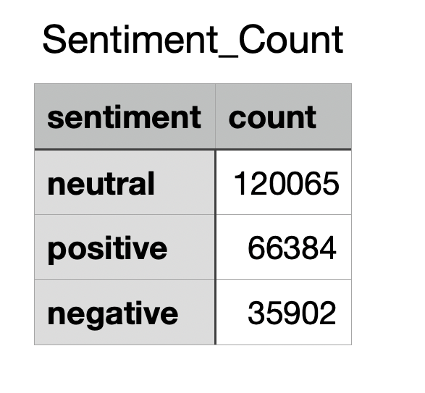
Results:
Sentiment Analysis: Percentage breakdown of positive, neutral, and negative reviews
Visualizations: Example graphs from Azure Data Studio (e.g., bar chart, pie chart)
Insights: Key findings from the sentiment analysis

Slide 6
Challenges and Learnings
Challenges:
Limited permissions in AWS Academy account (alternative solutions used)
Data privacy considerations
Learnings:
Hands-on experience with AWS services and big data tools
Practical application of NLP techniques for sentiment analysis

Slide 7
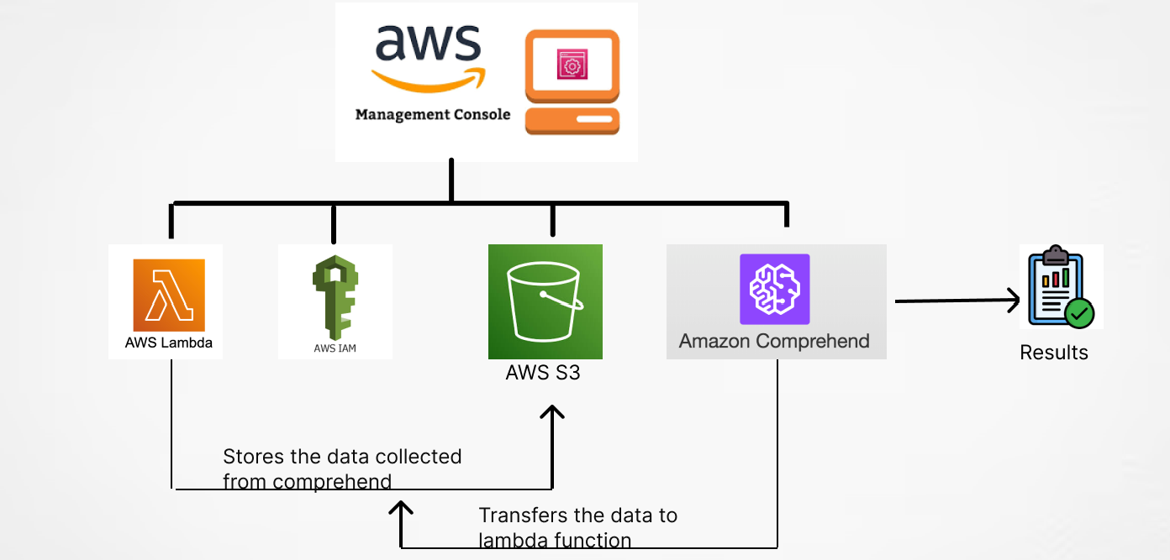
THANK YOU

