Slide 1

Parallelizing Object Detection Model Training: A Journey from Serial to Parallel Code Implementation
DSC 520
HIGH PERFORMANCE COMPUTING
Project
Team Members:
Bhanu Prasad Thota
Banoth Jeevan Kumar
Mule Vishnu Vardhan Reddy
Sohel Najeer Sheikh

Slide 2

AGENDA
Introduction to the Project
Serial Implementation Overview
Challenges Faced
Parallelization Strategy
Implementation in Parallel
Results and Performance Metrics
Conclusion and Future Work

Slide 3
Introduction to the project
Objective: Optimize the training workflow for an object detection model.
Dataset: Kaggle dataset on road sign detection.
Workflow:
Data pre-processing
Model training
Evaluation
https://www.kaggle.com/code/alincijov/road-traffic-signs-bounding-box-prediction we have used the data and base code from kaggle

Slide 4
Serial Implementation Overview
Serial Code Overview: Implemented in Python using popular libraries: NumPy, Pandas, OpenCV, and PyTorch.
Object detection model based on ResNet34 architecture.
Key Steps:
Data loading and preprocessing
Model training and evaluation

Slide 5
Challenges Faced
Data Size and Complexity:
Large dataset requiring extensive pre-processing.
Object detection task demands intricate bounding box annotations.
Training Time:
Serial training time was significant due to the size of the dataset.

Slide 6
Parallelization Strategy
Objective: Reduce training time by parallelizing data pre-processing.
Approach:
Employ ThreadPoolExecutor for parallel execution of image transformations.
Focus on the data augmentation step.

Slide 7
Implementation in Parallel
Code Modifications: Parallelized the transformsXY function using ThreadPoolExecutor.
Introduced ParallelRoadDataset class for parallel data loading.
Adjusted the number of workers based on system capabilities.

Slide 8
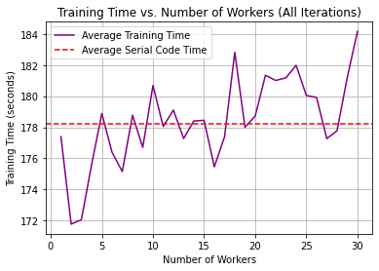
Results and Performance Metrics
Training Time Comparison:
Serial vs. Parallel
Scaling test and Efficiency:

Slide 9
Conclusion and Future Work
Conclusion:
Significant reduction in training time achieved.
Improved efficiency in data preprocessing.
Future Work:
Explore further parallelization opportunities.
Apply to larger datasets and different models.

Slide 10
Let’s go to Code and Plots…

