Slide 1
Week-6
Git, GitHub & Final Project

Slide 2
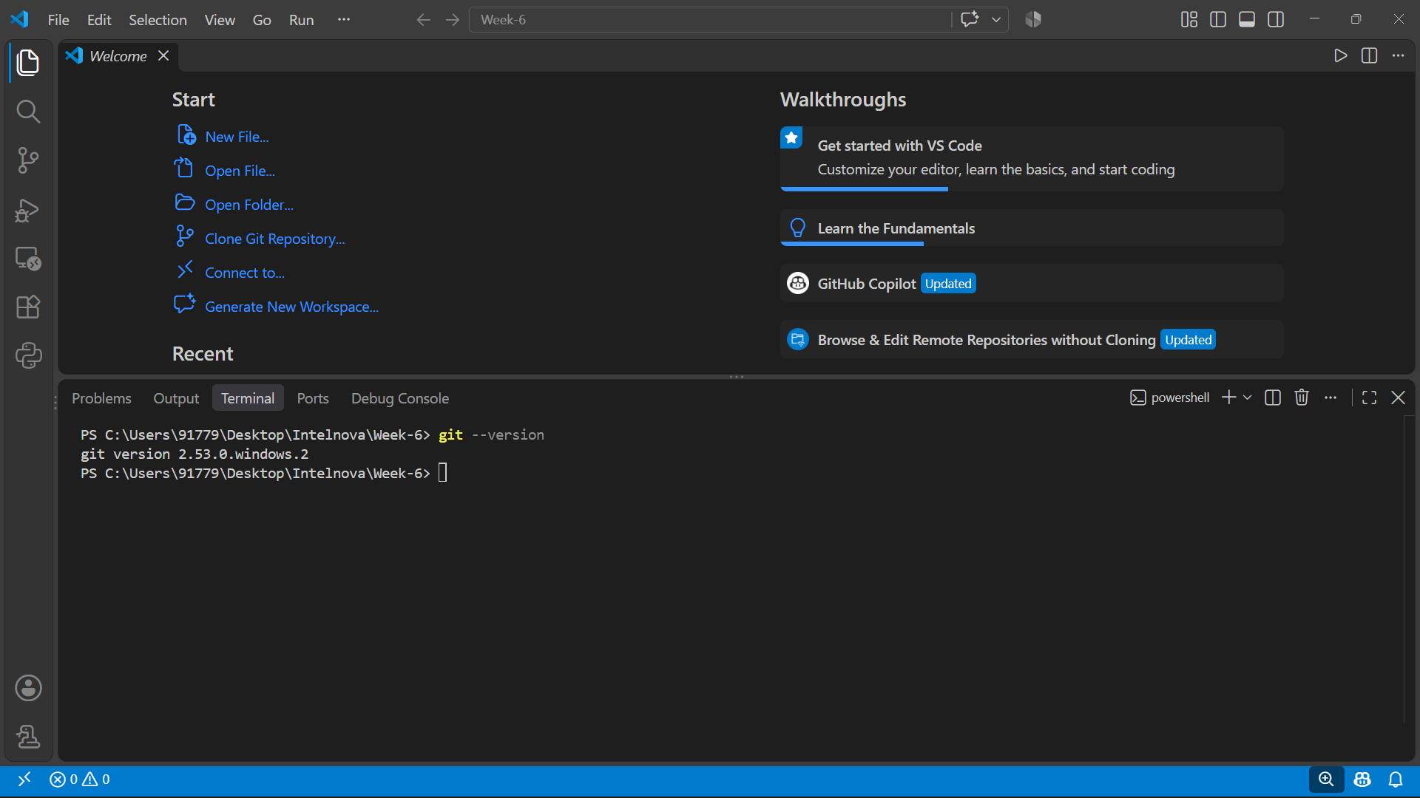
Git installation and version used

Slide 3
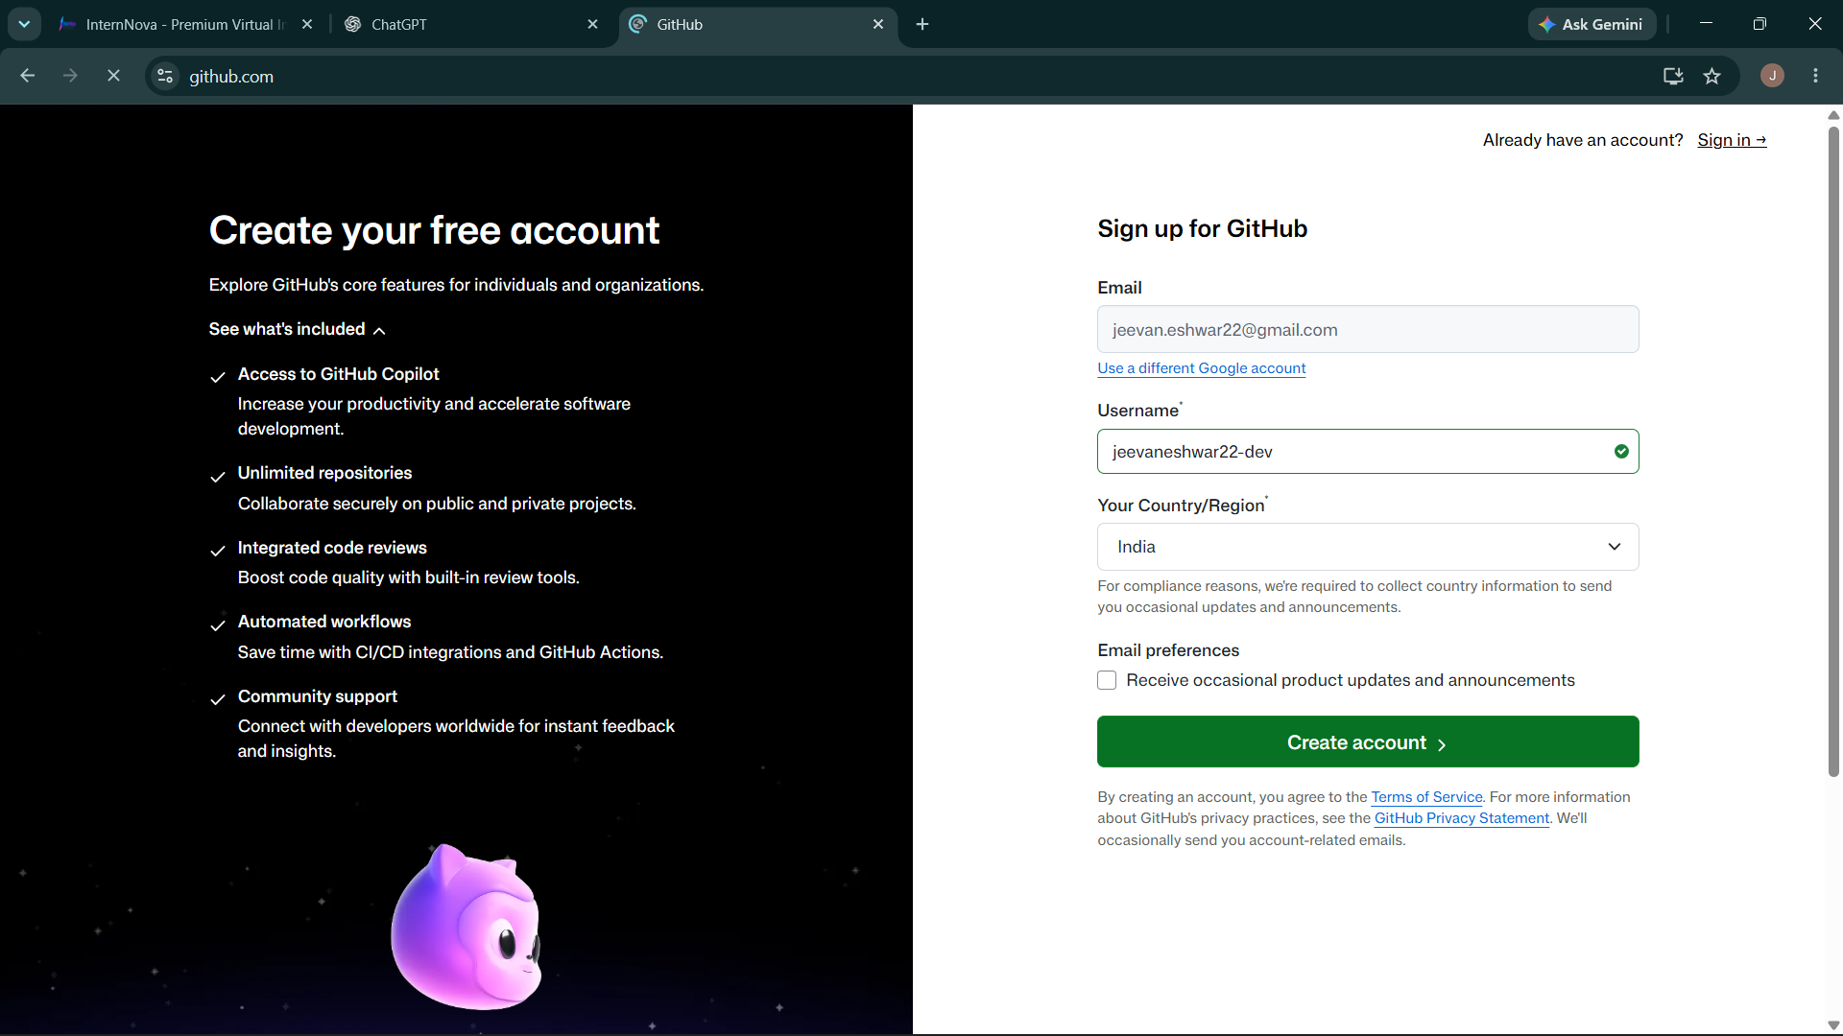
GitHub account creation

Slide 4
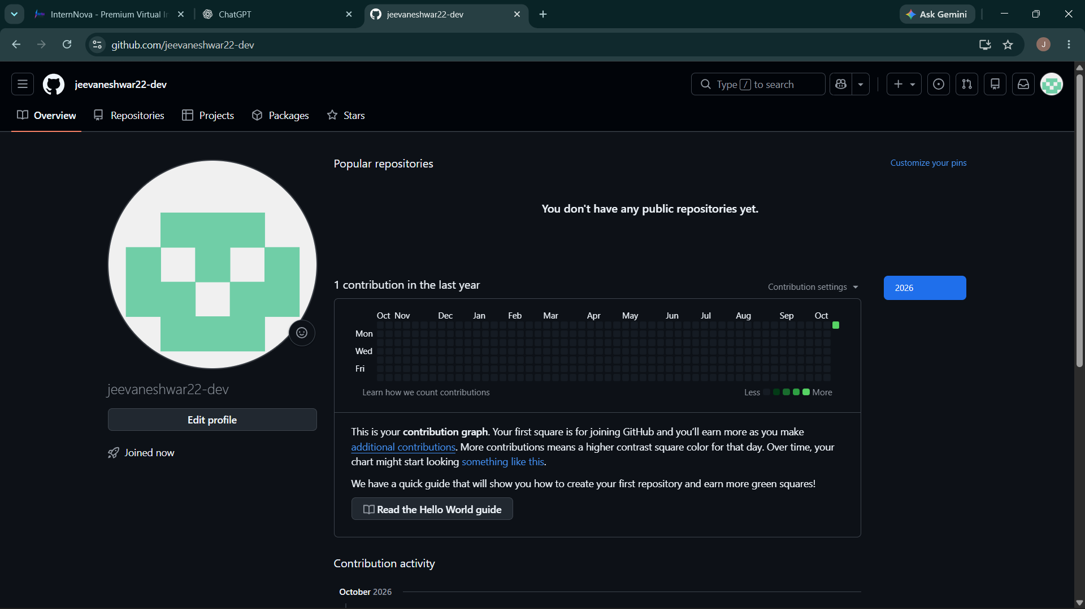
GitHub Profile:

Slide 5
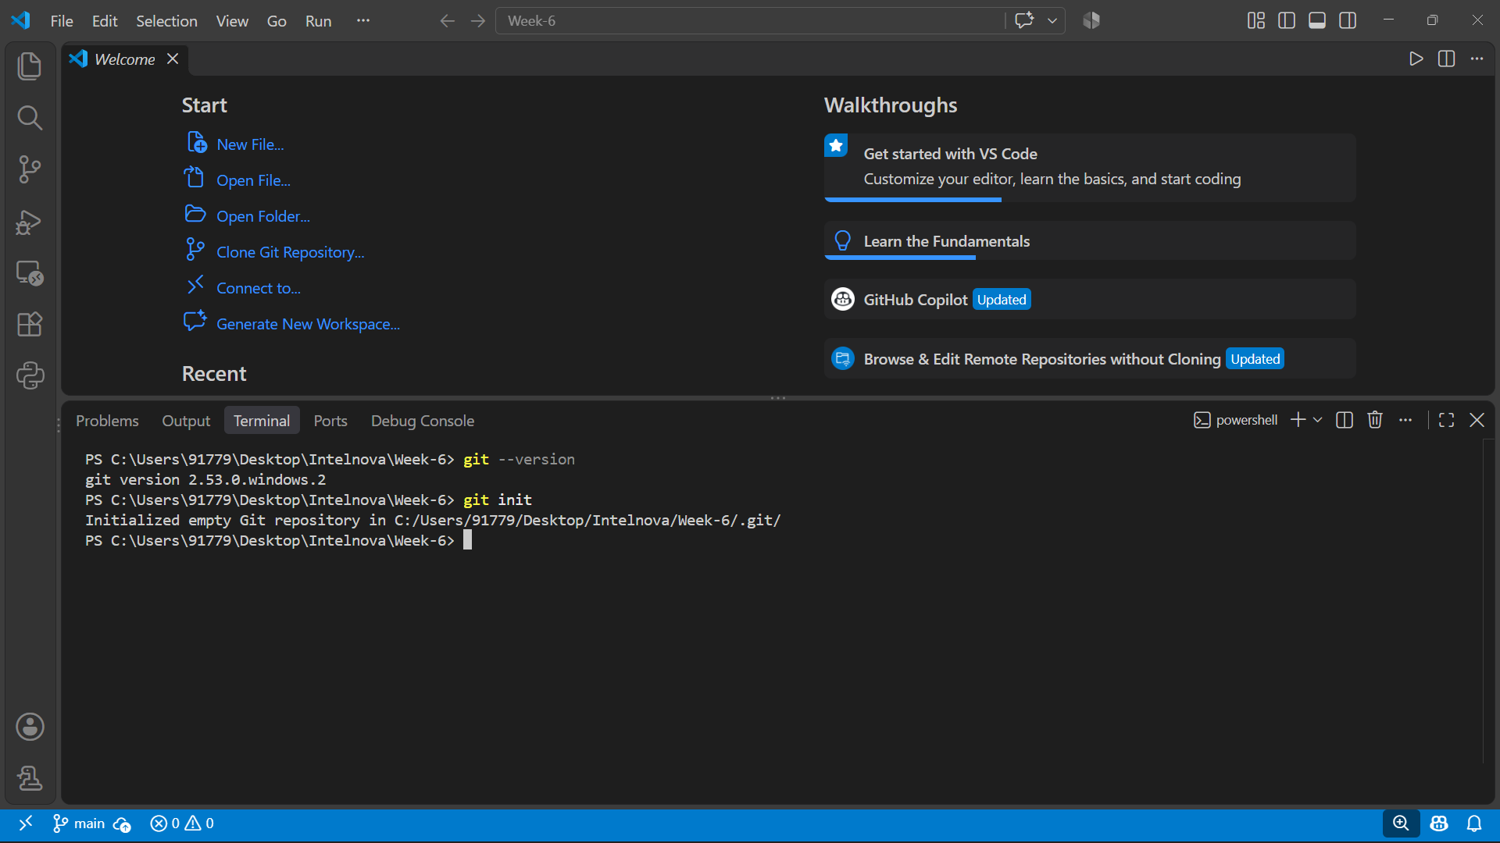
Local git repository initialization

Slide 6
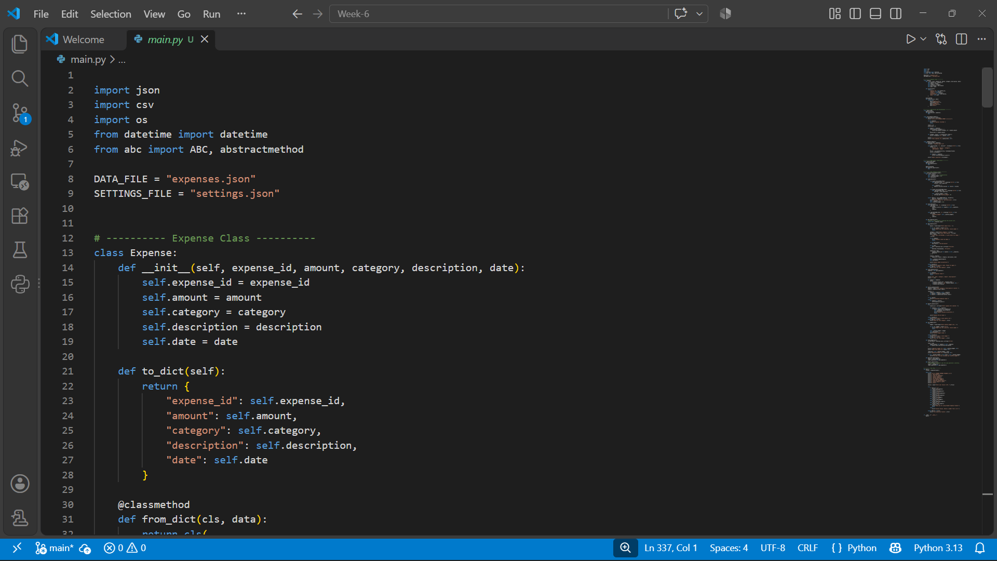
Source code:

Slide 7
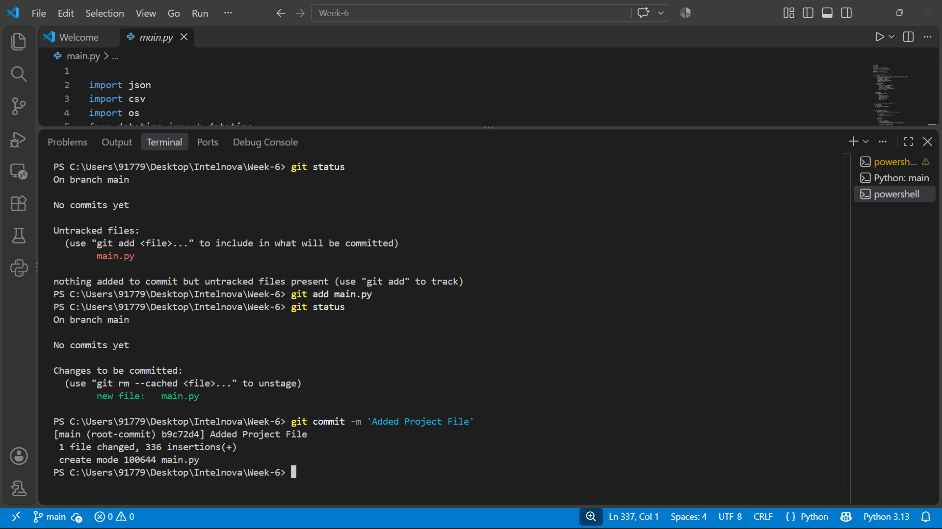
Adding project file to Git to track and commited the changes

Slide 8
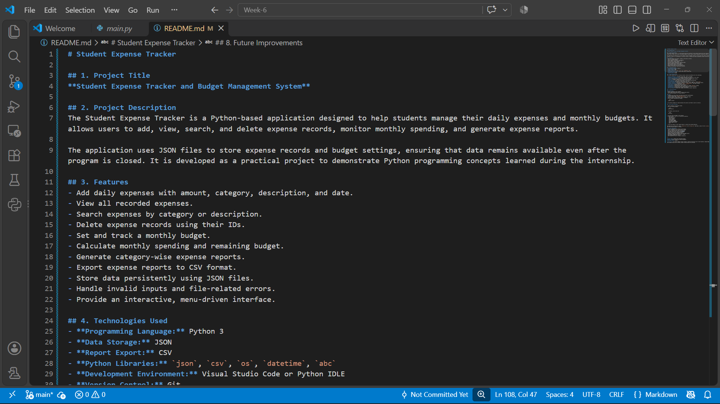
README.md File

Slide 9
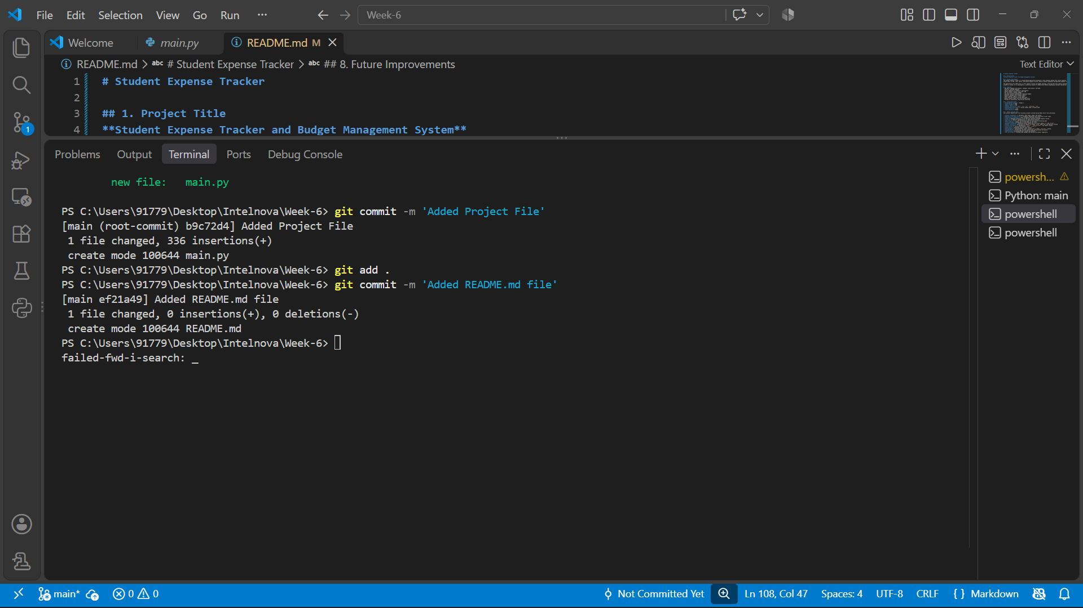
Added README.md to Git repo

Slide 10
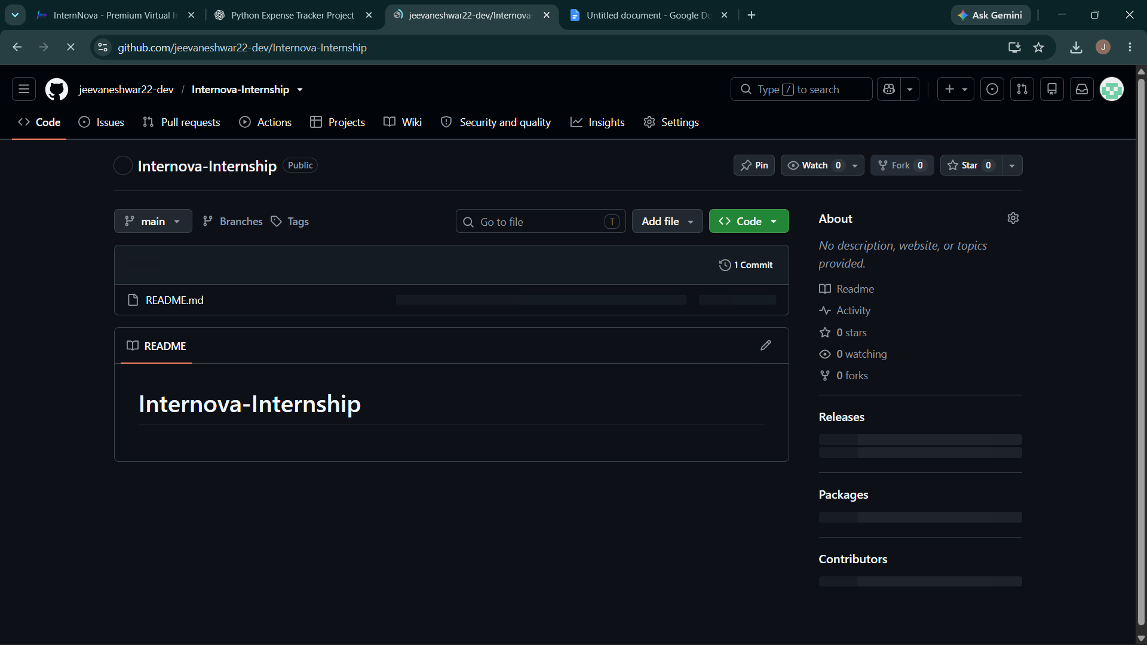
Creation of GitHub repository

Slide 11
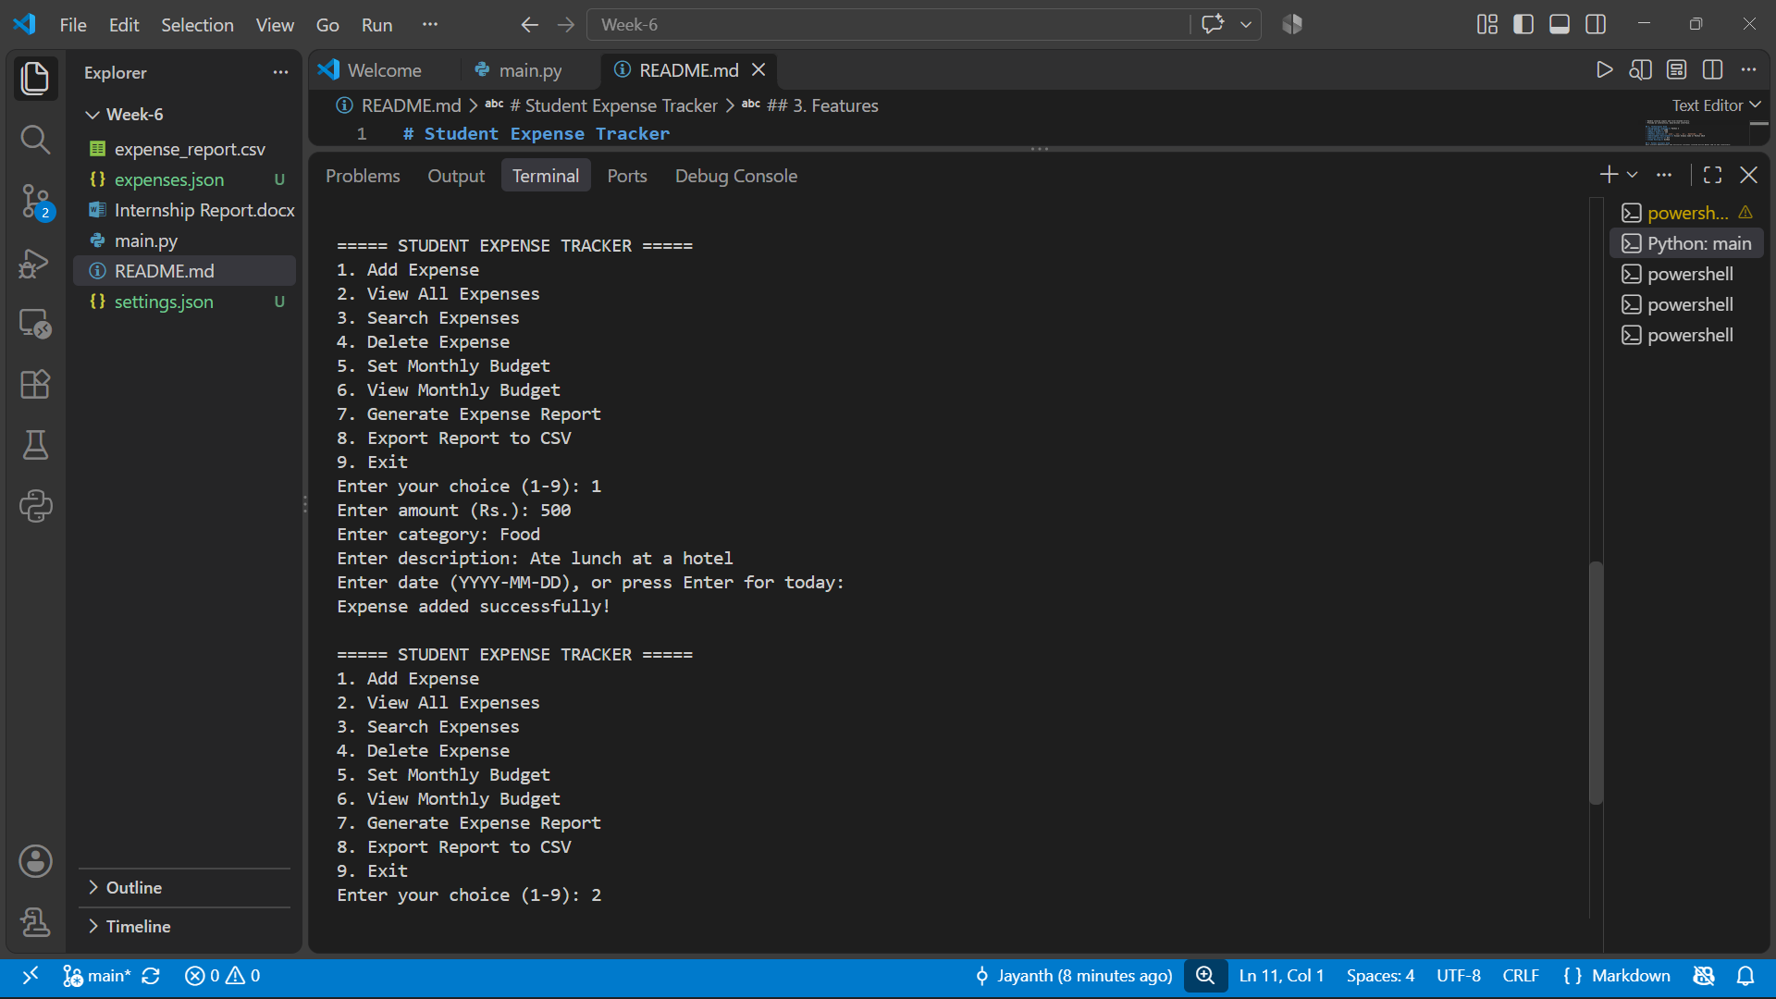
1.Adding Expenses

Slide 12
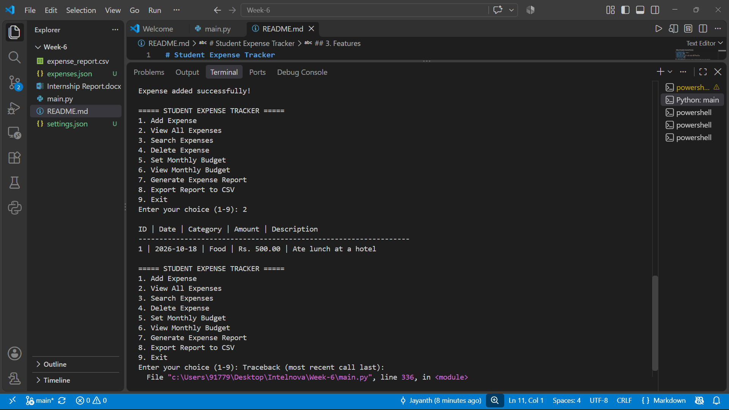
2.Viewing Expenses

Slide 13
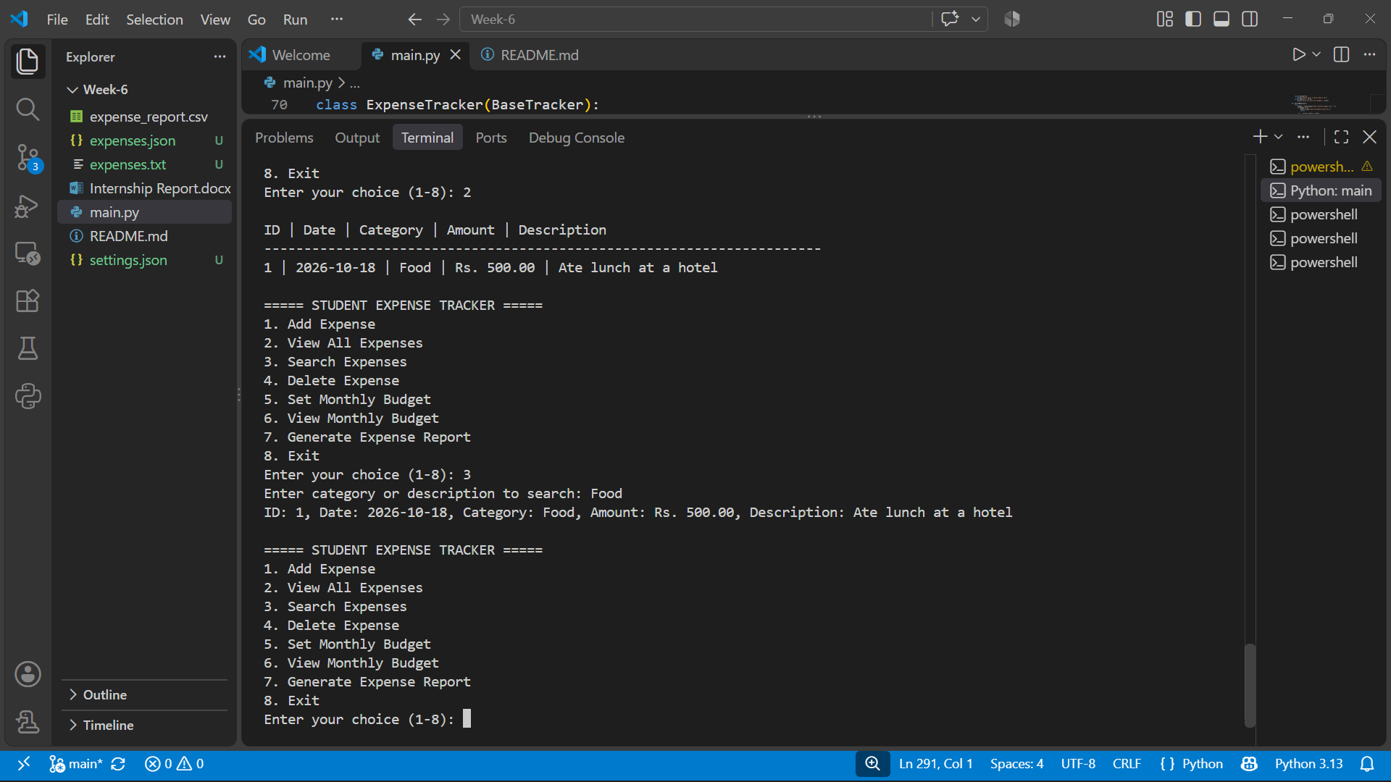
3.Searching Expenses

Slide 14
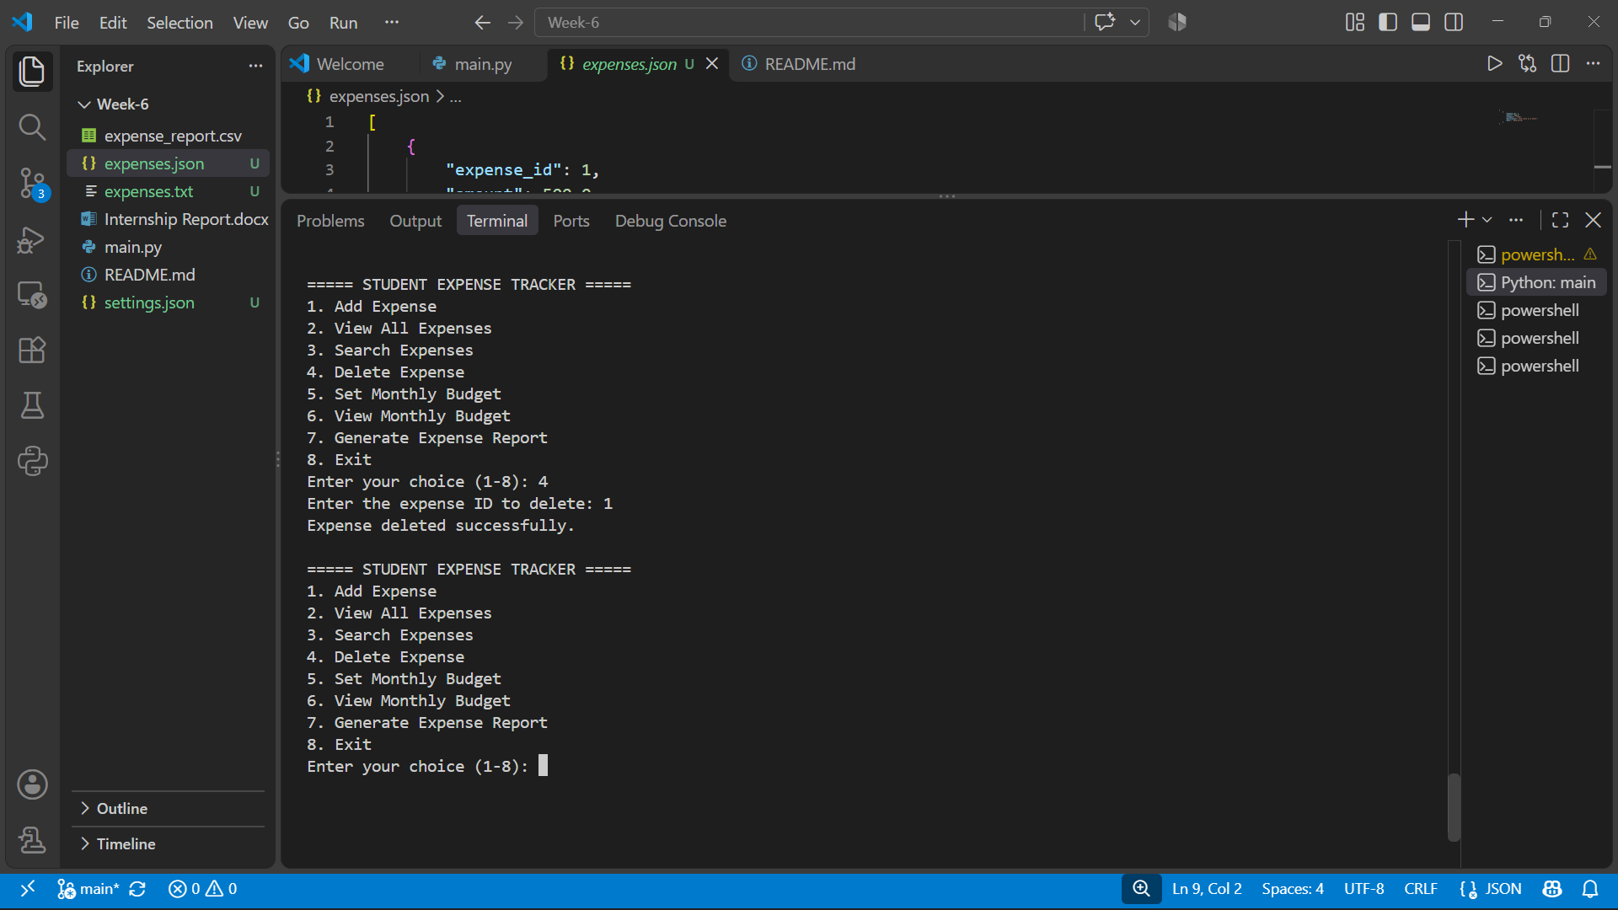
4.Deleting Expenses

Slide 15
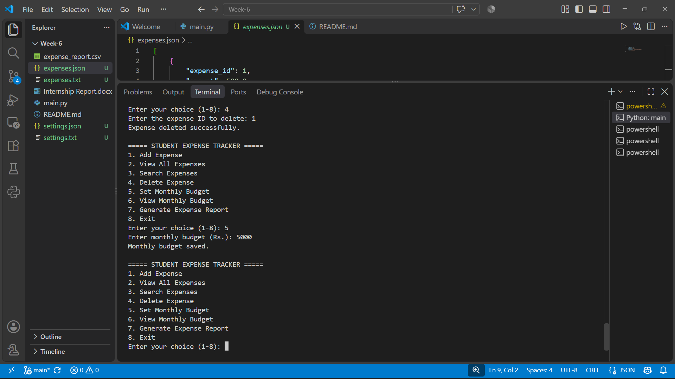
5.Setting Budget

Slide 16
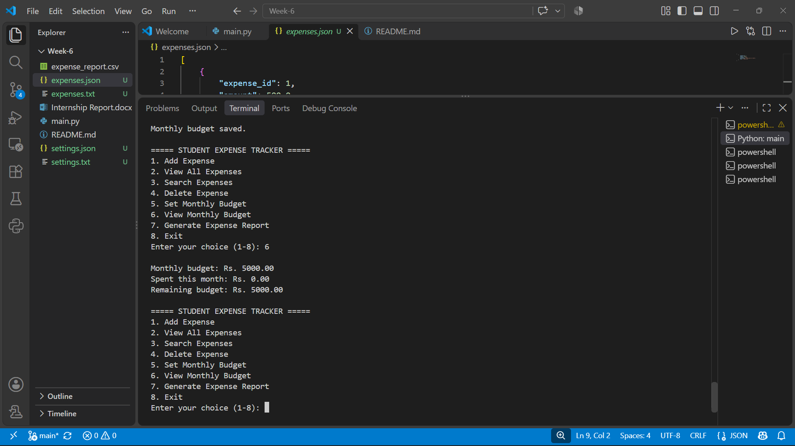
6.Viewing budget

Slide 17
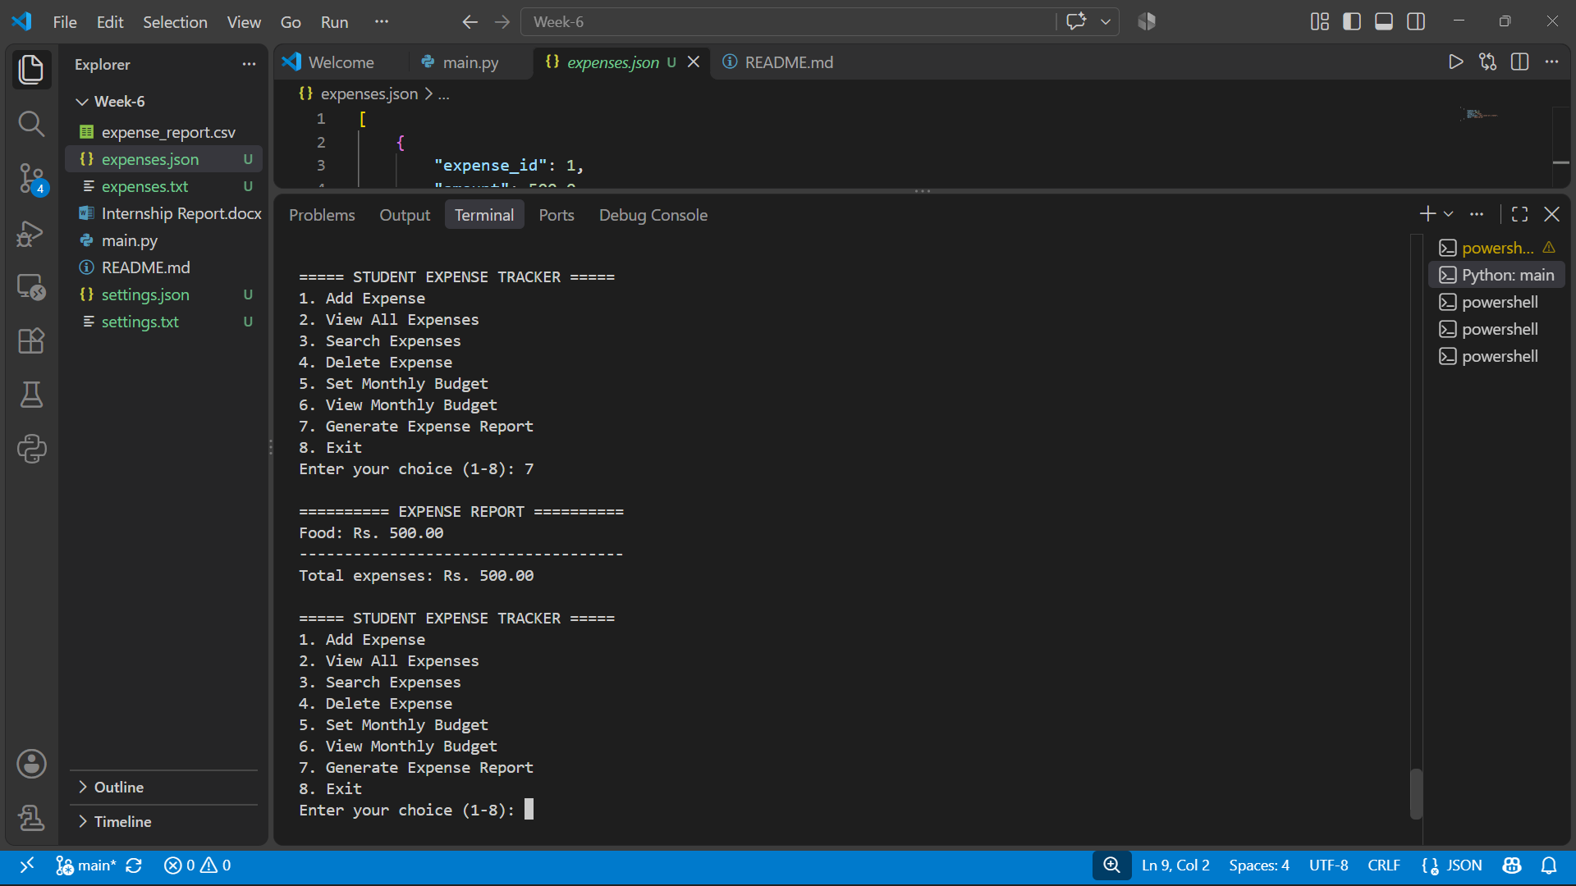
7.Report to CSV

Slide 18
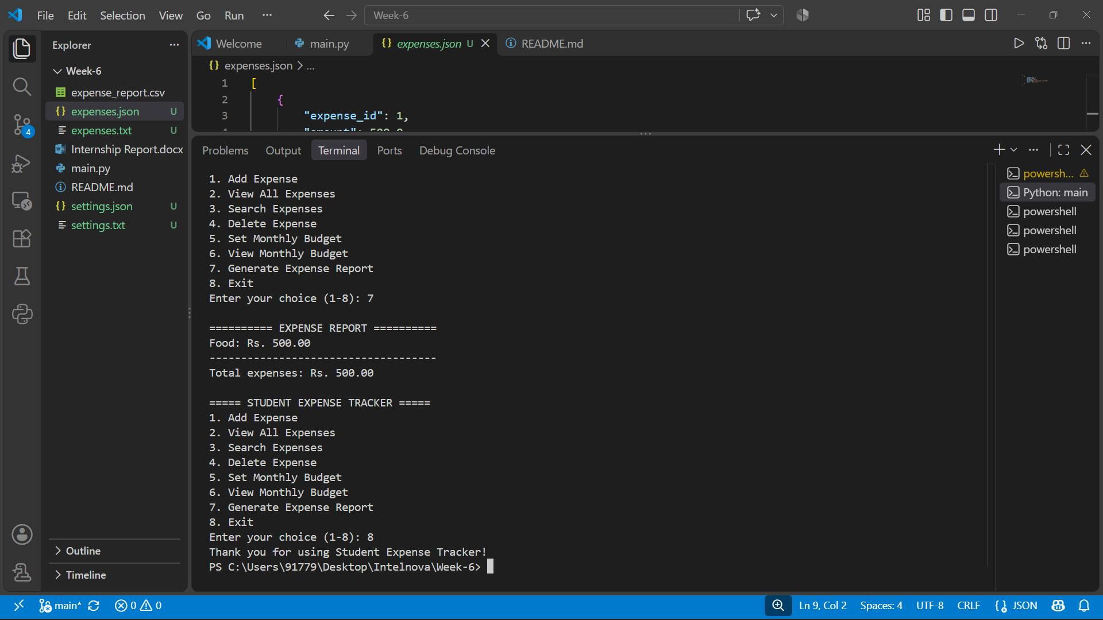
8.Exit

Slide 19
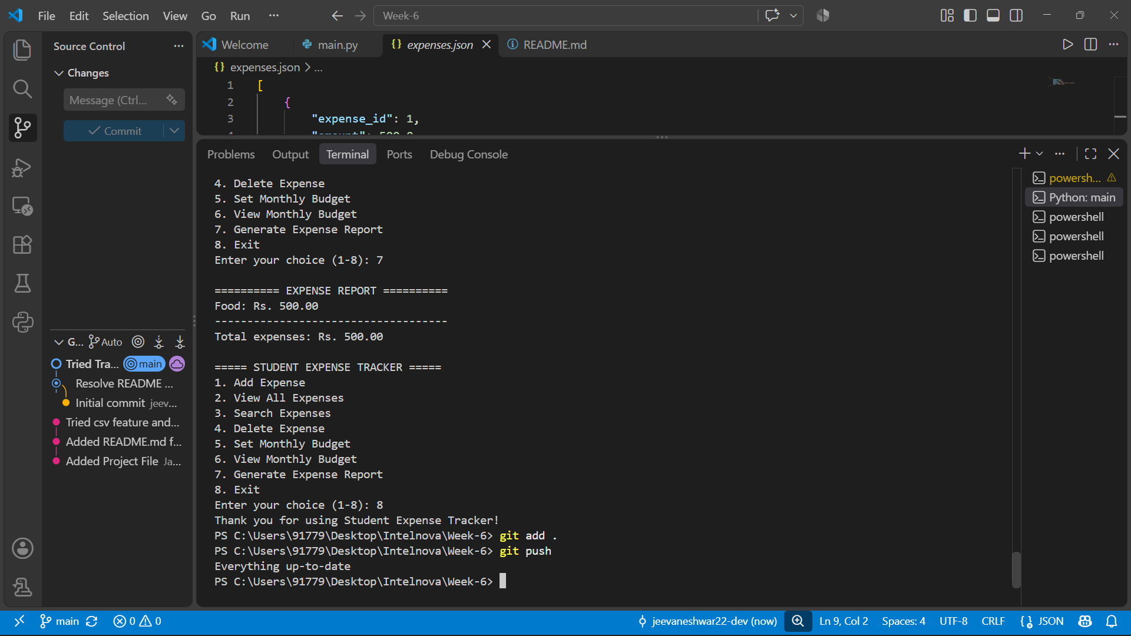
Added all files to GitHub repo

Slide 20
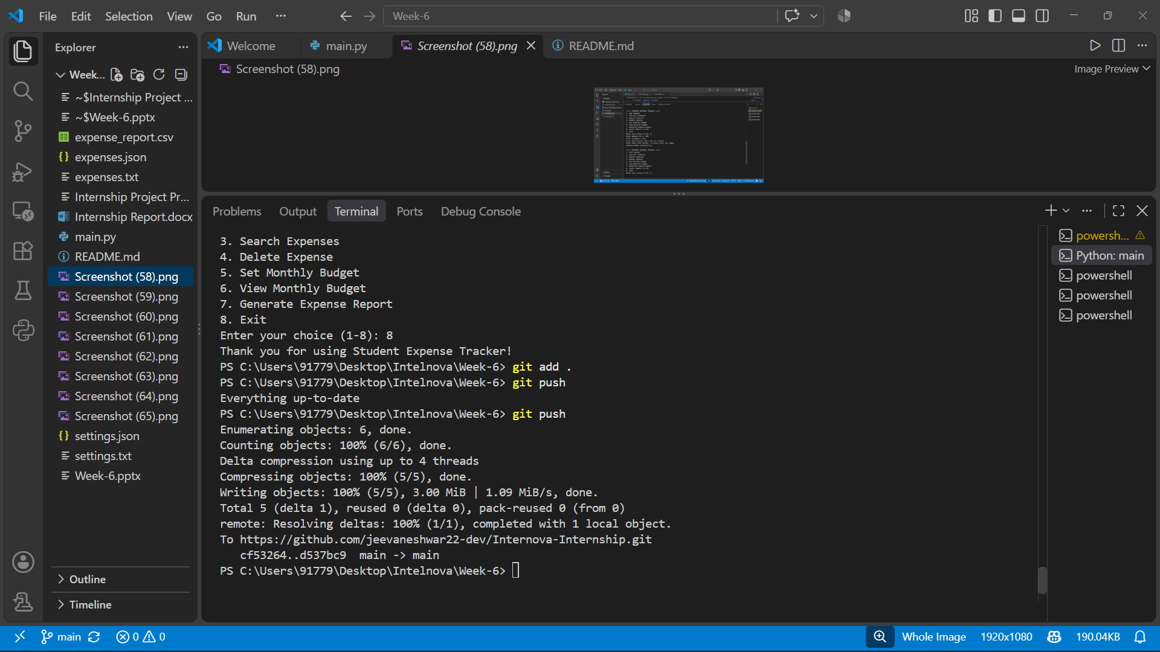
Finally pushing all code to GitHub

