Slide 1
Unit- 4
Network Layer

Slide 2
Network Layer
The network layer is responsible for the host- to-host delivery of datagrams.
It provides services to the transport layer , receives services from the data-link layer.
The network layer is involved at: Source host, Destination host, All routers in the path.

Slide 3
Network Layer
At the source host the network layer:
    accepts a packet from a transport layer.
    encapsulates the packet in a datagram.
    delivers the packet to the data-link layer.
At the destination:
  The datagram is decapsulated.
  The packet is extracted.
  Delivered to the corresponding transport layer.

Slide 4
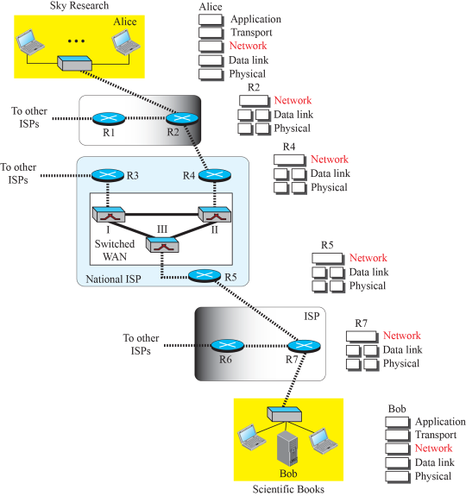
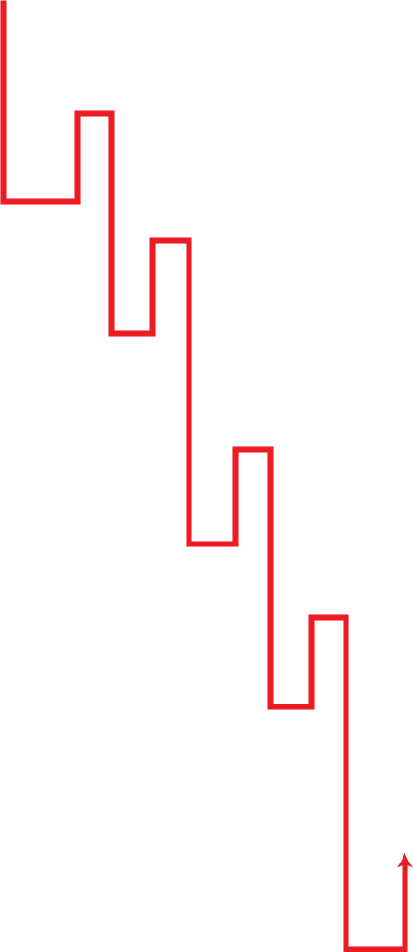
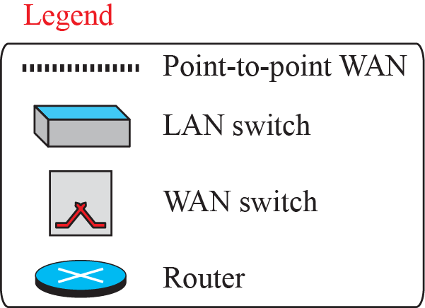
Figure : Communication at the network layer
Notes:
1.#

Slide 5
Network-Layer Services
Encapsulating the payload in a network-layer packet at the source and decapsulating the payload from the network-layer packet at the destination called Packetizing.
Routing: Filling the Routing tables using routing algorithms which are used to determine the route taken by packets from source to dest.
Forwarding: move packets from router’s input port to router’s appropriate output port.
Packetizing
Routing
Forwarding
Notes:
1.#
Route the packets from source to destination. Specific strategies for defining best route.-routing protocol.—to create the decision making tables for each router.
Forwarding can be defined as the action applied by each router when a packet arrives at one of its interfaces.

Slide 6
Network-Layer Services
Routing --Route the packets from source to destination.
  Specific strategies for defining best route.
  routing protocol--To create the decision making tables for each router.
Forwarding can be defined as the action applied by each router when a packet arrives at one of its interfaces.

Slide 7
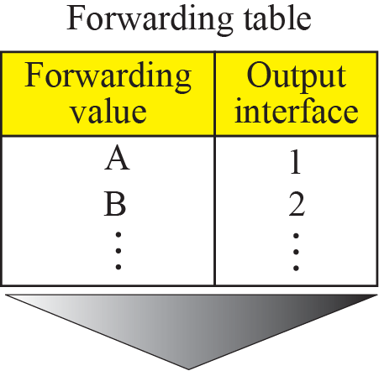
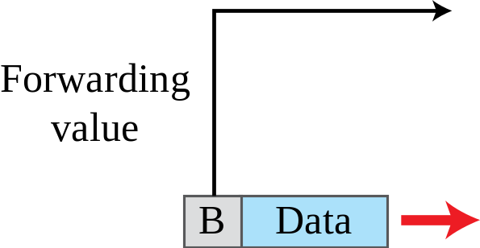
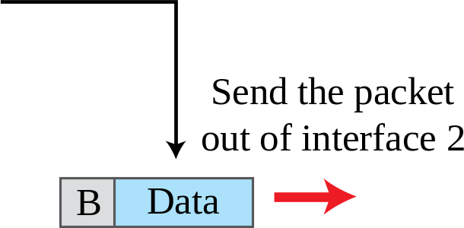
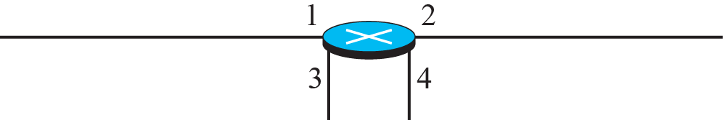
Figure : Forwarding process
Router looks for Destination address in the packet Header
Notes:
1.#

Slide 8
Network-Layer Services (continued)
Error Control – only Header checksum
Flow Control - no
Congestion Control - no
Quality of Service - no
Security - IPsec
Notes:
1.#

Slide 9
Packet Switching
From the discussion of routing and forwarding in the previous section, we infer that a kind of switching occurs at the network layer.
A router, in fact, is a switch that creates a connection between an input port and an output port (or a set of output ports), just as an electrical switch connects the input to the output to let electricity flow.
Notes:
1.#

Slide 10
Packet Switching(continued)
Switching – 2 Type: Circuit switching and Packet switching.
Packet Switching – 2 Types: Datagram Approach and VC Approach.
datagram network provides network-layer connectionless service.
virtual-circuit network provides network-layer connection oriented service.
Datagram Approach
Virtual-Circuit Approach
Setup Phase
Data-Transfer Phase
Teardown Phase
Notes:
1.#

Slide 11
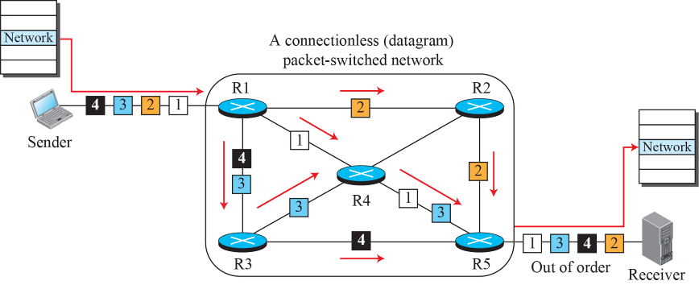
Figure : A connectionless packet-switched network
Notes:
1.#

Slide 12
Characteristics of Connectionless (Datagram) Network
A host can send a packet anywhere at any time, since any packet that turns up at the switch can be immediately forwarded (assuming a correctly populated forwarding table)
Each packet is forwarded independently of previous packets that might have been sent to the same destination.
Thus two successive packets from host A to host B may follow completely different paths – results in out of order packet delivery

Slide 13
Characteristics of Connectionless (Datagram) Network
A switch or link failure might not have any serious effect on communication if it is possible to find an alternate route around the failure and update the forwarding table accordingly
Forwarding decision is done based on the Destination Address in the packet header

Slide 14
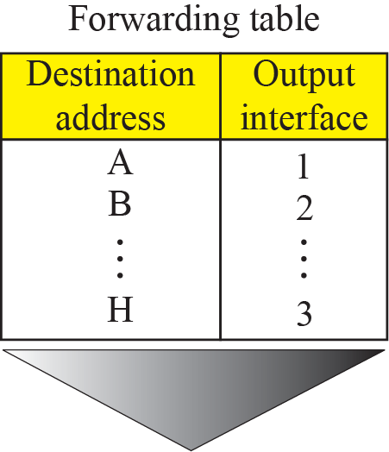
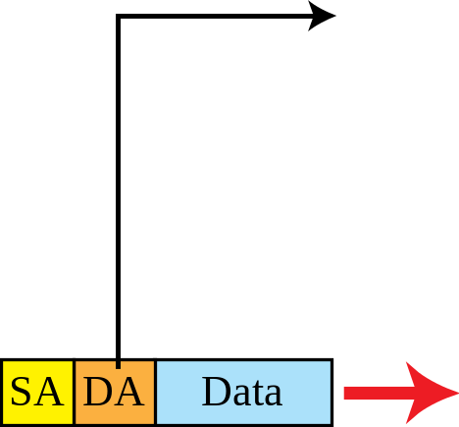
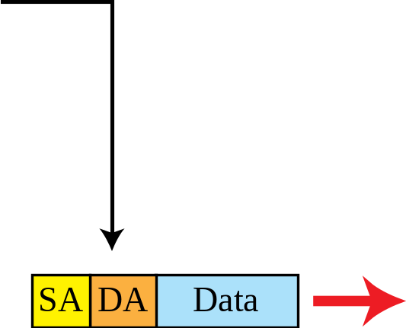
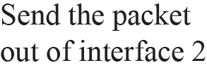
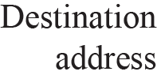
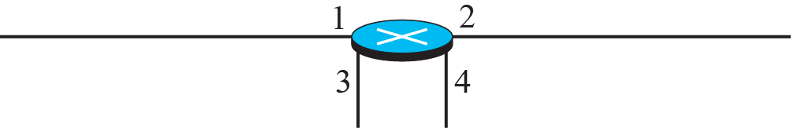
Figure : Forwarding process in a router when used in a
connectionless network
Notes:
1.#

Slide 15
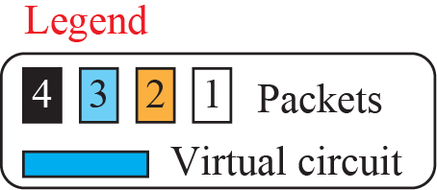
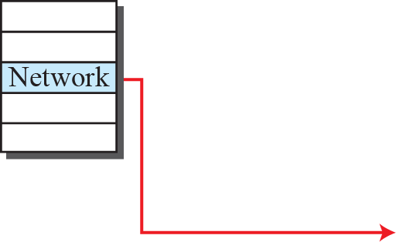
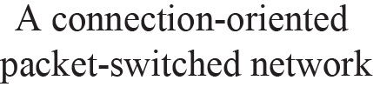

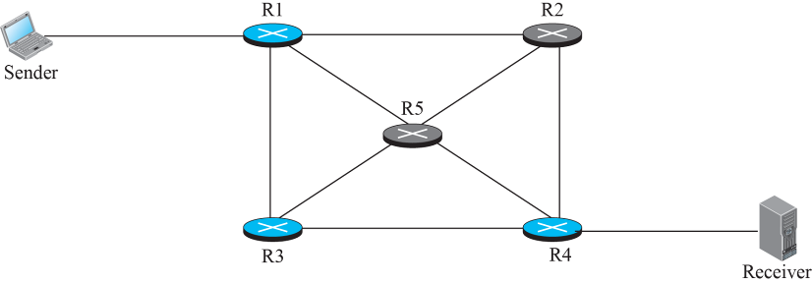


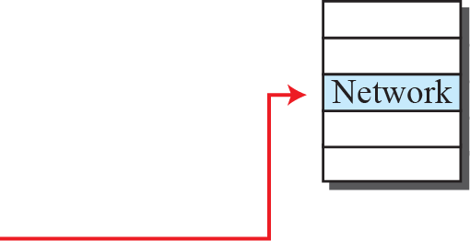
Figure : A virtual-circuit packet-switched network
Notes:
1.#

Slide 16
Virtual-Circuit Network
Three-stage process
  Connection setup
  Data Transfer
  Connection Termination
Connection setup
  Establish “connection state” in each of the switches between the source and destination hosts.
  The connection state for a single connection consists of an entry in the “VC table” in each switch through which the connection passes.

Slide 17
Virtual-Circuit Network
One entry in the VC table on a single switch contains
  A virtual circuit identifier (VCI) or Label (incoming VCI) that uniquely identifies the connection at this switch and that will be carried inside the header of the packets that belong to this connection.
  An incoming interface (port) on which packets for this VC arrive at the switch.
  An outgoing interface in which packets for this VC leave the switch.
  A potentially different outgoing VCI that will be used for outgoing packets.

Slide 18
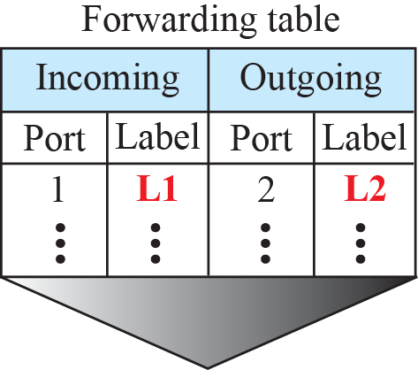
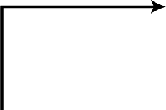
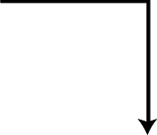


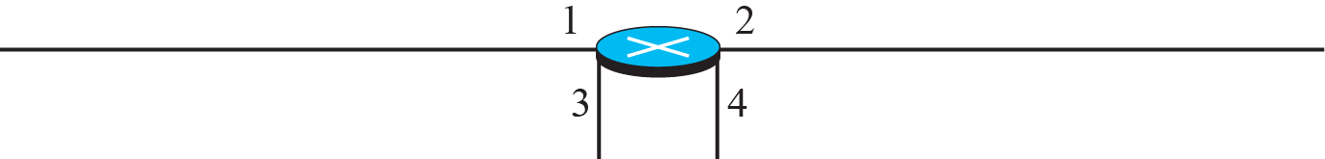


Figure : Forwarding process in a router when used in a virtual
circuit network
Notes:
1.#

Slide 19
1.Setup Phase
1. Request Packet
Source A sends a request packet to route R1.
R1 receives the request packet. It knows going from A to B, goes out through port 3. Router creates entry in its table (only 3 entry),It does not yet know the outgoing label, which will be found during the acknowledgement step.
2. Acknowledgment packet

Slide 20
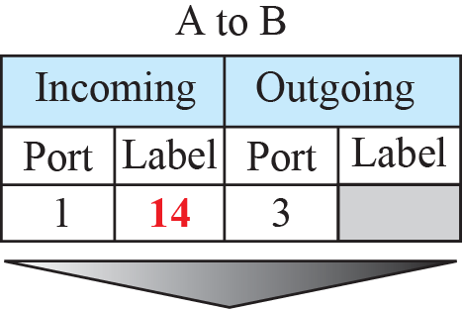
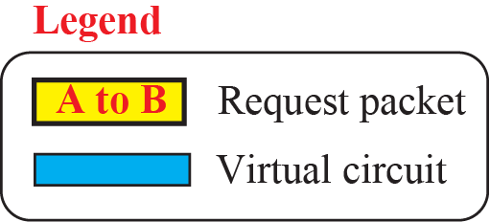
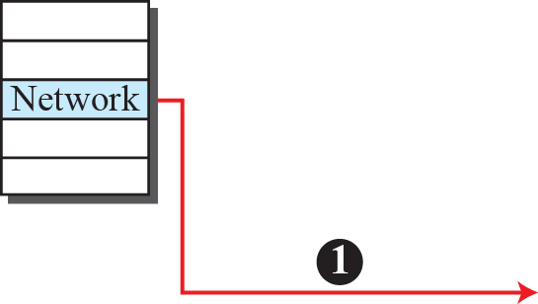
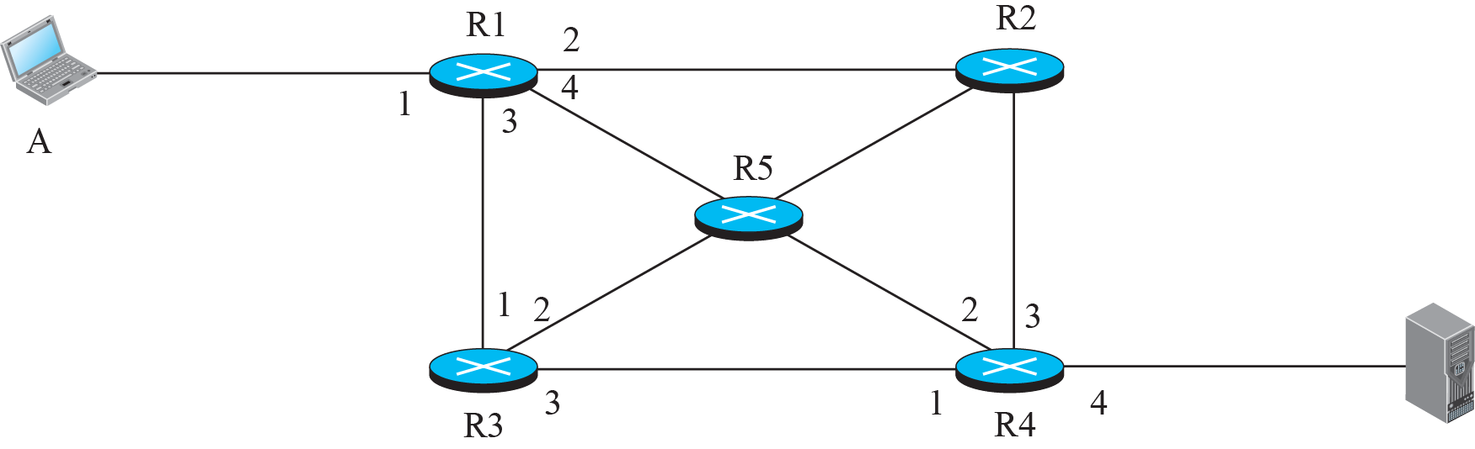

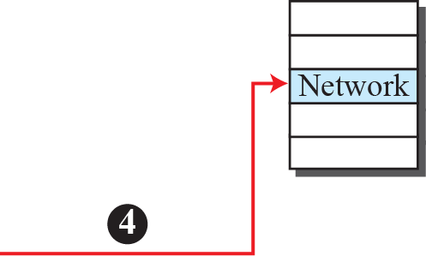


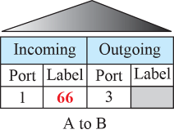
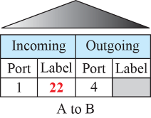
Figure : Sending request packet in a virtual-circuit network
Notes:
1.#

Slide 21
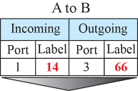
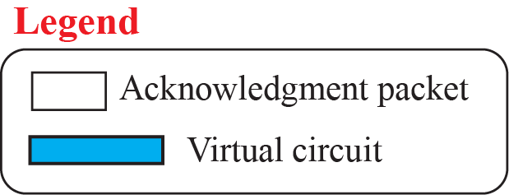
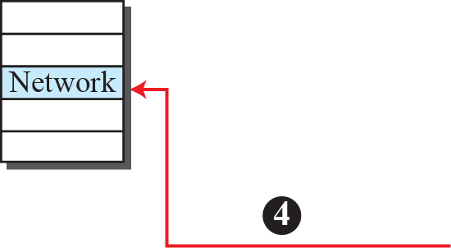

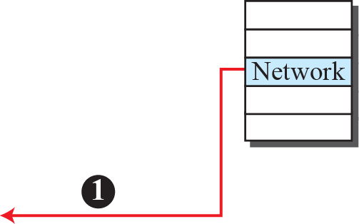





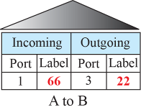
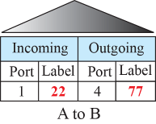
Figure : Sending acknowledgments in a virtual-circuit network
Notes:
1.#

Slide 22
2.Data Transfer Phase
After all routers have created their forwarding table for a specific virtual circuit, then the network layer packets belonging to one message can be sent one after another.
The packets arrive in order at its destination.

Slide 23
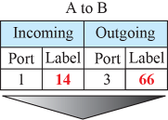
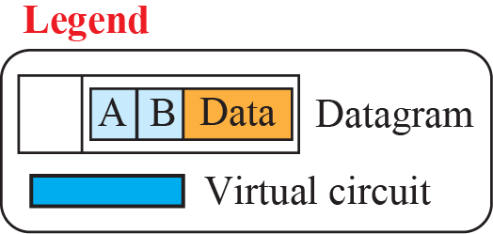
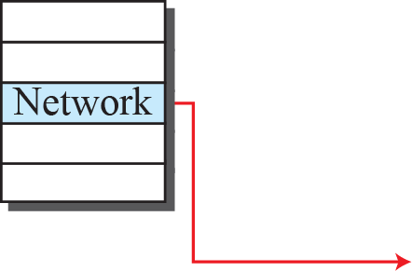

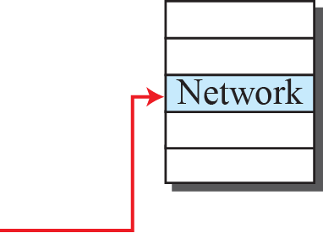



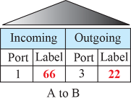
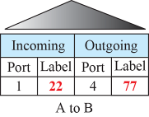
Figure : Flow of Data Packet in an established virtual-circuit network
Notes:
1.#

Slide 24
3.Teardown Phase:
Source A, after sending all packets to B, sends a special packet called a teardown packet.
Destination B responds with a confirmation packet.
All routers delete the corresponding entries from the VC table.
Notes:
RTT-Round Trip Time--Round-trip time (RTT) is the duration in milliseconds (ms) it takes for a network request to go from a starting point to a destination and back again
4.#

Slide 25
    NETWORK-LAYER PROTOCOLS
The protocols in the network layer have gone through several versions; concentrate on the current version (4), then we briefly discuss version 6.
The network layer in version 4 can be thought of as one main protocol and three auxiliary ones.
The main protocol, IPv4,.
ICMP( Internet Control Message Protocol).
IGMP ( Internet Group Management Protocol).
ARP (Address Resolution Protocol)
Notes:
19.#

Slide 26
NETWORK-LAYER PROTOCOLS
The main protocol, IPv4, is responsible for packetizing, forwarding, and delivery of a packet.
The ICMPv4 helps IPv4 to handle some errors that may occur in delivery.
The IGMP is used to help IPv4 in multicasting.
ARP is used in address mapping.

Slide 27
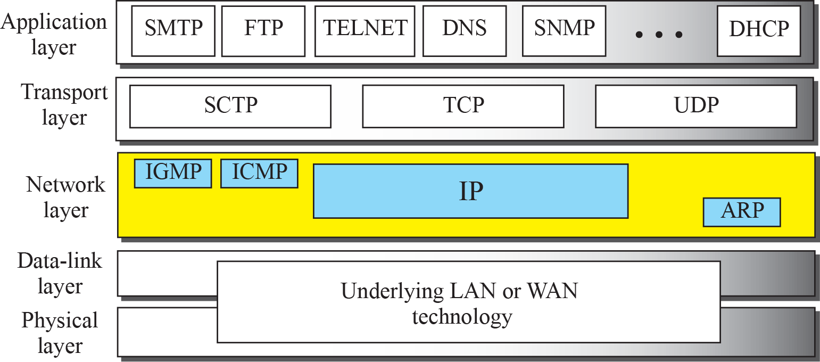
Figure: Position of IP and other network-layer protocols in
TCP/IP protocol suite
Notes:
1.#

Slide 28
Characteristics of IP
Packet Delivery Model
  IPv4 is an Unreliable protocol
  Connectionless model for data delivery (uses Datagram approach)
  Best-effort delivery (unreliable service)
    packets are lost
    packets are delivered out of order
    duplicate copies of a packet are delivered
    packets can be delayed for a long time
Global Addressing Scheme
  Provides a way to identify all hosts in the network
Notes:
The University of Adelaide, School of Computer Science
Chapter 2 — Instructions: Language of the Computer

Slide 29
IPv4 Datagram Format
Packets used by the IP are called datagrams.
A datagram is a variable-length packet consisting of two parts: header and payload (data).
The header is 20 to 60 bytes in length and contains information essential to routing and delivery. It is customary in TCP/IP to show the header in 4-byte sections.
Notes:
1.#

Slide 30
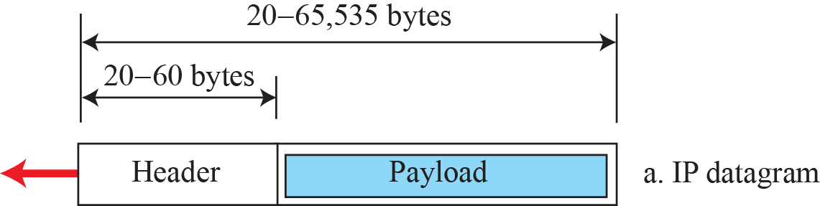
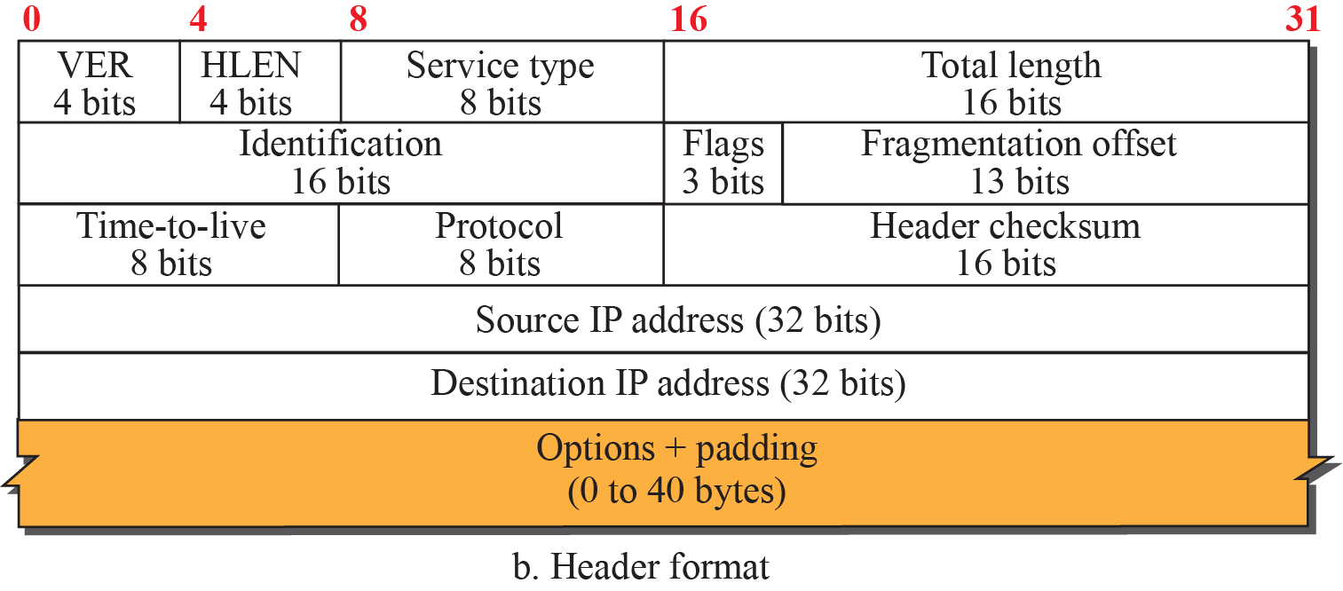
Figure: IP datagram
Notes:
1.#

Slide 31
IPv4 Fields
  Version (4): currently 4.
  Hlen (4): Number of 32-bit words in header.
  TOS (8): Type Of Service .
  Total Length (16): Number of bytes in this datagram including header.
  Identification (16): used by fragmentation.
  Flags/Offset (16): used by fragmentation.

Slide 32
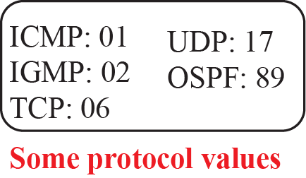
IPv4 Fields
  TTL-Time To-Live (8): number of hops this datagram has traveled.
  Protocol (8): demux key (TCP=6, UDP=17)
  Checksum (16): of the header only.
  DestAddr & SrcAddr (32).
  Options : rarely used, used for network testing and debugging.
  Payload : content (data) of the packet.

Slide 33
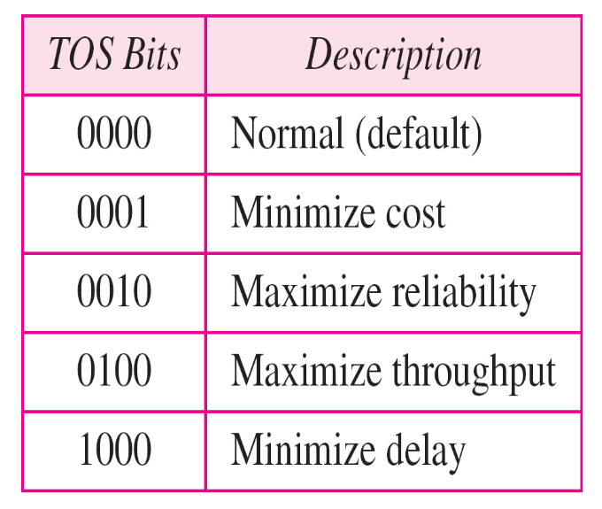
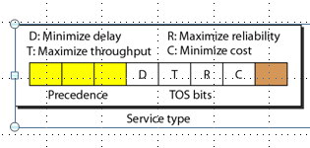
TOS (Service Type)Field of IPv4
In late 1990s IETF redefined this field to provide Differentiated Services(DiffServ)

Slide 34
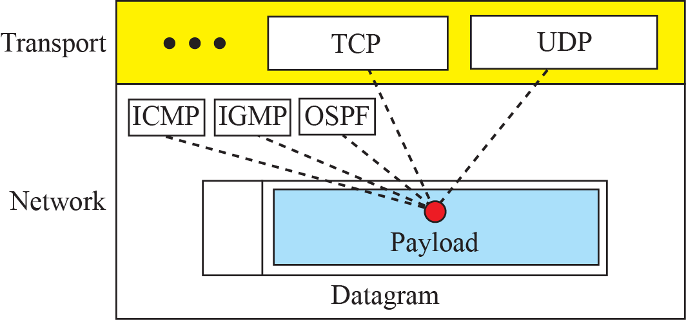
Figure : Multiplexing and demultiplexing using the value of
the protocol field
Notes:
1.#

Slide 35
IP Fragmentation
A datagram can travel through different networks.
Each router decapsulates the IP datagram from the frame it receives, processes it, and then encapsulates it in another frame.
The format and size of the received frame depend on the protocol used by the physical network through which the frame has just traveled.
The format and size of the sent frame depend on the protocol used by the physical network through which the frame is going to travel.
Eg-Router connects a LAN to a WAN, it receives a frame in the LAN format and sends a frame in the WAN format.
Notes:
19.#
Physical networks ma not support large packets –need Fragmantation

Slide 36
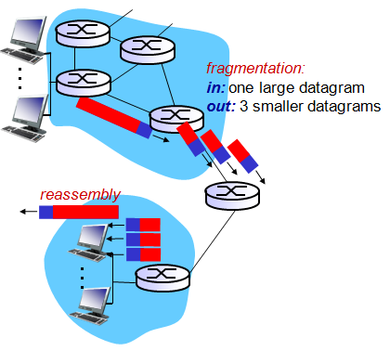
IP fragmentation & reassembly
network links have MTU (max.transfer size) - largest possible link-level frame
  different link types, different MTUs
large IP datagram divided (“fragmented”) within net
  one datagram becomes several datagrams
  “reassembled” only at final destination
  IP header bits used to identify, order related fragments

Slide 37
MTU (Maximum Transmission Unit)
Largest IP datagram that can be carried in a frame.
When a datagram is encapsulated in a frame, the total size of the datagram must be less than this maximum size.
Which is defined by the restrictions imposed by the hardware and software used in the network.
The value of MTU differs from one physical network protocol to another.
Eg--Ethernet (1500 bytes), FDDI (4500 bytes), PPP(296), WiFi (7981).
Notes:
Fiber Distributed Data Interface
4.#

Slide 38

Figure 4.26: Maximum transfer unit (MTU)
Notes:
1.#

Slide 39
IP Fragmentation and Reassembly
Strategy
  Fragmentation occurs in a sending host/router when it receives a datagram that it wants to forward over a network which has (MTU < size of datagram)
  Reassembly is done at the receiving host.
  A datagram may be fragmented several times before it reaches the final destination.
  All the fragments carry the same identifier in the Identification field
Notes:
The University of Adelaide, School of Computer Science
Chapter 2 — Instructions: Language of the Computer
Fiber Distributed Data Interface

Slide 40
Fields Related to Fragmentation
Identification field identifies a datagram originating from the source host. The combination of the identification and source IP address must uniquely define a datagram.
When a datagram is fragmented, the value in the identification field is copied into all fragments.
The identification number helps the destination in reassembling the datagram. It knows that all fragments having the same identification value should be assembled into one datagram.

Slide 41
Flag field define 3 flags. The leftmost bit is reserved (not used). The second bit(D bit) is called the do not fragment bit.
    If value=1, the machine must not fragment the datagram.
    If value=0, the datagram can be fragmented if necessary.
The third bit(M bit) is called the more fragment bit.
  If its value=1, the datagram is not the last fragment, there are more fragments after this one.
  If value=0, this is the last or only fragment.

Slide 42
fragmentation offset
The fragmentation offset field shows the relative position of this fragment with respect to the whole datagram.
It is the offset of the data in the original datagram measured in units of 8 bytes.
Identification : uses a counter
Flags: unused, DF, MF
Offset : relative position of this fragment

Slide 43




Data size: 4000 bytes
This is fragmented into 3 fragments 1400+1400+1200
2nd fragment is fragmented again into two fragments
Notes:
1.#

Slide 44

Figure : Detailed fragmentation example
Notes:
1.#

Slide 45
IP Fragmentation and Reassembly
The offset field is used by the destination host to reassemble the original datagram from the received segments.
The first fragment has an offset value of 0
Divide the length of the first fragment by 8, that will be the offset value for second fragment
Divide the total length of the first and second fragment by 8, the third fragment has the offset value equal to that.
Continue the process, the last fragment has the M bit set to zero.

Slide 46
Example 1
A packet has arrived with an M bit value of 0. Is this the first fragment, the last fragment, or a middle fragment? Do we know if the packet was fragmented?
Solution
If the M bit is 0, it means that there are no more fragments; the fragment is the last one.
However, we cannot say if the original packet was fragmented or not. A nonfragmented packet is considered the last fragment.

Slide 47
Example 2
A packet has arrived in which the offset value is 100, the value of HLEN is 5, and the value of the total length field is 100. What are the numbers of the first byte and the last byte?
Solution
The first byte number is 100 × 8 = 800. The total length is 100 bytes, and the header length is 20 bytes (5 × 4), which means that there are 80 bytes in this datagram. If the first byte number is 800, the last byte number must be 879.

Slide 48
IPv4 Addresses
The identifier used in the IP layer of the TCP/IP protocol suite to identify the connection of each device to the Internet is called the Internet address or IP address.
An IPv4 address is a 32-bit address that uniquely and universally defines the connection of a host or a router to the Internet.
The IP address is the address of the connection, not the host or the router, because if the device is moved to another network, the IP address may be changed.
Address Space
Notes:
1.#
There are 2³² or 4,294,967,296 possible addresses. This usable set of addresses is called as the address space of IPv4.

Slide 49


Figure : Three different notations in IPv4 addressing
Address space – 2 ³²
There are 2³² or 4,294,967,296 possible addresses. This usable set of addresses is called as the address space of IPv4.
Notes:
1.#

Slide 50





Figure: Hierarchy in addressing
Notes:
1.#

Slide 51



Figure : Occupation of the address space in classful addressing
Notes:
1.#

Slide 52
Class | Byte 1 | Byte 2 | Byte 3 | Byte 4
A | Net ID | Host Id | Host Id | Host Id
B | Net ID | Net ID | Host Id | Host Id
C | Net ID | Net ID | Net ID | Host Id

Slide 53
Mask— It helps to find Net Id and Host Id
Default mask
Class | Binary(Mask) | Decimal
A | 1111111100…….. (8 1’S) | 255.0.0.0
B | 11111111111111110000….. (16 1’S) | 255.255.0.0
C | 11111111111…….0000….. ( 24 1’S) | 255.255.255.0

Slide 54
Address Depletion
- addresses were not distributed properly
- great demand for class B addresses
Subnetting and supernetting
- in subnetting one block is divided into smaller sub blocks (larger prefixes) – increases the size of the routing tables
- in Supernetting smaller networks are grouped into one large network – Route aggregation (if requirement is 700, it can take 3 class C networks)
Classless addressing –
-remove class boundaries
- variable length blocks

Slide 55

Figure: Variable-length blocks in classless addressing
Prefix length is variable – 0 to 32
Prefix length is denoted using slash notation (/x)
Slash notation is also called CIDR (classless interdomain routing)
Notes:
1.#

Slide 56


Figure : Slash notation (CIDR)
Notes:
1.#

Slide 57






Figure : Information extraction in classless addressing
Notes:
1.#

Slide 58
Extracting Information from an Address
The number of addresses in the block is found as N=2^{32-n}.
To find the first address, we keep the n leftmost bits and set the (32-n) rightmost bits all to 0s.
To find the last address, we keep the n leftmost bits and set the (32-n) rightmost bits all to 1s.

Slide 59
Example 4.1
A classless address is given as 167.199.170.82/27. We can find the above three pieces of information as follows. The number of addresses in the network is 2^{32− n}= 2⁵ = 32 addresses. The first address can be found by keeping the first 27 bits and changing the rest of the bits to 0s.
The last address can be found by keeping the first 27 bits and changing the rest of the bits to 1s.

Slide 60
Address Mask
Another way to find the first and last addresses in the block is to use the address mask.
1. The number of addresses in the block
N= NOT(Mask)+1
2. The first address in the block
(Any address in the block) AND (Mask)
3. The last address in the block
(Any address in the block) OR (NOT(Mask))

Slide 61
4.<number>
Example
A classless address is given as 167.199.170.82/27 using the Address mask find out number of addresses , first address and last address in the block
The mask in dotted-decimal notation for the above example is is 255.255.255.224 The AND, OR, and NOT operations can be applied to get the results.
Number of addresses : 0.0.0.31+1 = 32
First address : 167.199.170.64 (normally the network address)
Last address : 167.199.170.95

Slide 62

TCP/IP Protocol Suite
Example
One of the addresses in a block is 17.63.110.114/24. Find the number of addresses, the first address, and the last address in the block.
Solution
The network mask is 255.255.255.0.
a. The number of addresses in the network is 2³² ⁻ ²⁴ = 256.
b. To find the first address, we use the short cut methods
discussed early in the chapter. The first address is
17.63.110.0/24.

Slide 63
TCP/IP Protocol Suite
Example Continued
c. To find the last address, we use the complement of the network mask and the first short cut method we discussed before. The last address is 17.63.110.255/24.
Address---17.63.110.114
Complement of n/w mask---0.0.0.255
OR operation→ Last address—17.63.110.255

Slide 64

TCP/IP Protocol Suite
Example
One of the addresses in a block is 110.23.120.14/20. Find the number of addresses, the first address, and the last address in the block.
Solution
The network mask is 255.255.240.0.
a. The number of addresses in the network is 2³² ⁻ ²⁰ = 4096.
b. To find the first address, we apply the first short cut to bytes 1, 2, and 4 and the second short cut to byte 3. The first address is 110.23.112.0/20.

Slide 65

TCP/IP Protocol Suite
Example Continued
c. To find the last address, we apply the first short cut to bytes 1, 2, and 4 and the second short cut to byte 3. The OR operation is applied to the complement of the mask. The last address is 110.23.127.255/20.

Slide 66


Figure : Network address
Each network is identified by its network address. First address is the network address used in routing
Notes:
1.#

Slide 67
Block allocation
ICANN assign large blocks to ISPs and they in turn assign blocks to organizations
Two restrictions:
- Number of requested addresses must be a power of 2
- The first address in the block must be divisible by the Number of addresses in the block(N).
Notes:
Internet Corporation for Assigned Names and Numbers)
4.#

Slide 68
Example 4.4
An ISP has requested a block of 1000 addresses. Since 1000 is not a power of 2, 1024 addresses are granted. The prefix length is calculated as n = 32 − 10 = 22. An available block, 18.14.12.0/22, is granted to the ISP.
ISP can divide the range of address into sub ranges and assign to sub network . It again divide and allocate to sub sub networks, and so on

Slide 69
Example 4.5
An organization is granted a block of addresses with the beginning address 14.24.74.0/24. The organization needs to have 3 subblocks of addresses to use in its three subnets: one subblock of 10 addresses, one subblock of 60 addresses, and one subblock of 120 addresses. Design the subblocks.
Solution
There are 2^{32– 24} = 256 addresses in this block. The first address is 14.24.74.0/24; the last address is 14.24.74.255/24. To satisfy the third requirement, we assign addresses to subblocks, starting with the largest and ending with the smallest one.

Slide 70
Example 4.5 (continued)
a. The number of addresses in the largest subblock, which requires 120 addresses, is not a power of 2. We allocate 128 addresses. The subnet mask for this subnet can be found as n₁= 32 − 7 = 25. The first address in this block is 14.24.74.0/25; the last address is 14.24.74.127/25.
b. The number of addresses in the second largest subblock, which requires 60 addresses, is not a power of 2 either. We allocate 64 addresses. The subnet mask for this subnet can be found as n₂ = 32 − 6 = 26. The first address in this block is 14.24.74.128/26; the last address is 14.24.74.191/26.

Slide 71
Example 4.5 (continued)
c. The number of addresses in the third subblock, which requires 10 addresses, is not a power of 2 either. We allocate 16 addresses. The subnet mask for this subnet can be found as n₂ = 32 − 4 = 28. The first address in this block is 14.24.74.192/28; the last address is 14.24.74.207/28.
If we add all addresses in the previous subblocks, the result is 208 addresses, which means 48 addresses are left in reserve. The first address in this range is 14.24.74.208. The last address is 14.24.74.255. We don’t know about the prefix length yet. Figure 4.36 shows the configuration of blocks. We have shown the first address in each block.

Slide 72








Figure 4.36: Solution to Example 4.5
Notes:
1.#

Slide 73
Address aggregation
Figure 4.37 shows how four small blocks of addresses are assigned to four organizations by an ISP. The ISP combines these four blocks into one single block and advertises the larger block to the rest of the world (route Aggregation).
Any packet destined for this larger block should be sent to this ISP. It is the responsibility of the ISP to forward the packet to the appropriate organization.
This is similar to routing we can find in a postal network. All packages coming from outside a country are sent first to the capital and then distributed to the corresponding destination.

Slide 74



Figure 4.37: Example of address aggregation
Notes:
1.#

Slide 75





Figure 4.47: Address aggregation (another example)
Notes:
1.#

Slide 76
Some Special Addresses
This-host Address: 0.0.0.0/32 – Host without knowing source IP want to send an IP datagram uses this as Src IP. (used in DHCP)
Limited Broadcast Address: 255.255.255.255 Edge Router blocks this packet.
Loopback Address : 127.0.0.0/8 used to send an IP packet to the same host(itself). Mainly used for testing the software.
Private Addresses : 10.0.0.0/8 , 172.16.0.0/12 , 192.168.0.0/16 and 169.254.0.0/16
Multicast Addresses: 224.0.0.0/4
Notes:
A multicast address, also called a group address, is a single IP address for a set of hosts that are joined in a multicasting group. ... A host is a computer that is connected to the network. Officially designated multicast addresses range from 224.0.0.0 to 239.255.255.255.
4.#

Slide 77
DHCP
After a block of addresses are assigned to an organization, the network administration can manually assign addresses to the individual hosts or routers. However, address assignment in an organization can be done automatically using the Dynamic Host Configuration Protocol (DHCP).
DHCP is an application-layer program, using the client-server paradigm, that actually helps TCP/IP at the network layer.
It is often called as plug and play protocol.
Notes:
18.#

Slide 78
DHCP: Dynamic Host Configuration Protocol
goal: allow host to dynamically obtain its IP address from network server when it joins network
  Address allocated on leased basis
  can renew its lease on address in use
  allows reuse of addresses (only hold address while connected/“on”)
  support for mobile users who want to join network
DHCP provides four things:
- Host IP address
- Network prefix (address Mask)
- address of default router (edge router)
- address of Name server (DNS)

Slide 79


Figure : DHCP message format
Notes:
1.#

Slide 80
DHCP: Dynamic Host Configuration Protocol Operation
DHCP overview:
  Host broadcasts “DHCP discover” msg (includes Transaction ID) (broadcast).
  DHCP server responds with “DHCP offer” msg (broadcast).
  Host select the best of them and sends the request message : “DHCP request” msg (broadcast).
  Selected DHCP server sends address: “DHCP ack” msg otherwise it may send “DHCP NAK” (broadcast).
  It uses two well known ports – 68(client) and 67 (server).
  It is an application layer protocol encapsulated in UDP datagram.

Slide 81








Figure 4.40: Operation of DHCP
Notes:
1.#

Slide 82
NAT (Network Address Translation)
In most situations, only a portion of computers in a small network need access to the Internet simultaneously.
A technology that can provide the mapping between the private and universal addresses(public IP addr), and support virtual private networks, is Network Address Translation (NAT).
The technology allows a site to use a set of private addresses for internal communication and a set of global Internet addresses (at least one) for communication with the rest of the world.
Notes:
18.#

Slide 83

Network Address Tranlation - NAT
Global address
Effective utilization of IP addresses
Notes:
1.#

Slide 84





Figure : Address translation
All incoming/outgoing packets should go through the NAT Router for address translation
Notes:
1.#

Slide 85

Figure : Translation : uses Translation table
Uses a pool of available IP addresses
Communication is initiated by the private network
Notes:
1.#

Slide 86

Table : Five-column translation table (instead of two column table)
This can be used to allow many to many relationship between private networks and external servers

Slide 87
ICMPv4
The IPv4 has no error-reporting or error-correcting mechanism. What happens if something goes wrong? There are examples of situations where an error has occurred and the IP protocol has no built-in mechanism to notify the original host.
The IP protocol also lacks a mechanism for host and management queries.
The Internet Control Message Protocol version 4 (ICMPv4) has been designed to compensate for the above two deficiencies.
Notes:
1.#

Slide 88
ICMPv4
It is a companion to the IP protocol.
Its messages are not passed directly to the data-link layer.
The messages are first encapsulated inside IP datagrams before going to the lower layer.

Slide 89
ICMPv4-Messages
ICMP messages are grouped into two major categories:
Error--Reporting messages: These messages report problems that a router/host may encounter when it processes an IP packet.
Query messages : which occur in pairs, help a host or a N/w manager get specific information from a router/ host.

Slide 90



Figure : General format of ICMP messages
Notes:
1.#

Slide 91
ICMPv4-Message format
Type—defines type of the message
Code– specifies the reason for the particular message type.
Checksum—common field
Rest of the headed—specific to each message type.
Data section—information for finding the original packet that had the error.
In query messages, the data section carries extra information based on the type of query.

Slide 92
ICMP messages
Destination unreachable:(Type 3, code 0-15)
  Dest Host unreachable, Dest Process unreachable
Source quench:(Type 4, code 0)
- congestion in the network, slow down
Parameter Problem: ( Type 12, code 0 and 1)
Problem in any field of the header
Time Exceeded: (Type 11, code 0 and 1)
  TTL becomes 0,
  All fragments not come to receiver

Slide 93
Query Messages
Comes in pairs — Request and Reply.
The echo request(type 8) and the echo reply(type 0) pair of messages are used by a host or a router to test the liveliness of another host or router.
Ping--application

Slide 94

ICMP error message delivery
Notes:
19.#

Slide 95
Type Code description
0 0 echo reply (ping)
3 0 dest. network unreachable
3 1 dest host unreachable
3 2 dest protocol unreachable
3 3 dest port unreachable
3 6 dest network unknown
3 7 dest host unknown
4 0 source quench (congestion control - not used)
8 0 echo request (ping)
9 0 route advertisement
10 0 router discovery
11 0 TTL expired
12 0 bad IP header

